Slide 1
EECS 489 Computer Networks Winter 2024
Mosharaf Chowdhury
Material with thanks to Aditya Akella, Sugih Jamin, Philip Levis, Sylvia Ratnasamy, Peter Steenkiste, and many other colleagues.

Slide 2
Agenda
Inter-domain-routing

Slide 3
Context and terminology
“Autonomous System (AS)” or “Domain” Region of a network under a single administrative entity
“End hosts”
“Clients”, “Users”
“End points”
“Route” or “Path”
“Border Routers”
“Interior Routers”

Slide 4
Autonomous systems (AS)
An AS is a network under a single administrative control
Currently, 75,000+ IPv4 ASes & ~33,000 IPv6 ASes
Source: https://radar.cloudflare.com/routing
ASes are sometimes called “domains”
Each AS is assigned a unique identifier (ASN)
E.g., University of Michigan owns ASNs 177 to 180

Slide 5
AS-level Internet
Used to be a large graph of ASes
In 2007, half of the Internet’s total traffic came from ~2000 ASes
It’s consolidating since then
In 2009, the largest 150 ASes contributed to half the traffic

Slide 6
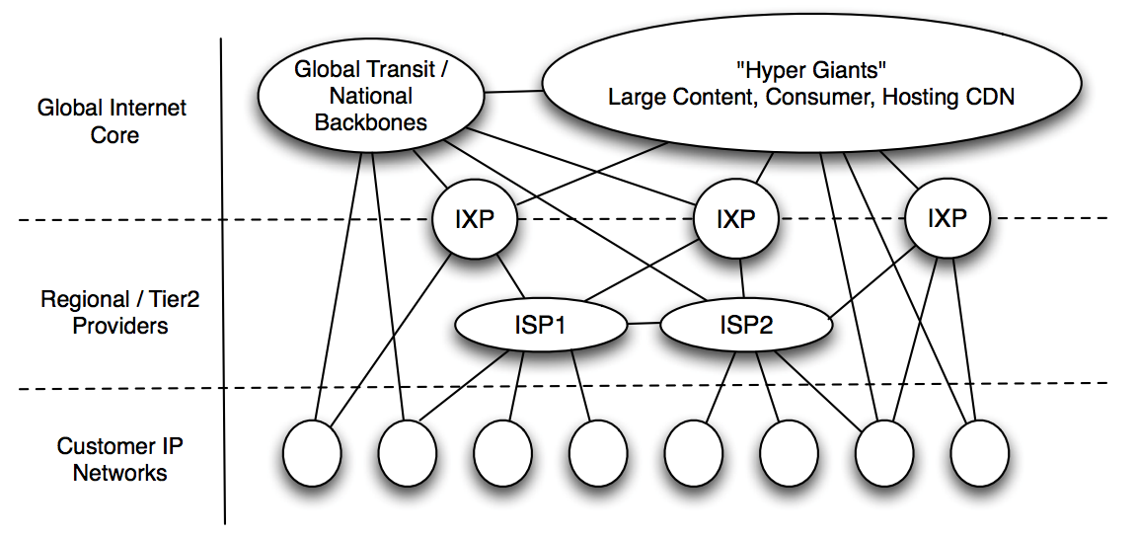
AS-level Internet
Internet Inter-Domain Traffic, SIGCOMM, 2010

Slide 7
AS-level Internet Today
By 2019, half the Internet traffic came from only five hypergiants such as Google, Netflix, Meta, Akamai
Seven Years in the Life of Hypergiants’ Off-nets, SIGCOMM, 2021

Slide 8
“Intra-domain” routing: Within an AS
Link-State (e.g., OSPF) and Distance-Vector (e.g., RIP)
Primary focus
Finding least-cost paths
Fast convergence

Slide 9
“Inter-domain” routing: Between ASes
Two key challenges
Scaling
Administrative structure
Issues of autonomy, policy, privacy

Slide 10
Recall: Addressing (so far)
Each host has a unique ID
No particular structure to those IDs

Slide 11
Recall: Forwarding
To UMich
111010010
MIT
To MIT
#1
#2
Forwarding Table @ #0
Dst | Next Hop
UMICH | 1
UCB | 3
MIT | 2
NYU | 4
#0
#4
#3
To UCB
To NYU

Slide 12
Two key challenges
Scaling
Administrative structure
Issues of autonomy, policy, privacy

Slide 13
Scaling
A router must be able to reach any destination
Given packet’s destination address, lookup next hop
Naive: Have an entry for each destination
There would be over 10⁸ entries!
AND routing updates per destination!
How can we improve scalability?
We have already seen an example: longest-prefix matching

Slide 14
A smaller table at node B?
1
2
A
B
C
6
3
4
Destination | Next Hop
to 1 | A
to 2 | C
to 3 | C
to 4 | A
to 5 | C
to 6 | A
to 7 | A
to 8 | C
8
7
5

Slide 15
Re-number the end-systems?
1
6
A
B
C
2
7
4
Destination | Next Hop
to [1-4] | A
to [5-8] | C
8
3
5
Careful address assignment → can aggregate multiple addresses into one range → scalability!
Akin to reducing the number of destinations

Slide 16
Scaling
A router must be able to reach any destination
Naive: Have an entry for each destination
Better: Have an entry for a range of addresses
Can’t do this if addresses are assigned randomly!
How addresses are allocated will matter!
Host addressing is key to scaling

Slide 17
Two key challenges
Scaling
Administrative structure
Issues of autonomy, policy, privacy

Slide 18
Administrative structure shapes inter-domain routing
ASes want freedom in picking routes
“My traffic can’t be carried over my competitor’s network”
“I don’t want to carry A’s traffic through my network”
Not expressible as Internet-wide “least cost”
ASes want autonomy
Want to choose their own internal routing protocol
Want to choose their own policy
ASes want privacy
Choice of network topology, routing policies, etc.

Slide 19
Choice of routing algorithm
Link-state
No privacy – broadcasts all network information
Limited autonomy – needs agreement on metric, algo
Distance-vector is a decent starting point
Per-destination updates give some control
BUT wasn’t designed to implement policy
AND is vulnerable to loops
The “Border Gateway Protocol” (BGP) extends distance-vector ideas to accommodate policy

Slide 20
Agenda
Inter-domain-routing
Addressing (Scalability)
BGP (Autonomy, policy, privacy)
Context and basic ideas: today
Details and issues: next lecture

Slide 21
IP addressing

Slide 22
Goal of addressing: Scalable routing
State: Small forwarding tables at routers
Much less than the number of hosts
Churn: Limited rate of change in routing tables
Ability to aggregate addresses is crucial for both

Slide 23
Aggregation works if…
1
6
A
B
C
7
2
4
8
3
5
Groups of destinations reached via the same path
These groups are assigned contiguous addresses
These groups are relatively stable
Few enough groups to make forwarding easy

Slide 24
IP addressing is hierarchical
Hierarchical address structure
Hierarchical address allocation
Hierarchical addresses and routing scalability

Slide 25
IP addresses (IPv4)
Unique 32-bit number associated with a host
Represented with the “dotted-decimal” notation
e.g., 12.34.158.5
00001100
00100010
10011110
00000101
12
34
158
5
00001100
00100010
10011110
00000101

Slide 26
Hierarchy in IP addressing
32 bits are partitioned into a prefix and suffix components
Prefix is the network component; suffix is the host component
Inter-domain routing operates on network prefix
12
34
158
5
00001100
00100010
10011110
00000101
Network (23 bits)
Host (9 bits)

Slide 27
CIDR: Classless inter-domain routing
Flexible division between network and host addresses
Offers a better tradeoff between size of the routing table and efficient use of the IP address space

Slide 28
CIDR example
Suppose a network has 50 computers
Allocate 6 bits for host addresses (2⁵ < 50 < 2⁶)
Remaining 32 - 6 = 26 bits as network prefix
Flexible boundary means the boundary must be explicitly specified with the network address!
Informally, “slash 26” → 128.23.9/26
Formally, prefix represented with a 32-bit mask: 255.255.255.192, where all network prefix bits set to “1” and host suffix bits to “0”
Also known as subnet mask (a group of machines with the same prefix are in the same subnet)

Slide 29
Before CIDR: Classful addressing
Three classes
8-bit network prefix (Class A),
16-bit network prefix (Class B), or
24-bit network prefix (Class C)
Example: an organization needs 500 addresses.
A single class C address is not enough (<500 hosts)
Instead, a class B address is allocated (~65K hosts)
Huge waste!

Slide 30
IP addressing is hierarchical
Hierarchical address structure
Hierarchical address allocation
Hierarchical addresses and routing scalability

Slide 31
Allocation done hierarchically
Internet Corporation for Assigned Names and Numbers (ICANN) gives large blocks to…
Regional Internet Registries, such as the American Registry for Internet Names (ARIN), which give blocks to…
Large institutions (ISPs), which give addresses to…
Individuals and smaller institutions
FAKE Example:
ICANN ➔ ARIN ➔ AT&T ➔ UMICH ➔ EECS

Slide 32
CIDR: Addresses allocated in contiguous prefix chunks
Recursively break down chunks as get closer to host
12.0.0.0/15
12.3.0.0/22
:
:
:
12.2.0.0/16
12.3.4.0/24
12.3.0.0/16
:
:
:
:
12.3.254.0/23
12.0.0.0/8
12.253.0.0/19
12.253.32.0/19
12.253.64.0/19
12.253.0.0/16
:
12.253.64.108/30
12.253.96.0/18
12.253.128.0/17

Slide 33
FAKE example in more detail
ICANN gave ARIN several /8s
ARIN gave AT&T one /8, 12.0/8
Network Prefix: 00001100
AT&T gave UMICH a /16, 12.34/16
Network Prefix: 0000110000100010
UMICH gave EECS a /24, 12.34.56/24
Network Prefix: 000011000010001000111000
EECS gave me specific address 12.34.56.78
Address: 00001100001000100011100001001110

Slide 34
IP addressing is hierarchical
Hierarchical address structure
Hierarchical address allocation
Hierarchical addresses and routing scalability

Slide 35
IP addressing → Scalable routing?
Hierarchical address allocation only helps routing scalability if allocation matches topological hierarchy

Slide 36
IP addressing → Scalable routing?
a.c.*.* is this way
a.b.*.* is this way
France Telecom
AT&T a.0.0.0/8
UMICH-D a.b.0.0/16
UMICH-AA a.c.0.0/16

Slide 37
IP addressing → Scalable routing?
Can add new hosts/networks without updating
the routing entries at France Telecom
a.*.*.* is this way
France Telecom
AT&T a.0.0.0/8
foo.com a.d.0.0/16
UMICH-D a.b.0.0/16
UMICH-AA a.c.0.0/16

Slide 38
IP addressing → Scalable routing?
ESNet must maintain routing entries for both a.*.*.* and a.c.*.*
AT&T a.0.0.0/8
ESNet
UMICH-D a.b.0.0/16
UMICH-AA a.c.0.0/16

Slide 39
IP addressing → Scalable routing?
Hierarchical address allocation only helps routing scalability if allocation matches topological hierarchy
May not be able to aggregate addresses for “multi-homed” networks
A multi-homed network is connected to more than one ASes for fault-tolerance, load balancing, etc.

Slide 40
5-minute break!

Slide 41
Announcements
My office hour is from 1:30 to 2:30PM for today (instead of 2-3PM)

Slide 42
BGP: Border Gateway Protocol

Slide 43
BGP (Today)
The role of policy
What we mean by it
Why we need it
Overall approach
Four non-trivial changes to DV

Slide 44
Administrative structure shapes Inter-domain routing
ASes want freedom to pick routes based on policy
ASes want autonomy
ASes want privacy

Slide 45
Topology & policy shaped by inter-AS business relationship
Three basic kinds of relationships between ASes
AS A can be AS B’s customer
AS A can be AS B’s provider
AS A can be AS B’s peer
Business implications
Customer pays provider
Peers don’t pay each other
Exchange roughly equal traffic
Notes:
Ehy???

Slide 46
Business relationships
Relations between ASes
Business implications
Customers pay provider
Peers don’t pay each other
provider
customer
peer
peer

Slide 47
Why peer?
D and E communicate a lot
A
Peering saves B and C money
B
C
D
E

Slide 48
Routing follows the money!
Q
Pr
Cu
Peer
Peer
A
B
C
D
E
F
traffic allowed
traffic not allowed
ASes provide “transit” between their customers
Peers do not provide transit between other peers

Slide 49
Routing follows the money!
Q
Pr
Cu
Peer
Peer
A
B
C
D
E
F
An AS only carries traffic to/from its own customers over a peering link

Slide 50
Routing follows the money!
Pr
Cu
X
Peer
Peer
A
B
E
Routes are “valley” free (more details later)

Slide 51
In short
AS topology reflects business relationships between ASes
Business relationships between ASes impact which routes are acceptable

Slide 52
BGP (Today)
The role of policy
What we mean by it
Why we need it
Overall approach
Four non-trivial changes to DV

Slide 53
Inter-domain routing: Setup
Destinations are IP prefixes (12.0.0.0/8)
Nodes are Autonomous Systems (ASes)
Internals of each AS are hidden
Links represent both physical links and business relationships
BGP (Border Gateway Protocol) is the Inter-domain routing protocol
Implemented by AS border routers

Slide 54
BGP: Basic idea
An AS advertises (“exports”) its best routes to one or more IP prefixes
Each AS selects the “best” route it hears advertised for a prefix
You’ve heard this story before!
Notes:
Arrows are routing message

Slide 55
BGP inspired by Distance-Vector
Per-destination route advertisements
No global sharing of network topology information
Iterative and distributed convergence on paths
With four crucial differences!

Slide 56
BGP & DV differences: (1) Not picking shortest-path routes
BGP selects the best route based on policy, not shortest distance (i.e., least-cost)
AS A may prefer “A,B,C” over “A,C”
How do we avoid loops?
A
B
C

Slide 57
BGP & DV differences: (2) Path-Vector routing
Key idea: advertise the entire path
Distance vector: send distance metric per dest d
Path vector: send the entire path for each dest d
“d: path (B,A)”
“d: path (A)”
C
B
A
data traffic
data traffic
d

Slide 58
BGP & DV differences: (2) Path-Vector routing
Key idea: advertise the entire path
Distance vector: send distance metric per destination
Path vector: send the entire path for each destination
Benefits
Loop avoidance is straightforward (simply discard paths with loops)
Flexible and expressive policies based on entire path

Slide 59
BGP & DV differences: (3) Selective route advertisement
For policy reasons, an AS may choose not to advertise a route to a destination
Hence, reachability is not guaranteed even if graph is physically connected
A
B
AS-C does not want to carry traffic to AS-B
C

Slide 60
BGP & DV differences: (4) BGP may aggregate routes
For scalability, BGP may aggregate routes for different prefixes
a.*.*.* is this way
France Telecom
AT&T a.0.0.0/8
foo.com a.d.0.0/16
UMICH-D a.b.0.0/16
UMICH-AA a.c.0.0/16

Slide 61
Summary
Two key challenges in inter-domain routing
Scaling (Addressing)
Administrative structure (BGP)
Issues of autonomy, policy, privacy
Next lecture: BGP policies, protocol, and challenges

