Slide 1
EECS 489 Computer Networks Winter 2024
Mosharaf Chowdhury
Material with thanks to Aditya Akella, Sugih Jamin, Philip Levis, Sylvia Ratnasamy, Peter Steenkiste, and many other colleagues.

Slide 2
Recap: End-to-end principle
Functions that can be completely and correctly implemented only with the knowledge of application end host, should not be pushed into the network
Fate sharing: fail together or don’t fail at all
“it is acceptable to lose the state information associated with an entity if, at the same time, the entity itself is lost”

Slide 3
Agenda
HTTP and the Web
Improving HTTP Performance

Slide 4
The Web: Precursor
1945, Vannevar Bush, Memex
Concept of the web based on microfilms
1967, Ted Nelson, Project Xanadu
A world-wide publishing network to store information as connected literature
Coined the term “Hypertext”
1968, Douglas Engelbart, NLS (oN-Line System)
The mother of all demos

Slide 5
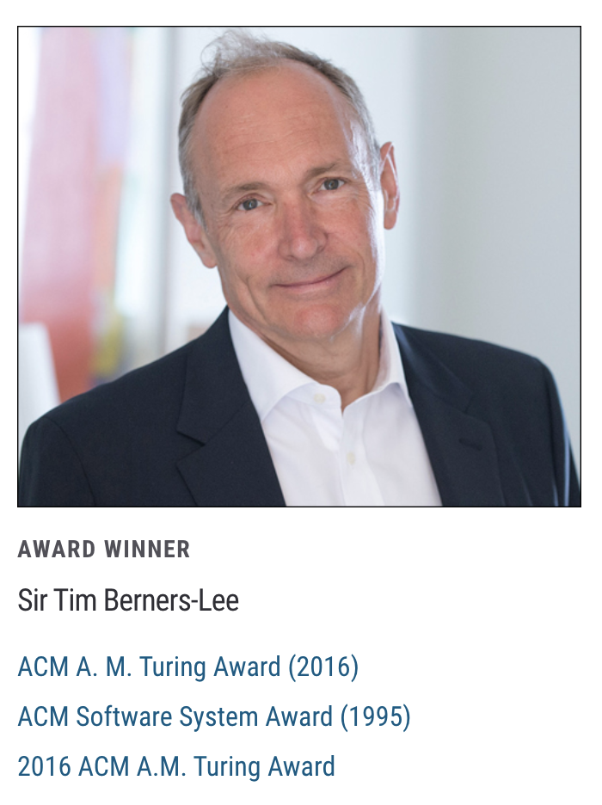
The Web: History
World Wide Web (WWW): a distributed database of “pages” linked through Hypertext Transport Protocol (HTTP)
First HTTP implementation – 1990
Tim Berners-Lee at CERN
HTTP/0.9 – 1991
Simple GET command for the Web
HTTP/1.0 – 1992
Client/server information, simple caching

Slide 6
The Web: History (cont’d)
World Wide Web (WWW): a distributed database of “pages” linked through Hypertext Transport Protocol (HTTP)
HTTP/1.1 – 1996
Performance and security optimizations
HTTP/2 – 2015
Latency optimizations via request multiplexing over single TCP connection
Binary protocol instead of text
Server push

Slide 7
The Web: History (cont’d)
World Wide Web (WWW): a distributed database of “pages” linked through Hypertext Transport Protocol (HTTP)
HTTP/3 – 2022
Built on top of QUIC, which is a user-space congestion control protocol on top of UDP
Solves the head-of-line (HOL) blocking problem when multiplexing over a single TCP connection

Slide 8
What does it consist of?
Who uses it?
Who provides the content?
How do they communicate?
How do we find the content?
How is the content organized?
How is it displayed?

Slide 9
Web components
Infrastructure:
Clients
Servers (DNS, CDN, Datacenters)
Content:
URL: naming content
HTML: formatting content
Protocol for exchanging information: HTTP

Slide 10
Why is there nothing about the network?
Application
Application
Transport
Transport
Network
Network
Network
Datalink
Datalink
Datalink
Physical
Physical
Physical
Clients
Switch
Servers

Slide 11



What we want
http://123.xyz
123.xyz server
HTTP Request

Slide 12
What we get
http://123.xyz
123.xyz server
Hello
HTTP Response

Slide 13
URL: Uniform Record Locator
protocol://host-name[:port]/directory-path/resource
Extend the idea of hierarchical hostnames to include anything in a file system
https://github.com/mosharaf/eecs489/blob/f24/Slides/012224.pptx
Extend to program executions as well…
https://www.google.com/search?q=eecs489
Server-side processing can be included in the name

Slide 14
URL: Uniform Record Locator
protocol://host-name[:port]/directory-path/resource
protocol: http, ftp, https, smtp, rtsp, etc.
host-name: DNS name, IP address
port: defaults to protocol’s standard port
E.g., http: 80, https: 443
directory path: hierarchical, reflecting file system
resource: Identifies the desired resource

Slide 15
Hyper Text Transfer Protocol (HTTP)
Client-server architecture
Server is “always on” and “well known”
Clients initiate contact to server
Synchronous request/reply protocol
Runs over TCP, Port 80
Stateless
ASCII format before HTTP/2 but Binary since then

Slide 16
Steps in canonical HTTP request/response
Client
Server
TCP syn
Establish
TCP connection
TCP syn + ack
Client
request
TCP ack + HTTP GET
.
.
Request
response
.
Close connection

Slide 17
Method types (HTTP 1.1)
GET, HEAD
POST
Send information (e.g., web forms)
PUT
Uploads file in entity body to path specified in URL field
DELETE
Deletes file specified in the URL field

Slide 18
Client-to-server communication
HTTP Request Message
Request line: method, resource, and protocol version
request line
GET /somedir/page.html HTTP/1.1
Host: www.someschool.edu
User-agent: Mozilla/4.0
Connection: close
Accept-language: fr
(blank line)
header
lines
carriage return line feed
indicates end of message

Slide 19
Client-to-server communication
HTTP Request Message
Request line: method, resource, and protocol version
Request headers: provide info or modify request
Body: optional data (e.g., to “POST” data to server)
request line
GET /somedir/page.html HTTP/1.1
Host: www.someschool.edu
User-agent: Mozilla/4.0
Connection: close
Accept-language: fr
(blank line)
header
lines
carriage return line feed
indicates end of message

Slide 20
Server-to-client communication
HTTP Response Message
Status line: protocol version, status code, status phrase
Response headers: provide information
Body: optional data
status line
(protocol, status code, status phrase)
HTTP/1.1 200 OK
Connection close
Date: Thu, 06 Jan 2017 12:00:15 GMT
Server: Apache/1.3.0 (Unix)
Last-Modified: Mon, 22 Jun 2006 ...
Content-Length: 6821
Content-Type: text/html
(blank line)
data data data data data ...
header lines
data
e.g., requested HTML file

Slide 21
HTTP is stateless
Each request-response treated independently
Servers not required to retain state
Good: Improves scalability on the server-side
Failure handling is easier
Can handle higher rate of requests
Order of requests doesn’t matter
Bad: Some applications need persistent state
Need to uniquely identify user or store temporary info
e.g., Shopping cart, user profiles, usage tracking, …
Notes:
Fate sharing

Slide 22
How does a stateless protocol keep state?

Slide 23
State in a stateless protocol: Cookies
Client-side state maintenance
Client stores small state on behalf of server
Client sends state in future requests to the server
Can provide authentication
Request
Store Cookie
Response
Set-Cookie: XYZ
DB
DB
Request
Cookie: XYZ
Client
Server
Notes:
Creates a notion of a “SESSION” for the user
Customize the user experience
Statefulness comes from the client side

Slide 24
Beyond cookies
Cookies provide excellent marketing opportunities and create concerns for privacy
Advertising companies tracks your preferences and viewing history across sites
Many are trying to curtail the (mis)use of cookies
Example: Google Chrome is deprecating third-party cookies in 2024

Slide 25
5-minute break!

Slide 26
Announcements
Assignment 1 is due on Jan 26, 2024
Group formation for A2-A4 by Jan 27 2024
https://docs.google.com/forms/d/e/1FAIpQLSfnVI9BlnTZL07BtIb4BGhQm5V4rvQbgXAsGgsYH2TfJroHNg/viewform?usp=sf_link

Slide 27
Performance goals
User
Fast downloads (not identical to low-latency communication!)
High availability
Content provider
Happy users (hence, above)
Cost-effective infrastructure
Network (secondary)
Avoid overload

Slide 28
Solutions?
Improve networking protocols including HTTP, TCP, etc.
User
Fast downloads (not identical to low-latency communication!)
High availability
Content provider
Happy users (hence, above)
Cost-effective infrastructure
Network (secondary)
Avoid overload

Slide 29
Solutions?
Improve networking protocols including HTTP, TCP, etc.
User
Fast downloads (not identical to low-latency communication!)
High availability
Content provider
Happy users (hence, above)
Cost-effective infrastructure
Network (secondary)
Avoid overload
Caching and replication

Slide 30
Solutions?
Improve networking protocols including HTTP, TCP, etc.
User
Fast downloads (not identical to low-latency communication!)
High availability
Content provider
Happy users (hence, above)
Cost-effective infrastructure
Network (secondary)
Avoid overload
Caching and replication
Exploit economies of scale; e.g., webhosting, CDNs, datacenters

Slide 31
HTTP performance
Most Web pages have multiple objects
e.g., HTML file and a bunch of embedded images
How do you retrieve those objects (naively)?
One item at a time
New TCP connection per (small) object!

Slide 32
Object request response time
RTT (round-trip time)
Time for a small packet to travel from client to server and back
Response time
1 RTT for TCP setup
1 RTT for HTTP request and first few bytes
Transmission time
Total = 2RTT + Transmission Time
Client
Server
TCP syn
RTT
TCP syn + ack
TCP ack + HTTP GET
RTT
Tx

Slide 33
Non-persistent connections
Default in HTTP/1.0
2RTT+△ for each object in the HTML file!
One more 2RTT+△ for the HTML file itself
Doing the same thing over and over again
Inefficient

Slide 34
Concurrent requests and responses
Use multiple connections in parallel
Does not necessarily maintain order of responses
Client
R2
R3
R1
T2
T3
T1
Client = ☺
Content provider = ☺
Network = ☹ Why?
Server

Slide 35
Persistent connections
Maintain TCP connection across multiple requests
Including transfers subsequent to current page
Client or server can tear down connection
Advantages
Avoid overhead of connection set-up and tear-down
Allow underlying layers (e.g., TCP) to learn about RTT and bandwidth characteristics
Default in HTTP/1.1

Slide 36
Pipelined requests & responses
Batch requests and responses to reduce the number of packets
Multiple requests can be contained in one TCP segment
Data are sent in a FIFO manner
Can lead to head-of-line (HOL) blocking if many small responses follow a large one
Not supported by default by major browsers circa 2015
Solution
Priority and preemption
Client
Server
Request 1
Request 2
Request 3
Transfer 1
Transfer 2
Transfer 3
Notes:
HTTP/1.1 allows multiple HTTP requests to be written out to a socket together without waiting for the corresponding responses. The requestor then waits for the responses to arrive in the order in which they were requested. The act of pipelining the requests can result in a dramatic improvement in page loading times, especially over high latency connections.

Slide 37
Scorecard: Getting n small objects
Time dominated by latency
One-at-a-time: ~2n RTT
m concurrent: ~2[n/m] RTT
Persistent: ~ (n+1) RTT
Pipelined: ~2 RTT
Pipelined and Persistent: ~2 RTT first time; RTT later for another n from the same site

Slide 38
Scorecard: Getting n large objects each of size F
Time dominated by TCP throughput B_{C} (<= B_{L}), where bottleneck link bandwidth is B_{L}
Assuming all TCP connections go through the same bottleneck link
One-at-a-time: ~ nF/B_{C}
m concurrent: ~ nF/(mB’_{C})
Assuming each TCP connection gets the same throughput (B’_{C}), where mB’_{C} <= B_{L}
Pipelined and/or persistent: ~ nF/B_{C}
The only thing that helps is higher throughput

Slide 39
Caching
Why does caching work?
Exploits locality of reference
How well does caching work?
Very well, up to a limit
Large overlap in content
But many unique requests
A universal story!
Effectiveness of caching grows logarithmically with size

Slide 40
Caching: How
Modifier to GET requests:
If-modified-since – returns “not modified” if resource not modified since specified time
GET /somedir/page.html HTTP/1.1
Host: www.someschool.edu
User-agent: Mozilla/4.0
If-modified-since: Wed, 18 Jan 2017 10:25:50 GMT
(blank line)

Slide 41
Caching: How
Modifier to GET requests:
If-modified-since – returns “not modified” if resource not modified since specified time
Client specifies “if-modified-since” time in request
Server compares this against “last modified” time of resource
Server returns “Not Modified” if resource has not changed
…. or a “OK” with the latest version otherwise

Slide 42
Caching: How
Modifier to GET requests:
If-modified-since – returns “not modified” if resource not modified since specified time
Response header:
Expires – how long it’s safe to cache the resource
No-cache – ignore all caches; always get resource directly from server

Slide 43
Caching: Where?
Options
Client (browser)
Forward proxies
Reverse proxies
Content Distribution Network

Slide 44
Caching: Where?
Many clients transfer same information
Generate unnecessary server and network load
Clients experience unnecessary latency
Server
Tier-1 ISP
ISP-1
ISP-2
Clients

Slide 45
Caching with Reverse Proxies
Cache documents close to server
Decrease server load
By content provider
Reverse proxies
Tier-1 ISP
ISP-1
ISP-2
Clients
45

Slide 46
Caching with Forward Proxies
Cache documents close to clients
Reduce network traffic and decrease latency
By ISPs or enterprises
Reverse proxies
Tier-1 ISP
Forward proxies
ISP-1
ISP-2
Clients
46

Slide 47
Summary
HTTP/1.1
Text-based protocol
Replaced by binary HTTP/2 protocol, which has been replaced by HTTP/3 in 2022
Many ways to improve performance
Pipelining and batching
Caching in proxies and CDNs
Datacenters

