Slide 1
EECS 489 Computer Networks Winter 2024
Mosharaf Chowdhury
Material with thanks to Aditya Akella, Sugih Jamin, Xin Jin, Philip Levis, Sylvia Ratnasamy, Peter Steenkiste, and many other colleagues.

Slide 2
Agenda
Software-defined networking
Programmable networks

Slide 3
The field of networking
CS networking today is largely the study of the Internet
Perhaps the only history class many will take in CS

Slide 4
Building an artifact, not a discipline
Other fields in “systems”: OS, DB, etc.
Teach basic principles
Are easily managed
Continue to evolve
Networking:
Teach big bag of protocols
Notoriously difficult to manage
Evolves very slowly
Networks are much more primitive and less understood than other computer systems

Slide 5
A tale of two planes
Data plane: forwarding packets
Based on local forwarding state
Control plane: computing that forwarding state
Involves coordination with rest of system

Slide 6
Original goals for the control plane
Basic connectivity: route packets to destination
Local state computed by routing protocols
Globally distributed algorithms
Inter-domain policy: find policy-compliant paths
Done by globally distributed BGP
What other goals are there in running a network?

Slide 7
Extended roles of the control plane
Performs various network management tasks
For example,
Where to route?
How much to route?
At what rate to route?
Should we route at all?
…

Slide 8
Bottom line
Many different control plane mechanisms
Each designed from scratch for their intended goal
Encompassing a wide variety of implementations
Distributed, manual, centralized,…
None of them particularly well designed
Network control plane is a complicated mess!

Slide 9
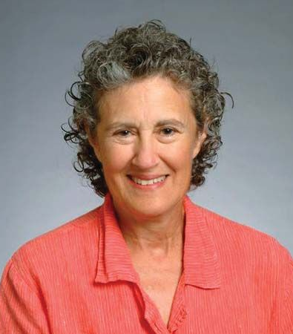
“The Power of Abstraction”
“Modularity based on abstraction is the way things get done”
Barbara Liskov
Abstractions → Interfaces → Modularity

Slide 10
Analogy: Mainframe to PC evolution
Vertical integration, closed
Open interfaces
Specialized application
Specialized operating system
Specialized hardware
Arbitrary applications
Commodity operating systems
Microprocessor
We want the same for networking!

Slide 11
Many control plane mechanisms
Variety of goals, no modularity
Routing: distributed routing algorithms
Isolation: ACLs, Firewalls,…
Traffic engineering: adjusting weights,…
Control Plane: mechanism without abstraction
Too many mechanisms, not enough functionality

Slide 12
Task: Compute forwarding state
Consistent with low-level hardware/software
Which might depend on vendor
Based on entire network topology
Because many control decisions depend on topology
For all routers/switches in network
Every router/switch needs forwarding state

Slide 13
Separate concerns with abstractions
Be compatible with low-level hardware/software
Forwarding abstraction
Make decisions based on entire network
Network state abstraction
Compute configuration of each physical device
Specification abstraction

Slide 14
#1: Forwarding abstraction
Express intent independent of implementation
Don’t want to deal with proprietary HW and SW
Design details concern exact nature of:
Header matching
Allowed actions

Slide 15
#2: Network state abstraction
Abstraction: global network view
Annotated network graph provided through an API
Creates a logically centralized view of the network (Network Operating System)
Runs on replicated servers in network (“controllers”)
Information flows both ways
Information from routers/switches to form “view”
Configurations to routers/switches to control forwarding

Slide 16
#3: Specification abstraction
Control mechanism expresses desired behavior
Whether it be isolation, access control, or QoS
It should not be responsible for implementing that behavior on physical network infrastructure
Requires configuring the forwarding tables in each switch
Abstract view of network
Models only enough detail to specify goals
Will depend on task semantics

Slide 17
Traditional fully decentralized control plane
Individual routing algorithm components in every router interact in the control plane
Control
Plane
Data
Plane
Dst | Next Hop
UMICH | 0
UCB | 0
MIT | 0
NYU | 0
111010010
MIT

Slide 18
Logically centralized control plane
A distinct (typically remote) controller interacts with local control agents (CAs)
Remote Control
Control
Plane
Data
Plane
Dst | Next Hop
UMICH | 0
UCB | 0
MIT | 0
NYU | 0
111010010
MIT

Slide 19
Each goal is an app via specification abstraction
What if an operator wants X?
What if a customer wants to do weighted traffic splitting?
…
There is an app for it!
Write your own routing protocol, load balancing algorithm, access control policies

Slide 20
Reason about each app via network state abstraction
Now that the network is not distributed anymore and is a simple graph, we can verify whatever the correctness of whatever we specified

Slide 21
Logically centralized control plane
A distinct (typically remote) controller interacts with local control agents (CAs)
Each router contains a flow table
Each entry of the flow table defines a match-action rule
Entries of the flow table is computed and distributed by the (logically) centralized controller

Slide 22
SDN: Many challenges remain
Hardening the control plane: dependable, reliable, performance-scalable, secure distributed system
Robustness to failures: leverage strong theory of reliable distributed system for control plane
Dependability, security: “baked in” from day one?
Networks, protocols meeting mission-specific requirements
E.g., real-time, ultra-reliable, ultra-secure
Internet-scaling

Slide 23
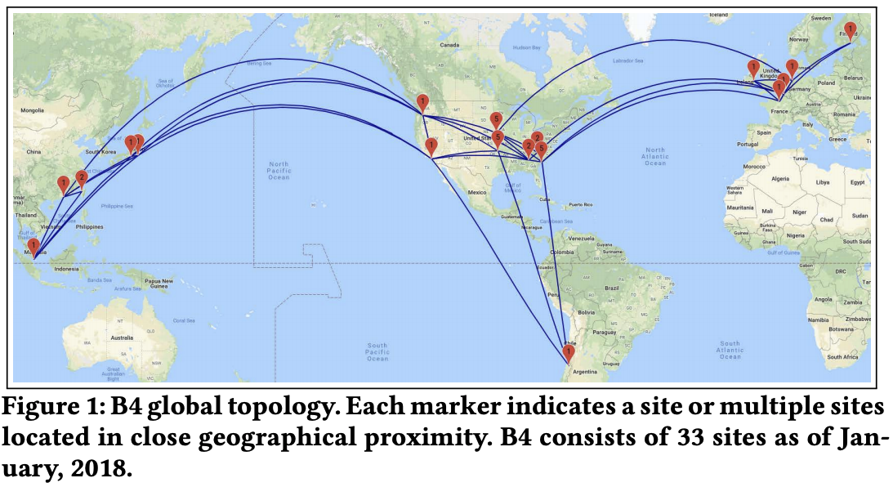
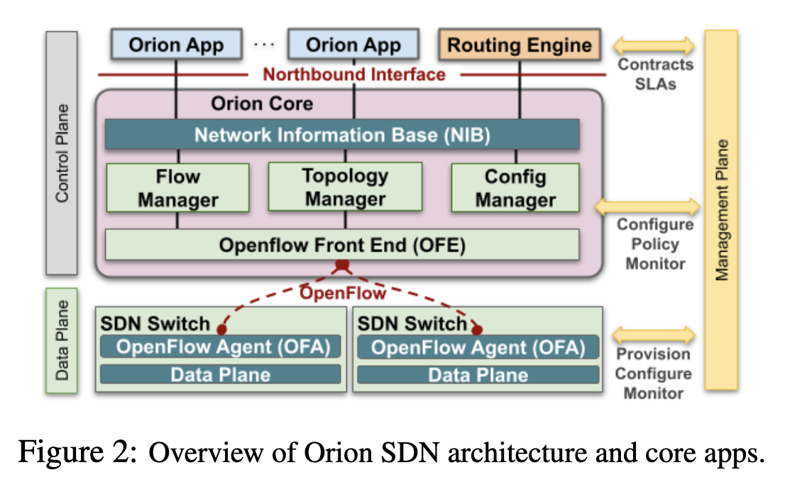
Some progress in the wide-area network (WAN)
Google and Microsoft use SDN to manage traffic between datacenters
One centralized controller to rule the entire world (well, their world)

Slide 24
5-minute break!

Slide 25
Announcements
Midterm regrading completed!
New average: 74%
New stdev: 7.88

Slide 26
A tale of two planes
Data plane: forwarding packets
Based on local forwarding state
Control plane: computing that forwarding state
Involves coordination with rest of system

Slide 27
OpenFlow data plane abstraction
Flow is defined by header fields
Generalized forwarding: simple packet-handling rules
Pattern: match values in packet header fields
Actions: for matched packet: drop, forward, modify, matched packet or send matched packet to controller
Priority: disambiguate overlapping patterns
Counters: #bytes and #packets
src=1.2.*.*, dest=3.4.5.* → drop
src = *.*.*.*, dest=3.4.*.* → forward(2)
3. src=10.1.2.3, dest=*.*.*.* → send to controller

Slide 28
OpenFlow: Flow table entries
Rule
Action
Stats
Packet + byte counters
Forward packet to port(s)
Encapsulate and forward to controller
Drop packet
Send to normal processing pipeline
Modify Fields
Switch
Port
VLAN
ID
MAC
src
MAC
dst
Eth
type
IP
Src
IP
Dst
IP
Prot
TCP
sport
TCP
dport
Link layer
Network layer
Transport layer
Notes:
Now I’ll describe the API that tries to meet these goals.
28

Slide 29
Forwarding abstraction
Match + Action: unifies different kinds of devices
Router
Match: longest destination IP prefix
Action: forward out a link
Switch
Match: destination MAC address
Action: forward or flood
Firewall
Match: IP addresses and TCP/UDP port numbers
Action: permit or deny
NAT
Match: IP address and port
Action: rewrite address and port

Slide 30

OpenFlow example
Example: datagrams from hosts h5 and h6 should be sent to h3 or h4, via s1 and from there to s2
match
action
Host h6
10.3.0.6
IP Src = 10.3.*.*
IP Dst = 10.2.*.*
forward(3)
1
s3
2
3
4
Host h5
10.3.0.5
1
s1
s2
1
2
Host h4
10.2.0.4
4
2
4
Host h1
10.1.0.1
3
3
Host h2
10.1.0.2
match
action
match
action
Host h3
10.2.0.3
ingress port = 2
IP Dst = 10.2.0.3
ingress port = 2
IP Dst = 10.2.0.4
forward(3)
ingress port = 1
IP Src = 10.3.*.*
IP Dst = 10.2.*.*
forward(4)
forward(4)

Slide 31
OpenFlow protocol
Operates between controller, switch
TCP used to exchange messages
Optional encryption
Three classes of OpenFlow messages:
Controller-to-switch
Asynchronous (switch to controller)
Symmetric (misc.)
OpenFlow Controller

Slide 32
Fixed-function data plane
Traditional switches are fixed-function
They can do whatever they can do at birth, but they cannot change!
Bottom-up design
Even OpenFlow was designed to be a fixed protocol
With a fixed table format
Capable of doing limited things

Slide 33
Takes forever to get a feature
Feature
Software
Team
Feature
Network Owner
Network Equipment Vendor
Weeks
Feature
ASIC
Team
Years
Years

Slide 34
Programmable data plane
What if we could tell switches exactly what we want?
What table to keep?
What rules to use?
What data to keep track of?
…

Slide 35
Top-down approach
Precisely specify what you want to do and how you want a packet to be processed
table int_table {
reads {
ip.protocol
}
actions {
export_queue_latency
}
}
action export_queue_latency (sw_id) {
add_header(int_header);
modify_field(int_header.kind, TCP_OPTION_INT);
modify_field(int_header.len, TCP_OPTION_INT_LEN);
modify_field(int_header.sw_id, sw_id);
modify_field(int_header.q_latency,
intrinsic_metadata.deq_timedelta);
add_to_field(tcp.dataOffset, 2);
add_to_field(ipv4.totalLen, 8);
subtract_from_field(ingress_metadata.tcpLength, 12);
}

Slide 36
What’s left?
Compile it down to be something runnable on a programmable switch
Similar to other high-level languages we use to run code on hardware like CPU, GPU, FPGA etc.
P4 for programmable switches
But which switch?

Slide 37
PISA: Protocol Independent Switch Architecture
Programmer declares which
headers are recognized
Programmer declares what
tables are needed and how packets are processed
Match + Action
Memory
ALU
Programmable
Parser
All stages are identical – makes PISA a good “compiler target”

Slide 38
How’s programmability used today?
Remove features to reduce complexity
Add proprietary features
Silicon independence or avoid vendor lock-in
Telemetry and measurements

Slide 39
Example: In-band network telemetry (INT)
“Which path did my packet take?”
“Which rules did my packet follow?”
“How long did it queue at each switch?”
“Who did it share the queues with?”

Slide 40
Why now?
One of the earlier incarnation of programmable networks was in mid 90s
Active networks
What’s changed after two+ decades?
Hardware: We can now make programmable switches as fast as fixed ones
Software: We have found a (so far) reasonable balance between programmability, performance, and security

Slide 41
Summary
Abstractions beget modularity
Modularity is (almost always) good
Programmability is powerful
Finding the right balance is hard
Next lecture: Layer 2

Slide 43
Traffic engineering
Want to avoid persistent overloads on links
Choose routes to spread traffic load across links

Slide 44

Traffic engineering: Difficult
5
3
v
w
5
2
u
2
1
z
3
1
2
x
y
1
Q: What if network operator wants u-to-z traffic to flow along uvwz, x-to-z traffic to flow xwyz?
A: Need to define link weights so traffic routing algorithm computes routes accordingly (or need a new routing algorithm)!
Link weights are only control “knobs”
Notes:
Note: implicit assumption here: destination based forwarding

Slide 45
Traffic engineering: Difficult
5
3
v
w
5
2
u
2
1
z
3
1
2
x
y
1
Q: What if network operator wants to split u-to-z traffic along uvwz and uxyz (load balancing)?
A: Can’t do it (or need a new routing algorithm)
Notes:
Note: implicit assumption here: destination based forwarding

Slide 46
Traffic engineering: Difficult
5
3
v
w
5
2
u
2
1
z
3
1
2
x
y
1
Q: What if w wants to route the two flows differently?
A: Can’t do it (with LS or DV)
Notes:
Note: implicit assumption here: destination based forwarding

Slide 47
OpenFlow: Controller-to-switch messages
Key controller-to-switch messages
Features: controller queries switch features, switch replies
Configure: controller queries/sets switch configuration parameters
Modify-state: add, delete, modify flow entries in the OpenFlow tables
Packet-out: controller can send this packet out of specific switch port

Slide 48
OpenFlow: Switch-to-controller messages
Key switch-to-controller messages
Packet-in: transfer packet (and its control) to controller. See packet-out message from controller
Flow-removed: flow table entry deleted at switch
Port status: inform controller of a change on a port
Network operators do not “program” switches by creating/sending OpenFlow messages directly.
Instead, they use higher-level abstraction at controller

