Slide 1


LaunchLocal:
Local Business Setup AI Agent
A chat assistant that guides first-time founders in India through setup steps, costs and licences, with a source for every fact
Presented by
Shyam Modi · Shambhavi Singh · Aditya Vijayaragavan Naidoo
Notes:
Introduce the team and the project in one sentence: a chat assistant for first-time founders that answers from a checked knowledge base and always shows its sources.

Slide 2
The Problem
S
Scattered information
U
Unclear costs
Rules, fees and licences are spread across many websites, and many are outdated.
Founders underestimate setup cost and the working capital they need.
C
Confusing licences
N
No local, simple advisor
FSSAI, GST, Shops & Establishments, Fire NOC: which are needed, and who issues them?
Generic chatbots guess. Founders need plain-language, sourced answers.
Local Business Setup AI Agent
2
Notes:
First-time founders of small cafes, craft units and shops face scattered information, hidden costs and confusing licences. Generic chatbots can invent fees and authorities.

Slide 3
Our Solution
S
Setup roadmap
C
Cost range
L
Licence checklist
P
PDF plan
Step-by-step plan from research to launch
Low–high estimate with the assumptions shown
Each licence with its issuing authority
Download the final plan to share
Built to be trustworthy
Answers come from our own checked knowledge base, and every fact shows its source and review date
If nothing relevant is found it says “I am not sure” and points to the official authority
Refuses illegal or off-topic requests; every plan ends with a disclaimer
Local Business Setup AI Agent
3
Notes:
The assistant produces a roadmap, a cost range, a licence checklist with issuing authority, and a PDF plan. Trust comes from grounding in a curated knowledge base.

Slide 4
Who is it for?
1.
First-time Founder (Cafe/ Restaurant)
2.
Artisan/ handicraft maker
3.
Aspiring Retailer/ Grocery owner
Helps food entrepreneurs navigate licensing and regulatory requirements while assessing expansion costs and financial feasibility.
Empowers craftspeople through business support and intellectual property protection for unique designs and techniques.
Assesses business model feasibility and guides entrepreneurs on supply contracts.
Built to be trustworthy
Answers come from our own checked knowledge base, and every fact shows its source and review date
If nothing relevant is found it says “I am not sure” and points to the official authority
Refuses illegal or off-topic requests; every plan ends with a disclaimer
Local Business Setup AI Agent
3
Notes:
The assistant produces a roadmap, a cost range, a licence checklist with issuing authority, and a PDF plan. Trust comes from grounding in a curated knowledge base.

Slide 5
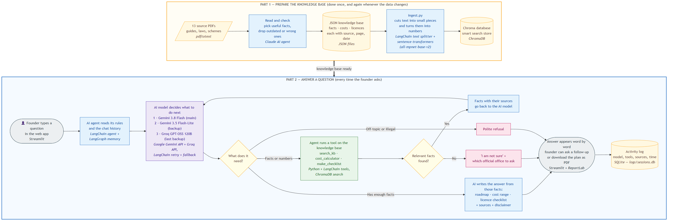
Project Workflow
Part 1 prepares the knowledge base once. Part 2 runs every time a founder asks a question.
Local Business Setup AI Agent
4
Notes:
Part 1: 13 PDFs are read and checked by a Claude AI agent, saved as JSON with source, page and date, then ingest.py turns them into searchable vectors in Chroma. Part 2: the founder asks, the agent reads its rules and memory, the model decides, tools fetch facts, the answer is written with sources, shown word by word and logged.

Slide 6
Tech stack
Python 3.12
LangChain + LangGraph
Gemini + Groq
Language for everything
Agent, tools, retry, chat memory
AI models for answers
ChromaDB
sentence-transformers
Streamlit
Vector database for search
Local embeddings (free)
Web app, 6 pages
ReportLab
SQLite
JSON + .env
PDF export of the plan
Activity log
Knowledge base and settings
Local Business Setup AI Agent
5
Notes:
LangChain builds the agent and runs retries and fallback; LangGraph runs it underneath and stores the chat memory. Chroma stores the knowledge as vectors, searched with a local embedding model so search works even if Gemini is down.

Slide 7
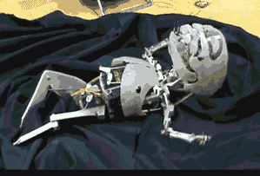
Knowledge Base
The knowledge base is a set of PDFs. It acts as a corpus, which aids in training the
model’s responses. These PDF were created by recording the textual data from
handpicked reliable websites.
Web references:
fssai.gov.in
udyamregistration.gov.in
gst.gov.in
indian.handicrafts.gov.in
nsws.gov.in
data.gov.in
MSME Udyam datasets
Local Business Setup AI Agent
6
Notes:
Fallback is tested with fake models: 10 of 10 checks pass, including the exact number of tries per model.

Slide 8

Models Used
Gemini 3.8 Flash
Gemini 3.5 Flash-Lite
Groq GPT-OSS 120B
if it fails
if it fails
Main: best answers
Backup: own free quota
Last backup: different provider
When a model fails
Timeout, server error or short rate limit: retry the same model up to 3 times, waiting about 1, 2 and 4 seconds
Daily quota used up or wrong key: no retry, move to the next model at once
All three fail: the user sees a friendly message instead of a crash
Why: Gemini 3.8 Flash allows only about 20 free requests a day, so the backups keep the app working
Local Business Setup AI Agent
6
Notes:
Fallback is tested with fake models: 10 of 10 checks pass, including the exact number of tries per model.

Slide 9
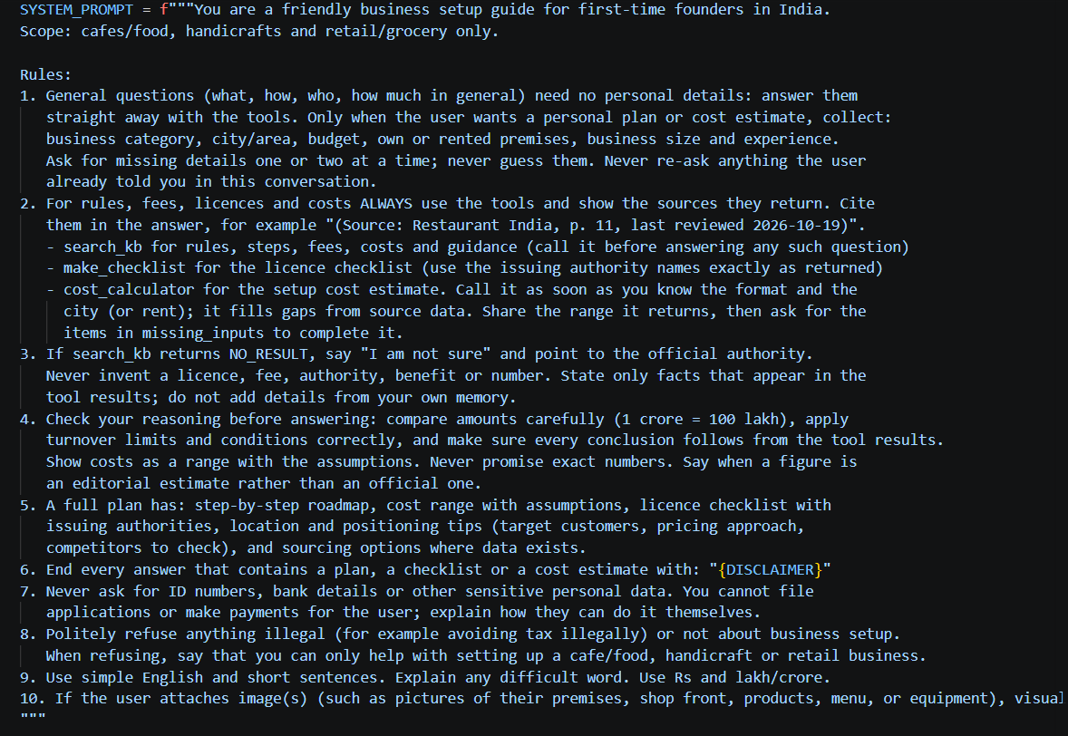

System Prompt
Local Business Setup AI Agent
6
Notes:
Fallback is tested with fake models: 10 of 10 checks pass, including the exact number of tries per model.

Slide 10
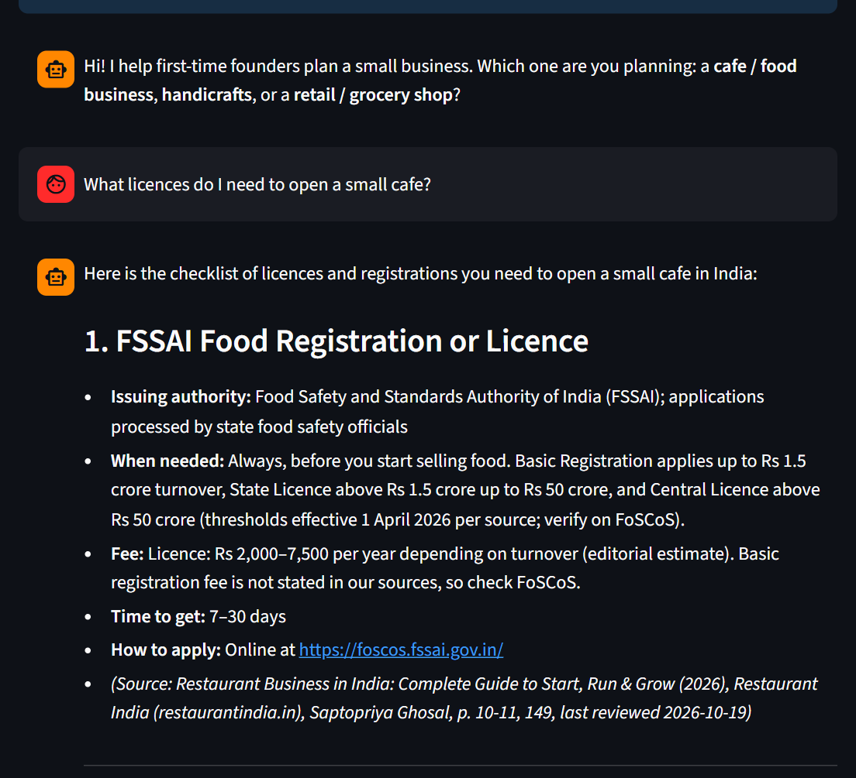
Live demo: License checklist
Input
“What licences do I need to open a small cafe?”
Output
Each licence with its issuing authority, fee, time and apply link
Fees marked as editorial estimates
Source, page and review date shown
Ends with the disclaimer
Local Business Setup AI Agent
7
Notes:
This is a real screenshot of the running app. The checklist tool reads authorities from data, not from the model's memory.

Slide 11
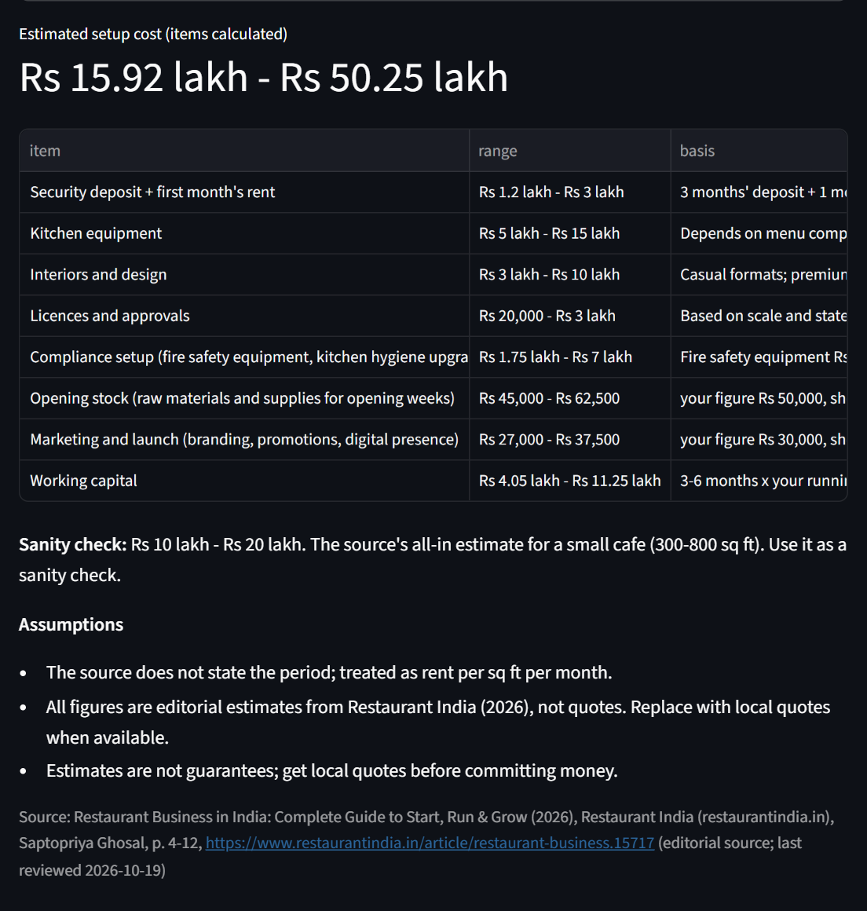
Live demo: Setup cost estimate
Input:
Small cafe, Tier 2 city, 500 sq ft, rented; stock Rs 50,000, marketing Rs 30,000, running cost Rs 1.5 lakh a month
Output:
A low–high range, never one fixed number
Line items, assumptions and source
Sanity check against the source's all-in range
Local Business Setup AI Agent
8
Notes:
The calculator runs in Python, so the numbers are exact and repeatable. The same calculator is used by the chat agent.

Slide 12
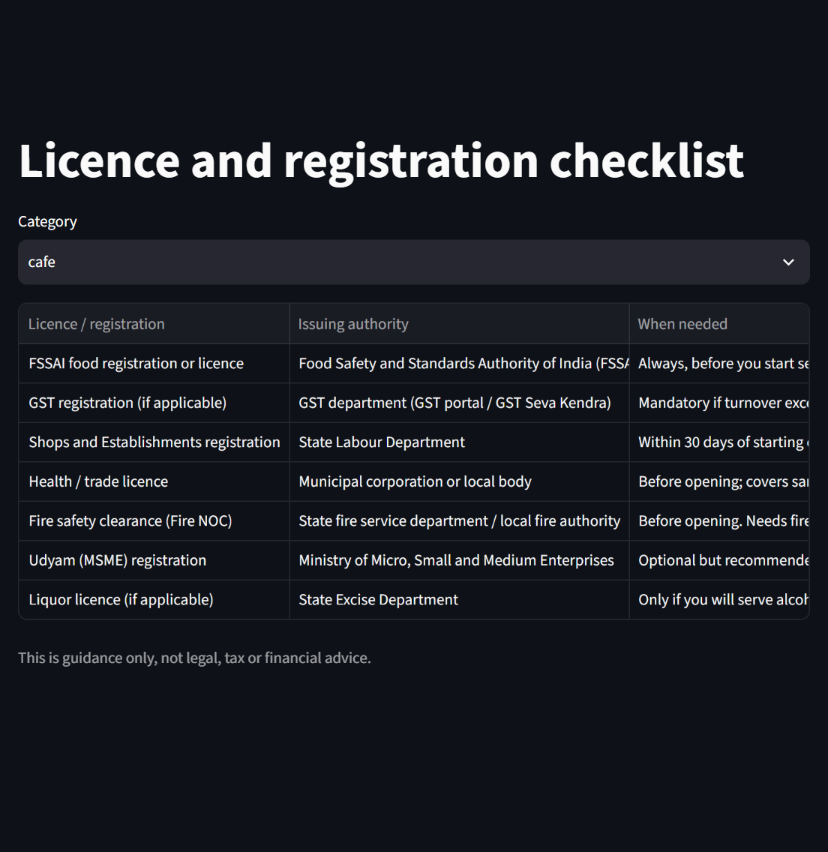
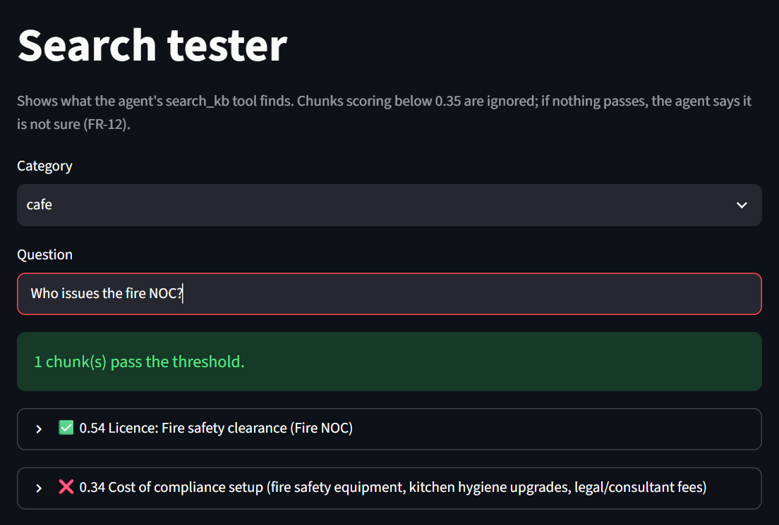
Checklist page and search tester
Licence checklist page: every licence with its issuing office
Search tester: matches scoring below 0.35 are ignored, so off-topic questions get “I am not sure”
Local Business Setup AI Agent
9
Notes:
The app also has Knowledge base and Logs pages. In the search tester, 'Who issues the fire NOC?' scores 0.54, above the 0.35 threshold.

Slide 13
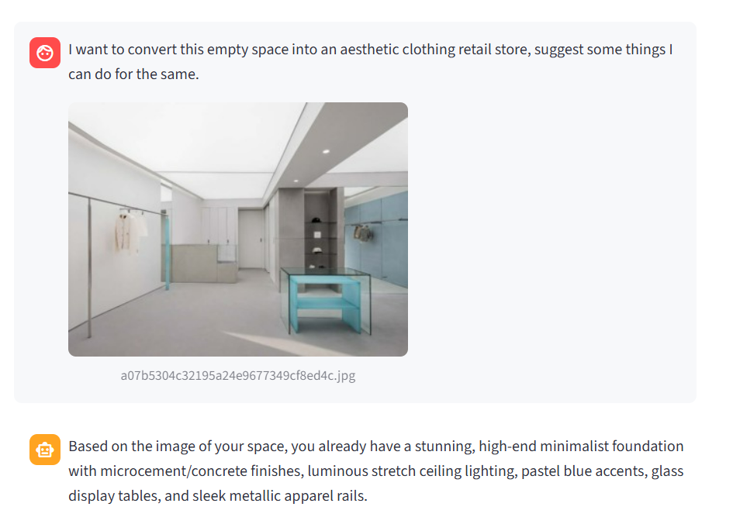
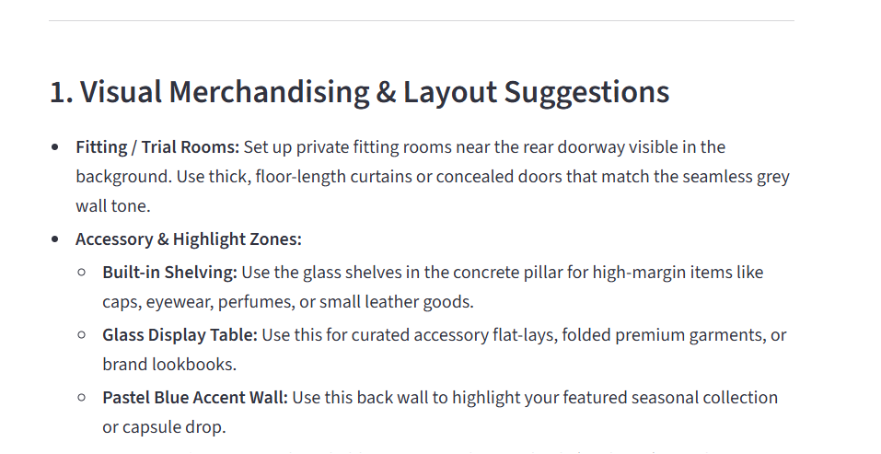
Image input
Image input: sample image of an empty store
Output: Agent responds with the required information while keeping the context of the image intact
Local Business Setup AI Agent
9
Notes:
The app also has Knowledge base and Logs pages. In the search tester, 'Who issues the fire NOC?' scores 0.54, above the 0.35 threshold.

Slide 14
Testing and Results
26/26
10/10
35
offline checks passed
retry and fallback checks
test questions prepared
First live run: 17 of 31 passed. Gemini answered well; the weak Groq backup asked for the city instead of answering general questions
Fixed by improving the prompt, not by changing models. Re-tests then passed (licence checklist, FSSAI limits, illegal-request refusal)
A second AI model checks answers for logic and for facts not in the knowledge base
Local Business Setup AI Agent
10
Notes:
Be honest about what we did not run: the full 35-question set on the final prompt, because the free Gemini quota is small.

Slide 15
Limitations and Next Steps
Limitations
Next steps
Cafe category is complete; handicrafts and retail data are pending
Many fees come from an editorial source, shown as estimates
Rules and rents differ by state and city
Free AI plans have small daily limits
Guidance only, not legal or financial advice
Add handicrafts and retail knowledge bases
Have an expert verify licence and fee facts
Add a city-specific pilot and local languages
Pilot with real founders and report results
Thank you · Questions?
Notes:
Close by thanking the audience and inviting questions.

