Slide 1
Full Stack Application Development (24SDCS02) Airline Customer Feedback And Compliant Resolution System
Team Members
Gurram Bhasker
Jai Raj
Madupathy Hari
Haran
Marisa Aditya
Vardhan
Boreddy Jayasimha
Reddy
24200304214
24200302243
24200900094
24200800035
Under the Esteemed Guidance of
Dr. S. Spandana

Slide 2
Introduction
In the aviation industry, handling passenger feedback and complaints efficiently is a significant challenge due to the large number of daily users. Airlines receive a high volume of feedback, making manual processing slow and difficult to manage.
Traditional systems often depend on human effort, which can lead to delays, errors, and inconsistent responses. As a result, important issues may not be addressed on time, affecting customer satisfaction. There is a growing need for a smarter system that can process and analyze feedback automatically.
An intelligent approach can help identify critical complaints quickly and prioritize them effectively. By integrating basic AI techniques, the system can understand user sentiment and intent. This ensures better decision-making and faster resolution of issues. Our project aims to solve these problems by introducing a smart complaint management system.

Slide 3
Solution
Our project proposes an intelligent complaint management system designed to automate and improve the handling of passenger feedback. The system allows users to submit feedback and complaints through a structured and user-friendly interface.
It then analyzes the input using keyword detection and sentiment analysis techniques. Based on this analysis, each complaint is automatically classified and assigned a priority level. High-priority issues are highlighted so that they can be addressed first.
The system also suggests possible resolution steps to assist administrators in decision-making. On the admin side, all complaints are displayed in an organized and easy-to-understand format.
This helps in tracking, managing, and responding to issues efficiently. Overall, the solution ensures faster response times, better resource management, and improved customer satisfaction.

Slide 4
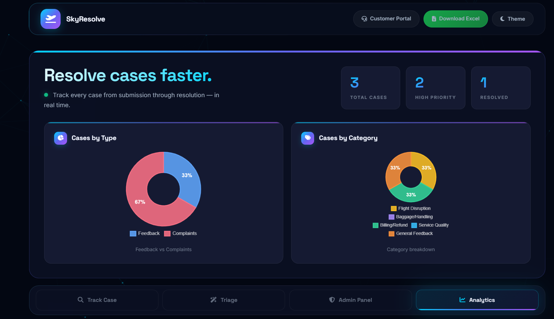
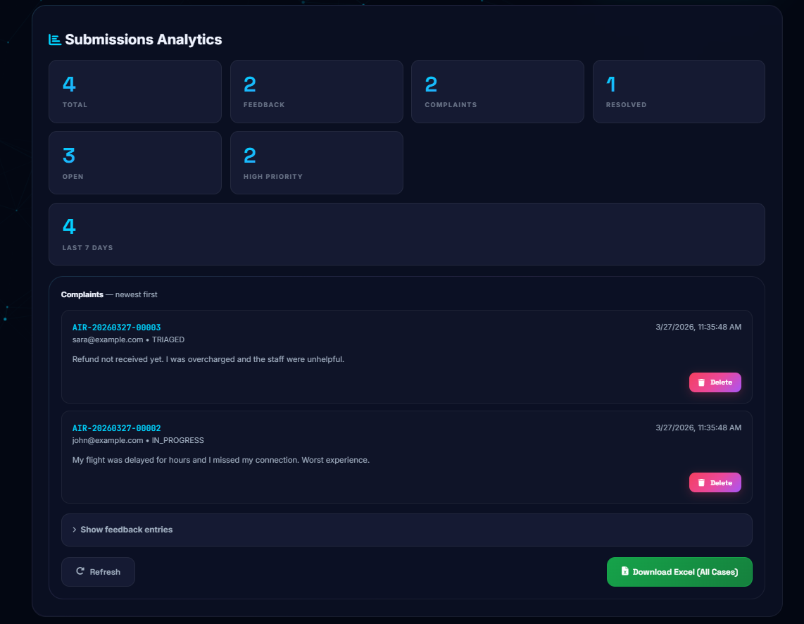
Working+Architecture
This slide represents the main dashboard of the Airline Customer Feedback System from the admin perspective. It provides a centralized view of all customer cases, including the number of recent cases, high-priority issues, and resolved complaints. The system also displays a real-time status timeline that shows the lifecycle of each case, starting from submission to resolution. One of the key features visible here is the smart triage mechanism, where each complaint is automatically categorized and assigned a priority based on keywords and sentiment analysis.

Slide 5
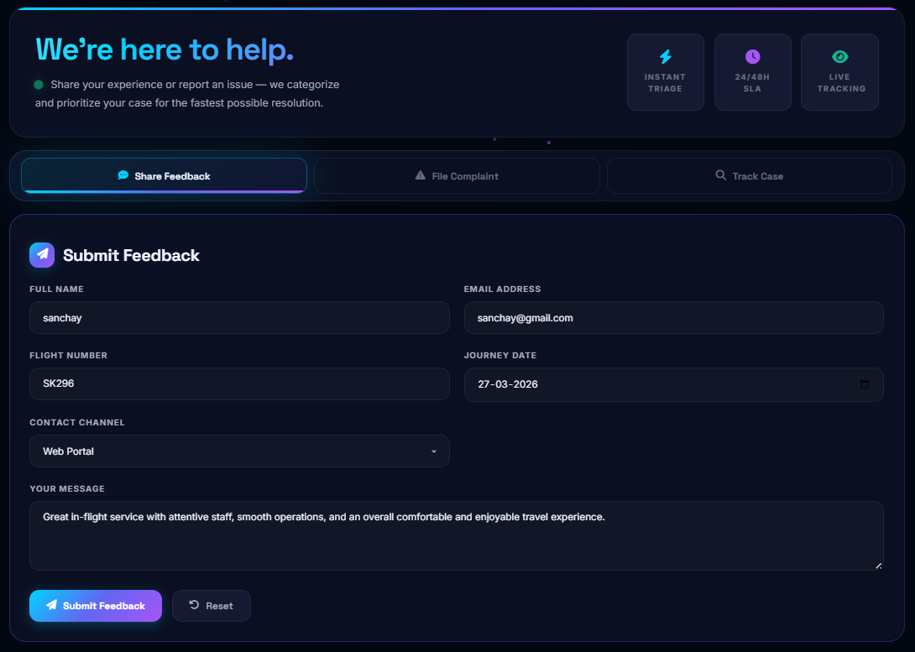
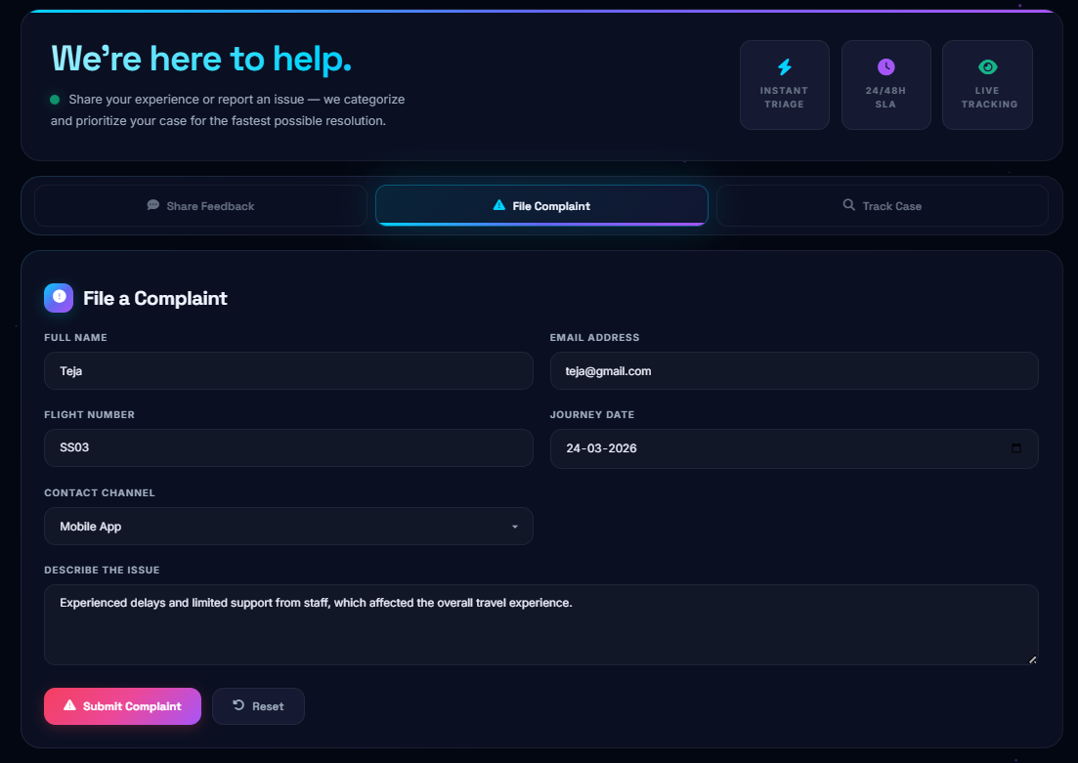
Feedback & Complaint Submission
This shows how users submit feedback and complaints through a simple and structured form. The system collects key details such as passenger information, flight number, journey date, and message. As the user enters their message, the system automatically analyzes it using keyword detection and sentiment analysis. It then classifies the issue and assigns a priority level based on urgency. For complaints, a suggested resolution plan is also generated. This reduces manual effort and helps in faster decision-making.

Slide 6
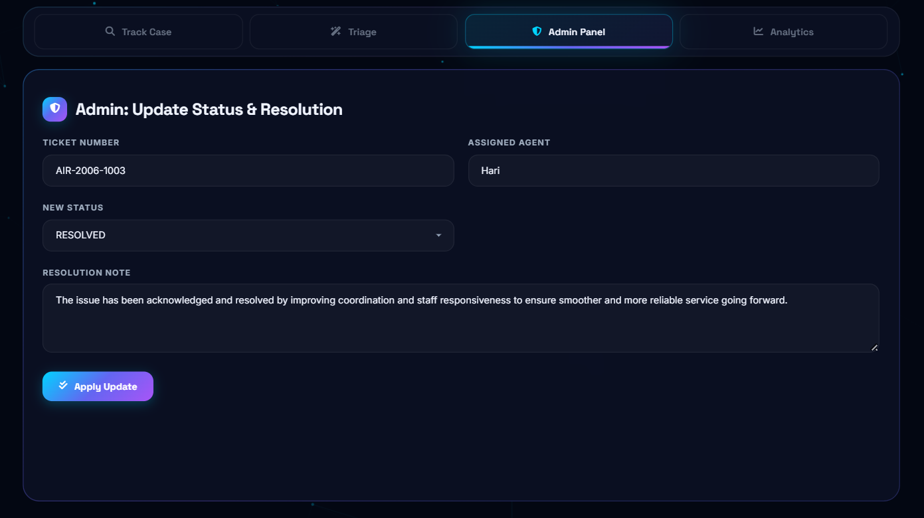
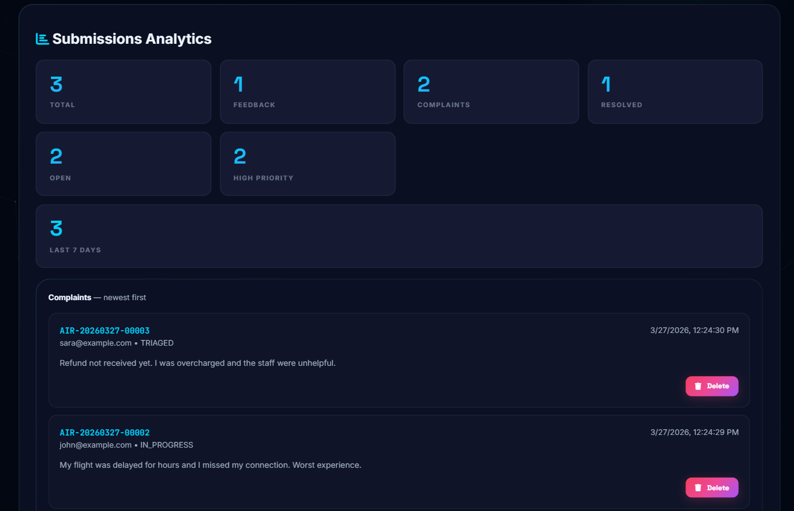
Complaint Management & Admin Response
This slide shows how complaints are managed on the admin side after submission. All complaints are displayed in a structured format along with their assigned priority levels. This helps the admin easily identify and focus on high-priority issues first. The system organizes complaints efficiently, reducing confusion and delay. Admins can review each complaint in detail and provide appropriate responses. This ensures timely resolution and improves overall user satisfaction.

Slide 7
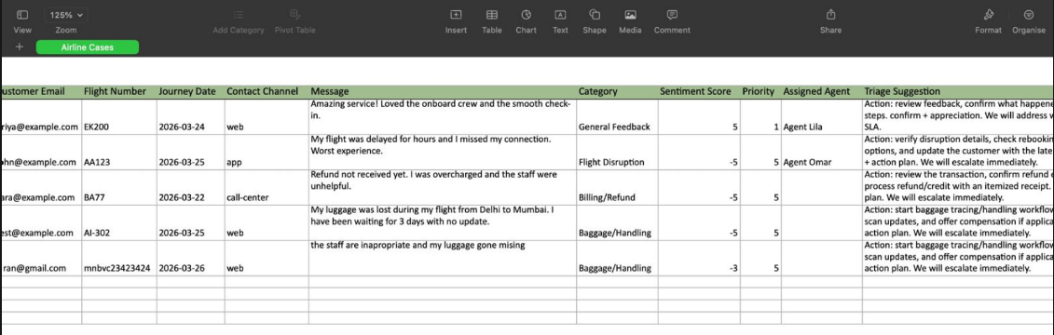
Backend Data Handling
This slide demonstrates the backend integration of the system where all user complaints are stored in a structured format. Whenever a user submits feedback or a complaint, the data is automatically sent to the backend and recorded in an Excel sheet. Each entry includes important details such as passenger information, complaint message, priority level, and timestamp. The Excel-based storage makes it easy to track, filter, and manage complaints efficiently. It also helps in maintaining transparency and accountability in the system. Overall, this integration connects the frontend and backend seamlessly, enabling smooth data flow and reliable storage.

Slide 8
Conclusion
Our project presents an efficient and intelligent approach to managing passenger feedback and complaints in the aviation industry. By integrating automation and basic AI techniques, the system simplifies the process of analyzing and prioritizing user input. It reduces the dependency on manual effort and minimizes delays in handling issues.
The priority-based classification ensures that critical problems are addressed quickly and effectively. The admin interface further helps in organizing and responding to complaints in a structured manner. This leads to improved operational efficiency and better decision-making.
Additionally, faster response times contribute to higher customer satisfaction and trust. The system demonstrates how technology can enhance service quality and streamline complaint management. Overall, it provides a scalable and practical solution for modern airline systems.

Slide 9
Thank You
Airline Customer Feedback & Complaint Resolution System
Team Members
Gurram Bhasker Jai Raj (24200304214) • Madupathy Hari Haran (24200302243)
Marisa Aditya Vardhan (24200900094) • Boreddy Jayasimha Reddy (24200800035)
Guided by: Dr. S. Spandana

