Slide 1
Foundations of Computer Science (26CSE0103)
Prepared By: Dr. Tajinder Kaur
Chitkara University Institute of Engineering and Technology,
Chitkara University, Punjab

Slide 2
UNIT-1 -Introduction to Computers
Contents
Characteristics,
Applications in daily life (Education, Healthcare, Banking, Engineering),
Evolution and Generations of Computers (Generations I–V).
Block Diagram of a Computer System: Functional units - input, output, memory, CPU, ALU, Control Unit, and CPU Registers, description of data bus, address bus, control bus, component interaction.

Slide 3
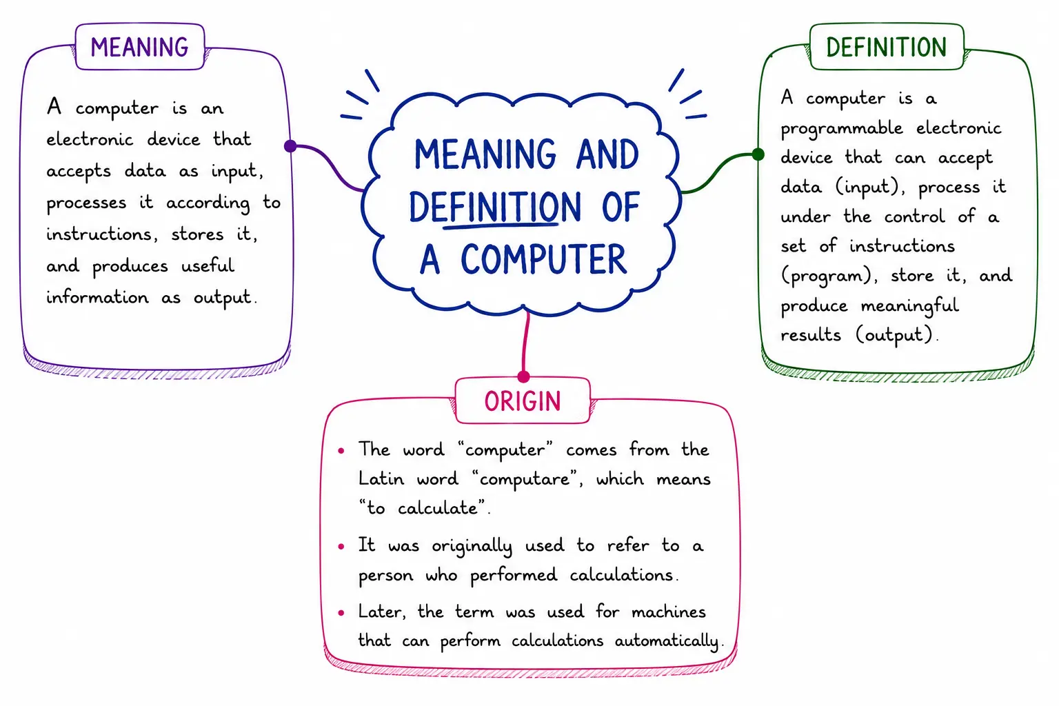
Computer?

Slide 4
A computer is an electronic machine that takes data as input, processes it, and gives the result as output. It works according to instructions (programs) given by the user and performs calculations, data analysis, file management, graphic design, internet browsing, and many other tasks quickly and accurately.
The working system of a computer depends on
Hardware (physical parts like monitor, keyboard, CPU)
Software (programs and applications).
Hardware
Hardware provides the physical infrastructure. The central processing unit (CPU), the mouse, storage and other components are examples of hardware components. The hardware components are the real component parts of a computer.
Software
Software instructs the hardware on what tasks to perform. Software components of a computer are the set of instructions which we store and execute on our system, which are known as software components.

Slide 5
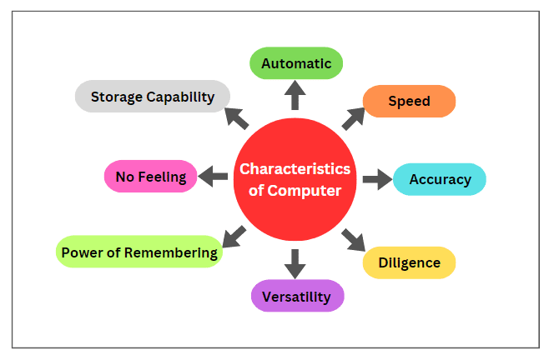
Characteristics of a computer
Fig.1.1 Characteristics of a Computer

Slide 6
Speed
Computers perform calculations and tasks very quickly.
They can process millions of instructions in seconds.
Compared to humans, computers complete large tasks in much less time.
Accuracy
Computers work free from errors.
If the input and program are correct, there is no mistake in the output.
It provides 100% accuracy in mathematical and logical operations.
Storage Capacity
Computers have the ability to store large amounts of data.
Data can be stored using hard disks, SSDs, pen drives, cloud storage, etc.
Data is safely kept for a long time and can be accessed easily when needed.

Slide 7
Diligence
Unlike human beings, a computer never gets tired and does not lose its concentration.
It can continuously work with a great accuracy for hours, creating no error and without rumbling.
e.g. if hundred million calculations have to be performed, a computer machine will perform the last one with exactly the same accuracy and speed as it did the first one.
Automatic
A computer is an automatic machine that works by itself without human intervention.
Once it started tasks, it carry out the task without human help until it is finished.
Versatility
It is capable of performing multitasks at a time simultaneously.
For example, we can use it to play music, as well as write a letter in the MS Office simultaneously.

Slide 8
Power of Remembering
Computers have the power of storing any amount of data or information.
We can store any information for several years, and recalled when we need it.
No Feeling
A computer is an electronic device that does not have any feelings, emotions, taste, knowledge and experience.
It does not get exhausted even after long hours of work.
Storage Capability
A computer has huge storage capability to store the information for a long time.
It has two types of storages: primary storage and secondary storage.
Primary storage is the main memory of a computer that stores the data temporarily. While secondary storage is a permanent storage for storing data.

Slide 9
Applications-Education
  Teaching and Learning Online
  Result Processing
  Student Data Processing
  Question Preparation
  Handouts and Notes Preparation

Slide 10
Banking
  Online Banking (e-banking)
  Reading and sorting cheques with the help of MICR (Magnetic Ink Character Reader)
  Additionally, ATM (Automated Teller Machine) is used to either deposit or withdraw cash in/from banks.

Slide 11
Healthcare
A computer plays an important role in the medical field also.
For example in the Intensive Care Unit (ICU) in the hospital, the computer keeps track of everything going inside the patient's body such as blood pressure and heartbeat, etc.
Keeping a record of patients and medicines also becomes easy through the use of the computer.
Diagnostic System — The computer is used to collect data and identify the cause of disease and illness.
Lab-diagnostic System — All tests can be done and the reports are prepared by computer.
Patient Monitoring System — Computers are also used to check the patient's signs for abnormality such as CT Scan, MRI, ECG, etc.
Pharmacy Information System — Computers are used to check medicine labels, expiry dates, harmful side effects, etc. Software: Epic Willow Pharmacy, Oracle Health Pharmacy.
Surgery — Computers are used in performing surgery. Software: Mako Smart Robotics

Slide 12
Engineering
  Structural Engineering — Requires stress and strain analysis for the design of buildings, ships, budgets, spaceships, airplanes, etc. Software used like ANSYS, Autodesk Robot Structural Analysis.
  Industrial Engineering — Here computers deal with the design, improvement, and implementation of integrated systems of people, materials, and equipment. Software: Arena Simulation, SIMUL8, FlexSim.
  Architectural Engineering — Computers help in planning cities and towns, designing apartments and buildings using both 2D and 3D drawings. Software: AutoCAD, Autodesk Revit.

Slide 13

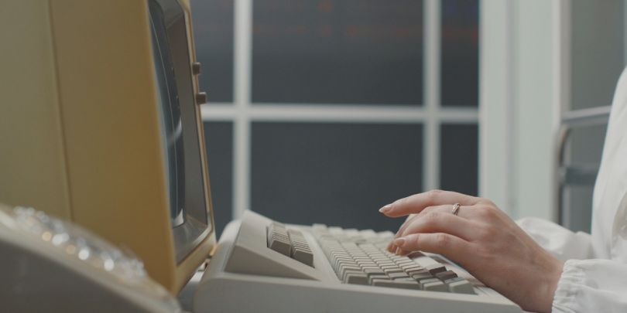
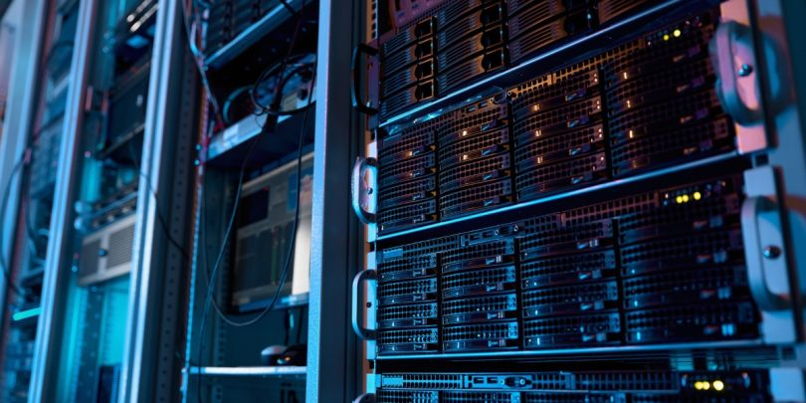

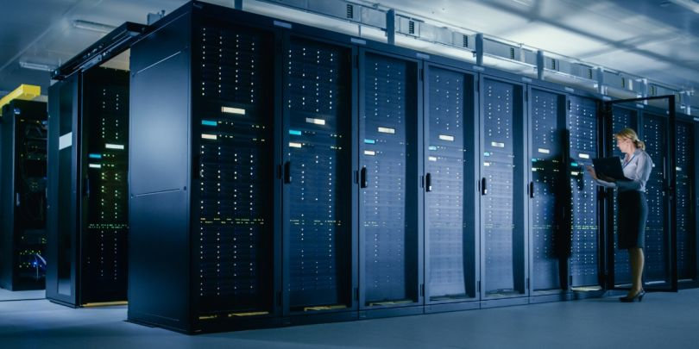
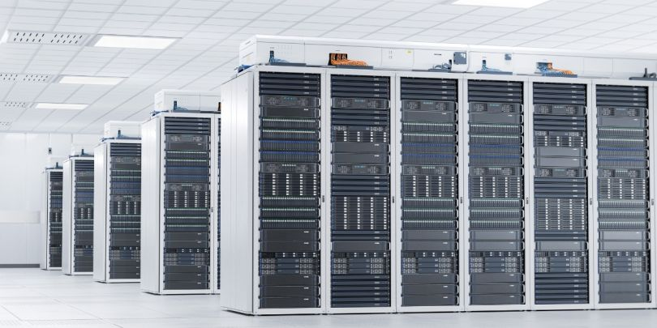
Types of Computers
1. Personal Computer (Microcomputer)
2. Minicomputer
3. Server
4. Workstation
5. Mainframe
6. Supercomputer

Slide 14
Feature | Microcomputer (PC) | Minicomputer | Mainframe Computer | Supercomputer | Workstation | Server
Definition | Small computer for a single user | Mid-range computer for multiple users | Large computer for high-volume data processing | Fastest computer for scientific and engineering computations | High-performance computer for professional applications | Computer that provides services and resources to other computers over a network
Users Supported | 1 | 10–100 | Hundreds to thousands | Few specialized users | 1 professional user | Hundreds to thousands of clients
Memory (RAM) | 4–64 GB | 16–256 GB | Hundreds of GB to several TB | Several TB to PB | 16–512 GB | 32 GB to several TB
Storage Capacity | 256 GB–4 TB | Several TB | Hundreds of TB to PB | PB or more | 1–20 TB | Several TB to PB
Operating System | Windows, Linux, macOS | UNIX, Linux | z/OS, Linux | Linux-based HPC OS | Windows, Linux, UNIX | Windows Server, Linux, UNIX
Primary Use | Personal computing | Departmental applications | Engineering, CAD/CAM, AI | Network, web, cloud, databases | Banking, airlines, government | Scientific simulations, weather forecasting, AI
Approximate Cost | ₹30,000–₹2 lakh | ₹5–50 lakh | ₹2–20 lakh | ₹5 lakh–₹5 crore | ₹10–500 crore | ₹500 crore–₹5,000+ crore

Slide 15
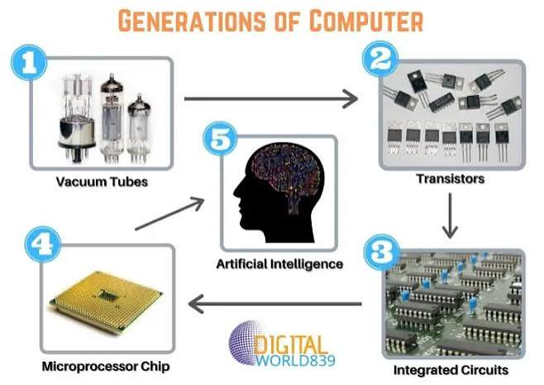
Generation & Description
First Generation
The period of first generation: 1946-1959.
Vacuum tube based.
Second Generation
The period of second generation: 1959-1965.
Transistor based.
Third Generation
The period of third generation: 1965-1971.
Integrated-Circuit based.
Fourth Generation
The period of fourth generation: 1971-1980.
VLSI microprocessor based.
Fifth Generation
The period of fifth generation: 1980-onwards.
ULSI microprocessor-based
Fig. 1.2 Key technologies behind five generations of a computer

Slide 16
First Generation Computers
The period of first generation was from 1946-1959. The computers of first generation used vacuum tubes as the basic components for memory and circuitry for CPU (Central Processing Unit).
These tubes, like electric bulbs, produced a lot of heat and the installations used to fuse frequently. Therefore, they were very expensive and only large organizations were able to afford it.
In this generation, mainly batch processing operating system was used. Punch cards, paper tape, and magnetic tape was used as input and output devices. The computers in this generation used machine code as the programming language.

Slide 17
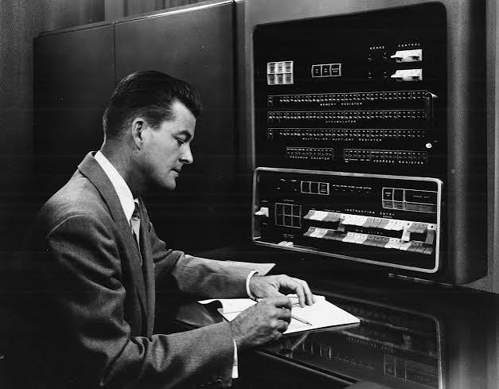
The main features of the first generation are:
• Vacuum tube technology
• Unreliable
• Supported machine language only
• Very costly
• Generates lot of heat
• Slow input and output devices
• Huge size
• Need of AC
• Non-portable
• Consumes lot of electricity
Some computers of this generation were:
• ENIAC
• EDVAC
• UNIVAC
• IBM-701
• IBM-750
Fig. 1.3 IBM 700 SERIES

Slide 18
Second Generation Computers
The period of second generation was from 1959-1965. In this generation, transistors were used that were cheaper, consumed less power, more compact in size, more reliable and faster than the first-generation machines made of vacuum tubes. In this generation, magnetic cores were used as the primary memory and magnetic tape and magnetic disks as secondary storage devices.
In this generation, assembly language and high-level programming languages like FORTRAN, COBOL were used. The computers used batch processing and multiprogramming operating system.

Slide 19
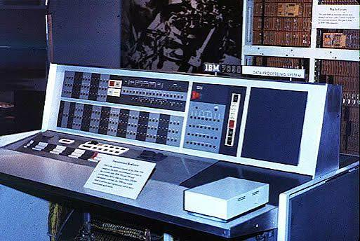
The main features of second generation are:
• Use of transistors
• Reliable in comparison to first generation computers
• Smaller size as compared to first generation computers
• Generates less heat as compared to first generation computers
• Consumed less electricity as compared to first generation computers
• Faster than first generation computers
• Still very costly
• AC required
• Supported machine and assembly languages
Some computers of this generation were:
• IBM 1620
• IBM 7094
• CDC 1604
• UNIVAC 1108
Fig. 1.4 IBM 7094

Slide 20
Third Generation Computers
The period of third generation was from 1965-1971. The computers of third generation used Integrated Circuits (ICs) in place of transistors. A single IC has many transistors, resistors, and capacitors along with the associated circuitry.
The IC was invented by Jack Kilby. This development made computers smaller in size, reliable, and efficient. In this generation remote processing, time-sharing, multi-programming operating system were used. High-level languages (FORTRAN-II TO IV, COBOL, PASCAL PL/1, BASIC, ALGOL-68 etc.) were used during this generation.

Slide 21
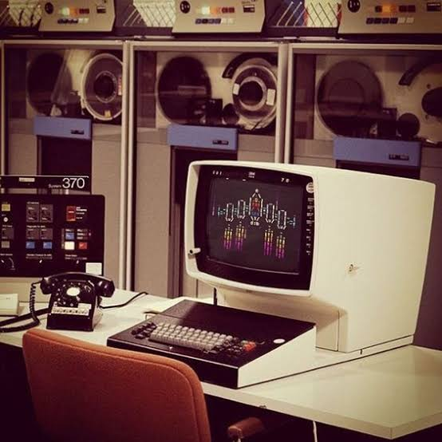
The main features of third generation are:
• IC used
• More reliable in comparison to previous two generations
• Smaller size
• Generated less heat
• Faster
• Lesser maintenance
• Costly
• AC required
• Consumed lesser electricity
• Supported high-level language
Some computers of this generation were:
• IBM-360 series
• Honeywell-6000 series
• PDP (Personal Data Processor)
• IBM-370/168
• TDC-316
Fig. 1.5 IBM SYSTEM 370 with color terminal

Slide 22
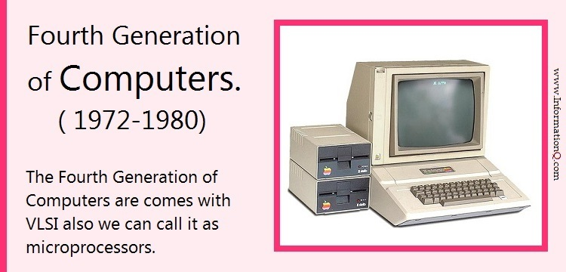
Fourth Generation Computers
Fourth generation computers became more powerful, compact, reliable, and affordable. As a result, it gave rise to Personal Computer (PC) revolution. In this generation, time sharing, real time networks, distributed operating system were used. All the high-level languages like C, C++, DBASE etc., were used in this generation

Slide 23
The main features of fourth generation are:
• VLSI technology used
• Very cheap
• Portable and reliable
• Use of PCs
• Very small size
• Pipeline processing
• No AC required
• Concept of internet was introduced
• Great developments in the fields of networks
• Computers became easily available
Some computers of this generation were:
• DEC 10
• STAR 1000
• PDP 11
• CRAY-1(Super Computer)
• CRAY-X-MP(Super Computer)

Slide 24
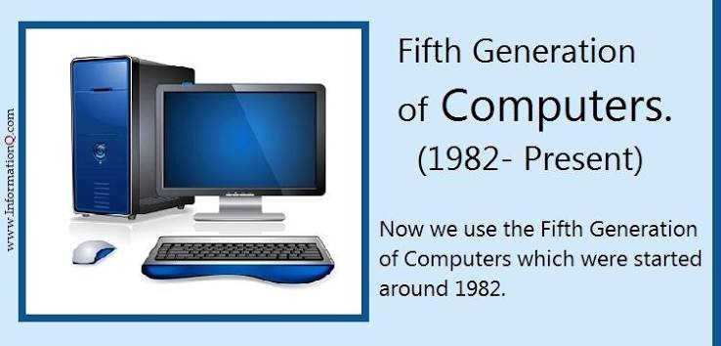
Fifth Generation Computers
In the fifth generation, VLSI technology became ULSI (Ultra Large Scale Integration) technology, resulting in the production of microprocessor chips having ten million electronic components.
This generation is based on parallel processing hardware and AI (Artificial Intelligence) software. AI is an emerging branch in computer science, which interprets the means and method of making computers think like human beings. All the high-level languages like C and C++, Java, .Net, Python, etc., are used in this generation.

Slide 25
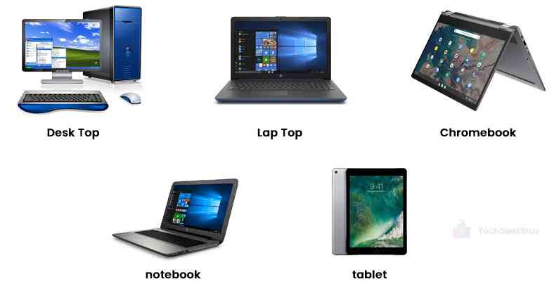
The main features of fifth generation are:
• ULSI technology
• Development of true artificial intelligence
• Development of Natural language processing
• Advancement in Parallel Processing
• Advancement in Superconductor technology
• More user-friendly interfaces with multimedia features
• Availability of very powerful and compact computers at cheaper rates
Fig.1.6 Types of computers in fifth generation
Some computer types of this generation are:
• Desktop
• Laptop
• Notebook
• Ultrabook
• Chromebook

Slide 26
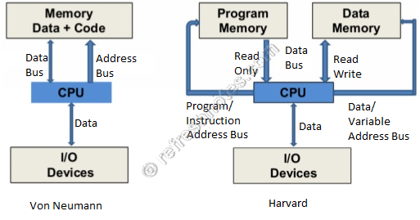
Von Neumann Architecture
From an architectural point of view, there are the two basic models: Von Neumann and Harvard architectures. These models explain the organization of memory and processing units in a computer system.
Fig. 1.7 Von Neumann Vs Harvard architecture

Slide 27
VON NEUMANN vs HARVARD ARCHITECTURE
VON NEUMANN ARCHITECTURE | HARVARD ARCHITECTURE
It is ancient computer architecture based on stored program computer concept. | It is modern computer architecture based on Harvard Mark I relay based model.
Same physical memory address is used for instructions and data. | Separate physical memory address is used for instructions and data.
There is common bus for data and instruction transfer. | Separate buses are used for transferring data and instruction.
Two clock cycles are required to execute single instruction. | An instruction is executed in a single cycle.
It is cheaper in cost. | It is costly than Von Neumann Architecture.
CPU can not access instructions and read/write at the same time. | CPU can access instructions and read/write at the same time.
It is used in personal computers and small computers. | It is used in micro controllers and signal processing.

Slide 28
Block Diagram of a Computer System
Secondary Storage Devices
Primary Memory
Input Device
Control Unit (CU)
Output Device
Arithmetic Logic Unit (ALU)
Central Processing Unit (CPU)
Fig. 1.8: Components of a computer system

Slide 29
Central Processing Unit (CPU)
It is the electronic circuitry of a computer that carries out the actual processing and usually referred as the brain of the computer. It is commonly called processor also. Physically, a CPU can be placed on one or more microchips called integrated circuits (IC). The ICs comprise semiconductor materials.

Slide 30
CPU Functioning Details
The CPU is given instructions and data through programs. The CPU then fetches the program and data from the memory and performs arithmetic and logic operations as per the given instructions and stores the result back to memory.
While processing, the CPU stores the data as well as instructions in its local memory called registers. Registers are part of the CPU chip and they are limited in size and number. Different registers are used for storing data, instructions or intermediate results
CPU has two main components — Arithmetic Logic Unit (ALU) and Control Unit (CU).
ALU performs all the arithmetic and logic operations that need to be done as per the instruction in a program.
CU controls sequential instruction execution, interprets instructions and guides data flow through the computer’s memory, ALU and input or output devices. CPU is also popularly known as microprocessor

Slide 31




Input Devices
The devices through which control signals are sent to a computer are termed as input devices. These devices convert the input data into a digital form that is acceptable by the computer system.
Some examples of input devices include keyboard, mouse, scanner, touch screen, etc., as shown in Figure.
Specially designed braille keyboards are also available to help the visually impaired for entering data into a computer.
Besides, we can now enter data through voice, for example, we can use Google voice search to search the web where we can input the search string through our voice.
Data entered through input device is temporarily
stored in the main memory (also called RAM) of the computer system.
For permanent storage and future use, the data as well as instructions are stored permanently in additional storage locations called secondary memory.
Keyboard
Mouse
Scanner
Touch Screen
Fig. 1.9: Input devices

Slide 32



Output Devices
Display monitor
Speaker
Printer
3D printer
The device that receives data from a computer system for display, physical production, etc., is called output device. It converts digital information into human-understandable form. For example, monitor, projector, headphone, speaker, printer, etc.
Some output devices are shown in Figure. A braille display monitor is useful for a visually challenged person to understand the textual output generated by computers.
A printer is the most commonly used device to get output in physical (hardcopy) form. Three types of commonly used printers are inkjet, laserjet and dot matrix.
Now-a-days, there is a new type of printer called 3D-printer, which is used to build physical replica of a digital 3D design. These printers are being used in manufacturing industries to create prototypes of products. Their usage is also being explored in the medical field, particularly for developing body organs.
Fig. 1.10: Output devices

Slide 33
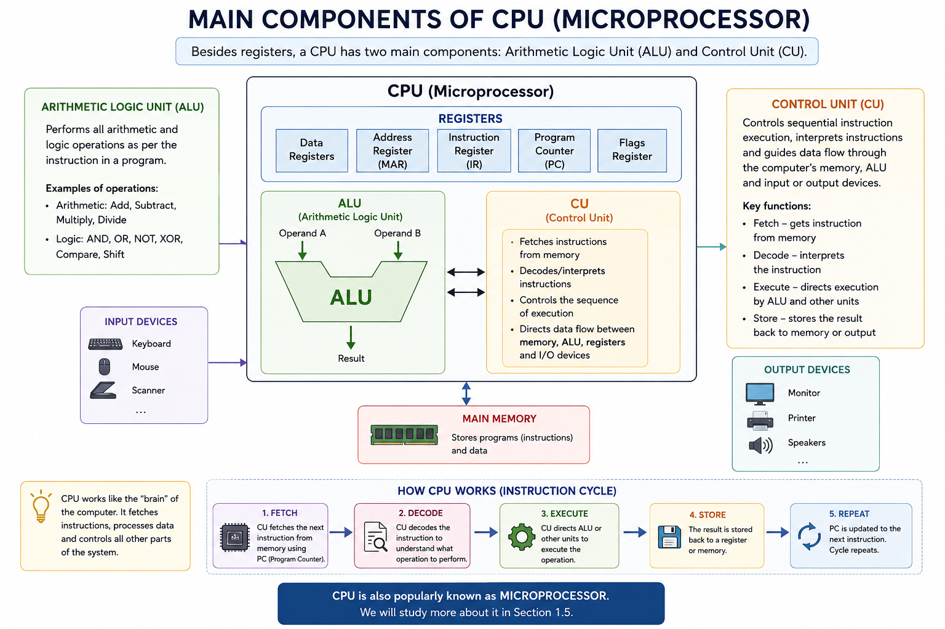

Slide 34
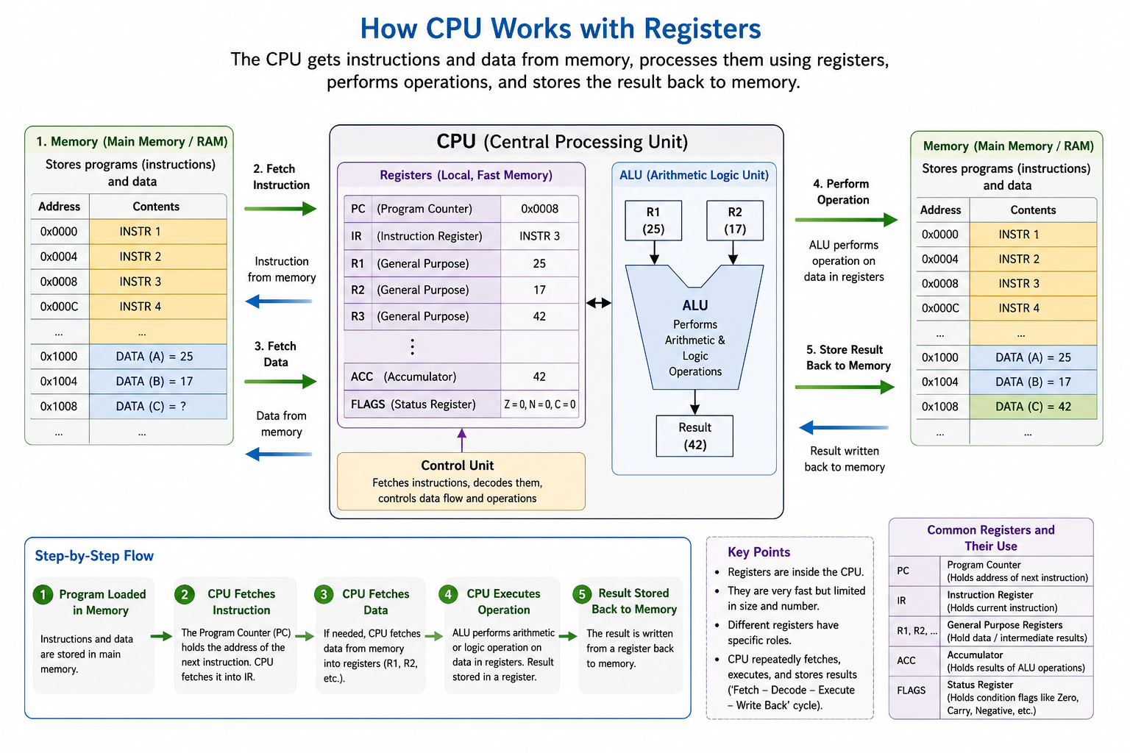

Slide 35
Computer Registers
Table 1.1 Computer registers
Register | Full Name | Function
General Purpose Registers (GPRs) | Data Registers | Store operands, variables, and intermediate results during calculations. Examples: R0, R1, R2, R3.
Accumulator (ACC) | Accumulator Register | Holds one of the operands and stores the result of arithmetic and logic operations performed by the ALU.
Program Counter (PC) | Program Counter | Stores the address of the next instruction to be fetched from memory. It automatically increments after each instruction unless modified by a branch or jump instruction.
Instruction Register (IR) | Instruction Register | Holds the instruction currently being executed by the CPU after it has been fetched from memory.
Memory Address Register (MAR) | Memory Address Register | Stores the address of the memory location that the CPU wants to read from or write to.
Status Register / Flag Register (SR/FLAGS) | Status Register | Stores the status of the CPU after an operation, such as Zero, Carry, Sign/Negative, Overflow, and Parity flags.
Stack Pointer (SP) | Stack Pointer | Stores the address of the top of the stack. Used during function calls, interrupts, and local variable storage.

Slide 36
Computer Memory
A computer system needs memory to store the data and instructions for processing. Whenever we talk about the ‘memory’ of a computer system, we usually talk about the main or primary memory. The secondary memory (also called storage device) is used to store data, instructions and results permanently for future use.
Units of Memory
A computer system uses binary numbers to store and process data. The binary digits 0 and 1, which are the basic units of memory, are called bits. Further, these bits are grouped together to form words. A 4-bit word is called a Nibble. Examples of nibble are 1001, 1010, 0010, etc. A two nibble word, i.e., 8-bit word is called a byte, for example, 01000110, 01111100, 10000001, etc.
Table 1.2 Measurement units for digital data
Unit | Description | Unit | Description
KB (Kilobyte) | 1 KB = 1024 Bytes | PB (Petabyte) | 1 PB = 1024 TB
MB (Megabyte) | 1 MB = 1024 KB | EB (Exabyte) | 1 EB = 1024 PB
GB (Gigabyte) | 1 GB = 1024 MB | ZB (Zettabyte) | 1 ZB = 1024 EB
TB (Terabyte) | 1 TB = 1024 GB | YB (Yottabyte) | 1 YB = 1024 ZB

Slide 37
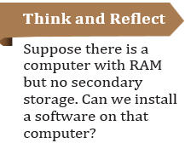
Primary Memory
Primary memory is an essential component of a computer system. Program and data are loaded into the primary memory before processing. The CPU interacts directly with the primary memory to perform read or write operation. It is of two types viz. (i) Random Access Memory (RAM) and (ii) Read Only Memory (ROM).
RAM is volatile, i.e., as long as the power is supplied to the computer, it retains the data in it. But as soon as the power supply is turned off, all the contents of RAM are wiped out. It is used to store data temporarily while the computer is working. Whenever the computer is started or a software application is launched, the required program and data are loaded into RAM for processing. RAM is usually referred to as main memory and it is faster than the secondary memory or storage devices.
ROM is non-volatile, which means its contents are not lost even when the power is turned off. It is used as a small but faster permanent storage for the contents which are rarely changed. For example, the startup program (boot loader) that loads the operating system into primary memory, is stored in ROM.

Slide 38
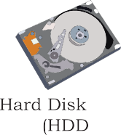








Secondary Memory
Primary memory has limited storage capacity and is either volatile (RAM) or read-only (ROM). Thus, a computer system needs auxiliary or secondary memory to permanently store the data or instructions for future use.
The secondary memory is non-volatile and has larger storage capacity than primary memory.
It is slower and cheaper than the main memory.
But, it cannot be accessed directly by the CPU. Contents of secondary storage need to be first brought into the main memory for the CPU to access.
Examples of secondary memory devices include Hard Disk Drive (HDD), CD/ DVD, Memory Card, etc., as shown in Figure 1.7.
However, these days, there are secondary storage devices like SSD which support very fast data transfer speed as compared to earlier HDDs. Also, data transfer between computers have become easier and simple due to the availability of small-sized and portable flash or pen drives.
Pen Drive
CD/DVD
Figure 1.11:Storage devices

Slide 39
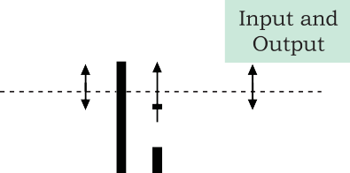

SYSTEM Bus- Data, Address & Control
Function of system Bus: Data need to be transferred between the CPU and primary memory as well as between the primary and secondary memory.
Data are transferred between different components of a computer system using physical wires called bus. For example, bus is used for data transfer between a USB port and hard disk or between a hard disk and main memory. Bus is of three types — (i) Data bus to transfer data between different components, (ii) Address bus to transfer addresses between CPU and main memory. The address of the memory location that the CPU wants to read or write from is specified in the address bus,
Figure 1.12: Data transfer between components through system bus

Slide 40
Continue..
(iii) Control bus to communicate control signals between different components of a computer. All these three buses collectively make the system bus, as shown in Figure 1.8.
How these buses works when CPU need to perform some task ?
As the CPU interacts directly with main memory, any data entered from input device or the data to be accessed from hard disk needs to be placed in the main memory for further processing. The data is then transferred between CPU and main memory using bus.
The CPU places on the address bus, the address of the main memory location from which it wants to read data or to write data. While executing the instructions, the CPU specifies the read or write control signal through the control bus.
As the CPU may require to read data from main memory or write data to main memory, a data bus is bidirectional. But the control bus and address bus are unidirectional.
To write data into memory, the CPU places the data on the data bus, which is then written to the specific address provided through the address bus.
In case of read operation, the CPU specifies the address, and the data is placed on the data bus by a dedicated hardware, called memory controller. The memory controller manages the flow of data into and out of the computer's main memory.

Slide 41
Section A — 1-Mark MCQs
1. Which of the following is a characteristic of a computer?
A. Slow processing
B. High accuracy
C. Limited storage
D. Emotional intelligence
Answer: B
2. Which computer application is commonly used in education?
A. Online learning
B. ATM withdrawal
C. X-ray scanning
D. CAD designing
Answer: A
3. Which technology is commonly used in healthcare?
A. Medical imaging
B. Word processing
C. Spreadsheet formatting
D. File compression
Answer: A
4. The first generation of computers primarily used:
A. Transistors
B. Integrated Circuits
C. Vacuum tubes
D. Microprocessors
Answer: C
5. The second generation of computers used:
A. Vacuum tubes
B. Transistors
C. Microprocessors
D. Artificial intelligence
Answer: B

Slide 42
6. Integrated Circuits were primarily associated with which generation?
A. First
B. Second
C. Third
D. Fifth
Answer: C
7. The fourth generation of computers is characterized by:
A. Vacuum tubes
B. Transistors
C. Microprocessors
D. Magnetic drums
Answer: C
8. The fifth generation is mainly associated with:
A. Artificial Intelligence
B. Vacuum tubes
C. Punch cards
D. Magnetic drums
Answer: A
9. Which unit is responsible for performing arithmetic and logical operations?
A. Control Unit
B. ALU
C. Input Unit
D. Output Unit
Answer: B
10. Which unit controls and coordinates all operations of a computer?
A. ALU
B. Memory Unit
C. Control Unit
D. Output Unit
Answer: C

Slide 43
Section B — 5-Mark MCQs
Scenario 1: Online Education
A college conducts online classes using computers. Students use a keyboard and webcam to provide information, the CPU processes instructions, memory stores data temporarily, and the monitor displays the result.
1. Which functional unit receives information from the keyboard and webcam?
A. Output Unit
B. Input Unit
C. ALU
D. Control Unit
Answer: B
2. Which component performs arithmetic and logical operations on the student's data?
A. ALU
B. Monitor
C. Input Unit
D. Register only
Answer: A
3. Which unit coordinates the activities of the CPU?
A. ALU
B. Control Unit
C. Output Unit
D. Memory Unit
Answer: B
4. The monitor is an example of:
A. Input device
B. Processing device
C. Output device
D. Storage device
Answer: C
5. Which bus would carry the actual data being transferred between CPU and memory?
A. Address bus
B. Data bus
C. Control bus
D. Power bus
Answer: B

Slide 44
Scenario 2: Hospital
A hospital uses computers to maintain patient records, process medical information and display diagnostic reports. Doctors enter patient information and retrieve stored records when required.
1. Patient information entered using a keyboard is initially handled by the:
A. Input Unit
B. Output Unit
C. ALU
D. Printer
Answer: A
2. A diagnostic report displayed on a screen is an example of:
A. Input
B. Processing
C. Output
D. Addressing
Answer: C
3. If the computer performs calculations on a patient's test results, which CPU component performs the calculations?
A. Control Unit
B. ALU
C. Register
D. Address Bus
Answer: B
4. Which component stores instructions and data required during processing?
A. Memory Unit
B. Monitor
C. Keyboard
D. Printer
Answer: A
5. Which CPU component directs other components to perform their required operations?
A. ALU
B. Control Unit
C. Register
D. Output Unit
Answer: B

Slide 45
Section C — 5-Mark Linux Command-Based MCQs
Scenario 1: Basic Linux File Management
A student is working in a Linux terminal and wants to manage files and directories.
1. Which command displays the files and directories in the current directory?
A. pwd
B. ls
C. cd
D. mkdir
Answer: B
2. Which command displays the current working directory?
A. ls
B. cd
C. pwd
D. dir
Answer: C
3. Which command is used to create a new directory named college?
A. create college
B. mkdir college
C. md college
D. new college
Answer: B
4. Which command changes the current directory to college?
A. move college
B. cd college
C. goto college
D. open college
Answer: B
5. Which command creates an empty file named notes.txt?
A. make notes.txt
B. touch notes.txt
C. file notes.txt
D. create notes.txt
Answer: B

Slide 46
Scenario 2: Viewing and Managing Files
A user has created a file called report.txt and wants to examine and manage it.
1. Which command displays the contents of report.txt?
A. cat report.txt
B. show report.txt
C. viewfile report.txt
D. display report.txt
Answer: A
2. Which command copies report.txt to backup.txt?
A. mv report.txt backup.txt
B. cp report.txt backup.txt
C. copy report.txt backup.txt
D. duplicate report.txt backup.txt
Answer: B
3. Which command renames report.txt as final.txt?
A. cp report.txt final.txt
B. mv report.txt final.txt
C. rn report.txt final.txt
D. renamefile report.txt final.txt
Answer: B
4. Which command removes a file named old.txt?
A. delete old.txt
B. erase old.txt
C. rm old.txt
D. removefile old.txt
Answer: C
5. Which command provides detailed information about files, including permissions and ownership?
A. ls -l
B. pwd -l
C. cd -l
D. file -l
Answer: A

Slide 47
Thank You

