Slide 1
Foundations of Computer Science (26CSE0103)
Prepared By: Dr. Tajinder Kaur
Chitkara University Institute of Engineering and Technology,
Chitkara University, Punjab

Slide 2
UNIT-1 -Introduction to Computers
Contents
Characteristics,
Applications in daily life (Education, Healthcare, Banking, Engineering),
Evolution and Generations of Computers (Generations I–V).
Block Diagram of a Computer System: Functional units - input, output, memory, CPU, ALU, Control Unit, and CPU Registers, description of data bus, address bus, control bus, component interaction.

Slide 3
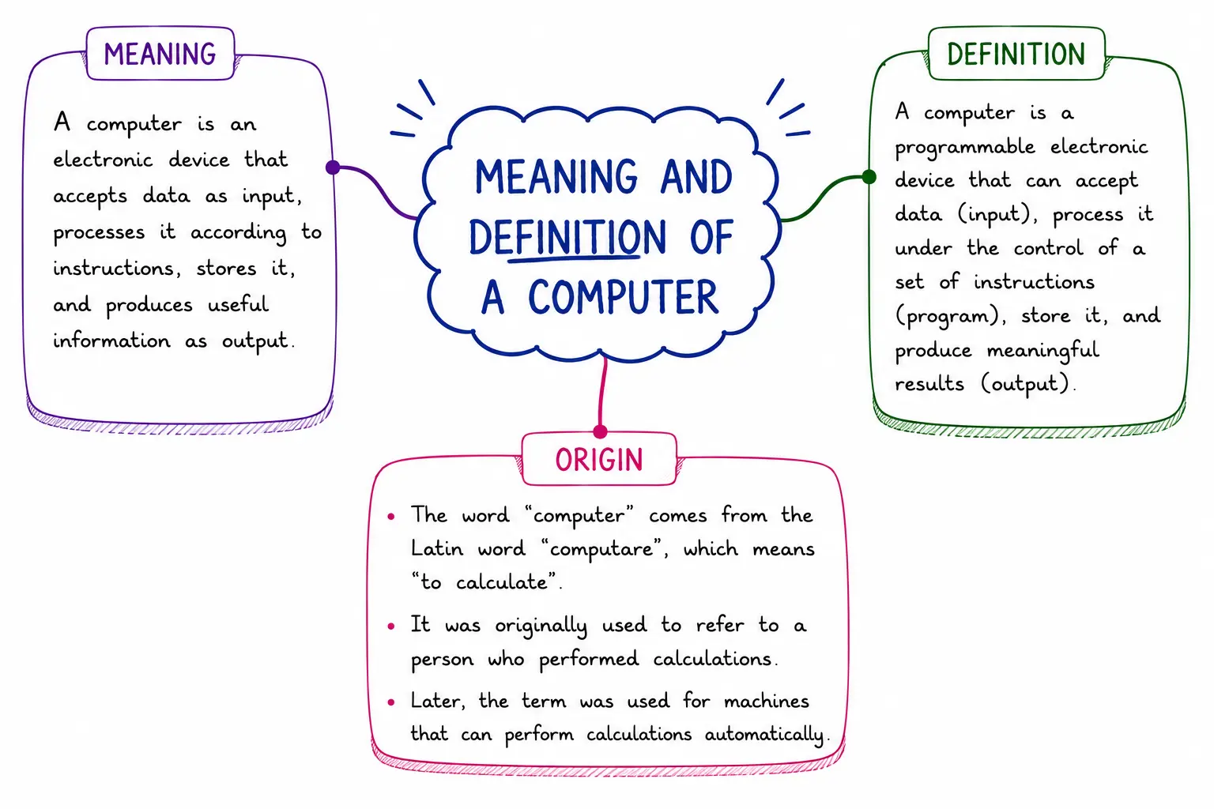
Computer?

Slide 4
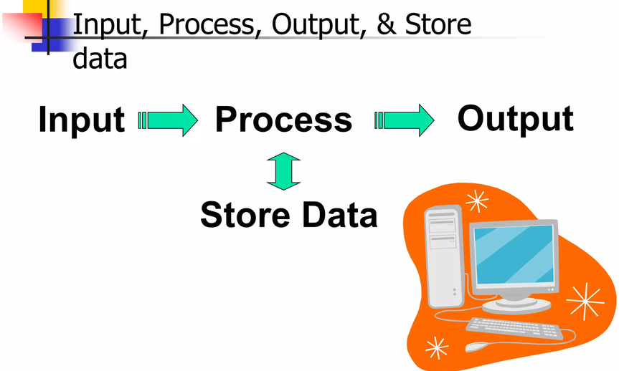
What do computer do?

Slide 5
Definition: A computer is an electronic machine that takes data as input, processes it, and gives the result as output. It works according to instructions (programs) given by the user and performs calculations, data analysis, file management, graphic design, internet browsing, and many other tasks quickly and accurately.
The working system of a computer depends on
Hardware (physical parts like monitor, keyboard, CPU)
Software (programs and applications).
Hardware provides the physical infrastructure. The central processing unit (CPU), the mouse, storage and other components are examples of hardware components. The hardware components are the real components of a computer.
Software instructs the hardware on what tasks to perform. Software components of a computer are the set of instructions which we store and execute on our system, which are known as software components.

Slide 6
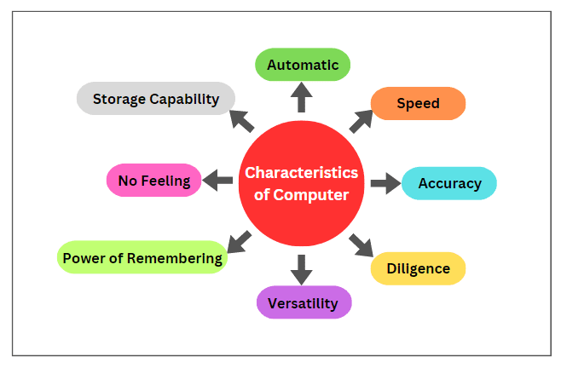
Characteristics of a computer
Fig.1.1 Characteristics of a Computer

Slide 7
Speed
A Computer can perform data processing jobs very fast, usually measured in microseconds (10⁻⁶), nanoseconds (10⁻⁹), and picoseconds (10⁻¹²).
Accuracy
Computers work free from errors.
If the input and program are correct, there is no mistake in the output.
It provides 100% accuracy in mathematical and logical operations.
Storage Capacity
Computers have the ability to store large amounts of data.
Data can be stored using hard disks, SSDs, pen drives, cloud storage, etc.
Data is safely kept for a long time and can be accessed easily when needed.

Slide 8
Diligence
Unlike human beings, a computer never gets tired and does not lose its concentration.
It can continuously work with a great accuracy for hours, creating no error and without rumbling.
e.g. if hundred million calculations have to be performed, a computer machine will perform the last one with exactly the same accuracy and speed as it did the first one.
Automatic
Given a job, a computer can work on it automatically without human intervention.
Versatility
It is capable of performing multitasks at a time simultaneously.
For example, we can use it to play music, as well as write a letter in the MS Office simultaneously.

Slide 9
Power of Remembering
Computers have the power of storing any amount of data or information.
We can store any information for several years, and recalled when we need it. It forgets or loses certain information only when it is asked to do so.
No Feeling
A computer is an electronic device that does not have any feelings, emotions, taste, knowledge and experience.
It does not get exhausted even after long hours of work.
Storage Capability
A computer has huge storage capability to store the information for a long time.
It has two types of storages: primary storage and secondary storage.
Primary storage is the main memory of a computer that stores the data temporarily. While secondary storage is a permanent storage for storing data.

Slide 10
Applications of Computers
1. Communication
Email & Messaging: Gmail, Outlook, WhatsApp, Slack.
Video Conferencing: Zoom, Google Meet, Microsoft Teams.
Social Media: Facebook, Instagram, X (Twitter), LinkedIn.
2. Education & Learning
Online Classes & E-Learning Platforms: Coursera, Udemy, Swayam-NPTEL.
Research & Study: Google Scholar, Wikipedia, digital libraries, IEEE expolre
Interactive Learning Tools: Simulations, virtual labs, and educational games.

Slide 11
Applications of Computers
3. Business & Work
Office Productivity: Word processors, spreadsheets, presentations.
Data Management: Databases, CRM systems (Salesforce, HubSpot).
Automation: Payroll systems, inventory control, AI chatbots.
4. Banking & Finance
Online Banking: Checking balances, transferring money, paying bills.
Digital Payments: PayPal, Google Pay, Apple Pay.
Stock Trading: Platforms like Robinhood, E-TRADE.
5. Healthcare
Medical Records Management: Electronic Health Records (EHR).
Diagnostics & Imaging: MRI, CT scans, X-rays.
Telemedicine: Online doctor consultations and health monitoring devices.

Slide 12
Applications of Computers
6. Entertainment
Streaming: Netflix, YouTube, Spotify.
Gaming: PC games, VR experiences.
Digital Art & Music Production: Photoshop, FL Studio.
7. Shopping
E-commerce: Amazon, eBay, local online marketplaces.
Price Comparison Tools: Finding best deals online.
Order Tracking & Delivery Services.
8. Transport & Navigation
Ride-hailing Apps: Uber, Lyft.
GPS Navigation: Google Maps
Traffic & Public Transport Updates.

Slide 13
Applications of Computers
9. Home Automation
Smart Devices: Alexa, Google Home, smart thermostats.
Security: CCTV monitoring, smart locks.
Appliance Control: Smart ovens, washing machines.
10. Creative Work
Design & Media Production: Video editing, 3D modeling, animation.
Writing & Publishing: Blogs, books, newsletters.
Photography & Image Editing.

Slide 14
Healthcare
A computer plays an important role in the medical field also.
For example in the Intensive Care Unit (ICU) in the hospital, the computer keeps track of everything going inside the patient's body such as blood pressure and heartbeat, etc.
Keeping a record of patients and medicines also becomes easy through the use of the computer.
Diagnostic System — The computer is used to collect data and identify the cause of disease and illness.
Lab-diagnostic System — All tests can be done and the reports are prepared by computer.
Patient Monitoring System — Computers are also used to check the patient's signs for abnormality such as CT Scan, MRI, ECG, etc.
Pharmacy Information System — Computers are used to check medicine labels, expiry dates, harmful side effects, etc. Software: Epic Willow Pharmacy, Oracle Health Pharmacy.
Surgery — Computers are used in performing surgery. Software: Mako Smart Robotics

Slide 15
Types of computers
Computers are grouped by size, power, and how they process data. The main categories include supercomputers, mainframes, minicomputers, and microcomputers (personal computers).

Slide 16
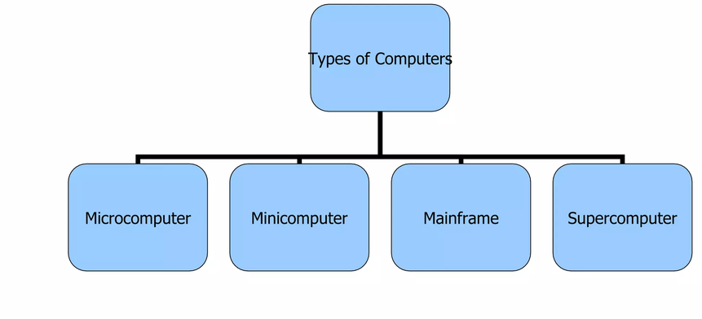
Types of Computers

Slide 17

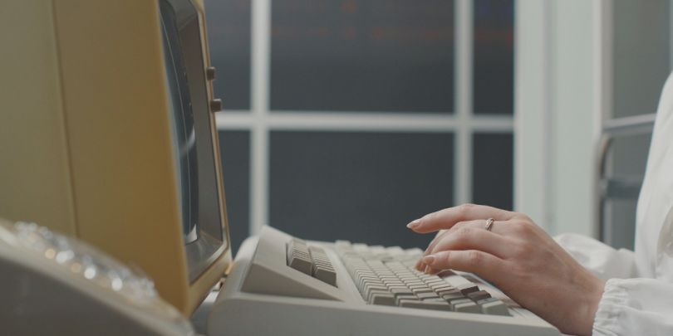
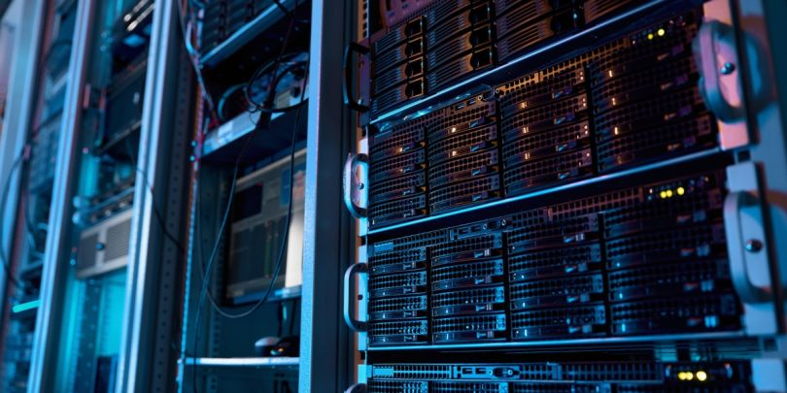

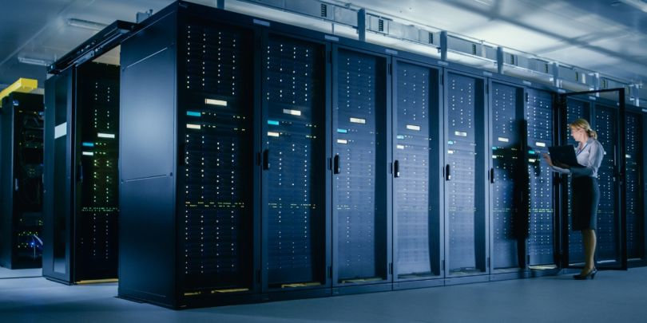
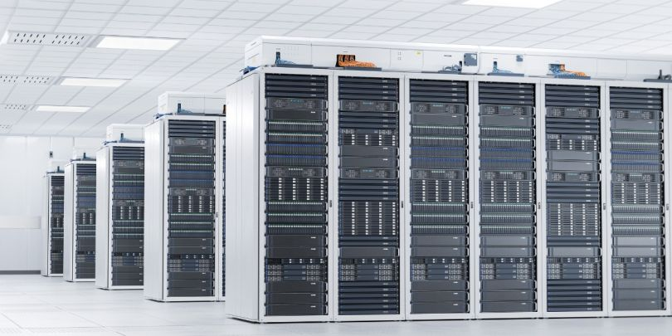
1. Personal Computer (Microcomputer)
2. Minicomputer
3. Server
4. Workstation
5. Mainframe
6. Supercomputer

Slide 18
Classification by Size and Power
Supercomputer: The fastest and most powerful machines. They handle massive scientific calculations, climate research, and weather forecasting
Mainframe Computer: Large, highly secure systems built to process millions of transactions simultaneously. Used by banks and big companies

Slide 19
Cont…
Minicomputer (Mid-range): Medium-sized computers that sit between mainframes and microcomputers. They support multiple users for business tasks.
Microcomputer (Personal Computer): Small, affordable devices for individual use. This group includes desktops, laptops, tablets, and smartphones.

Slide 20
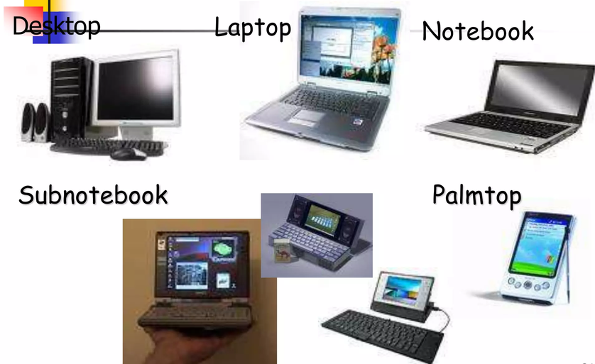
Microcomputer Models

Slide 21
Classification by Operation
Analog Computer: Analog computers are used mainly for measurement, monitoring, simulation, and control of continuously changing physical quantities. Aircraft and flight simulation
Digital Computer: Works with discrete values or binary data (0s and 1s). This is the standard type used for modern laptops, phones, and servers.

Slide 22
Cont…
Hybrid Computer: Combines features of both analog and digital types. It uses analog speed with digital memory, often found in medical and industrial setups.

Slide 23
Feature | Microcomputer (PC) | Minicomputer | Mainframe Computer | Supercomputer | Workstation | Server
Definition | Small computer for a single user | Mid-range computer for multiple users | Large computer for high-volume data processing | Fastest computer for scientific and engineering computations | High-performance computer for professional applications | Computer that provides services and resources to other computers over a network
Memory (RAM) | 4–64 GB | 16–256 GB | Hundreds of GB to several TB | Several TB to PB | 16–512 GB | 32 GB to several TB
Storage Capacity | 256 GB–4 TB | Several TB | Hundreds of TB to PB | PB or more | 1–20 TB | Several TB to PB
Operating System | Windows, Linux, macOS | UNIX, Linux | z/OS, Linux | Linux-based HPC OS | Windows, Linux, UNIX | Windows Server, Linux, UNIX
Primary Use | Personal use, education, office work, internet browsing, gaming | Used by small/medium organizations for database management | Banking, railway/airline reservations, insurance, government records, | Weather forecasting, climate research, space research, nuclear research, scientific simulations, AI | Engineering design (CAD), 3D graphics, animation, scientific research, software development, video editing | Hosting websites and applications, file sharing, database management, email services, cloud services,
Approximate Cost | ₹30,000–₹2 lakh | ₹5–50 lakh | ₹2–20 lakh | ₹5 lakh–₹5 crore | ₹10–500 crore | ₹500 crore–₹5,000+ crore

Slide 24
Evolution of Computer
Blaise Pascal invented the first mechanical adding machine in 1642
Baron Gottfried Wilhelm von Leibniz invented the first calculator for multiplication in 1671
Keyboard machines originated in the United States around 1880
Around 1880, Herman Hollerith came up with the concept of punched cards that were extensively used as input media until the late 1970s
Charles Babbage is considered to be the father of the modern digital computer
    He designed the “Difference Engine” in 1822
    He designed a fully automatic analytical engine in 1842 for performing basic arithmetic functions
    His efforts established several principles that are fundamental to the design of any digital computer

Slide 25
Computer Generations
“Generation” in computer talk is a step in technology. It provides a framework for the growth of computer industry
Originally it was used to distinguish between various hardware technologies, but now it has been extended to include both hardware and software
Till today, there are five computer generations

Slide 26
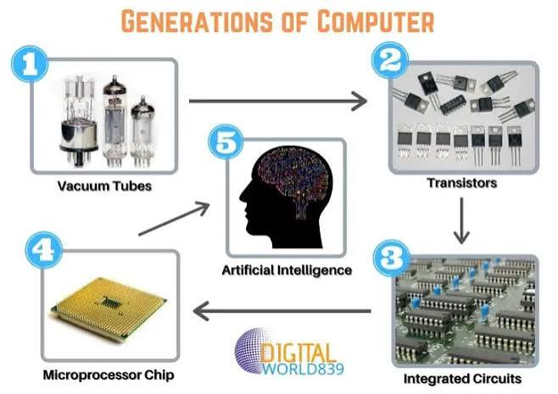
Generation & Description
First Generation
The period of first generation: 1946-1959.
Vacuum tube based.
Second Generation
The period of second generation: 1959-1965.
Transistor based.
Third Generation
The period of third generation: 1965-1971.
Integrated-Circuit based.
Fourth Generation
The period of fourth generation: 1971-1980.
VLSI microprocessor based.
Fifth Generation
The period of fifth generation: 1980-onwards.
ULSI microprocessor-based
Fig. 1.2 Key technologies behind five generations of a computer

Slide 27
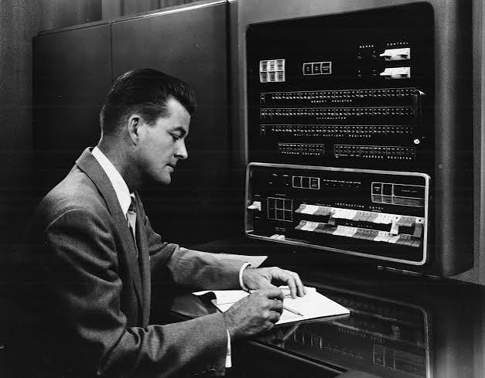
1. First Generation (1940s–1956s)
Technology: Vacuum tubes.
Language: Machine language (binary).
Size: Huge (room-sized).
Examples: Electronic Numerical Integrator and Computer (ENIAC), Universal Automatic Computer I (UNIVAC I).
Features: Very slow, produced a lot of heat, high electricity use, need of AC, Non-portable.

Slide 28
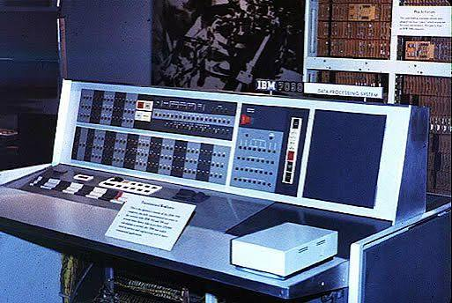
2. Second Generation (1956s–1963s)
Technology: Transistors (replaced vacuum tubes).
Language: Assembly language.
Size: Smaller than first generation.
Examples: IBM 1401, CDC 1604.
Features: Faster, more reliable, less heat, lower power consumption, still very costly, AC required.

Slide 29
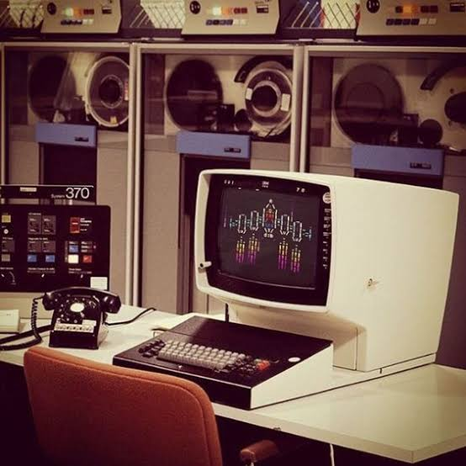
3. Third Generation (1964s–1971s)
Technology: Integrated Circuits (ICs) — many transistors on a single chip.
Language: High-level languages (COBOL, FORTRAN).
Examples: IBM 360 series, PDP-8.
Features: Cheaper, smaller, more efficient, started to be used for business and government.

Slide 30
4. Fourth Generation (1970s–Present)
Technology: Microprocessors (all computer functions on a single chip bringing an entire CPU onto a single chip ).
Language: Advanced high-level languages (C, C++).
Examples: Apple II, IBM PC.
Features: Personal computers become common, rapid growth in networking.

Slide 31
5. Fifth Generation (Present & Future)
Technology: Artificial Intelligence (AI), Machine Learning and parallel processing.
Language: Natural language processing, AI programming languages (Python, Prolog).
Examples: AI assistants (Siri, ChatGPT), supercomputers.
Features: High speed, massive data processing, focus on learning and decision-making,
ULSI technology,
More user-friendly interfaces with multimedia features,
Availability of very powerful and compact computers at cheaper rates

Slide 32
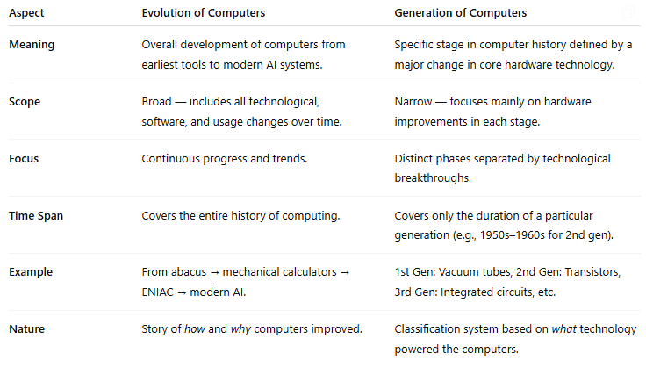
Difference between Evolution and Generation

Slide 33
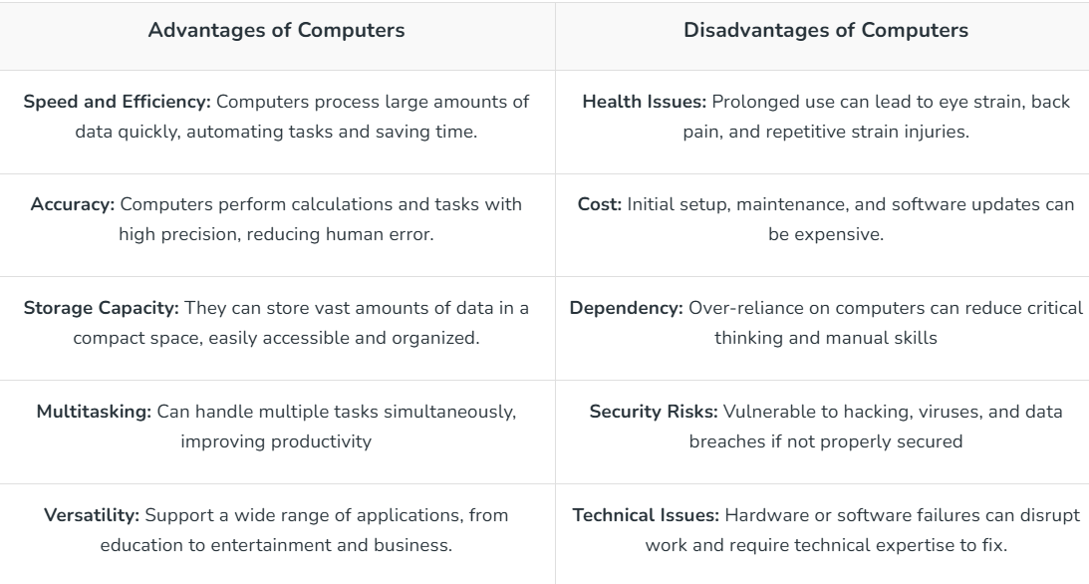
Advantage and Disadvantages of Computers

Slide 34
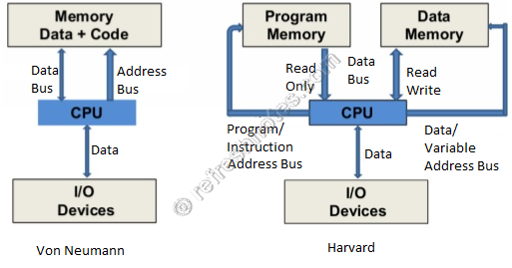
Von Neumann Architecture
From an architectural point of view, there are the two basic models: Von Neumann and Harvard architectures. These models explain the organization of memory and processing units in a computer system.
Fig. 1.7 Von Neumann Vs Harvard architecture

Slide 35
Von Neumann Architecture
Historically, there have been 2 types of Computers:
  Fixed Program Computers - Their function is very specific, and they couldn't be reprogrammed, e.g., calculators.
  Stored Program Computers - These can be programmed to carry out many different tasks, applications are stored on them, hence the name.

Slide 36
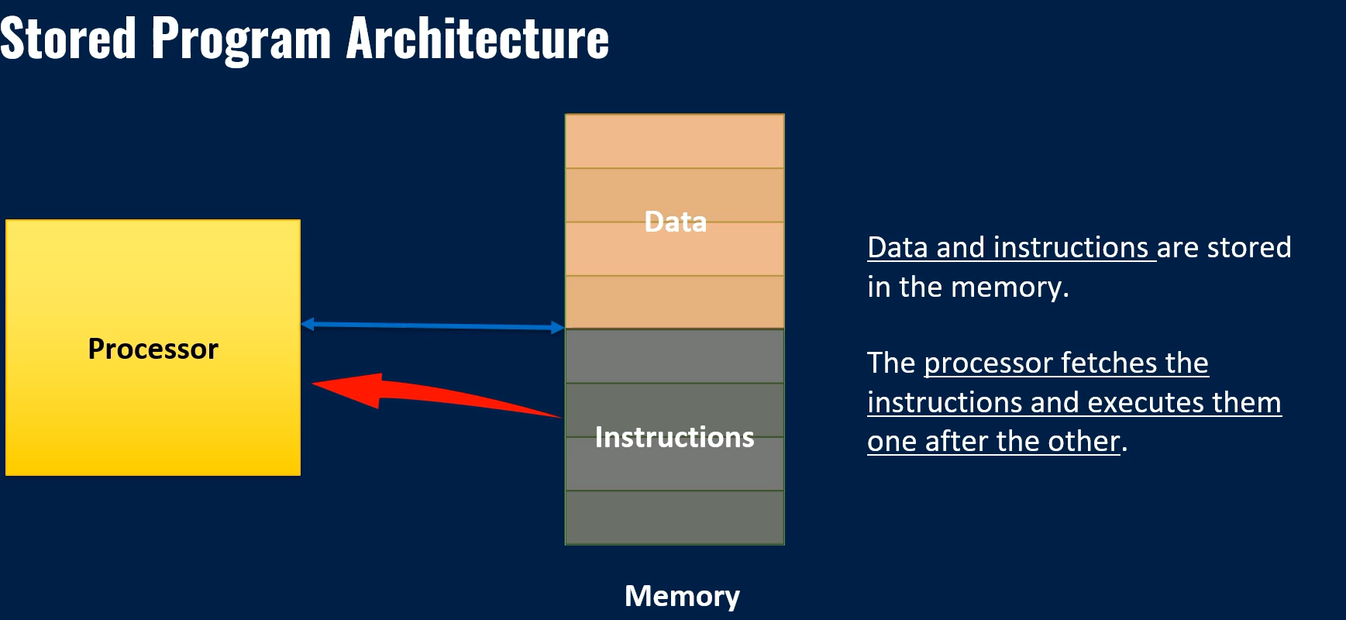

Slide 37
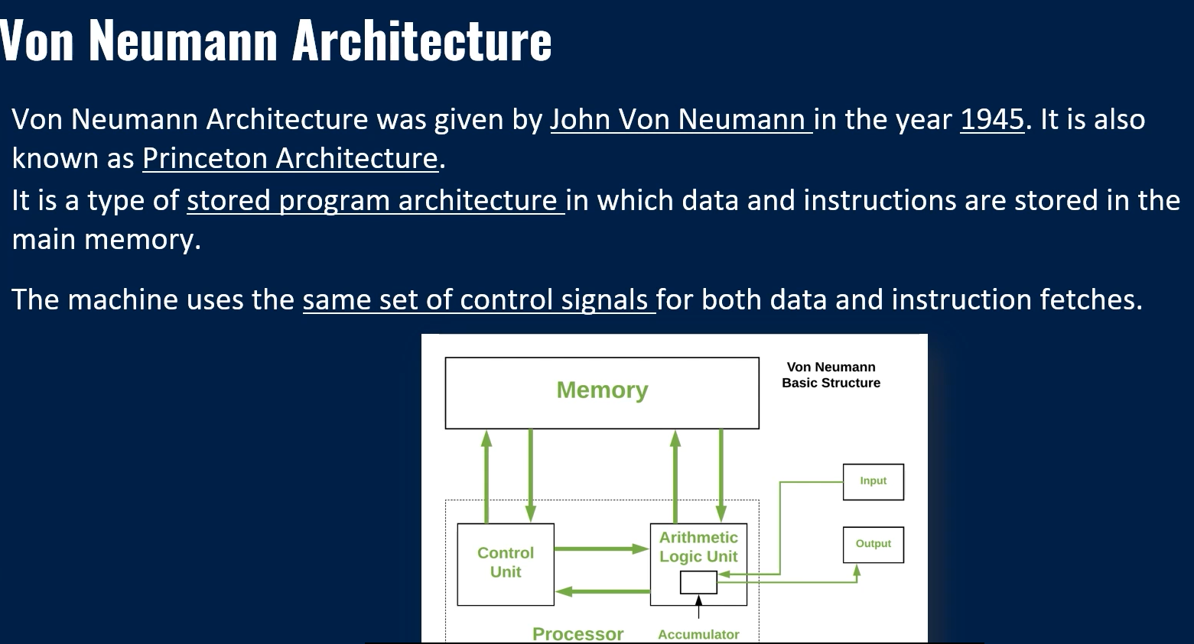

Slide 38
Key Characteristics of Von Neumann Architecture
Stored Program Concept (programs and data in the same memory).
Sequential execution (one instruction after another).
Single memory for both data and instructions.
Control unit directs the flow of execution.

Slide 39
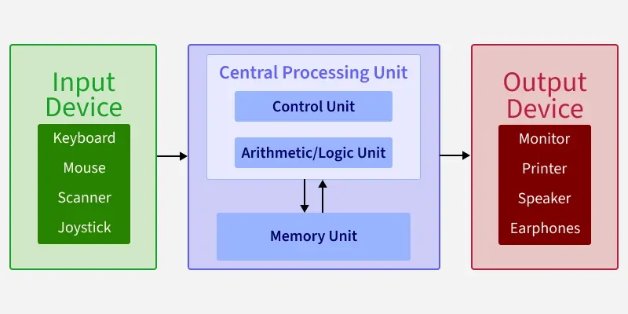
Basic components of a computer system
Particularly focusing on the memory and processor

Slide 40
Basic components of a computer system
Memory: This is where data and instructions are stored. It is a crucial part of the computer system that allows for the storage and retrieval of information.
Input: This refers to the devices or methods through which data is entered into the computer system.
Output: This refers to the devices or methods through which data is presented to the user or other systems.
Processor: The processor, or CPU, is the central component that carries out the instructions of a computer program. It includes the ALU and Control Unit.
Control Unit: This component manages the operations of the computer. It directs the flow of data between the CPU and other components.
Arithmetic Logic Unit (ALU): The ALU performs arithmetic and logical operations. It is responsible for calculations and decision-making processes.

Slide 41
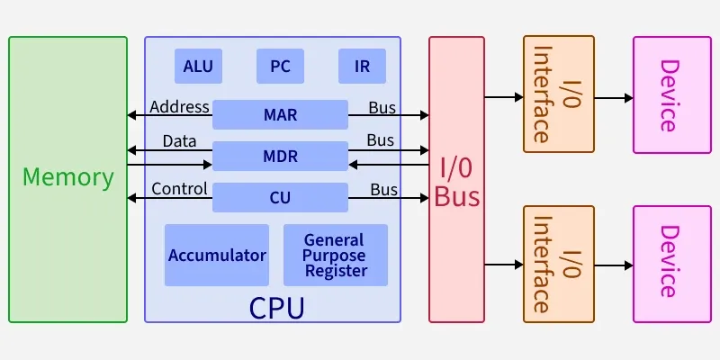
Basic CPU structure, illustrating ALU
In this architecture, both data and instructions are stored in the same memory and share a common bus for communication

Slide 42
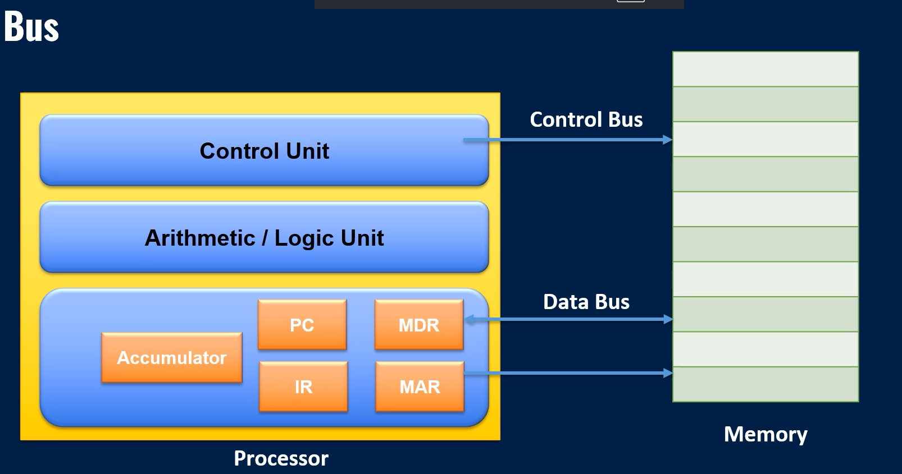
Address Bus

Slide 43
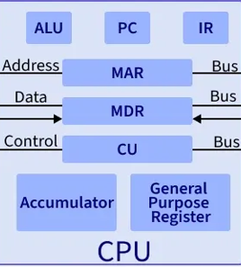
CPU (Central Processing Unit)
The CPU is the core processing unit that executes instructions. It consists of:
ALU (Arithmetic Logic Unit): Performs arithmetic and logical operations (e.g., addition, subtraction, comparisons).
PC (Program Counter): Keeps track of the address of the next instruction to be executed.
IR (Instruction Register): Holds the current instruction being executed.
MAR (Memory Address Register): Stores the address of the memory location being accessed.
MDR (Memory Data Register): Temporarily holds data being transferred to or from memory.
CU (Control Unit): Coordinates the activities of the CPU, managing the flow of data and instructions.
Accumulator: A register that stores intermediate results of arithmetic and logic operations.
General Purpose Registers: Used for temporary storage of data during processing.

Slide 44
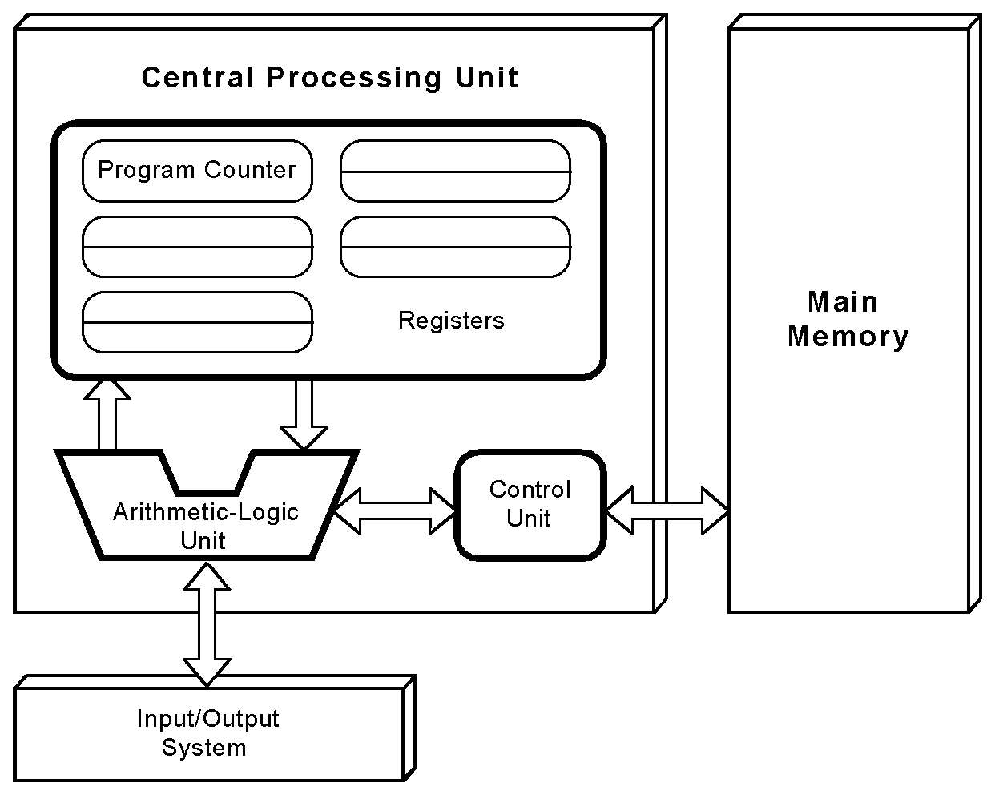
The von Neumann Model
This is a general depiction of a von Neumann system:
These computers employ a fetch-decode-execute cycle to run programs as follows . . .

Slide 45
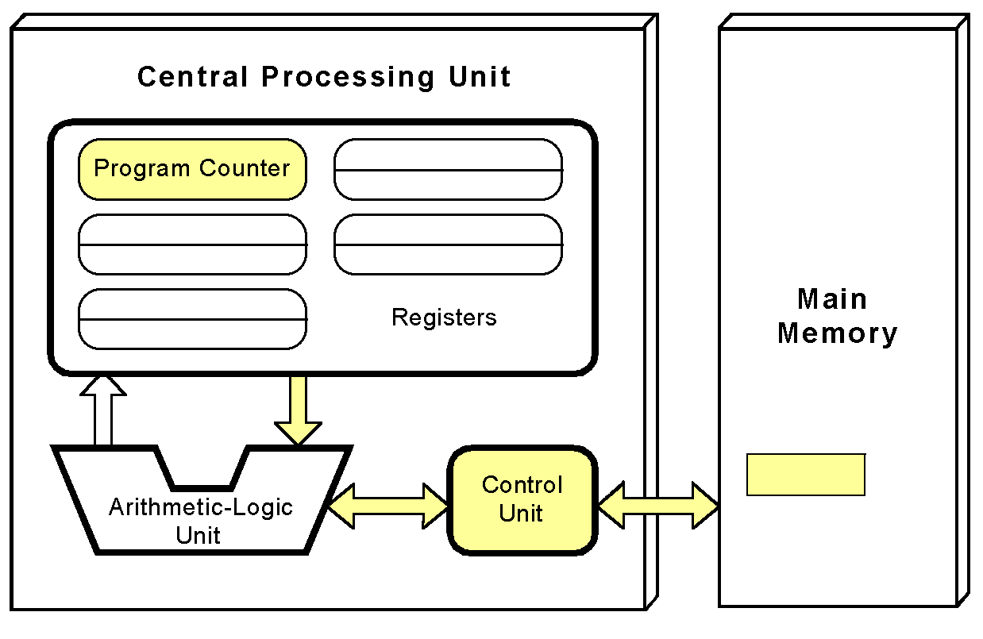
The von Neumann Model
The control unit fetches the next instruction from memory using the program counter to determine where the instruction is located.

Slide 46
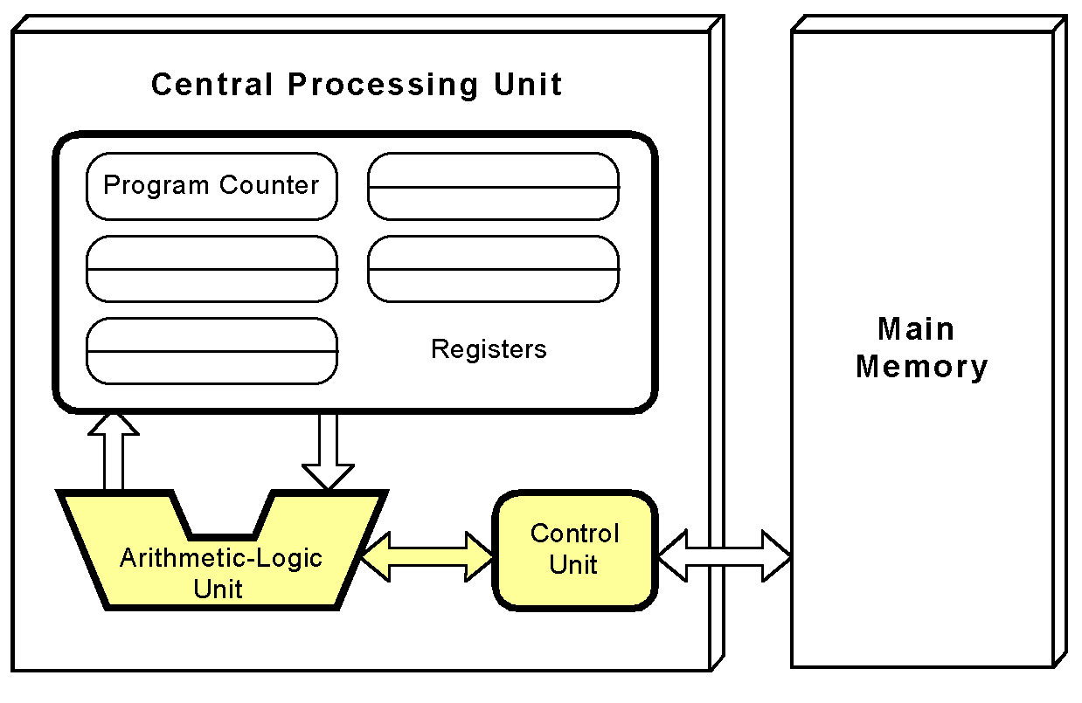
The von Neumann Model
The instruction is decoded into a language that the ALU can understand.

Slide 47
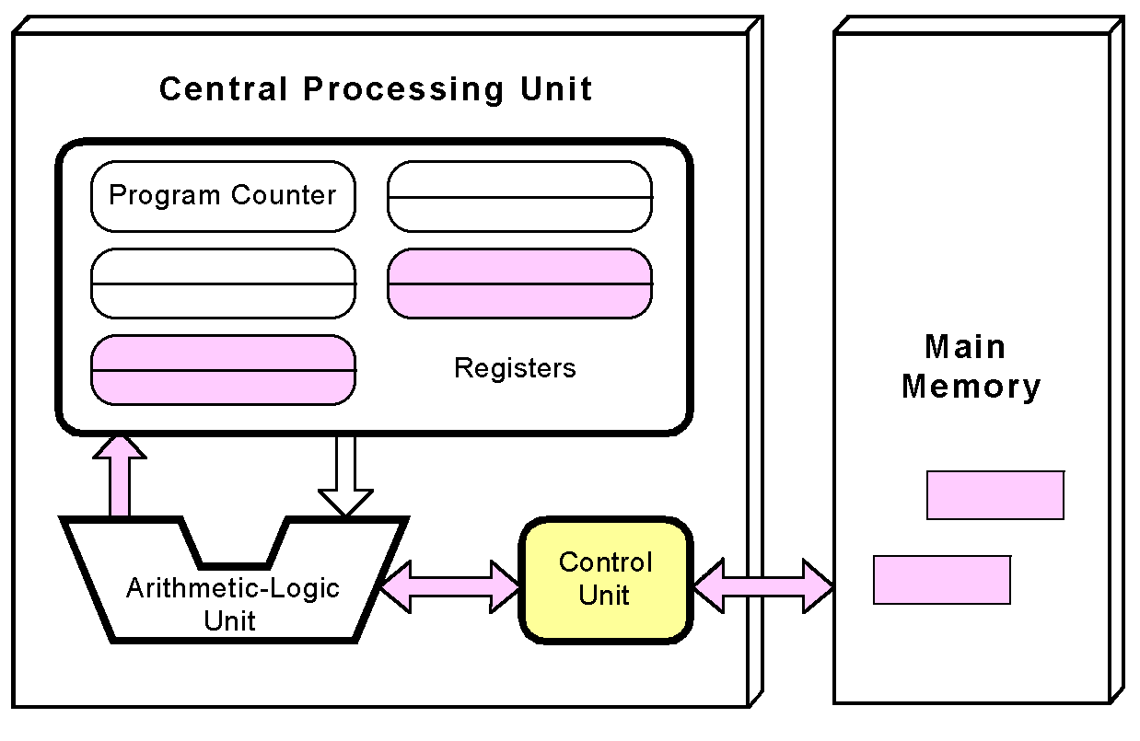
The von Neumann Model
Any data operands required to execute the instruction are fetched from memory and placed into registers within the CPU.

Slide 48
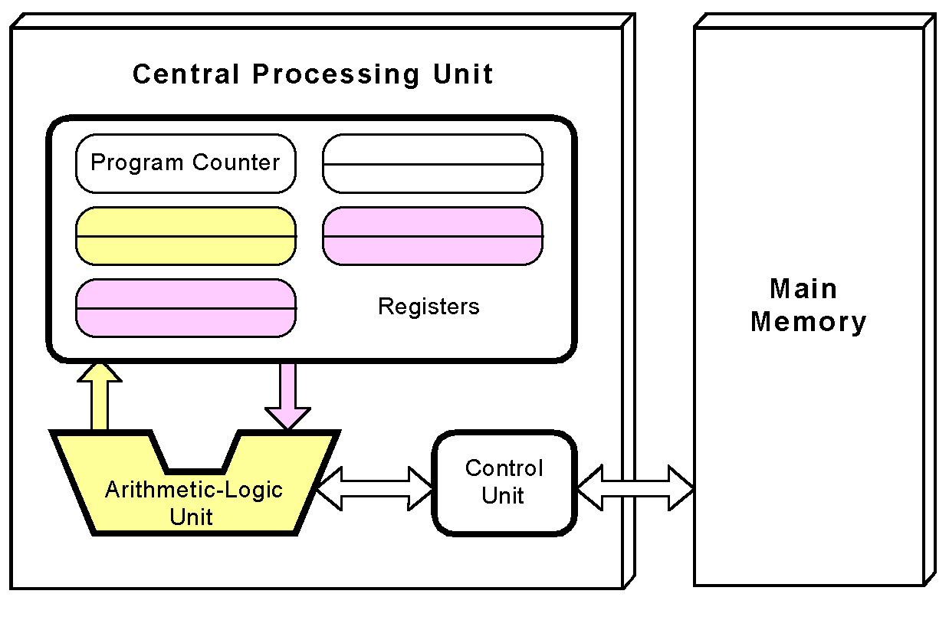
The von Neumann Model
The ALU executes the instruction and places results in registers or memory.

Slide 49
Working (Fetch-Decode-Execute Cycle)
1. Fetch: Instruction is fetched from memory using the Program Counter (PC).
2. Decode: The Control Unit interprets (decodes) the instruction.
3. Execute: ALU or other parts execute the instruction.
4. Repeat: The PC updates to the next instruction.

Slide 50
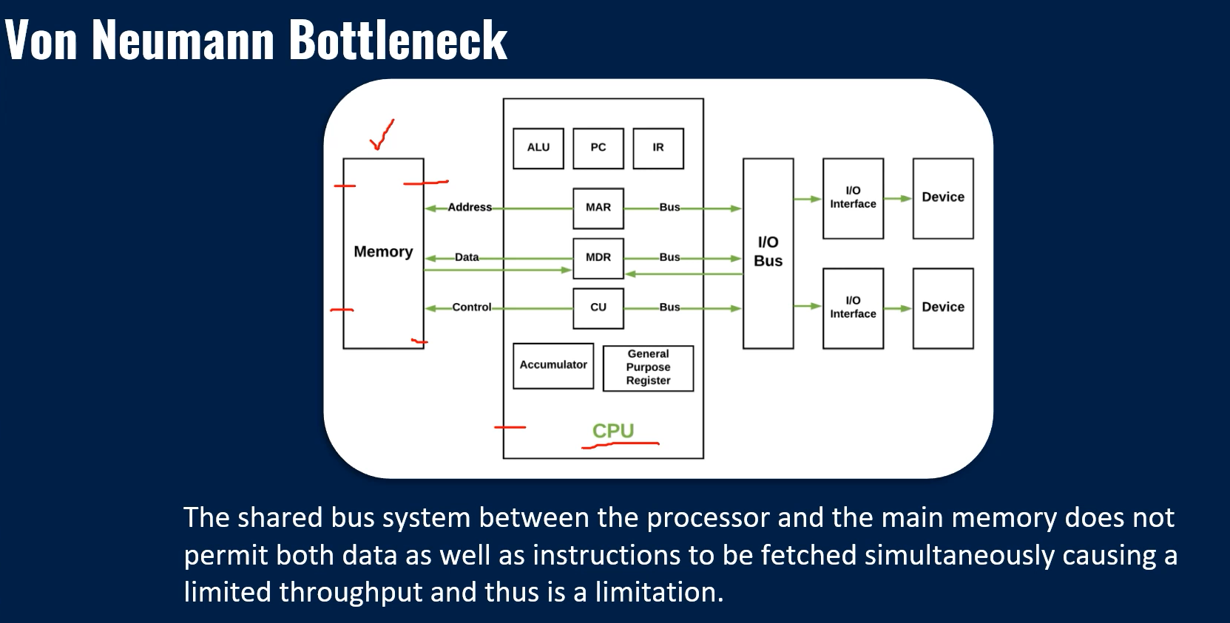

Slide 51
Advantages of Von Neumann Architecture
Simplified Design: Uses a single memory for data and instructions, reducing hardware complexity.
Cost-Effective: Lower production costs due to fewer components.
Flexibility: Can run various programs and makes it suitable for general-purpose computing.
Ease of Programming: Unified memory structure simplifies software development.
Widely Adopted: Forms the foundation of most modern computers hence, ensures widespread compatibility.

Slide 52
Limitations of Von Neumann Architecture
Single bus system → instructions and data can’t be fetched at the same time → slows down performance.
Memory Bottleneck: Shared memory slows down data and instruction transfer. (Memory latency issues → CPU often waits for data)
Sequential Processing: Cannot process data and instructions simultaneously. (→ not suitable for parallel processing)
Scalability Issues: Struggles with high-performance tasks requiring rapid memory access.
Energy Inefficiency: Frequent memory access increases power consumption.
Latency: Data and instruction fetch delays reduce overall system efficiency.

Slide 53
Applications of Von Neumann Architecture
General-Purpose Computing: Powers desktops, laptops, and smartphones.
Software Development: Shapes programming tools and languages due to its unified structure.
Education: A foundational concept in computer science courses.
Gaming and Multimedia: Supports complex applications like video games and editing software.

Slide 54
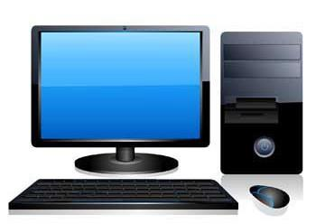
Computer System
A digital computer is defined as a device that operates upon information/data.
To be able to process data, the computer is made of various functional units to perform its specified task.

Slide 55
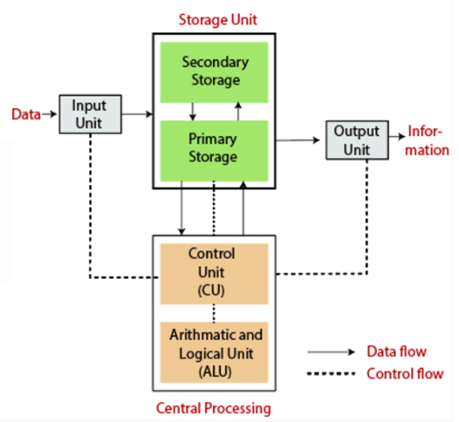
Block Diagram of Computer System
Block diagram provides the basic structure of a computer system where the main parts of the computer system are represented.

Slide 56
Block Diagram of Computer System
Each block of the diagram performs particular tasks, and all blocks are well coordinated to run the system.
The Major Components of the block diagram of the computer system are:
Input Unit
Output Unit
Memory Unit
Central Processing Unit (CPU)
Control Unit (CU)
Arithmetic And Logic Unit (ALU)

Slide 57
Input Unit
The computer requires the input unit to receive data and information and then use it to solve problems.
The user provides the computer with data and information.
The input unit is made up of a variety of input devices. Some input devices are a keyboard, mouse, microphone, scanner, etc.

Slide 58
Basic Functions of Input Unit
Accept data from the user.
Convert the data from electrical signals to computer-readable machine language.
Instruct the CPU to receive data from the input devices.
Provide the transformed data to the CPU through the memory unit for further processing.

Slide 59
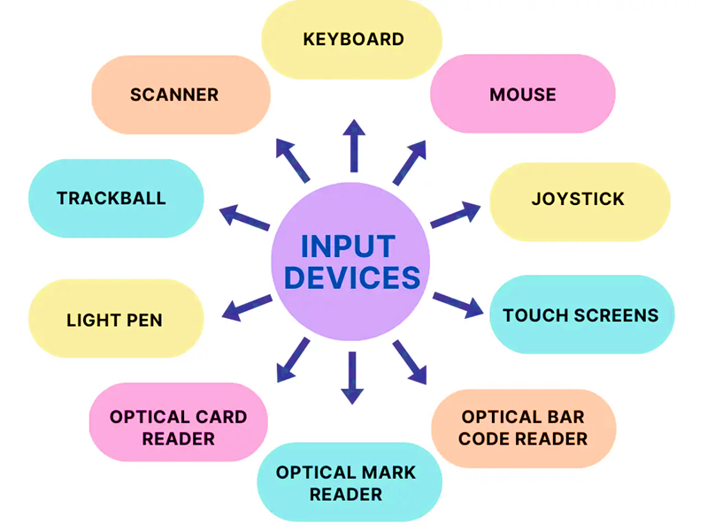
Input Unit (Devices)

Slide 60
Basic Functions of Output Unit
The computer’s output unit communicates the results of processing and information to the outside world.
In general, the output unit reverses the process of the input unit, converting machine language into electronic signals readable by the output devices.
The Visual Display Unit (VDU), usually known as the monitor, is the most commonly utilized output device.

Slide 61
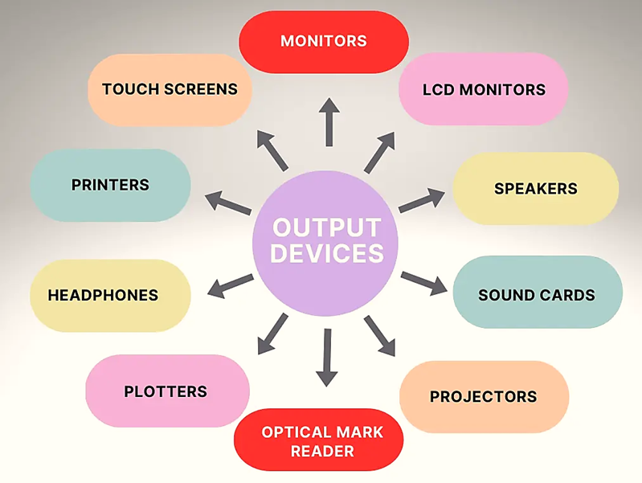
Output Unit (Devices)

Slide 62
Storage (Memory) Unit
The storage unit of the computer holds data and instructions that are entered through the input unit, before they are processed.
It preserves the intermediate and final results before these are sent to the output devices.
It also saves the data for the later use.

Slide 63
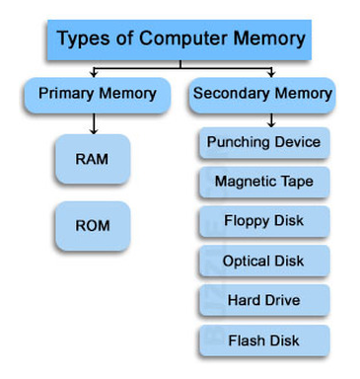
Storage (Memory) Unit

Slide 64
Storage Unit: Primary Memory
Data stored in this memory is temporary -volatile.
Typically, smaller in size compared to secondary memory.
Holds currently executing programs, Intermediate data during computation.
CPU can directly access primary memory.
Faster as compared to secondary storage.

Slide 65
Storage Unit: Secondary Memory
Used to store data and programs permanently.
It is non-volatile.
Has much larger storage capacity than primary memory
Slower than primary memory in terms of data access speed.
The cost is less compared to the primary storage.
Some secondary storage devices are portable.

Slide 66
Central Processing Unit
The Central Processing Unit or CPU is known as the brain of the computer.
Just like the human brain controls all human activities, the CPU also takes care of all the tasks.
The CPU is responsible for performing all the arithmetic and logical operations within the computer.

Slide 67
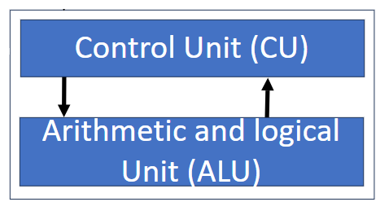
Central Processing Unit
The CPU comprises two parts:
ALU (Arithmetic Logic Unit)
CU (Control Unit)

Slide 68
Control Unit
Generally referred as the central nervous system of the computer (directs and coordinates all the operations).
It receives information from the main memory of computer.
It tells the Logic Unit, Memory Unit, as well as Input or Output devices how to handle the instructions in proper order.
It does not process or store data; it only controls the flow of data.

Slide 69
Arithmetic Logic Unit
Comprises of two terms: Arithmetic and Logic.
Performs operations like addition, subtraction, multiplication, and division.
Handles comparisons like greater than, less than, equal to, etc.
Doesn’t control or manage the process flow.
Executes operations as instructed by the Control Unit.

Slide 70
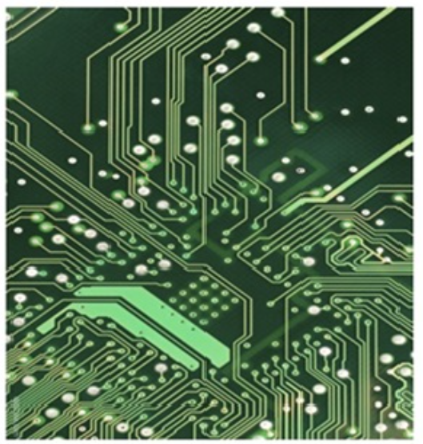
Introduction to Computer Bus
The Computer Bus is a communication link used in a computer system to send data, addresses, control signals, and power to various hardware components in a computer system.
These buses act as a shared communication channel.

Slide 71
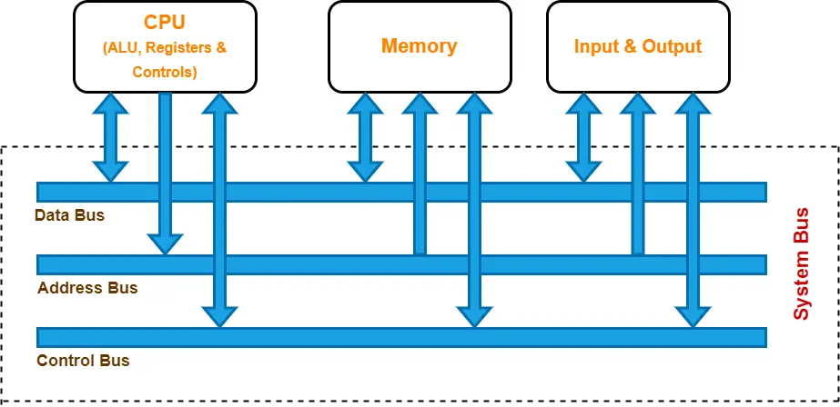
Introduction to Computer Bus

Slide 72
Computer Bus (Data Bus)
Dedicated for the transmitting the data between the CPU, peripheral devices and other hardware components.
A data bus has many different features, but one of the most important feature is the bus width.
Width of a data bus refers to the number of bits (wires) that the bus can carry at a time.
The Common data bus widths include 8 bit, 16 bit, 32 bit and 64 bit.
The data bus is bidirectional because the data can flow in either direction from CPU to memory(or input/output device) or from memory to the CPU.
The size (width) of bus determines how much data can be transmitted at one time.
Example:
  A 16-bit bus can transmit 16 bits of data at a time.
  A 32-bit bus can transmit 32 bits at a time.

Slide 73
Computer Bus (Control Bus)
Control bus is used to transfer the control signals from one component to another component.
Used by the CPU to communicate the devices that are connected to the computer system.
These devices are connected with the help of cables and printed circuits board such motherboard.
It is control bus assist the CPU in synchronizing the control signals.
The Control bus is bidirectional because the data can flow in either direction from CPU to memory(or input/output device) or from memory to the CPU.
it also transmits response signals from the hardware.
Example
  This bus is used to indicate whether the CPU is reading from memory or writing to memory.

Slide 74
Computer Bus (Address Bus)
The computer program consists of several program instructions.
These instructions direct the CPU to perform the desired operation.
The CPU executes the program instructions one by one by fetching the program instructions from the main memory.
To operate, the CPU sends either a read or write control signal on the control bus and the address of the memory location along the "Address Bus" from where the operation is to be performed.
The address bus is unidirectional.
The size of address bus determines how many unique memory locations can be addressed.
Example:
  A system with 4-bit address bus can address 2⁴ = 16 Bytes of memory.
  A system with 16-bit address bus can address 2¹⁶ = 64 KB of memory
  A system with 20-bit address bus can address 2²⁰ = 1 MB of memory.

Slide 75
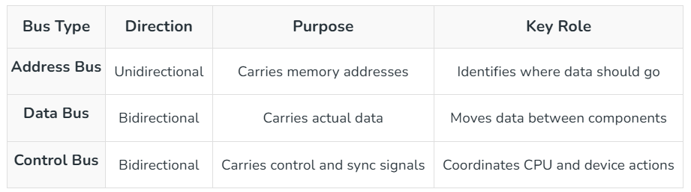

Slide 76
Section A — 1-Mark MCQs
1. Which of the following is a characteristic of a computer?
A. Slow processing
B. High accuracy
C. Limited storage
D. Emotional intelligence
Answer: B
2. Which computer application is commonly used in education?
A. Online learning
B. ATM withdrawal
C. X-ray scanning
D. CAD designing
Answer: A
3. Which technology is commonly used in healthcare?
A. Medical imaging
B. Word processing
C. Spreadsheet formatting
D. File compression
Answer: A
4. The first generation of computers primarily used:
A. Transistors
B. Integrated Circuits
C. Vacuum tubes
D. Microprocessors
Answer: C
5. The second generation of computers used:
A. Vacuum tubes
B. Transistors
C. Microprocessors
D. Artificial intelligence
Answer: B

Slide 77
6. Integrated Circuits were primarily associated with which generation?
A. First
B. Second
C. Third
D. Fifth
Answer: C
7. The fourth generation of computers is characterized by:
A. Vacuum tubes
B. Transistors
C. Microprocessors
D. Magnetic drums
Answer: C
8. The fifth generation is mainly associated with:
A. Artificial Intelligence
B. Vacuum tubes
C. Punch cards
D. Magnetic drums
Answer: A
9. Which unit is responsible for performing arithmetic and logical operations?
A. Control Unit
B. ALU
C. Input Unit
D. Output Unit
Answer: B
10. Which unit controls and coordinates all operations of a computer?
A. ALU
B. Memory Unit
C. Control Unit
D. Output Unit
Answer: C

Slide 78
Section B — 5-Mark MCQs
Scenario 1: Online Education
A college conducts online classes using computers. Students use a keyboard and webcam to provide information, the CPU processes instructions, memory stores data temporarily, and the monitor displays the result.
1. Which functional unit receives information from the keyboard and webcam?
A. Output Unit
B. Input Unit
C. ALU
D. Control Unit
Answer: B
2. Which component performs arithmetic and logical operations on the student's data?
A. ALU
B. Monitor
C. Input Unit
D. Register only
Answer: A
3. Which unit coordinates the activities of the CPU?
A. ALU
B. Control Unit
C. Output Unit
D. Memory Unit
Answer: B
4. The monitor is an example of:
A. Input device
B. Processing device
C. Output device
D. Storage device
Answer: C
5. Which bus would carry the actual data being transferred between CPU and memory?
A. Address bus
B. Data bus
C. Control bus
D. Power bus
Answer: B

Slide 79
Scenario 2: Hospital
A hospital uses computers to maintain patient records, process medical information and display diagnostic reports. Doctors enter patient information and retrieve stored records when required.
1. Patient information entered using a keyboard is initially handled by the:
A. Input Unit
B. Output Unit
C. ALU
D. Printer
Answer: A
2. A diagnostic report displayed on a screen is an example of:
A. Input
B. Processing
C. Output
D. Addressing
Answer: C
3. If the computer performs calculations on a patient's test results, which CPU component performs the calculations?
A. Control Unit
B. ALU
C. Register
D. Address Bus
Answer: B
4. Which component stores instructions and data required during processing?
A. Memory Unit
B. Monitor
C. Keyboard
D. Printer
Answer: A
5. Which CPU component directs other components to perform their required operations?
A. ALU
B. Control Unit
C. Register
D. Output Unit
Answer: B

Slide 80
Section C — 5-Mark Linux Command-Based MCQs
Scenario 1: Basic Linux File Management
A student is working in a Linux terminal and wants to manage files and directories.
1. Which command displays the files and directories in the current directory?
A. pwd
B. ls
C. cd
D. mkdir
Answer: B
2. Which command displays the current working directory?
A. ls
B. cd
C. pwd
D. dir
Answer: C
3. Which command is used to create a new directory named college?
A. create college
B. mkdir college
C. md college
D. new college
Answer: B
4. Which command changes the current directory to college?
A. move college
B. cd college
C. goto college
D. open college
Answer: B
5. Which command creates an empty file named notes.txt?
A. make notes.txt
B. touch notes.txt
C. file notes.txt
D. create notes.txt
Answer: B

Slide 81
Scenario 2: Viewing and Managing Files
A user has created a file called report.txt and wants to examine and manage it.
1. Which command displays the contents of report.txt?
A. cat report.txt
B. show report.txt
C. viewfile report.txt
D. display report.txt
Answer: A
2. Which command copies report.txt to backup.txt?
A. mv report.txt backup.txt
B. cp report.txt backup.txt
C. copy report.txt backup.txt
D. duplicate report.txt backup.txt
Answer: B
3. Which command renames report.txt as final.txt?
A. cp report.txt final.txt
B. mv report.txt final.txt
C. rn report.txt final.txt
D. renamefile report.txt final.txt
Answer: B
4. Which command removes a file named old.txt?
A. delete old.txt
B. erase old.txt
C. rm old.txt
D. removefile old.txt
Answer: C
5. Which command provides detailed information about files, including permissions and ownership?
A. ls -l
B. pwd -l
C. cd -l
D. file -l
Answer: A

Slide 82




