Slide 1
Foundations of Computer Science (26CSE0103)
Prepared By: Dr. Tajinder Kaur
Chitkara University Institute of Engineering and Technology,
Chitkara University, Punjab

Slide 2
UNIT-2 -Memory Hierarchy and Classification
Contents
Memory layers from registers to hard disk
Volatile vs non-volatile memory;
RAM types (SRAM, DRAM) and ROM types (PROM, EPROM, EEPROM).
Secondary Storage Ecosystems: Structural mechanics, magnetic storage (HDDs) vs. solid-state technology (SSDs, NVMe), flash media.

Slide 3
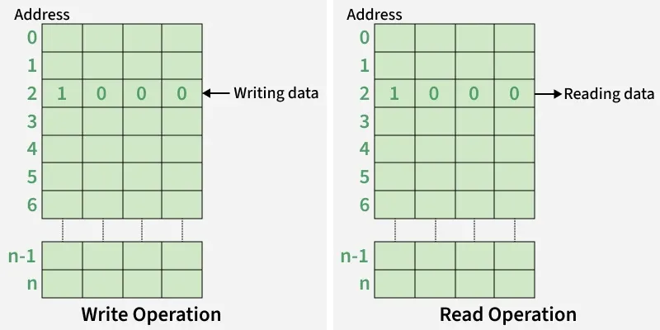
Introduction to Memory and Memory Units
Memory is an essential component of a computer system, responsible for storing data and instructions needed for processing. It enables the CPU to execute programs efficiently and ensures that the system operates properly.
Memory Cell: The smallest storage unit that holds 1 bit of data. Each address in memory typically refers to a byte.
Word & Byte: A word is a group of bits; 1 byte = 8 bits.
Capacity: Total number of bits a memory can hold.

Slide 4
Memory Unit
A memory unit is a standard unit used to measure the amount of data that can be stored, processed, or transferred in a computer system. It represents the storage capacity of memory and storage devices.
The smallest memory unit is a Bit (0 or 1) and larger units are KB, MB, GB, TB, PB, EB, ZB, and YB.
A Byte is the basic unit of storage and equals 8 bits.
Memory units are used to measure file sizes, RAM capacity, and storage device capacity.
Computers use the binary number system, so memory units are typically based on powers of 2 (1024).
Example: A computer with 8 GB RAM can store approximately 8 gigabytes of data in its main memory.

Slide 5
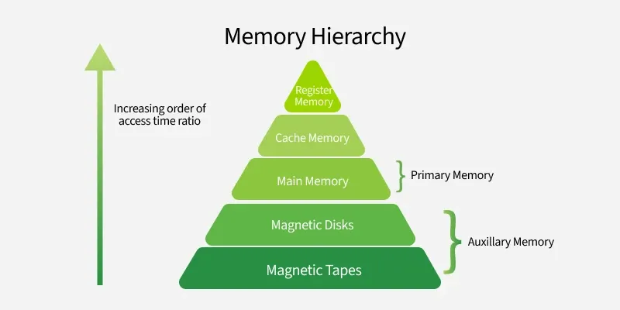
Memory layers from registers to hard disk

Slide 6
Volatile and Non-Volatile Memory
The main memory of a computer is typically categorised as volatile and non-volatile
Volatile Memory | Non-Volatile Memory
Volatile memory is the type of memory in which data is lost as it is powered-off. | Non-volatile memory is the type of memory in which data remains stored even if it is powered-off.
In volatile memory, the processor has direct access to data. | In non-volatile memory, processor has no direct access to data.
It is faster than non-volatile memory. | It is slower than volatile memory.
RAM(Random Access Memory) is an example of volatile memory. | ROM(Read Only Memory) is an example of non-volatile memory.
Volatile memory generally has less storage capacity. | Non-volatile memory generally has more storage capacity than volatile memory.
In volatile memory, the program's data are stored which are currently in process by the CPU. | In non-volatile memory, any kind of data which has to be saved permanently are stored.
Volatile memory is more costly per unit size. | Non-volatile memory is less costly per unit size.
Volatile memory has a huge impact on the system’s performance. | Non-volatile memory has a huge impact on a system’s storage capacity.

Slide 7
Main Memory (Volatile) The memory unit that communicates directly within the CPU, Cache memory is called main memory. It is fast memory used to store data during computer operations. Main memory is made up of RAM and ROM, majority part consists of RAM.
RAM Random Access Memory
DRAM: Dynamic RAM, is made of capacitors. It is slower and cheaper than SRAM.
SRAM: Static RAM, is made of flip-flop that consists of transistors, costly than DRAM but fast.

Slide 8
SRAM (Static RAM)
Static Random Access Memory (SRAM) is a type of volatile memory that stores data using flip-flop circuits. It does not need to be continuously refreshed like DRAM, making it faster but more expensive. SRAM is mainly used where very high-speed data access is required.
SRAM (Static Random Access Memory)
Works by: Using flip-flops (circuits that hold data as long as power is on).
Speed: Very fast
Cost: Expensive
Power use: Low (doesn’t need refreshing)
Use: Inside CPU as cache memory (L1, L2, L3).
Size: Smaller in capacity

Slide 9
Real life applications of SRAM
CPU Cache Memory: SRAM is widely used for L1, L2, and L3 cache in processors. It stores frequently used instructions and data close to the CPU, allowing the processor to access them much faster than accessing main memory. Because SRAM is extremely fast, it helps reduce CPU waiting time and improve overall system performance.
Hard Disk and SSD Controllers: Storage controllers may use SRAM as a high-speed temporary buffer while reading, writing, or managing data.
Embedded Systems: SRAM is commonly found in microcontrollers and embedded systems used in automobiles, industrial machines, medical equipment, and smart devices where quick access to small amounts of data is important.
Important Point is
SRAM = Very Fast + No Refresh Required + Volatile + Expensive

Slide 10
DRAM (Dynamic Random Access Memory)
DRAM (Dynamic Random Access Memory) is the most common type of main memory (RAM) in computers and electronic devices. It stores data temporarily and requires periodic refreshing.
Real Life Applications of DRAM
Computers & Laptops: Used as the main system RAM to store the operating system, applications, and active data.
Smartphones & Tablets: Provides working memory for running multiple applications and processes.
Gaming Systems: Stores game data, textures, maps, and other information required during gameplay.

Slide 11
Smart TVs: Stores video-processing data, applications, and temporary operating data.
Automobiles: Used in infotainment systems, navigation, driver-assistance systems.
Digital Cameras: Temporarily stores image data during photo and video processing.
Printers & Multifunction Devices: Holds documents and image data while printing or scanning.
Graphics Systems: GDDR DRAM is used as graphics memory in GPUs for storing image, video, and gaming data.
Important Point
DRAM = Main Memory + High Capacity + Temporary Storage + Low Cost per Bit

Slide 12
Difference between SRAM and DRAM
SRAM | DRAM
Transistors are used to store information in SRAM. | Capacitors are used to store data in DRAM.
Capacitors are not used hence no refreshing is required. | It needs to be refreshed periodically.
SRAM is faster | DRAM is slower as compared to SRAM.
These are expensive. | These are cheaper.
These are used in cache memories. | These are used in main memories.
SRAMs are low density devices. | DRAMs are high density devices.

Slide 13
ROM Read Only Memory (Non-volatile)
Read Only Memory, is non-volatile and is more like a permanent storage for information. It also stores the bootstrap loader program, to load and start the operating system when computer is turned on. PROM (Programmable ROM), EPROM (Erasable PROM) and EEPROM (Electrically Erasable PROM) are some commonly used ROMs.
Following are types of ROM:
MROM: Pre-programmed at manufacture
PROM: User-programmable once
EPROM: UV-erasable
EEPROM: Electrically erasable
Flash Memory: Fast, used in SSDs and USB drives

Slide 14
Types of ROM
PROM (Programmable ROM)
  Blank when manufactured.
  Can be programmed once by the user.
  Data cannot be changed later.
EPROM (Erasable Programmable ROM)
  Can be erased by ultraviolet (UV) light.
  Can be reprogrammed after erasing.
EEPROM (Electrically Erasable Programmable ROM)
  Can be erased and reprogrammed electrically.
  Allows selective byte-by-byte erasing.
Flash Memory
  Fast, reprogrammable.
  Used in SSDs, USB drives, memory cards.
  Can erase and write in blocks.

Slide 15
Types of Memory in a Computer System
Auxiliary Memory (Non-Volatile)
Devices that provide secondary or backup storage are called auxiliary memory. For example, Magnetic disks and tapes are commonly used auxiliary devices. It is not directly accessible to the CPU, is accessed using the Input/Output channels.
Hard Disk Drive (HDD): A permanent storage device that holds large amounts of data even when the computer is turned off. It is slower than RAM but offers much more capacity.
Solid-State Drive (SSD): A faster alternative to HDDs with no moving parts. SSDs provide faster read/write speeds compared to HDDs.
Optical Discs and USB Flash Drives: Optical discs and USB flash drives are other forms of secondary memory used for storage, though they are less common in modern high-speed systems.

Slide 16
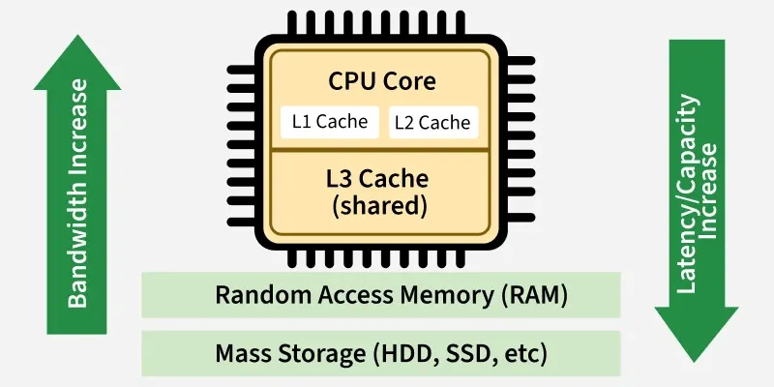
Cache Memory
The cache memory is used to store program data that is currently being executed in the CPU. Whenever the CPU needs to access memory, it first checks the cache memory. If the data is not found in cache memory then the CPU moves onto the main memory.
Registers
These are small, ultra-fast memory locations within the CPU used to hold data that is being processed. Registers are crucial for executing instructions efficiently.

Slide 17
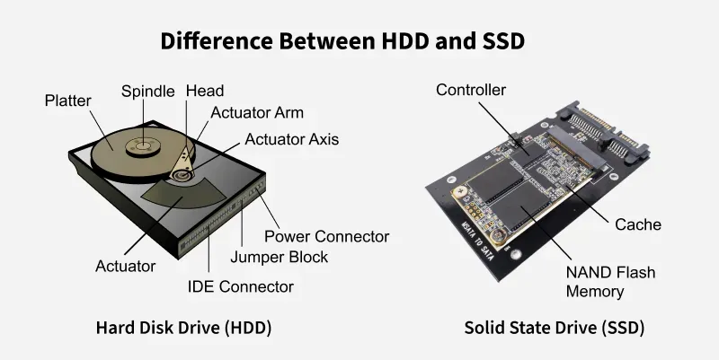
Hard Disk Drive (HDD) vs Solid State Drive (SSD)
Storage devices play a crucial role in determining a computer’s speed, performance, and data access efficiency. Among them, Hard Disk Drives (HDD) and Solid State Drives (SSD) are widely used storage technologies that differ in their working mechanisms.
HDDs using mechanical parts and SSDs relying on flash memory. These differences impact their speed, durability, cost, and overall performance.

Slide 18
Hard Disk Drive(HDD)
Hard Disk Drive (HDD), which stores data on spinning magnetic platters and uses a read/write head to access information. It is widely used in desktops, laptops, and servers due to its ability to handle large amounts of data efficiently.
Solid State Drive(SSD)
Modern storage devices use electronic memory to deliver faster and more efficient data access. One such technology is the Solid State Drive (SSD), which stores data using flash memory instead of moving parts. This allows quicker read/write operations and improved system performance. SSDs are commonly used in laptops and high-performance systems due to their speed and reliability.

Slide 19
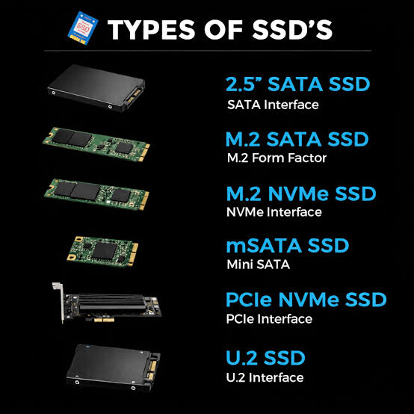
Types of SSD’S

Slide 20
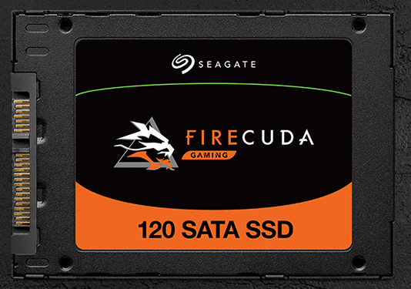
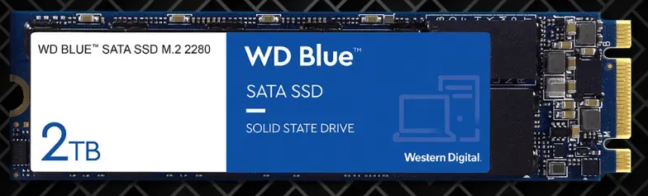
a) SSD SATA 2.5"
The oldest SSD format.
Connected in SATA III (max speed ~550 MB/s).
Compatible with almost all desktop and laptop PCs.
Perfect for a cheap upgrade .
b) SSD M.2 SATA
Use the format M.2 , smaller than the 2.5".
But limited by the SATA interface, so same speeds (≈ 550 MB/s).
Running on laptops and recent motherboards .

Slide 21
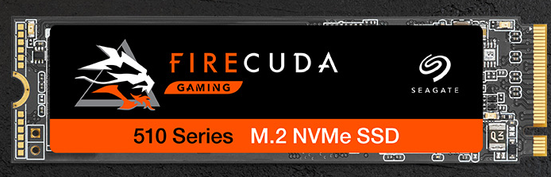
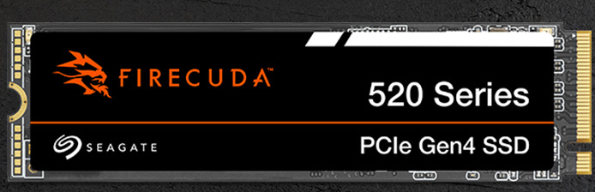
c) SSD M.2 NVMe
The most popular today .
Use the PCIe bus via the M.2 format.
Speeds ranging from 2000 MB/s to over 7000 MB/s depending on the generation (PCIe 3.0, 4.0, 5.0).
Ideal for gamers and content creators.
d) SSD PCIe (Add-in Card)
Presents itself in the form of a PCIe card plugged directly into a PCIe x4 or x16 port.
Mainly used in servers and workstations.
Very high performance, but bulky.

Slide 22
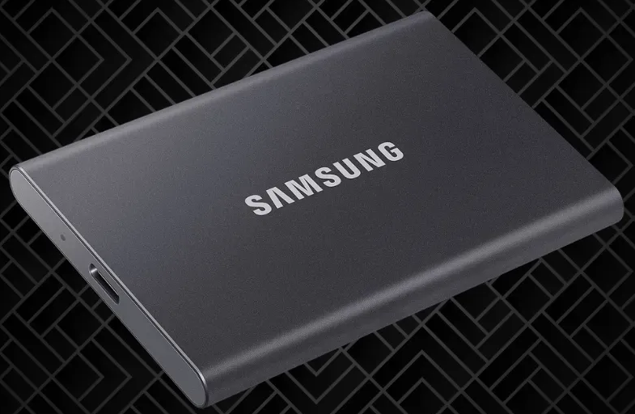
e) External SSD
Connected via USB 3.2, USB 4, or Thunderbolt.
Variable speed depending on the interface.
Convenient for backing up and transporting data.
SSD Speed
A key point that differentiates types of SSDs is their speed.
SATA III → ≈ 500–550 MB/s
NVMe PCIe 3.0 → 2000 to 3500 MB/s
NVMe PCIe 4.0 → 5000 to 7500 MB/s
NVMe PCIe 5.0 → can exceed 10,000 MB/s
SSD size
The SSD size (capacity) is also an important criterion.
250 GB - 500 GB → sufficient for Windows and a few apps.
1 To → the best compromise for OS + software + games.
2 To and more → perfect for big gamers or video creators.

Slide 23
Feature | HDD (Hard Disk Drive) | SSD (Solid State Drive)
Definition | Uses spinning disks and mechanical parts | Uses electronic components (no moving parts)
Storage Technology | Uses spinning magnetic disks for storage. | Uses NAND flash memory with no moving parts.
Speed | Slower boot times and file access. | Much faster boot times and file access.
Durability | Has moving parts, making it prone to damage. | More durable and shock-resistant.
Noise | Produces noise due to spinning disks. | Operates silently.
Power Consumption | Consumes more power. | Uses less power, improving battery life.
Lifespan | Wears out over time due to mechanical movement. | Lasts longer but has limited write cycles.
Cost | More affordable per GB, cost-effective for large storage. | More expensive per GB but offers better performance.
Reliability | Less reliable due to moving parts (e.g., head crash) | More reliable (no moving parts, less risk of failure)
Data Fragmentation | Performance can suffer from fragmentation | No fragmentation; performance remains consistent

Slide 24
What is the main difference between HDD and SSD?
A HDD uses flash memory, SSD uses magnetic disks
B HDD uses mechanical parts, SSD uses electronic memory
C Both use mechanical parts
D Both use magnetic storage
Which storage device provides faster data access and boot time?
A HDD
B SSD
C CD-ROM
D Floppy Disk

Slide 25
Why is SSD considered more durable than HDD?
A It uses magnetic disks
B It has larger storage
C It has no moving parts
D It is cheaper
Which device is more cost-effective for large data storage?
A SSD
B HDD
C Both are equal
D Optical Disk
What is a disadvantage of HDD compared to SSD?
A Higher power consumption
B Silent operation
C Faster performance
D No fragmentation

Slide 26
Thank You

