Slide 1






AI212 PROJECT
Weapon Detection System
Identification of weapons in images and videos
Team Members:
Aditya Kumar Verma (2024AIB1002)
Harsh Yadav (2024AIB1006)

Slide 2
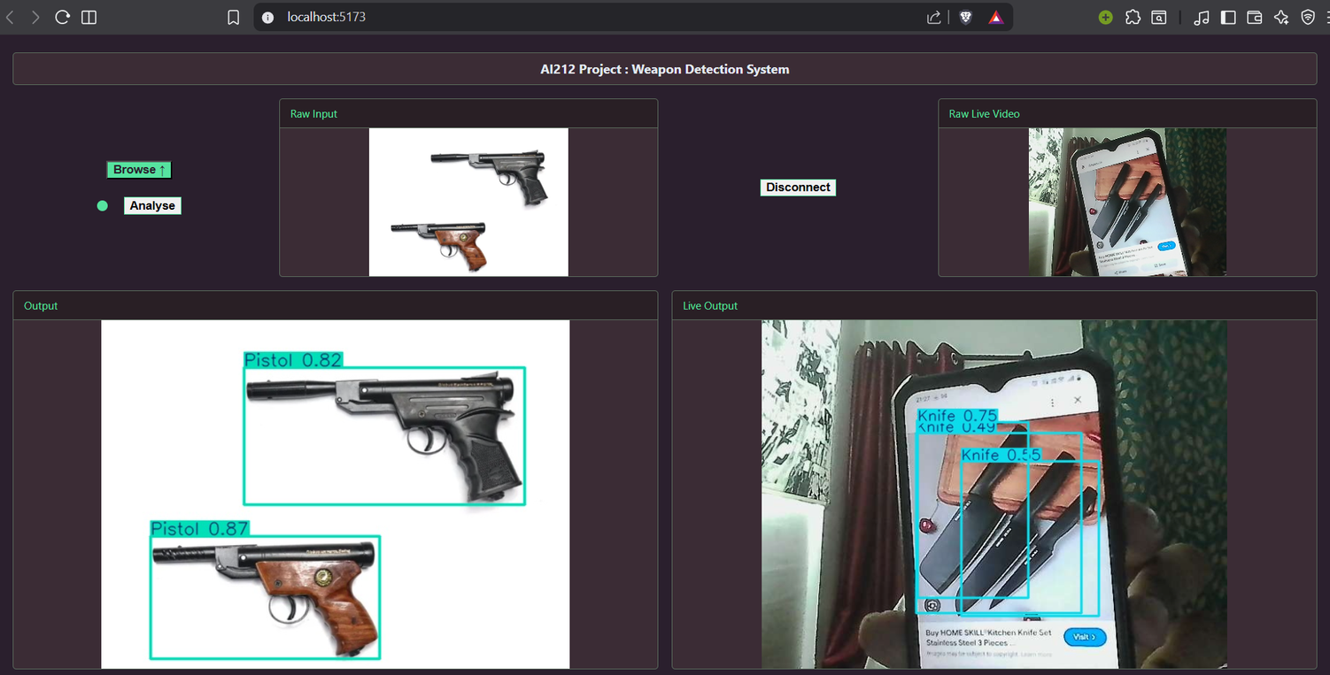
FINAL PROJECT
Connect the camera to detect any wepon live
Upload Image to detect wepons

Slide 3
TECHNOLOGY USED
AI / Deep Learning:
YOLOv8 (Ultralytics): Model used for real-time object detection, chosen for its balance of speed and accuracy.
PyTorch Backend: Acts as the underlying framework for model loading and tensor computations.
Backend:
FastAP
WebSockets: Enables full-duplex communication for real-time video streaming between the client and server.
Parallel Processing:
Ray Distributed Framework: Distributs tasks across multiple CPU/GPU workers
Frontend:
A React-based interface that handles file uploads and manages live webcam streams using hooks to maintain a responsive, high-density UI.

Slide 4
WORK FLOW
OpenCV draws bounding boxes and labels on the frame. The processed data (or annotated frame) is sent back to the frontend
Ray picks up the request and assigns it to an available worker node to ensure parallel execution.
Response
The user provides an image or initiates a live camera stream via the React frontend
Detection
Task Distribution
Request Handling
Input
The YOLOv8 model analyzes the frame to identify potential weapons
FastAPI takes the incoming data. For live streams, this happens over WebSocket connection

Slide 5
MODEL TRAINING
We used a pre-buiilt YOLO model, specifically YOLOv8 nano, and then trained on a weapon detection dataset we obtained from roboflow. The dataset contained around 9k images, with around 7k being for training and the rest for testing and validation.
We trained the model in two phases. For the first phase we used ray to distribute compute for the first 20 epochs. Then we fine tuned the model for 10 epochs without using ray. This approach was especially relevant on our relatively low compute power machines.
Upon completion of the training cycle, the model achieved a high degree ofclassification accuracy and localization precision. The graphs for different types of losses over epochs for the second training cycle and a sample output are shown in the next few slides.

Slide 6
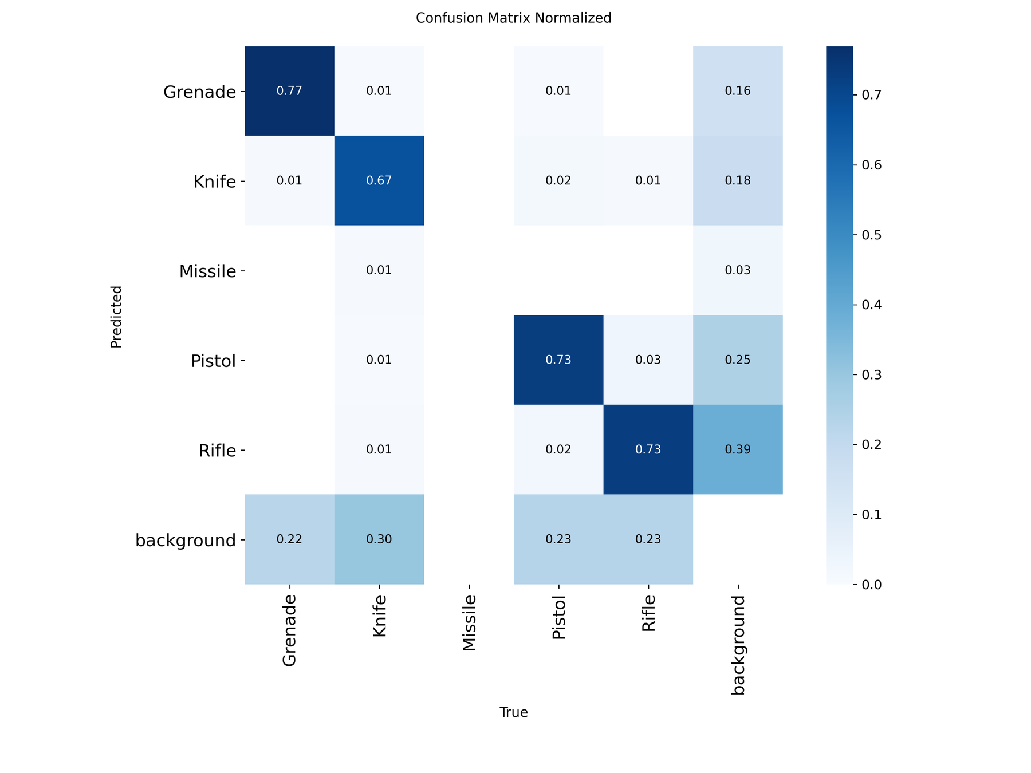

Slide 7
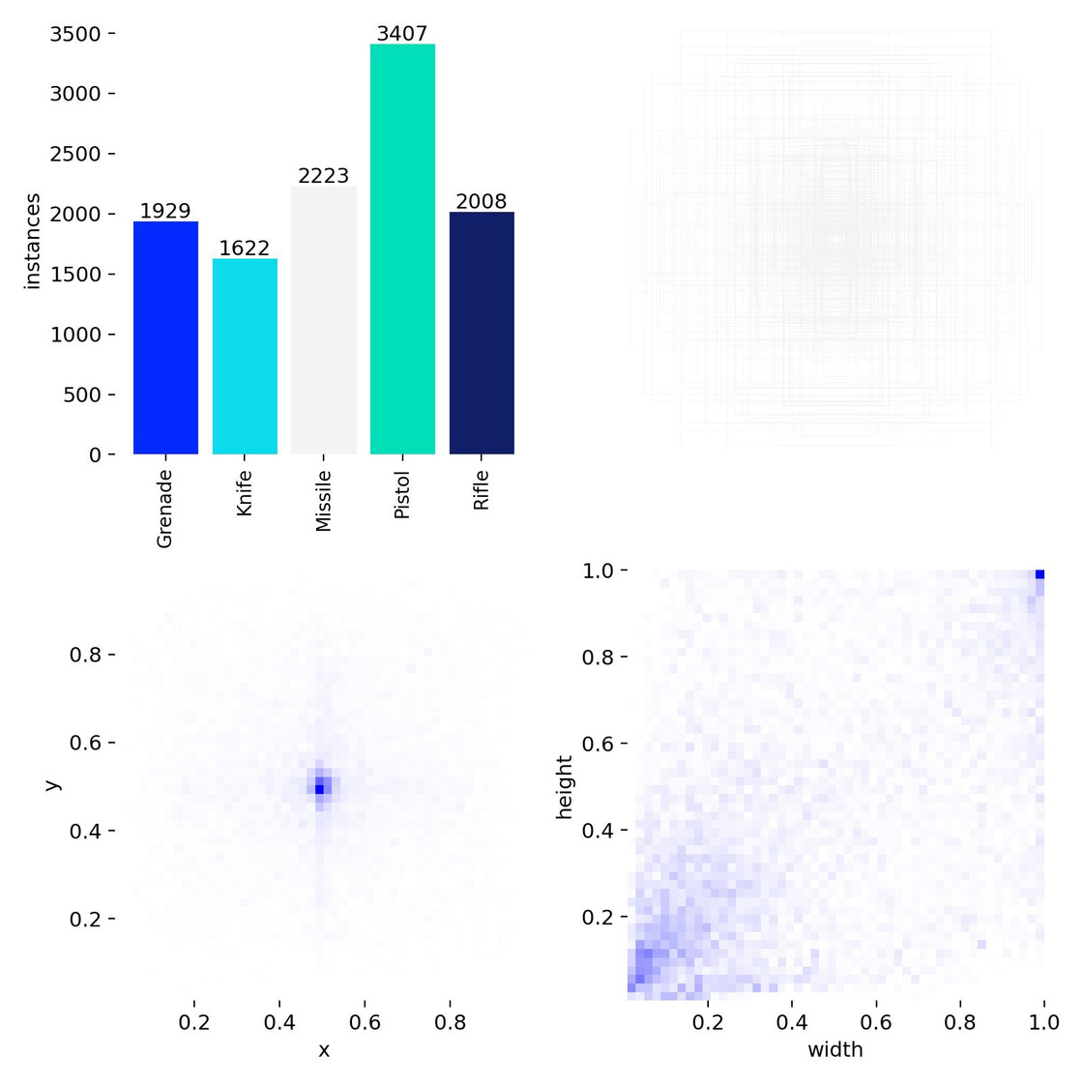

Slide 8
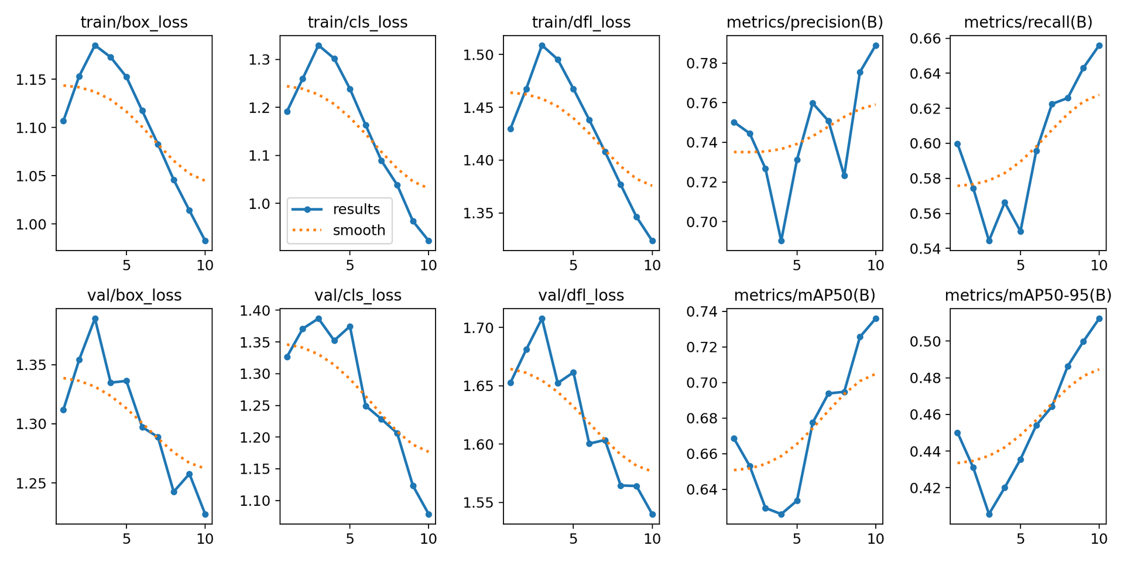

Slide 9
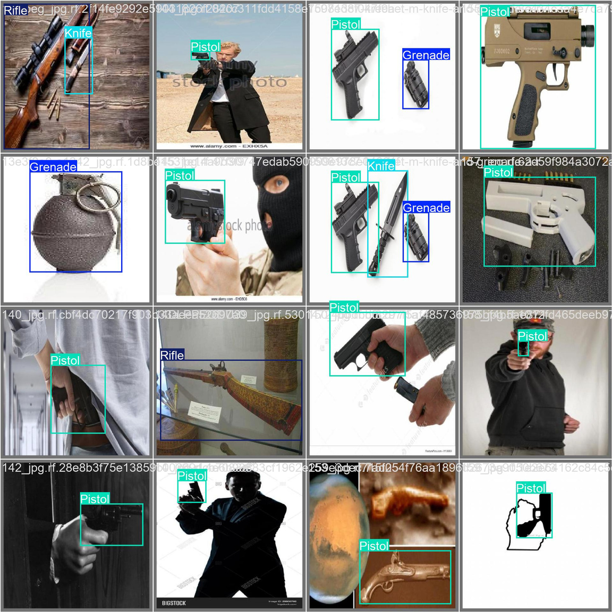
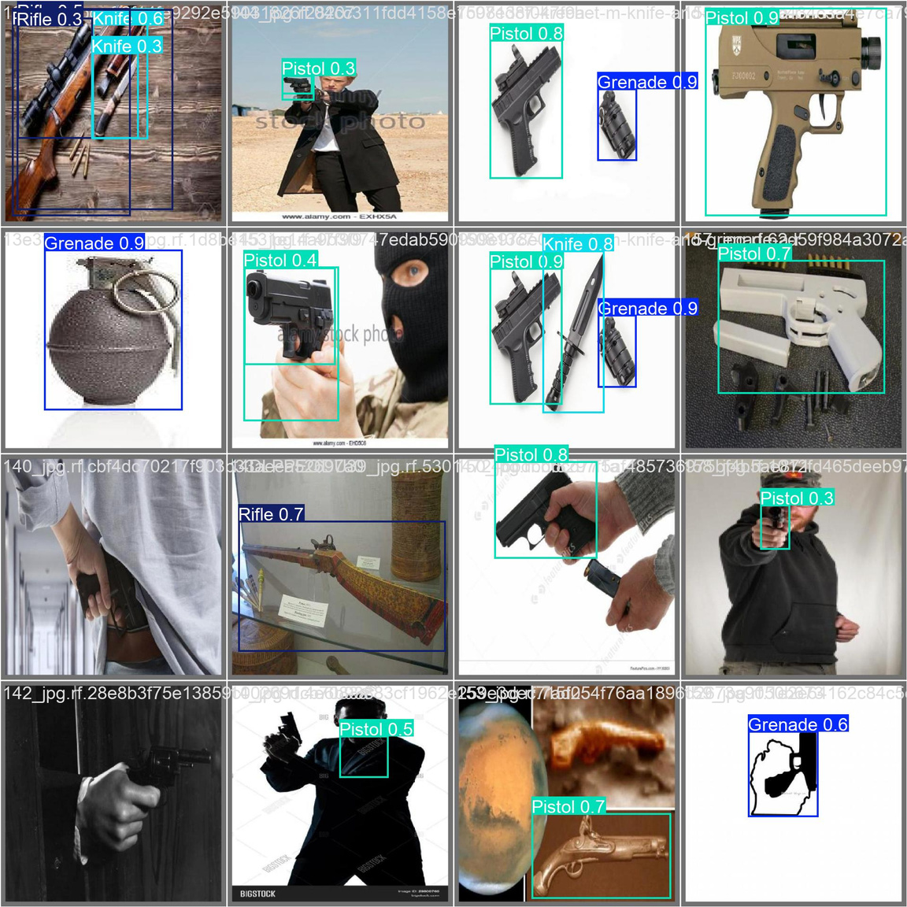

Slide 10
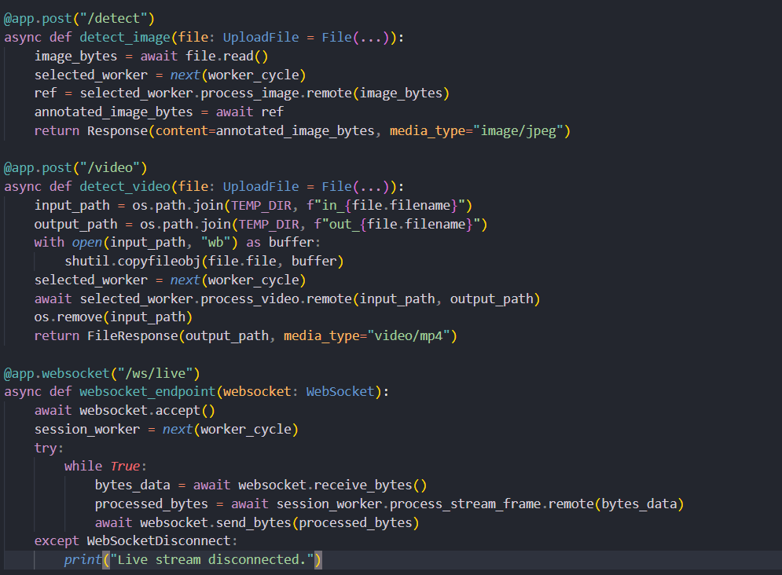
BACKEND FUNCTIONS

Slide 11
LIVE VIDEO DETECTION
01
Capture
Camera frames are captured on the client side and sent as binary bytes through the WebSocket.
02
Ingestion
The backend receives these bytes and converts them into a format compatible with the model (using NumPy).
03
Inference
YOLO predicts the presence of weapons in milliseconds.
04
Annotation
Bounding boxes are overlaid onto the frames locally on the server.
05
Streaming
The processed frames are pushed back to the frontend, where the video feed is updated instantly.

Slide 12
PERFORMANCE OPTIMIZATIONS
Multiple Ray Workers: By using a distributed actor model, the system can handle multiple concurrent users or high-resolution streams without crashing.
Confidence Thresholds: Fine-tuned logic that ignores low-probability detections, significantly reducing false positives in complex environments.
Dockerization: The entire backend and worker environment is containerized, ensuring consistent performance across different hardware and cloud environments.

Slide 13
FUTURE IMPROVEMENTS
Advanced Classification: Expanding the model to distinguish between different types of weapons (e.g., firearms vs. knives).
Automated Alerts: Integrating an instant notification system (via Email or SMS) when a high-confidence threat is detected.
Expanded Recognition: Adding face recognition to identify individuals in the vicinity of a detected threat.
Deployment Versatility: Moving beyond local servers to Cloud and Edge AI (like NVIDIA Jetson) for on-site, low-power monitoring.
Mobile Support: Developing a dedicated mobile application for security personnel to receive real-time feeds on the go.

Slide 14
THANK
YOU

