Slide 1
Introduction
Project Name : Exploratory Data Analysis (EDA) for Real Estate Pricing: Unveiling the Dynamics of House Valuation in a
Dynamic Market.
Submitted By: ADITYA KUMAR

Slide 2
1. To perform a detailed Exploratory Data Analysis on housing data. 2. To uncover hidden patterns and insights that impact house prices. 3. To engineer new features and understand market trends over time. 4. The real estate pricing dataset into a Pandas Data Frame 5. The data quality by eliminating missing values, removing duplicate entries, and addressing any anomalies or inconsistencies in the dataset. 6. Conducted a univariate analysis to understand the distribution of key variables like house prices. Utilize histograms, kernel density plots, or other visualizations to gain insights into the data. 7. Calculated the price per square foot or engineer a feature representing the property's age. 8. The dataset to understand how specific amenities impact house prices. Reviews to gauge the perceived value.

Slide 3
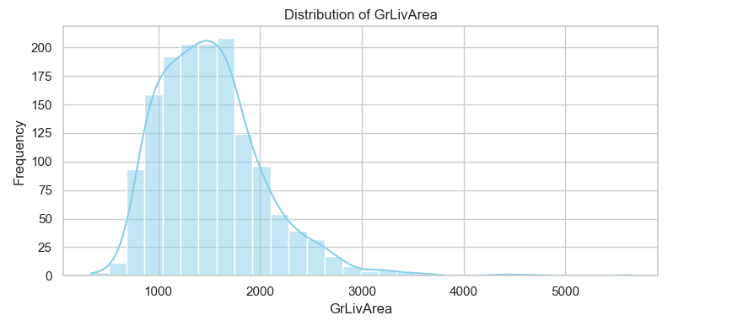

Slide 4
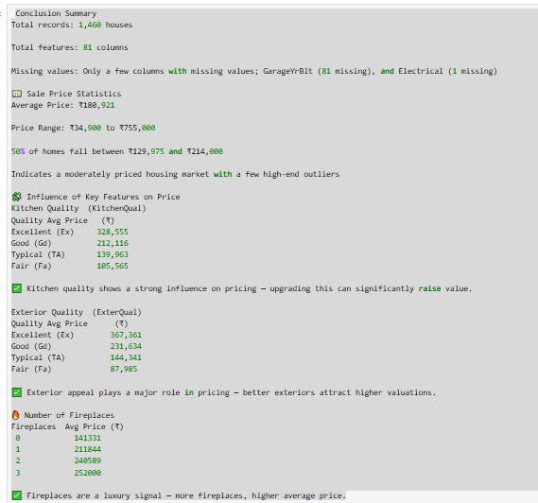

Slide 5
THANK YOU

