Slide 1

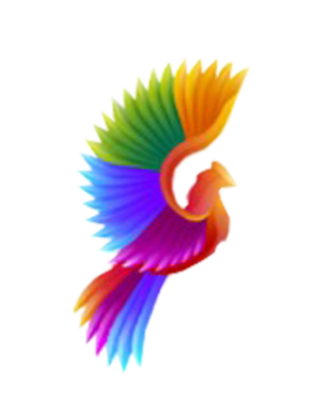
NEXT HIKES
IT SOLUTIONS
Project Name: Scientific Calculator
Submitted By: ADITYA KUMAR

Slide 2
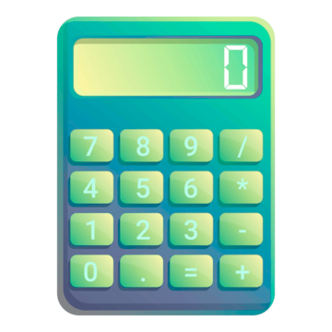
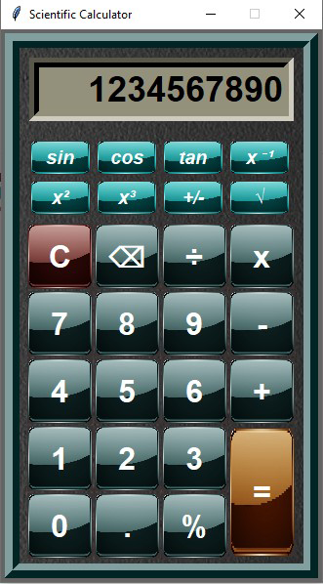
INTRODUCTION
This scientific calculator built using Python's Tkinter library. The calculator includes basic arithmetic operations and advanced functions such as sin, cos, tan, inverse, square root, and cube.
The calculator also features keyboard support, allowing users to input values using their keyboard. The calculator's GUI is customizable, utilizing background images and custom fonts.
Key features of this calculator include:
Basic arithmetic operations: addition, subtraction, multiplication, division
Advanced functions: sin, cos, tan, inverse, square root, cube
Keyboard support for input
Customizable GUI with background images and custom fonts
Error handling for invalid mathematical expressions

Slide 3
LIBRARIES
Tkinter's ease of use and simplicity make it a great choice for simple GUI applications and prototyping. There are various widgets such as labels, buttons, text entries, and more to create interactive GUI elements.
1. Tkinter
PIL - there are several other imaging libraries available for Python. But I chose PIL because it is easy to learn and use, even for developers without extensive image processing experience. PIL supports a wide range of image formats, including JPEG, PNG, GIF.
The libraries used in this project.
These libraries enable the calculator to have a user-friendly interface, display images, handle keyboard input, and perform mathematical calculations.
2. PIL
PYNPUT - Pynput is a popular library for monitoring and controlling user input in Python. Pynput has a simple and intuitive API that makes it easy to learn and use.
3. Pynput
Math - The Math library in Python is a built-in module that provides functions for performing mathematical operations. It includes functions for trigonometry, exponential and logarithmic functions, power functions, and more.
4. Math

Slide 4

CHALLENGES
"While working on this project, I encountered challenges in designing visually appealing buttons with a 3D look. To overcome this, I had an idea to use custom images on buttons. However, I was unsure about how to implement this. To learn more, I watched several YouTube tutorials on Python and discovered how to import custom images into my project and apply them to buttons and the main window background."

Slide 5

Thank you!

