Slide 1
Summer Training project Business data analysis
ADITYA SHARMA
CSE-B
06220802719

Slide 2
TABLE OF CONTENt
Certificate
About
Data Collection
Setup
Data Cleaning
Pivot tables
Dashboard

Slide 3
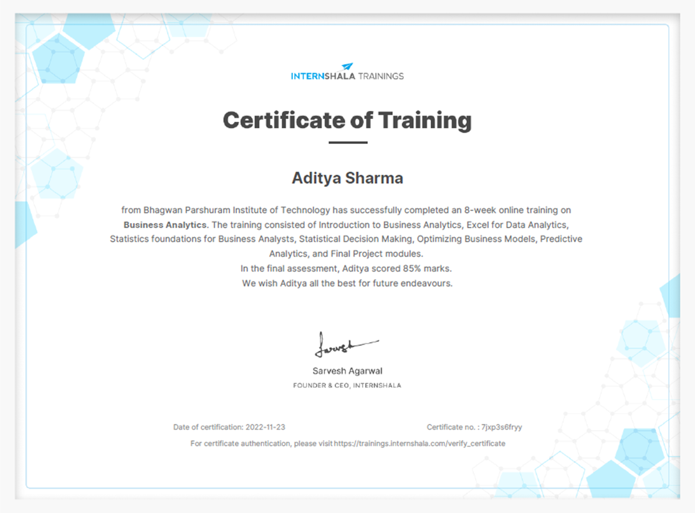
CERTIFICATE

Slide 4
About
The goal of this project would be to deliver valuable insights that can be used to improve the company's sales performance, such as identifying new revenue opportunities, increasing conversion rates, and reducing costs. This project would also help to understand the customer preferences, demographics and purchase patterns which will help to optimize the marketing efforts.

Slide 5
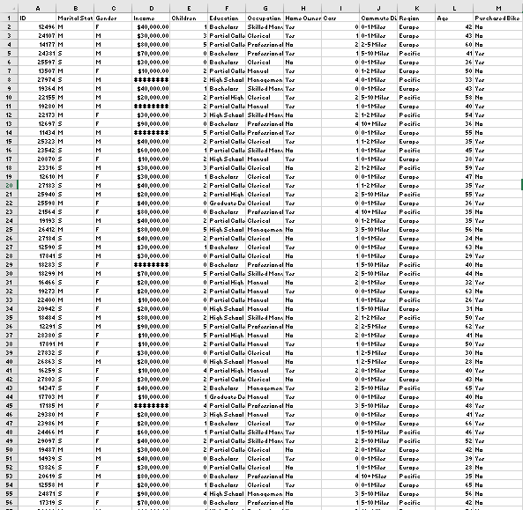
Data collect
The data present around us is not necessarily timely updated. So, for that reason we sometimes extract data from websites and that is known as Web Scraping.
For my project the sales data is being extracted from a site.
Here’s a quick look:
More than 10,000 data regarding sales of Bike is present in this excel file

Slide 6
setup
We will be using Excel for Cleaning and for organizing.
As data is selected, we have to point out things which to be processed so that a meaningful insight can be drawn.
Eliminate duplicate data
Replace confusing data with sorted data
Change number format
Group together wide range of age in column ‘Age’
Create Pivot tables from the insightful data
Average income(gender based) per Purchase
Commute based Purchase
Age based Purchase
Make a informative Dashboard
Use slicer to filter data in Pivot table to understand the selected data.

Slide 7
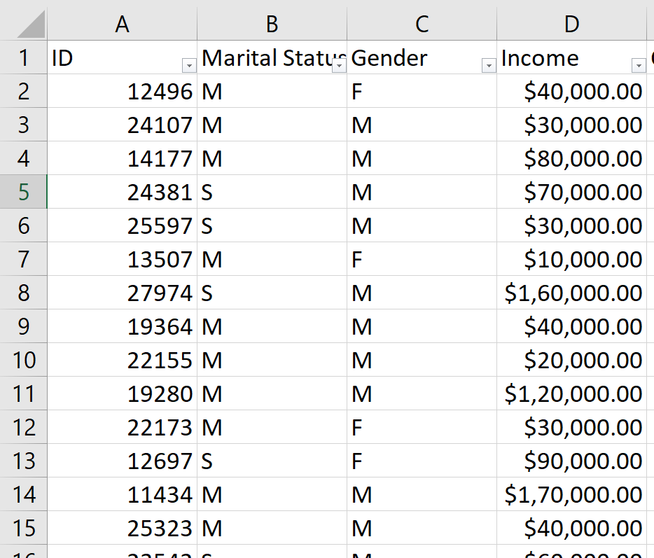
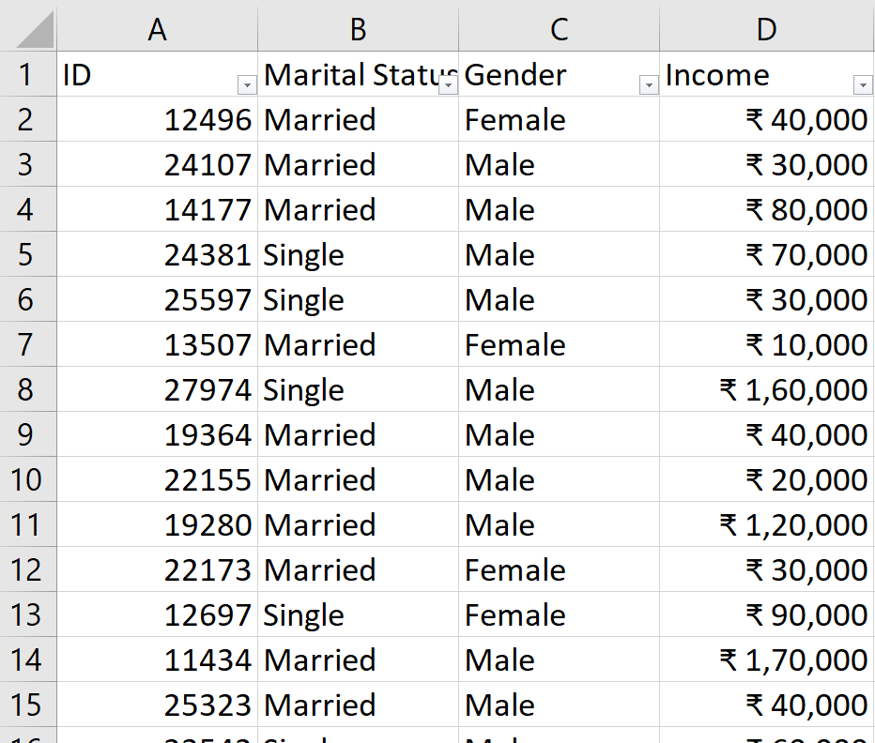
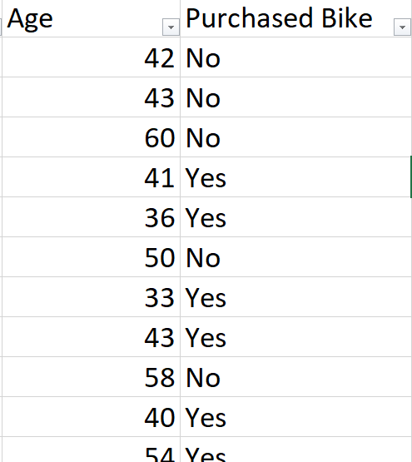
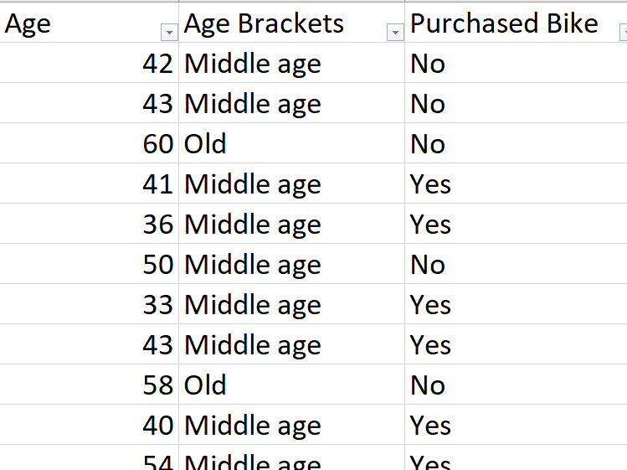

data cleaning
Target data is converting what useful and important insight/info we want from raw data.
We will create a ‘working sheet’ for our target data.

Slide 8
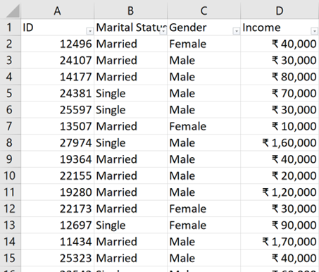

First we removed duplicates from out data. – using remove duplicate in excel
For good insight, change in marital status column and gender column- using find and replace in excel
Change in currency – using number format and decrease decimal
Adding a new column ‘Age Brackets’ for grouping the different age-using IF function=IF(L2>54,"Old",IF(L2>=31,"Middleage",IF(L2<31,"Adolescent","Invalid")))

Slide 9
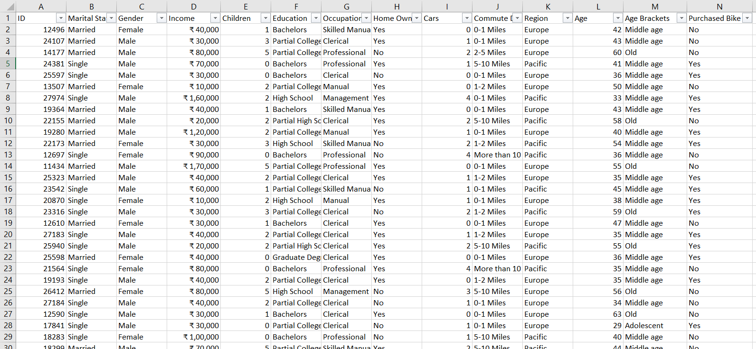
Our clean data look like this from which we can include Pivot tables and create meaningful Dashboard:

Slide 10
Pivot tables
As our data is processed, now we have to include Pivot Tables of the new data.
Here, we can include Pivot tables as follows:
Select a cell in ‘Pivot table’ worksheet
Go to insert ribbon and from there add Pivot table
Select whole data reference from ‘working sheet’ worksheet
Select desired fields for pivot tables.
In this project, 3 Pivot tables and its relevant charts are made.
After that insert chart equivalent to pivot table:
Use bar, line, pie or any chart which Best represent the data.

Slide 11
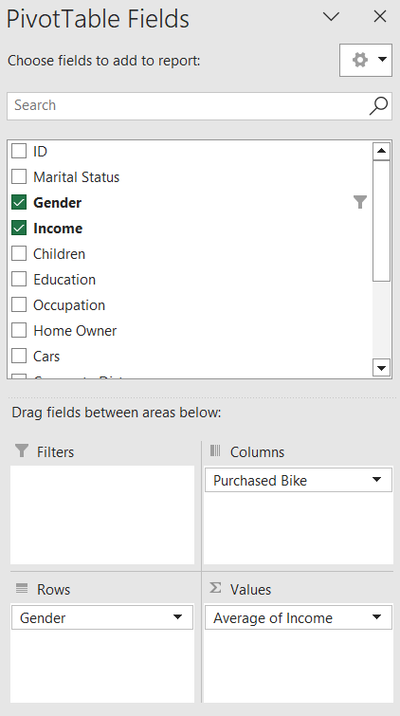
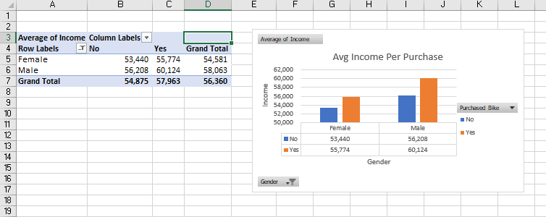
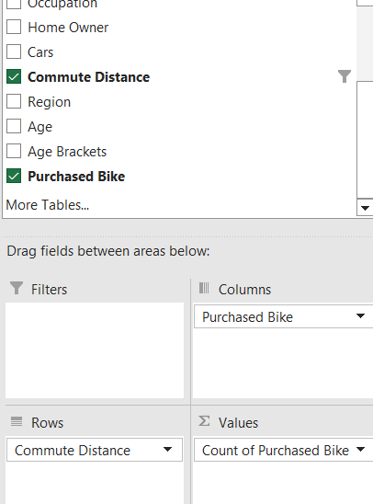
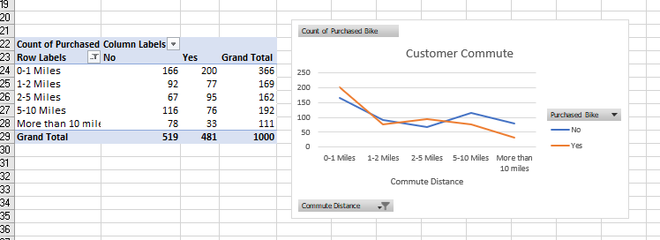
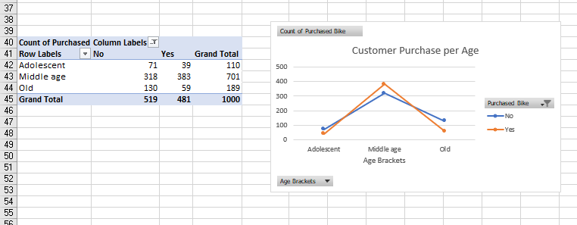
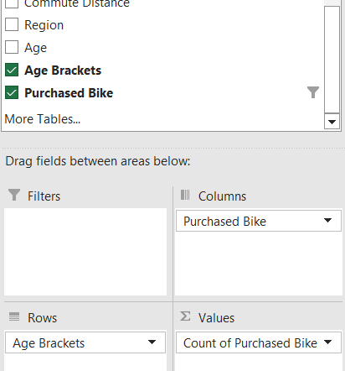

Slide 12
Dashboarding
The last step in our Project is to create a informative Dashboard with processed/cleaned data.
An interactive Dashboard will help in analysing the data.
Few steps for creating Dashboard:
Disable gridlines in ‘Dashboard’ worksheet.
Transfer pivot tables and charts to this worksheet.
Arrange them in order
Create slicer for filtering the data.
At last, refresh all the data so that any changes done can be updated and Yes, our project is done.

Slide 13
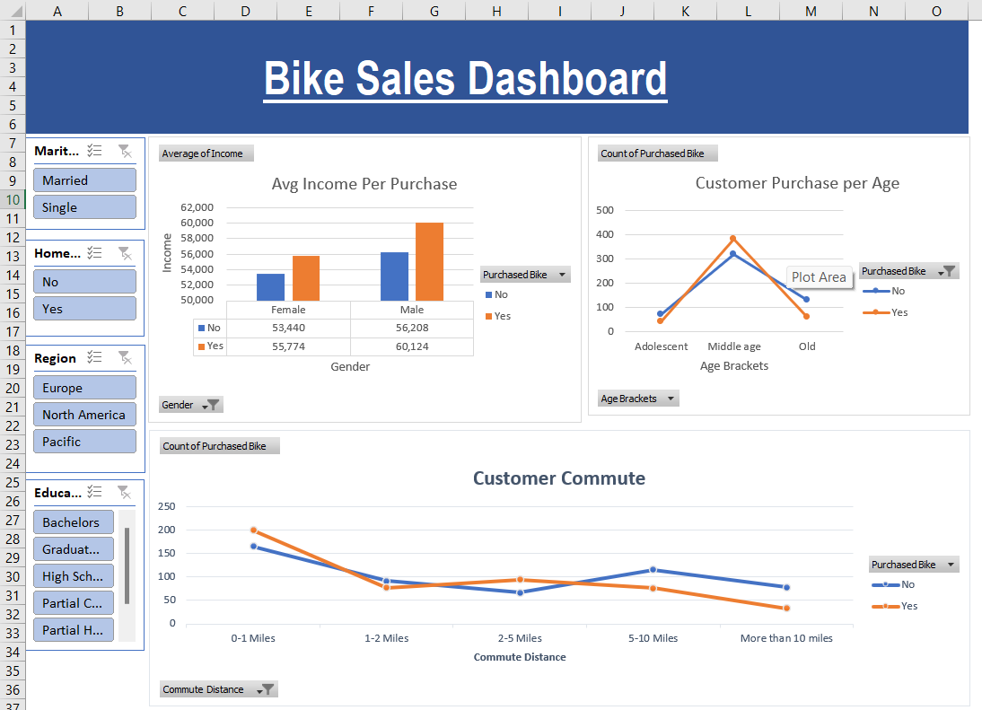
Interactive Dashboard

Slide 14
Thank you😁

