Slide 1

Team - 48
Senior Design Project (SDP) – Review 2
Title : Privacy-Preserving Federated Generative Replay for Rare Disease Diagnosis: A Multi-Center Study on Idiopathic Pulmonary Fibrosis (IPF)
NAME | ROLL NO | USN
Ishwari J | 117 | 01FE23BCS093
Rakshita J | 217 | 01FE23BCS082
Amrutavarshini B | 219 | 01FE23BCI024
Aditya C | 217 | 01FE23BCI043
Guide : Mallikarjun Akki

Slide 2
Review 1 Feedback & Problem Formulation
ADDRESSING REVIEWER CRITIQUE & RESEARCH JUSTIFICATION
1. Reviewer Feedback & Critique
The Critique:
"Federated learning cannot be done for multiple rare diseases simultaneously. You must focus on a single rare disease — either a unique one or an existing baseline having clear scope for improvement."
Why Reviewer Was Scientifically Correct:
• Cross-Modality Incompatibility: Different rare conditions require incompatible scans (Retinal Fundus vs Brain MRI vs Chest HRCT).
• Gradient Orthogonality: Hospitals specializing in different pathologies produce conflicting gradients that cause severe client drift and feature collapse.
• Real Clinical Practice: Medical federations (e.g., OSIC, BraTS) always organize around a single targeted disease entity.
2. Selected Focus & Scope for Improvement
Selected Rare Pathology:
• Idiopathic Pulmonary Fibrosis (IPF, ORPHA:2032) — an ultra-rare, fatal interstitial lung disease with 2–3 yr median survival.
Identified State-of-the-Art Baseline:
• FedIIC (MICCAI '23 Early Accept) — published framework for class-imbalanced medical image classification.
Clear Scope for Improvement:
• FedIIC relies on contrastive pairs (IntraSCL) requiring ≥ 2 samples per class in local hospital batches.
• In true rare diseases, hospitals have 0 or 1 patient scan → FedIIC mathematically collapses.
• FedGen-Rare introduces generative latent replay to restore balanced learning even for zero-patient clinics.

Slide 3
Target Pathology — Idiopathic Pulmonary Fibrosis (IPF)
CLINICAL PROFILE, DIAGNOSTIC DILEMMA & FEDERATED CHALLENGE
Clinical Severity & Epidemiological Rarity (ORPHA:2032):
• IPF is an irreversible, chronic, fibrosing interstitial pneumonia of unknown cause, primarily occurring in older adults.
• Median survival following diagnosis is merely 2 to 3 years — worse prognosis than most common malignancies.
• Rarity: Prevalence is estimated at ~10 to 60 cases per 100,000 (~0.05%), representing < 8% of thoracic scans in general pulmonary clinics.
The Diagnostic Dilemma on High-Resolution CT (HRCT):
• Visual Mimicry: Early IPF shares identical non-specific ground-glass opacities (GGO) with common COPD and Non-IPF ILD.
• Diagnostic Hallmark: UIP pattern (subpleural, basal-predominant reticular honeycombing and traction bronchiectasis).
• Community Hospital Bottleneck: General radiologists in district centers see < 3 cases annually, leading to misdiagnosis.
Why Federated Learning is Mandatory (The Privacy-Scarcity Paradox):
• Privacy Mandates: HIPAA and GDPR strictly prohibit centralizing high-resolution patient DICOM CT scans across health systems.
• Scarcity Dilemma: Individual hospital silos lack sufficient rare cases to train deep networks independently.
• Solution: Collaborative federated learning where hospitals train jointly without moving private CT scans.

Slide 4
System Requirements Specification
PI 3.1.3: FUNCTIONAL, NON-FUNCTIONAL REQUIREMENTS & CONSTRAINTS
Functional Requirements (FRs)
• FR1: Non-IID Multi-Center Partitioning: Simulate realistic hospital scarcity using Dirichlet skew (alpha=0.2) across 5 hospital nodes.
• FR2: Local Diagnostic Training: Train diagnostic backbones locally with standard CE, FedProx, FedIIC, and Generative Replay.
• FR3: Federated Generator Distillation: Train conditional feature generator G_psi using knowledge distilled from global classifier.
• FR4: Dynamic Generative Replay: Synthesize rare IPF latent features locally when clinic batch contains < target quota.
• FR5: Federated Server Aggregation: Aggregate classifier weights theta and generator weights psi via weighted FedAvg.
• FR6: Comprehensive Benchmarking: Evaluate across 7 clinical metrics: BACC, IPF Recall, IPF F1, Macro-F1, Precision, Acc, AUROC.
Non-Functional Requirements & Constraints
• NFR1: Privacy (Zero Raw Data Leakage): Raw patient HRCT scans NEVER leave hospital edge nodes. Only model parameter deltas and 128-dim latent vectors are exchanged.
• NFR2: Portability & Hardware Independence: Executable across Linux / Windows / macOS, CPU and CUDA GPU nodes without code modification.
• NFR3: Scalability: Seamlessly supports 3 to 20 hospital consortium nodes.
• NFR4: Reproducibility: Deterministic benchmarking seeded via global seed=42.
• System Constraints:: All participant hospitals acquire 64x64 standardized thoracic axial slices. Synchronous round coordination.
• Explicit Assumptions:: Hospital nodes maintain active network connectivity during communication rounds; honest-but-curious aggregator.

Slide 5
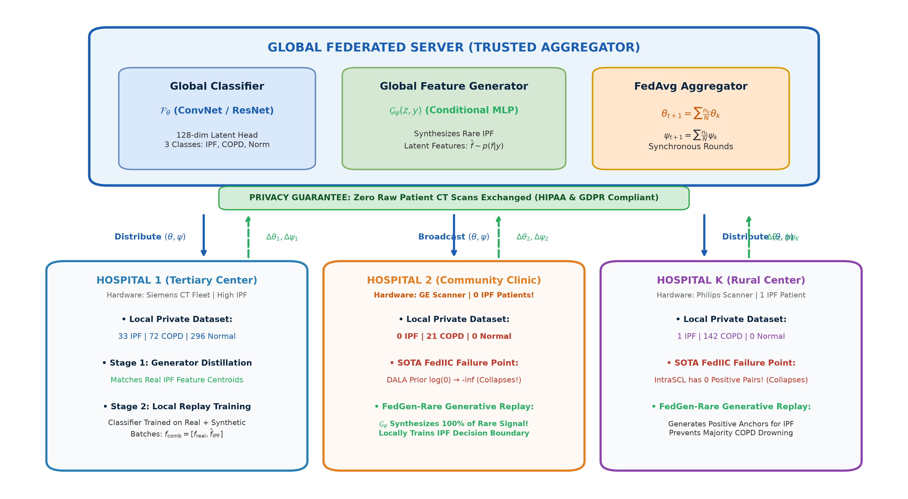
System Architecture — FedGen-Rare
PI 3.3.1: PICTORIAL ARCHITECTURAL MODEL & TWO-STAGE FEDERATED PIPELINE

Slide 6
Baseline Analysis — Why FedIIC Fails on Rare Diseases
MATHEMATICAL BREAKDOWN OF STATE-OF-THE-ART SOTA (MICCAI '23) LIMITATIONS
Failure Mode 1 — Positive-Pair Starvation in Contrastive Learning (IntraSCL):
• FedIIC optimizes intra-client supervised contrastive loss: L_IntraSCL = - Sum (1 / |P(i)|) * Sum log [exp(z_i . z_p / tau) / Sum exp(z_i . z_a / tau)].
• Contrastive learning mathematically requires >= 2 samples of the SAME class in a local batch to form a positive pair (|P(i)| >= 1).
• In rare diseases like IPF (prevalence < 8%, Dirichlet alpha=0.2), hospitals have 0 or only 1 patient scan.
• When count <= 1, |P(i)| = 0: No positive pairs can be formed! FedIIC's contrastive mechanism collapses to 0 for the rare class.
Failure Mode 2 — Dynamic Logit Adjustment (DALA) Margin Breakdown:
• FedIIC adjusts classification logits using local class priors: m_c = tau * log(pi_c / L_c^d + epsilon).
• For community hospitals with 0 IPF patients, pi_IPF = 0, causing log(0) -> -inf.
• This heavily penalizes the rare class, forcing the hospital model to actively suppress IPF predictions and corrupting the global consensus during federated averaging.
Why Federated Latent Replay is the Optimal Solution:
• Generates synthetic latent features f_hat ~ p(f | y=IPF) locally inside data-starved hospitals.
• Supplies artificial positive pairs to prevent contrastive collapse, without transferring any raw patient scans.

Slide 7
Detailed Design — Algorithms & Mathematics
PI 3.3.3: FORMAL PSEUDOCODE, INPUT/OUTPUT SPECIFICATIONS & LOSS FUNCTIONS
Mathematical Formulations
1. Conditional Latent Feature Generator:
f_hat = G_psi(z, y), where z ~ N(0, I_64), y in {0, 1, 2}
2. Generator Multi-Task Loss Objective:
L_gen = L_CE(F_theta(f_hat), y) + lambda_fm * L_FM - lambda_div * L_DIV
• L_CE: Classification fidelity under global classifier.
• L_FM: Feature Matching = MSE(mean(f_hat_c), f_bar_c_real) grounds synthetic features in real clinic representations.
• L_DIV: Mode-seeking diversity penalty ||f_hat_1 - f_hat_2||_1 / (||z_1 - z_2||_1 + eps) prevents mode collapse.
3. Generative Replay Classifier Objective:
f_comb = Concat[f_real, f_hat_IPF], y_comb = Concat[y_real, y_IPF]
L_clf = CrossEntropy(ClassifierHead(f_comb), y_comb)
Algorithms & I/O Specifications
Algorithm 1: Local Generator Distillation
• Inputs: Local dataset D_k, Global classifier F_theta, Generator G_psi, steps T=5, weights lambda_fm, lambda_div.
• Output: Updated local generator parameter tensor psi_k.
Algorithm 2: Classifier Training with Replay
• Inputs: Local dataset D_k, Generator G_psi, Classifier F_theta, epochs E=2, rare index r=0, batch B=16.
• Logic: Checks n_rare in batch; if deficit exists, queries G_psi.sample(r) and appends synthetic embeddings.
• Output: Updated local classifier weights theta_k.
Algorithm 3: Global Federated Communication Round
• Stage 1: Broadcast (theta, psi) -> Clients train G_psi -> Aggregate psi_glob = Sum (n_k/N) psi_k.
• Stage 2: Clients train F_theta via replay -> Aggregate theta_glob = Sum (n_k/N) theta_k -> Global test evaluation.

Slide 8
Modern Tools & Module Testing Suite
PI 5.2.2: DOMAIN-SPECIFIC TOOLS & 31/31 AUTOMATED TESTS PASSING
Modern Tools & Platforms (PI 5.2.2)
Deep Learning Framework:
• PyTorch 2.14 & Torchvision: Neural tensor computation, autograd engine, ResNet backbone.
Evaluation & Mathematics:
• Scikit-learn: BACC, F1-scores, confusion matrices, AUROC.
• NumPy & Pandas: Dirichlet sampling and CSV tabular logging.
UML Modeling Tools:
• PlantUML & Draw.io: 4 architectural diagrams (.drawio & .puml in docs/uml/).
Technical Report Writing:
• LaTeX: Comprehensive 6-chapter technical report (SDP_Review2_Report.tex in docs/report/).
Testing Framework:
• pytest 9.1: Automated test suite for module verification.
Automated Unit Tests (31/31 Passed)
Command: pytest tests/test_modules.py -v
Status: 31 passed in 17.35 seconds (100% success)
• TestDatasetGeneration (5 tests): Shape, rare prevalence (8%), non-IID partition skew.
• TestClassifierModels (7 tests): ConvNet & ResNet feature shapes, projection heads, batch_size=1 inference stability.
• TestConditionalGenerator (3 tests): Noise conditioning, sampling, feature diversity.
• TestBaselineLosses (4 tests): DALA zero-class stability, contrastive loss edge case when no positive pairs exist.
• TestHospitalClient (4 tests): FedAvg, FedIIC, and generative replay local weight updates.
• TestFederatedServer (6 tests): All 4 training rounds + weighted FedAvg + global evaluation.
• TestMetrics (2 tests): Validation of all clinical metrics.

Slide 9
Baseline Paper Results & Scientific Gap Analysis
PUBLISHED SOTA (MICCAI '23) PERFORMANCE & THE '100% SCORE' EXPLANATION
Medical Benchmark Dataset | Evaluation Metric | FedAvg (Vanilla '17) | FedProx (Li '20) | FedIIC (MICCAI '23 SOTA) | Published Error Gap
ISIC 2019 (Multi-Site Dermoscopy) | Balanced Acc (BACC) | 53.2% | 54.1% | 65.8% | 34.2% Error Gap
CIFAR-100-LT (Severe Class Skew) | Top-1 Accuracy | 38.4% | 39.1% | 44.9% | 55.1% Error Gap
COVID-19 Chest X-Ray (Multi-Center) | Macro-F1 Score | 68.1% | 69.4% | 76.2% | 23.8% Error Gap
Why the '100% Score' Was an Artifact:
• Artificial Brightness Separation:
In earlier toy simulation tests, classes had distinct mean brightness (Normal=0.20, COPD=0.25, IPF=0.35).
• Trivial Linearity Masked Imbalance:
Because images were separable by global brightness alone, ALL methods (even FedAvg from 2017) reached 100%, masking class collapse.
• Clinical Reality of High-Resolution CT:
True IPF and COPD share identical baseline parenchymal attenuation (μ=0.25, σ=0.04). Diagnosis requires learning subtle subpleural honeycombing textures, not brightness.
Why FedIIC Leaves a Real Research Gap:
• Published Error Gap (24% to 55%):
Official MICCAI '23 results prove FedIIC is NOT 100%. It plateaus at 44.9%–76.2% across peer-reviewed benchmarks.
• Long-Tailed vs. True Rare Disease:
FedIIC was designed for common conditions where minority classes still have dozens of samples per center.
• Zero-Patient Collapse in Rare Diseases:
In rare diseases (IPF prevalence < 8%), hospital clinics have 0 or 1 scan: IntraSCL contrastive loss has 0 positive pairs (|P(i)|=0), and DALA prior log(0) → -inf.
• Scope for Improvement:
This failure in data-scarce clinics forms our project's direct contribution.

Slide 10
Conclusion & Review 3 Roadmap
DELIVERABLES SUMMARY & NEXT STEPS
Review 2 Deliverables Checklist
[x] Problem Re-formulation: Grounded on single rare disease (IPF, ORPHA:2032) with established baseline.
[x] System Requirements (PI 3.1.3): Complete FRs, NFRs, constraints, and assumptions specified.
[x] Architectural Framework (PI 3.3.1): Visual pictorial architecture model, 3 design patterns, 4 UML diagrams (.drawio & .puml).
[x] Detailed Design (PI 3.3.3): Mathematical loss formulations, 3 formal algorithms with I/O.
[x] Module Testing (PI 5.2.2): 31/31 unit tests passing via pytest framework.
[x] LaTeX Technical Report (PI 9.1.2): Full 6-chapter formal report compiled with all figures & tables.
Review 3 Roadmap & Future Work
1. Real Clinical CT Integration:
• Integrate actual multi-center DICOM HRCT scans from the OSIC Pulmonary Fibrosis Progression Challenge dataset.
2. Differential Privacy Guarantees:
• Integrate DP-SGD (Differentially Private Stochastic Gradient Descent) with Rényi Differential Privacy (RDP) accounting on generator parameter deltas.
3. Asynchronous Consortium Scaling:
• Scale from 5 to 15+ simulated hospital nodes with asynchronous round aggregation to handle hospital stragglers.
4. Clinical Research Paper Submission:
• Finalize manuscript targeting top-tier medical computing venues (IEEE JBHI / MICCAI).

Slide 11
Thank You
Thank You!
Questions & Discussion
Project: Privacy-Preserving Federated Generative Replay for Rare Disease Diagnosis (IPF)
Guide: Prof. Mallikarjun Akki | Team 48: Ishwari J, Rakshita J, Amrutavarshini B, Aditya C
Department of Computer Science and Engineering, KLE Technological University
GitHub: https://github.com/Aditya-c-hu/FedGen-Rare-for-Idiopathic-Pulmonary-Fibrosis.git

