Slide 1
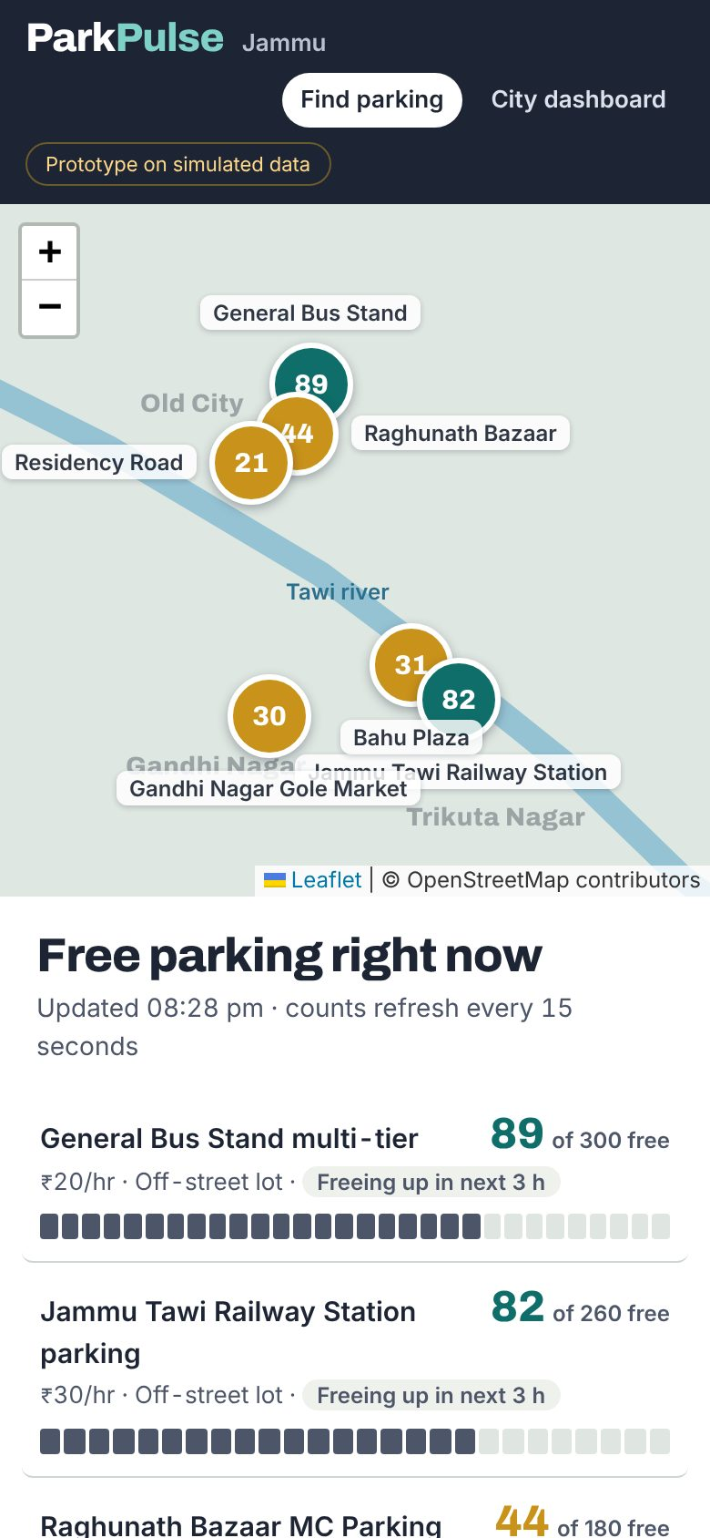
ParkPulse Jammu
Working prototype on simulated data
Live parking and congestion intelligence from the city's existing cameras
Digital Governance, Mobility & Smart Infrastructure
Problem statement: use real-time data and technology to optimise parking, manage congestion and discourage illegal parking.
Notes:
ParkPulse Jammu reuses the city's CCTV to count free parking bays, tells citizens and pilgrims where to park on WhatsApp, alerts traffic police to illegal parking and gives JMC and JSCL data to plan. Everything shown runs today, on simulated data.

Slide 2




Jammu's parking problem is an information problem
Bays exist, but nobody can see which ones are free, so drivers circle, double-park and block junctions.
Drivers circle the markets
Illegal parking blocks traffic
Pilgrim and festival surges
The city plans without data
Raghunath Bazaar, Residency Road and Gandhi Nagar fill at midday and evening. With no live information, drivers search street by street and add to the jam.
Vehicles left at City Chowk, Gole Market and station roads choke junctions. Enforcement relies on patrols that cannot be everywhere.
Vaishno Devi pilgrims, Navratri and Diwali bring visitors who do not know the city, all arriving at the railway station and bus stand.
JMC and JSCL have no hour-by-hour view of where and when lots fill, or how much parking fee goes uncollected.
Notes:
Keep this qualitative: we have not measured Jammu search times yet. That is what the pilot measures.

Slide 3

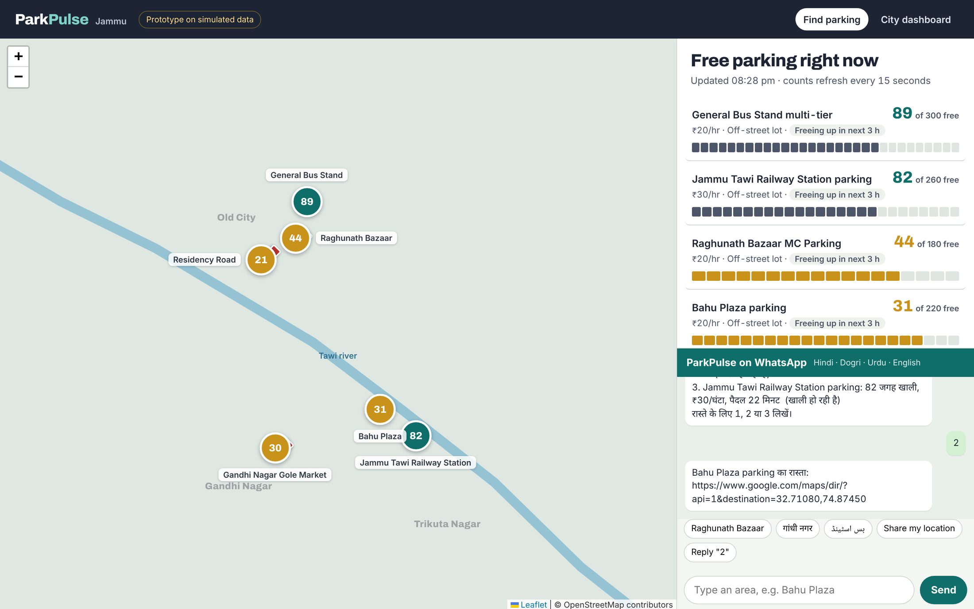


One camera feed, three jobs
Citizens and pilgrims
Free-bay counts on a web map and a WhatsApp bot in Hindi, Dogri, Urdu and English. Reply 1, 2 or 3 for directions. No app to install.
Traffic police
An automatic alert when a vehicle stays in a no-parking zone past 5 minutes, with location and vehicle type.
JMC and JSCL planners
Hour-by-hour fill patterns, a 6-hour forecast per zone, enforcement hotspots and an estimate of uncollected fees.
Citizen map, live in the prototype

Slide 4
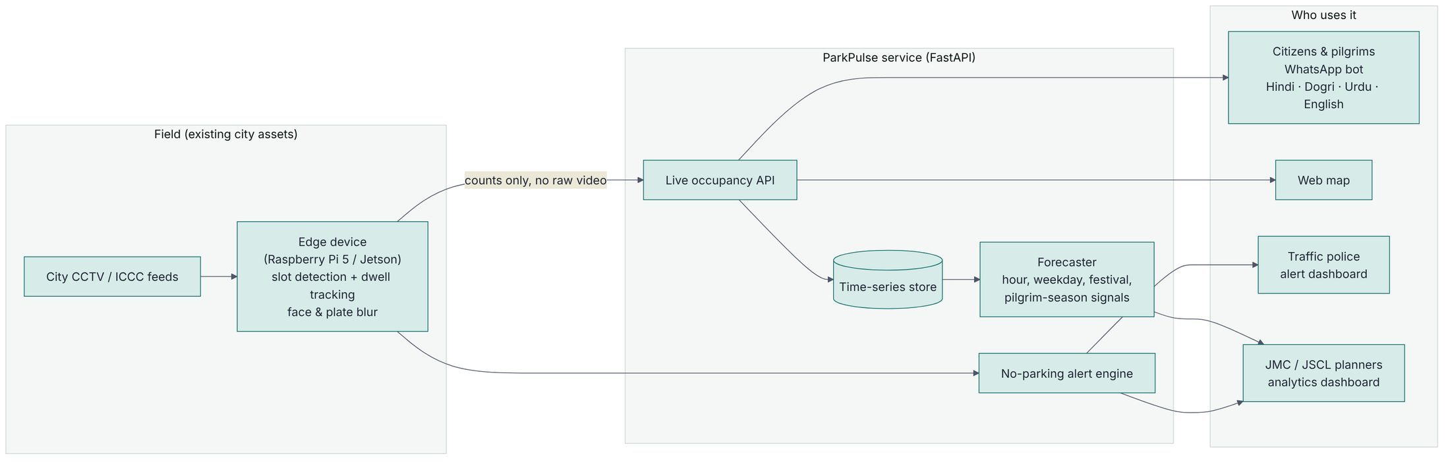



How it works
Edge, next to the camera
City service
People
Raspberry Pi 5 or Jetson Orin Nano. OpenCV slot counter by default, optional YOLO for hard angles. Faces and plates blurred on the device; only counts leave it.
Python and FastAPI keep live occupancy, run per-zone forecasts with gradient boosting and raise alerts. Ships as one Docker image.
WhatsApp Cloud API webhook, a Leaflet web map for citizens and a dashboard for officials. Works offline for demos.

Slide 5
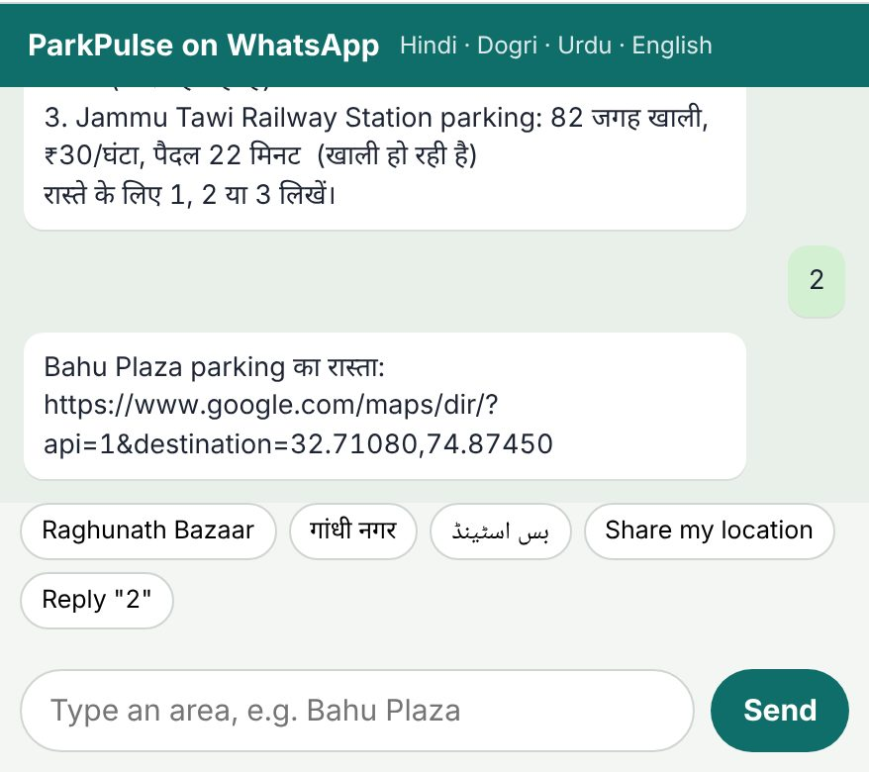
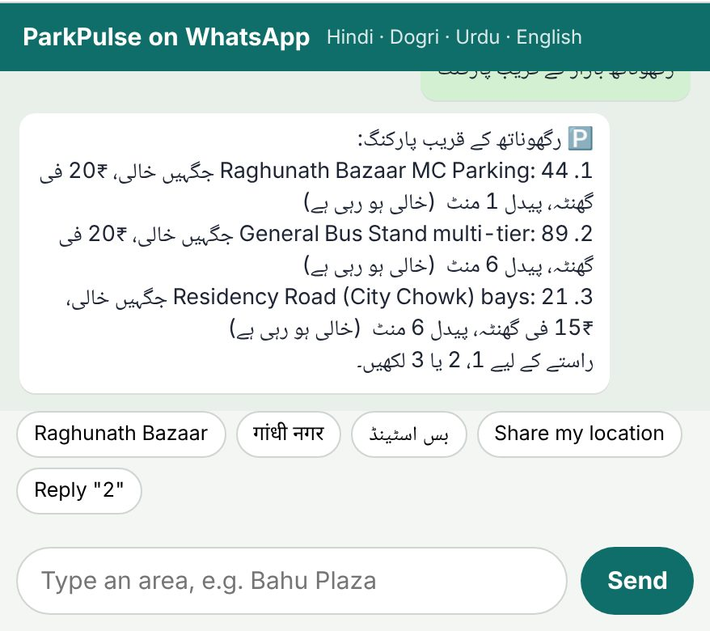
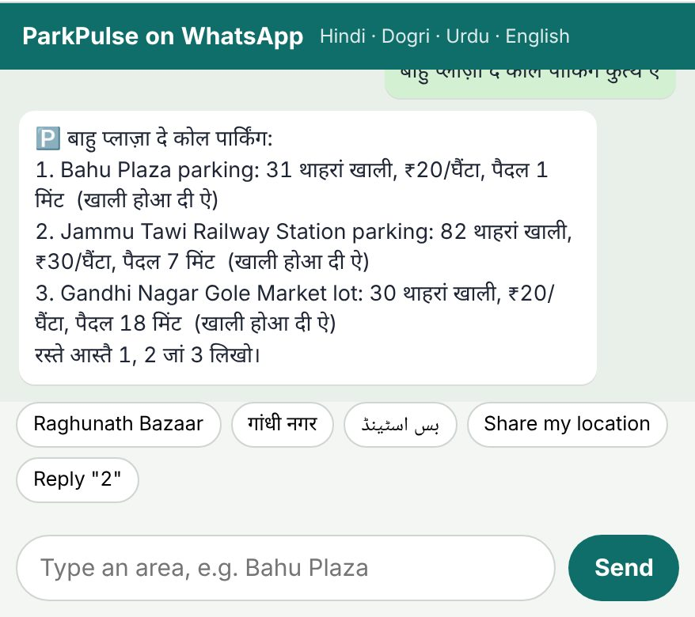
Ask in your language, get the nearest free bay
Type an area name (typos are fine) or share a location pin. The bot lists the three nearest zones with free bays, fee and walking time.
Hindi
Urdu, right to left
Dogri
Dogri and Urdu replies are a first draft and will be reviewed by native speakers before launch.

Slide 6
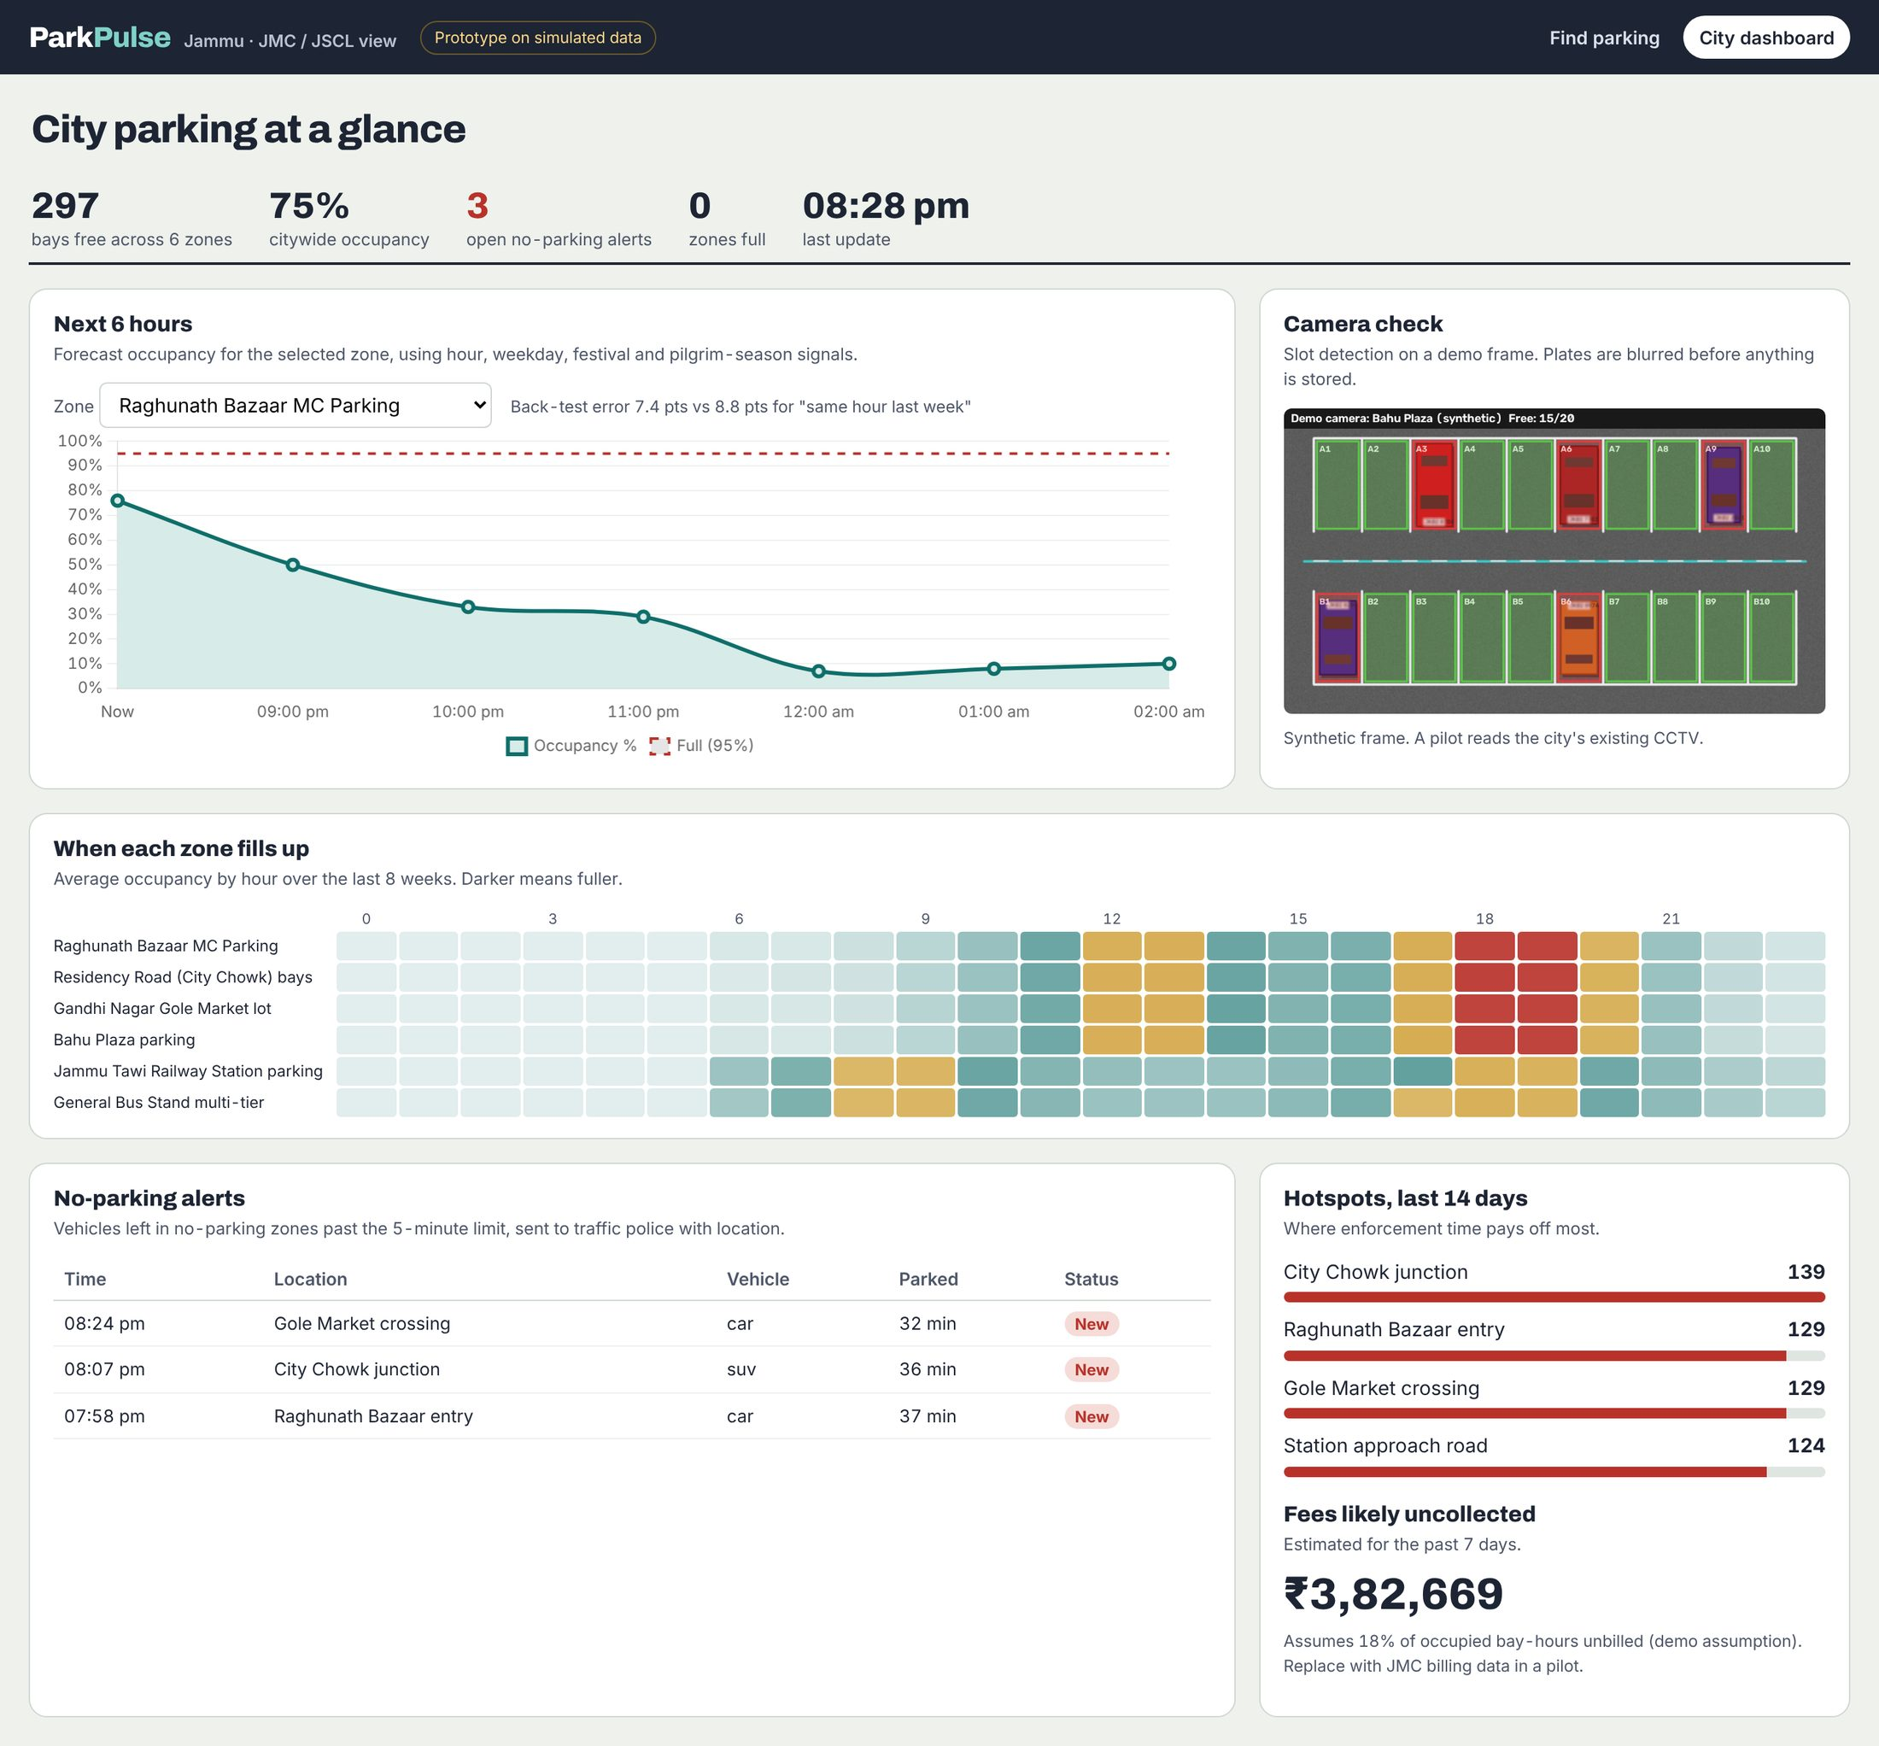
A dashboard the city can act on
Heatmap of fill by hour
Market zones fill at 12–13h and 18–19h; the bus stand and station peak at 8–9h. That is when marshals and overflow lots help most.
6-hour forecast
Warns before a zone crosses 95% full, so fees or marshals can be adjusted hours ahead.
Alerts and hotspots
Live no-parking alerts, and segments ranked by alerts over 14 days so patrols go where they matter.
Uncollected fees
An estimate of fees lost to unbilled and overstayed parking, to size the revenue case.

Slide 7
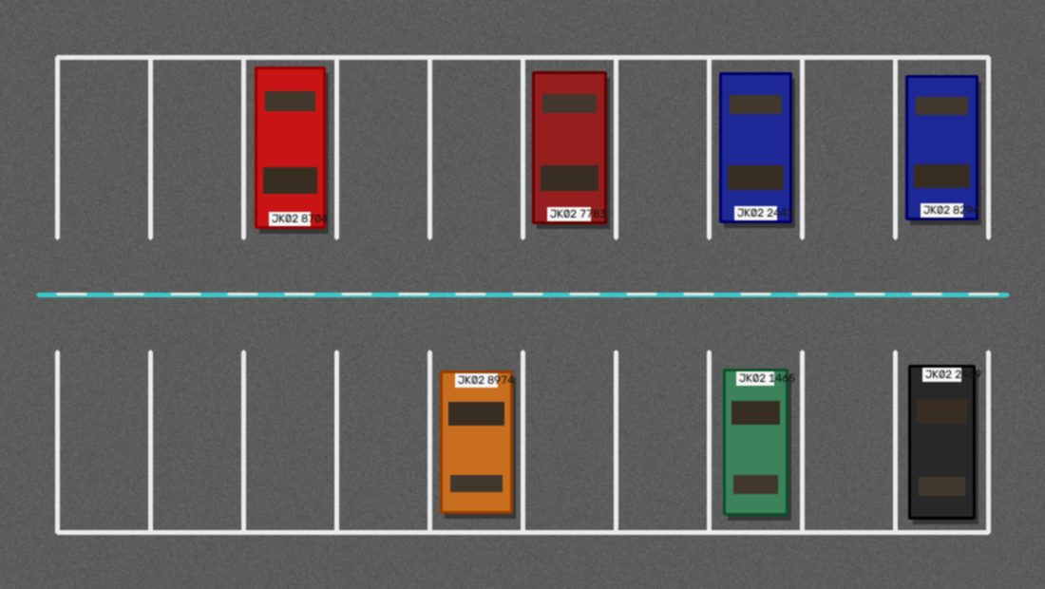

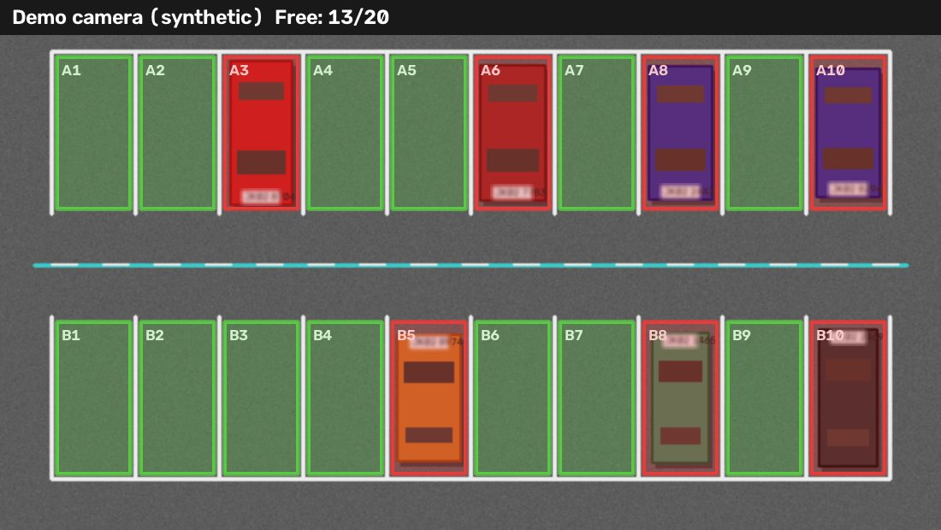
From camera frame to free-bay count, privately
1. Camera frame
2. Plates and faces blurred
3. Each bay marked free or taken
100%
89%
1 alert
Synthetic frames are easy. On Jammu CCTV we draw bay outlines per camera with the included tool, switch oblique cameras to YOLO, and use a trained Indian-plate detector before any deployment.
bays classified correctly
number plates found and blurred
per vehicle after a 5-minute no-parking stay
Measured on 50 synthetic frames (1,000 bays).

Slide 8
Forecasts beat the simple rule in all six zones
1.1–2.4
percentage points less error than the simple rule, depending on zone
Signals the model uses
Hour and weekday
Festival windows (Navratri, Diwali)
Pilgrim-season index
Same hour yesterday and last week
Back-tested on the last 7 of 8 weeks of simulated history. Real error is measured in the pilot.

Slide 9





What makes ParkPulse different
Reuses the city's cameras
WhatsApp, in local languages
Almost no new hardware, so a pilot starts in weeks, not months.
Reaches residents and pilgrims who will never install another app.
Three jobs from one system
Tuned to Jammu
Guides drivers, feeds enforcement and gives planners data at the same time.
Forecasts know market days, festivals and the Vaishno Devi pilgrim season.
Private by default
Cheap to run
Blurring on the device and counts-only uploads make it easier for a government body to adopt.
Classical vision runs on a Raspberry Pi; open-source stack, no licence fees.

Slide 10
Impact we will measure in a 12-week pilot
Targets for 2–3 high-demand zones, measured against a pre-pilot baseline. These are goals, not results.
25–30%
20–25%
15–20%
less time spent searching for parking
fewer illegal-parking incidents
more parking fee collected
Also expected
Less circling in markets, so less congestion and fewer emissions
Steadier footfall for shopkeepers; an easier first visit for pilgrims and tourists
Data for JMC and JSCL to set capacity, pricing and enforcement ward by ward

Slide 11
A single-zone pilot costs under ₹1 lakh
Item | Approx. cost
2 edge AI devices (Raspberry Pi 5 + accelerator, or Jetson Orin Nano) | ₹25,000–45,000
2–3 IP cameras with mounts (only if city feeds are not shared) | ₹10,000–18,000
4G routers and data SIMs | ₹5,000–8,000
Cloud hosting, database and maps, 3 months | ₹6,000–12,000
WhatsApp Business API messaging | ₹3,000–6,000
Power, weatherproofing, testing | ₹5,000–10,000
Total | ₹55,000–1,00,000
≈ ₹75,000
for one zone with our own cameras
≈ ₹20,000
if the city shares existing CCTV feeds
The software is already built and open source, so the money goes on hardware and running costs.
Prices are typical Indian retail estimates.

Slide 12
12 weeks from approval to a rollout decision
Weeks 1–2
Weeks 3–4
Weeks 5–8
Weeks 9–12
Pick zones
Calibrate
Go live
Measure
Choose 2–3 zones with JMC, such as Raghunath Bazaar, Residency Road and Gandhi Nagar. Get camera access or mount low-cost cameras.
Draw bay outlines, label a few hundred real frames, pick the vision backend per camera and check accuracy against manual counts.
Open the bot to a test group, route alerts to one traffic police unit, review Dogri and Urdu copy with native speakers.
Compare search time, illegal parking and fee collection with the baseline, then decide on ward-by-ward rollout.
What we need from the city
Read access to camera feeds in the pilot zones, current parking capacity and fee records, a traffic police contact for alerts, and mentorship from JSCL's command centre team.

Slide 13
Built, running, ready for Jammu's cameras
Every screen in this deck runs today. Connect two or three city camera feeds and we can measure real impact within a quarter.
Code, tests and docs
github.com/Aditya-eng/ParkPulse
Team Byte Bros

