Slide 1


SMART INDIA HACKATHON 2026
TITLE PAGE
Problem Statement ID: SIH26061
Problem Statement Title: AI-Driven Smart Energy Management System for Polar Research Stations
Theme: Clean & Green Technology
PS Category: Software
Team ID: <Team ID>
Team Name: <Team Name>
HIMSHAKTI
Fuel-survivability operating policy for Indian Antarctic stations

Slide 2
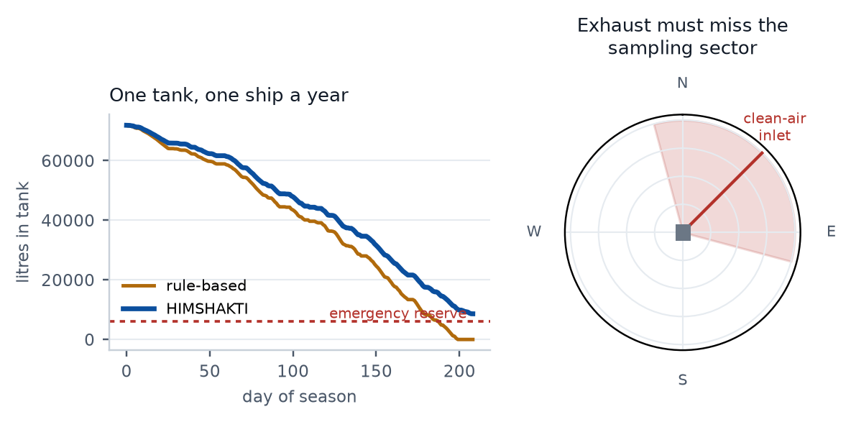
HIMSHAKTI — fuel survivability, not another dashboard
<Team Name>
Proposed Solution
• Two-level operating policy for a station with ONE fuel delivery a year
• Outer level: Monte Carlo allocator sets a daily litre allowance that holds P(critical load served to the ship) ≥ 99%
• Inner level: rolling MILP re-optimises every step inside that allowance
Detailed explanation
• Physics digital twin of Maitri/Bharati on 9 years of real ERA5 weather
• Loads built bottom-up: headcount, envelope heat loss, snow-melt water, 24x7 science
• PV modelled at 70 deg tilt with snow albedo and cold-temperature gain; wind with air-density gain
• LightGBM quantile forecasts (p10/p50/p90) for load, solar and wind, 1–48 h
• MILP commits gensets, battery, curtailment and tiered shedding on a 36 h horizon
How it addresses the problem
• Delivers all four asks of the statement: load forecasting, renewable integration, fuel optimisation, extreme conditions
• But scores them on survivability to the next ship, not on cost per kWh
Innovation and uniqueness
• Annual-resupply fuel budgeting — absent from every commercial EMS (ABB, Schneider, SMA)
• Science-integrity dispatch — generator hours priced when forecast wind carries exhaust into the station's own clean-air samplers
• Physical-availability forecasting — drifted panels and iced blades, which decorrelate from the weather forecast
Left: same weather, same station, two tanks draining. Right: the sector in which our own exhaust would corrupt our own measurements.

Slide 3
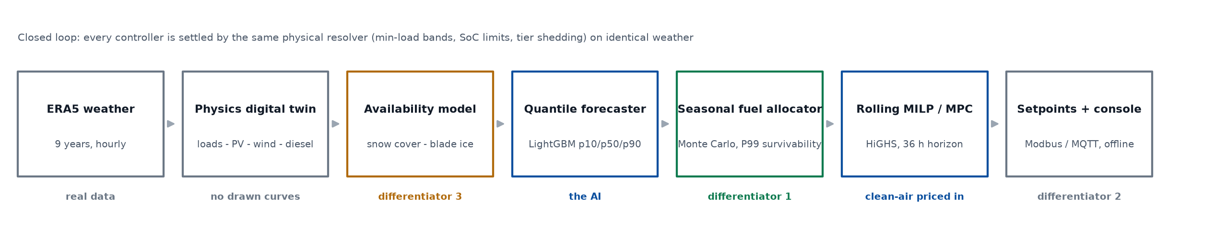
TECHNICAL APPROACH
<Team Name>
Technologies to be used
• Python · pandas · NumPy · pvlib (PV physics) · LightGBM (quantile regression)
• PuLP + HiGHS mixed-integer solver · SciPy · Parquet cache · pytest
• ERA5 reanalysis (Copernicus, via an open archive API — no credentials, cached offline)
• Offline single-file HTML console (Plotly inlined) · Modbus + MQTT setpoint interface
Methodology and process for implementation
• Closed-loop simulation of a 210-day season (2023-02-01 to 2023-08-30), re-optimised on a 36 h rolling horizon
• Four controllers on identical weather: fixed schedule, tuned rule-based, ours, perfect-foresight oracle — plus a point-forecast ablation
• Stress tests: four-day blizzard, 48 h genset failure, 12 h badly wrong forecast
Every stage is implemented and runs end to end on one command; the whole pipeline works with the network down, which is the station's real operating condition.

Slide 4
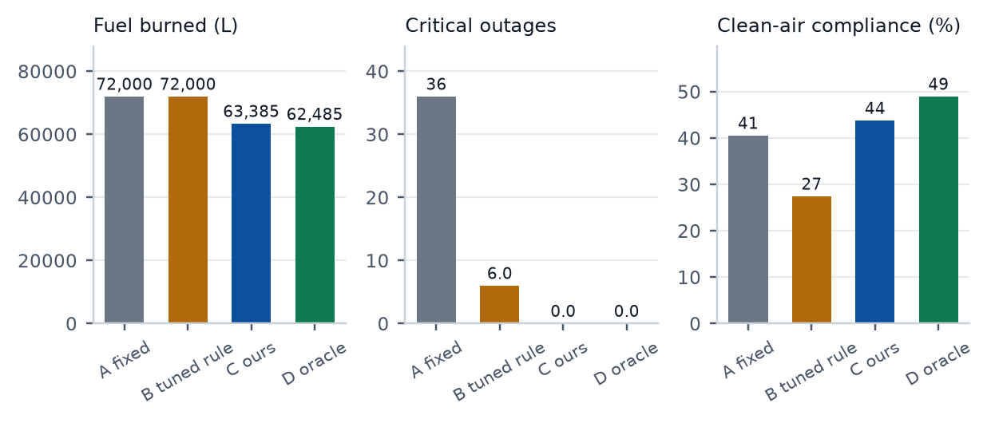
FEASIBILITY AND VIABILITY
<Team Name>
Analysis of the feasibility
• Already built and running: no hardware, no data collection, no annotation
• MILP solves in ~667 ms per step — an edge laptop is enough
• Forecast skill on an unseen year: load 2.2% MAPE, solar 12.1%, wind 20.0%
• p90 forecast band covers 89% of hours — calibrated, which is what the reserve rule consumes
Potential challenges and risks
• No public electrical-load data exists for ANY polar research station
• Maitri II generator, PV and turbine ratings are not yet published
• The team writes both the simulator and the controller
• Margin over a well-tuned rule-based controller can be modest
Strategies for overcoming these challenges
• Load synthesised bottom-up from physics, never drawn; calibrated to published Antarctic station fuel-demand shapes
• All 64 parameters carry source, confidence and a sensitivity range, shown in an Assumptions tab in the demo
• Honest baselines: a tuned rule-based controller and a perfect-foresight oracle bound
• Framed as a sizing and operating-policy explorer for Maitri II, turning the unknown ratings into the use case
Same weather, same twin. Ours closes 91% of the gap between the tuned baseline and a perfect-foresight bound, at 0 critical outages against 6.

Slide 5
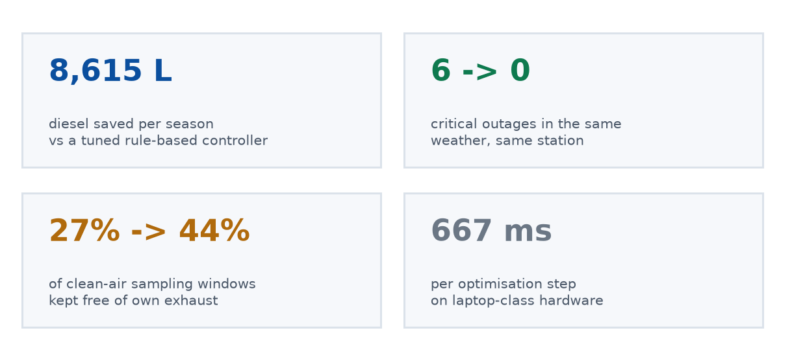
IMPACT AND BENEFITS
<Team Name>
Potential impact on the target audience
• NCPOR station engineers at Maitri and Bharati: decision support for a fatigued operator in polar night, not a replacement
• Maitri II — approved, ~Rs 2,000 crore, targeted 2029, explicitly a green station: this is an operating policy and a sizing tool for a station still on the drawing board
• Directly transferable to Himalayan, island and forward defence outposts on annual resupply
Benefits of the solution
• Economic — 8,615 L less diesel over the modelled season; fuel delivered by ice-class ship costs a multiple of its pump price
• Operational — critical outages cut from 6 to 0 on identical weather; unserved critical energy 328.4 → 0.0 kWh
• Scientific — clean-air sampling windows protected 27% → 44%, so the station's own record stays usable
• Environmental — less combustion and fewer fuel movements in an Antarctic Treaty protected area; renewables actually used 92% of what they generate
• Strategic — an Indian-built operating policy for Indian polar assets, not a licensed foreign EMS
Measured over the simulated season on identical weather; every figure is regenerated from results/run.json, never typed in.

Slide 6
RESEARCH AND REFERENCES
<Team Name>
Polar energy literature
• de Witt, Chung & Lee (2024). Mapping Renewable Energy among Antarctic Research Stations. Sustainability 16(1), 426. doi:10.3390/su16010426
• Modeling Hybrid Renewable Microgrids in Remote Northern Regions. Energies (2025) 18, 5827. doi:10.3390/en18215827
• Learning from Arctic Microgrids: cost and resiliency with hydrogen and battery storage. Sustainability (2025) 17, 5996. doi:10.3390/su17135996
• Parent & Ilinca (2011). Anti-icing and de-icing techniques for wind turbines. Cold Regions Science and Technology 65, 88–96
• MPC-based energy management for an isolated electro-thermal microgrid. Energy Conversion and Management (2024)
Data and tooling
• ERA5 reanalysis, Copernicus Climate Change Service / ECMWF — hourly, 9 years at 70.77 S, 11.73 E (Maitri, Schirmacher Oasis)
• pvlib-python for irradiance transposition and cell temperature
• HiGHS mixed-integer solver; LightGBM quantile regression
• SCAR READER, AMRC automatic weather stations, BSRN radiation — cross-checks
Station and programme sources
• NCPOR / COMNAP Antarctic Station Catalogue: Maitri (1989), Bharati (2012)
• Public reporting on Maitri II approval: ~Rs 2,000 crore, target January 2029, wind and solar powered, waste-heat recovery, unmanned data relay
• SIH 2026 portal record for SIH26061 (MoES / NCPOR, Clean & Green Technology)
Our work
• Code, tests, results and the offline console: github.com/NSUT-SIH-26/NSUT-SIH-DEMO
• One command reproduces every number on these slides from real ERA5 weather

