Slide 1
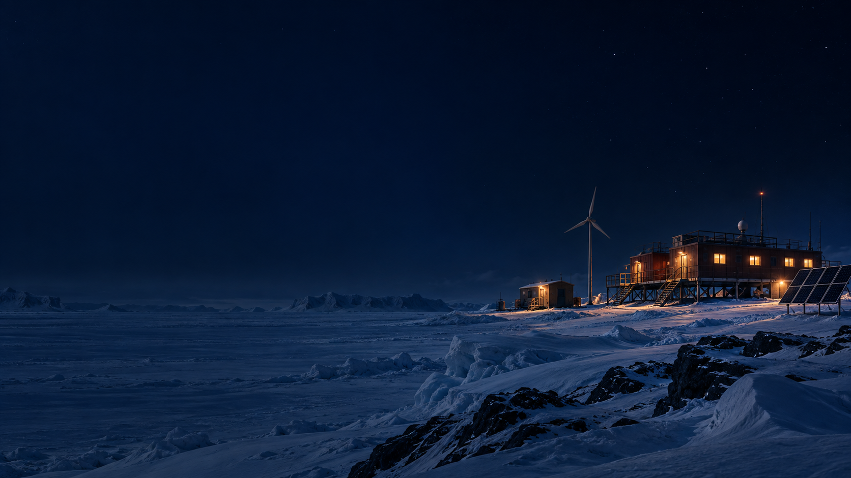
SMART INDIA HACKATHON 2026
Fuel-Survivability
Energy Management
Power planning for the polar winter
SIH26061
AI-Driven Smart Energy Management
System for Polar Research Stations
Clean & Green Technology / Software
TEAM PINK MONSTER
Concept illustration
Notes:
Opening, about 35 seconds. Our project asks a practical question: how should a polar station use a limited fuel stock while keeping critical power available through winter? We combine AI forecasts with an explainable generator and battery schedule. The prototype described in our brief is an offline simulation and planning tool. It is not a deployed station controller. PS title, ID, category and 2026 year follow the supplied SIH_HANDOFF_BRIEF_claude.md section 1. Visual: AI-generated conceptual illustration using the built-in image tool, not Maitri or a verified station design. Prompt: cinematic polar station on the right, dark navy negative space, modest hybrid equipment, no text or futuristic structures.

Slide 2
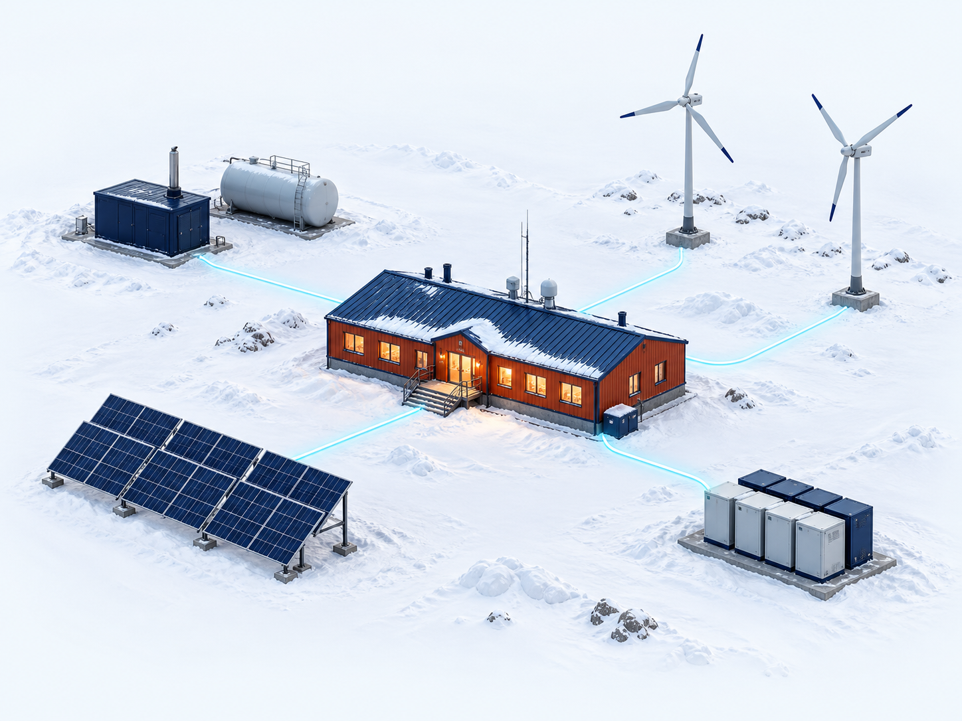
IDEA TITLE / PROPOSED SOLUTION
A daily energy plan that protects the fuel stock
One offline planner coordinates diesel, renewables and battery reserve.
01
Budget fuel until resupply
Use weather history and fuel remaining to set daily allowances. Carry unused allowance forward.
02
Forecast power actually available
Predict demand and solar/wind ranges. Reduce expected output for snow cover and icing.
03
Choose the operating schedule
Plan generator use and battery reserve. Prioritise critical loads and flag risky sampling windows.
DIESEL + FUEL WIND SOLAR BATTERY
Illustrative system layout
PINK MONSTER
02 / 06
Notes:
About 55 seconds. Solar and wind alone do not resolve a polar energy problem. The station must also manage limited fuel, snow-covered equipment and changing wind conditions. Our distinction is how those operating constraints enter the schedule together. A seasonal fuel allowance guides the next operating horizon. Availability estimates reduce expected solar and wind output when snow or icing affects equipment. A clean-air penalty discourages diesel operation during forecast contamination windows, but this is a soft preference and does not guarantee uncontaminated measurements. The operating policy prioritises science and life-safety loads under the model assumptions. Visual: AI-generated conceptual hybrid system, not actual station equipment or electrical design. Sources: supplied brief sections 2 and 7. Context: de Witt, Chung and Lee (2024), Mapping Renewable Energy among Antarctic Research Stations, https://doi.org/10.3390/su16010426 and https://repository.kopri.re.kr/handle/201206/15069. No claim of being the first system or having no competitors.

Slide 3
TECHNICAL APPROACH
A 36-hour plan, refreshed every 6 hours
01
02
03
04
Model
Forecast
Schedule
Review
Weather history
Station assumptions
Fuel and battery state
Demand and renewables
Likely values plus
uncertainty ranges
Generator operation
Battery use and reserve
Flexible load timing
Offline console
Fuel remaining
Critical-load shortfalls
AI sets the forecast range. The optimiser uses that range to size reserve.
Python / ERA5 + pvlib / LightGBM / PuLP + HiGHS / Plotly
PINK MONSTER
03 / 06
Notes:
About 60 seconds. Historical weather drives a documented station model. LightGBM forecasts electrical demand and available solar and wind output with low, central and high estimates. A wider forecast range asks the optimiser to hold more reserve. A mixed-integer optimisation model schedules generators, battery use and load priorities over 36 hours, then refreshes every 6 hours. The offline console exposes outcomes and assumptions. The seasonal allocator uses eight historical weather years to inform daily fuel allowances. The prototype uses ERA5 reanalysis with deliberately degraded forecasts, not a live weather forecast service. The controller does not see future weather truth. Source: supplied brief sections 4 through 7. Run locally after data caching and model preparation. Modbus/MQTT interfaces exist only as untested translation layers.

Slide 4
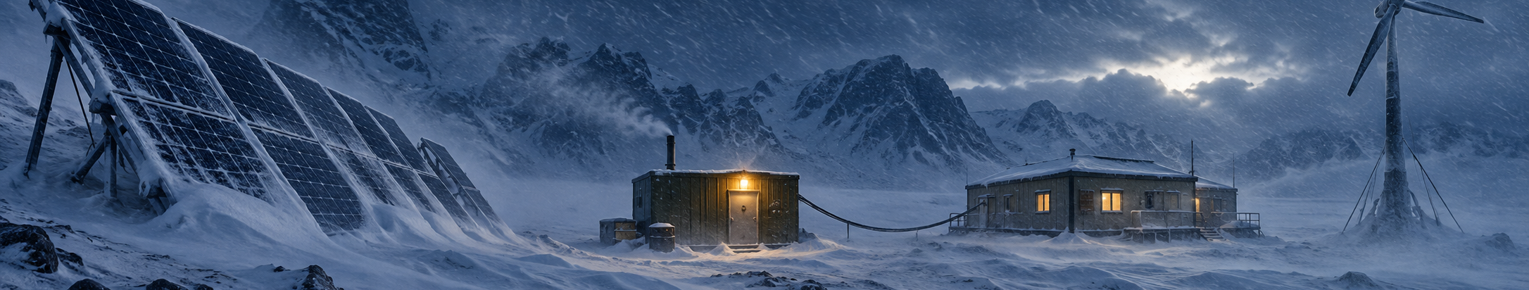
FEASIBILITY AND VIABILITY
An offline prototype for difficult conditions
Concept illustration
Snow, icing and equipment failure shape the test cases.
What we can demonstrate | What needs validation
Offline replay and controller comparison | More weather years, seeds and stress tests
Documented station and equipment model | Measured station loads and calibrated ratings
Generator and battery operating schedules | Operator review and hardware testing
PINK MONSTER
04 / 06
Notes:
About 50 seconds. The supplied brief describes a working software pipeline and offline dashboard. Our immediate demonstration scope is the seasonal replay, comparison with tuned rules and inspection of decisions. No public station load dataset was used by this project, so loads come from a physics-based model. Equipment sizes and fuel stock are design assumptions, not published Maitri II specifications. The 72,000-litre tank was deliberately set near baseline seasonal need to create a fuel-constrained test. Storm, generator-failure and forecast-bust test outcomes were pending in the brief. Before any real actuation, station-specific calibration, operator procedures and hardware-in-the-loop testing remain necessary. A 36-hour student build should focus on reproducing and validating this workflow rather than adding untested integrations. Visual: AI-generated conceptual blizzard scene, not evidence of a real station event. Source: supplied brief sections 6, 8, 10 and 12.

Slide 5
IMPACT AND BENEFITS
8,615 litres remained after the simulated season
Same 210-day test. Both controllers start with 72,000 litres.
Baseline tank depleted
Zero critical outages in this run
Brief-reported simulation. Synthetic loads, one test year and one seed. No field reliability or savings claim.
PINK MONSTER
05 / 06
Notes:
About 60 seconds. In the single 210-day 2023 simulation reported by our brief, the proposed controller consumed 63,385 litres of a 72,000-litre tank, leaving 8,615 litres. The tuned rules controller depleted its tank and experienced six critical outage events. The proposed controller recorded none in this run. We do not claim a 12 percent like-for-like fuel saving because the baseline ran out of fuel and delivered a different level of service. The tank was deliberately calibrated near the baseline seasonal requirement. Real-world fuel savings and reliability require independent validation. Quantile forecasts are also not a free efficiency gain: the point-forecast version used 63,280 litres but had one critical outage, versus 63,385 litres and zero with uncertainty-based reserve. This is suggestive evidence from one run, not statistical proof. Modelled clean-air compliance was 43.7 percent versus 27.4 percent for tuned rules, so we do not claim clean-air protection is solved. Reduced fuel consumption could reduce local combustion emissions, but no validated emissions or cost result is claimed. Source: supplied SIH_HANDOFF_BRIEF_claude.md sections 6, 8 and 10.

Slide 6
RESEARCH AND REFERENCES
Evidence behind the design
Polar operating context
de Witt, Chung & Lee (2024)
Mapping Renewable Energy among Antarctic Research Stations
doi.org/10.3390/su16010426
Weather input
ERA5 historical weather through Open-Meteo
Environmental input for the station simulation
open-meteo.com/en/docs/historical-weather-api
Methods and tools
pvlib for PV modelling, LightGBM for forecast ranges
PuLP and HiGHS for constrained scheduling
pvlib-python.readthedocs.io / lightgbm.readthedocs.io / highs.dev
Prototype evidence
Team technical brief, sections 6–10
Configuration assumptions, comparison runs and limitations
SIH_HANDOFF_BRIEF_claude.md
PINK MONSTER
06 / 06
Notes:
About 20 seconds. These sources support the operating context and modelling choices. Our simulation results come from the team brief, not from the cited literature. The next useful step is to test how sensitive those results are to load assumptions and difficult weather. We are presenting an explainable fuel-planning prototype for polar operations. References: de Witt M, Chung C, Lee J (2024), Sustainability 16(1), 426, https://doi.org/10.3390/su16010426. Primary author repository: https://repository.kopri.re.kr/handle/201206/15069. ERA5 documentation: https://cds.climate.copernicus.eu/datasets/reanalysis-era5-single-levels and https://open-meteo.com/en/docs/historical-weather-api. Software: https://pvlib-python.readthedocs.io/ , https://lightgbm.readthedocs.io/ , https://coin-or.github.io/pulp/ , https://highs.dev/ . Team evidence: supplied SIH_HANDOFF_BRIEF_claude.md, sections 6–10. Research references are contextual support, not external validation of this controller.

