Slide 2
Index
Problem Statement
Objectives
Approach
Product Functions
System Requirements

Slide 3
Problem Statement
What's the point of a strong alumni network if you have no means of communication with them.
NSUT is among the best engineering institutions of India and hence also has a great alumni network. However, there is no easy way for the alumni to participate in various activities taking place at their college after their graduation. Even the students have no means to connect with their seniors and hence are not able to avail the full benefits of the university.
Having such interactions if beneficial for both the alumni and the student. The students have access to some great employers, teachers and funders and simultaneously the alumni can find great talent at their fingertips.
After the graduation even the college loses track of their alumni's due to the change in the individuals' social credentials throughout their journey. Having this data can be quite helpful the university as well.
Both alumni and students of NSUT require a medium to do the above and aim to solve the same problem by developing a platform to promote such interactions in the community.

Slide 4
Objectives
We aim to gather all the spread-out data about our alumni and students and make a platform which helps people a part of NSUT to access the same information on a web portal in an interactive manner.
Another purpose of the platform is allowing alumni to make job/internship offers and fund various college startups on the portal.
Various college events will also be updated on the platform in case some of the graduates want to attend those events. Alumni can even send a request to conduct a session for students which they think can help them, whenever they are able to offer time.
The desired application may allow the students to interact with each other and their seniors in the forum section of the application so as to get accurate information at one place rather than dispersed inaccurate information

Slide 5
Approach
Alum is a dedicated connectivity platform designed exclusively for NSUT students and alumni, fostering various forms of engagement and interaction.
This web-based, cross-platform application allows NSUT students and alumni to register by confirming their identity through specific methods. The platform encourages interaction between students and alumni, enabling users to find fellow students and classmates. Alumni are kept informed about university events, and students gain access to job and internship opportunities from their seniors. Additionally, alumni can coordinate educational sessions for students through the platform.
Additional features comprise startup funding, sponsorships, and a discussion forum for college-related topics.
An overview of the portal's subsystems is as follows:
User Management System: Maintains a record of registered students and alumni, assisting users in finding classmates.
Post Management System: Admins can share updates on college events via the admin portal using this system.
Offer Management System: Tracks and updates alumni offers made to students.
Funds Management System: Allows students to request sponsorships and startup funding. Session Management System: Facilitates alumni in submitting requests to conduct sessions at the college.
Form Management System: Supports the creation of new posts in the forum section.

Slide 6
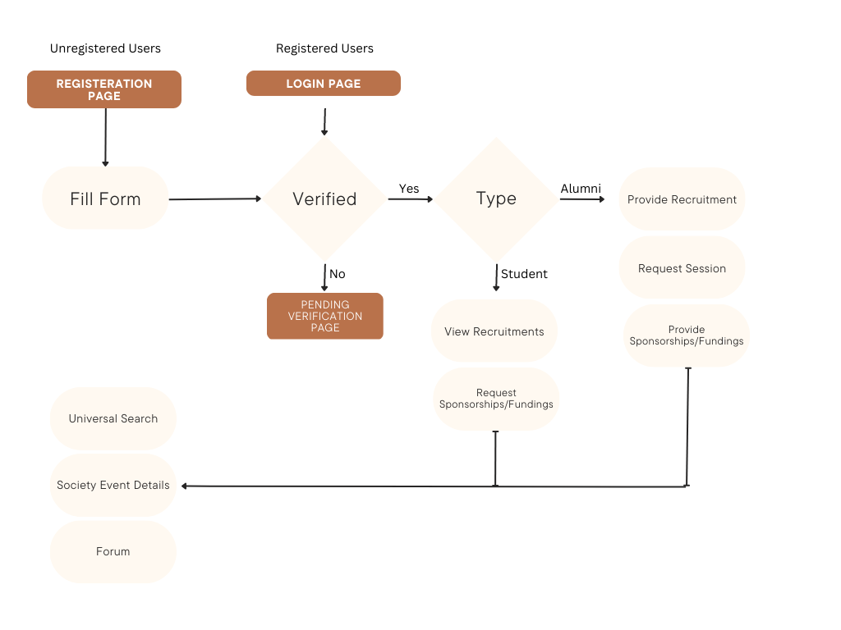
Approach
Image Management System: Provides efficient file management by updating all uploaded images to a subsection of this system, where data is compressed and saved as a base64 string.

Slide 7
Product Functions
The Alum app offers a variety of features and functionalities depending on the user's status (logged out, logged in as a student, alumni, or admin). The app structure is outlined below, reorganized, and detailed for presentation purposes:
Logged Out Users:
Home Page: A crisp introduction to the app and its usage.
About Page: Detailed information about the app.
Privacy Page: Information about the data collected by Alum and the site's security.
Login Page: Allows users to log in to their existing accounts.
Registration Page: A page for users to create new accounts.
Reset Password Page: A page for users to reset their passwords.
Logged In Users (Unverified Alumni or Student):
Pending Verification Page: Displayed until the user's account is verified.
Logged In Users (Alumni and Students):
Home Page: Showcases responses to their requests (recruitment, event, or investment) and upcoming university events.
Search Page: Users can search for registered students and alumni on the platform.
Profile Page: Displays user activity and details but does not allow editing of other users' profiles or viewing their post statuses.

Slide 8
Product Functions
Logged In Users (Alumni):
New Post Page: Alumni can create new recruitment requests or event conduction requests to the admin.
User Profile: Alumni can update their profile, view their recruitment and event requests, delete or edit requests, and check request statuses.
Editing Page: Allows users to edit recruitment and event requests.
Status Page: Displays the status of recruitment and event requests.
Event Detail Page: Offers detailed information about specific events when their respective links are clicked.
Investment Page: Allows alumni to view student or admin posts requesting sponsorships or investments for startups and events.
Logged In Users (Student):
Request Investment Page: Allows students to request investments or sponsorships for events and startups.
View Openings Page: Displays available openings posted by alumni, with details and application options.
Portfolio Upload / LinkedIn Integration: Students can upload a portfolio or link their LinkedIn profiles on the Profile page.
User Profile: Students can update their profile and view their investment requests, delete or edit requests, and check request statuses.

Slide 9
Product Functions
Logged In Users (Admin):
Requests Page: Approve or decline registration requests from students and alumni.
Event Conduction Approval Screen: Approve or decline event conduction requests by alumni.
Event Adding Screen: Add information about college events.
Sponsorship Requesting: Raise funds for major college events.

Slide 10
System Requirements
The Alum application is built using Next.js, MongoDB server, GraphQL, and hosted on Vercel, providing a seamless experience for its users. To run the web application smoothly, users require the following prerequisites:
Web Browser: Users must have a modern web browser installed, such as Google Chrome, Mozilla Firefox, Safari, or Microsoft Edge, to ensure compatibility and optimal performance.
Internet Connection: A stable internet connection is necessary for accessing the web application and its features.
Screen Resolution: For the best user experience, a minimum screen resolution of 1024x768 pixels is recommended.
JavaScript Enabled: Users should have JavaScript enabled in their web browsers, as the application relies on it for interactivity and functionality.
Cookies Enabled: Users must enable cookies in their web browsers to ensure proper authentication and session management.
By meeting these prerequisites, users can efficiently utilize the Alum web application and benefit from its features and functionalities.

