Slide 1

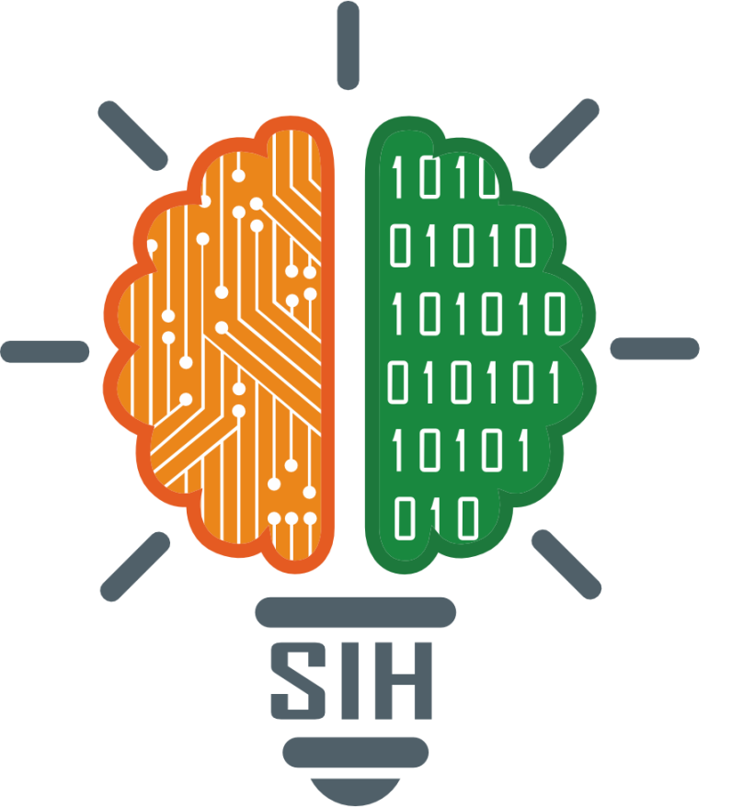
SMART INDIA HACKATHON 2025
CHAITANYA
Problem Statement ID – 25092
Problem Statement Title- Development of a Digital Mental Health and Psychological Support System for Students in Higher Education
Theme - Healthcare
PS Category- Software
Team ID-
Team Name – Chaitanya

Slide 2
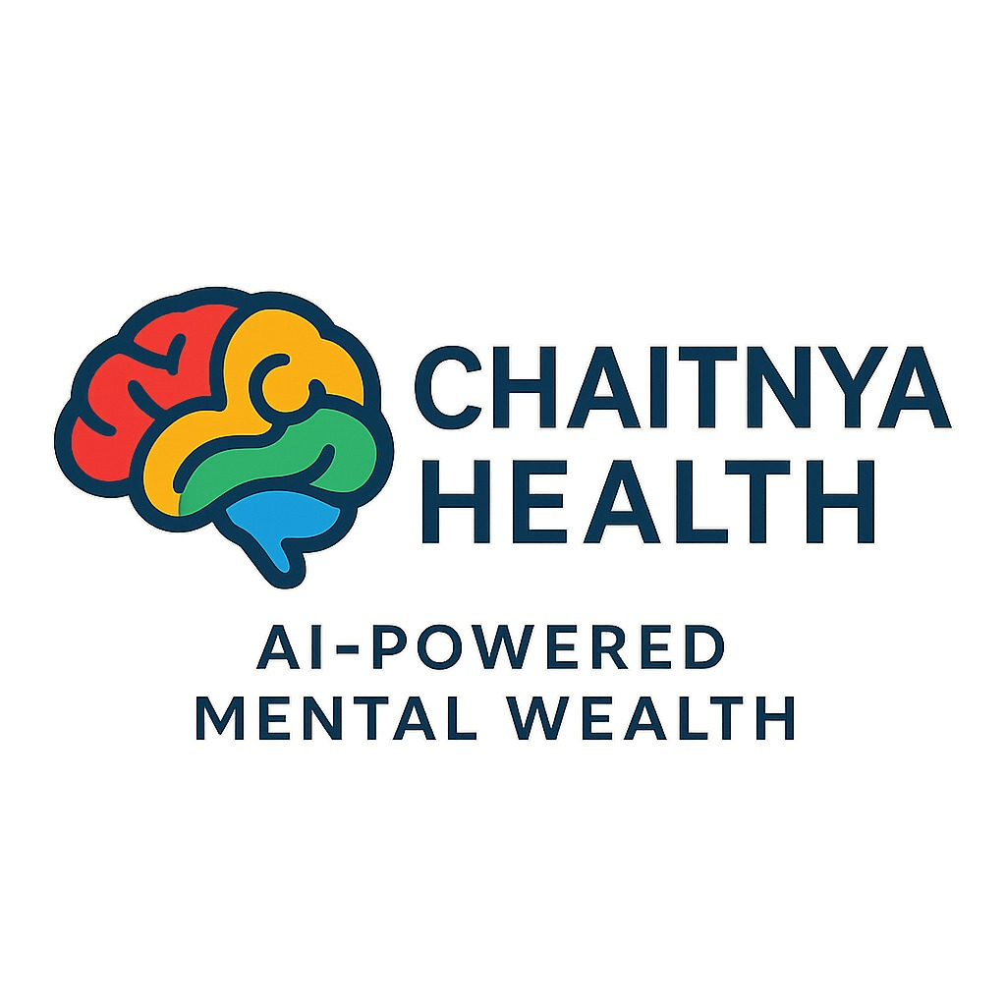
Chaitanya Health : AI-Powered Digital Mental Health Platform
Idea/Solution
Problem Resolution
Breaks the Stigma Barrier
Enables Affordable Care
Solves the Access Crisis
Chaitanya Health is a visionary web application that builds a proactive wellness ecosystem for higher education institutions, making mental health support accessible, stigma-free, and seamlessly integrated into student life .
Multi-Lingual AI Companion: Saathi (Text Agent), Vani (Voice Agent)
Marketplace of Verified Therapists: Online Sessions , Offline Sessions
Unique Value Propositions
The Institutional Dashboard
Radical Empathy by Design (Guided Audio Navigation)
Hybrid Tech :

Slide 3
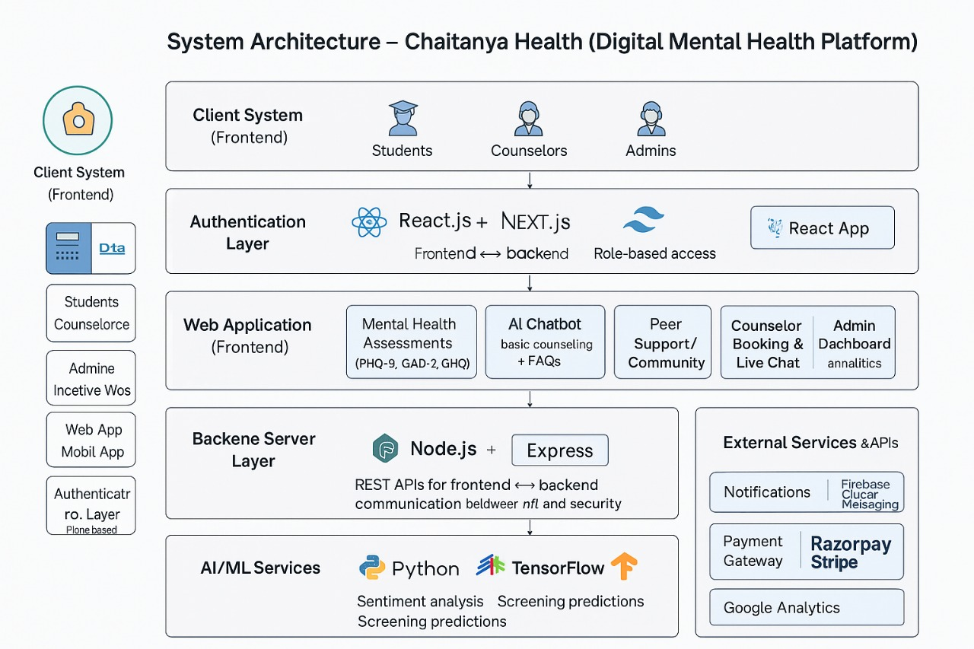
TECHNICAL APPROACH
Technologies
Frontend: React.js (for a type-safe, component-based user interface)
Backend: Node.js with Express.js (for a fast and scalable server)
Database: MongoDB (for flexible data storage and simplified database queries).
AI & ML: open ai API (for powering the multi-lingual, responsive AI Companion).
Styling: TailwindCSS (for a modern, responsive design system).
PROCESS FLOW ARCHITECTURE
Product Status: 60% product built completed and further build is on progress. Testing and validation process are next to be undergone

Slide 4
FEASIBILITY AND VIABILITY
Potential challenges and risks
User Trust & Data Privacy: Gaining user trust with highly sensitive personal health information is a major challenge. Any security breach could be catastrophic for the brand.
Therapist Vetting & Quality Control: Ensuring that all therapists on the platform are qualified and provide high-quality care is a significant operational challenge.
Feasibility
Technical Feasibility : The proposed tech stack (React, Node.js, Open API, Web socket, MongoDB) is mature, widely supported, and allows for rapid prototyping and scaling.
Market Feasibility: Post-COVID, there is a high and validated demand for digital mental health solutions for students
Strategies for overcoming these challenges
Trust & Privacy: We will implement a strict "Anonymity First" policy for the AI chat, use end-to-end encryption for all communications, and adhere to a "Zero Data Selling" policy to build user trust from day one.
Quality Control: We will implement a rigorous multi-step vetting process for all therapists, including license verification, background checks, and a video interview with our clinical team.

Slide 5
IMPACT AND BENEFITS
Potential impact on the target audience
Breaks the Stigma Barrier:
24/7 Instant Support:
Empowers with Self-Awareness:
Improves Academic Performance
Benefits of the solution
Normalizes Mental Health Conversations:
Creates a Supportive Ecosystem:
Increases Inclusivity:
Economic Benefits:
Boosts Productivity:
Contributes to National Economy:
Environmental Benefits:
Reduces Carbon Footprint:

Slide 6
RESEARCH AND REFERENCES
WHO, Suicide Rates & Youth Mental Health
https://www.who.int/india/health-topics/mental-health
Deloitte, "Mental health and well-being in the workplace" Survey
https://upstox.com/news/trending/latest-updates/india-s-workplace-stress-epidemic-a-silent-crisis-claiming-lives-and-billions/article-177871/
McKinsey Health Institute Survey (2023):
https://www.allindiansmatter.in/workplace-burnout-has-reached-epidemic-levels/
National Mental Health Survey of India (2015-16), NIMHANS:
https://ruralindiaonline.org/en/library/resource/national-mental-health-survey-of-india-2015-16-summary/

