Slide 1

Machine Learning
Topic:-​
Intrusion Detection System
Using Machine Learning

Slide 2

Asansol Engineering College
Project Mentor :
Prof. Arnab Chakraborty
Student Details :
Name - Budhaditya Mukherjee
Roll No. - 10871023018
Course - MCA
Semester - 4th (2nd Year)

Slide 3

CONTENTS
Project Objective & Scope
Data Description
Methodology
Data Preprocessing
Models Used
Accuracy Comparison
Inference
Future Scope of Improvements

Slide 4
Project Objective
Develop an Intrusion Detection System (IDS) using machine learning to enhance cybersecurity.
Detect unauthorized access and malicious activities in real-time.
Utilize anomaly detection and classification techniques for accurate threat identification.
Minimize false positives and improve detection efficiency.
Implement adaptive learning to counter evolving cyber threats.
Ensure scalability and compatibility with enterprise and cloud environments.

Slide 5
Project Scope
Data Processing – Collect, clean, and preprocess network traffic data for analysis.
Feature Selection – Identify key attributes for improving model performance.
Model Development – Train and evaluate machine learning models for intrusion detection.
Threat Detection – Implement hybrid techniques for detecting both known and unknown threats.
System Integration – Develop a real-time monitoring framework for deployment.
Performance Analysis – Assess accuracy, detection rate, and efficiency.
Scalability & Adaptability – Ensure seamless deployment and continuous learning for enhanced security.

Slide 6
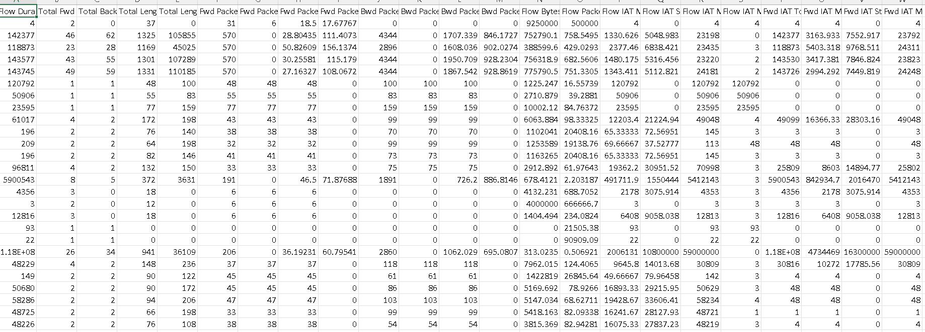
Data description
The description of the data with type and description of each Attribute is given/shown in the table. [Rows - 56662, Columns - 78]

Slide 7
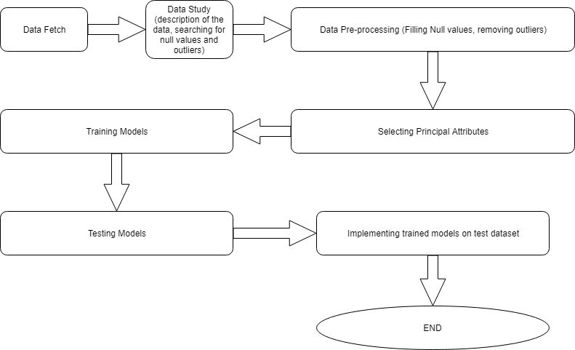
Methodology

Slide 8
Models used
The Machine Learning models used for this project are:
Regression ( Logistic )
Decision Tree
Random Forest
Support Vector Machine
K – NN Classification
Naive Bayes ( Gaussian )

Slide 9
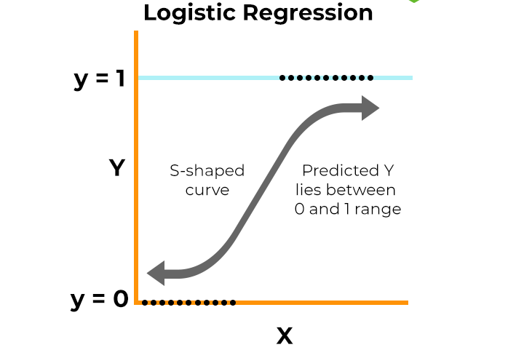
Logistic Regression
Logistic Regression is the appropriate regression analysis to conduct when the dependent variable is dichotomous (binary). Like all regression analyses, the logistic regression is a predictive analysis. Logistic regression is used to describe data and to explain the relationship between one dependent binary variable and one or more nominal, ordinal, interval or ratio level independent variables.

Slide 10
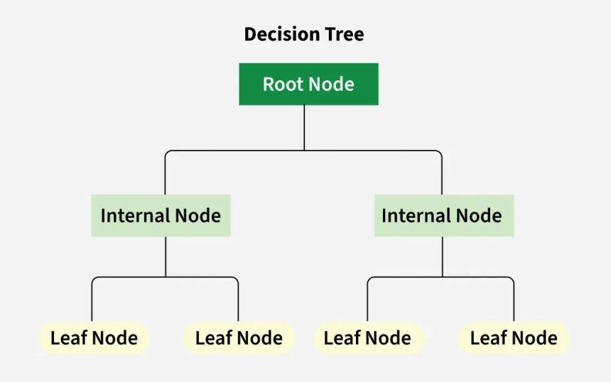
Decision Tree
A decision tree is a graphical representation of specific decision situations that are used when complex branching occurs in a structured decision process. A decision tree is a predictive model based on a branching series of Boolean tests that use specific facts to make more generalized conclusions.
The main components of a decision tree involve decision points represented by nodes, actions and specific choices from a decision point. Each rule within a decision tree is represented by tracing a series of paths from root to node to the next node and so on until an action is reached.

Slide 11
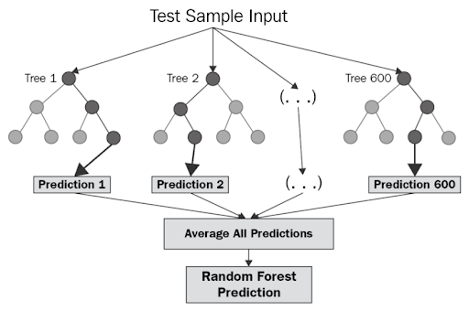
Random Forest
Random Forest is a powerful supervised machine learning algorithm used for classification and regression. It works by creating a "forest" of decision trees and aggregates their outputs to reduce overfitting and improve accuracy. This ensemble approach is robust to noise and missing data, and it provides feature importance scores for feature selection.
Random Forest is widely used in fields like finance, healthcare, and cybersecurity due to its high performance and reliability.

Slide 12
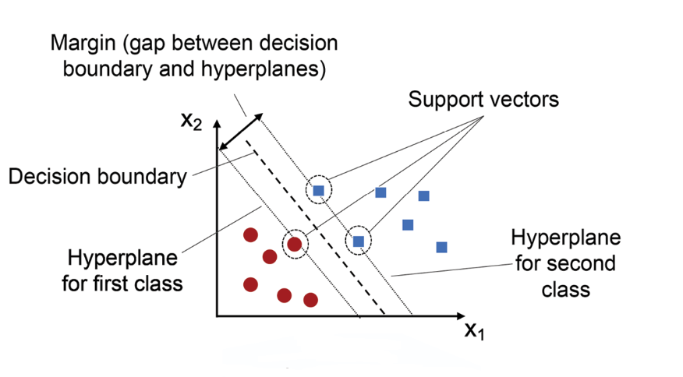
Support Vector Machine
SVM is a supervised machine learning algorithm used for classification and regression tasks. It finds the optimal hyperplane that maximizes the margin between data points, ensuring better generalization. SVM is effective in high-dimensional spaces and can handle non-linear data using kernel functions, making it widely used in applications like image recognition and intrusion detection systems.

Slide 13
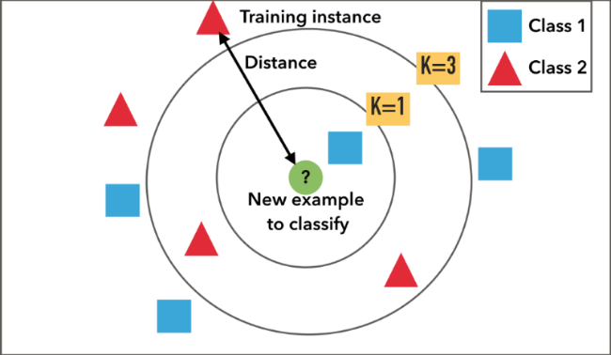
K-Nearest Neighbor
A K-Nearest-Neighbor algorithm, often abbreviated K-NN, is an approach to data classification that estimates how likely a data point is to be a member of one group or the other depending on what group the data points nearest to it are in.
The k-nearest-neighbor is an example of a "lazy learner" algorithm, meaning that it does not build a model using the training set until a query of the data set is performed.

Slide 14
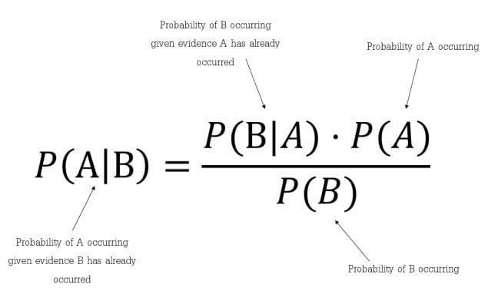
Naive Bayes
Principle of Naive Bayes Classifier :
A Naive Bayes classifier is a probabilistic machine learning model that’s used for classification task. The crux of the classifier is based on the Bayes theorem.
Bayes Theorem:
To find the probability of A happening, given that B has occurred.
Gaussian Naive Bayes:
When the predictors take up a continuous value and are not discrete, we assume that these values are sampled from a gaussian distribution.
Since the way the values are present in the dataset changes, the formula for conditional probability changes to,

Slide 15
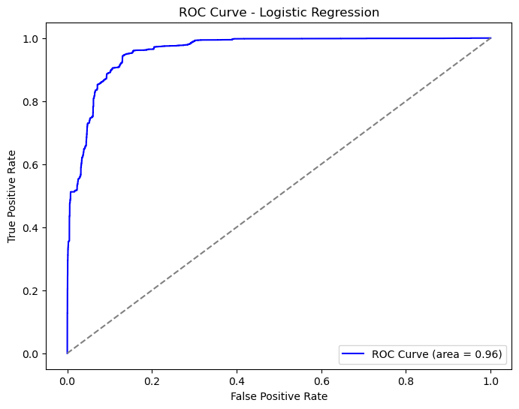
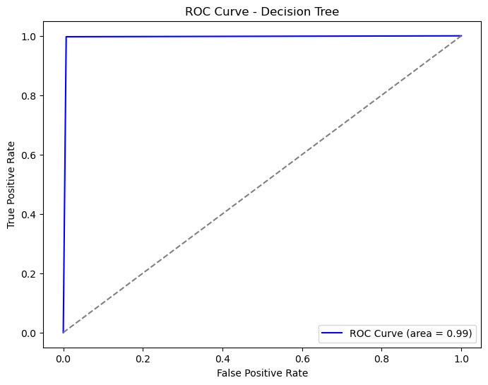
Receiver Operating characteristic curves
Logistic Regression
Decision Tree

Slide 16
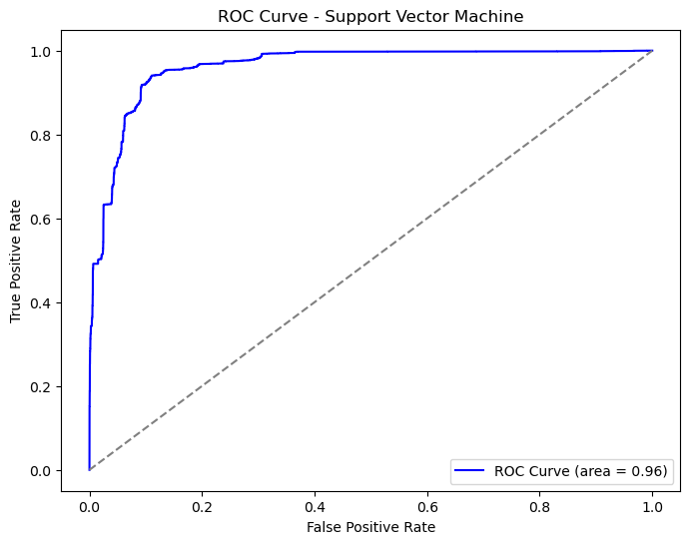
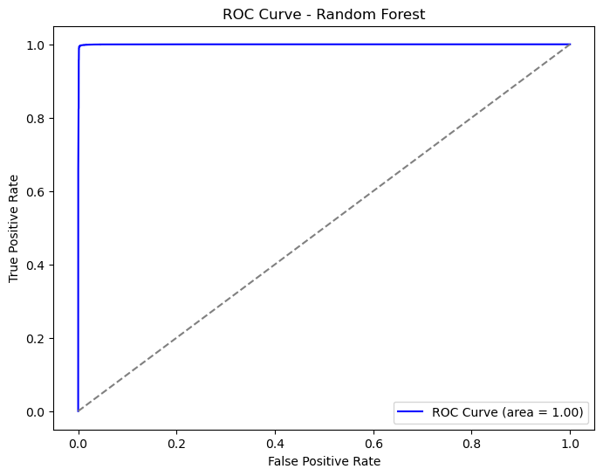
Receiver Operating characteristic curves
Support Vector Machine
Random Forest

Slide 17
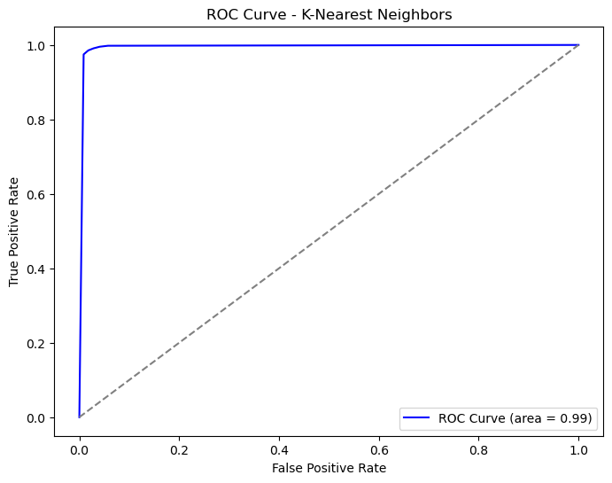
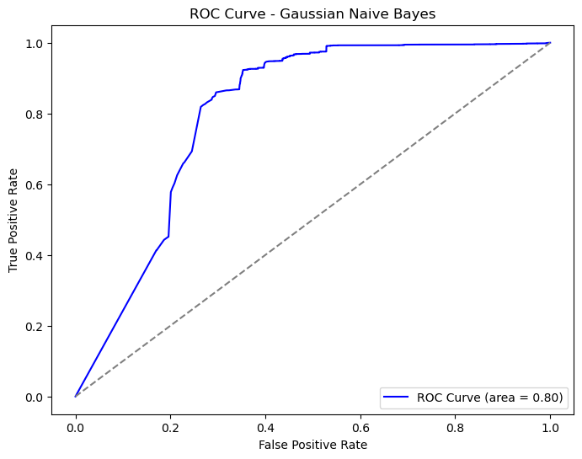
Receiver Operating characteristic curves
K-NN
Guassian Naive Bayes

Slide 18
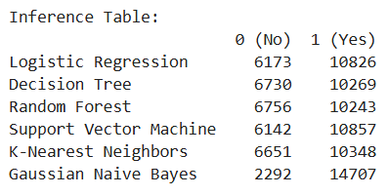
Inference
The output result of the test dataset obtained by Random Forest model is inferred to be accepted as 6756 "No" instances and 10243 "Yes" instances, totaling 16999 correct predictions..

Slide 19
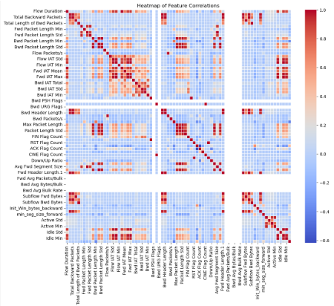
HEATMAP - Correlation matrix

Slide 20
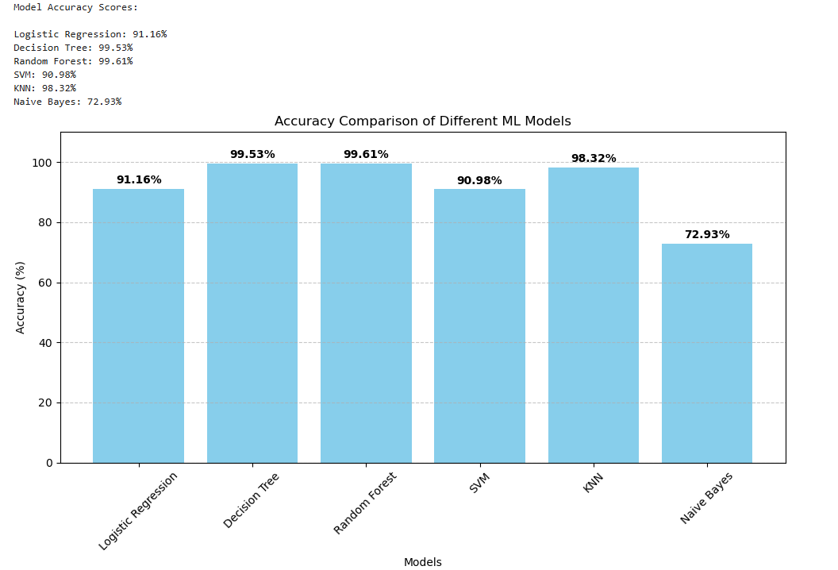
Accuracy Scores of All Models

Slide 21
Future scope of improvements
Enhance model performance through algorithm experimentation, feature engineering, and diverse training data.
Integrate automated threat response mechanisms like firewalls or intrusion prevention systems.
Develop real-time monitoring and alerting capabilities to quickly identify and mitigate potential threats.
Expand anomaly detection and behavior analysis using techniques like deep learning or unsupervised learning.
Design for scalability and deployment flexibility to handle increasing traffic and cater to diverse organizational needs.

Slide 22
THANK YOU

