Slide 1

24-783 Lecture 02

Slide 2
Command Terminal Learning Resources
macOS and Linux Terminal: http://lifehacker.com/5633909/who-needs-a-mouse-learn-to-use-the-command-line-for-almost-anything
Power Shell: https://msdn.microsoft.com/en-us/powershell/scripting/getting-started/getting-ready-to-use-windows-powershell
Windows CMD: http://www.cs.princeton.edu/courses/archive/spr05/cos126/cmd-prompt.html

Slide 3
Problem Set 01 can also be checked out from the SVN server. The location is: https://ramennoodle.me.cmu.edu/svn/teaching/24783_S19/course_files
Also, sample source files written in class will be available from: https://ramennoodle.me.cmu.edu/svn/teaching/24783_S19/course_files/lecture_sample
You will learn how to check out from the SVN server today.

Slide 4
Leftover from Lecture 1: CMake Introduction
Version-Control System – SubVersion
Compiling with other CMake Library Projects
Intro to Event-Driven Programming

Slide 5
Let’s set up CMake scripts for some programs used in 24-780 .
We will use the following CMake commands:
add_executable
add_library
target_link_libraries
target_include_directories
set
add_subdirectory

Slide 6
CMake Example – Console Application
Let’s make a small example of a console application.
Directory Structure:
high_low_game
highlow.cpp
CMakeLists.txt
build
(Build files for the platform)

Slide 7
You might feel that you are typing too many commands.
But, believe or not, once you get used to it, you won’t want to move your hand off of the keyboard home position to the mouse any more.
Even moving your thumb off the space key to the track pad is too much.

Slide 8
Running CMake from Command Line
Windows (CMD)
C:\Users\soji>pushd %USERPROFILE% (Moving to the user directory)
C:\Users\soji>mkdir 24783 (Creating a director for the course)
C:\Users\soji>cd 24783 (Moving to the new directory)
C:\Users\soji\24783>mkdir lecture01 (Creating a sub-directory for lecture01)
C:\Users\soji\24783>cd lecture01 (Moving to the new directory)
C:\Users\soji\24783\lecture01>mkdir high_low_game
C:\Users\soji\24783\lecture01>cd high_low_game
C:\Users\soji\24783\lecture01\high_low_game>echo "" >> highlow.cpp (Creating a source)
C:\Users\soji\24783\lecture01\high_low_game>devenv /edit highlow.cpp
Edit highlow.cpp
C:\Users\soji\24783\lecture01\high_low_game>echo "" >> CMakeLists.txt(Creating Cmake script)
C:\Users\soji\24783\lecture01\high_low_game>devenv /edit CMakeLists.txt
Edit CMakeLists.txt
C:\Users\soji\24783\lecture01\high_low_game>cd .. (Go up a directory)
C:\Users\soji\24783\lecture01>mkdir build (Creating a build directory)
C:\Users\soji\24783\lecture01>cd build (Moving to the build directory)
C:\Users\soji\24783\lecture01\build>cmake ..\high_low_game
C:\Users\soji\24783\lecture01\build>start Project.sln
Build a program in Visual Studio
C:\Users\soji\24783\lecture01\build>debug\highlow.exe

Slide 9
Running CMake from Command Line
macOS and Linux and Windows Power Shell
In Linux and PowerShell, use other editor such as emacs.
[~] % cd ~
[~] % mkdir 24783
[~] % cd 24783
[~/24783] % mkdir lecture01
[~/24783] % cd lecture01
[~/24783/lecture01] % mkdir high_low_game
[~/24783/lecture01] % cd high_low_game
[~/24783/lecture01/high_low_game] % echo "" >> highlow.cpp
[~/24783/lecture01/high_low_game] % open -a xcode highlow.cpp
[~/24783/lecture01/high_low_game] % echo "" >> CMakeLists.txt
[~/24783/lecture01/high_low_game] % open -a xcode CMakeLists.txt
[~/24783/lecture01/high_low_game] % cd ..
[~/24783/lecture01] % mkdir build
[~/24783/lecture01] % cd build
[~/24783/lecture01/build] % cmake ../high_low_game/ -G "Xcode"
[~/24783/lecture01/build] % open Project.xcodeproj
[~/24783/lecture01/build] % Debug/highlow
In Linux and PowerShell, you don’t need this –G option.

Slide 10
CMake Example – Console Application
High-Low Game
CMake command: add_executable
add_executable(highlow highlow.cpp)
This CMakeLists.txt generates a project that builds an execurable called highlow (highlow.exe in Windows) from a source file highlow.cpp
Project name. For an executable project, it is same as the binary name.
Source files needed for this executable. You can specify multiple files.

Slide 11
CMake Example - Library
String Parser
CMake Commands: add_library and target_link_libraries
add_library(stringParser parserClass.h parserClass.cpp)
add_library(Fgets Fgets.h Fgets.cpp)
add_executable(parserSample main.cpp)
target_link_libraries(parserSample stringParser Fgets)
A file that is created or built, such as an executable and a library is called a target.
A target corresponds to a project in IDE.

Slide 12
CMake Example – Simple Window framework
A Shooting Game
CMake command set and some CMake-controlling variables (CMAKE_CXX_STANDARD and CMAKE_CXX_STANDARD_REQUIRD)
Using variables
if statement
target_include_directories command

Slide 13
Question: What to do if I need to compile a different source code for different platform?
Solution: Identify platform in the CMake script and set up targets accordingly.
(* We do this once here just to demonstrate how to do it in CMakeLists.txt. But you won’t have to write this long CMakeLists.txt for FsSimpleWindow library for the rest of the semester because FsSimpleWindow library will be given as a CMake project.)

Slide 14
CMake Example – Simple Window framework
set(CMAKE_CXX_STANDARD 11)
set(CMAKE_CXX_STANDARD_REQUIRED ON)
if("${CMAKE_SYSTEM_NAME}" STREQUAL "WindowsStore")
message(FATAL_ERROR "This framework not supported for UWP")
elseif(MSVC)
set(LIB_SRCS
graphics/windows/fssimplewindow.cpp
graphics/windows/fssimplewindow.h
)
set(HEADER_PATH graphics/windows)
elseif(APPLE)
set(LIB_SRCS
graphics/macosx/fssimplewindow.h
graphics/macosx/fssimplewindowcpp.cpp
graphics/macosx/fssimplewindowobjc.m
)
set(HEADER_PATH graphics/macosx)
elseif(UNIX)
set(LIB_SRCS
graphics/linux/fssimplewindow.cpp
graphics/linux/fssimplewindow.h
)
set(HEADER_PATH graphics/linux)
else()
message(FATAL_ERROR "Unsupported platform")
endif()
Enable C++11 features
Check if it is for Universal Windows Platform, which FsSimpleWindow does not support.
If it is for Win32 application, set source files in variable LIB_SRCS and header path in HEADER_PATH.
If it is for Mac OSX application, set source files in variable LIB_SRCS and header path in HEADER_PATH.
If it is for Unix application, set source files in variable LIB_SRCS and header path in HEADER_PATH.

Slide 15
CMake Example – Simple Window framework (continued)
Add a library project from the files set in variable LIB_SRCS. Also specify header path in variable HEADER_PATH. By PUBLIC, this header path is also respected in the projects that link to this library. (PUBLIC ⬄ PRIVATE)
add_library(simplewindow ${LIB_SRCS})
target_include_directories(simplewindow PUBLIC ${HEADER_PATH})
if(APPLE)
find_library(COCOA_LIB Cocoa)
find_library(OPENGL_LIB OpenGL)
target_link_libraries(simplewindow ${COCOA_LIB} ${OPENGL_LIB})
elseif(UNIX)
target_link_libraries(simplewindow GL GLU X11)
endif()
add_executable(bouncing_ball MACOSX_BUNDLE main.cpp)
target_link_libraries(bouncing_ball simplewindow)
t
MACOSX_BUNDLE is needed for graphical application in macOS. This keyword is ignored in other platforms.

Slide 16
CMake Example – Sub-directories
Shooting Game
You don’t want to write one gigantic CMakeLists.txt for all of your libraries and executables.
For a practical development, the number of projects grows easily more than 100.
You can split CMakeLists.txt to multiple sub-directories.
Use add_subdirectory command, and write CMakeLists.txt for each sub-directory.

Slide 17
CMake Example – Sub-directories
Directory structure
Shootinggame
graphics
macosx
linux
windows
main
menutest
ysglfontdata
shooting_class
CMake is flexible and does not force you to make one-target per sub-directory, but it is a good practice to not create many targets in each sub-directory.
Write CMakeLists.txt for each of these sub-directories.

Slide 18
CMake Example – Sub-directories
CMakeLists.txt in the top-Level (Shootingame) directory
set(CMAKE_CXX_STANDARD 11)
set(CMAKE_CXX_STANDARD_REQUIRED ON)
add_subdirectory(graphics)
add_subdirectory(ysglfontdata)
add_subdirectory(shooting_class)
add_subdirectory(menutest)
add_subdirectory(main)
Top-Level CMakeLists.txt should have global settings and add_subdirectory commands.
It is possible to define a target if it is appropriate.
CMakeLists.txt in ysglfontdata sub-directory
add_library(ysglfontdata ysglfontdata.c ysglfontdata.h)
target_include_directories(ysglfontdata PUBLIC .)
If the header file is in the same directory as CMakeLists.txt, add “.” as the target_include_directories, so that the depending projects can find the header file.

Slide 19
CMake Example – Sub-directories
if("${CMAKE_SYSTEM_NAME}" STREQUAL "WindowsStore")
message(“FsSimpleWindow framework not supported for UWP") return()
elseif(MSVC)
set(LIB_SRCS
windows/fssimplewindow.cpp
windows/fssimplewindow.h
)
set(HEADER_PATH windows)
elseif(APPLE)
set(LIB_SRCS
macosx/fssimplewindow.h
macosx/fssimplewindowcpp.cpp
macosx/fssimplewindowobjc.m
)
set(HEADER_PATH macosx)
elseif(UNIX)
set(LIB_SRCS
linux/fssimplewindow.cpp
linux/fssimplewindow.h
)
set(HEADER_PATH linux)
else()
message(FATAL_ERROR "Unsupported platform")
endif()
add_library(simplewindow ${LIB_SRCS})
target_include_directories(simplewindow PUBLIC ${HEADER_PATH})
if(APPLE)
find_library(COCOA_LIB Cocoa)
find_library(OPENGL_LIB OpenGL)
target_link_libraries(simplewindow ${COCOA_LIB} ${OPENGL_LIB})
elseif(UNIX)
target_link_libraries(simplewindow GL GLU X11)
endif()
CMakeLists.txt in graphics sub-directory
Basically same as CMakeLists.txt for the bouncing-ball example except an executable target.

Slide 20
CMake Example – Sub-directories
CMakeLists.txt in shooting_class
add_library(shooting_game_lib shoot-3-class.cpp shoot-3-class.h)
target_include_directories(shooting_game_lib PUBLIC .)
target_link_libraries(shooting_game_lib simplewindow ysglfontdata)
You can set target_link_libraries for a library.
In this case, shooting_game_lib depends on simplewindow and ysglfontdata libraries.
Include paths of simplewindow and ysglfontdata is also transferred to the targets that depends on shooting_game_lib.
CMakeLists.txt in menutest
add_executable(menutest menutest.cpp)
target_link_libraries(menutest shooting_game_lib)
Menutest program depends on shooting_game_lib.
It automatically linkes simplewindow and ysglfontdata libraries.

Slide 21
CMake Example – Sub-directories
CMakeLists.txt in main
add_executable(main MACOSX_BUNDLE shoot-3-main.cpp)
target_link_libraries(main shooting_game_lib)
Target dependencies form a tree structure.
It is called a build tree. (Also called a dependency graph.)
main
menutest
shooting-class
simplewindow
ysglfontdata

Slide 22
CMake - Adding a new target
In a typical CMake-managed build-tree, you need to add:
A sub-directory,
CMakeLists.txt, and
Source files.
To add a new target.

Slide 23
Now CMake is in control
(Again)
DO NOT – Add Existing Item, or Add New Item from Visual Studio or XCode. This was the major confusion in the last year.
CMakeLists.txt to IDE is one way traffic. Adding files in the IDE will not automatically update CMakeLists.txt
When adding or deleting a source code, modify CMakeLists.txt and re-run cmake command.

Slide 24
Version-Controlling System
Keeps source files in the repository.
Keeps track of changes. (Solution to: Oh no! My program was working yesterday!)
Particularly useful when you are developing a program in a team.
You can use it not just for a programming project, but for anything.
Research paper
Modeling
Simulation

Slide 25
Version-Controlling System
A little bit of change of paradigm: The newest version code is (should be) kept in the repository, not in your disk drive.
You can (should be able to) check out, or update, the working copy from the repository and work from any computer.
If you mess up and lost track of what you did to the code, you can casually delete (I recommend to rename rather) the source code and re-check out and continue working.
Your working copy in the local disk drive is good for a back up copy, in case of catastrophic server failure.

Slide 26
So, what does it do?
In short, a version-control system client essentially upload/download files to/from the server.

Slide 27
Popular Version-Controlling System
CVS
Old version-controlling system. Only one person could work on the same part of the repository. (Locking/Unlocking)
SubVersion (svn)
Well tested and gets the job done.
Very simple and easy to use.
Git
More sophisticated.
Local-commit capability (Locally tracking changes before pushing it to the main repository.)

Slide 28
Setting up SubVersion
Windows
Tortois SVN https://tortoisesvn.net/
Slik SVN https://sliksvn.com/download/
Make sure to install command-line tools and set system path. (We use a lot of command line!)
Mac OSX
SVN comes with XCode Command-Line Tools.

Slide 29
Before Version Control System….
Before Version Control System, when you work on your assignment….
Work on your program until you finish.
Then submit.
While working on your assignment, you might have experienced a situation like:
Finish one requirement and tested it.
Work on the next requirement.
Suddenly, the feature for the first requirement is broken.
Cannot find why.
Delete everything and start from scratch.
because nothing is keeping track of your changes.

Slide 30
Problem without Version Control
Same problem for the industry.
When something is broke, we need to find the cause.
We need a way to compare yesterday’s and today’s version to find it.
The solution is a Version-Control System.

Slide 31
With Version-Control System
Preparation:
Make a directory for the assignment in the server.
When you work on your assignment:
Work on the problem, finish one part of the problem. (eg. finish writing a function or class. Or, even can be in the middle of writing)
Commit (=submit) your sources to the server.
Repeat 1 and 2 until you finish all of the requirements.
After submitting your final version of the assignment:
Check out your directory from the server in the different location of your computer and verify that all of your files have been submitted, and the files are up to date.

Slide 32
SVN Server for this course
Libraries that you can use (including FsSimpleWindow etc.)
git clone https://github.com/captainys/public.git
Your directory where you work on and submit your assignments.
https://ramennoodle.me.cmu.edu/svn/teaching/24783_S19/students/yourAndrewId

Slide 33
Check out libraries from the repository.
Open Terminal (Developer Command Prompt for VS2015 in Windows or Terminal in macOS or Linux)
Type the following:
PS D:\Users\soji> cd ~ <- In old Windows Command Prompt, cd /D %USERPROFILE%
PS D:\Users\soji> cd 24783
PS D:\Users\soji\24783> mkdir src
PS D:\Users\soji\24783> cd src
PS D:\Users\soji\24783\src> git clone https://github.com/captainys/public.git

Slide 34
From this week on….
When you start your assignment…
cd ~/24783/src/public
git pull
This will keep your public directory up to date. I am actively developing libraries in that directory, and you may occasionally see updates.

Slide 35
If you haven’t created your SVN account, please do so as soon as possible.

Slide 36
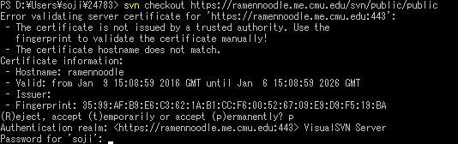
Check out your directory.
Type the following (at the same directory):
svn checkout https://ramennoodle.me.cmu.edu/svn/teaching/24783_S17/students/yourAndrewId
SVN may complain about the server certificate. Enter p for accept permanently. (Sorry, I don’t want to pay for the certificate from my pocket.)
Then type your SVN account and password.
Then, you will have the following directory structure.
(Home directory)
24783
src
public
(Bunch of files)
yourAndrewId
(You will work on your assignments by creating sub-directories here.)

Slide 37
Making a sub-directory for a new project
Let’s make a sub-directory for bouncing-ball.
SubVersion must recognize the project directory as version-controlled directory.
Two options:
Make a directory, then add to the SVN, or
cd yourAndrewId
mkdir bounce
svn add bounce
svn commit -m "Added a project directory."
Make a SVN sub-directory.
svn mkdir bounce
svn commit -m "Added a project directory."

Slide 38
Set up a project for bouncing ball
Copy bounce.cpp to the directory you have created.
Add bounce.cpp to the SubVersion’s control
svn add bounce.cpp
Write the following CMakeLists.txt.
add_executable(bounce MACOSX_BUNDLE bounce.cpp)
target_link_libraries(bounce fssimplewindow)
Add CMakeLists.txt to the SubVersion’s control
svn add CMakeLists.txt

Slide 39
Write a top-level CMakeLists.txt
Top-Level CMakeLists.txt combines projects in the public directory and your projects.
Place CMakeLists.txt of the following content in ~/24783/src
cmake_minimum_required(VERSION 3.6) set(CMAKE_CXX_STANDARD 11)
set(CMAKE_CXX_STANDARD_REQUIRED ON)
add_subdirectory(public/src)
add_subdirectory(hummingbird/bounce)
Since the top-level directory is not under SubVersion’s control, it cannot be added to the repository.
Therefore it must be simple, short, and easily re-creatable.

Slide 40
Now build and run
Windows Power Shell:
macOS (With make)
PS D:\Users\soji\24783\src> cd ~/24783 (<- In old Command Prompt, cd /D %USERPROFILE%\24783)
PS D:\Users\soji\24783> mkdir build
PS D:\Users\soji\24783> cd build
PS D:\Users\soji\24783\build> cmake ../src
Then, open Project.sln from the Visual Studio and compile and run from there, or
PS D:\Users\soji\24783\build> msbuild .\Project.sln /p:Configuration=Release /p:Platform=Win32 /target:bounce
PS D:\Users\soji\24783\build> yourAndrewId\bounce\Release\bounce.exe
cd ~/24783
mkdir build
cd build
cmake ../src
make bounce
yourAndrewId/bounce/bounce.app/Contents/MacOS/bounce

Slide 41
macOS (with XCode)
Type the following commands:
Then, in XCode, you do:
Select a scheme for the bounce program from Product -> Scheme
Compile and run
cd ~/24783
mkdir build
cd build
cmake ../src -G Xcode (<- Xcode is case sensitive, actuall everything is case sensitive in Unix)
open Project.xcodeproj

Slide 42
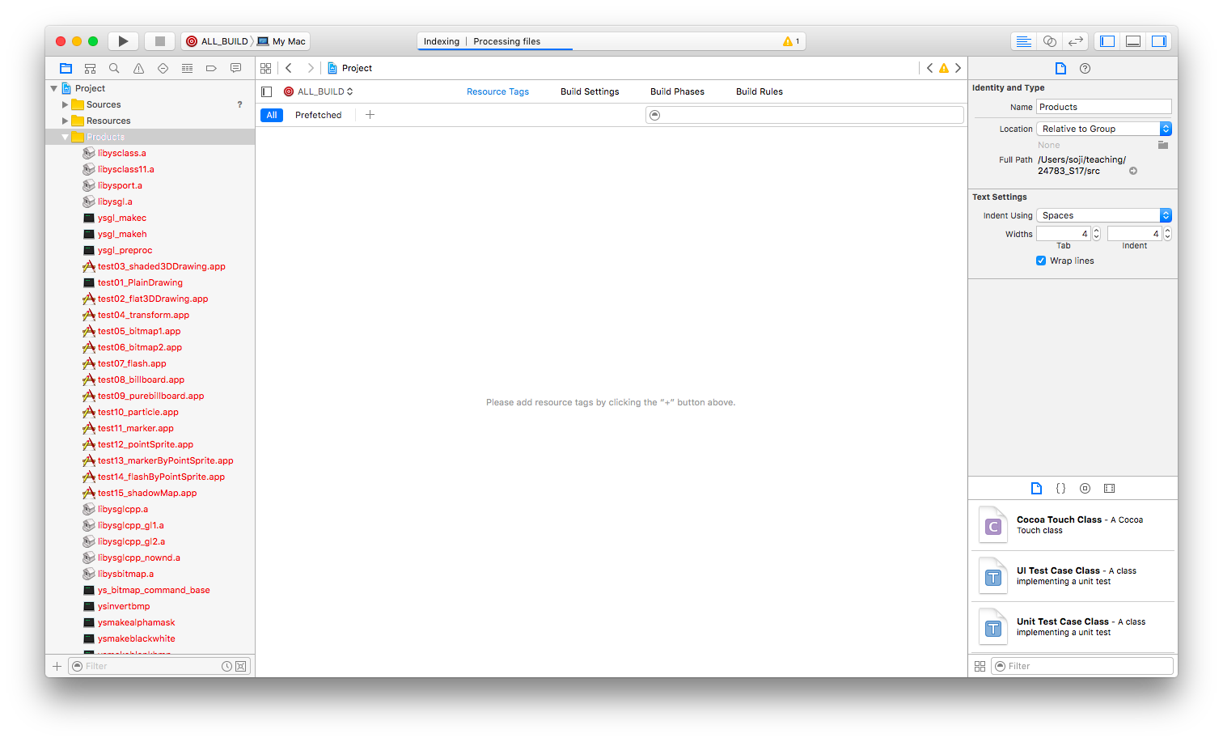
macOS (with XCode):
Open Project -> Products tab

Slide 43
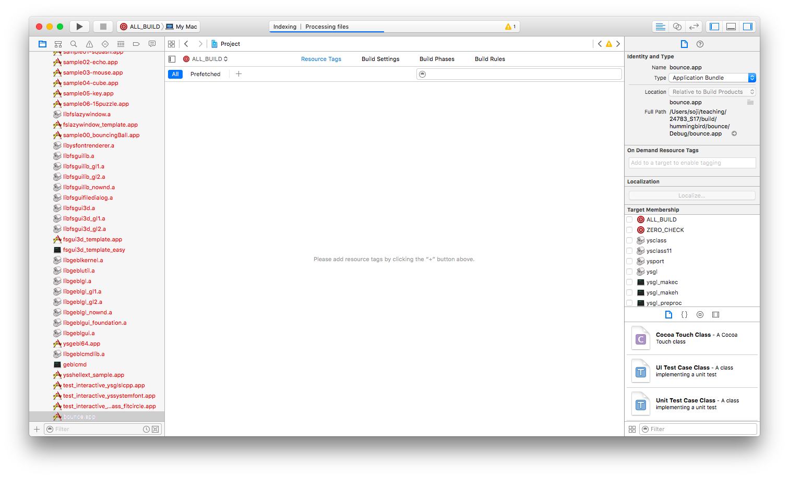
macOS (with XCode):
Scroll down to find bounce.app project

Slide 44
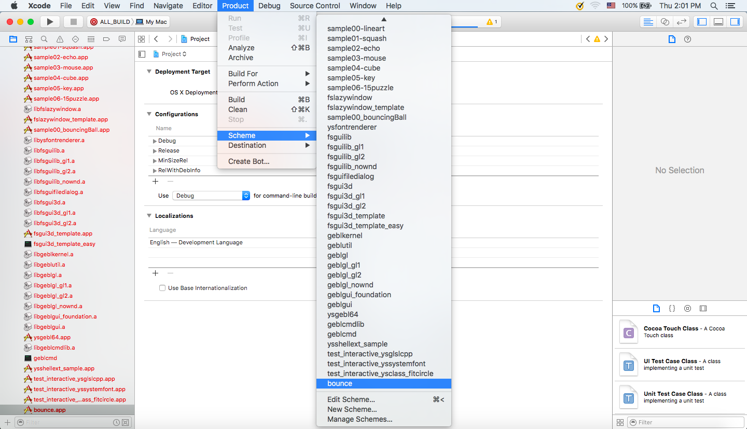
macOS (with XCode):
Select “bounce” from Product->Scheme, and then you can click on the “Play” button to compile and run.

Slide 45
Then submit your files to the repository.
You can commit files that are not for assignments as well, such as project that you create for practice.
Do:
cd ~/24783/src/yourAndrewId
svn commit -m “Submitting a practice problem.”
SubVersion command requires you to enter a commit comment. It is good to give a meaningful comment so that you can make sense of what changes you made later time.

Slide 46
Working from multiple computers
You can use SubVersion server for working on your assignment or project from multiple computers.
Follow the instructions to check out public and your repositories on all the computers that you use.
When you start working on your assignment or project, always do:
svn update ~/24783/src/public svn update ~/24783/src/yourAndrewId
After working on your project always do:
svn commit ~/24783/src/yourAndrewId -m "A meaningful comment."

Slide 47
If you mess up:
If you mess up your code and do not want to commit and rather going back to the last update, do:
svn revert ~/24783/src/yourAndrewId --depth infinity
To see changes:
cd ~/24783/src/yourAndrewId svn log

Slide 48
Want to roll back to a specific revision?
If you messed up, unnoticed, and ended up committing your changes, you can still go back to a specific revision.
First, find:
What revision you are at by typing: svn update
What revision you want to go back to by typing: svn log
Let’s say your current revision is 100 and want to go back to 90. Then,
cd ~/24783/src/yourAndrewId
svn merge -r 100:90
svn commit -m "Rolling back to revision 90.“
Oops, that’s not the revision I actually wanted to go back. Then, instead of commit, do:
svn revert . --depth infinity

Slide 49
There is no penalty for committing too often.
So, when you are working on your assignment, make a commit when you make a small (but meaningful) change.

Slide 50
Event-Driven Programming
Polling-based programming vs. Event-Driven programming
Polling-based programming
The application actively checks for the events such as key strokes, mouse movement, finger touches, etc.
The application has its own main loop.
Event-driven programming
The application stays idle most of the time.
The application can do something only when it is called from the operating system upon events.
To move something continuously, the application uses an timer or interval event.
The application must not hold on to its main loop. The event-handling function must return as soon as one step of the process is done.

Slide 51
Polling-based programming is in general easier because you control in what order the events are checked and processed.
In event-driven programming you cannot expect in what order the events are thrown at your program.

Slide 52
Motivation
Early days: Poor man’s multi-tasking (or cooperative multi-tasking)
Cooperative Multi-tasking ⬄ Pre-emptive Multi-tasking
Cooperative:
Windows 3.x
Mac OS (Before Mac OSX.)
Pre-emptive:
Unix-based systems

Slide 53
Pre-emptive multi-tasking
The operating system switches the tasks using a CPU mechanism called IRQ (Interrupt Request).
Any program runs concurrently.
A program does not have to be written in a specific format.
Cooperative multi-tasking
The program needs to hand control to the operating system so that the task can be switched to the next program.
When the program holds on to the control, the entire system froze.
Event-Driven programming is one of the programming styles for cooperative multi-tasking.

Slide 54
Now, all popular operating systems are pre-emptive operating systems.
The main purpose of the event-driven programming is not for multi-tasking, but for:
Graphical User Interface, and
Less power consumption.

Slide 55
Event Driven Programming APIs
GLUT (Cross-Platform, C/C++)
Qt (Cross-Platform, C/C++)
Cocoa (MacOSX , Objective-C/Swift)
Cocoa Touch (iOS, Objective-C/Swift)
Win32 API (Windows, C/C++, Visual Basic)
Microsoft Foundation Classes (Windows, C++)
Universal Windows Platform (Windows 10+, C++/C#)
X11 (Unix-based systems, C/C++)

Slide 56
Life Cycles of the APIs
Win32 API and MFC will probably be shut down when the majority of the Windows Apps are ported to UWP.
Objective-C code for Cocoa API will probably be unusable when Swift completely take over, which Apple seems to want to do. Swift’s inability to work with C/C++ code base (Swift can call C/C++ function, but C/C++ cannog call Swift) will be problematic then, but that Apple’s problem.
X11 is staying there, but Unix only.
Qt was started by Nokia, which was bought by Microsoft, and then dumped the project to the open-source community. Uncertain future. It is OpenGL friendly, but the library is becoming obese.
By the way, the perception that open-source projects are future proof is wrong.

Slide 57
What about GLUT?
GLUT has been staying alive quite long.
It is good for writing experimental program. Proof of concept. Etc.
The biggest advantage is simplicity.
Too primitive support of the input devices. (Can detect key-press, but not key-release. Cannot check special-key states, etc.)
Not good for real application that is shipped to the customers.

Slide 58
FsLazyWindow framework
In this course, we will use FsLazyWindow framework, which you can re-write a program written for FsSimpleWindow framework in an event-driven fashion with ‘minimum effort’
Supports iOS in addition to macOS, Linux, and Windows.
Universal Windows Platform almost supported.

Slide 59
Compiling the template application as is
Then you get a program that opens a window, and run until the user presses the ESC key.
You need to use target_link_libraries and link fslazywindow library.

