Slide 1

Secure File Vault
Project Synopsis Presentation
Date: 02/12/2025
INDUSTRIAL TRAINING (ECS591)
Degree : B.Tech (Computer Science & Engineering)-IBM
Project Guide:
Mr. Amit Kumar
Student Name:
Aditya Kumar (TCA2357004)
College of Computing Sciences & Information Technology (CCSIT)
Teerthanker Mahaveer University, Moradabad

Slide 2

Team Details
Student Name | Role
Aditya Kumar(TCA2357004) | Developer
2

Slide 3
Project Brief
The project Secure File Vault is a cybersecurity-based desktop application designed to protect sensitive user files.
It provides strong encryption, tamper detection, and secure access control using modern cryptographic techniques.
The system offers a simple and user-friendly GUI, allowing users to easily encrypt, decrypt, and verify files.
A hybrid database design enables smooth working in both online (MongoDB Atlas) and offline (Local MongoDB) environments.
The project focuses on providing confidentiality, integrity, and secure file management for personal and professional use.
It demonstrates practical implementation of AES encryption, PBKDF2 key derivation, SHA-256 hashing, and secure authentication in real-world scenarios.
3

Slide 4
Methodologies/ Technologies/ Tools to be used
AES Encryption, PBKDF2, SHA-256 Hashing
Hybrid Database: MongoDB Atlas + Local MongoDB
Secure Authentication & Session Management
Python Tkinter GUI
Python Libraries: cryptography, hashlib, pymongo
Tools: VS Code / PyCharm, MongoDB Compass, GitHub
4

Slide 5
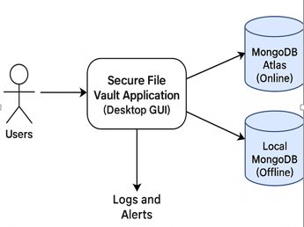
Context Diagram (Overall Project)
User interacts with the Secure File Vault Application (Desktop GUI)
Application handles file encryption, decryption & integrity check
Connects to MongoDB Atlas (Online) for cloud storage
Automatically switches to Local MongoDB (Offline) when internet is unavailable
System generates logs & alerts for all activities
5

Slide 6
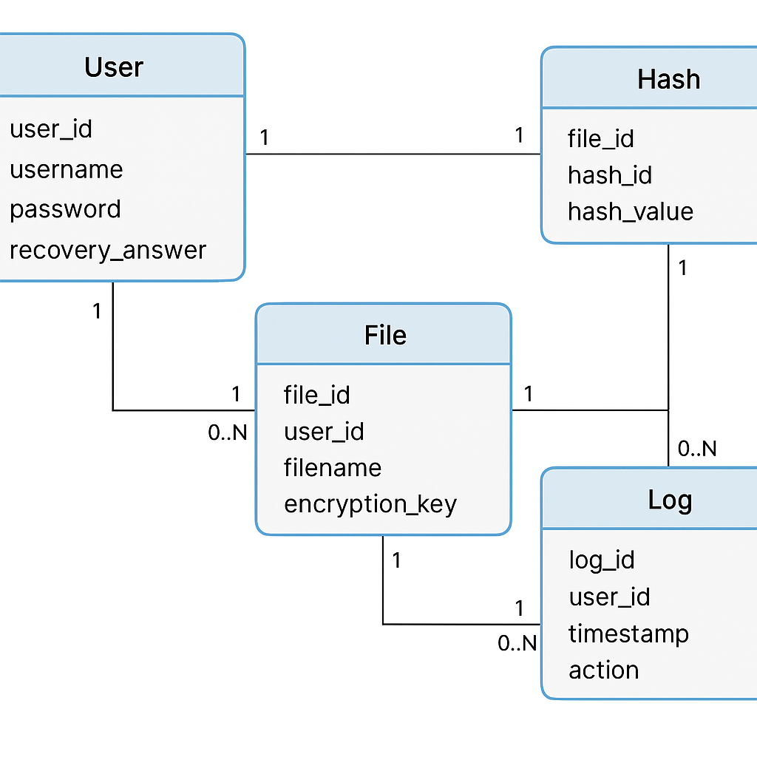
Entity Relationship Diagram (ERD)
User Entity stores user credentials and recovery details
Each User can have multiple Files stored in the vault
File Entity maintains filename, encryption info, and associated user
Each File has one Hash Entry for integrity verification
Log Entity records all user actions (login, encryption, integrity check)
Each User can have multiple Logs linked to their activities
6

Slide 7
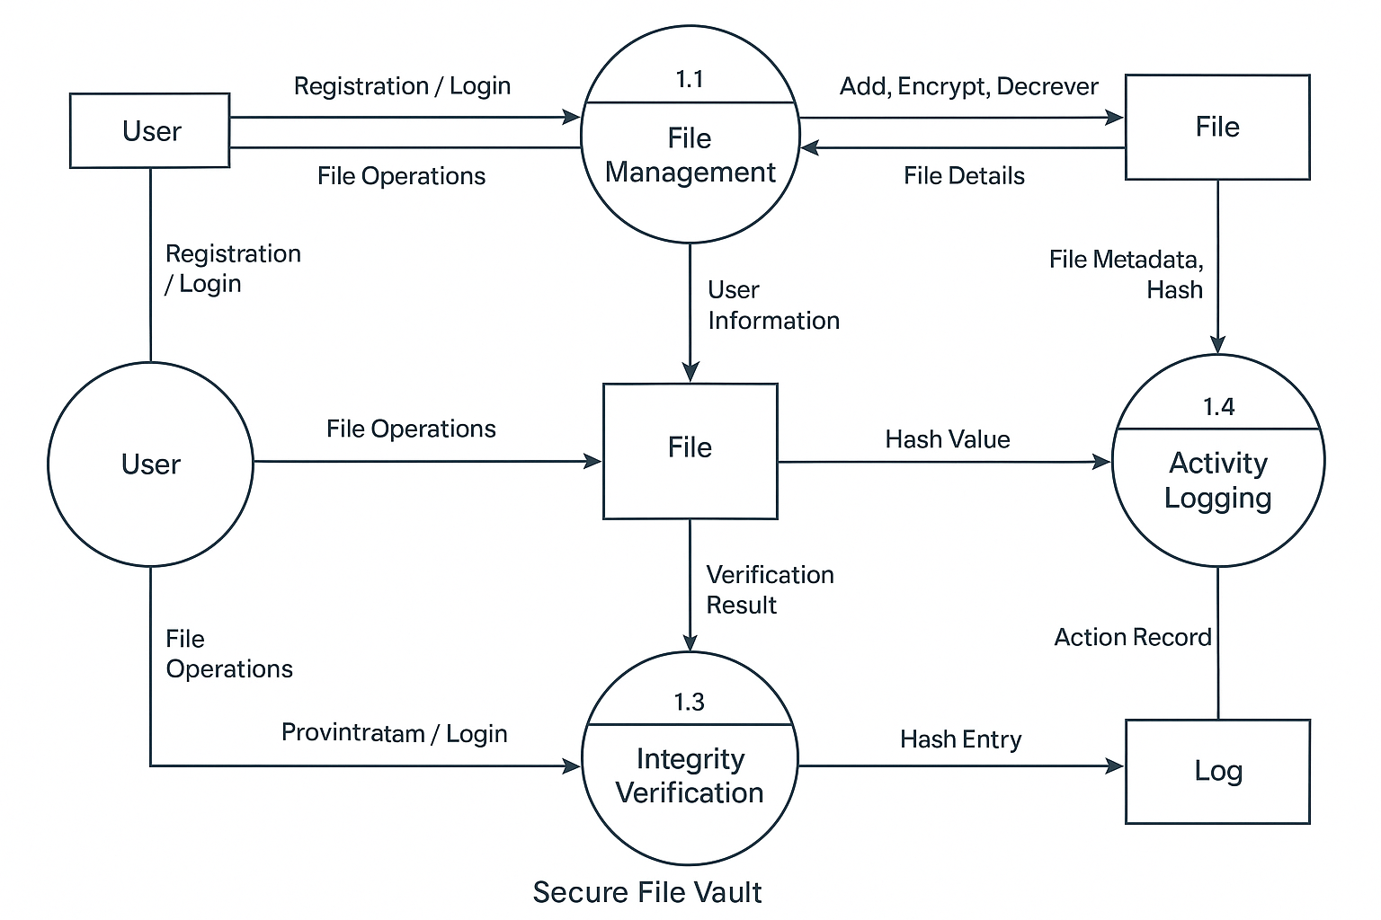
Data Flow Diagram (DFD)
7

Slide 8
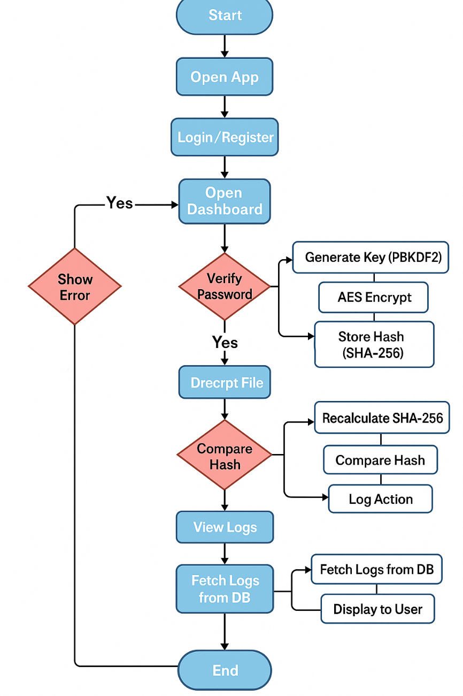
Flow Chart
8

Slide 9
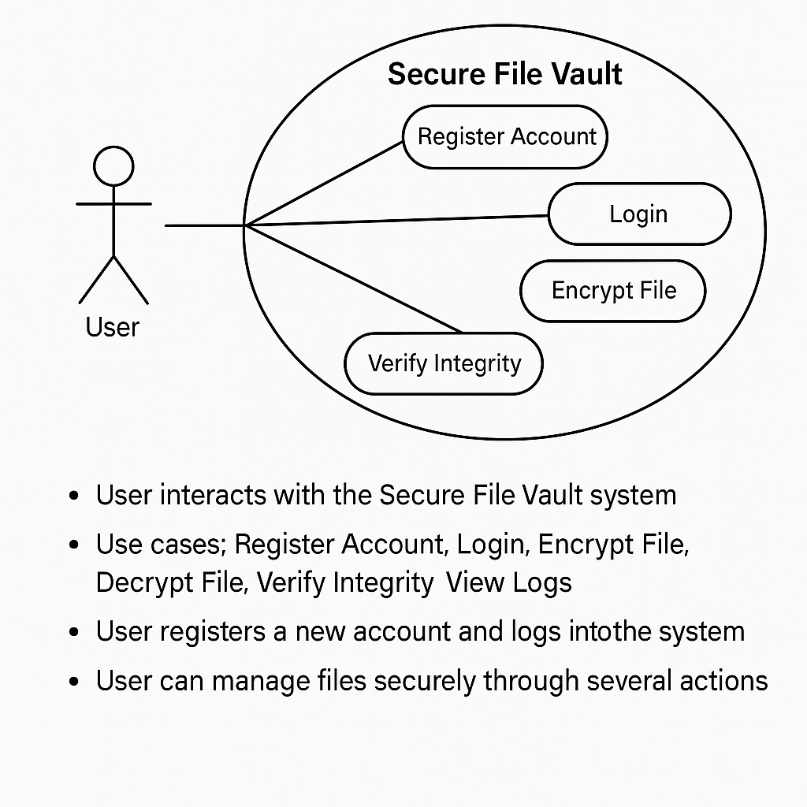
Use Case Diagram
9

Slide 10
\
Advantage of The Project
Provides strong file security through AES encryption
Ensures tamper detection using SHA-256 hashing
Works online and offline using hybrid database mode
Offers a simple and user-friendly GUI
Protects user accounts with secure authentication (PBKDF2)
Maintains full activity logs for tracking actions
Prevents misuse with auto-lock on inactivity
10

Slide 11
References, if any
Python Documentation – https://docs.python.org
MongoDB Official Documentation – https://www.mongodb.com/docs
Cryptography Library Docs (AES, PBKDF2, SHA-256) – https://cryptography.io
Tkinter GUI Reference – https://docs.python.org/3/library/tkinter.html
11

Slide 12
THANKS

