Slide 1
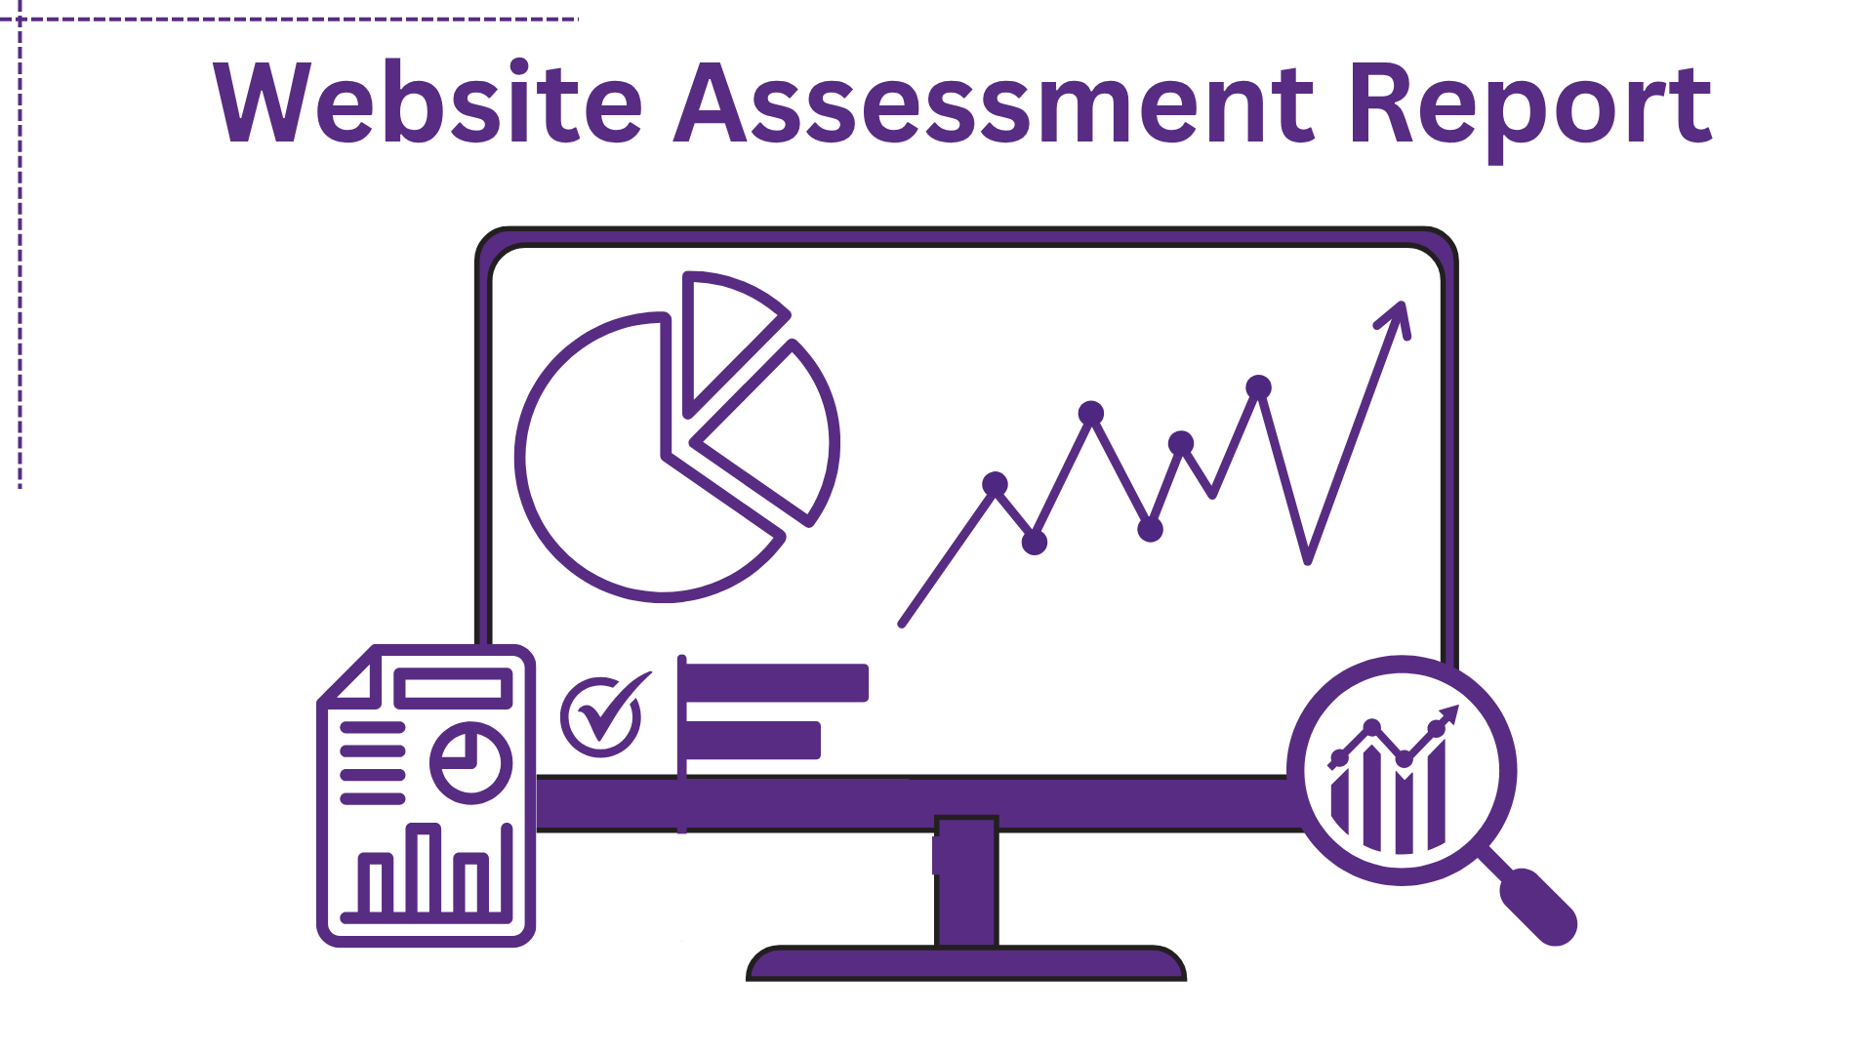

Slide 2
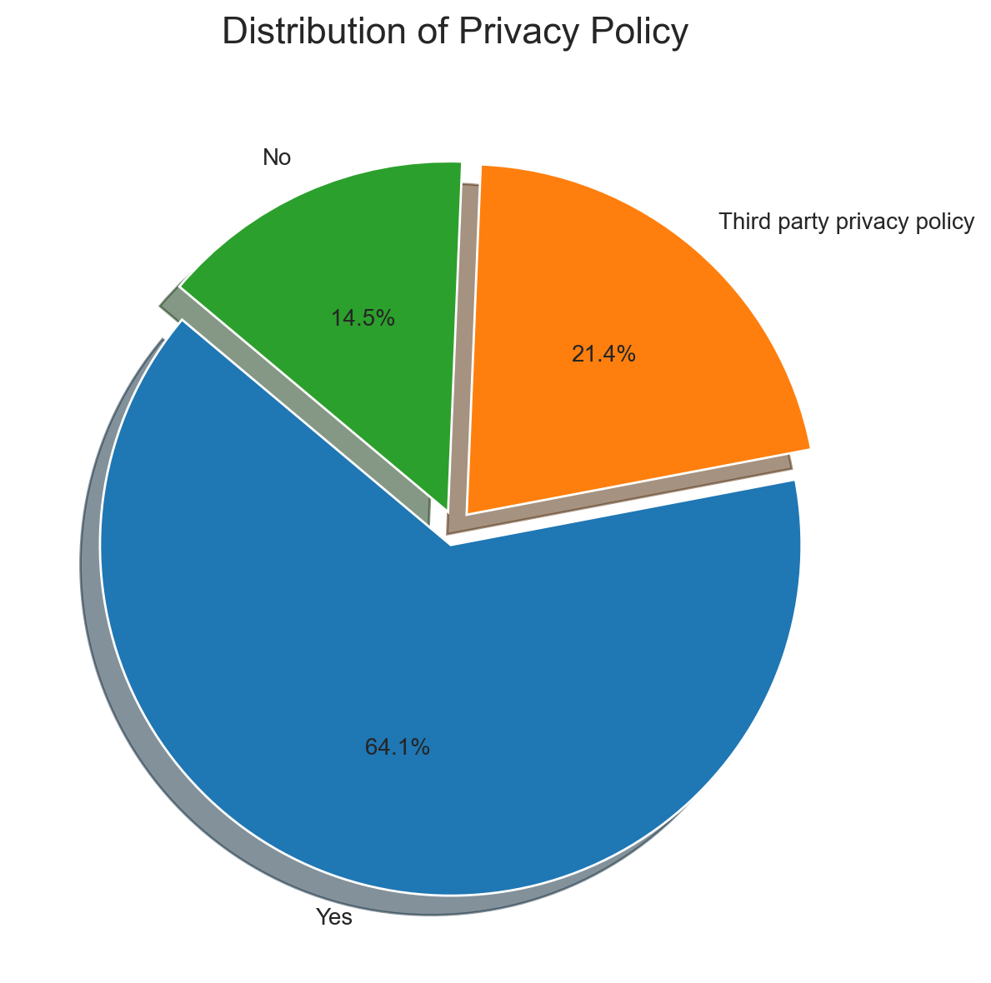
Privacy Policy Distribution
• The dataset contains 3 distinct categories across 117 records.
• The dominant category 'Yes' has 75 occurrences (64.1%).
• The distribution is skewed towards a few dominant categories.
• Category representation is highly variable.

Slide 3
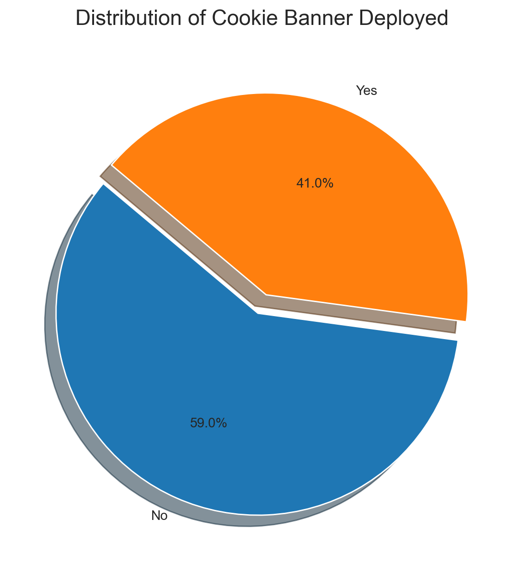
Cookie Banner Deployed Distribution
• The dataset contains 2 distinct categories across 117 records.
• The dominant category 'No' has 69 occurrences (59.0%).
• The distribution is skewed towards a few dominant categories.
• Category representation is fairly consistent.

Slide 4
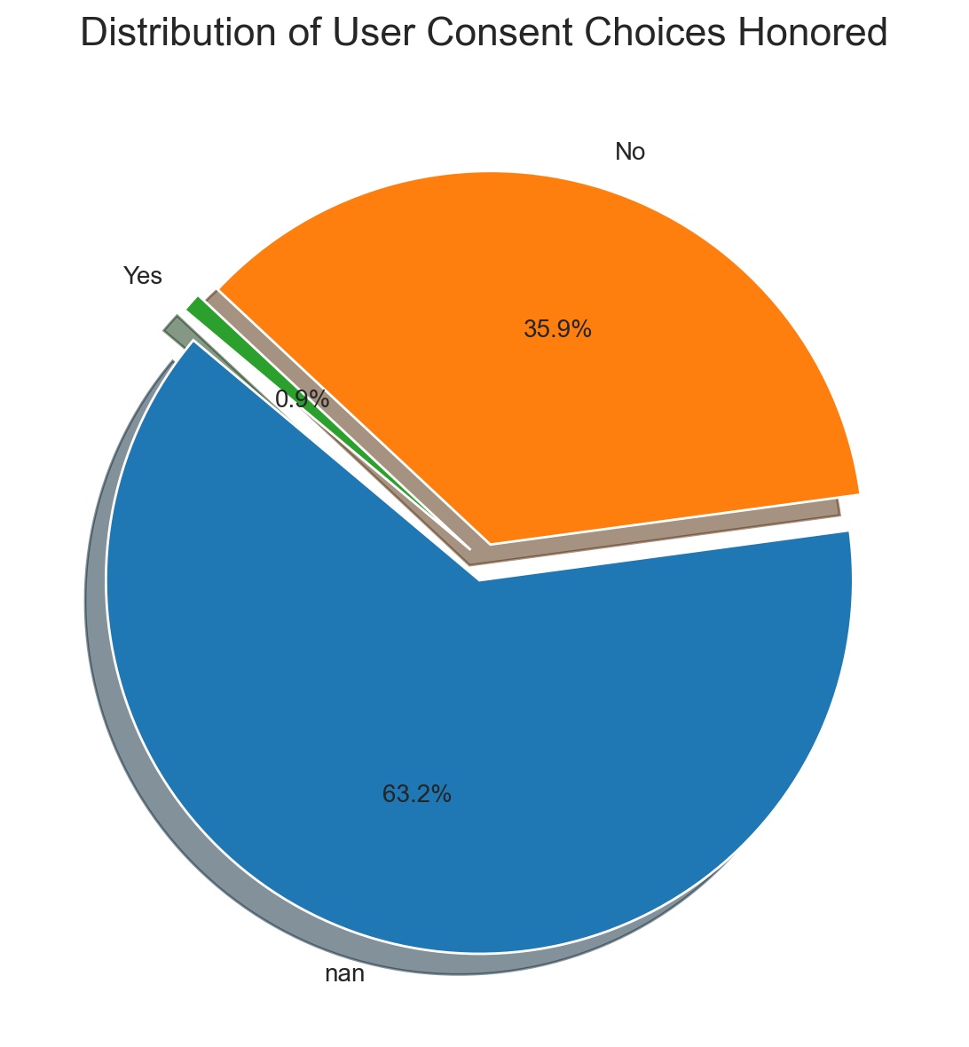
User Consent Choices Honored Distribution
• The dataset contains 3 distinct categories across 117 records.
• The dominant category 'nan' has 74 occurrences (63.2%).
• The distribution is skewed towards a few dominant categories.
• Category representation is highly variable.

Slide 5
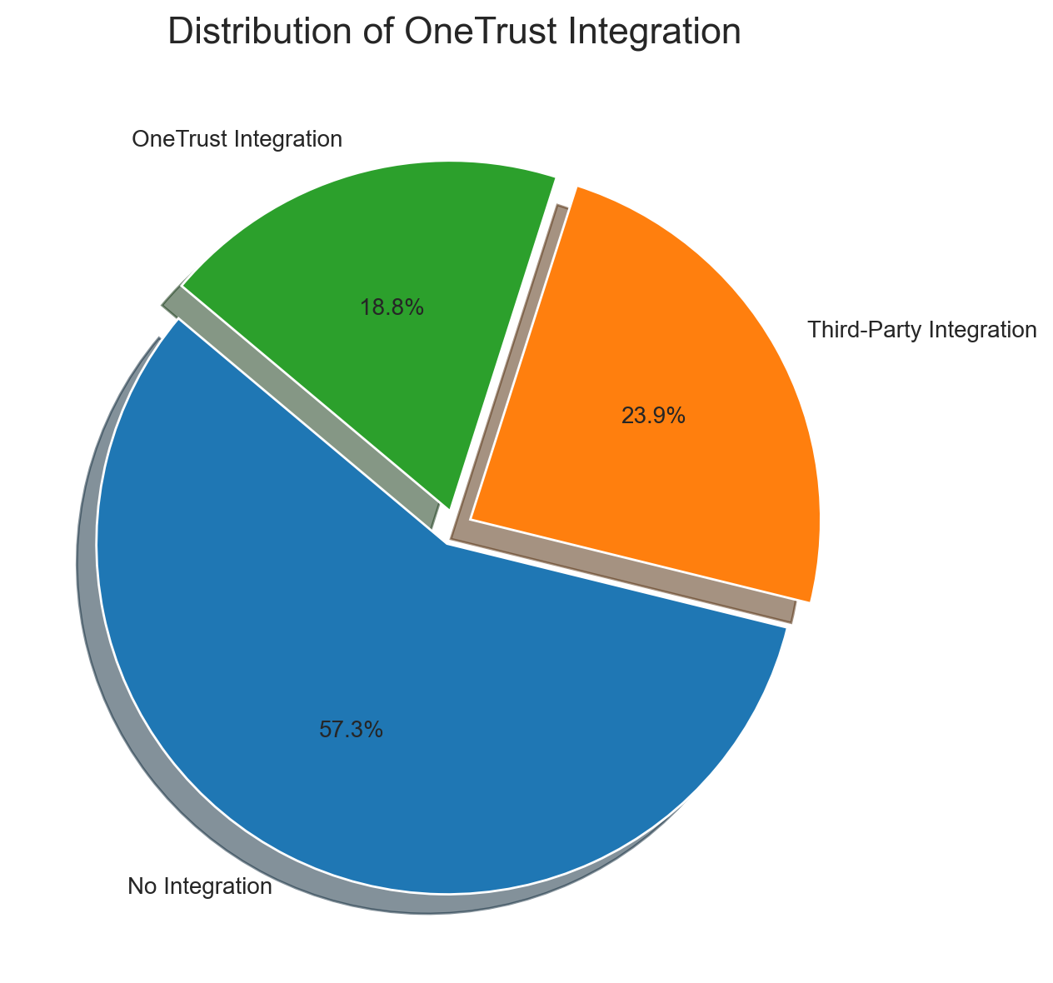
Onetrust Integration Distribution
• The dataset contains 3 distinct categories across 117 records.
• The dominant category 'No Integration' has 67 occurrences (57.3%).
• The distribution is skewed towards a few dominant categories.
• Category representation is highly variable.

Slide 6
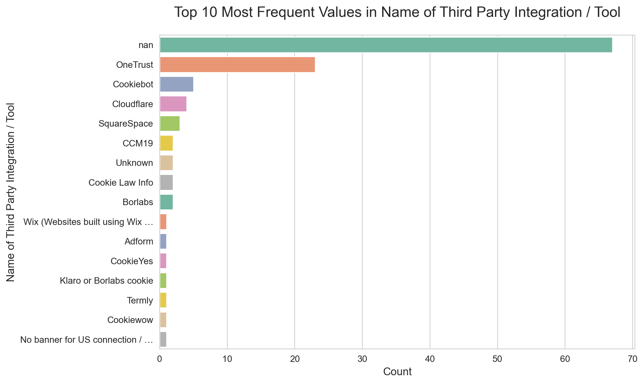
Top 10 Name Of Third Party Integration / Tool Values
• The column Name of Third Party Integration / Tool has 16 unique categories across 117 records.
• The top category 'nan' accounts for 57.3% of the data.
• The top 10 categories make up 94.9% of all entries.
• The categories are mostly focused on a few values.

Slide 7
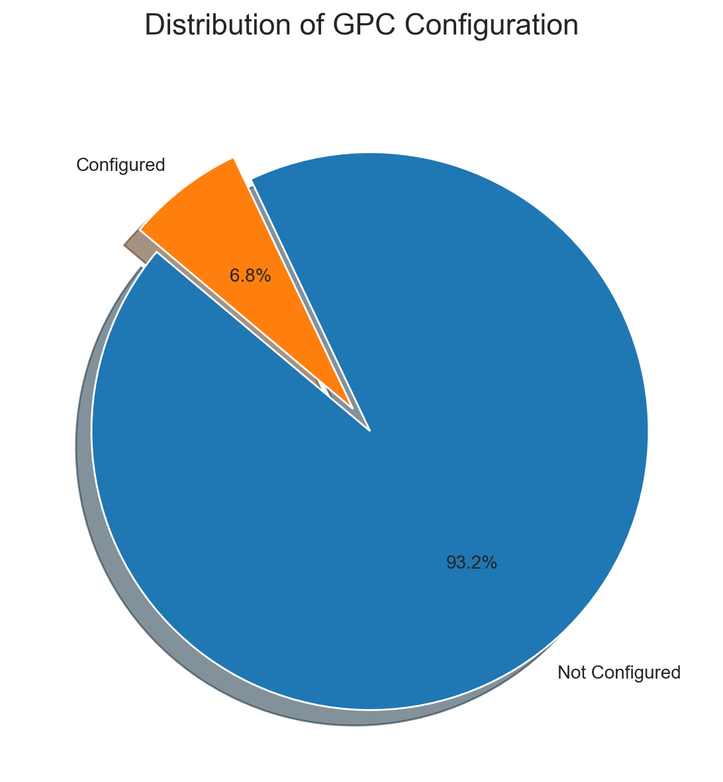
Gpc Configuration Distribution
• The dataset contains 2 distinct categories across 117 records.
• The dominant category 'Not Configured' has 109 occurrences (93.2%).
• The distribution is skewed towards a few dominant categories.
• Category representation is highly variable.

Slide 8
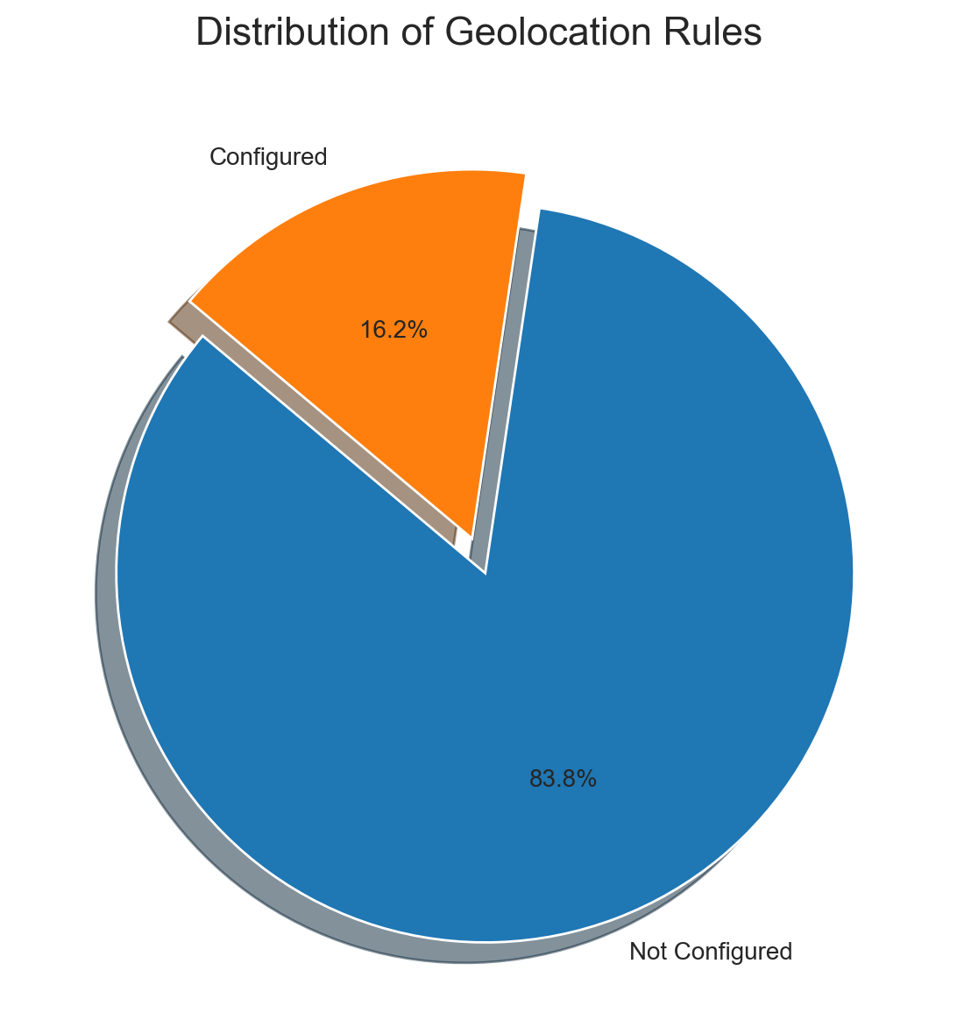
Geolocation Rules Distribution
• The dataset contains 2 distinct categories across 117 records.
• The dominant category 'Not Configured' has 98 occurrences (83.8%).
• The distribution is skewed towards a few dominant categories.
• Category representation is highly variable.

Slide 9
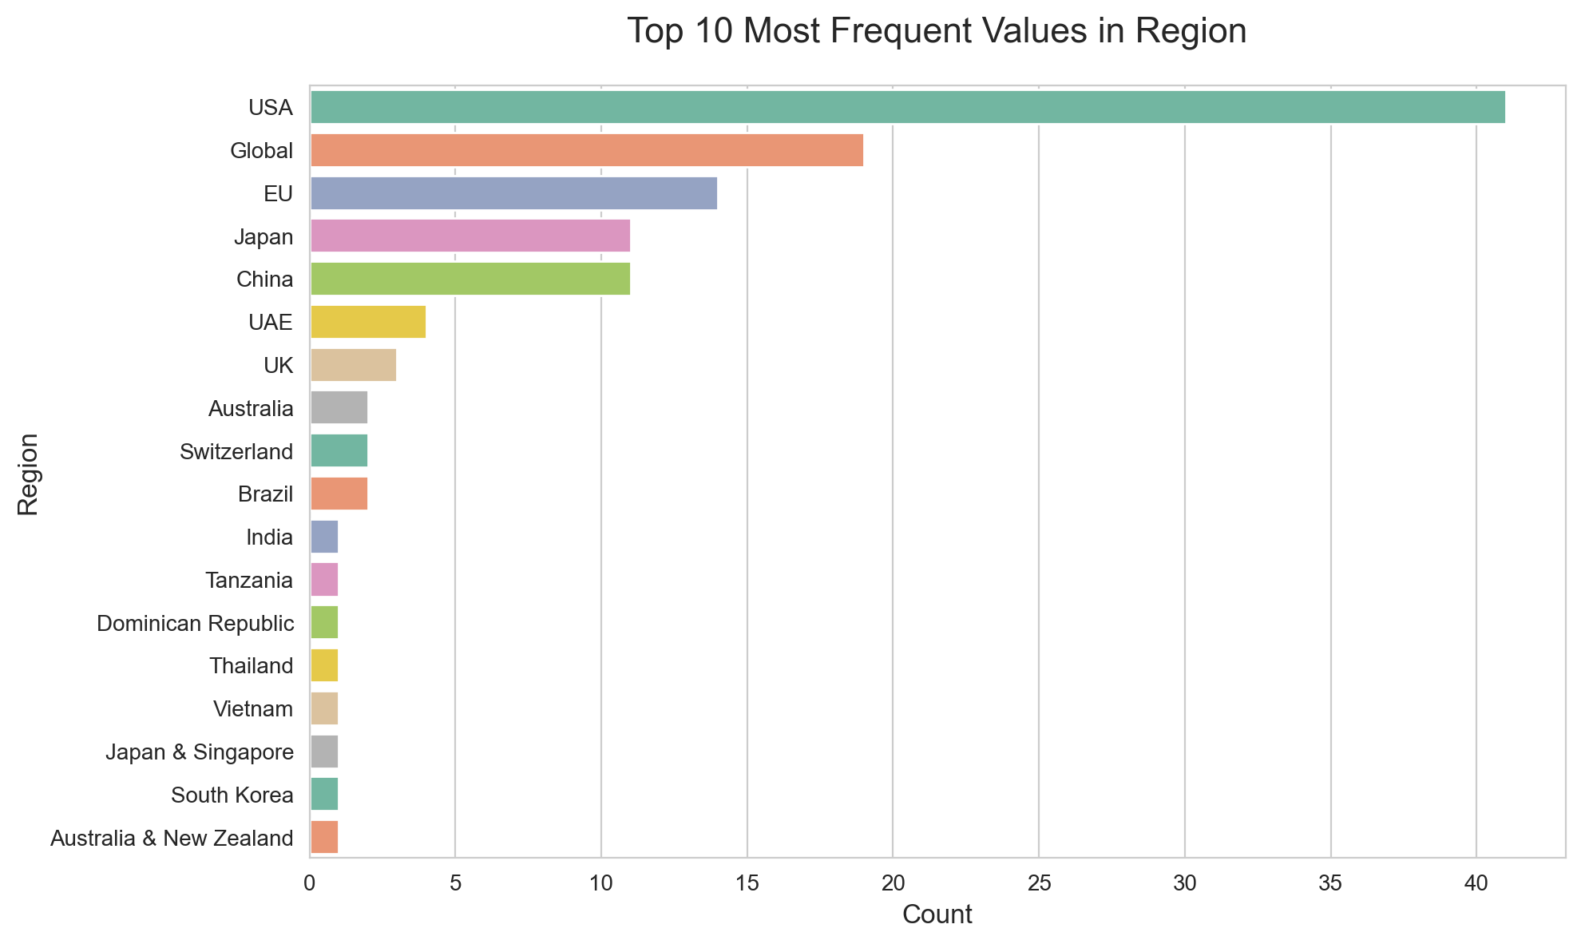
Top 10 Region Values
• The column Region has 18 unique categories across 117 records.
• The top category 'USA' accounts for 35.0% of the data.
• The top 10 categories make up 93.2% of all entries.
• The categories are mostly focused on a few values.

Slide 10
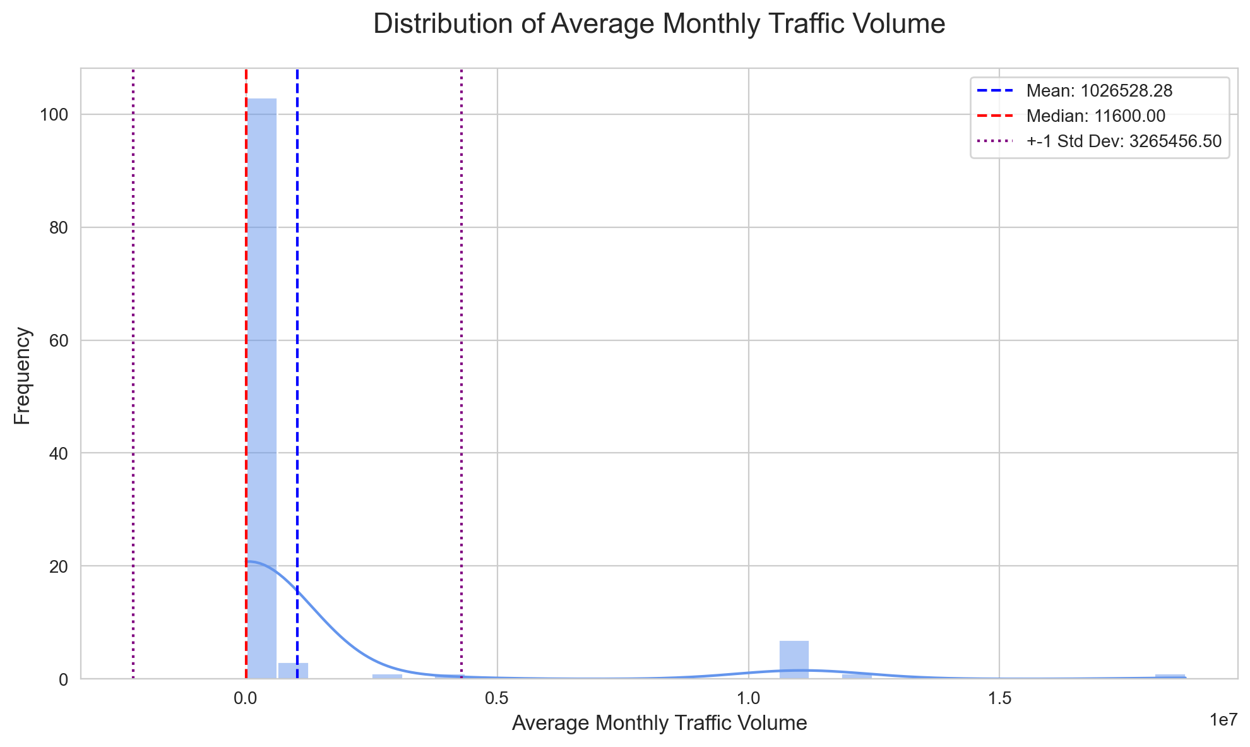
Average Monthly Traffic Volume Distribution
• The dataset has 117 valid entries and 100 unique values.
• The average value is 1026528.28, with a median of 11600.00.
• The 25th percentile is 3530.00, and the 75th percentile is 41000.00.
• The middle 50% of data lies between 3530.00 and 41000.00.

Slide 11
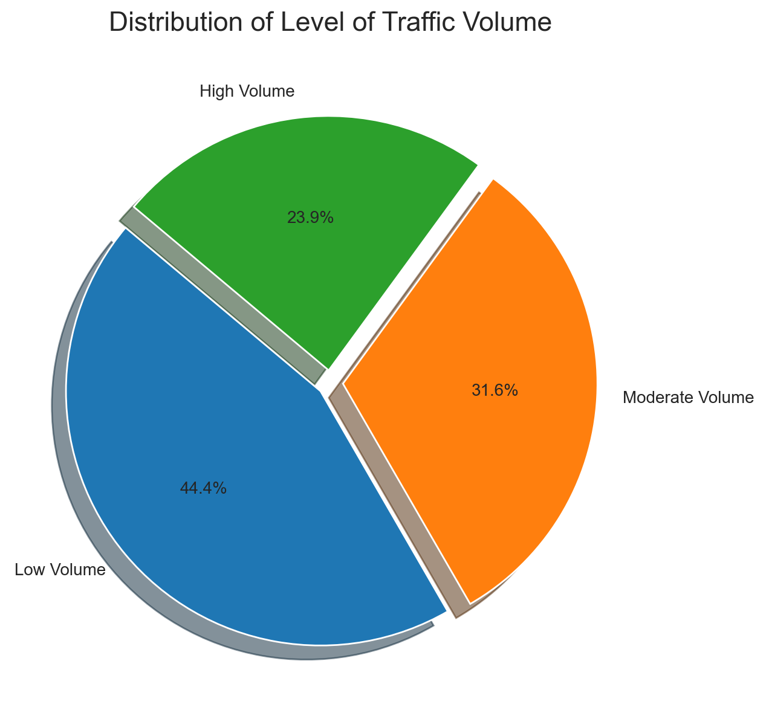
Level Of Traffic Volume Distribution
• The dataset contains 3 distinct categories across 117 records.
• The dominant category 'Low Volume' has 52 occurrences (44.4%).
• The distribution is skewed towards a few dominant categories.
• Category representation is fairly consistent.

Slide 12
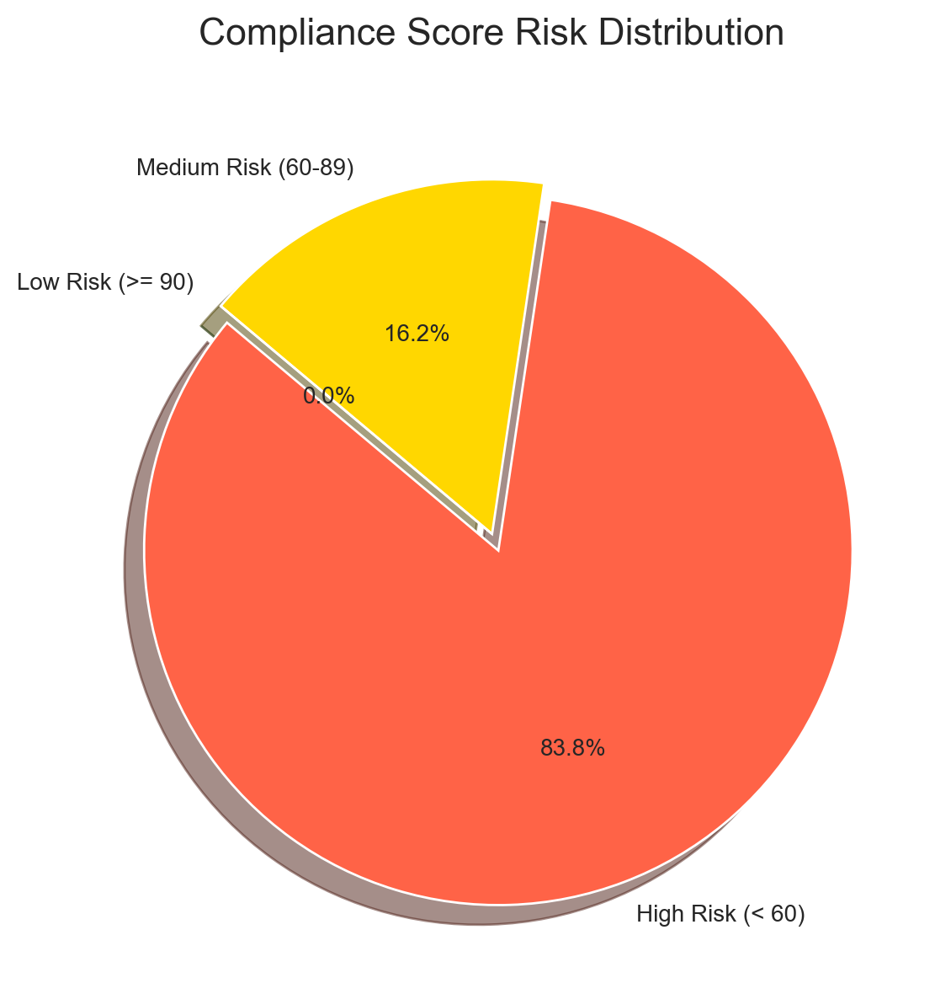
Compliance Score Risk Distribution
• Total 117 records analyzed with average score of 31.8
• High risk sites represent 83.8% (98) of total records
• Low risk sites account for 0.0% (0) of total records
• Immediate attention needed for 98 high-risk sites

Slide 13
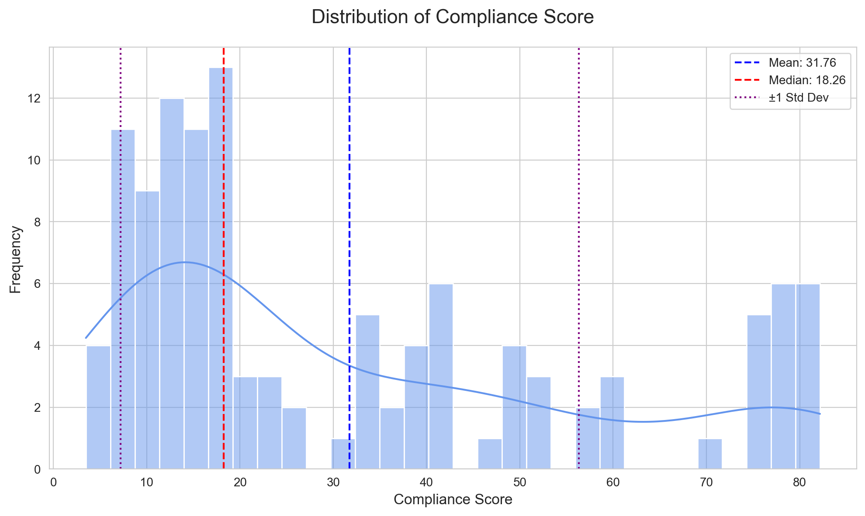
Compliance Score Distribution
• Scores range from 3.5 to 82.2 with a mean of 31.8.
• Standard deviation of 24.6 shows high variability.
• The distribution is right-skewed (most values below average).
• Median of 18.3 is distinct from the mean.

Slide 14
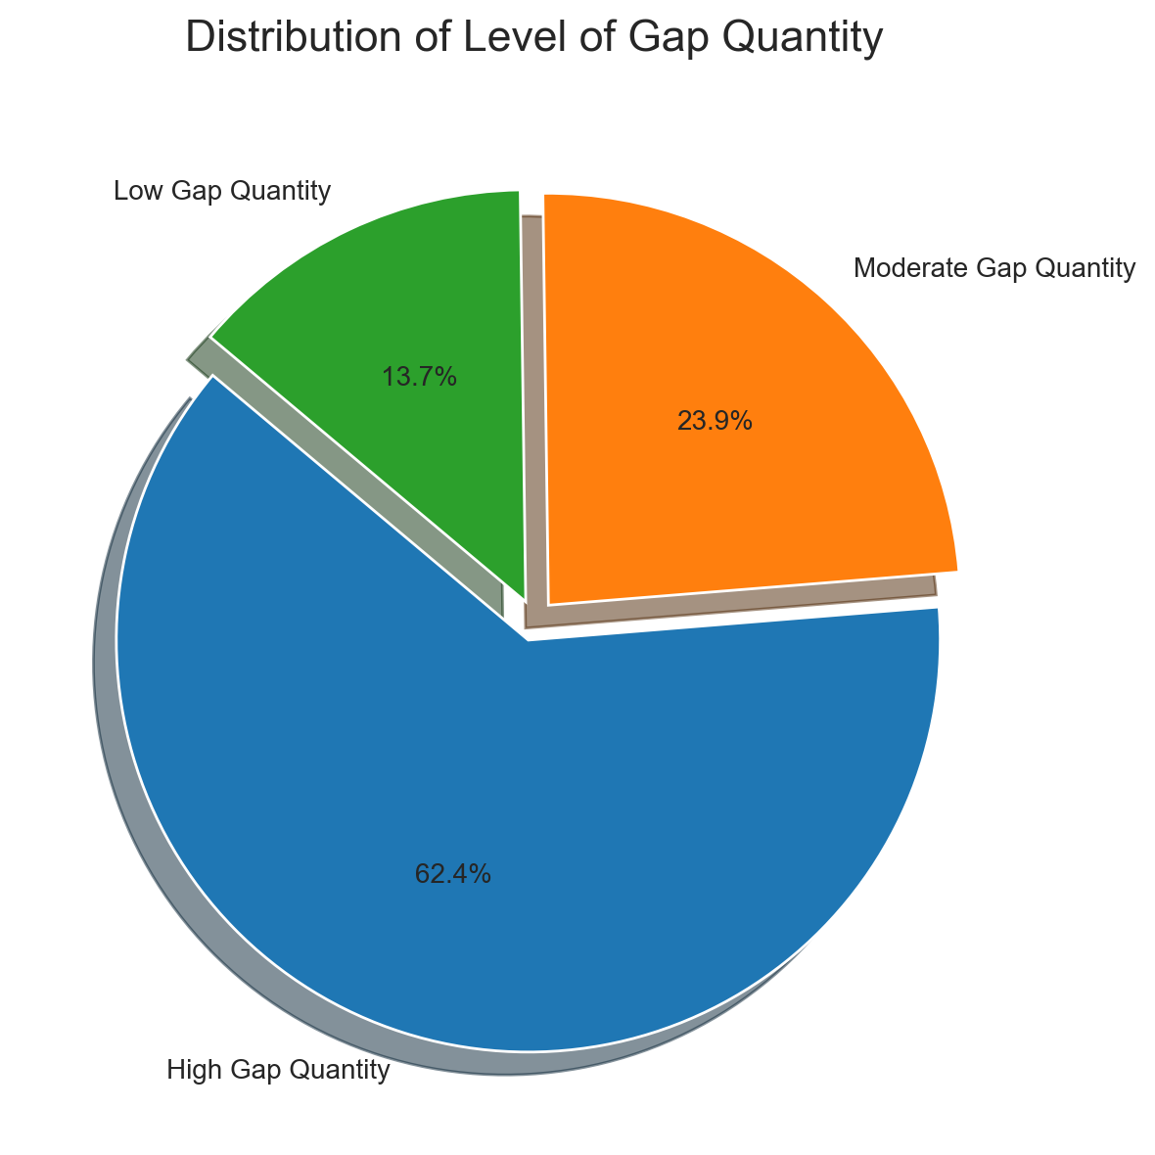
Level Of Gap Quantity Distribution
• The dataset contains 3 distinct categories across 117 records.
• The dominant category 'High Gap Quantity' has 73 occurrences (62.4%).
• The distribution is skewed towards a few dominant categories.
• Category representation is highly variable.

Slide 15
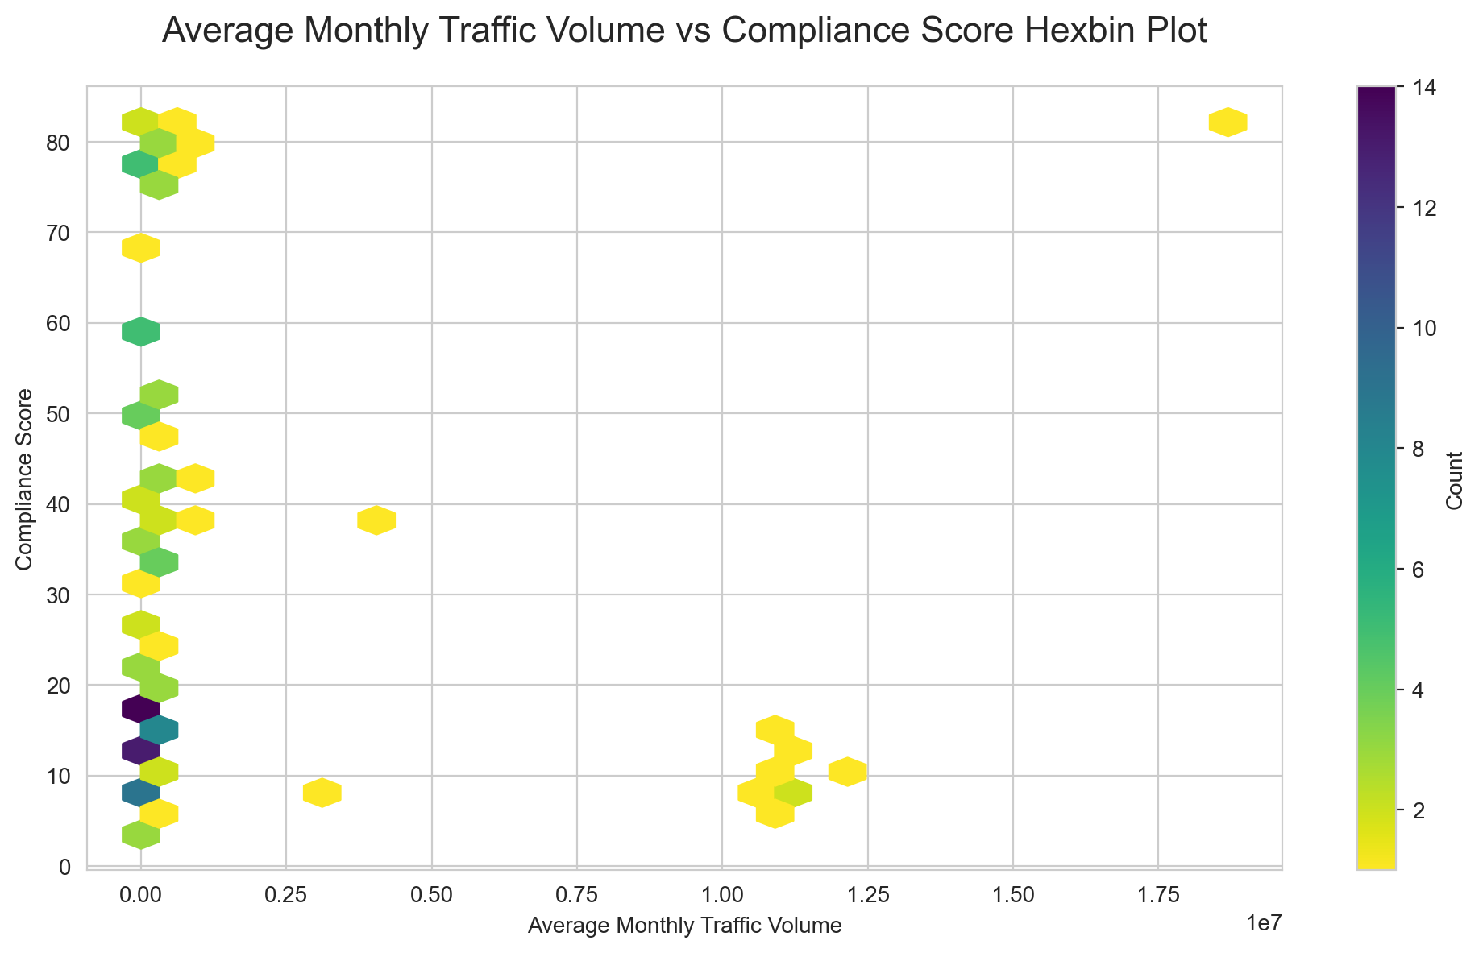
Average Monthly Traffic Volume vs Compliance Score Relationship
• Darker hexagons indicate denser data regions, while lighter ones show sparser observations.
• A negative linear trend exists (Pearson correlation coefficient: -0.10).
• Average Monthly Traffic Volume ranges from 0.0 to 18696564.0, and Compliance Score ranges from 3.5 to 82.2.

Slide 16
SUMMARY INSIGHTS
• gemini

Slide 17
THANK YOU

