Slide 1
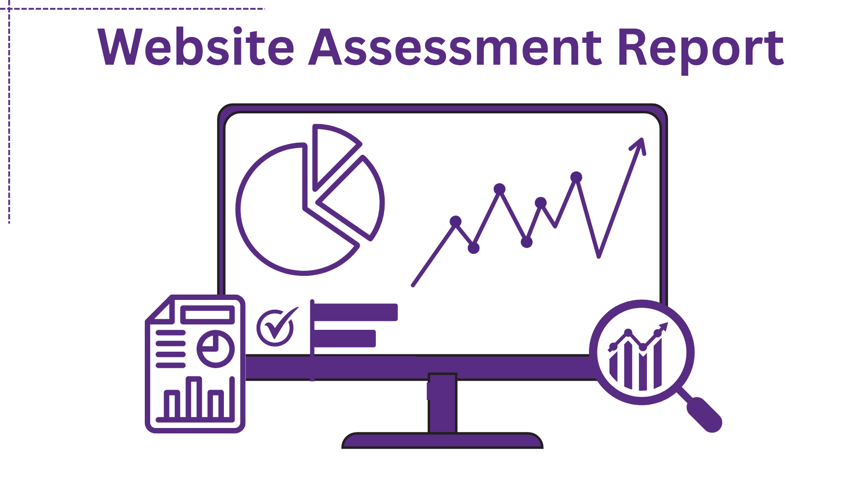

Slide 2
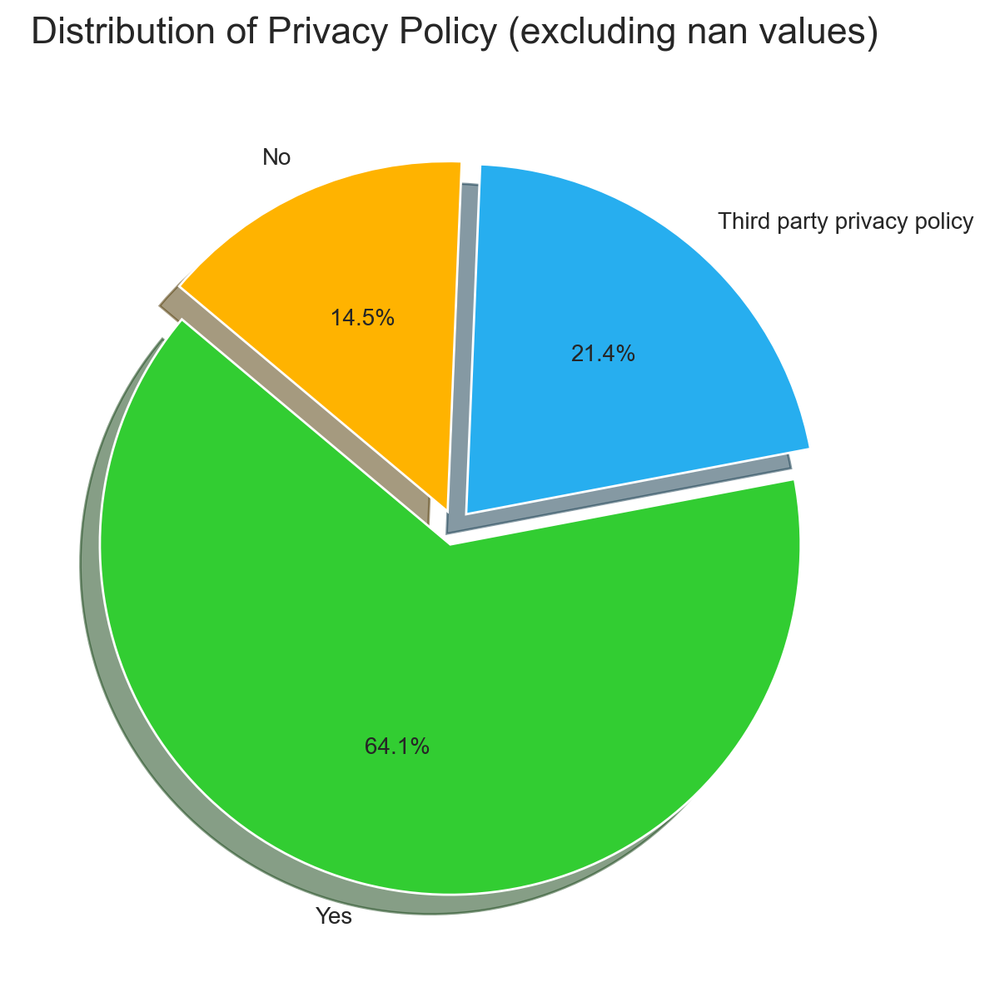
Privacy Policy Distribution
• The dataset contains 3 distinct categories across 117 valid records (excluding 'nan').
• The dominant category 'Yes' has 75 occurrences (64.1%).
• The distribution is skewed towards a few dominant categories.
• The categories are mostly focused on a few values.

Slide 3
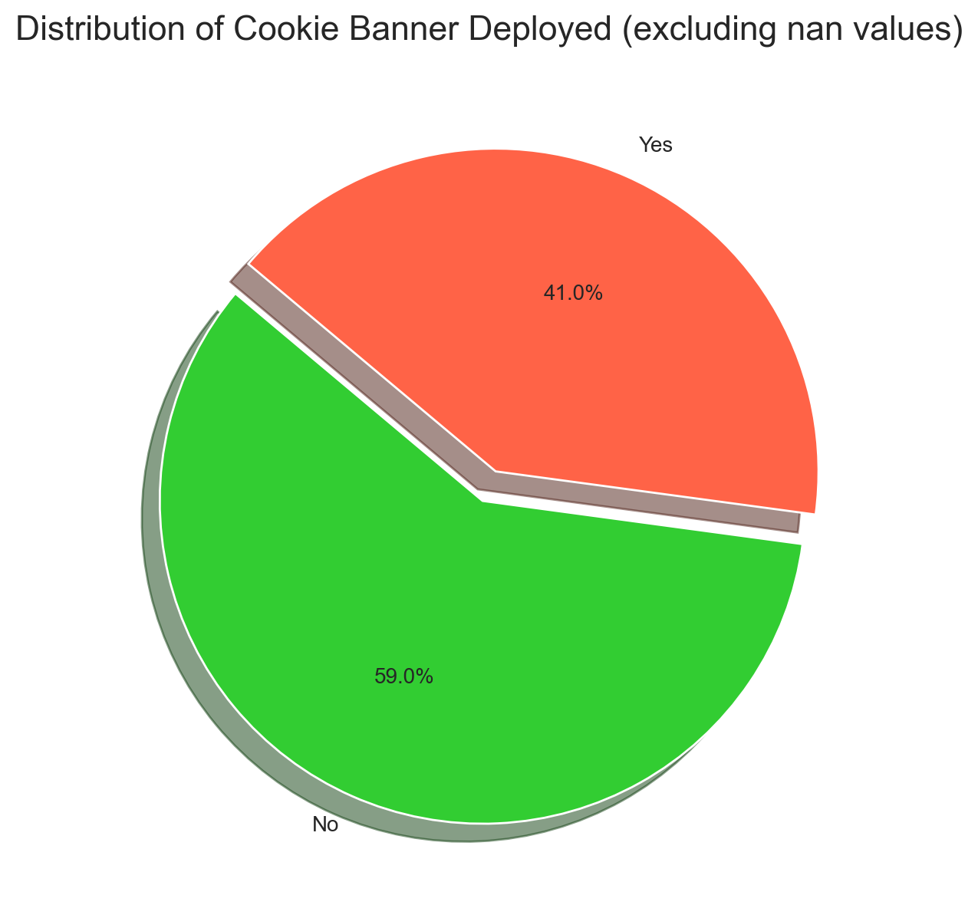
Cookie Banner Deployed Distribution
• The dataset contains 2 distinct categories across 117 valid records (excluding 'nan').
• The dominant category 'No' has 69 occurrences (59.0%).
• The distribution is skewed towards a few dominant categories.
• The categories are mostly focused on a few values.

Slide 4
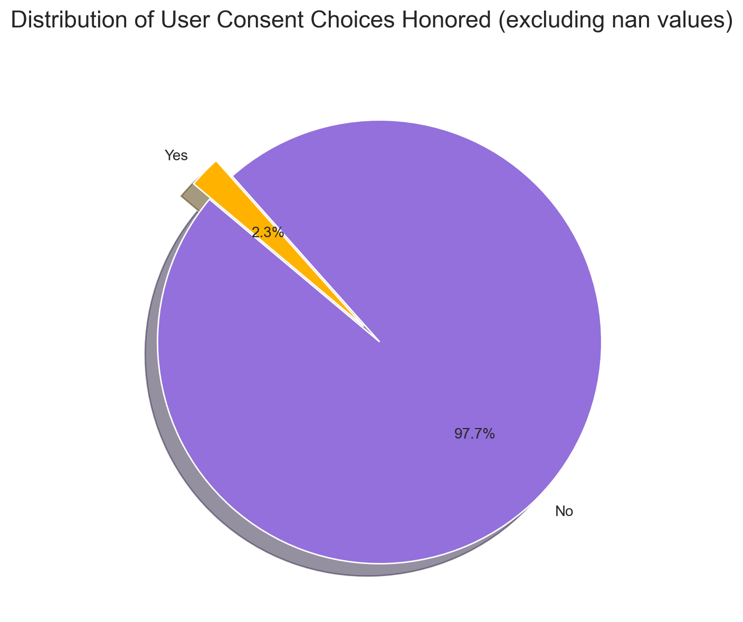
User Consent Choices Honored Distribution
• 63.2% of entries (74 records) are missing or 'nan'.
• The dataset contains 2 distinct categories across 43 valid records (excluding 'nan').
• The dominant category 'No' has 42 occurrences (97.7%).
• The distribution is skewed towards a few dominant categories.

Slide 5
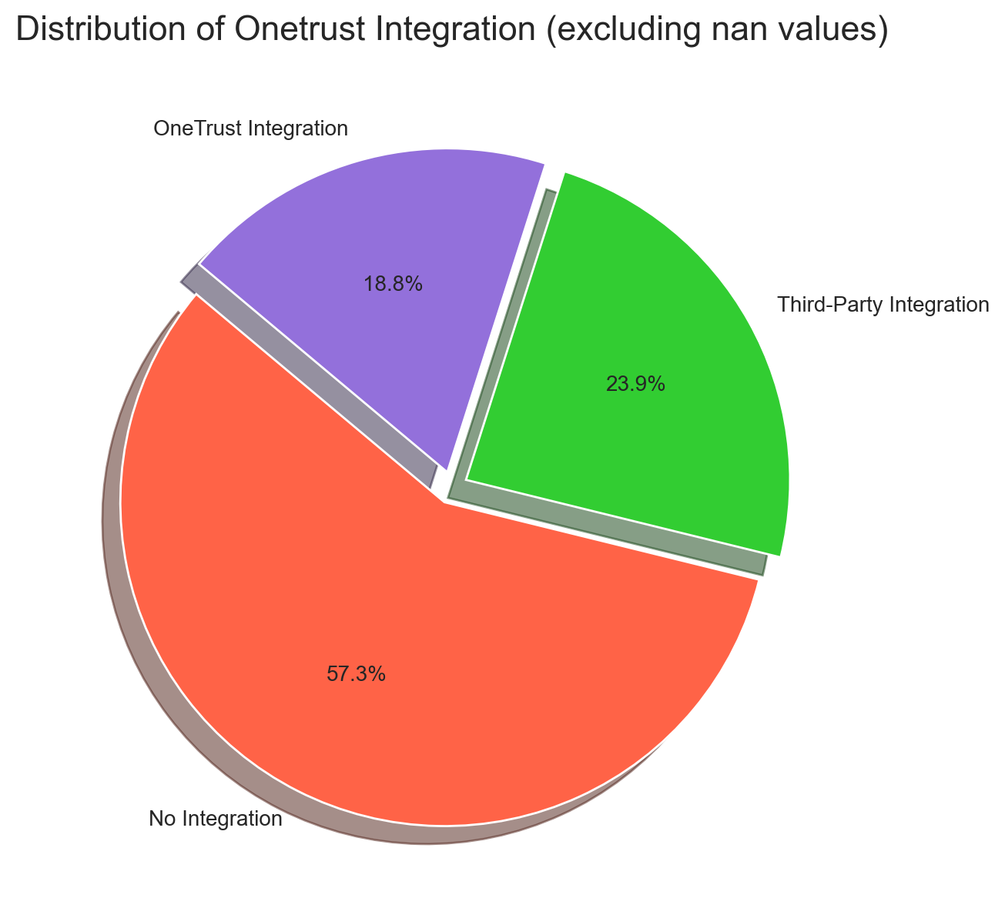
Onetrust Integration Distribution
• The dataset contains 3 distinct categories across 117 valid records (excluding 'nan').
• The dominant category 'No Integration' has 67 occurrences (57.3%).
• The distribution is skewed towards a few dominant categories.
• The categories are mostly focused on a few values.

Slide 6
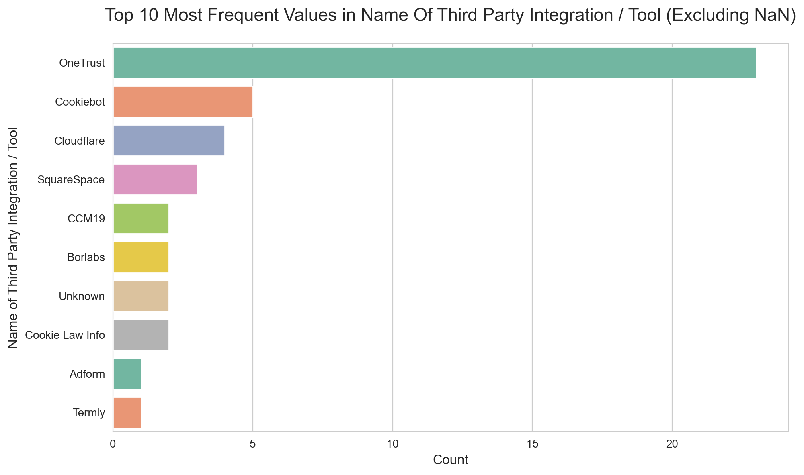
Top 10 Name Of Third Party Integration / Tool Values
• 57.3% of entries (67 records) are missing or 'nan'.
• The dataset contains 15 distinct categories across 50 valid records (excluding 'nan').
• The dominant category 'OneTrust' has 23 occurrences (46.0%).
• The top 10 categories (excluding 'nan') make up 90.0% of all valid entries.

Slide 7
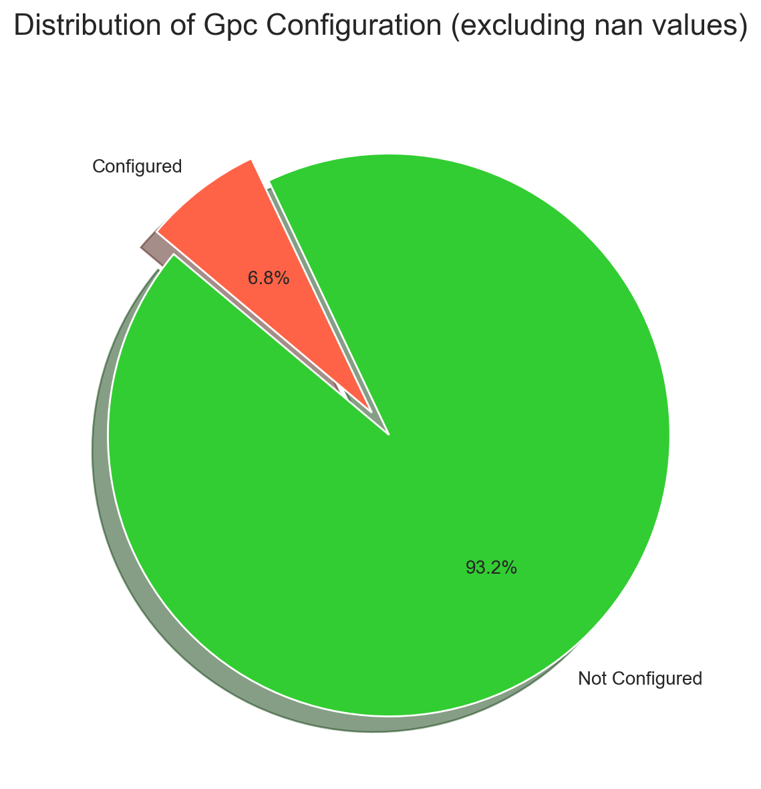
Gpc Configuration Distribution
• The dataset contains 2 distinct categories across 117 valid records (excluding 'nan').
• The dominant category 'Not Configured' has 109 occurrences (93.2%).
• The distribution is skewed towards a few dominant categories.
• The categories are mostly focused on a few values.

Slide 8
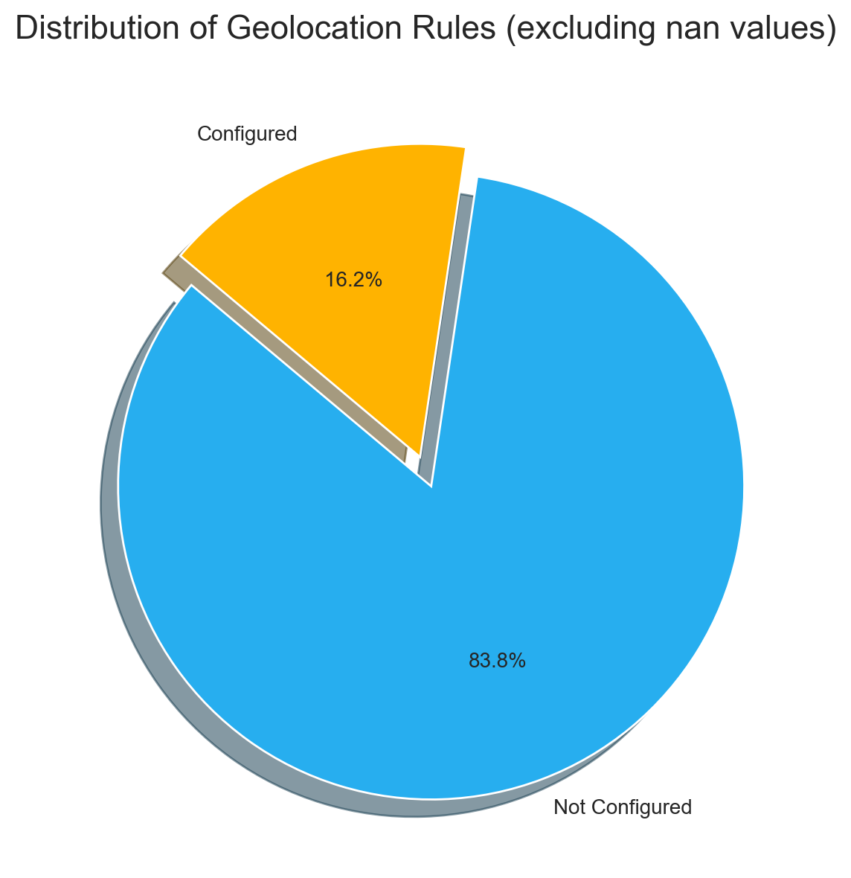
Geolocation Rules Distribution
• The dataset contains 2 distinct categories across 117 valid records (excluding 'nan').
• The dominant category 'Not Configured' has 98 occurrences (83.8%).
• The distribution is skewed towards a few dominant categories.
• The categories are mostly focused on a few values.

Slide 9
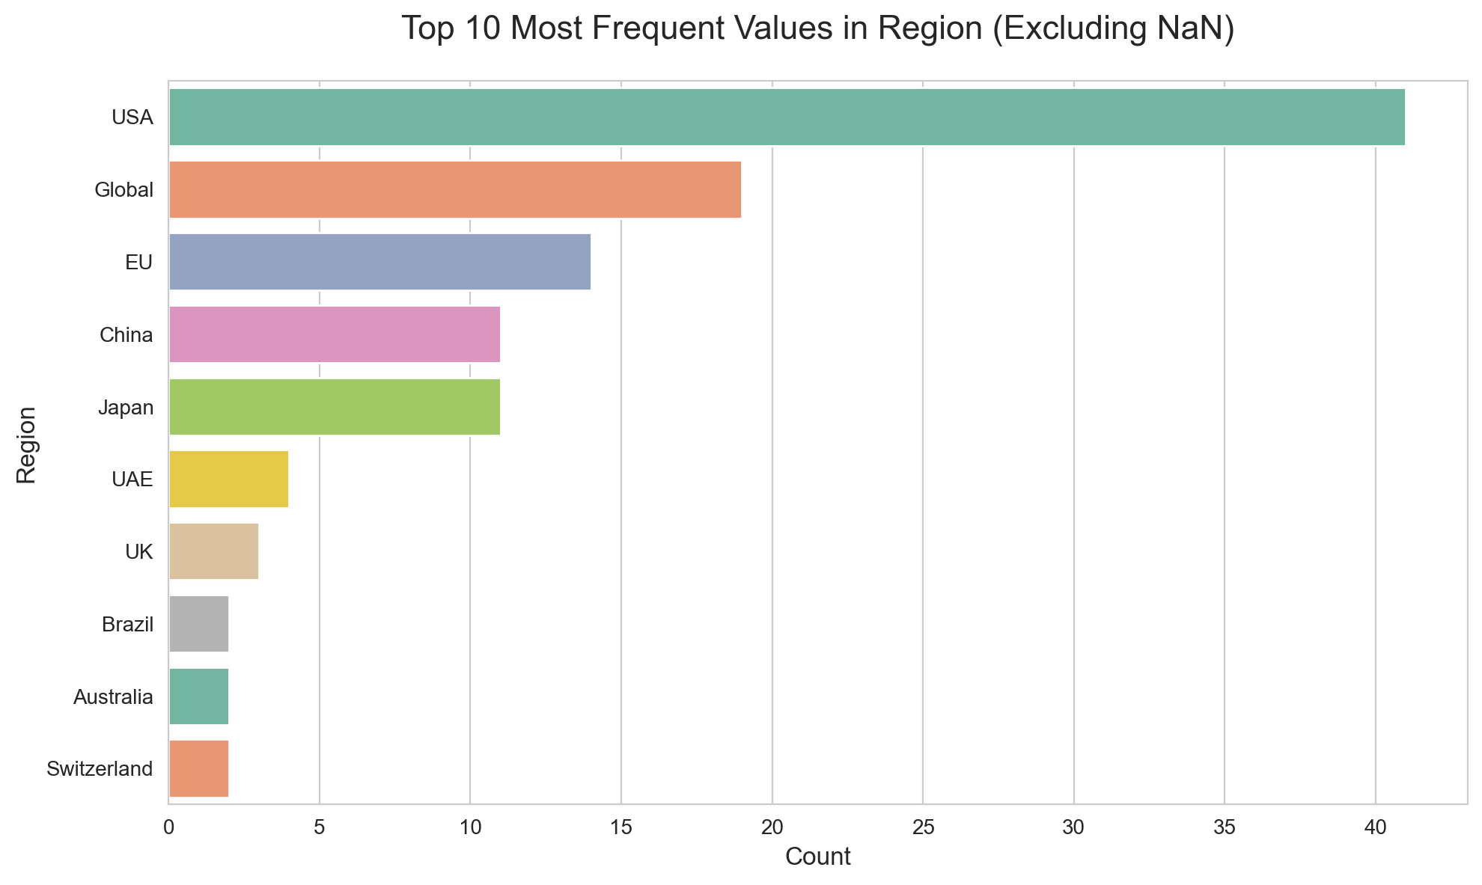
Top 10 Region Values
• The dataset contains 18 distinct categories across 117 valid records (excluding 'nan').
• The dominant category 'USA' has 41 occurrences (35.0%).
• The top 10 categories (excluding 'nan') make up 93.2% of all valid entries.
• The categories are mostly focused on a few values.

Slide 10
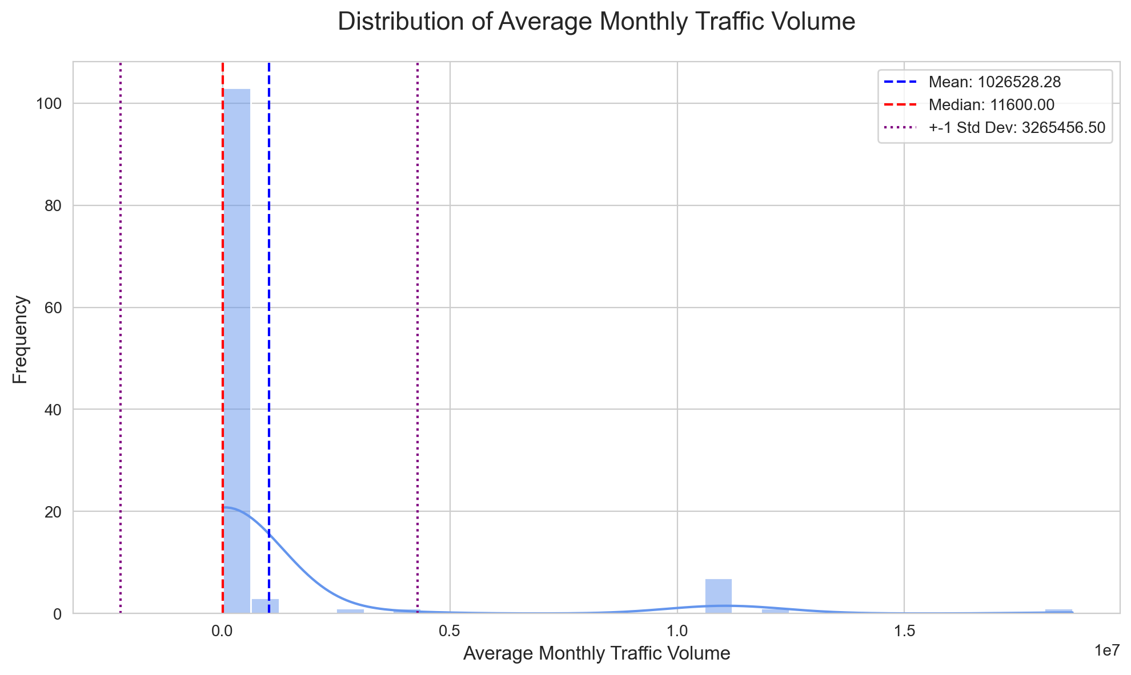
Average Monthly Traffic Volume Distribution
• The dataset has 117 valid entries and 0 missing entries (about 0.0%).
• The average value is 1026528.28, with a median of 11600.00.
• The 25th percentile is 3530.00, and the 75th percentile is 41000.00.
• The middle 50% of data lies between 3530.00 and 41000.00.

Slide 11
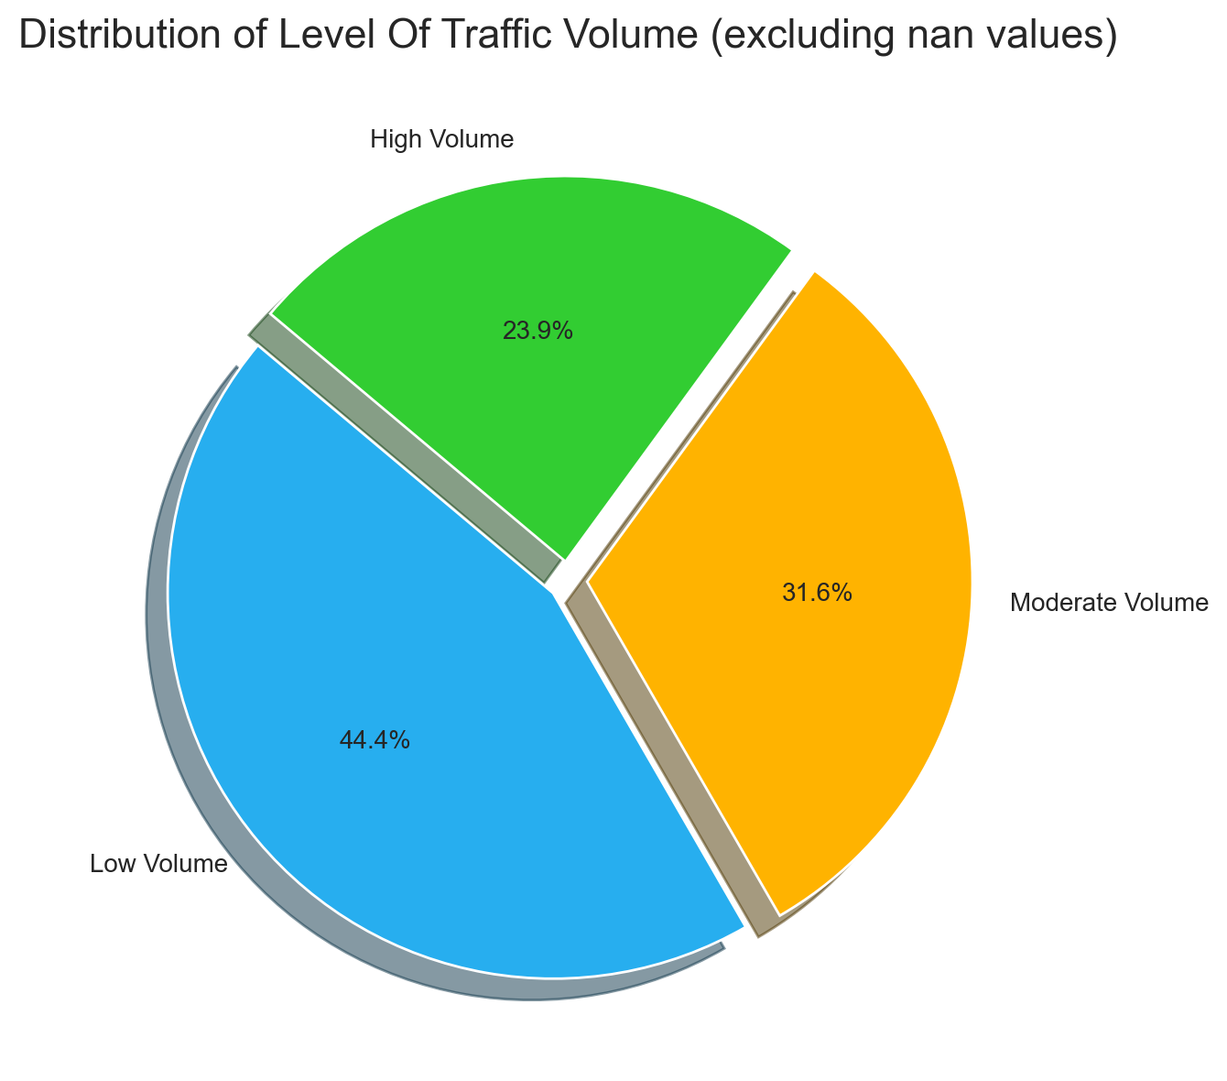
Level Of Traffic Volume Distribution
• The dataset contains 3 distinct categories across 117 valid records (excluding 'nan').
• The dominant category 'Low Volume' has 52 occurrences (44.4%).
• The distribution is skewed towards a few dominant categories.
• The categories are mostly focused on a few values.

Slide 12
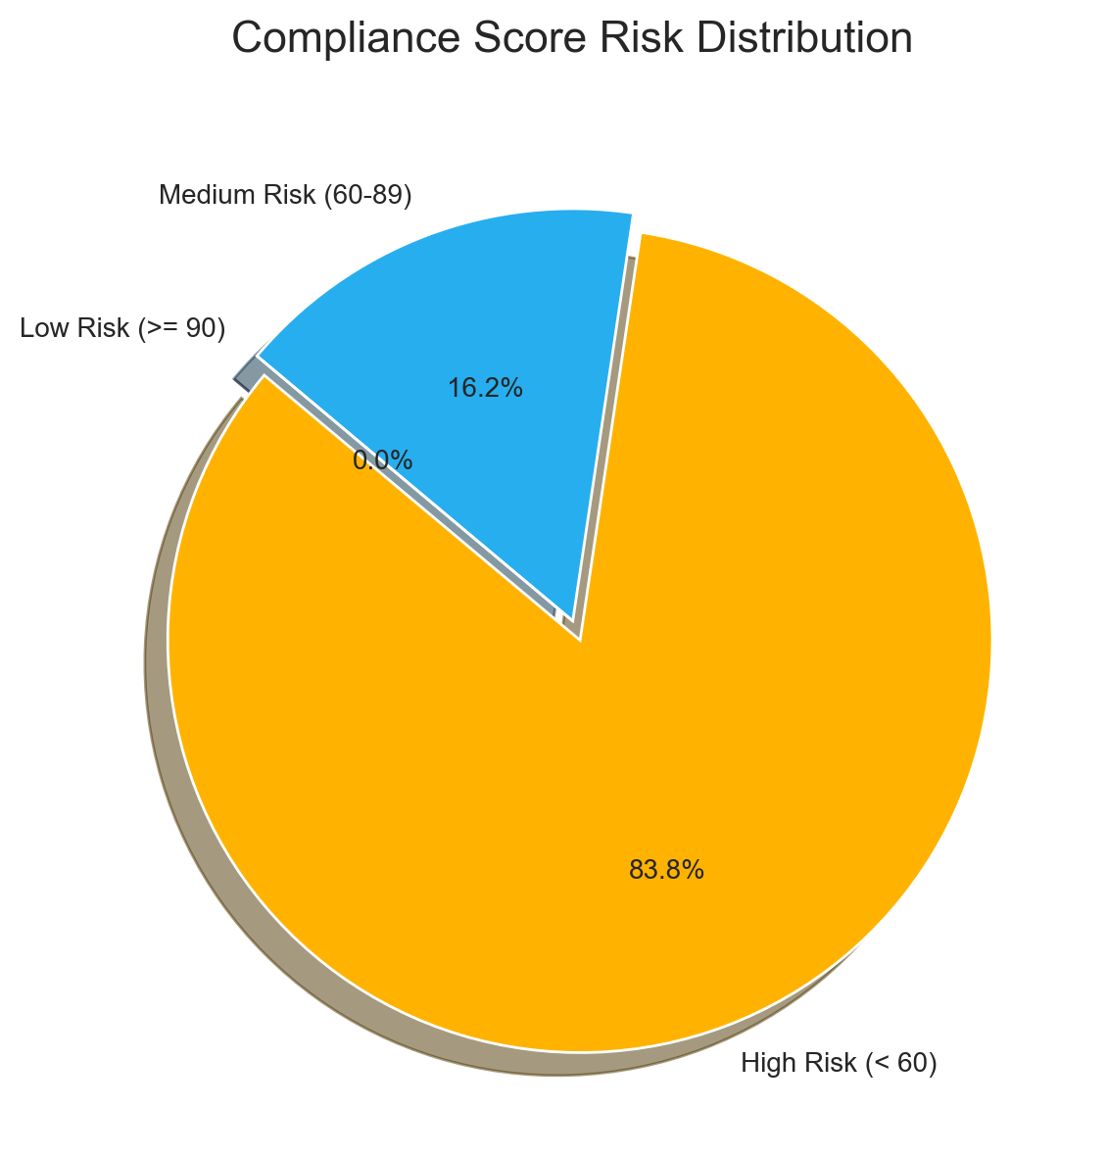
Compliance Score Risk Distribution
• Total 117 records analyzed with average score of 31.8
• High risk sites represent 83.8% (98) of total records
• Medium risk sites account for 16.2% (19) of total records
• Low risk sites account for 0.0% (0) of total records

Slide 13
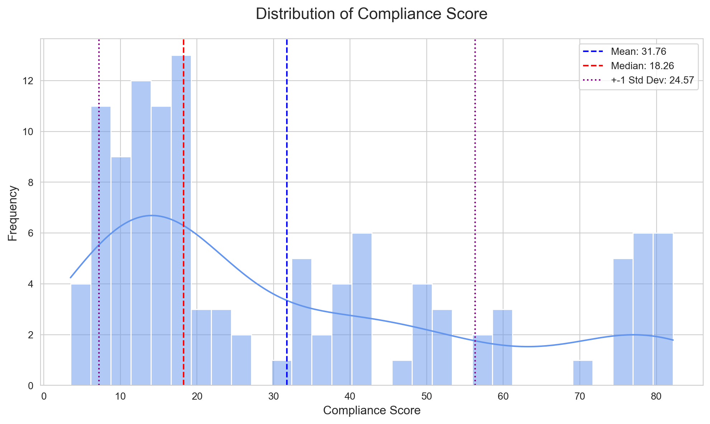
Compliance Score Distribution
• Scores range from 3.5 to 82.2 with a mean of 31.8.
• Standard deviation of 24.6 shows high variability.
• The distribution is right-skewed (most values below average).
• Median of 18.3 is distinct from the mean.

Slide 14
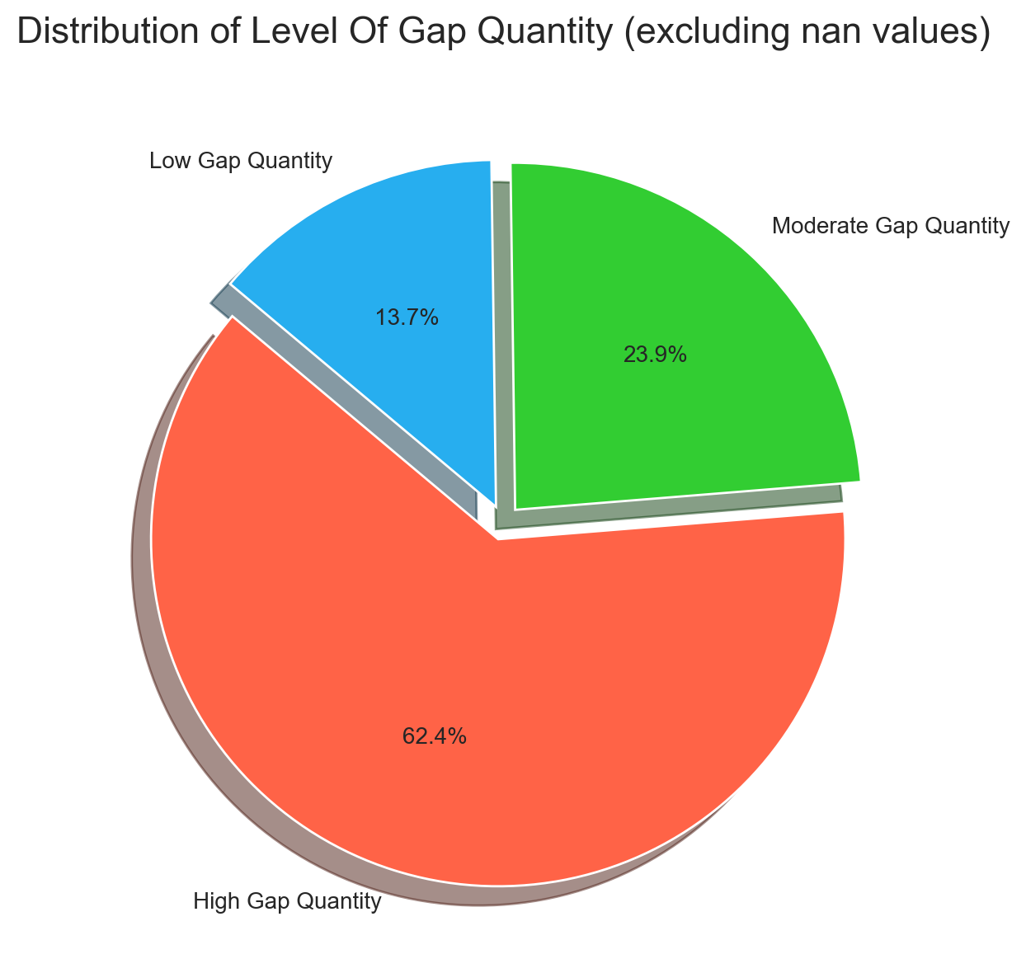
Level Of Gap Quantity Distribution
• The dataset contains 3 distinct categories across 117 valid records (excluding 'nan').
• The dominant category 'High Gap Quantity' has 73 occurrences (62.4%).
• The distribution is skewed towards a few dominant categories.
• The categories are mostly focused on a few values.

Slide 15
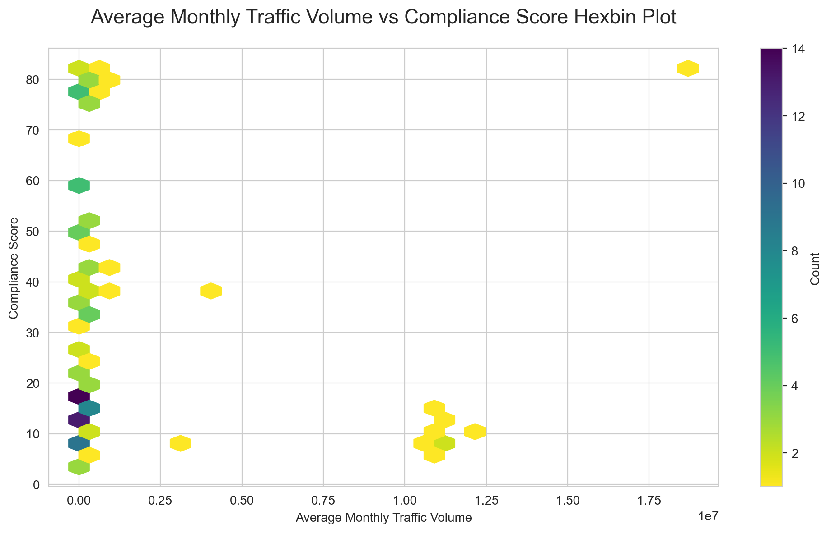
Average Monthly Traffic Volume vs Compliance Score Relationship
• Darker hexagons indicate denser data regions, while lighter ones show sparser observations.
• A negative linear trend exists (Pearson correlation coefficient: -0.10).
• Average Monthly Traffic Volume ranges from 0.0 to 18696564.0, and Compliance Score ranges from 3.5 to 82.2.

Slide 16
SUMMARY INSIGHTS
• The current dataset includes the following key columns: ID, Website Name / Domain Name, Privacy Policy, Cookie Banner Deployed, User Consent Choices Honored, OneTrust Integration, Name of Third Party Integration / Tool, GPC Configuration, Geolocation Rules, Region, Average Monthly Traffic Volume, Level of Traffic Volume, Compliance Score, Level of Gap Quantity
• The sites shadowweb.co, uniquesandbox.org, innovationspace.info, oneoffpage.info, distinctivepage.io, oneandonly.store, innovationpage.biz, groundbreakingtrial.co, and revolutionarypage.io are considered high-risk given their low compliance score despite having high level of traffic volume.

Slide 17
THANK YOU

