Slide 1
BY RITIKA

Slide 2
WHAT IS A DASHBOARD?
In Excel, a dashboard is a visual display of key business metrics and performance indicators, designed to provide a clear and concise overview of data. It's a way to consolidate information from various sources into a single, easy-to-understand interface, typically using charts, graphs, and tables.

Slide 3
BENEFITS OF USING DASHBOARD
1) Improved Decision-Making:
Dashboards provide a comprehensive overview of data, allowing users to quickly grasp the current state of affairs and make data-driven decisions based on real-time insights. This can lead to more effective strategies and better outcomes across various business areas.
2) Increased Efficiency:
By consolidating data from multiple sources into a single, easily accessible interface, dashboards save time and resources. Users can quickly access the information they need without having to navigate through multiple systems or reports.

Slide 4
BENEFITS OF USING DASHBOARD
3)Data Visualization:
Dashboards transform complex data into visually appealing and easy-to-understand charts and graphs. This makes it easier for users to identify trends, patterns, and outliers, leading to a deeper understanding of the data and its implications.
4) Enhanced Collaboration:
Dashboards can be shared with multiple users, facilitating better communication and collaboration across teams and departments. Real-time updates and interactive features enable users to work together more effectively, discuss findings, and make joint decisions.

Slide 5
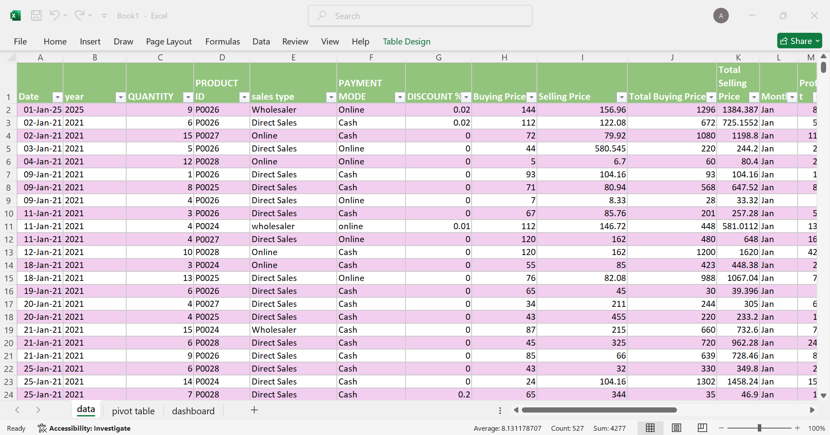
RAW DATA

Slide 6
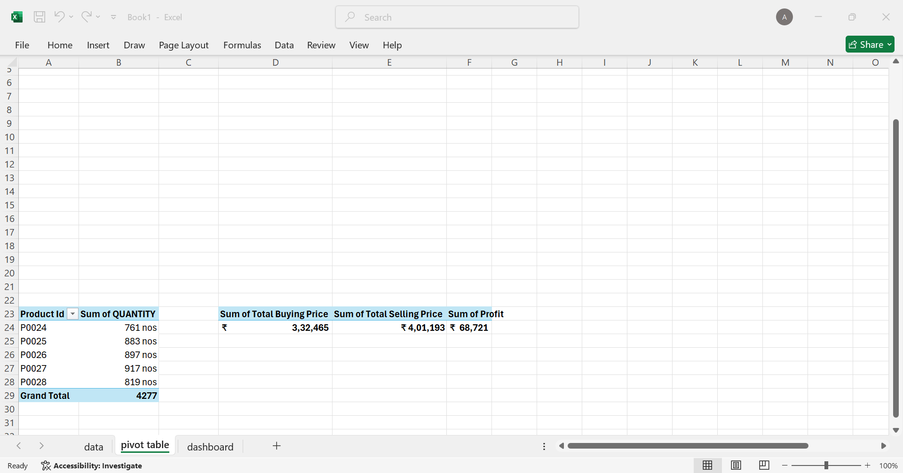
SUMMARIZING DATA INTO PIVOT TABLE

Slide 7
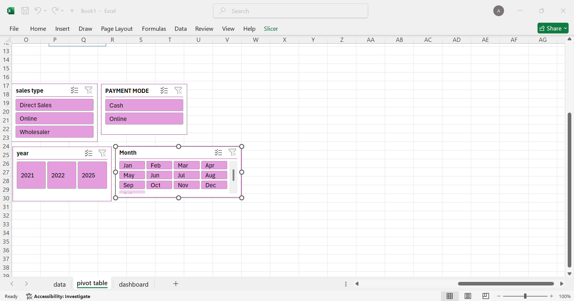
INSERTING SLICER

Slide 8
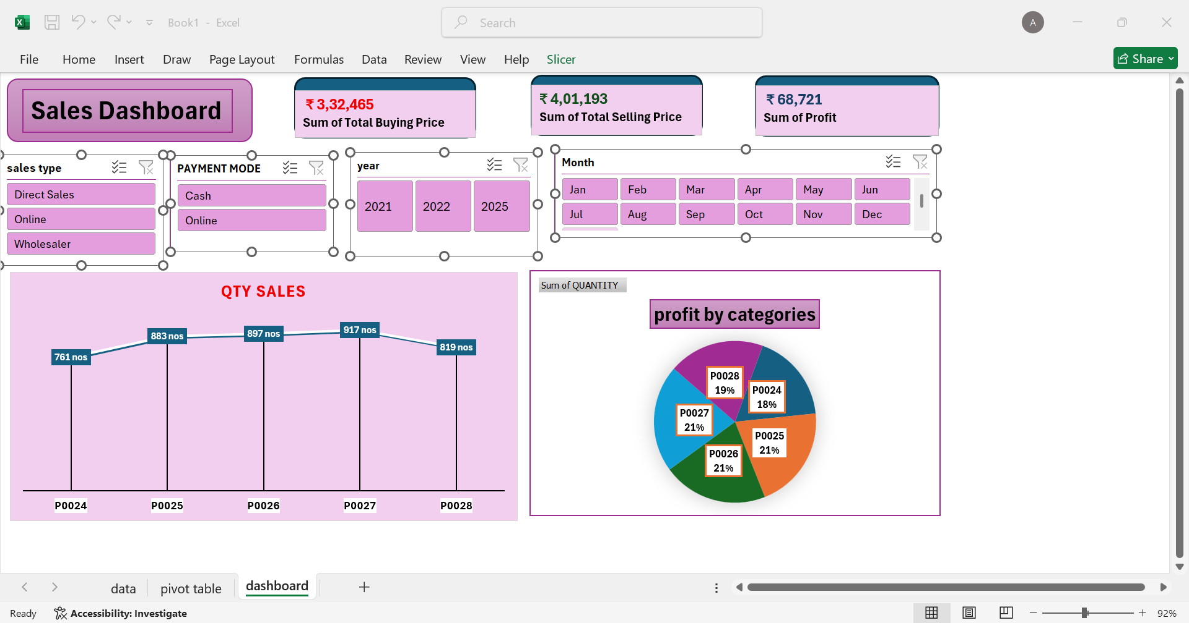
FINAL DASHBOARD

