Slide 1
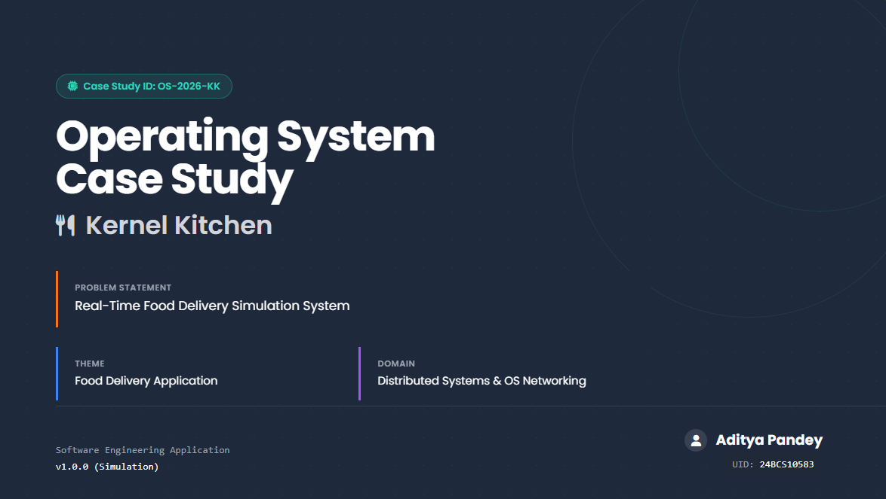

Slide 2
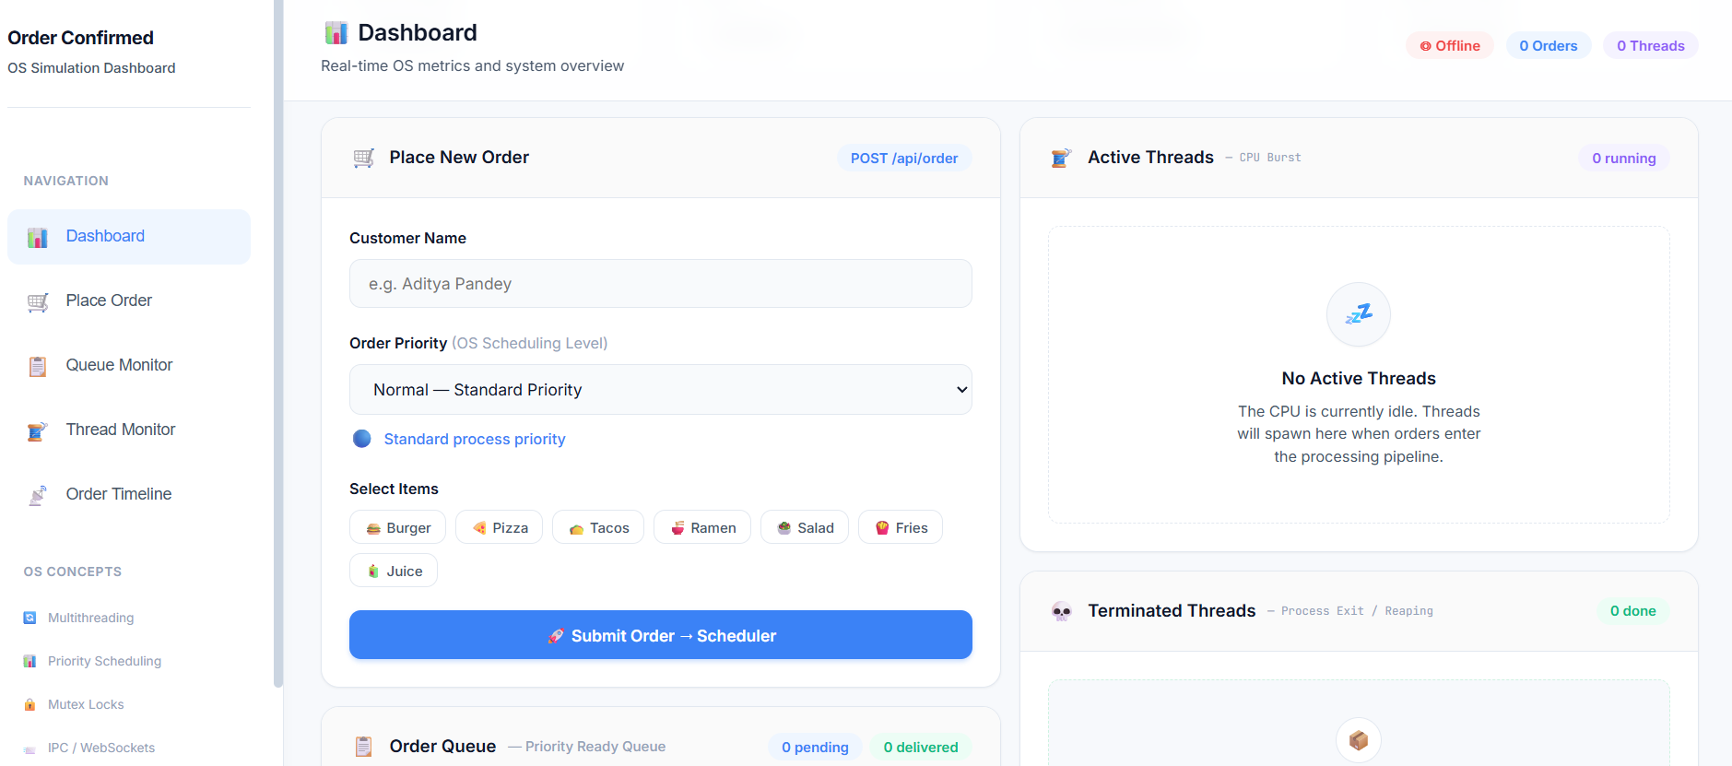
Kernel Kitchen
Idea / Prototype:
Real-time food delivery workflow simulation platform..
Users place orders and track status transitions (Confirmed → Preparing → Delivered).
Real-time synchronization across services using message passing.
How it addresses the problem:
Demonstrates how distributed systems manage real-time requests
Provides a visual representation of scheduling.
Simulates real-world server communication and latency handling.
Innovation & Uniqueness :
SE concepts visualized through a real-world application scenario.
Live monitoring dashboard for queue and thread lifecycle.
Hybrid architecture combining simulation engine + API gateway.
Offline-first + multilingual support for coastal communities.

Slide 3
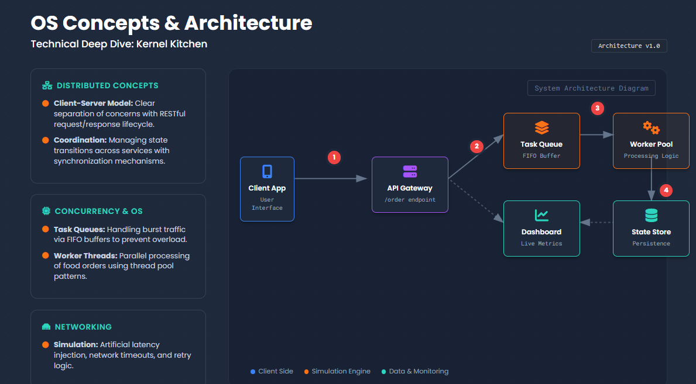

Slide 4
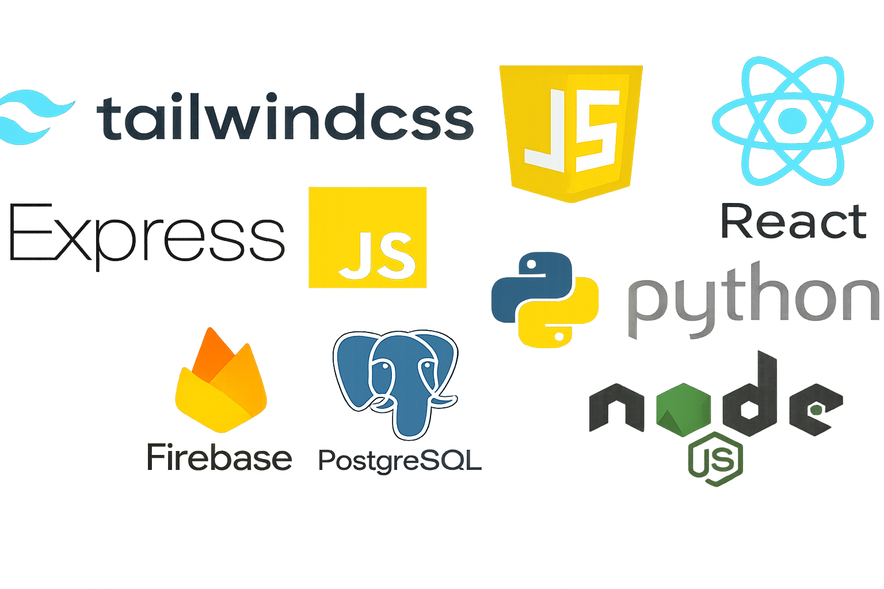
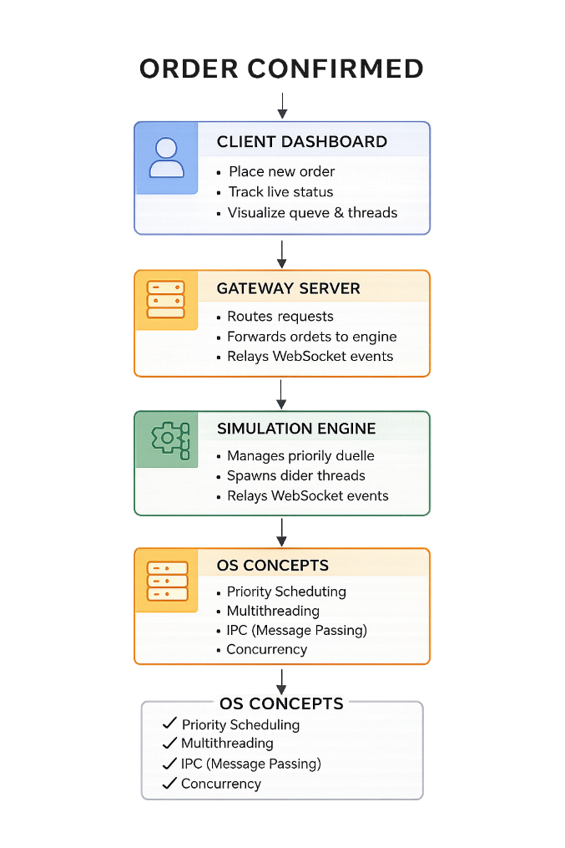
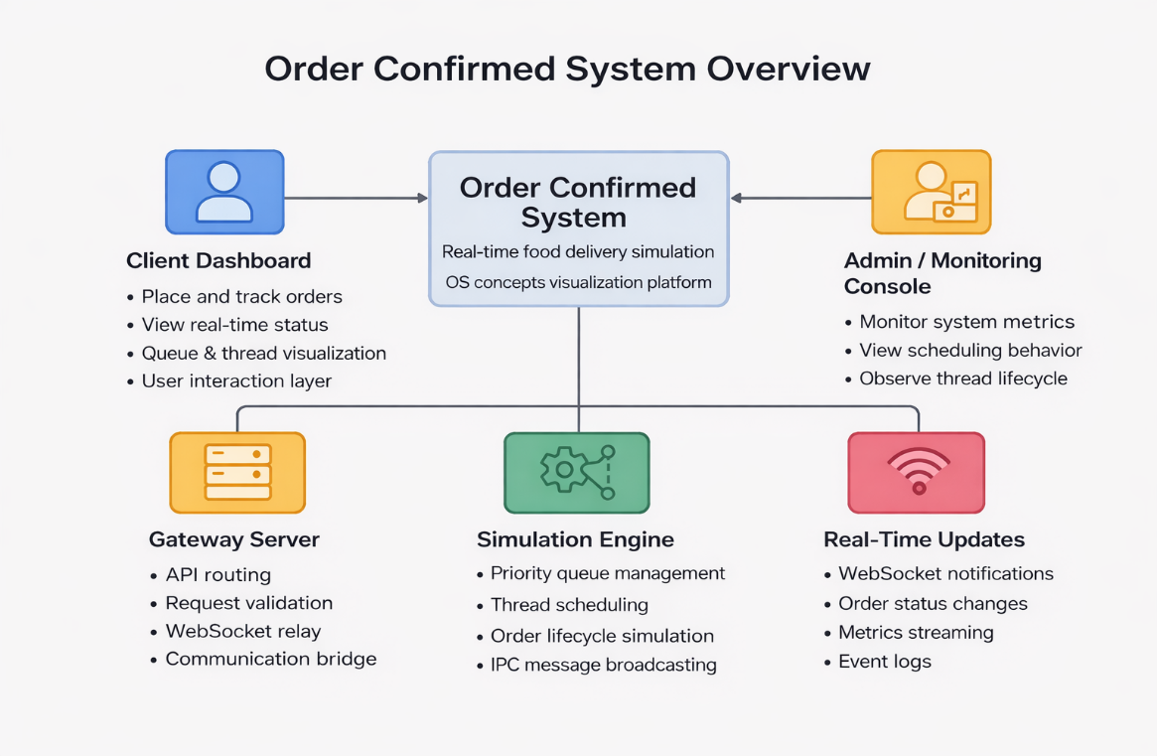
Technologies / Stack
i)Frontend: React.js, Tailwind CSS, WebRTC.
ii)Backend: Node.js + Express.js, Python (Flask), Socket.IO, REST APIs.
iii) OS Simulation: Multithreading, Priority Scheduling, Thread-safe Queue, Event-driven architecture
Methodology / Process Flow
Client Dashboard – Place orders & track status.
Gateway Server – Route requests & relay events.
Simulation Engine – Schedule & process orders.
Monitoring Dashboard – Show metrics & analytics.

Slide 5
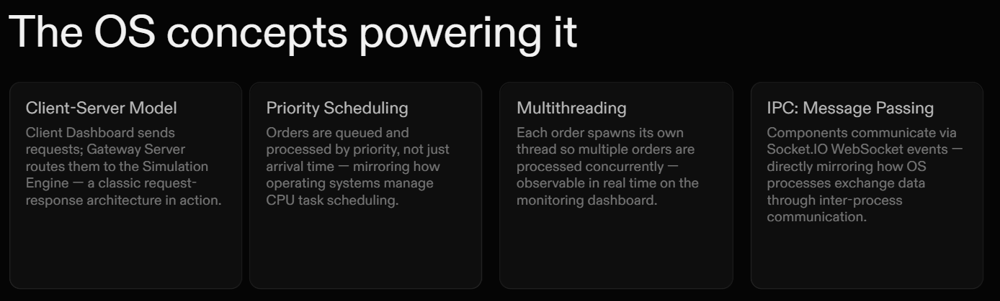
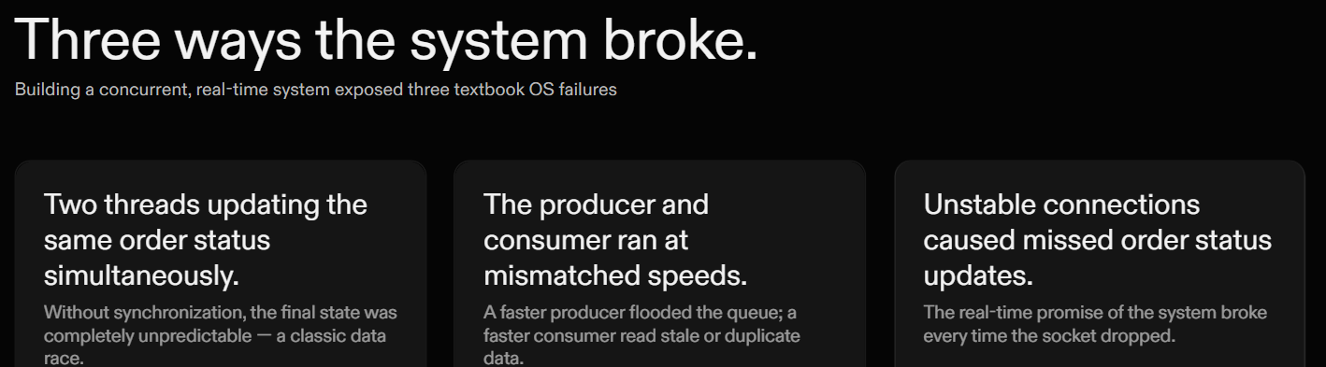

Slide 6




FEASIBILITY AND VIABILITY
Feasibility
Technical
Proven web and networking technologies enable rapid development and deployment.
Modular distributed architecture ensures reliable real-time communication between system components.
Scalable design supports concurrent order processing, real-time updates, and performance monitoring.
Financial
Market
Operational
Easy onboarding through a simple web-based dashboard interface.
. Modular design enables easy deployment, testing, and maintenance.
System monitoring and logs support smooth operation and troubleshooting.
Low development cost due to open-source frameworks and free development tools.
Minimal infrastructure requirements as the system can run on local or cloud environments.
Cost-effective scalability using modular architecture and optional cloud deployment.
Growing demand for real-time service platforms and efficient delivery systems.
Strong alignment with modern cloud-based and distributed application trends.
Wide applicability across food delivery, logistics, and real-time service industries.
Challenges
Strategies
Concurrency Management: Handling multiple orders simultaneously without conflicts.
Synchronization Issues: Preventing race conditions while updating shared order data.
Real-Time Communication: Ensuring stable WebSocket connections for live updates.
System Scalability: Maintaining performance as the number of users and orders increases.
Security & Data Integrity:Protecting order data and ensuring reliable communication.
Technical - Use modular microservice architecture and scalable real-time communication to ensure reliability and performance.
Financial - Utilize open-source technologies and low-cost deployment options to minimize development and maintenance expenses.
Market - Align the system with real-time service and distributed application trends to demonstrate relevance in modern software systems.
Operational - Provide an intuitive dashboard, monitoring tools, and clear system logs to ensure smooth usage and easy maintenance.
@SIH Idea submission- Template
4

Slide 7
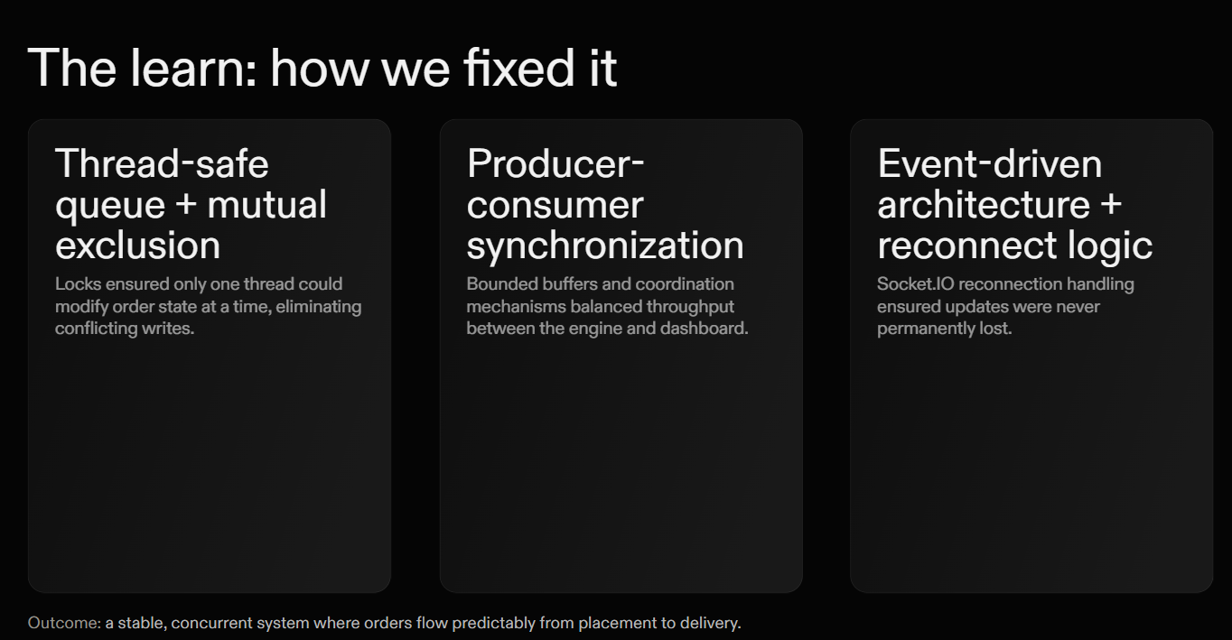

Slide 8



IMPACTS AND BENEFITS
Potential Impacts on Target Audience
Users:
Developers:
Students / Learners
Organizations
Understand practical implementation of OS concepts like scheduling and concurrency.
Helps visualize system performance and process behavior.
Provides a hands-on learning platform for operating systems and distributed architecture.
Improves conceptual understanding through real-time visualization.
Demonstrates scalable real-time system design used in delivery and logistics platforms.
Supports better understanding of system monitoring and performance optimization.
Gain real-time order updates and transparent tracking experience.
Improves convenience, trust, and engagement with real-time services.
Benefits of the Solution:
Social: Enhances user experience through transparent real-time tracking.
Economic: Provides a practical demonstration of OS concepts in real-world applications.
Governance: Acts as a learning tool for understanding scheduling, IPC, and concurrency.
Scientific & Research: Reflects architecture used in modern real-time service platforms.
@SIH Idea submission- Template
5

Slide 9
RESEARCH AND REFERENCES
🖥️Operating System Concepts – Silberschatz, Gavin & Gagne: Primary reference for process management, scheduling, concurrency, and IPC concepts.
🌐Distributed Systems & Client-Server Architecture Resources: Used to understand real-time communication and service coordination patterns.
⚙️Official Documentation – React, Node.js, Flask, Socket.IO: Technical references for implementing real-time web applications and APIs.
📊Modern System Design Case Studies (Real-Time Platforms):Helped align the project with real-world architectures used in delivery and logistics systems.
Thank You

