Slide 1

MACHINE LEARNING INTERNSHIP
MEDIVISION
An Intelligent Machine Learning Based Disease Prediction &
Healthcare Analytics Platform
Aditya Raghav
Roll No: 25SCS1003000812 | Section: 2CSE23
B.Tech CSE, IILM University, Greater Noida
Codec Technologies Pvt. Ltd. • National Internship Portal (AICTE & ICAC) • Google for Education

Slide 2
Introduction
ML
A one-month internship (12th July – 12th August 2026) completed remotely at Codec Technologies Pvt. Ltd. under the AICTE & ICAC approved National Internship Portal, as a Machine Learning Intern.
1
2
3
Project
Role
Outcome
Contributed to MEDIVISION — a disease prediction & healthcare analytics platform.
Data preprocessing, model building, evaluation, and interface development.
Practical exposure to end-to-end applied ML and data engineering.

Slide 3
Organization Profile
Codec Technologies Pvt. Ltd.
Internship Snapshot
A technology training and product-engineering unit developing student-facing and enterprise-grade learning solutions — operating in association with the National Internship Portal and recognised under AICTE & ICAC approval, delivering its Machine Learning track with Google for Education.
Duration
1 Month (12 Jul – 12 Aug 2026)
Mode
Remote
Track
Machine Learning
Python Application Development
Approval
AICTE & ICAC
Data Analytics
Automation Engineering
Partner
Google for Education
Applied Machine Learning
Mentor
Dr. Anurag Shrivastava

Slide 4
Problem Statement
!
The Gap
✓
The Objective
Early detection of common lifestyle and chronic diseases is critical, yet most individuals lack easy access to quick, preliminary health-risk assessments without visiting a doctor or undergoing expensive diagnostic tests.
Existing digital health tools are either too generic to give meaningful insight, or too complex for an everyday, non-technical user.
Design and develop MEDIVISION — a machine learning based healthcare analytics platform that:
Allows users to input basic health parameters
Delivers automated preliminary risk predictions
Surfaces clear, actionable insights
Requires no technical or medical background

Slide 5
Project Objectives
1
Understand the workflow of a real, product-oriented ML engineering team
2
Build a robust data-preprocessing pipeline for healthcare datasets
3
Train and evaluate supervised ML models for disease risk prediction
4
Compare model performance using accuracy, precision, recall & F1-score
5
Integrate the trained model into a functional prediction application
6
Design a Tkinter-based graphical interface for real-time prediction
7
Practice clean code & collaborative development using Git & GitHub

Slide 6
Scope of the Project
The internship supported the design and development of MEDIVISION — Codec Technologies' healthcare analytics platform — through the effective use of Python, machine learning libraries, and data-visualization tools.
Data Pipeline
→
Model Training
& Evaluation
→
Prediction
Engine
→
User
Interface
Demonstrates how thoughtful use of machine learning, data analysis, and automation can turn a routine, manual task — preliminary health risk assessment — into an intelligent, insight-driven experience.

Slide 7
Technologies & Tools Used
1
2
3
4
5
Core Language & Data
Machine Learning
Visualization
Interface & Storage
Collaboration
Python 3
Pandas & NumPy
Scikit-learn
Logistic Regression, Decision Tree, Random Forest
Matplotlib
Seaborn
Tkinter GUI
CSV-based local storage
Git & GitHub

Slide 8
System Architecture
Input Layer
Tkinter form for entering patient health parameters
Data Preprocessing
↓
Cleaning, encoding, normalisation using Pandas
Model Training
↓
Supervised models trained & validated with Scikit-learn
Prediction & Evaluation
↓
Risk prediction scored via accuracy, precision, recall, F1
Visualization
↓
Charts and summaries via Matplotlib & Seaborn
Presentation
↓
Tkinter dashboard displaying results & insights
Storage & Collaboration
↓
CSV storage; Git & GitHub version control

Slide 9
Methodology — 4-Week Timeline
1
2
3
4
Week 1
Week 2
Week 3
Week 4
Onboarding & Fundamentals
Data & Exploratory Analysis
Core Model Development
Evaluation, GUI & Finalisation
Program induction; Python & core ML concepts — supervised learning, evaluation metrics
NumPy/Pandas for cleaning & aggregation; EDA and visualization with Matplotlib/Seaborn
Preprocessing pipeline built; trained & compared Logistic Regression, Decision Tree, Random Forest
Model evaluation via precision/recall/F1; Tkinter GUI; testing, docs, final walkthrough

Slide 10
Expected Outcomes
✓
Practical exposure to a structured ML product-engineering team
✓
Enhanced skills in preprocessing & evaluation using Scikit-learn
✓
Proficiency in training & selecting supervised learning models
✓
Improved analytical & problem-solving skills under deadlines
✓
Understanding predictive analytics for real-world healthcare
✓
Hands-on GUI design experience for ML applications
✓
Strengthened Git & GitHub version-control practices
✓
Confidence in end-to-end feature development
✓
Applied academic knowledge in a real ML engineering setting
✓
Improved professional competencies for future career growth

Slide 11
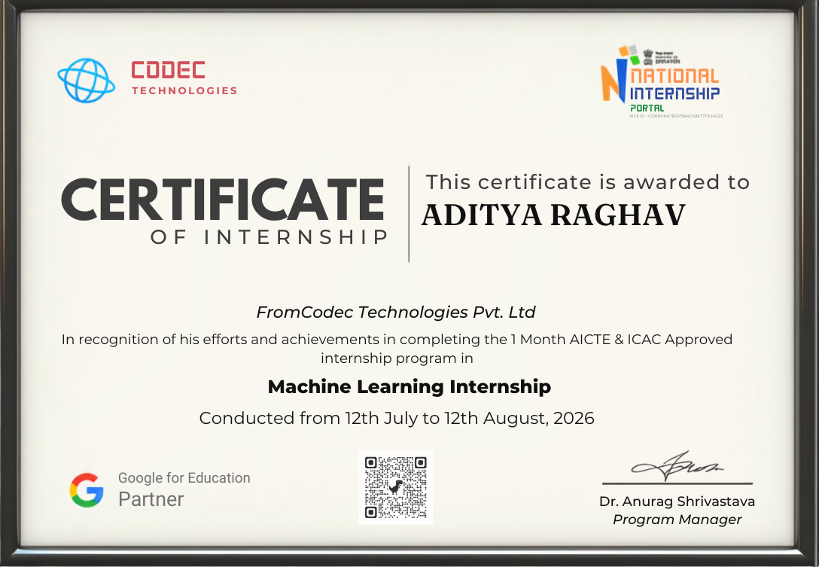
Internship Completion Certificate
Issued by Codec Technologies Pvt. Ltd. • Verified via QR • Signed by Dr. Anurag Shrivastava, Program Manager

Slide 12
Thank You
MEDIVISION — Machine Learning Internship at Codec Technologies Pvt. Ltd.
Aditya Raghav | 25SCS1003000812 | Section 2CSE23

