Slide 1

Think more write less

Slide 2
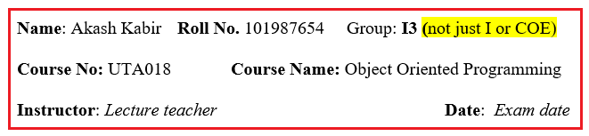
Complete details on the answer sheet

Slide 3
Must follow the instructions of Q paper
NOTE: Solve only 5 out of 6 questions in order, new problem on new page, if not sure, then leave appropriate pages for the leftovers. Plan on the last page before writing to avoid cutting. No partial credit and no rechecking for the messy exams. (also there are instructions in each question)

Slide 4
Brief answer
Q: Fill in the blanks in this code
______<stdio.h> // to link this header file
int main(){
______(“Hello world”); // to display the message
return 0;
}
Answer sheet
ANS:
(i) #include
(ii) printf

Slide 5
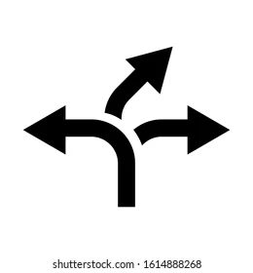
Thinking is more important than writing
An engineer always find 2-3 alternatives, then chooses the best one.

Slide 6

Plan on the last page before start writing. Why rush, when you have 2-3 hours?

Slide 7
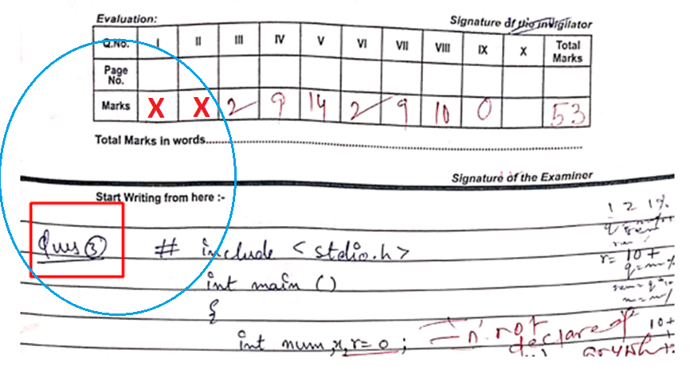
Out of order or mess will not be re-evaluated (also no partial credit)

Slide 8
Don’t know Q1 or Q2 and want to start Q3?
Leave appropriate number of pages with your judgement

Slide 9

New page for new problem

Slide 10
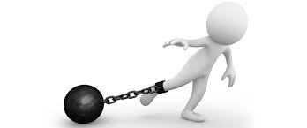
Avoid asking for extra sheet
Smart people are always to the point.

Slide 11
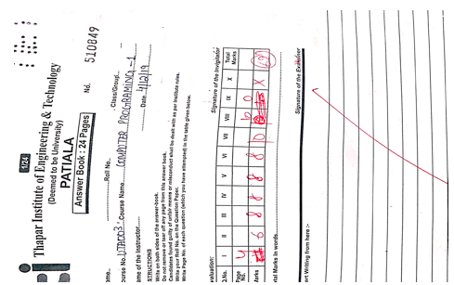
Do not leave the first page blank

Slide 12
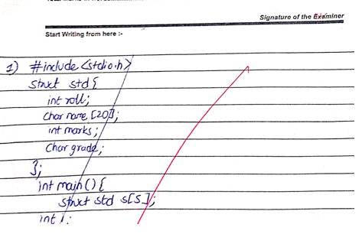
Cutting on the first page is poor impression

Slide 13
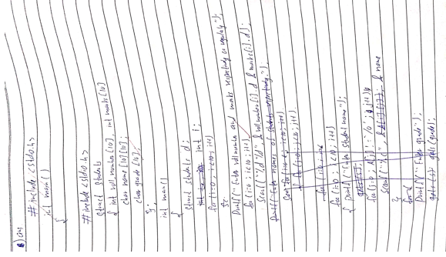
No revaluation for such writeups

Slide 14
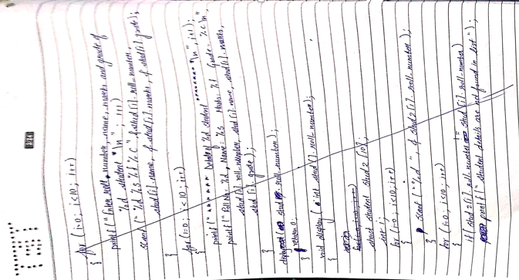
Be conscious while writing

Slide 15
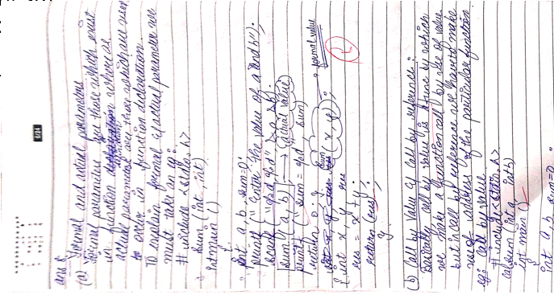
Maggie noodles

Slide 16
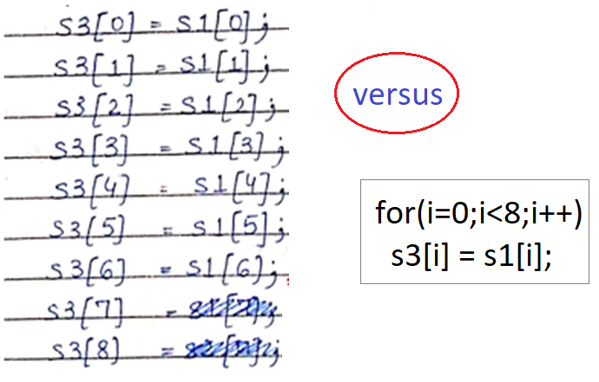

Manual vs Programming

Slide 17
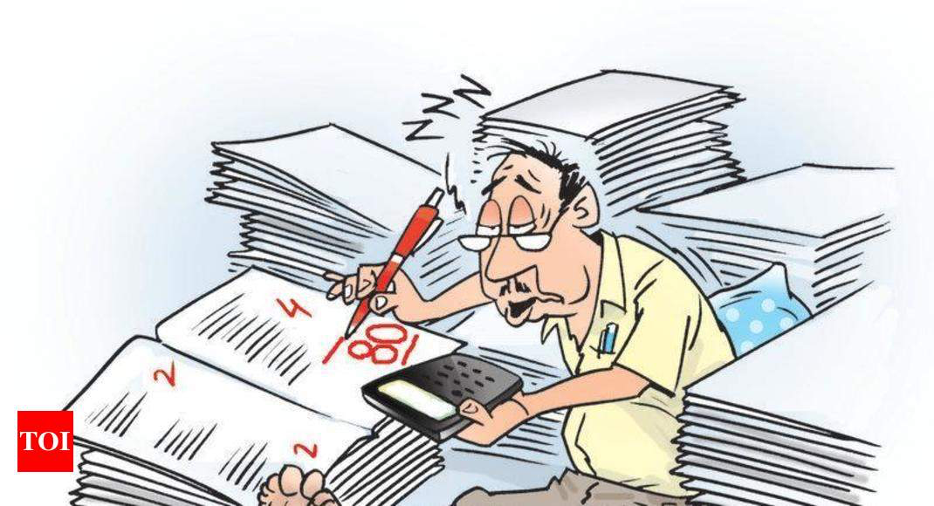
Checking + rechecking of 2,000 exams efficiently without order, poor handwriting and cutting is impossible.

Slide 18
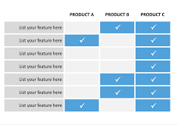

Engineers make diagrams and tables instead of stories

Slide 19

Mature writing
Writing extra is silly and involves more mistakes.
Box the answer

Slide 20

Grace
Write gracefully like a university student

Slide 21
QAs
What is the meaning of PTO? Is it really smart?
Putting God symbols on the exam.
Who invented the theory of writing more than required gets you more points?
What does a neat exam says to a reader?
What is the advantage of instructions in the Q paper?
Should you use pencil or pen for the exam?

