Slide 1
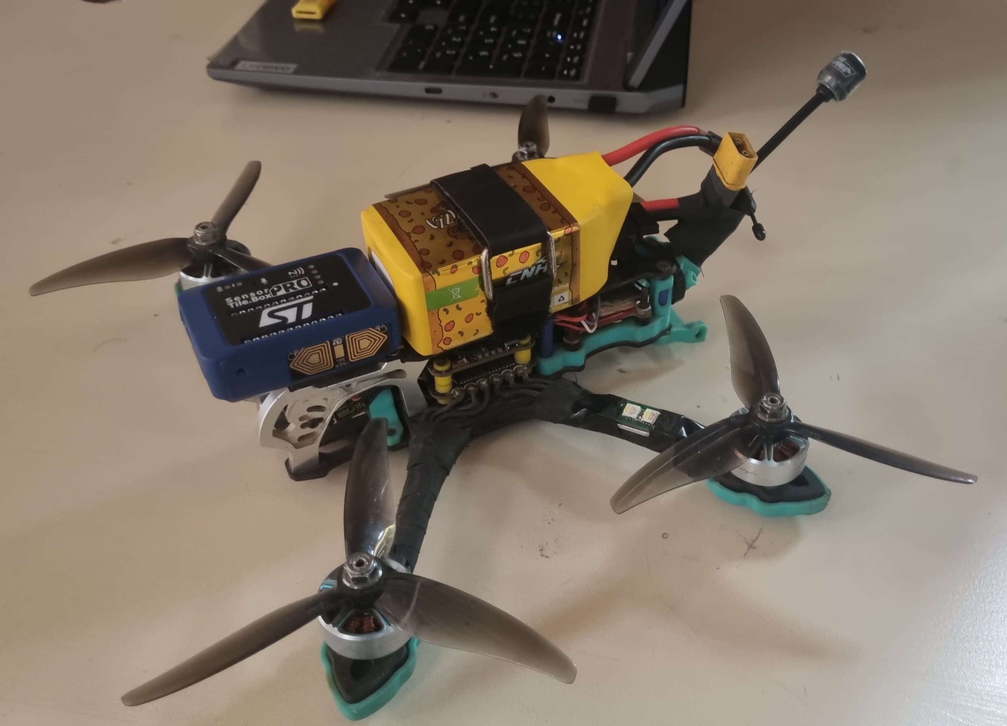
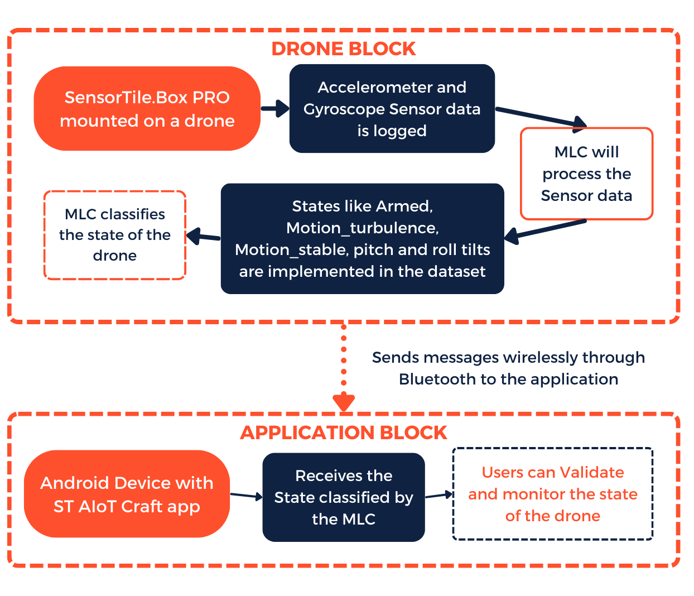
InnovationFair
ST AIoT Craft
Drone Turbulence Detector and Monitoring System
Objective: To design a comprehensive system that integrates sensor-based turbulence detection with machine learning classification to monitor flight stability and control.
Key Features
1. Real-Time Turbulence Detection: Identifies and classifies turbulence affecting drone stability.
2. Multi-State Flight Classification: Differentiates between No Power, Armed, Motion stable, Motion Turbulence, and Pitch/Roll States.
3. Machine Learning Core: Uses MLC for accurate turbulence and motion classification.
4. Data Logging & Analysis: Records flight data for further study and model improvement or drone maintainence..
5. Wireless Model Validation & Deployment: Allows testing and deployment via Bluetooth using ST AloT Craft.
6. Customizable Dataset Creation: Enables dataset generation for different flight conditions.
7. Scalable for Future Applications: Can be extended to larger UAVs or integrated with autopilot systems and aircrafts.
AI Implementation Details
The MLC configuration in this project classifies turbulence levels in real-time by analyzing sensor data from the flight module.
To enhance performance, feature extraction techniques/algorithms such as Analysis of Variance (ANOVA), AdaBoost (ADA), Random Forest (RF), and Recursive Feature Elimination (RFE) are utilized for optimal data selection (default mode of training).
The model achieves high training accuracy upto 99.43% in identifyng turbulence patterns.
Block Diagram
Application
Enhances drone flight stability by detecting and classifying turbulence in real-time.
Improves operational safety for delivery, surveillance, and industrial inspection drones.
Uses machine learning core to optimize control strategies for turbulence mitigation.
Provides a no-code Al solution for easy deployment on embedded systems.
Enables real-time validation and monitoring via Bluetooth connectivity.
Conclusion
The Drone Turbulence Detector and Monitoring System is a crucial innovation in drone technology, integrating advanced sensors and Al for turbulence detection. By monitoring stability and maneuverability, it enhances drone efficiency across various applications. With its automated classification system and real-time data analysis, this project offers a cost-effective, adaptable, and scalable solution for turbulence monitoring in UAVs.
Presented by : Aditya Patil, Nikhil Mittal
Faculty : Dr. Abhay Kumar
College : Jaypee Institute Of Information Technology, Noida
Notes:
Pending Faculty name and Conclusion

