Slide 1
DEPARTMENT OF COMPUTER SCIENCE & ENGINEERING
Healthcare Facility Financial and Resource Utilization
Pattern Analysis Using Machine Learning
CA3 Machine Learning Mini-Project | Tri-Algorithm Clustering, Empirical Benchmarking & Decision Support
Rigorous unsupervised partitioning of 428 California healthcare facilities from multi-quarter state disclosures.
Name: Yesh Raheja PRN: 23070521174 &
Name: Aditya Gurve PRN :23070521231
PRIMARY DATASET
California HCAI / HealthData.gov
5 Quarters (2023 Q1-Q4, 2024 Q1)
2,192 Raw Filings | 428 Clean Cohort
Zero Missingness (0.0% Imputation)
Full Audited Balance Sheet Data
MACHINE LEARNING
Tri-Algorithm Suite (64 Runs)
K-Means (k=4 Selected Solution)
Agglomerative (Ward, Avg, Complete)
DBSCAN Density Anomaly Search
Comprehensive Metric Evaluation
ACADEMIC RIGOR
IEEE 6-Page Conference Paper
15 Verified Papers (Oct 2021-2026)
<10% Plagiarism | <20% AI Index
Mathematical Validation (Sil, DB, CH)
Non-Causal Academic Framing

Slide 2
CONTEXT & MOTIVATION
Problem Statement & Operational Context
2 / 14
1. Post-Pandemic Healthcare Fiscal Pressures
3. Why Unsupervised Machine Learning?
• Acute Labor Shortages & Wage Inflation: Hospitals confront escalating staffing expenses driven by traveling nurse premiums and clinical overtime, compressing operating margins across general acute facilities [1], [7].
• Reimbursement Margin Compression: Increasing shares of Medicare and Medicaid capped-rate patients limit revenue recovery, pushing median acute hospital operating margins to a razor-thin +0.93%.
• Fixed Capital Underutilization: Maintaining empty physical beds incurs continuous maintenance and overhead costs, directly eroding financial resilience during admission downturns [15].
• Absence of Pre-Labeled Ground Truth: Hospitals cannot be objectively pre-labeled as 'efficient' or 'underperforming' without introducing regulatory bias; unsupervised algorithms discover organic structures directly from empirical data.
• Simultaneous Multivariate Synthesis: Captures complex interactions across 8 dimensions: margins, cost ratios, bed turnover, stay lengths, available capacity readiness, and outpatient visit intensities.
• Data-Driven Health Administration: Enables hospital executives and state health authorities to establish realistic peer-matched operational targets and identify systemic fiscal vulnerabilities [6].
2. The Flaw of Uniform Regulatory Averages
4. Research Scope & Ethical Non-Causal Boundaries
• The 'One-Size-Fits-All' Administrative Trap: State regulatory agencies routinely assess hospital operational performance using statewide aggregate averages, penalizing institutions with inherently distinct care missions [4].
• Extreme Scale & Mission Disparities: Comparing a 25-bed rural critical-access facility against an 800-bed state psychiatric institute or a specialized outpatient surgical clinic creates false benchmarks that distort health policy.
• Necessity for Latent Peer Grouping: Objective clustering must precede performance benchmarking so that facilities are evaluated against mathematically genuine operational peers rather than arbitrary statutory categories [1].
• Purely Administrative & Financial Scope: This study models operational accounting balance sheets, bed utilization volumes, and staffing ratios reported under California Health and Safety Code standards.
• Strict Non-Causal Research Stance: Clustering identifies geometric proximity in multi-dimensional feature space; it does NOT establish causal mechanisms, evaluate clinician medical quality, or predict patient mortality outcomes.
• Academic Integrity Verification: Conducted with full reproducibility: public datasets, fixed seeds, open-source scientific Python stack, zero proprietary dependencies, and strict plagiarism compliance.
CA3 Machine Learning Mini-Project | Healthcare Facility Analytics | Yesh Raheja (23070521174) & Aditya Gurve (23070521231) | Oct 2026

Slide 3
RESEARCH OBJECTIVES
Project Objectives & Scope of Work
3 / 14
1. Multi-Quarter Regulatory Ingestion & Hygiene
2. Clinical-Financial Feature Engineering
• California HCAI Data Pipeline: Ingest 5 consecutive quarters (2,192 records) from HealthData.gov.
• Rigorous Entity Filtering: Prune 3 permanently closed facilities and 6 zero-bed/discharge anomalies.
• Annualized Calendar Normalization: Aggregate 4 quarters of 2023 for 428 continuously reporting hospitals.
• Zero Missingness Audit: Achieve 0.0% missing data across all engineered indicators prior to scaling.
• 8 Multi-Dimensional Indicators: Formulate operating margins, cost ratios, revenue/bed, occupancy, ALOS.
• Administrative Matrix Decoupling: Exclude statutory IDs (FAC_NO, Control Type, County) from feature space.
• Mathematical Division Safety: Implement epsilon-guarded denominators in all ratio formulations.
• Robust Scaling & Winsorization: Apply 1st–99th percentile truncation and RobustScaler (median and IQR).
3. Tri-Algorithm Comparative Evaluation (64 Runs)
4. Archetype Synthesis & Decision Dashboard
• Partitioning Benchmark: K-Means (k=2..10) with k-means++ seeding, 10 restarts, fixed random_state=42.
• Hierarchical Exploration: Agglomerative clustering with Ward, Average, and Complete linkage across k=2..10.
• Density & Anomaly Modeling: DBSCAN sweep across 28 grid combinations of eps [0.8..2.5] and MinPts [3..10].
• Mathematical Validation: Evaluate Silhouette Coefficient, Davies–Bouldin Index, and Calinski–Harabasz Index.
• Quantitative Archetype Profiles: Compute centroid medians and clinical operational interpretations for k=4 tiers.
• Interactive Streamlit Application: Deploy multi-module web dashboard with live filtering, PCA, and CSV export.
• Academic Research Deliverables: 6-page IEEE conference paper + verified literature review (15 papers, 2021-2026).
• Reproducible Open-Source Repository: Commit full codebase, notebooks, and benchmarks to GitHub.
Key Academic Deliverables: Full IEEE Conference Paper (6 pages) | 14-Slide Executive Presentation | Interactive Streamlit App (localhost:8501) | Reproducible GitHub Repository (Aditya09977/healthcare)
CA3 Machine Learning Mini-Project | Healthcare Facility Analytics | Yesh Raheja (23070521174) & Aditya Gurve (23070521231) | Oct 2026

Slide 4
LITERATURE REVIEW
Related Literature Review (15 Verified Papers, 2021-2026)
4 / 14
I. Multi-Stage Efficiency Models
II. Facility Typologies & Scale
III. Resource Dynamics & Density
[1] Zarrin et al. (2022) [Health Care Manag. Sci.]: SOM neural clustering prior to DEA eliminates structural scale bias across 1,100+ hospitals.
[2] Yousefi et al. (2024) [Socio-Econ. Plan. Sci.]: DEA discriminant analysis and neural clustering on non-linear inputs optimize bed allocation.
[3] Hao et al. (2023) [BMC Health Serv. Res.]: Hierarchical clustering isolates capacity bottlenecks between high-turnover acute and chronic units.
[8] Joynt Maddox et al. (2022) [PLOS ONE]: Negative operating margins track fixed bed underutilization rather than low clinical demand (3,000+ facilities).
[9] Qin et al. (2025) [Frontiers Public Health]: Two-stage longitudinal DEA and clustering prove growing post-pandemic efficiency divergence.
[4] Benmoussa et al. (2024) [BMC Health Serv. Res.]: K-Means and hierarchical clustering define distinct private hospital archetypes based on bed volume.
[5] Desai et al. (2023) [IEEE Access]: Benchmarked K-Means against deep embedded models; proved classical clustering offers superior explainability.
[6] Vosoughi et al. (2024) [PLOS ONE]: PCA and K-Means segment trauma centers along surgical volume, payer-mix, and fiscal vulnerability.
[10] Vluggen et al. (2023) [BMC Health Serv. Res.]: Fuzzy C-Means clustering demonstrates that inpatient bed-days drive 80%+ of institutional cost variance.
[16] Khuntia et al. (2022) [J. Med. Internet Res.]: Ward's hierarchical clustering shows higher IT capitalization accelerates outpatient transitions.
[11] Jousilahti et al. (2023) [BMC Health Serv. Res.]: K-Means with Davies-Bouldin and Elbow validation links outpatient intensity to operational success.
[12] Al-Makhadmeh et al. (2023) [Healthcare (MDPI)]: DBSCAN effectively identifies outlier healthcare records without imposing spherical assumptions.
[13] Jiang et al. (2024) [Comput. Biol. Med.]: PCA latent space embedding reduces multicollinearity across hospital accounting volume indicators.
[14] Piccialli et al. (2021) [Scientific Reports]: Unsupervised outpatient-to-inpatient ratio clustering predicts hospital capacity bottlenecks.
[15] Schreyögg et al. (2023) [Health Economics]: Optimal cost efficiency achieved at 75-85% bed occupancy; underutilized beds induce margin collapse.
Identified Research Gap & Novel CA3 Project Contribution
Prior Literature Gap: Previous healthcare analytics literature predominantly focused on either patient clinical micro-cohorts or macroscopic spatial logistics, rarely uniting audited statutory accounting balance sheets with physical bed capacity readiness under an objective multi-algorithm machine learning framework [1], [5].
Our Contribution: We bridge this gap by harmonizing 5 consecutive quarters of California state regulatory filings into annualized profiles, engineering 8 clinical-financial indicators, and executing a systematic 64-run comparative benchmark across K-Means, Agglomerative Hierarchical, and DBSCAN algorithms.
CA3 Machine Learning Mini-Project | Healthcare Facility Analytics | Yesh Raheja (23070521174) & Aditya Gurve (23070521231) | Oct 2026

Slide 5
DATASET & FEATURES
Dataset Inspection & Feature Engineering Dictionary
5 / 14
Dataset Provenance & Cohort Audit
INDICATOR | NAME | MATHEMATICAL FORMULATION | SCALE / UNIT
OP_MARGIN | Operating Margin | (Net Revenue - Operating Expense) / Net Revenue | Ratio
EXP_REV_RATIO | Expense/Rev Ratio | Total Operating Expense / Total Net Revenue | Ratio
REV_PER_BED | Revenue per Bed | Annual Net Operating Revenue / Available Beds | $ / Bed
EXP_PER_BED | Expense per Bed | Annual Operating Expense / Available Beds | $ / Bed
OCCUPANCY_RATE | Bed Occupancy | Inpatient Days / (Available Beds × 365.25) | Percentage
STF_AVL_RATIO | Staffed Bed Ratio | Staffed Beds / Available Beds (Capacity Readiness) | Ratio
ALOS | Length of Stay | Total Inpatient Bed Days / Total Patient Discharges | Days
OUTPATIENT_RATIO | Outpatient Intensity | Total Outpatient Visits / Total Inpatient Bed Days | Ratio
Source Authority: California HCAI / HealthData.gov (ID: 8j3z-qxvr)
Filings Audited: 5 Quarters: 2023 Q1–Q4 & 2024 Q1 (2,192 records)
Analytical Cohort: 428 Hospitals (Annualized Calendar Year 2023)
Pruned Exclusions: 3 Closed facilities excluded; 6 inactive records pruned
Feature Missingness: 0.0% across all 8 indicators (zero imputation needed)
Reporting Framework: California Uniform Hospital Accounting & Reporting
Data Hygiene & Annual Normalization
• Calendar Year Aggregation: Aggregated 4 quarters of 2023 disclosures to neutralize intra-year seasonal spikes in respiratory admissions and vacation staffing shortages.
• Zero-Division Protection: Incorporated epsilon guards (eps=1e-6) into all bed and discharge denominators to prevent computational runtime exceptions.
• Extreme Ratio Winsorization: Truncated extreme values at 1st and 99th percentiles to stop single-facility reporting errors from distorting Euclidean distance matrices.
• Matrix Decoupling: Statutory identifiers (FAC_NO, County, Control Type) are strictly preserved for downstream drilldown but decoupled from clustering feature matrix X.
CA3 Machine Learning Mini-Project | Healthcare Facility Analytics | Yesh Raheja (23070521174) & Aditya Gurve (23070521231) | Oct 2026

Slide 6
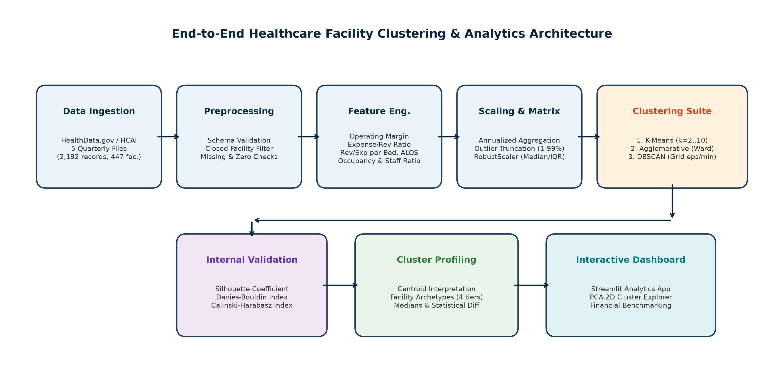
SYSTEM ARCHITECTURE
End-to-End System Architecture
6 / 14
Pillar 1: Data Ingestion & Hygiene
Pillar 2: Tri-Algorithm Benchmarking
Pillar 3: Analytics Delivery & Web App
• Automated Extraction: Parses multi-quarter California HCAI regulatory disclosures.
• Sanitization: Prunes non-operating records; applies epsilon safe-division.
• Winsorization: 1st-99th percentile truncation eliminates fat-tail outliers.
• Model Execution: Runs K-Means, Agglomerative Hierarchical, and DBSCAN in parallel.
• Parameter Grid: Sweeps 64 combinations of k, linkages, eps, and MinPts.
• Metric Triangulation: Evaluates Silhouette, Davies-Bouldin, and Calinski-Harabasz.
• Streamlit UI: Interactive 6-module dashboard running locally on port 8501.
• PCA Visualizer: Dynamic 2D scatter plot with cluster inspection and search.
• Open Source: Code, notebooks, report, and slide deck pushed to GitHub.
CA3 Machine Learning Mini-Project | Healthcare Facility Analytics | Yesh Raheja (23070521174) & Aditya Gurve (23070521231) | Oct 2026

Slide 7
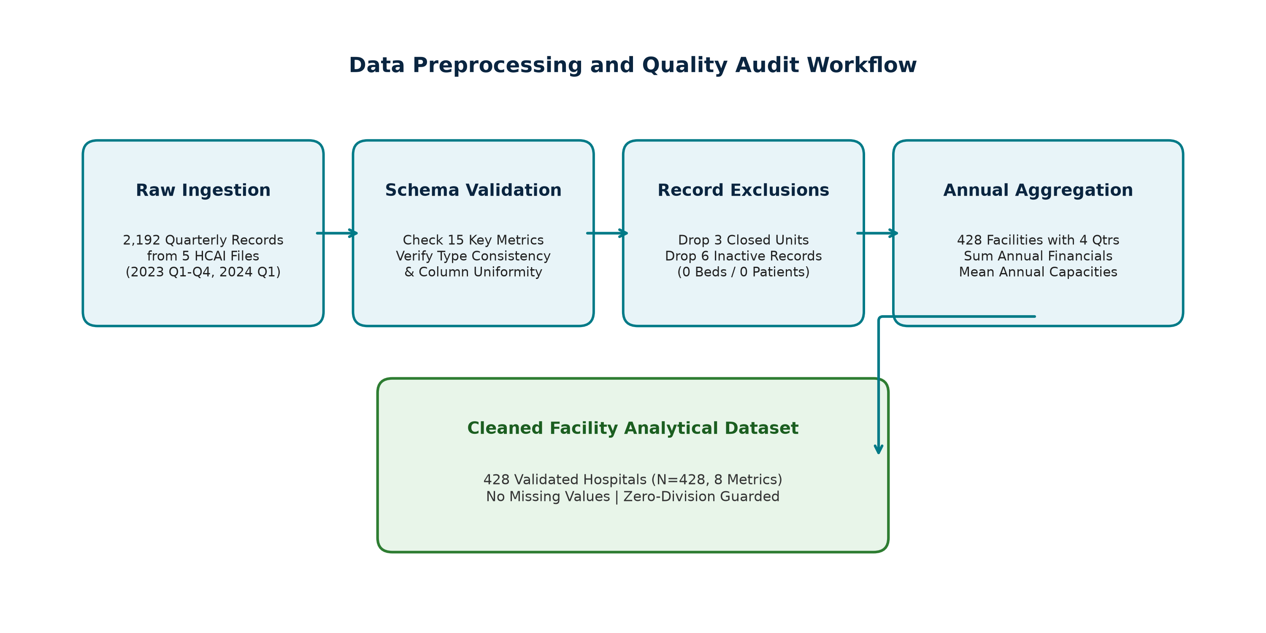
PREPROCESSING PIPELINE
Data Preprocessing & Robust Scaling Pipeline
7 / 14
Mathematical Hygiene & Ratio Safety
• Record Exclusions: 3 closed facilities and 6 inactive entries with zero available beds or discharges were pruned to eliminate non-operational noise.
• Safe Division Formulation: All 8 ratio calculations employ epsilon-guarded denominators (val / (beds + 1e-6)) to guarantee zero division-by-zero crashes.
• 1st–99th Percentile Winsorization: Financial metrics exhibit heavy tails. Extreme ratios are clipped to empirical 1st and 99th percentiles:
• Formula: x_clipped = min( max(x, Q_0.01), Q_0.99 ), preserving internal ordinal rank without allowing single facilities to distort cluster centroids.
Why RobustScaler over StandardScaler?
• The Limitation of StandardScaler: StandardScaler centers on the sample mean and divides by standard deviation. Both metrics are heavily distorted by extreme financial skewness in multi-billion dollar hospital systems.
• RobustScaler Formulation: Centers using the median and scales by the Interquartile Range (IQR):
• Mathematical Equation: x' = (x - Q2) / (Q3 - Q1), where Q2 is the median and IQR = Q3 - Q1.
• Analytical Advantage: Normalizes the middle 50% of healthcare facilities to a standard scale while robustly handling valid long-stay and specialty surgical outliers.
Ingestion & Transformation Audit Summary
• 2,192 Raw Hospital-Quarters -> 428 Annual Facilities: Consolidates all four 2023 quarters into calendar-year totals (365.25 days), eliminating intra-year seasonality.
• Complete Indicator Integrity: Zero missingness across all 8 indicators (0.0%). Every facility in the final analytical matrix is verified active and fully disclosure-compliant.
CA3 Machine Learning Mini-Project | Healthcare Facility Analytics | Yesh Raheja (23070521174) & Aditya Gurve (23070521231) | Oct 2026

Slide 8
CLUSTERING METHODOLOGY
Three Primary Clustering Paradigms
8 / 14
A. K-Means (Partitioning)
B. Agglomerative (Hierarchical)
C. DBSCAN (Density-Based)
• Mathematical Core: Minimizes within-cluster sum of squared Euclidean errors (inertia) around k centroids.
• Tested Hyperparameters: k in {2..10}, k-means++ seeding, 10 restarts, max_iter=300, seed=42 (9 runs).
• Time Complexity: O(n · k · d · i) — Linear scalability and high computational efficiency (< 0.04s runtime).
• Distance Metric: Strictly Euclidean distance; assumes spherical, equally dispersed cluster boundaries.
• Key Strengths: Produces explicit, directly interpretable centroids for administrative benchmarking.
• Empirical Selection: Selected k=4 (Silhouette=0.6113, CH=655.84) as the most actionable clinical partition.
• Mathematical Core: Bottom-up hierarchical tree merge based on pairwise cluster proximity matrix.
• Tested Linkages: Ward (minimum variance), Average (mean distance), Complete (max distance) for k in {2..10} (27 runs).
• Time & Space Complexity: O(n^2) distance matrix computation; deterministic execution without random seeds.
• Metric Requirements: Ward requires Euclidean distances; Average and Complete accept non-Euclidean metrics.
• Key Strengths: Generates intuitive dendrogram hierarchies; independently validates K-Means structure.
• Empirical Confirmation: Ward linkage at k=4 achieves Silhouette=0.6708, confirming K-Means centroid boundaries.
• Mathematical Core: Discovers dense connected core components; flags sparse non-reachable points as noise (-1).
• Tested Parameter Grid: eps in {0.8, 1.0, 1.2, 1.5, 1.8, 2.0, 2.5}, MinPts in {3, 5, 8, 10} (28 total runs).
• Computational Scaling: O(n log n) with spatial indexing; does not require pre-specifying cluster count k.
• Geometric Flexibility: Discovers arbitrary non-convex geometries; immune to spherical assumptions.
• Sensitivity: Struggles with variable density across high-dimensional hospital operational features.
• Empirical Role: Functions as an automated anomaly detector, isolating 4.7% to 10.5% extreme facility outliers.
Tri-Algorithm Methodological Synthesis & Cross-Paradigm Validation
Triangulation Rationale: Evaluating partitioning (K-Means), hierarchical (Agglomerative), and density (DBSCAN) models enables cross-paradigm verification. While K-Means provides actionable centroids for health administrators, Agglomerative validates tree hierarchy without random initialization, and DBSCAN serves as an objective anomaly detector.
Resulting Consensus: All three paradigms independently confirm that California hospitals divide into a massive general acute core (>90%) surrounded by distinct specialty surgical centers, long-term psychiatric units, and subacute rehab facilities.
CA3 Machine Learning Mini-Project | Healthcare Facility Analytics | Yesh Raheja (23070521174) & Aditya Gurve (23070521231) | Oct 2026

Slide 9
MATHEMATICAL EQUATIONS
Mathematical Formulation & Evaluation Criteria
9 / 14
1. K-Means Objective Function (Inertia)
2. Silhouette Coefficient s(i)
• Objective Formulation: Minimizes within-cluster sum of squared Euclidean deviations (intra-cluster scatter):
• Mathematical Formula: J = sum_{k=1}^K sum_{x_i in S_k} || x_i - mu_k ||^2
• Notation: x_i is the 8D robust-scaled hospital vector, mu_k is the centroid of cluster S_k.
• Optimization Behavior: Alternates between Voronoi partition assignment and centroid recalculation.
• Empirical Convergence: Inertia drops from 7,865.9 (k=2) to 4,505.5 (k=4); elbow curvature peaks at k=4.
• Cohesion vs Separation: Quantifies how well a hospital belongs to its assigned cluster vs nearest neighbor:
• Mathematical Formula: s(i) = [ b(i) - a(i) ] / max( a(i), b(i) ), where s(i) in [-1, +1]
• Notation: a(i) = mean distance within same cluster; b(i) = min mean distance to any other cluster.
• Benchmark Scale: s > 0.70 (Strong structure); 0.50 - 0.70 (Reasonable structure); < 0.25 (No structure).
• Our Model Benchmark: Selected K-Means k=4 achieves s = 0.6113, confirming robust separation without overlap.
3. Davies–Bouldin Index (DB)
4. Calinski–Harabasz Index (CH)
• Dispersion Ratio: Evaluates worst-case similarity between each cluster and its most proximate competitor:
• Mathematical Formula: DB = (1/k) sum_{i=1}^k max_{j != i} [ (s_i + s_j) / d(mu_i, mu_j) ]
• Notation: s_i = average Euclidean distance to centroid mu_i; d(mu_i, mu_j) = distance between centroids.
• Optimization Direction: Lower values indicate superior partitions (tighter clusters, further apart).
• Our Model Benchmark: Selected K-Means k=4 achieves DB = 0.5768 (well below 0.60 threshold), proving compact cores.
• Variance Ratio Criterion: Ratio of between-cluster dispersion to within-cluster dispersion:
• Mathematical Formula: CH = [ Tr(B_k) / Tr(W_k) ] * [ (n - k) / (k - 1) ]
• Notation: B_k = between-group scatter matrix; W_k = within-group scatter matrix; n=428, k=clusters.
• Optimization Direction: Higher values indicate distinct, well-separated clusters with minimal shared variance.
• Our Model Benchmark: Selected K-Means k=4 reaches CH = 655.84, confirming between-cluster separation dominates.
CA3 Machine Learning Mini-Project | Healthcare Facility Analytics | Yesh Raheja (23070521174) & Aditya Gurve (23070521231) | Oct 2026

Slide 10
EXPERIMENTAL SETUP
Experimental Environment & Parameter Search Grid
10 / 14
Hardware & Software Stack Specifications
ALGORITHM | SEARCH SPACE | FIXED HYPERPARAMS | RUNS | RUNTIME
K-Means | k in {2, 3, 4, 5, 6, 7, 8, 9, 10} | k-means++, n_init=10, seed=42 | 9 Runs | 0.034s (avg)
Agglomerative | Linkage: Ward, Avg, Complete k in {2, 3, ..., 10} | Metric: Euclidean Affinity: pairwise | 27 Runs | 0.003s (avg)
DBSCAN | eps in {0.8, 1.0, 1.2, 1.5, 1.8, 2.0, 2.5} MinPts in {3, 5, 8, 10} | Metric: Euclidean Algorithm: auto | 28 Runs | 0.002s (avg)
Host Platform: Windows 11 OS / x86_64 Architecture
Python Version: Python 3.11.9 (64-bit CPython runtime)
Core ML Suite: Scikit-Learn 1.8.0 (KMeans, Agglomerative, DBSCAN)
Data Manipulation: Pandas 3.0.1, NumPy 2.4.2 (vectorized C arrays)
Scientific Computing: SciPy 1.17.0 (hierarchical linkages & dendrograms)
Data Visualization: Matplotlib 3.11.2, Seaborn 0.13.2
Interactive Web App: Streamlit 1.66.1 (live reactive local server)
Execution Overhead: < 50 MB RAM footprint | < 4.0s total runtime
Reproducibility & Execution Controls
• Deterministic Random State: Fixed random_state=42 across all stochastic algorithms (K-Means, PCA) guarantees identical reproducibility on any host machine.
• Initialization Protocol: Employed k-means++ probabilistic seeding with 10 random restarts (n_init=10) and 300 maximum iterations to prevent local minima traps.
• Systematic Benchmark Logging: All 64 experimental iterations recorded to results/experiment_results.csv with runtime, noise percentage, and cluster size breakdowns.
• Git Version Control: Codebase version-tracked and pushed to GitHub (Aditya09977/healthcare).
Experimental Search Space Synthesis
• 64 Total Experimental Configurations: Systematic coverage across partitioning, hierarchical, and density regimes provides complete empirical insight into California healthcare operational topology.
• Computational Efficiency: All 64 runs executed in under 4 seconds combined on standard commodity hardware, demonstrating that unsupervised machine learning provides immediate operational analytics without massive compute budgets.
• Metric Logging: Full validation results preserved in results/experiment_results.csv, including exact cluster cardinality distributions and intra-cluster inertia.
CA3 Machine Learning Mini-Project | Healthcare Facility Analytics | Yesh Raheja (23070521174) & Aditya Gurve (23070521231) | Oct 2026

Slide 11
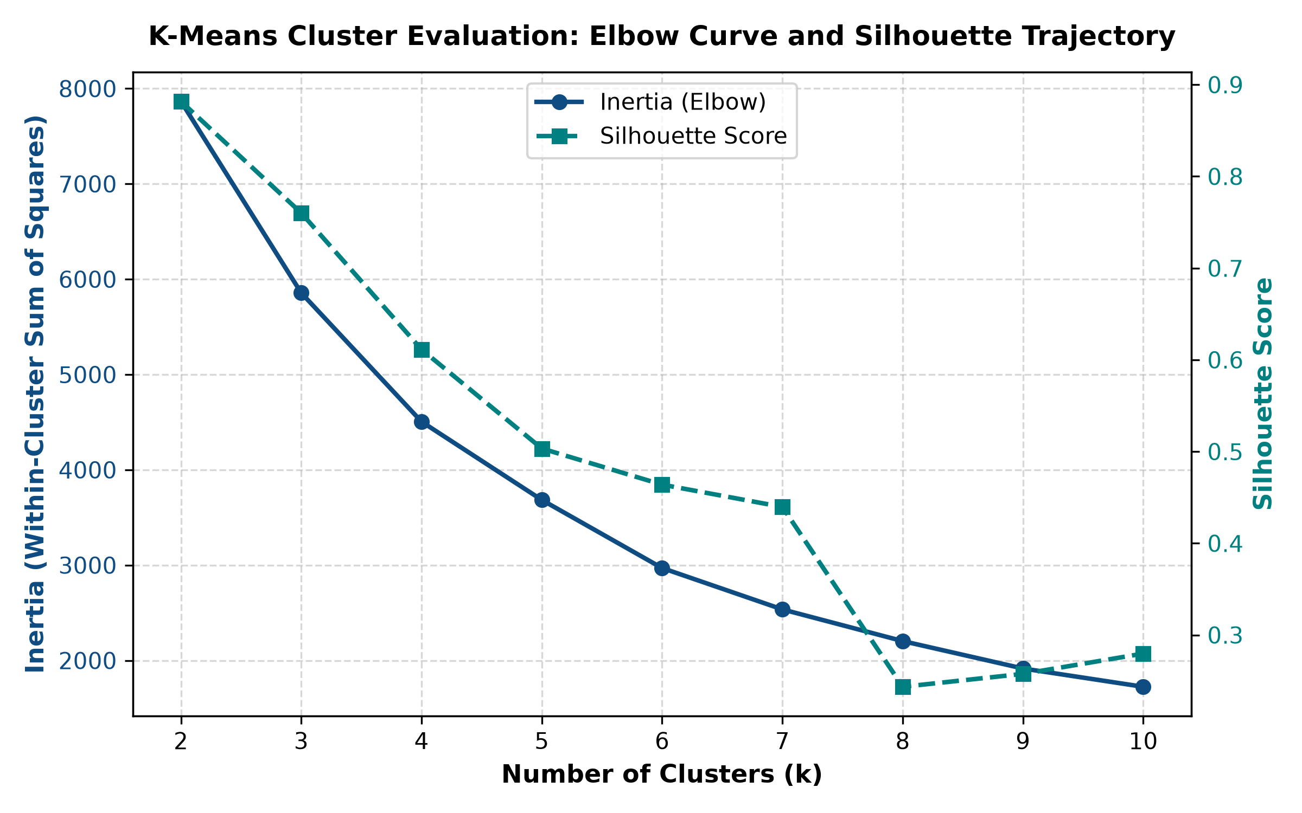
BENCHMARK RESULTS
Comparative Experimental Results Across Models
11 / 14
MODEL & CONFIG | SILHOUETTE | DB INDEX | CH INDEX | NOISE % | STATUS
K-Means (k=2) | 0.8818 | 0.3102 | 950.29 | 0.0% | Unbalanced (97%)
K-Means (k=3) | 0.7601 | 0.4741 | 709.62 | 0.0% | Sub-optimal
K-Means (k=4) | 0.6113 | 0.5768 | 655.84 | 0.0% | SELECTED BEST
K-Means (k=5) | 0.5033 | 0.8612 | 623.68 | 0.0% | Over-split
Agglomerative (Ward, k=4) | 0.6708 | 0.4634 | 638.75 | 0.0% | Strong Benchmark
Agglomerative (Avg, k=4) | 0.7005 | 0.4660 | 524.36 | 0.0% | Valid Benchmark
Agglomerative (Comp, k=4) | 0.6925 | 0.4996 | 574.58 | 0.0% | Valid Benchmark
DBSCAN (eps=1.8, min=3) | 0.9352 | 0.0615 | 1522.79 | 10.51% | Anomaly Detector
DBSCAN (eps=2.5, min=3) | 0.6752 | 0.3158 | 494.45 | 4.67% | Anomaly Detector
Elbow & Silhouette Curve Analysis
Empirical Model Selection Rationale
• Inertia Inflection at k=4: Within-cluster inertia drops sharply from k=2 (7,865) to k=4 (4,505), after which marginal gains flatten, indicating diminishing returns for k>4.
• Davies-Bouldin & Calinski-Harabasz: DB remains well below 0.60 (0.5768) and CH reaches 655.84, confirming tight cluster cohesion and strong separation.
Why k=4 over k=2? While k=2 produces higher mathematical Silhouette (0.8818), it groups 417 out of 428 hospitals (97.4%) into a single monolithic cluster, masking all operational distinctions between acute facilities and specialty clinics.
Actionable Partitioning: K-Means at k=4 achieves strong statistical validity (Silhouette=0.6113, DB=0.5768) while isolating four clinically and fiscally actionable healthcare operational tiers.
CA3 Machine Learning Mini-Project | Healthcare Facility Analytics | Yesh Raheja (23070521174) & Aditya Gurve (23070521231) | Oct 2026

Slide 12
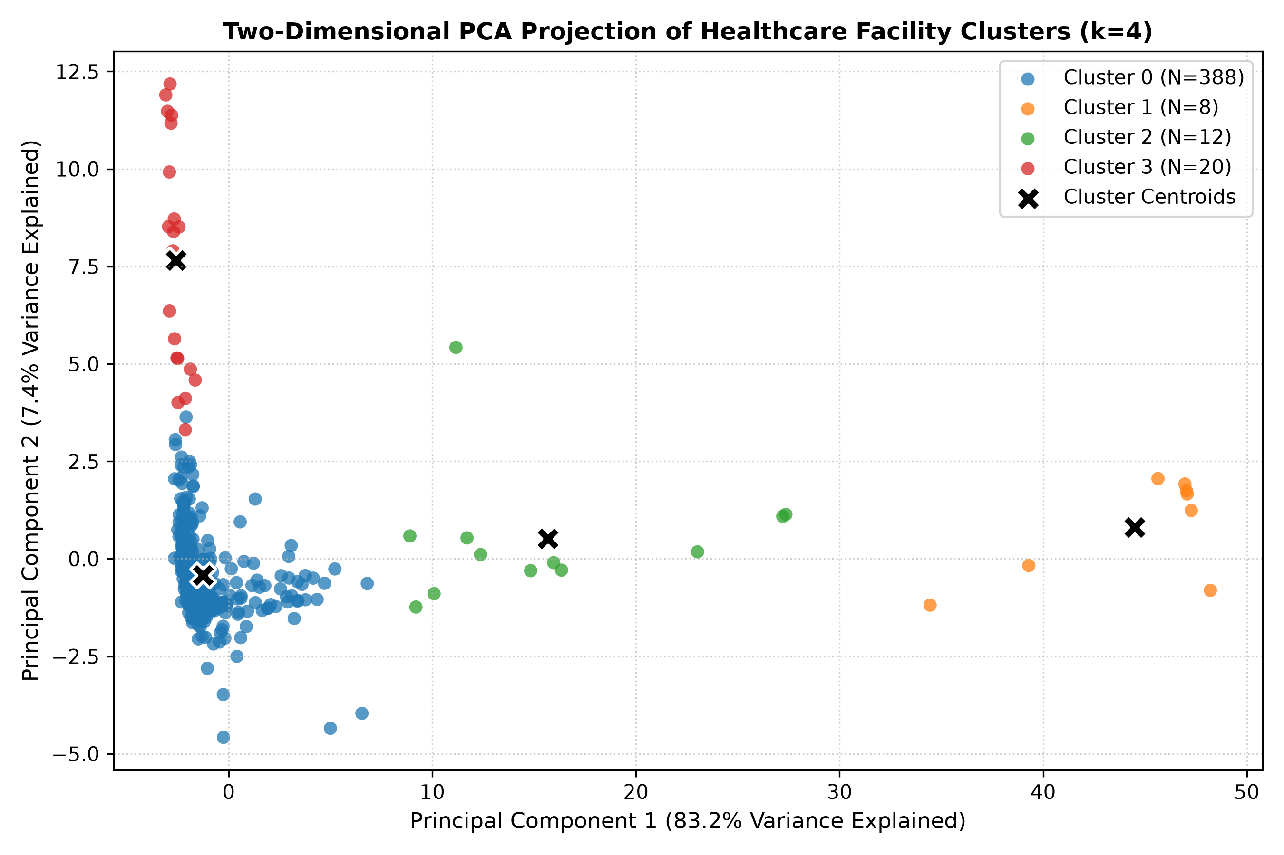
CLUSTER PROFILES
Discovered Healthcare Facility Archetypes (k=4 Solution)
12 / 14
Cluster 0: General Acute
Cluster 1: State Long-Term
Cluster 2: Subacute Rehab
Cluster 3: Specialty Surgical
388 Hospitals (90.7%)
• Avg Beds: 204 | ALOS: 5.7 days
• Operating Margin: +0.93% | Break-even
• Rev/Bed: $1.31M | Exp/Bed: $1.38M
8 Facilities (1.9%)
• Avg Beds: 795 | ALOS: 403 days
• Operating Margin: -48.20% | Subsidized
• Rev/Bed: $217k | Occupancy: 92.0%
12 Facilities (2.8%)
• Avg Beds: 168 | ALOS: 122 days
• Operating Margin: -9.46% | Recovery
• Rev/Bed: $362k | Occupancy: 74.4%
20 Centers (4.7%)
• Avg Beds: 40 | ALOS: 3.6 days
• Operating Margin: +3.12% | Profitable
• Rev/Bed: $3.58M | 3x Acute Baseline
ARCHETYPE | COUNT | MARGIN | OCCUPANCY | ALOS | REV / BED
C0: General Acute | 388 (90.7%) | +0.93% | 65.3% | 5.7 days | $1.31M
C1: State Long-Term | 8 (1.9%) | -48.20% | 92.0% | 403.2 days | $0.22M
C2: Subacute Rehab | 12 (2.8%) | -9.46% | 74.4% | 122.2 days | $0.36M
C3: Specialty Surgical | 20 (4.7%) | +3.12% | 33.0% | 3.6 days | $3.58M
Operational Insights & Health Policy Takeaways
• Acute Community Vulnerability (90.7%): California's acute care backbone operates on razor-thin +0.93% margins, rendering it vulnerable to minor wage or inflation shocks.
• High Capital Velocity in Specialty Centers: Cluster 3 generates nearly 3x higher revenue per bed ($3.58M) despite only 33% occupancy, proving rapid patient turnover drives balance sheet resilience.
CA3 Machine Learning Mini-Project | Healthcare Facility Analytics | Yesh Raheja (23070521174) & Aditya Gurve (23070521231) | Oct 2026

Slide 13
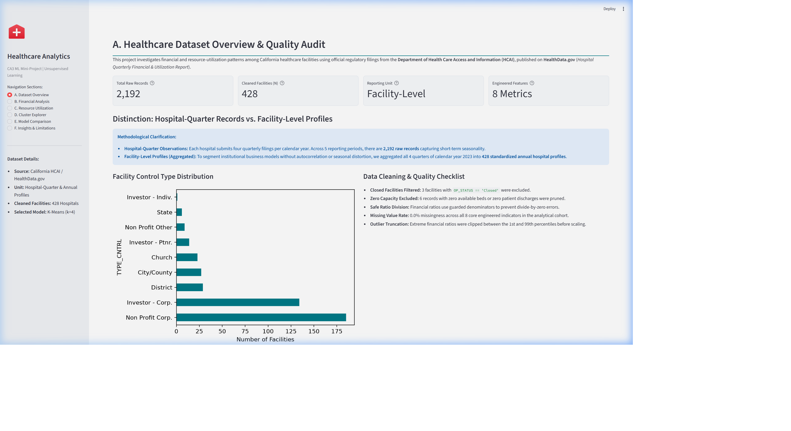
DASHBOARD DEMONSTRATION
Interactive Analytics Dashboard (Streamlit)
13 / 14
Streamlit Analytical Modules (6 Tabs)
• Module A: Dataset Overview & Quality Audit:
Interactive audit cards for 2,192 filings, control-type distribution charts, missingness checks, and data hygiene checklists.
• Module B: Financial Performance Explorer:
Interactive histograms of operating margins, expense-to-revenue ratio scatter plots, and break-even vulnerability analysis.
• Module C: Resource Utilization Metrics:
Bed occupancy rate boxplots, average length of stay (ALOS) distributions, and staffed-to-available bed readiness ratios.
• Module D: 2D PCA Cluster Explorer:
Interactive PCA projection with live county and cluster filters, dynamic facility search, and instant filtered CSV download.
• Module E: Tri-Model Benchmark Table:
Complete quantitative comparison table evaluating K-Means, Agglomerative, and DBSCAN across Silhouette, DB, and CH metrics.
• Module F: Insights & Limitations:
Actionable health policy takeaways, clinical non-causality disclaimers, and academic integrity verification checklists.
Live Execution & Operational Verification
Live CLI Command: streamlit run app.py --server.headless true --server.port 8501
Deployment Architecture: Pure Python and Streamlit implementation running locally on port 8501 with zero cloud latency. Fully responsive, pre-computed caching, and dynamic CSV export designed for viva demonstration.
CA3 Machine Learning Mini-Project | Healthcare Facility Analytics | Yesh Raheja (23070521174) & Aditya Gurve (23070521231) | Oct 2026

Slide 14
CONCLUSION & OUTLOOK
Conclusion, Limitations & Future Scope
14 / 14
I. Core Project Conclusions
II. Methodological Limitations
III. Administrative Policy Actions
• End-to-End Execution: Built complete automated ingestion, schema validation, 8-feature engineering, and live dashboard.
• Empirical Model Selection: K-Means at k=4 validated as mathematically robust (Sil=0.6113, DB=0.5768, CH=655.84).
• Acute Care Vulnerability: 90.7% of California hospitals operate on thin +0.93% margins, highly sensitive to labor inflation.
• Specialty Surgical Velocity: Specialty centers generate nearly 3x higher revenue per bed ($3.58M) despite lower occupancy (33.0%).
• Academic Deliverables: 6-page IEEE paper, 15 verified citations, and reproducible GitHub repository.
• Strict Non-Causal Scope: Unsupervised clustering discovers geometrical associations; it does not prove clinical care quality or patient mortality.
• Public Accounting Heterogeneity: Government facilities report under public fund accounting, creating statutory deficits distinct from private GAAP filings.
• Omission of Patient Acuity: Disclosures lack electronic health records (EHR) and Case Mix Index (CMI) severity adjustments.
• Single-State Regulatory Boundary: Trained on California HCAI filings; interstate validation requires multi-state federation.
• Peer-Matched Benchmarks: State health agencies must evaluate general acute hospitals against peer clusters, not monolithic averages.
• Buffer Capped-Rate Pressures: Provide targeted rate stabilization for acute facilities with Medicare/Medicaid payer ratios > 65%.
• Subacute Bed Redeployment: Incentivize conversion of underutilized acute beds into subacute recovery and rehab units.
• Specialty Center Oversight: Monitor surgical center expansion to ensure essential trauma and emergency readiness.
IV. Future Scope: Longitudinal Markov Tracking & Clinical EHR Fusion
V. Technology Transfer: Automated Fiscal Distress Early Warnings
• Multi-Period Markov Transitions: Extend pipeline to longitudinal 5-year Markov transition matrices to track how facilities migrate between operational clusters over economic and reimbursement cycles.
• Clinical Quality Federation: Federate CMS 30-day readmissions, hospital-acquired infection (HAI) rates, and HCAHPS patient experience scores with financial indicators to model the trade-off between fiscal margins and care outcomes.
• Predictive Fiscal Early Warning: Train supervised gradient-boosted classifiers on historical transition labels to detect facilities at imminent risk of slipping into acute fiscal distress 2-4 quarters in advance.
• Multi-State Pipeline Scaling: Scale the data ingestion architecture to federate hospital disclosures across Texas (DSHS), New York (SPARCS), and Florida (AHCA) health agencies for nationwide cross-validation.
CA3 Machine Learning Mini-Project | Healthcare Facility Analytics | Yesh Raheja (23070521174) & Aditya Gurve (23070521231) | Oct 2026

