Slide 1


Crop Yield Analysis in India
An analytical project examining how rainfall, fertilizer, and pesticide usage affect crop yield across Indian states and seasons.
Presented by: Aditya Singh & Sonali kumari

Slide 2
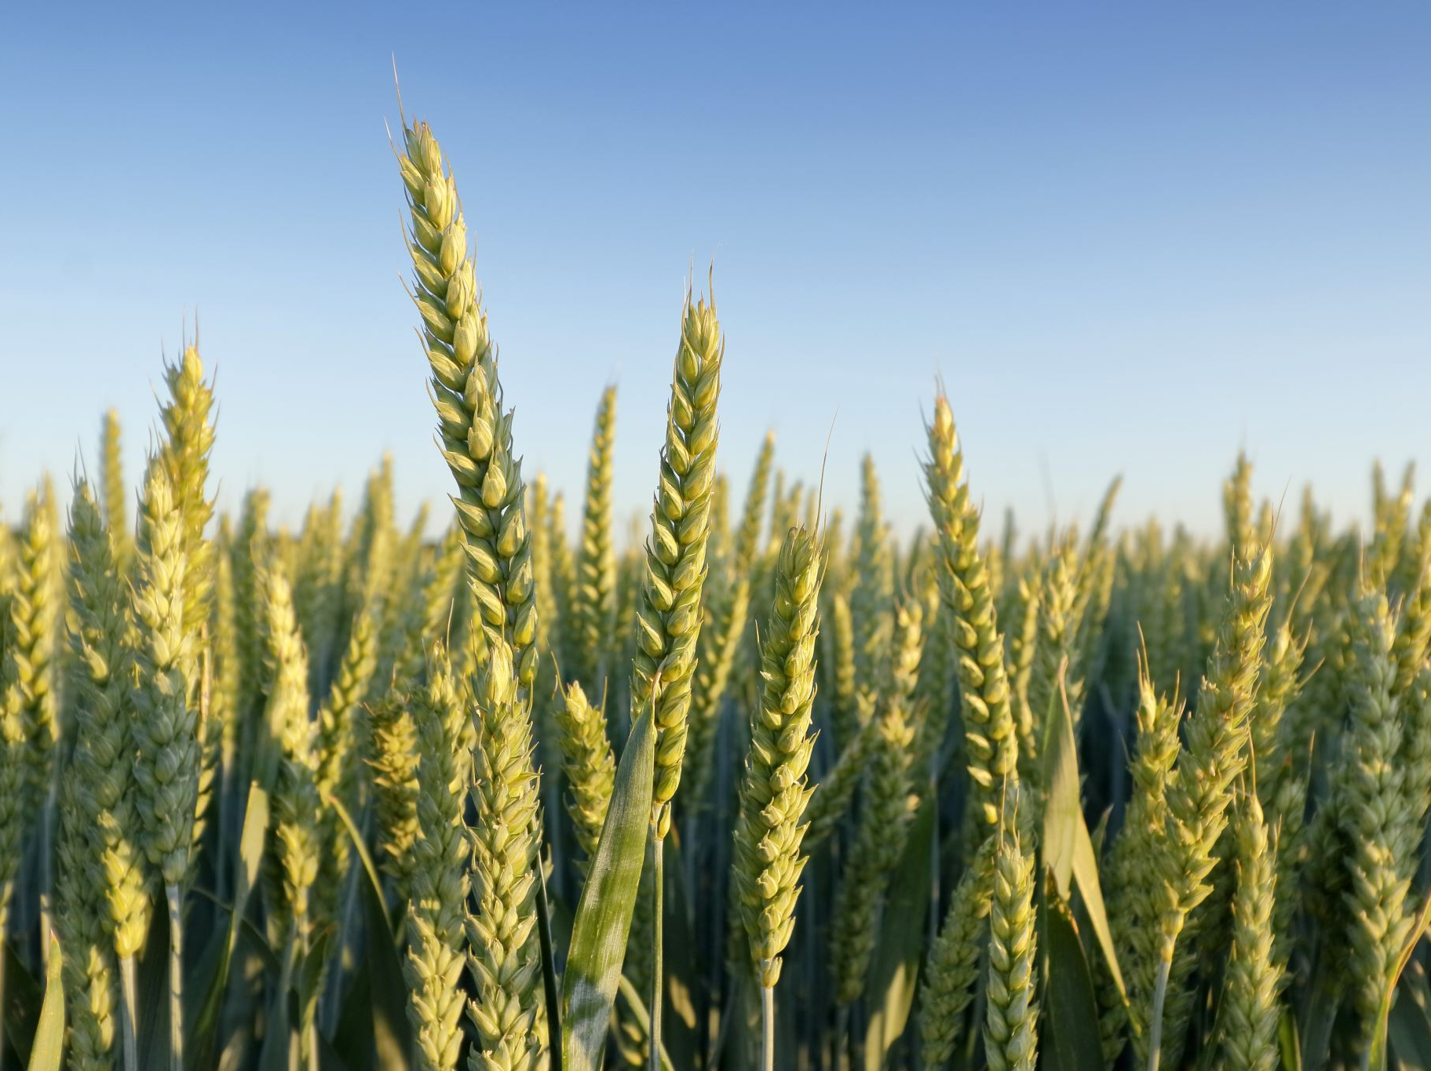
Introduction
Agriculture plays a vital role in India’s economy.
This study investigates how climatic and agricultural inputs influence yield using data science methods in R.

Slide 3

Objectives
1. Analyze relationships using Regression.
1
2. Study yield variation across seasons using ANOVA.
2
3. Cluster similar yield patterns using K-Means.
3
4. Classify yield categories using KNN.
4
5. Find hidden relationships via Apriori rules.
5
6. Compare models and identify best fit.
6

Slide 4
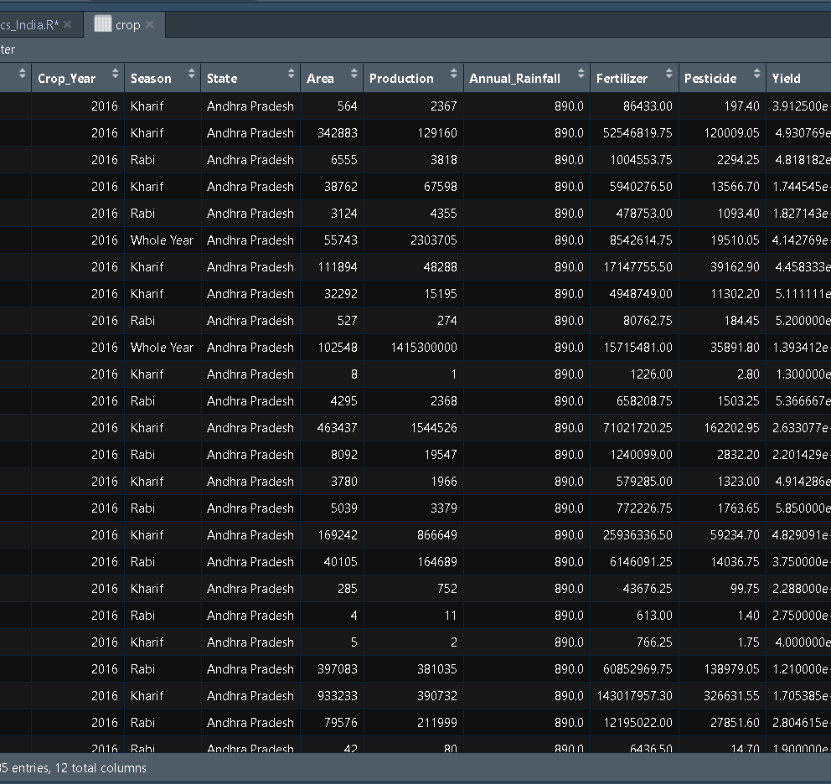
Dataset Overview
Dataset: crop_yield_5_years.csv
Years: 2016–2020 | Rows: 4285 | Columns: 10
Source: data.gov.in
Key Attributes: Crop, State, Season, Rainfall, Fertilizer, Pesticide, Yield

Slide 5
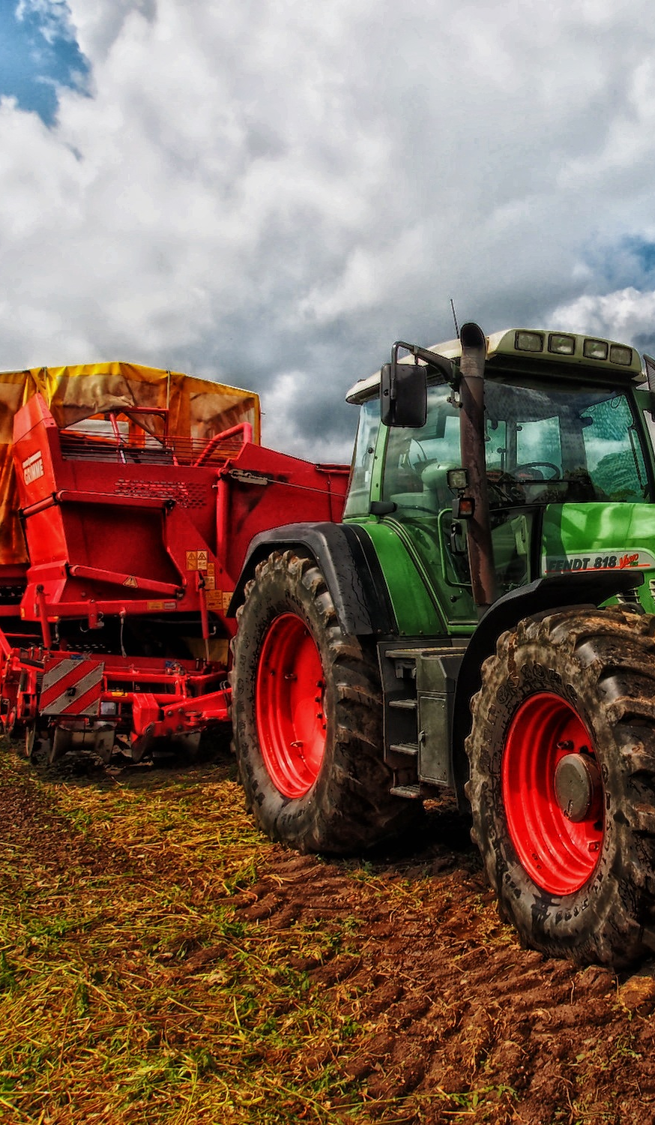
Tools & Technologies
RStudio IDE
Libraries: ggplot2, caret, cluster, arules, arulesViz, class
Purpose:
• Visualization:
• Classification: KNN
• Clustering: K-Means
• Statistical Analysis: Regression & ANOVA

Slide 6
Data Preprocessing
Performed:
• Removal of missing/duplicate values
• Factor conversion of categorical data
• Applied log1p transformation for skewed variables
• Normalization for numeric features

Slide 7
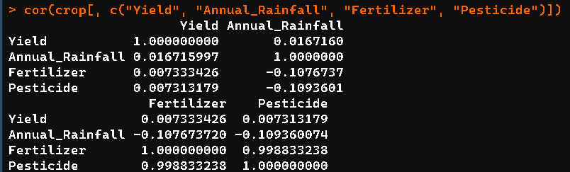
Descriptive Statistics
Mean Yield: 74.9 | Median: 1.15 | SD: 851.5
Correlations:
• Rainfall vs Yield = 0.0167
• Fertilizer vs Yield = 0.0073
Inference: Weak single-factor correlation — yield is multi-dependent.

Slide 8
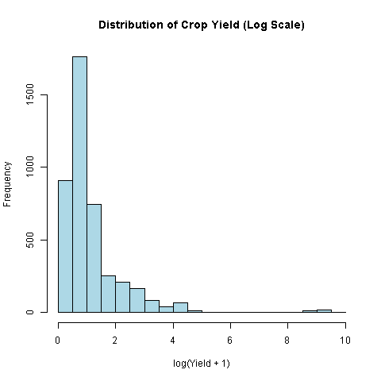
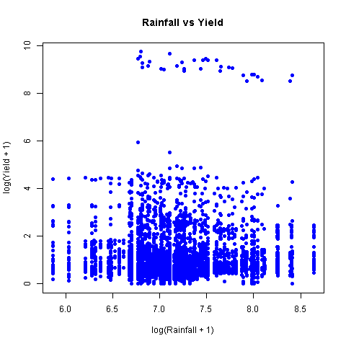
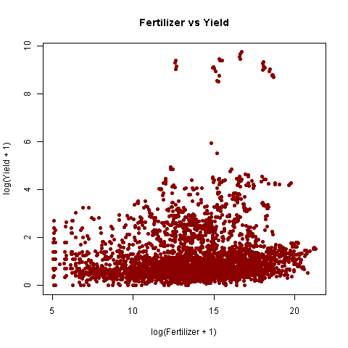
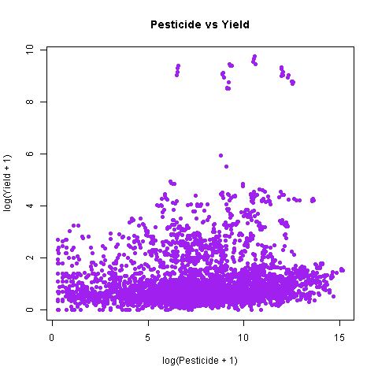
Visual Analysis
1. Yield Distribution
2. Rainfall vs Yield
3. Fertilizer vs Yield
4. Pesticide vs Yield
Observations:
- Most crops show low yield values.
- Rainfall and input usage show weak trends.

Slide 9
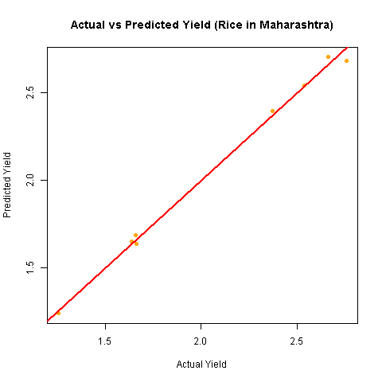
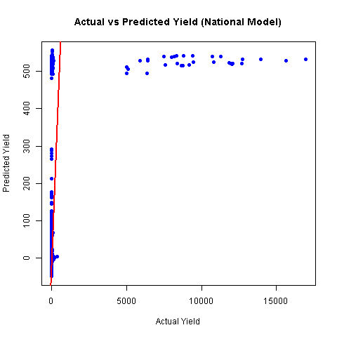
Linear Regression
National Model:
R² = 0.045 | Adj R² = 0.043
State Model (Rice, Maharashtra):
R² = 0.996 | Adj R² = 0.99
Inference:
Local (state-specific) regression yields better accuracy.

Slide 10
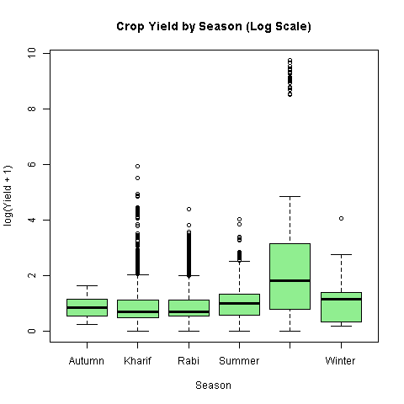
ANOVA — Seasonal Variation
F(5,4279) = 39.62 | p < 0.001
Inference: Yield varies significantly across seasons.
Highest yields in Winter and Whole-Year crops.

Slide 11
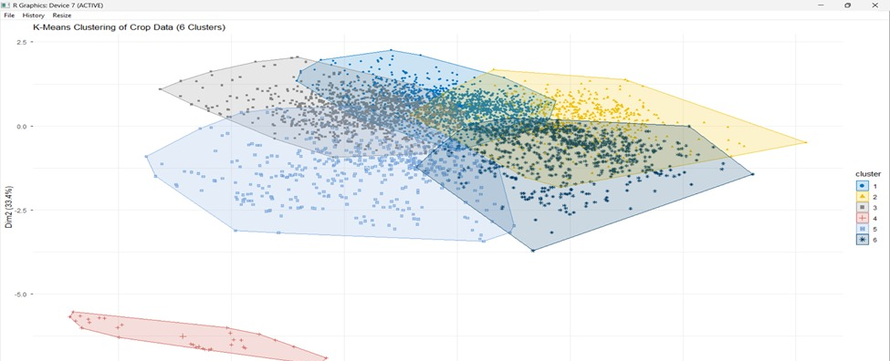
K-Means Clustering
Clusters 1 and 2 represent low-yielding traditional systems with minimal input usage.
Cluster 3 reveals inefficient input utilization—fertilizer levels are excessively high, but yields remain low.
Cluster 4 contains rare, extremely high-yield outliers, possibly due to intensive controlled cultivation or data anomalies.
Cluster 5 corresponds to high-productivity regions where input levels and environmental conditions are balanced.
Cluster 6 highlights rain-abundant areas producing moderate yields, suggesting that rainfall alone does not guarantee higher productivity

Slide 12
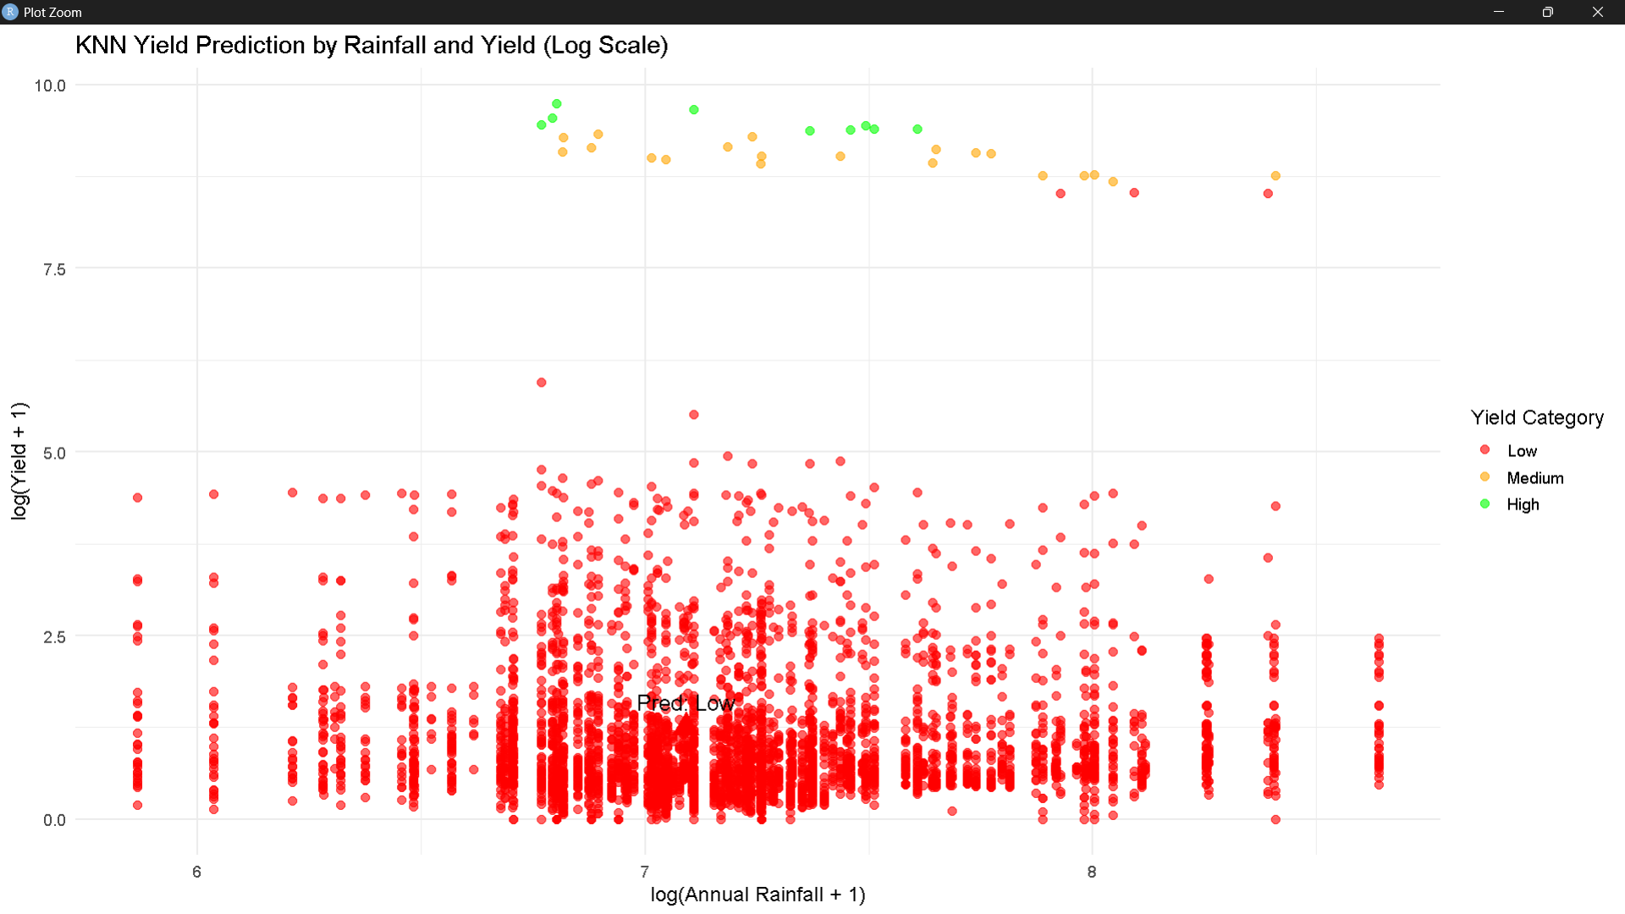
KNN Classification
Accuracy: 99.3% | K = 5
Minimal misclassification across yield groups.
KNN effectively classifies yield into Low, Medium, and High.

Slide 13
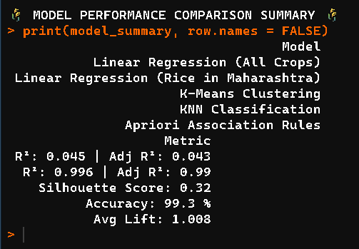
Model Performance Comparison
Regression (All): R² = 0.045
Regression (Rice, MH): R² = 0.996
KNN: Accuracy = 99.3%

Slide 14
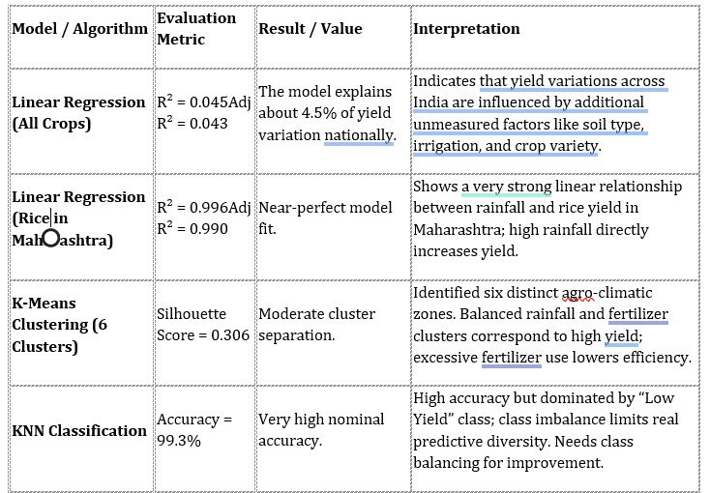

Slide 15

Conclusion
Key Findings:
• Season & region affect yield significantly.
• KNN provides the highest predictive accuracy (99.3%).
• Regression suits localized crop models.
R² = 0.996 | Adj R² = 0.99
Future Scope:
Include soil & temperature parameters for forecasting.

Slide 16
References
Data Source: data.gov.in
R Packages: ggplot2, caret, class, arules, cluster

