Slide 1


STOCKS PREDICTION AND VISUALIZATION USING MACHINE LEARNING

Slide 2
Guide Name and Team Members
Guide Name :- Prof. Avani Ray
Team Members :-
1. OM SHARAD SHINDE
2. ADITYA NITIN PATIL
3. MAYUR BHARAMBE
4. TANMAY MULAY
5. ATHARVA SHETE

Slide 3
Introduction
Welcome to the presentation on Stock Prediction and Visualization! We'll explore the fascinating world of data visualization and predictive analytics as they relate to stock markets in this project. Our project's goal is to find meaningful patterns in stock data and use ML forecasting methods to predict future changes in the market.

Slide 4
Problem Statement
Development of software to predict value of stocks using various parameters, and providing further visualization.

Slide 5
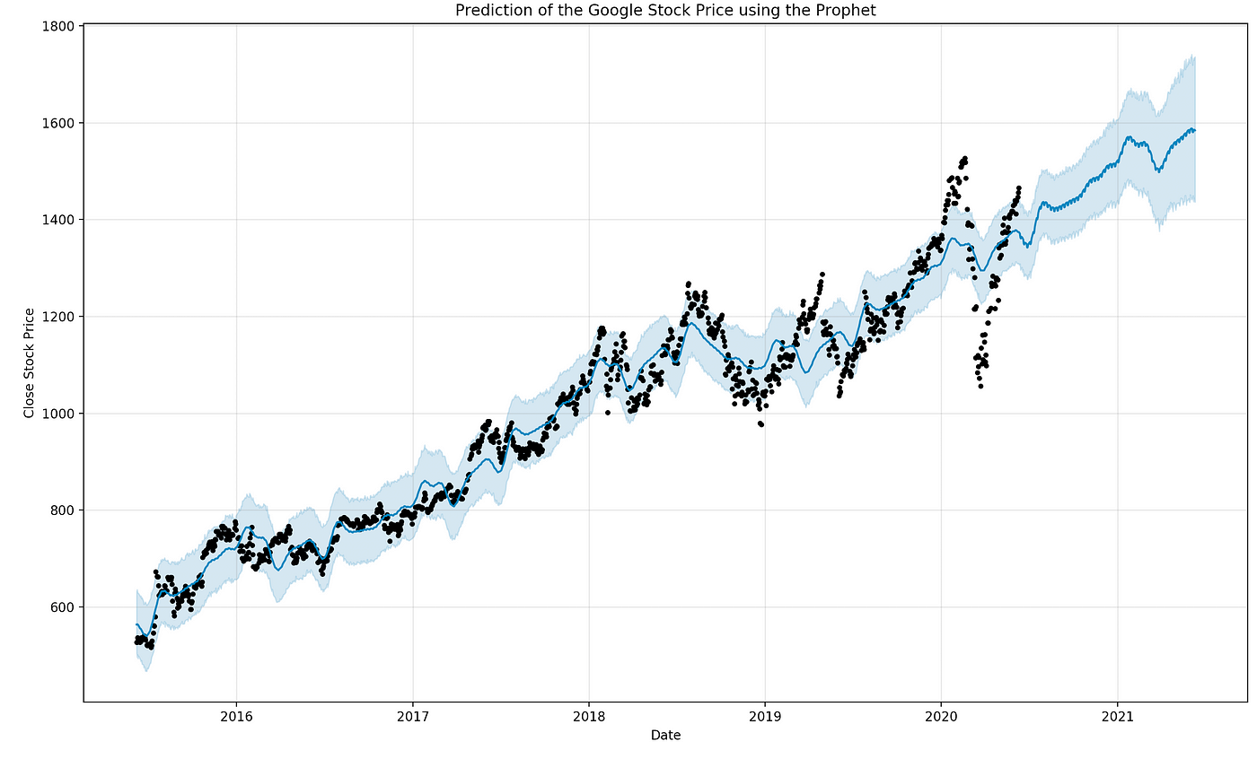
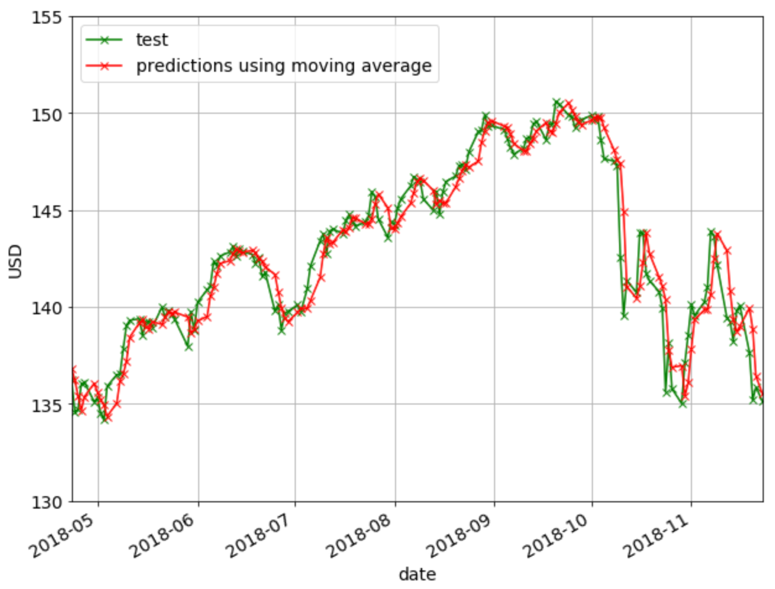

Slide 6
Scope of the Project
Prediction Timeframe: Select the timeframe of which the data values will be used to train the model for price prediction.
Stock Selection: Choose the stocks that your model can forecast. It may be specific equities or even market indices.
Data Sources: Locate and gather data sources so the model can be trained. In this project we are using Yahoo Finance.
Model Evaluation: Choosing a method for assessing the model's effectiveness. It is possible to employ metrics such as accuracy scores, mean squared error (MSE), and mean absolute error (MAE).

Slide 7
Objective of the Project
Predictive Accuracy: Our website's main goal is to make accurate predictions about stock values. To reduce prediction errors and gradually increase accuracy, this entails training our model.
User Interface (UI): Create an intuitive and user-friendly UI so that users can engage with our website. To ensure that the data the end user receives is simple to visualize and comprehend, we will display the results both statistically and graphically (using a variety of comparing graphs).
Extra Information: Offer articles regarding technical analysis, the stock market, and the constraints of stock prediction algorithms. This can assist users in making sensible financial decisions.

Slide 8
Proposed System
1. Data collection:
Compile past stock market data from Yfinance Library.
A wide range of features, including moving averages, price history, trading volume, technical indicators and macroeconomic indicators, should be taken into consideration.
2. Model Selection:
Conduct trials using ML model - linear regression.

Slide 9
Proposed System
3. Training and Testing:
Divide the historical data into training and testing sets, making sure the testing set includes previously unknown data to examine the generalization performance of the model.
4. Assessment and Implementation:
Determine the models' suitability for real-time implementation, computational efficiency, and predicted accuracy.
5.External References and documentation of stocks:
Provide valuable articles to help the user, and provide Yfinance link for reference

Slide 10
Web Application Development-Streamlit
The user interface, or what the user interacts with, is usually referred to as the front end of a stock prediction project.
In our application, we have used Streamlit Library for developing the web application.
Streamlit lets you transform Python scripts, especially related to ML and data science, into interactive web apps rapidly and effectively.
Once we have created the application, we can use Streamlit Community Cloud platform to deploy, manage and share our app.

Slide 11
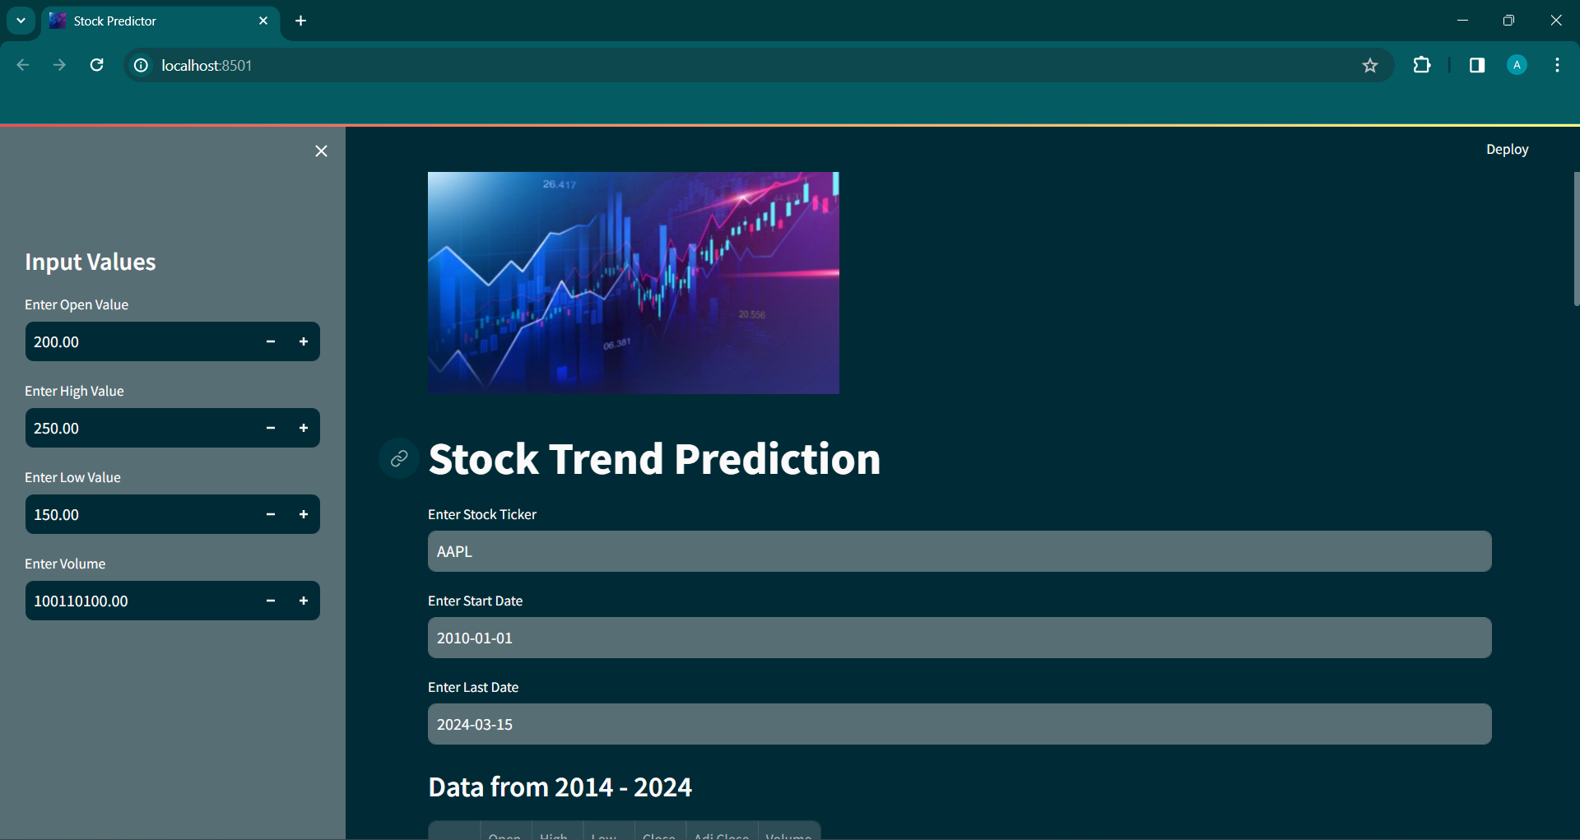
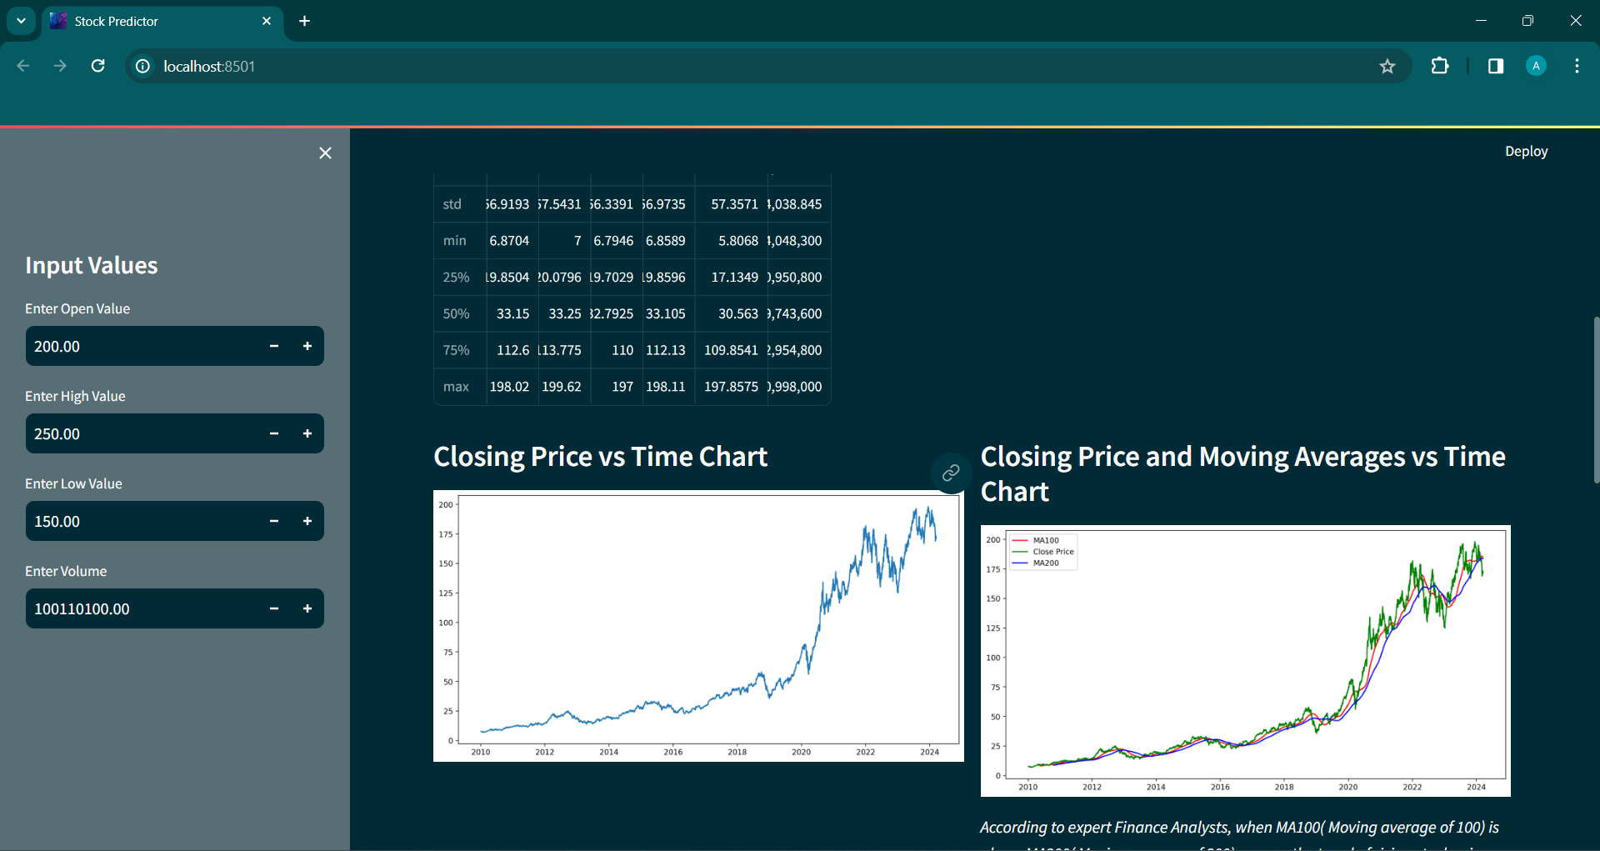

Slide 12
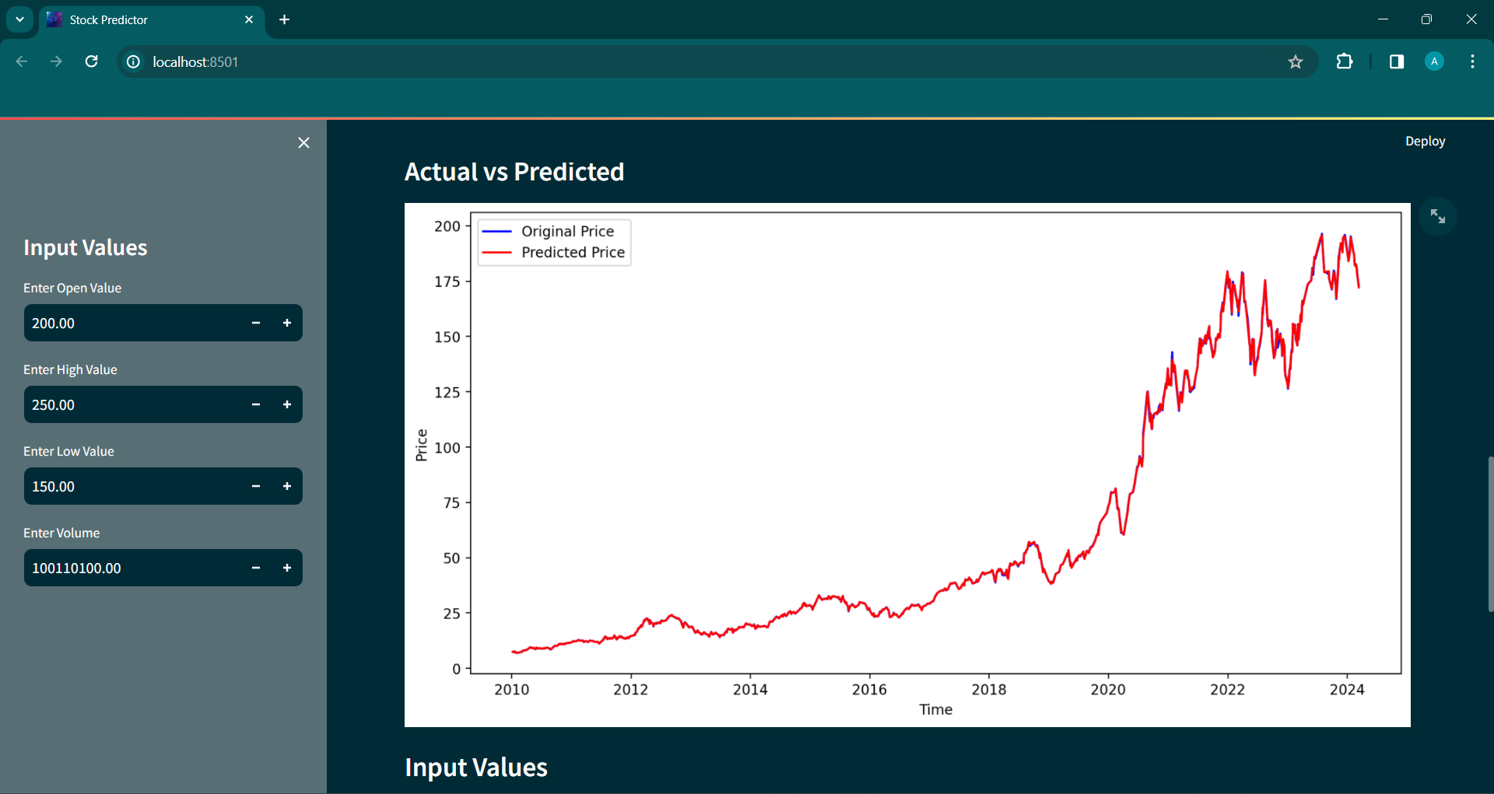
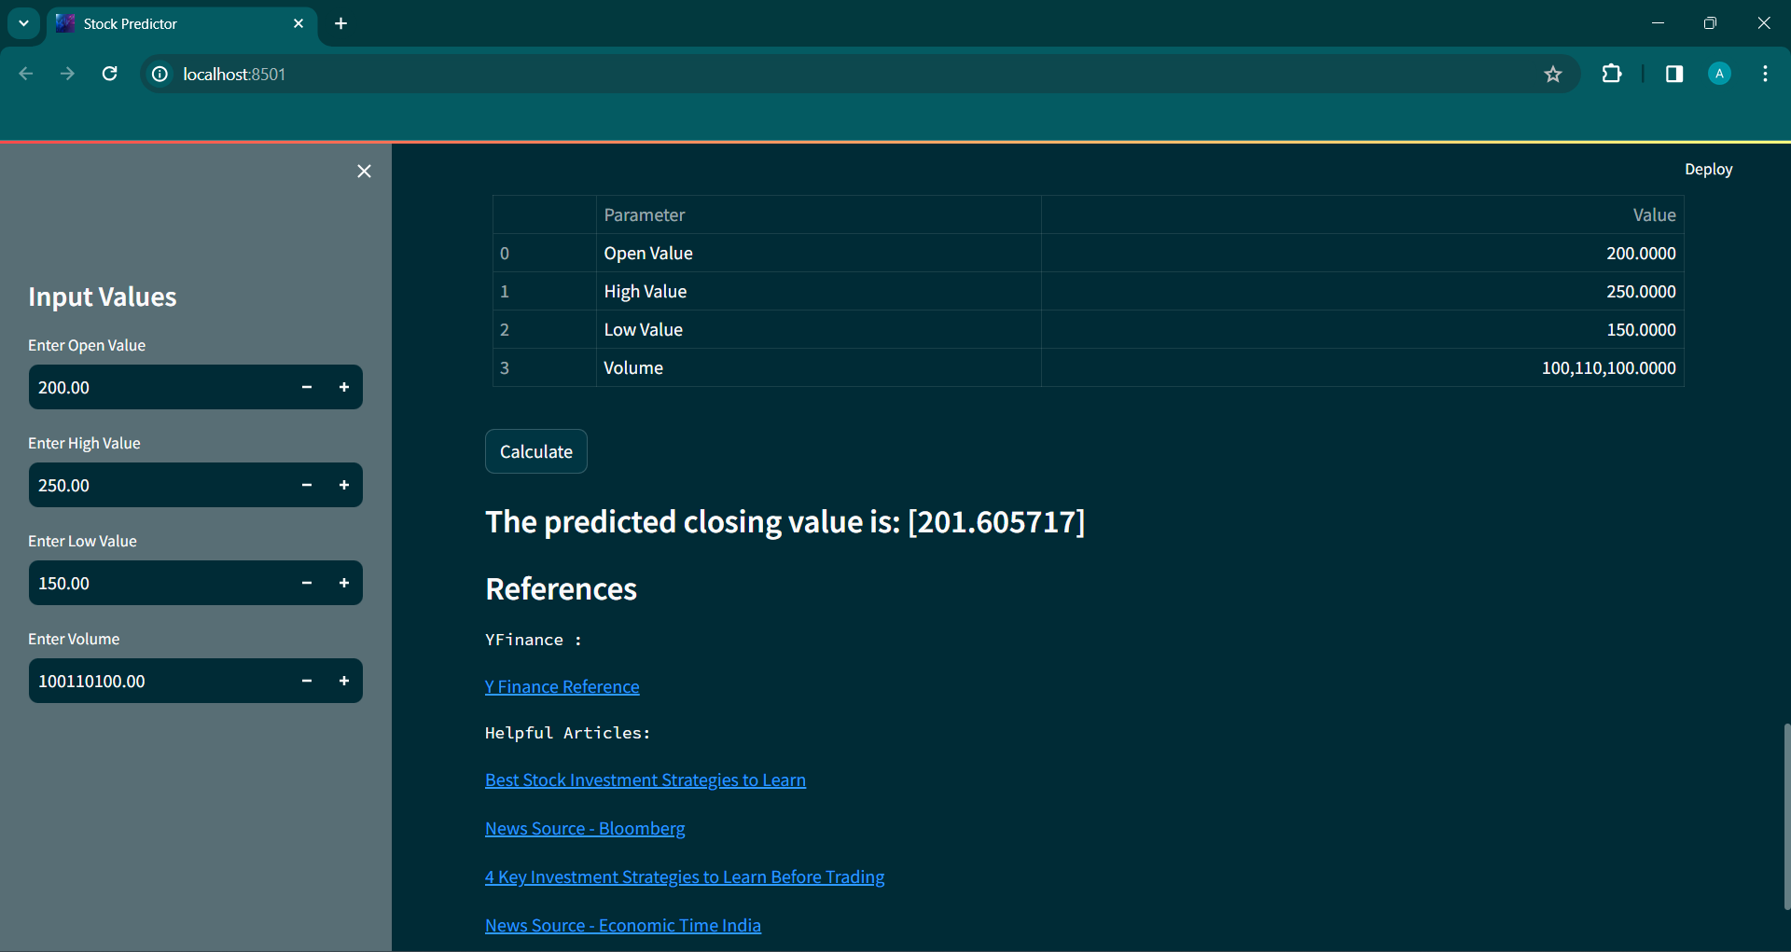

Slide 13
Software Specification
1. Programming Languages:
We have used Python for developing this web application.
2. Web frameworks:
Streamlit library has been used for frontend as well as backend.
3. Data:
The data we use is scraped from Yahoo finance using yfinance libraray.

Slide 14
4. Machine learning libraries:
Pandas, Numpy, Matplotlib, yfinance, streamlit, pandas_datareader have been used.
5.Deployment and management:
Once we have created the application, we can use Streamlit Community Cloud platform to deploy it on services like Azure, Amazon EC2, Google App Engine, manage and share our app.
Streamlit Documentation provides guide to deploy our streamlit application for various cloud services and platforms, e.g. Streamlit Community Cloud, Docker, Kubernetes.

Slide 15
Hardware Specification
Development and Testing Environment
For development and testing purposes, a basic setup can suffice:
Processor: Intel Core i5 or AMD Ryzen 5 processor.
RAM: 8GB of RAM.
Storage: 256GB SSD for faster data access.
Operating System: Windows, macOS, or Linux.

Slide 16
Conclusion
In today’s age of evergrowing businesses and markets, one must be knowledgable on how to participate i.e, invest in them. Here we have used linear regression model and yfinance datasets, to efficiently predict prices of stocks with a good accuracy. It will enable investors to make informed decisions regarding investment. Data visualization has been provided for better understanding and experience. We aim to continously add new better features to the application for improved user experience.

Slide 17
THANK YOU

