Slide 1
Hindi Handwritten Character Recognition Using Convolutional Neural Network
ICT304 – Soft Computing Techniques
KALAGA V S K ADITYA
125004390

Slide 2
Problem statement:
New technologies are emerging like a light and making our lives much easier.
With the increasing digitization of documents and data, there is a growing need for automated systems that can recognize and process handwritten text.
Still many people who are more comfortable writing by hand than typing or using digital devices.

Slide 3
Objective:
To develop an efficient system that can accurately identify and classify handwritten characters in Hindi script.
No need of human’s efforts in recognition.
Can automate the recognition for text for data entry, which can reduce human error.
Recognition is basic step for translation of language.

Slide 4
Why Hindi..?
Fourth most spoken language in the world, with over 600 million speakers.
Official language of INDIA.
Rich literary tradition.

Slide 5
Literature Survey:
Author | Title | Source link
R. Vijaya Kumar Reddy U. Ravi Babu | Handwritten Hindi Character Recognition using Deep Learning Techniques | (PDF) Handwritten Hindi Character Recognition using Deep Learning Techniques (researchgate.net) With accuracy – 97.33%
Kaushal Sharma Deepak Chaudhary | Hindi Handwritten Character Recognition using Deep Convolution Neural Network | Hindi Handwritten Character Recognition using Deep Convolution Neural Network | IEEE Conference Publication | IEEE Xplore With accuracy – 95.72%
Bhargav Rajyagor Rajnish Rakholia | Handwritten Character Recognition using Deep Learning | https://www.researchgate.net/publication/354330561_Handwritten_Character_Recognition_using_Deep_Learning
Hazem M El-Bakry Abdulaziz Shehab | Handwritten Text Recognition System based on Neural Network | https://www.researchgate.net/publication/298808334_Handwritten_Text_Recognition_System_based_on_Neural_Network

Slide 6
Methodology
Load the Dataset
Starting pre processing by
Resizing the images & converting images to arrays
Defining CNN architecture
Splitting data set to train and test part
Scaling pixel values between 0 and 1
Compiling model by loss function and optimisers
Training the model
Evaluating model and saving model

Slide 7
CNN ( Convolutional Neural network )
Convolutional Neural Networks (CNNs) are a type of artificial neural network inspired by the human visual system.
Kind of feed forward neural network widely used for analyzing and processing visual data, such as images.
Because the information flows through the network in a forward direction, from the input layer to the output layer
The key idea behind CNNs is the use of convolutional layers, which perform convolutions on the input data.
It can automatically learn and extract meaningful features from images

Slide 8
CNN - Architecture
Conv layer
Number of filters = 32 , Filter size= 3X3,
Max Pooling
Window of size 2X2
Conv Layer
Number of filter =64, activation=rectified liner units
Max pooling
Input shape= 32X32 , L2 regularise factor=0.001
Window of size 2X2
Dense Layer
128 neurons, activation=rectified linear units
L2 regularise factor=0.001
L2 regularise factor=0.001
Dense Layer
Number of neurons = length of class
Activation= softmax

Slide 9
CNN – Architecture:
Convolutional layer:
This layer applies 32 filters of size (3,3) to the input data.
Each filter performs a convolution operation, extracting local patterns or features.
The activation function 'relu' is applied element-wise to the output feature maps.
L2 regularization with a coefficient of 0.001 helps prevent overfitting by adding a penalty term to the loss function.
Pooling layer:
performs max pooling with a pool size of (2,2) on the output of the first convolutional layer.
reduces the spatial dimensions of the feature maps while retaining the most important information by selecting the maximum value within each pooling region.

Slide 10
CNN – Architecture:
Convolutional Layer 2:
Similar to the first convolutional layer, this layer applies 64 filters of size (3,3)
Max-Pooling Layer 2:
This layer performs max pooling with a pool size of (2,2) on the output of the second convolutional layer,
Flatten Layer:
This layer flattens the output of the previous layer into a 1-dimensional vector.
It reshapes the feature maps into a single long vector, preparing the data for the subsequent fully connected layers.

Slide 11
CNN – Architecture:
Dense Layer 1:
This layer consists of 128 neurons and applies the 'relu' activation function.
It performs a linear transformation on the input and introduces non-linearity using the activation function.
Kernel regularization is used for regularization.
Dense Layer 2 (Output Layer):
This layer consists of neurons equal to the number of classes in the classification task.
It uses the 'softmax' activation function to produce class probabilities.
The output represents the predicted probabilities of the input belonging to each class.

Slide 12
CNN – Architecture:
L2 regularization:
Known as weight decay.
Technique used to prevent overfitting by adding regularization terms to the loss function during training to penalize the large weights.
Instead of learning , the model will memories the samples it is called overfitting.
It encourages the network to find a balance between fitting and training the data well and keeping the weights small.

Slide 13
Dataset and results:
Dataset source– Kaggle.
Contains 92,000 images of 45 classes (35 letters and 10 digits ) black and white images.
using 78,200 for train and 13,800 for testing.
Accuracy :
Training : 97.38%
Validation : 98.49%

Slide 14
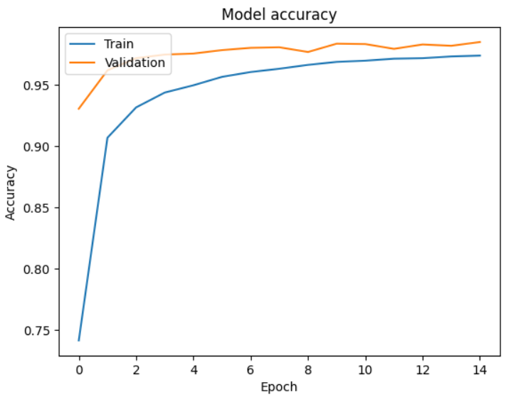
Graphs :

Slide 15
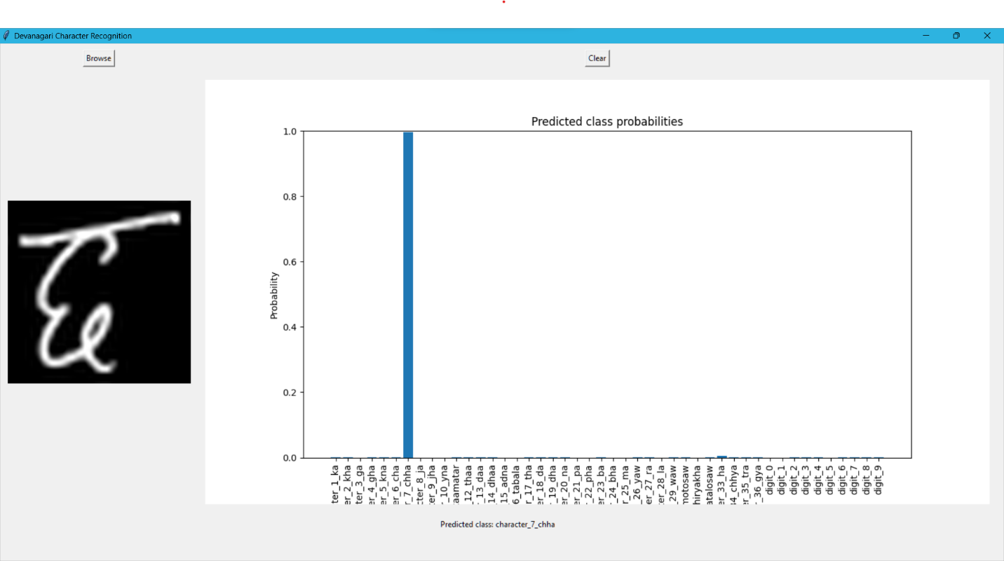
Sample Outputs:

Slide 16
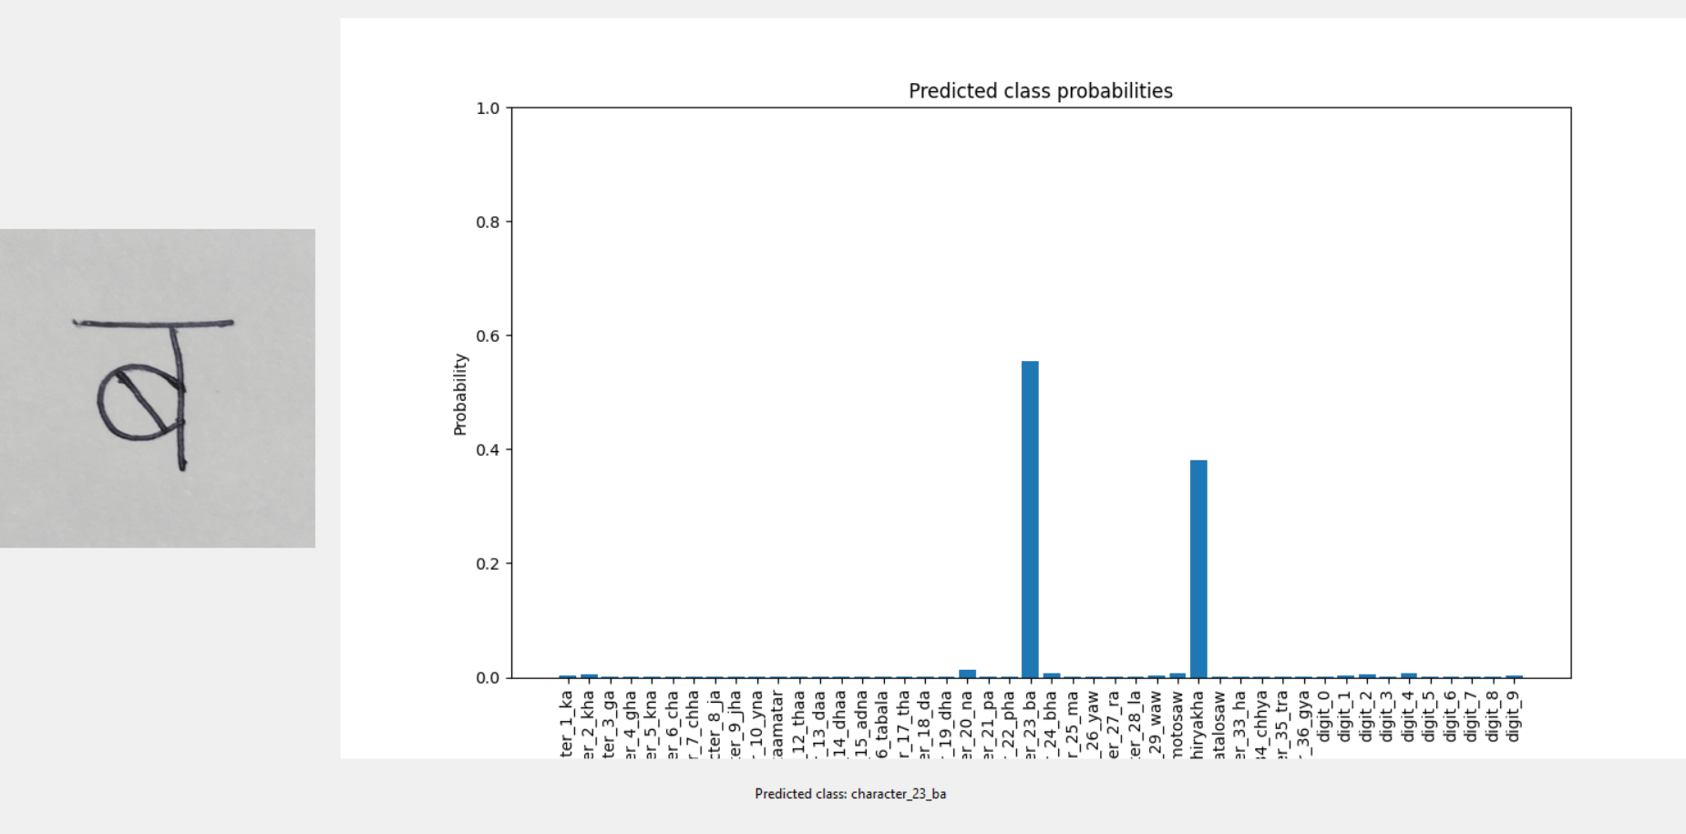
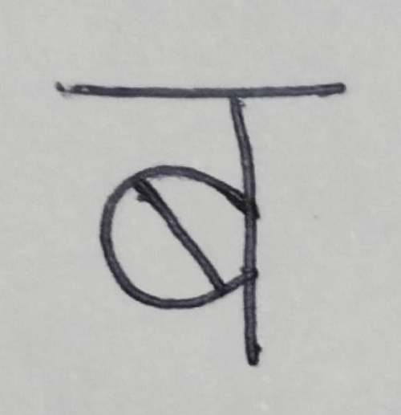
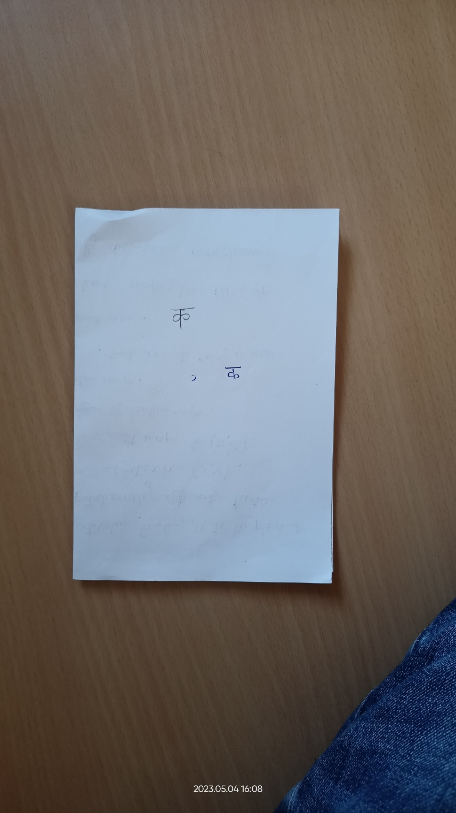
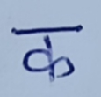
Sample Outputs:

Slide 17
Future Scope:
Multilingual recognition.
Word recognition.
Text extraction from handwritten documents.
Recognition and translation.

Slide 18
References:
https://www.bing.com/search?q=hindi+handwritten+text+recognition+using+cnn&qs=n&form=QBRE&sp=-1&ghc=1&lq=0&pq=hindi+handwritten+text+recognition+using+cn&sc=10-43&sk=&cvid=54CAA7101EBA4033ACD6540133A3566E&ghsh=0&ghacc=0&ghpl=
An efficient Devanagari character classification in printed and handwritten documents using SVM – ScienceDirect
Hindi Handwriting Recognition - Rishabh Nimje (risx3.github.io)
Introduction to Convolutional Neural Networks CNNs (aigents.co)
https://www.bing.com/search?q=hindi+handwritten+text+recognition+using+cnn&qs=n&form=QBRE&sp=-1&ghc=1&lq=0&pq=hindi+handwritten+text+recognition+using+cn&sc=10-43&sk=&cvid=54CAA7101EBA4033ACD6540133A3566E&ghsh=0&ghacc=0&ghpl=
(PDF) Handwritten Hindi Character Recognition using Deep Learning Techniques (researchgate.net)
Hindi Handwritten Character Recognition using Deep Convolution Neural Network | IEEE Conference Publication | IEEE Xplore
https://www.researchgate.net/publication/354330561_Handwritten_Character_Recognition_using_Deep_Learning
https://www.researchgate.net/publication/298808334_Handwritten_Text_Recognition_System_based_on_Neural_Network

Slide 19
Thank You

