Slide 1
Retinal blood vessel segmentation using staircase-net architecture
NAME : A SHYAM SAI RAJ
REG : 124004294

Slide 2
Problem statement
Retinal fundus images play an essential role in diagnosing and treatment of several eye diseases .
The main challenging factors regarding the fundus images are low contrast and an inhomogeneous illumination of the background.
Due to retinal vascular problems can cause blindness and disease like hyper-tensive retinopathy.
Hence, the study of these retinal blood vessels can be of great use to ophthalmologists , making their work easier.
The analysis of the width, length and tortuosity attributes of the vessels can aid in the diagnosis.
So it is vital for developing an automatic segmentation of retinal fundus images

Slide 3
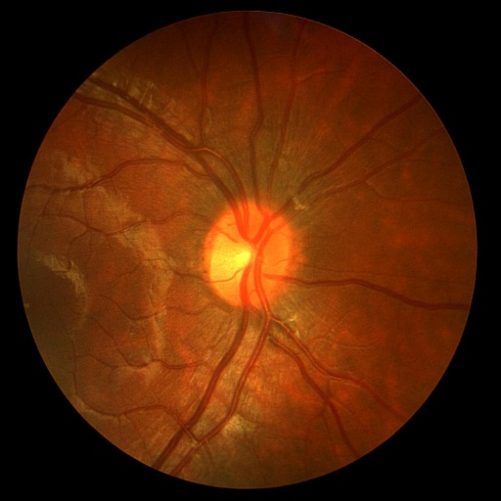
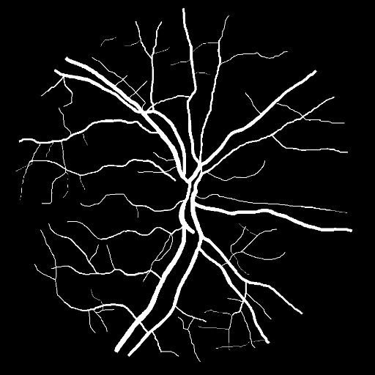
OBJECTIVE
The main objective of this project to segmentation of retinal blood vessels of fundus images using a proposed convolutional neural network architecture called staircase net architecture for early diagnosis of diseases like hypertensive retinopathy , diabetic retinopathy.

Slide 4
Literature survey
Author | Methodology | Accuracy
SRIVARADHARAJAN | STAIRCASE-NET | 97.76%
POWEL | CNN | 97.5%
GUO Y | MDCNN | 95.9%
XIOHONG WANG | multiplex vessel partition (MVP) | 95.47%
MIAO BINGYI | UNET | 97.5%
KISHORE BALASUBRAMANIAN | SVM | 95.36%
ATLI I | SINE-NET | 96.35%
YILONG YIN | RF | 97.10%
HAO ZHANG | Supervised Learning | 96.3%
YAN PEI | PRE PROCESSING | 95.4%

Slide 5
PROPOSED METHODOLOGY
DATA
Data Augmentation
Image processing
Data
Staircase-net architecture
(CNN MODEL)
Segmented image

Slide 6
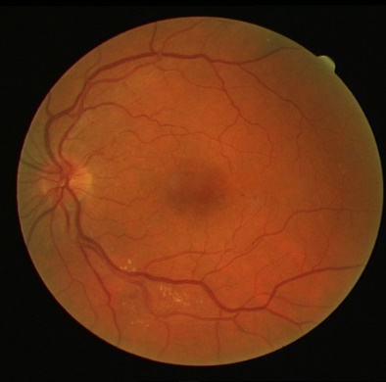
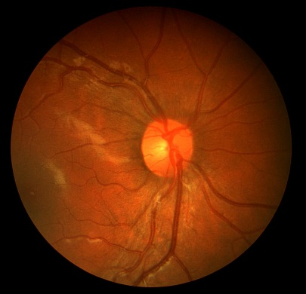
DATA:
DRIVE Dataset (Digital Retinal Images For Vessel Extraction)
Contains fundus image and their respective ground truth named as mask.
Publicly available dataset .This images are acquired from DR patients study in nether lands.
Size : 564 * 564 pixels
Chase DB1 data set (CHILD HEART AND HEALTH STUDY).
Contains both 28 total images
14 right eye images and 14 left eye images
Size: 999 * 960 pixels
DATA DIVISION:
 | Test | Training
Fundus Images | 20 | 20
Mask | 20 | 20
Dive and Chase_db1 dataset
 | Test | Training
Fundus Images | 20+14(R&L) | 20+14(R&L)
Mask | 34 | 34

Slide 7
DATA AUGMENTATION:
To increase the training dataset and avoid overfitting of model due to limited data.
Data Augmentation techniques used in this project are:
Resizing testing and training data to 512,512.
Horizontal Flip.
Vertical Flip.
Elastic Transform.
Grid Distortion.
Optical Distortion.
Rotate.
Training data after augmentation is total with 272 funds images with their respective masks

Slide 8
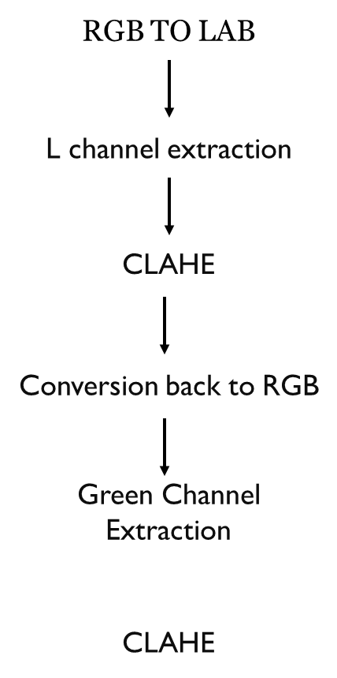
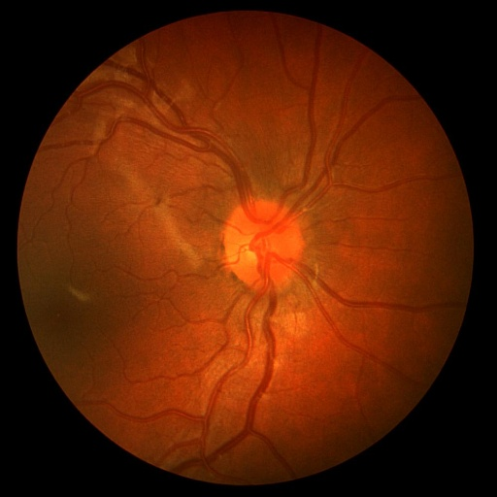
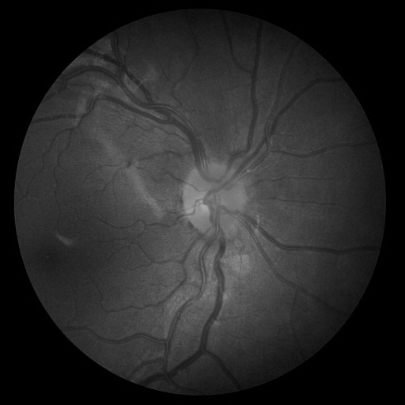
IMAGE PRE PROCESSING:
RGB TO LAB CONVERSION:
Splitting of Red , Green, Blue into A,B Colour
channels where : A - green-red
B - Blue yellow
device independent
Colour correction
Colour segmentation
Reduce problems during contrasting .
OUPUT:
IMAGE PRE-PROCESSING TECHNIQUES

Slide 9

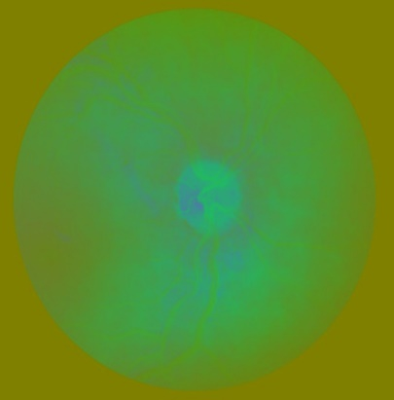

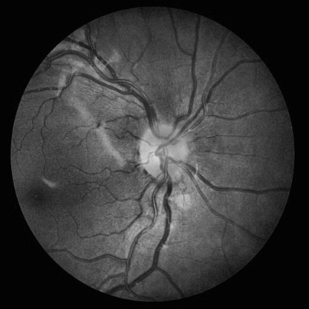

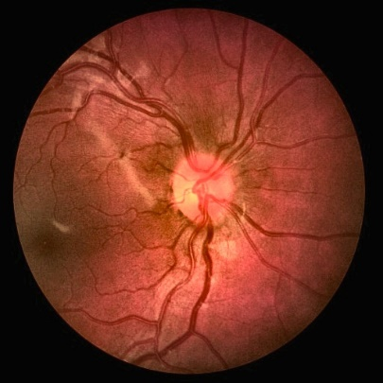
L Channel extraction:
L channel represents the grayscale image and contains
information about luminance.
Extraction of L channel from A B components for further
image processing techniques
CLAHE:
Contrast Limited Adaptive Histogram Equalisation.
Applied to improve contrast of the image by modifying
the intensity distribution of the image.(Tiles)
RECOMBINATION AND CONVERSION
BACK TO RGB:
To get green channel back which are present in the A B
components

Slide 10
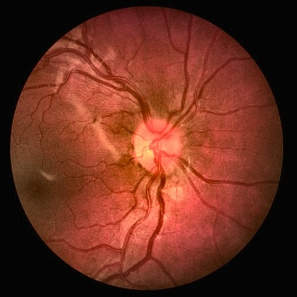
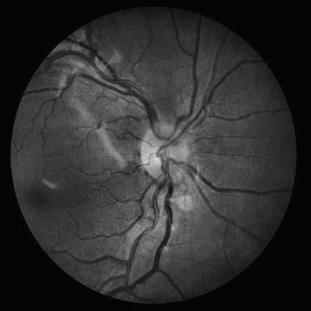
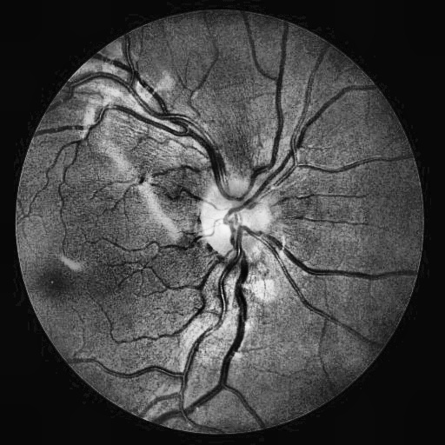
Green channel extraction:
Extracting the green channel information form RGB.
It will enhance the contrast of the image in grayscale
and reduce noise .
Provides better contrast between the blood vessels and
background of the fundus images.
Applying the Clahe algorithm will increase the contrast of the blood vessels alone.
Final pre-processed image

Slide 11
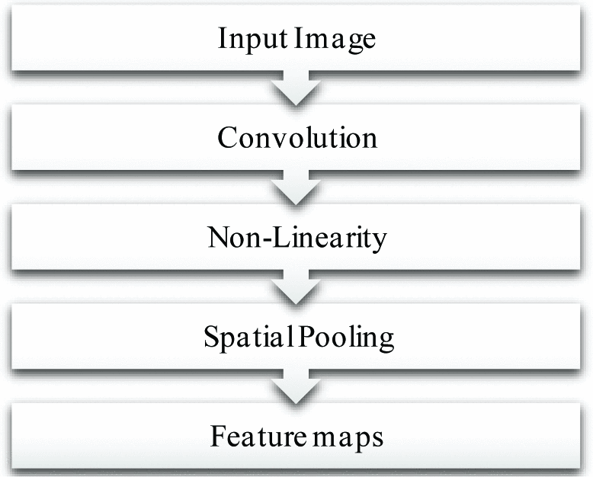
CONVOLUTION NEURAL NETWORK:
CNN is a type of deep learning algorithm that is widely used for image classification.
It consists of convolution layers , pooling layers and fully connected layers.
In convolution layers the input image is convolved with set of
filters with two dimensional size.
This filters produce a set of feature maps which captures the
certain feauters of the image.
Nonlinearity in CNN enables to learn complex relationships
and patterns in the input data.
Pooling layers reduce the spatial dimensionality of the
feauters maps by down sampling which helps to reduce the
computation and prevent overfitting.
Staircase-Net architecture is a type CNN model.
slight modification of a famous model called U-Net

Slide 12
STAIRCASE-NET:
In this staircase-net CNN there are total of 36 convolutional layers of filter size 3*3
with activation function as ReLu .
The architecture is followed by
Convolution
Up sampling
Down sampling
Concatenation – combine feature maps
The model is more efficient because due to concatenation of feature maps with past layers.
After concatenation feature maps are followed by fully connected layers with filter size as 1*1 and activation function as sigmoid
Relu – rectified linear unit
Introduces nonlinearity between the layer.
F(x) = max(0,x)
For negative values the F(x) is zero.
Sigmoid activation function maps any value between 1 and 0.
Can be interpreted as probability.
F(x) = 1/(1+e^(-x))

Slide 13
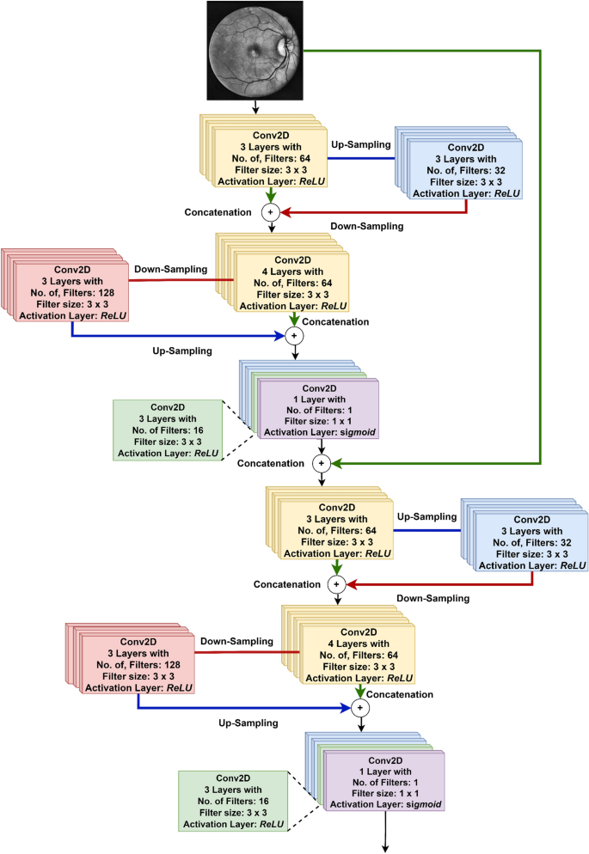

Slide 14
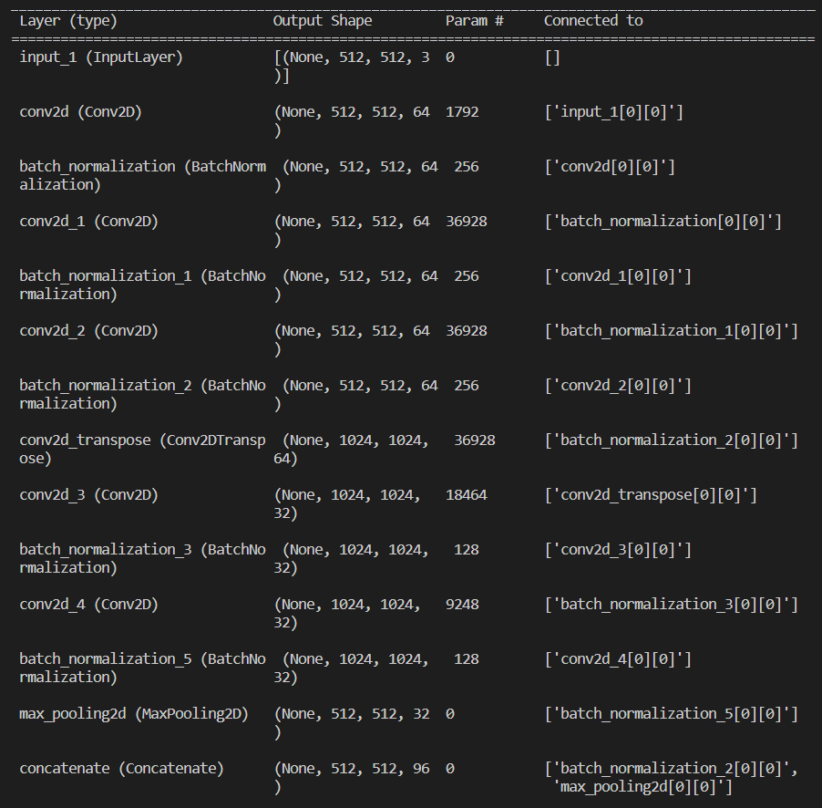
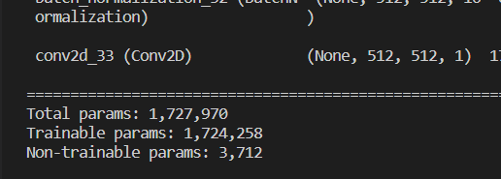
Summary of my model used
in project
Batch normalization is a powerful technique that can significantly improve the performance of Our model.
Observation:
None : Represents the any number of samples can be processed .
(512,512):It represents the spatial dimensions of the output feature maps.
Input size (512,512)
Filter size 3.
No of parameters = Weights + baises
Weights =(fs*no of inputs*no of o/p)

Slide 15
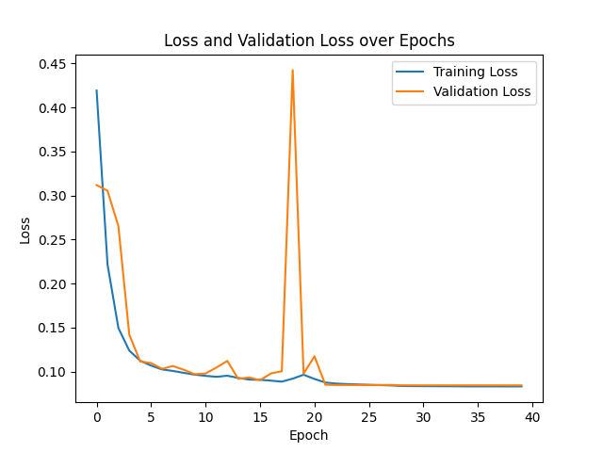
Metrics used are:
Sensitivity : Also known as True positive rate : (TP)/(TP+FN)
Performance metric that measure proportion of actual positive instances classified as positive.
Specificity : Also known as TNR:(TN)/(TN+FP)
Proportion of actual negative instances correctly classified as negative.
Area under curve: The AUC measures the probability that a randomly chosen positive instance will be ranked higher than a randomly chosen negative instance according to the model's predicted probabilities
Binary Cross Entropy: Used as measure of loss function in model training..
measures the dissimilarity between the predicted probabilities and the true binary labels of a classification model
BCE = - [y * log(p) + (1 - y) * log(1 - p)]

Slide 16
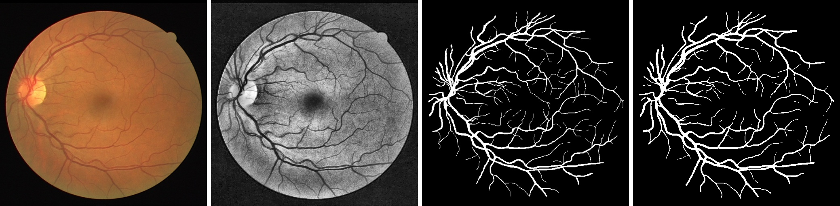
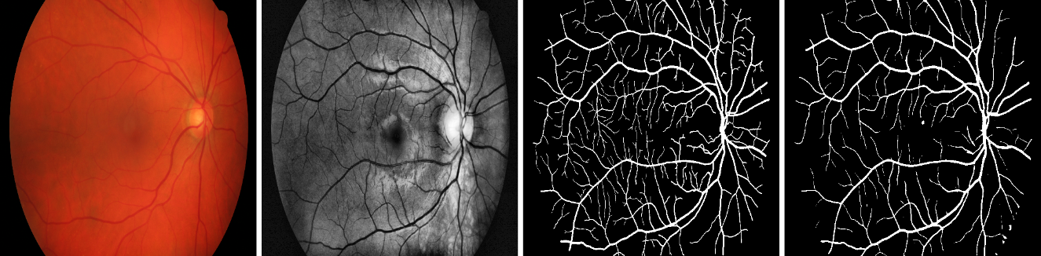
Results:
The Test dataset used for this project is showing 95.32%accuracy.
INPUT
PREPROCESSED
GROUNDTRUTH
OUTPUT
Drive dataset test results
HRF dataset test results(Not used for training)

Slide 17
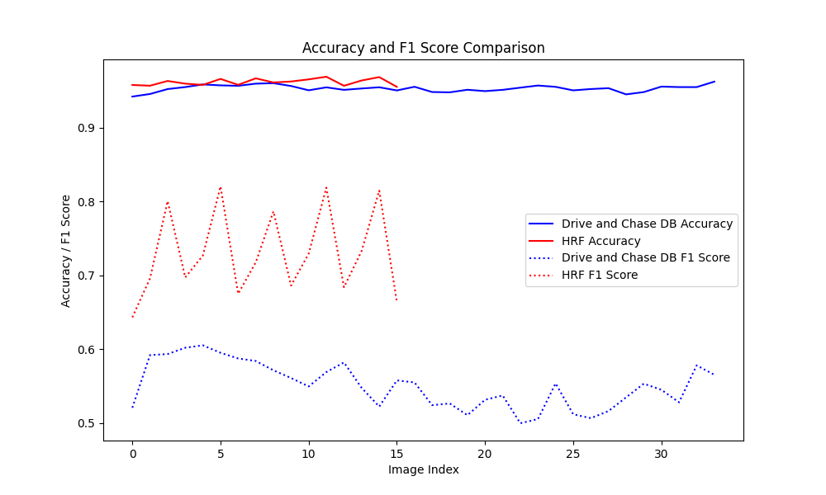
Dataset | F1 | JACCARD | RECALL | PRECISION
Drive + Chasedb1 | 0.55096 | 0.38036 | 0.8907 | 0.39838
HRF | 0.7307 | 0.5792 | 0.8540 | 0.64798
Table showing values of Jaccard, recall, precision of DRIVE AND HRF DATASETS
Graph for accuracy and F1scores of DRIVE + CHASEDB1 & HRF DATASET
CONCLUSION & FEAUTRE PLANS
Created a simple model for segmentation of blood vessels by seeing sensitivity specificity the model is good but concentrate on loss.
FEAUTRE PLANS:
Determine Arteriole to veniole ratio (grade of hypertensive retinopathy ).
Determine the arteries occlusion.
Determine the diabetic retinopathy

Slide 18
References:
SRIVARADHARAJAN SETHURAMAN and VARUN GOPI, ” Staircase-Net: a deep learning based architecture for retinal blood vessel segmentation" https://link.springer.com/article/10.1007/s12046-022-01936-w
Guo Y, Budak Ü and Şengür A 2018 A novel retinal vessel detection approach based on multiple deep convolution neural networks. Comput. Methods Programs Biomed. 167: 43–48 https://www.sciencedirect.com/science/article/pii/S0169260718307818
Wang X and Jiang X 2019 Retinal vessel segmentation by a divide-and-conquer funnel-structured classification framework. Signal Process. 165: 104–114. https://www.sciencedirect.com/science/article/pii/S0169260718307818
Jiang Z, Zhang H, Wang Y and Ko S B 2018 Retinal blood vessel segmentation using fully convolutional network with transfer learning. Comput. Med. Imaging Gr. 68: 1–15 https://www.sciencedirect.com/science/article/pii/S0895611118302313
Staal J, Abràmoff M D, Niemeijer M, Viergever M A and Van Ginneken B 2004 Ridge-based vessel segmentation in colour images of the retina. IEEE Trans. Med. Imaging 23(4): 501–509 https://ieeexplore.ieee.org/abstract/document/1282003

