Slide 1

BOOK RECOMMENDER SYSTEM WITH BLOCKCHAIN TECHNOLOGY
AJAY KUMAR GARG ENGINEERING COLLEGE, GHAZIABAD
Project Presentation on
Guided By
Mr. Pankaj Singh
Presented By,
Aditya Shukla (2000270130011)
Aman Kumar Yadav (2000270310018)
Dhruv Porwal (2000270130053)
Somya Singh (2100270139008)

Slide 2

INTRODUCTION
A blockchain-based book recommender engine leverages the decentralized and secure nature of blockchain technology to enhance the functionality and trustworthiness of a recommendation system for books. By employing smart contracts on a blockchain, user profiles, preferences, and interactions can be securely managed and recorded, fostering transparency and privacy. This integration ensures the immutability of recommendation histories, making them resistant to tampering and fraud.
Users maintain greater control over their data, with the ability to manage and share preferences securely. Tokenization and smart contracts can incentivize users for constructive contributions, creating a more engaged and collaborative community. The decentralized architecture enables cross-platform interactions and interoperability, allowing users to seamlessly carry their preferences across various services. Overall, a blockchain-based book recommender engine combines the power of AI algorithms with the security and decentralization of blockchain technology to provide users with personalized, trustworthy, and transparent book recommendations.

Slide 3
PROBLEM STATEMENT
This project focuses on developing a blockchain-protected book recommendation system tailored to the demands of today's busy and modern world. The system features an intelligent and user-friendly GUI implemented using content-based filtering and the Flask framework.
The project's problem statement involves analyzing user data, book data, and review data to develop a content-based filtering recommendation engine. An application is then implemented to deliver personalized recommendations to end users. To address privacy and security concerns, the system adopts Ethereum-based blockchain technology, ensuring a secure and transparent environment for user interactions and data transactions.

Slide 4
OBJECTIVE AND SCOPE
The objective of the blockchain-based book recommender system is to develop an intelligent book recommendation application that prioritizes user confidentiality. The system aims to provide efficient book suggestions, significantly reducing the time users spend searching for relevant books and enhancing their overall experience. It is built on content-based filtering principles and incorporates the Ethereum blockchain for added security.
The scope of this project is extensive, with potential applications in various platforms, including social media, book applications, library sectors, as well as educational and business institutions. The widespread demand for efficient book recommendations across these diverse domains underscores the versatility and relevance of the proposed blockchain-based recommender system.

Slide 5
TECHNICAL REQUIREMENTS
HARDWARE REQUIREMENTS
Intel(R) Core(TM) i5-7300U CPU @ 2.60GHz 2.71 GHz
4GB RAM
15MB Hard drive storage
SOFTWARE REQUIREMENTS
Anaconda Distribution
Ethereum
Vscode
Xampp Server

Slide 6
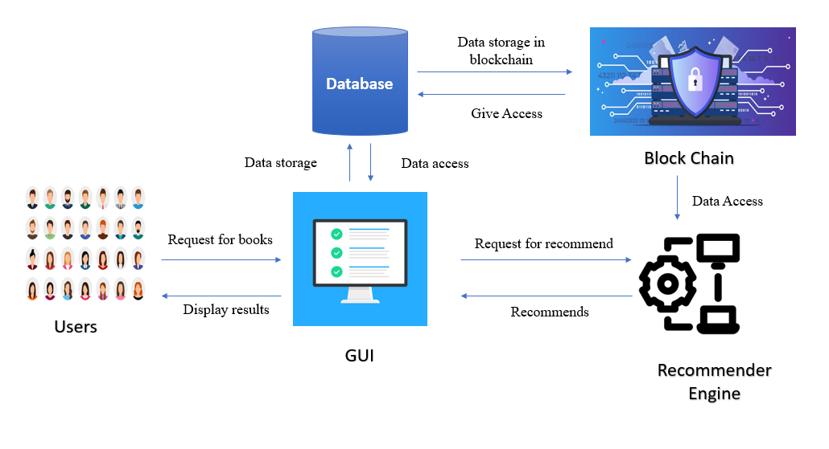
System overall architechture

Slide 7
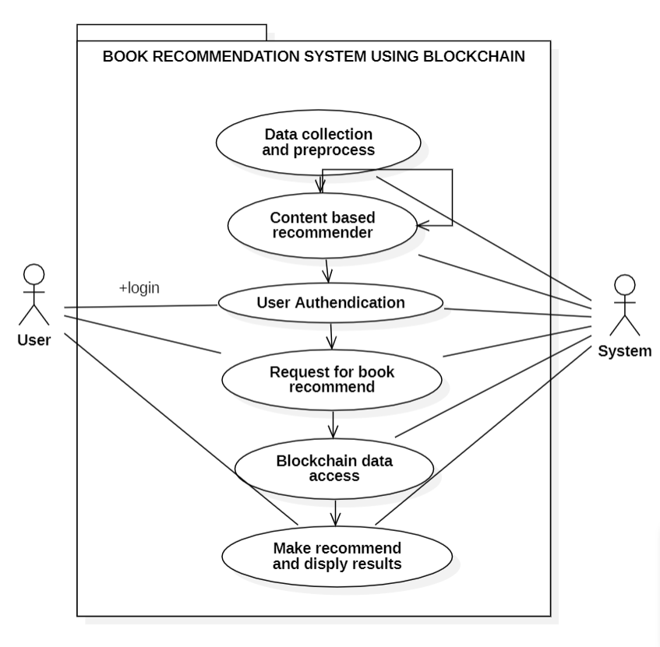
USE CASE DIAGRAM

Slide 8
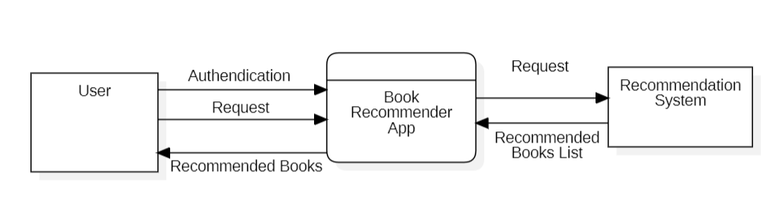
DATA FLOW DIAGRAM
LEVEL 0 DFD

Slide 9
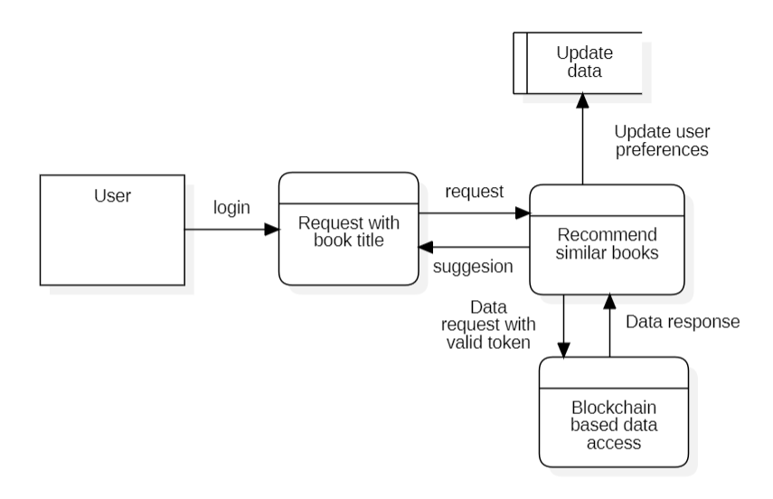
DATA FLOW DIAGRAM
LEVEL 1 DFD

Slide 10
METHODOLGIES USED
While talking about methodology, it devided as per the modules
Data collection and Preprocesing
Pandas
NumPy and Matplotlib
2. Content Based Filtering Recommender
Cosine similarity
3. Blockchain Integration
Ethereum
4. Web GUI
HTML, CSS
Bootstrap
Jquery
5. Data Management
Mysql Database

Slide 11
Project progress
Until this day we have concentrated on preprocess the data and developing the recommender system. We have analyzed the data we have considered and some of the things are explained in the upcoming slides

Slide 12
Data collection
The data has been downloaded from the Kaggle data portal[7]. The number of data available in the dataset are
User Data – 1149780 Rows
Ratings Data – 271360 Rows
Book data – 278858 Rows
Pre process Done
Found some books with empty data, searched in internet and filled it
Analyzed and dropped unwanted columns
Merged user, preferred books and reviews data
Found invalid year of publication on some books and replaced with correct years

Slide 13
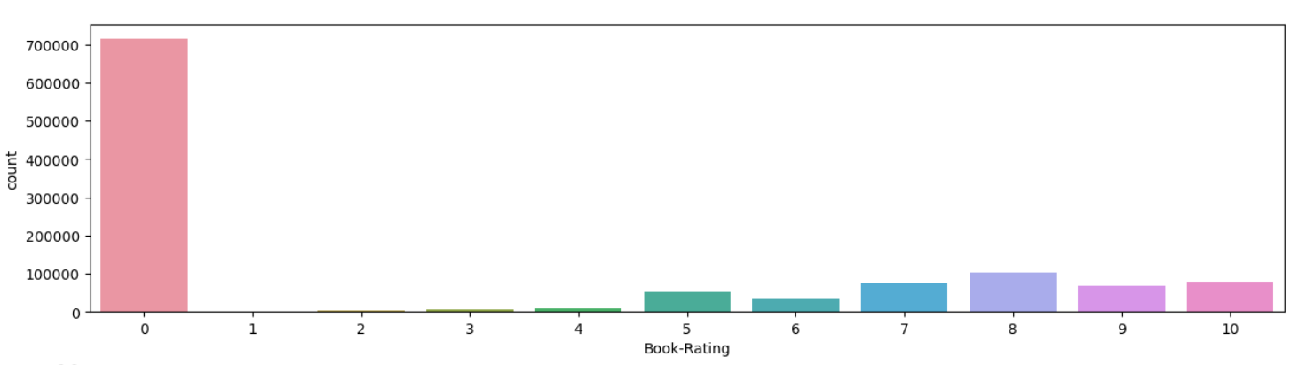
Data analysis
Ratings

Slide 14
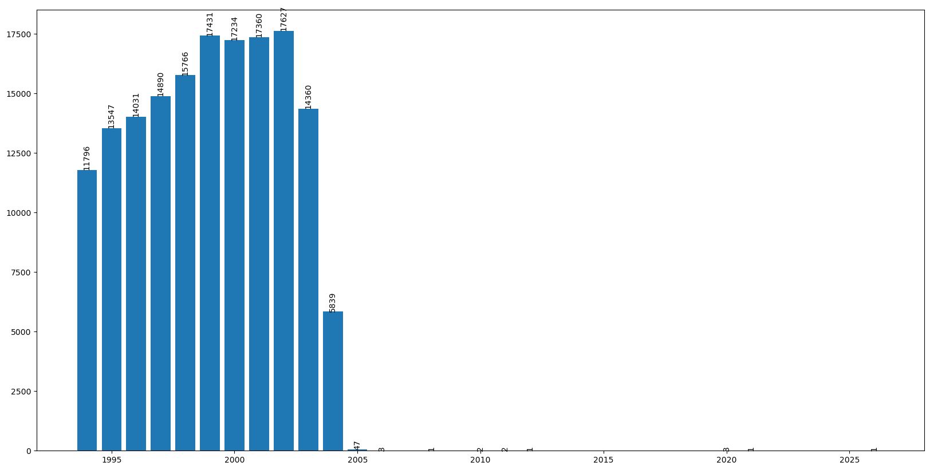
Data analysis
Number of books on published on each year

Slide 15
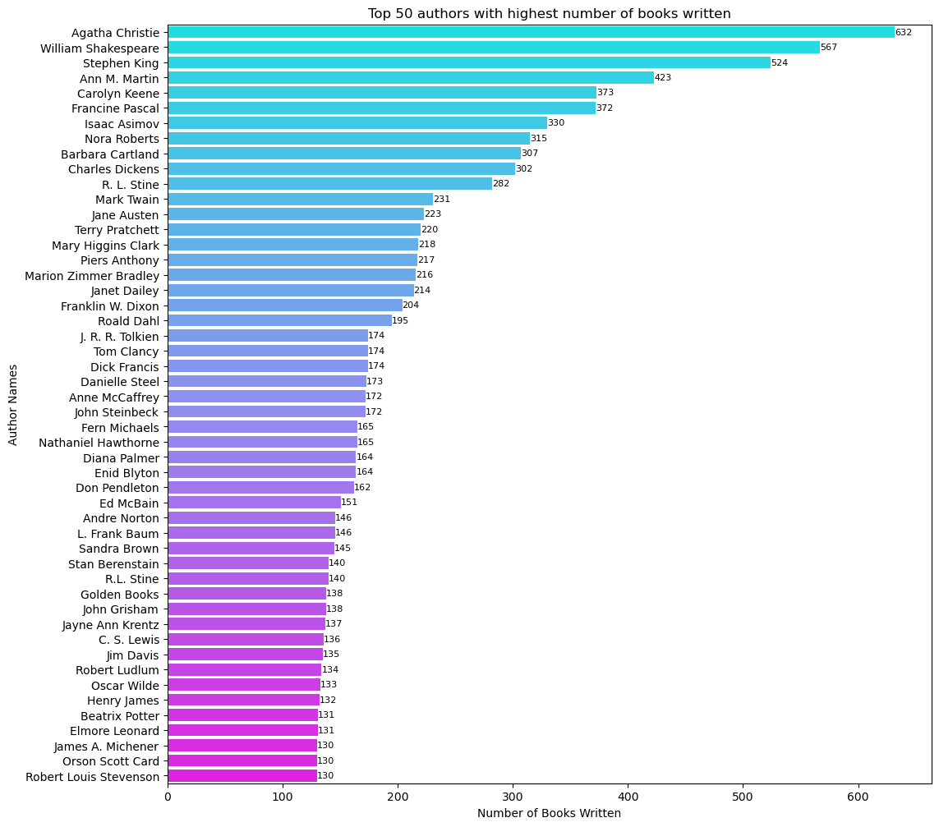
Data analysis
Books written by top authors

Slide 16
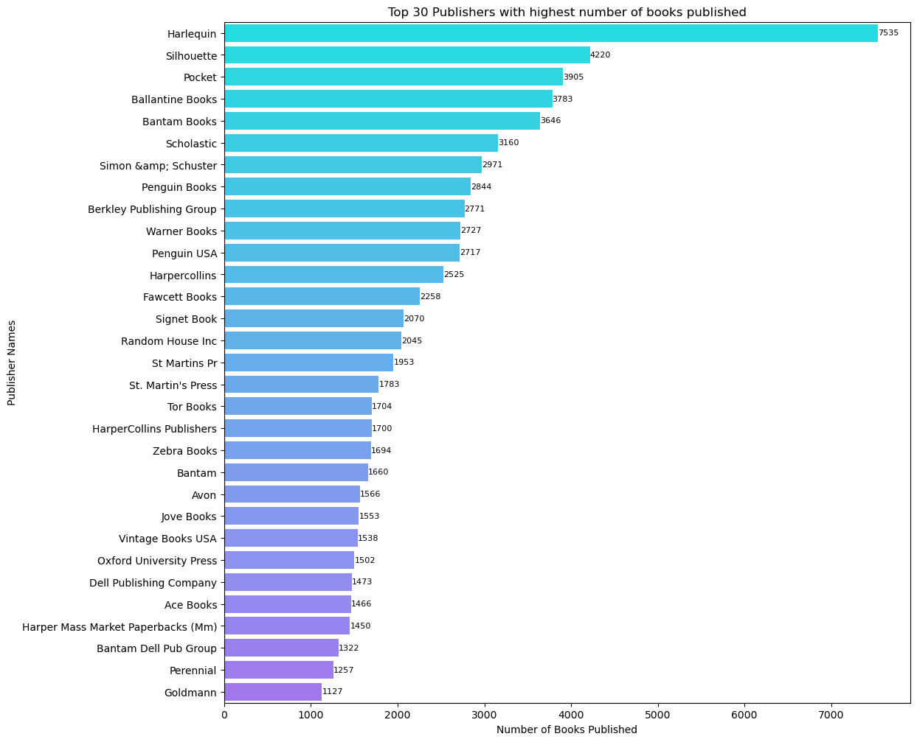
Data analysis
Books published by top publications

Slide 17
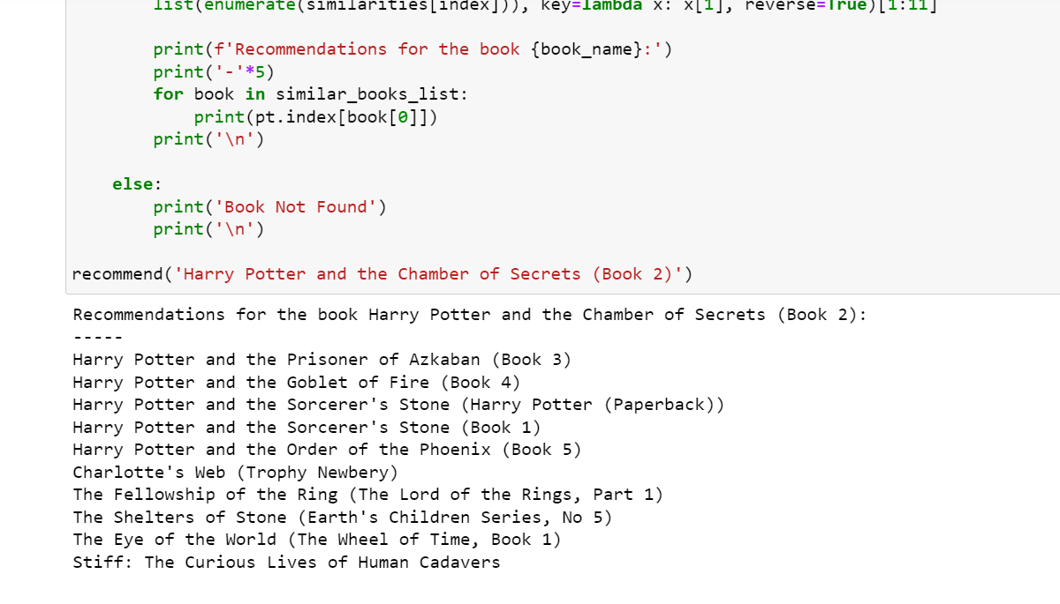
Data analysis
Sample output up to developed

Slide 18
Where we are ?
Up to this we have developed the recommender system. In the upcoming phases we will develop a GUI with database plans and Ethereum based data access

Slide 19
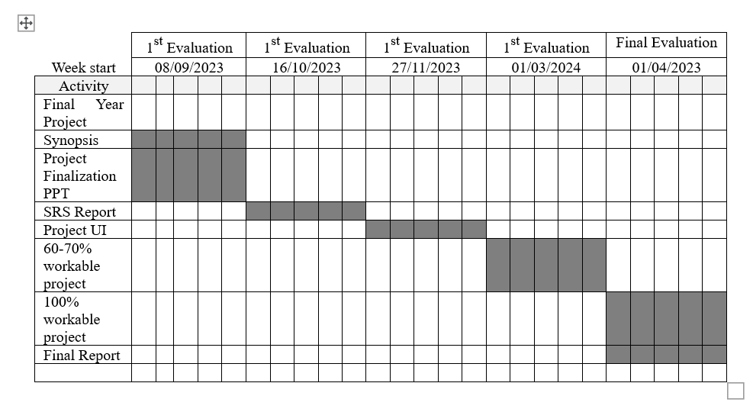
Gantt chart

Slide 20
REFERENCES
Yassine Himeur, Aya Sayed, Abdullah Alsalemi, Faycal Bensaali, Abbes Amira, Iraklis Varlamis d , Magdalini Eirinaki e, Christos Sardianos, George Dimitrakopoulos, "Blockchain-based recommender systems: Applications, challenges and future opportunities", Computer Science Review, Elsevier, 2021, https://doi.org/10.1016/j.cosrev.2021.100439.
Dariel Bobadilla and Carlo Lipizzi, "A Blockchain-Based Collaborative Filtering Recommendation System Based on Trust", IEE, 2021 18th International Computer Conference on Wavelet Active Media Technology and Information Processing (ICCWAMTIP), 2022, 10.1109/ICCWAMTIP53232.2021.9674128.
Bushra Alhijawi, Mutaz Abo Alrub and Mustafa Al-Fayoumi, "Generalized Ethereum Blockchain-based recommender system framework", Information Systems, Volume 111, January 2023, 102113, https://doi.org/10.1016/j.is.2022.102113

Slide 21
REFERENCES
4. Sudeep Tanwar, Qasim Bhatia, Pruthvi Patel, Aparna Kumari and Pradeep Kumar Singh, "Machine Learning Adoption in Blockchain-Based Smart Applications: The Challenges, and a Way Forward", IEEE Access ( Volume: 8), 23 December 2019 Electronic ISSN: 2169-3536, DOI: 10.1109/ACCESS.2019.296137z
5. PV Devika, K Jyothisree, PV Rahul, S Arjun, Jayasree Narayanan, "Book Recommendation System", 2021 12th International Conference on Computing Communication and Networking Technologies (ICCCNT), DOI : 10.1109/ICCCNT51525.2021.9579647
6. Zhi Hui Wang and De Zhi Hou, "Research on Book Recommendation Algorithm Based on Collaborative Filtering and Interest Degree", Volume 2021, Article ID 7036357, DOI: https://doi.org/10.1155/2021/7036357
7. https://www.kaggle.com/datasets/arashnic/book-recommendation-dataset/data

