Slide 1

USB Device Control &
Monitoring Framework
USB Monitoring
Whitelist System
Blue Team Project
ADITYA VINOD DOSHI
CYBERSECURITY PROJECT
Notes:
1

Slide 2
Why Are USB Drives Dangerous?
USB SECURITY THREAT
USB drives are one of the most common ways hackers attack computers.
They can spread viruses, steal files, and take over your PC within seconds of being plugged in.
Malware Spread
Data Theft
Infected USB copies viruses to every computer it is plugged into
Attacker silently copies private files to USB and walks away
BadUSB Attack
Stuxnet 2010
Modified USB pretends to be a keyboard — types malicious commands
Real USB worm that destroyed nuclear equipment in Iran
Our tool detects every USB connection and immediately flags unknown devices.
Notes:
2

Slide 3
What Does Our Tool Do?
PROJECT GOALS
5 clear goals — all written in Python with zero extra installations:
1
Detect USB Plug / Remove
Catches every USB connection and disconnection within 5 seconds
2
Check the Whitelist
Checks USB serial number against trusted devices list
3
Save a Baseline Snapshot
Records clean starting state of all connected drives
4
Log Every Event
Saves every event with the exact date and time
5
Generate CSV Report
Exports all events to a spreadsheet file for Excel
Notes:
3

Slide 4
Step by Step — How the Tool Works
HOW IT WORKS
STEP 1
Run as Administrator
STEP 2
Load Whitelist
Open CMD as Admin → type: python usb_monitor.py
Reads trusted serial numbers from JSON file
STEP 3
Create Baseline
STEP 4
Monitor Loop
Saves a snapshot of currently connected drives
Checks drive letters D to Z every 5 seconds
STEP 5
USB Connected?
STEP 6
Whitelist Check
New drive found — reads its serial number via wmic
Trusted = log OK | Unknown = log ALERT!
Notes:
4

Slide 5
How the Whitelist Works
WHITELIST SYSTEM
Every USB drive has a unique Serial Number — like a fingerprint that cannot be changed.
Our tool saves trusted serial numbers in a whitelist file and checks every USB against it.
USB Plugged In
Read Serial No.
Check Whitelist
Drive connected
wmic reads
Look in
to USB port
unique ID code
usb_whitelist.json
YES — TRUSTED
NO — UNKNOWN DEVICE!
[OK] Device is safe — serial found in whitelist
No alert raised — monitoring continues normally
[ALERT] Unknown USB connected!
Serial NOT in whitelist — investigate now!
Notes:
5

Slide 6
Alert Levels Explained
ALERT SYSTEM
[OK]
Trusted USB connected — device is on the whitelist
Safe — no action needed — monitoring continues
[WARN]
A USB drive was disconnected from the computer
Note it — check if this was expected
[ALERT]
Unknown USB connected — NOT in the whitelist
Investigate immediately — could be an attack
[INFO]
Routine scan completed — no changes detected
All clear — this is a normal scan update
Notes:
6

Slide 7
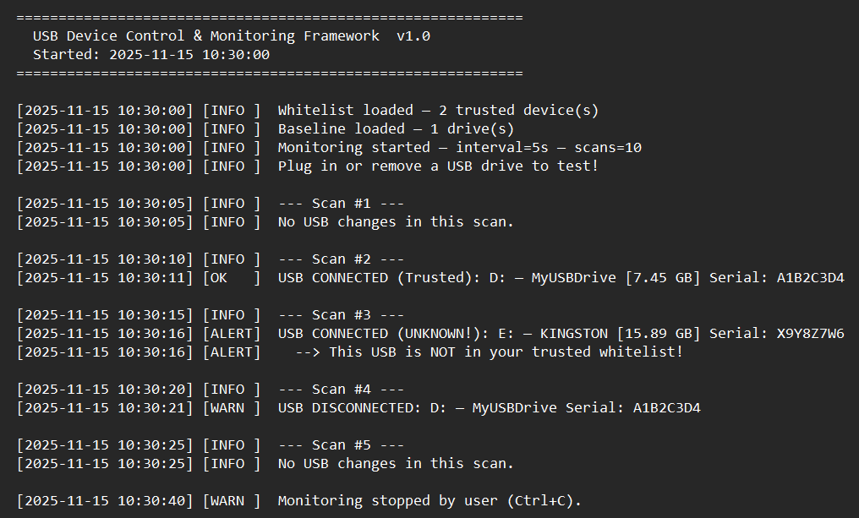
What Does the Output Look Like?
SAMPLE OUTPUT
● ● ●
usb_events.log
All events — open Notepad
usb_report.csv
Event table — open Excel
usb_baseline.json
Snapshot — Notepad
usb_whitelist.json
Trusted serials
Notes:
7

Slide 8
Tools and Technologies Used
TOOLS USED
ALL modules are BUILT INTO Python 3 — Zero extra installations needed!
Python 3
os
json
LANGUAGE
BUILT-IN
BUILT-IN
Free programming language — download from python.org
Check if USB drives and files exist on the computer
Save the whitelist and baseline as readable files
csv
hashlib
subprocess
BUILT-IN
BUILT-IN
BUILT-IN
Export event report — open in Microsoft Excel
Create SHA-256 checksum of the baseline file
Run wmic command to read USB drive info from Windows
Notes:
8

Slide 9
What Did We Learn?
LEARNING OUTCOMES
USB Security
Whitelist System
How USB drives are used in real attacks like Stuxnet and BadUSB
How trusted device lists work — used in real security software
Baseline Method
Python Scripting
How comparing to a clean snapshot detects security changes
Building a real security tool using only Python built-in modules
Log + CSV Reports
Blue Team Thinking
Creating structured logs and Excel-friendly reports
How defenders monitor, detect, and respond to threats
Notes:
9

Slide 10
Project Summary
USB Device Control & Monitoring Framework
Detects
Every USB plug/unplug within 5 seconds
Checks
Serial number against trusted whitelist
Alerts
Immediately for unknown USB devices
Logs
All events with timestamps to log file
Reports
Full CSV report — open in Excel
Notes:
10

