Slide 1



Slide 2


CODE VERSE HACKATHON 2025
Problem Statement
Automating the workflow from Google Ads to Excel reports for analysis.
Team Name
TriFusion
Team Members
Nisha, Swapnil, Aditya
Idea Title
AdGenius – Smarter Way to Read Ads Data

Slide 3
AdGenius
We are planning a lightweight automation tool that can guide marketers through the whole reporting journey—from pulling campaign data to creating analysis-ready Excel sheets.
At the center will be a “One-Click Report Generator”—a flexible system that fetches fresh data from Google Ads and instantly updates Excel dashboards without manual effort.
It will run on two core parts:
Data Engine (API + Processing): will fetch campaign metrics (clicks, impressions, cost, conversions) directly from the Google Ads API, process them with Pandas, and prepare clean datasets.
2.Report Engine (Excel Automation): will fill a pre-designed Excel template with tables, KPIs, and charts, auto-refreshing on schedule or on-demand.

Slide 4
How It Will Solve the Problem
We plan to replace manual, repetitive report downloads with one flexible automated system.
It will reduce workload by handling tasks that now take hours of copy-paste and formatting every week.
It will offer ready-to-use Excel dashboards for marketers, agencies, and businesses of all sizes.
We plan to include custom templates, scheduled updates, and error-free reporting to make analysis simple and reliable.

Slide 5
Features
Feature 1: Automated Data Fetch
Why: We plan to remove the need for manual downloads from Google Ads.
How: The Python Core Engine connects with the Google Ads API (GAQL) to fetch key metrics (clicks, impressions, cost, conversions).
Feature 2: Smart Data Processing
Why:We plan to ensure clean, structured data for analysis.
How: The Pandas Processing module cleans raw data, handles missing values, and calculates KPIs (CTR, CPC, ROI).

Slide 6
Features
Feature 3: Historical Data Storage & Trends
Why: To enable long-term reporting and trend analysis.
How: The Python Core Engine saves processed datasets into SQLite/CSV storage, preserving historical performance for insights.
Feature 4: Excel Report Generator (Dashboards & Charts)
Why: To provide ready-to-use, visually rich reports.
How: The Excel Reporting Layer (OpenPyXL/XlsxWriter) auto-fills pre-designed templates with tables, charts, and dashboards for instant analysis.
Feature 5: Scheduled Automation & One-Click Sharing
Why: To save time, reduce effort, and improve collaboration.
How: The Automation & Distribution module uses Cron/Scheduler to refresh reports automatically and distribute them via email or shared drives.

Slide 7
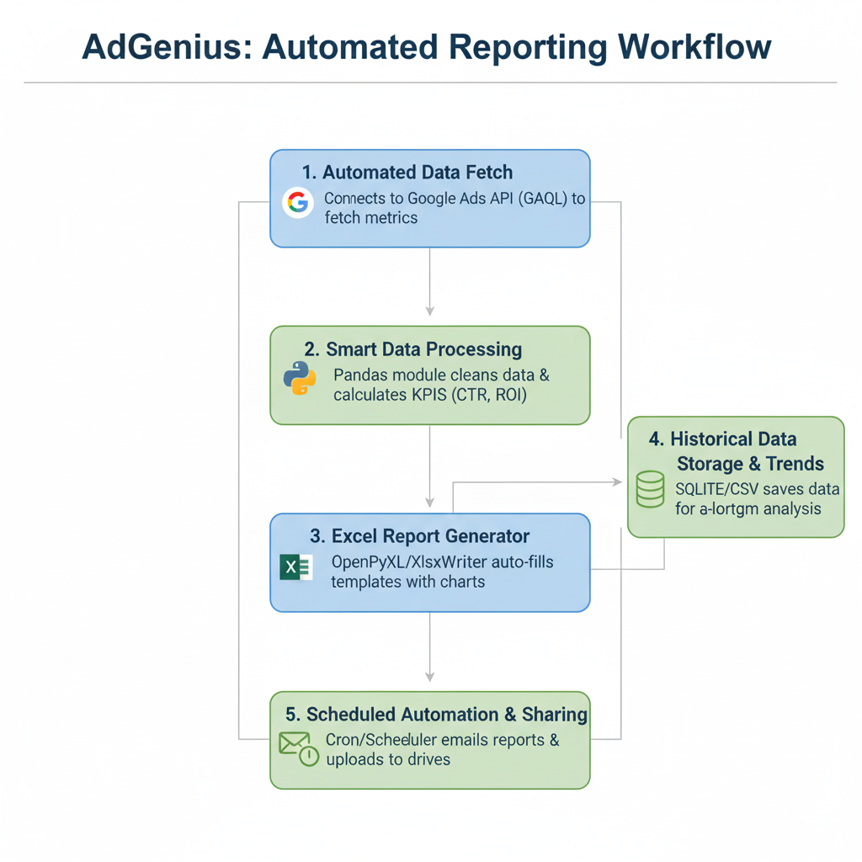
Workflow

Slide 8
TECHNICAL APPROACH
Tech Stack (Planned)
1. Core Engine: Python Script
Acts as the main controller of the workflow.
Orchestrates API calls, processing, reporting, storage, and scheduling.
2. Data Source: Google Ads API (GAQL)
Connects directly to Google Ads using GAQL queries.
Fetches campaign performance data (Clicks, Impressions, Cost, Conversions, etc.).
3. Data Processing: Pandas
Cleans and structures raw data.
Calculates KPIs (CTR, CPC, ROI, etc.).
Prepares datasets for both reporting and storage.

Slide 9
TECHNICAL APPROACH
4. Data Storage (Optional but Recommended)
SQLite or CSV used to store historical data.
Enables trend analysis and long-term performance tracking.
Works alongside Pandas for feeding into reports.
5. Reporting Layer: Excel (OpenPyXL/XlsxWriter)
Generates dashboards, tables, and charts automatically.
Uses processed data and historical datasets.
Provides a marketer-friendly reporting format.
6. Automation & Scheduling
Uses Cron jobs/Task Scheduler to refresh data & reports automatically.
Distribution: Auto-saves, emails reports, or uploads to shared drives.
Eliminates manual intervention.

Slide 10
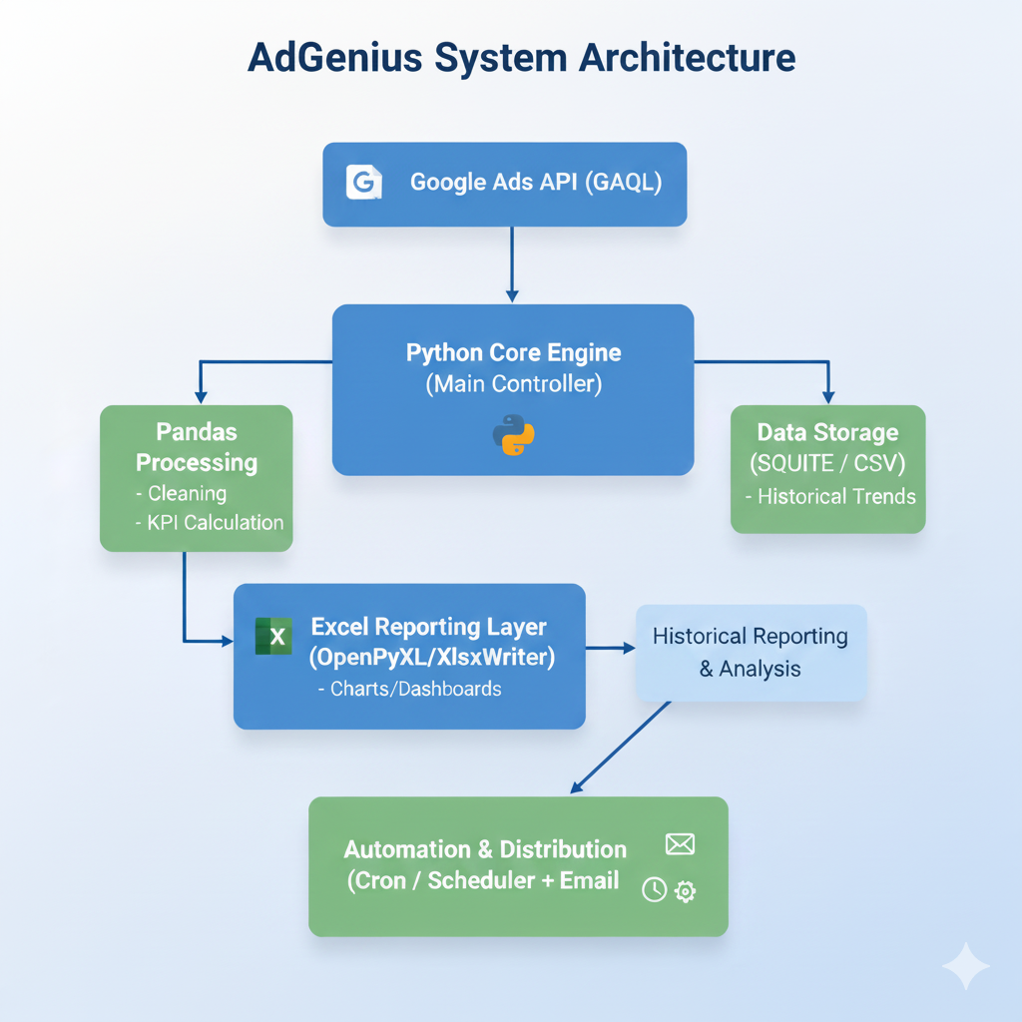
System Architecture
Notes:
10

Slide 11
FEASIBILITY AND VIABILITY
Feasibility
Technically possible with current Google Ads API and Python libraries (Pandas, OpenPyXL).
Excel provides a familiar, reliable interface for marketers → no learning curve.
Strong demand as businesses want faster, error-free ad reporting and time savings.
Potential Challenges & Our Plan
API limits or downtime: We plan to optimize GAQL queries and add caching/batch processing.
Authentication setup (OAuth, tokens): We plan to use Google’s client libraries for smooth integration.
Large accounts with big datasets: We plan to pull only required fields and process in chunks.
User trust in automation: We plan to provide logs, error handling, and manual refresh options.

Slide 12
IMPACT AND BENEFITS
Expected Impact
For Users: We plan to save marketers hours of manual reporting and turn a repetitive task into a smooth, automated process.
For the Industry: We aim to set a new benchmark for smart, automated AD reporting solutions that boost productivity and accuracy.
Key Benefits for Users
Error-Free Reports: Always consistent, accurate, and up to date.
Time Savings: Hours of copy-pasting reduced to seconds.
Instant Insights: Fresh data delivered in ready-to-use Excel dashboards.
End-to-End Automation: From API data fetch to formatted reports, handled in one flow.
Scalability: Works for individuals, agencies, or large enterprises.
Collaboration: Easy sharing of Excel files across teams without Google Ads logins.
Better Decisions: Reliable data enables smarter campaign optimization.

