Slide 1

ecoEats
ecoEats is a non-profitable organization doing social welfare by
managing waste food efficiently and sustainably.

Slide 2

Why ecoEats?
Waste Food Crisis
Environmental Impact
Millions of tons of food go to waste annually, contributing to environmental issues and hunger.
Food waste leads to greenhouse gas emissions, water wastage, and deforestation.
Social Responsibility
We have a responsibility to combat food waste and ensure everyone has access to food.

Slide 3
Global Food Waste Stats
Food Waste Amount
Environmental Impact
Social and Economic Costs
Approximately 1.3 billion tons of food is wasted globally every year, accounting for one-third of all food produced.
Food waste generates about 3.3 billion tons of greenhouse gases, contributing significantly to climate change.
Wasted food has a staggering economic cost of $1 trillion annually and leads to food insecurity for millions worldwide.

Slide 4
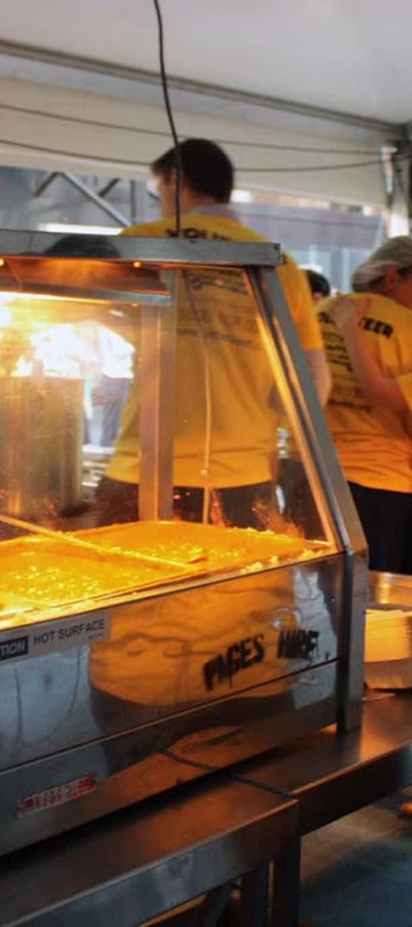
Explore our
works

Slide 5
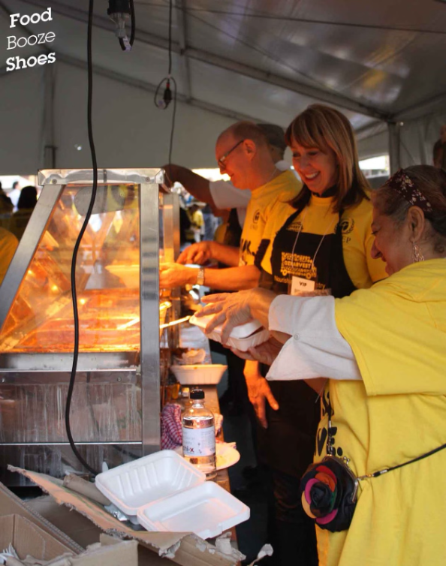
Food Rescue
Our food rescue program aims to recover surplus food from restaurants, events, and markets, preventing it from going to waste.
We partner with local food banks and NGO’s to redistribute the rescued food to those in need.
Rescuing excess food
Collaborating with NGO’s
Supporting the community

Slide 6
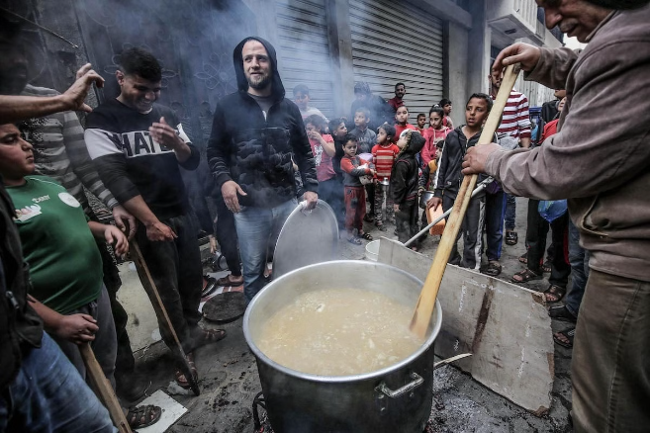
Food Distribution
Our food distribution network ensures that surplus food reaches those in need. We work with NGO’s, volunteers ,community organizations, and food banks to efficiently distribute food to individuals and families facing food insecurity. Through our partnerships, we strive to minimize food waste and address hunger in our communities.

Slide 7
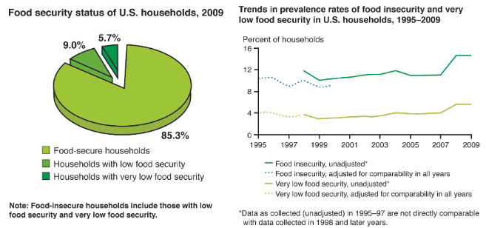
Left over management
Managing leftover food is crucial to reducing waste and promoting sustainability. At ecoEats, we buys leftovers at the end of the day from our partnered restaurants and redistributes them through ours wide network of partnered NGO’s and volunteers and make a way ahead to minimize food waste.

Slide 8



Disaster response
Flood Relief
Wildfire Assistance
Hurricane Response
Providing immediate aid and support to areas affected by floods.
Assisting communities in managing food supply during wildfire emergencies.
Responding to food needs in the aftermath of destructive hurricanes.

Slide 9

Awareness programmes
Community Workshops: Engaging local communities in educational workshops to promote sustainable food practices.
School Programs: Collaborating with schools to educate students about food waste reduction and its impact.
Online Campaigns: Utilizing social media and online platforms to raise awareness about food wastage and its solutions.

Slide 10

Contact Us
Have any questions or suggestions? We're here to help.
Reach out to us via email, phone, or social media.
We value your feedback and are committed to assisting you.

