Slide 1



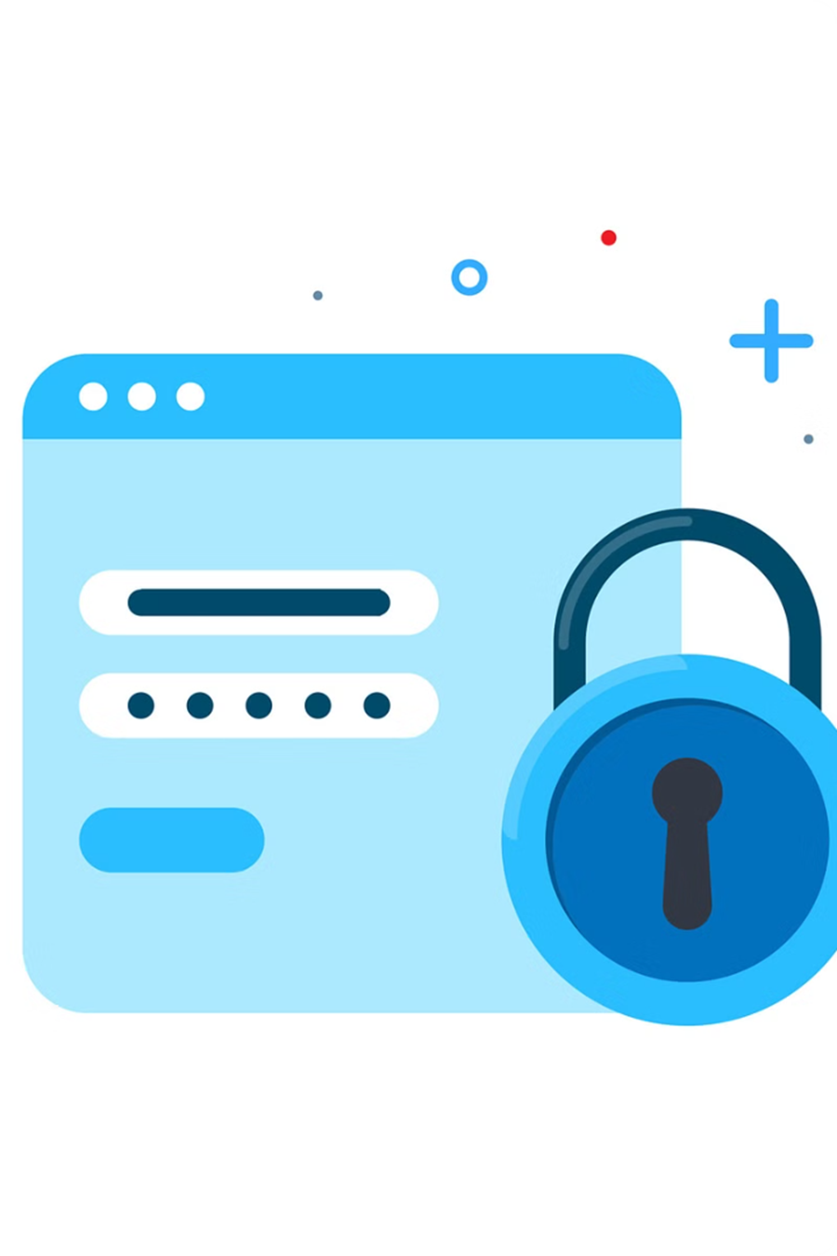
Secure Password Management System
CSA1601:Data warehousing and data mining
FACULTY NAME: Dr.Arumugam
SUBMITED BY:
K.Aditya(192111130)
G.Vinay(192211565)

Slide 2
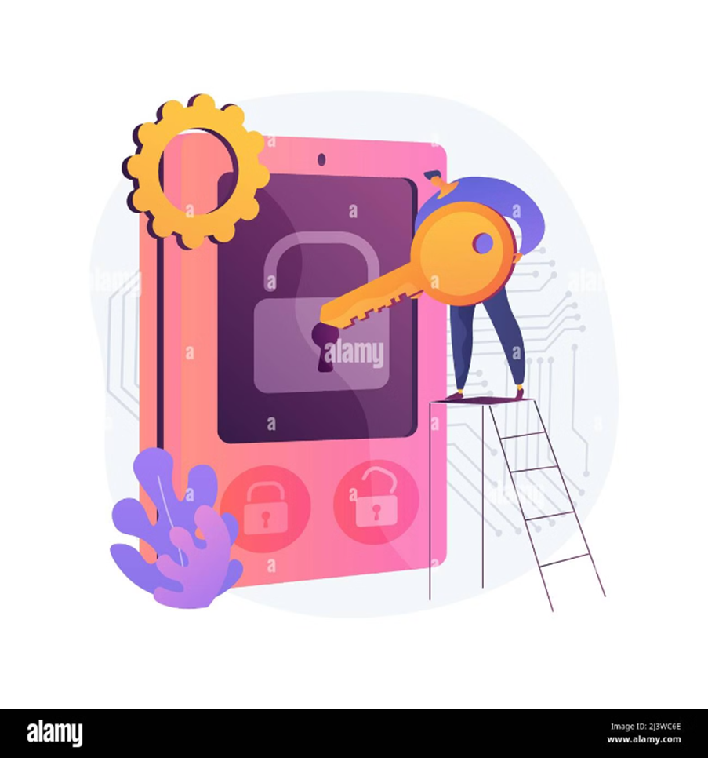
Abstract
This presentation outlines the development of a secure password management system. It covers key considerations such as password storage, encryption, multi-factor authentication, password rotation, and secure sharing and collaboration features.
The goal is to provide a comprehensive solution that enhances organizational security and user productivity by streamlining password management across the enterprise.

Slide 3
Introduction to Password Security Challenges
Weak Passwords
1
Easy-to-guess passwords put data at risk
Password Reuse
2
Using same password across accounts is dangerous
Phishing Attacks
3
Stealing credentials through deceptive tactics
Passwords are the primary line of defense for user accounts, but they are notoriously vulnerable to a variety of security threats. Weak, easily guessable passwords, password reuse across accounts, and sophisticated phishing attacks all pose major risks to data security. Overcoming these challenges is crucial for protecting sensitive information in the digital age.

Slide 4
Password Storage and Encryption Best Practices
Secure Password Hashing
Encryption at Rest
Implement encryption for password databases and any password-related data stored on servers. This protects sensitive information even if the storage is compromised.
Avoid storing passwords in plain text. Instead, use a secure hashing algorithm like bcrypt or Argon2 to store password hashes with added salts, making it difficult for attackers to crack.
End-to-End Encryption
Hardware Security Modules
Utilize end-to-end encryption for password transmission, ensuring passwords remain secure during network communication and storage.
Consider using Hardware Security Modules (HSMs) to securely store encryption keys and perform cryptographic operations, adding an extra layer of protection.

Slide 5



Multi-Factor Authentication Integration
Secure Access
Convenient Options
Centralized Control
Integrate multi-factor authentication to add an extra layer of security for user logins, preventing unauthorized access to sensitive data.
Offer a variety of multi-factor options like push notifications, one-time codes, and biometric authentication for a seamless user experience.
Manage multi-factor settings and policies from a central dashboard, ensuring consistent security standards across the organization.

Slide 6
Password Rotation and Expiration Policies
1
Scheduled Password Resets
2
Adaptive Expiration
Implement policies that automatically adjust password expiration based on risk factors like account activity, geographical login locations, and suspicious login attempts.
Require users to change their passwords at regular intervals, such as every 90 days, to limit the window of exposure for compromised credentials.
3
Password History Restrictions
4
Password Strength Enforcement
Prevent users from reusing previous passwords to encourage the creation of new, unique credentials with each rotation.
Enforce strong password requirements, such as minimum length, character complexity, and the avoidance of common passwords, to enhance the overall security of the system.

Slide 7
Secure Password Sharing and Collaboration
Secure Sharing
Collaborative Editing
Secure Backup
Secure Access
Safely share sensitive passwords with authorized team members using end-to-end encryption. Grant granular access controls and audit user activity to maintain security.
Enable real-time collaborative editing of shared passwords. Multiple users can securely view, update and comment on password details within a centralized, audited system.
Automatically back up and encrypt all password data, allowing secure recovery in case of emergency or data loss. Maintain version history for easy rollback.
Restrict access to password vaults based on user roles and permissions. Enforce multi-factor authentication to verify identities before granting access.

Slide 8
Code
#include <iostream>
#include <vector>
#include <string>
#include <algorithm>
std::string encryptPassword(const std::string &password) {
std::string encrypted = password;
for (size_t i = 0; i < encrypted.length(); ++i) {
encrypted[i] += 1;
}
return encrypted;
}
std::string decryptPassword(const std::string &encrypted) {
std::string decrypted = encrypted;
for (size_t i = 0; i < decrypted.length(); ++i) {
decrypted[i] -= 1;
}
return decrypted;
}
struct PasswordEntry {
std::string service;
std::string username;
std::string encryptedPassword;
PasswordEntry(const std::string &service, const std::string &username, const std::string &password)
: service(service), username(username), encryptedPassword(encryptPassword(password)) {}
};

Slide 9
class PasswordManager {
private:
std::vector<PasswordEntry> passwords;
public:
void addPassword(const std::string &service, const std::string &username, const std::string &password) {
passwords.push_back(PasswordEntry(service, username, password));
std::cout << "Password added successfully.\n";
}
std::string getPassword(const std::string &service) {
for (size_t i = 0; i < passwords.size(); ++i) {
if (passwords[i].service == service) {
return decryptPassword(passwords[i].encryptedPassword);
}
}
return "Password not found.";
}
void removePassword(const std::string &service) {
for (size_t i = 0; i < passwords.size(); ++i) {
if (passwords[i].service == service) {
passwords.erase(passwords.begin() + i);
std::cout << "Password removed successfully.\n";
return;
}
}
std::cout << "Service not found.\n";
}

Slide 10
void displayPasswords() {
std::cout << "Stored Passwords:\n";
for (size_t i = 0; i < passwords.size(); ++i) {
std::cout << "Service: " << passwords[i].service << ", Username: " << passwords[i].username << "\n";
}
}
};
int main() {
PasswordManager manager;
manager.addPassword("Google", "user123", "securePassword123");
manager.addPassword("Facebook", "user456", "anotherSecurePassword456");
std::cout << "Password for Google: " << manager.getPassword("Google") << "\n";
std::cout << "Password for Yahoo: " << manager.getPassword("Yahoo") << "\n";
manager.displayPasswords();
manager.removePassword("Google");
manager.displayPasswords();
return 0;
}

Slide 11
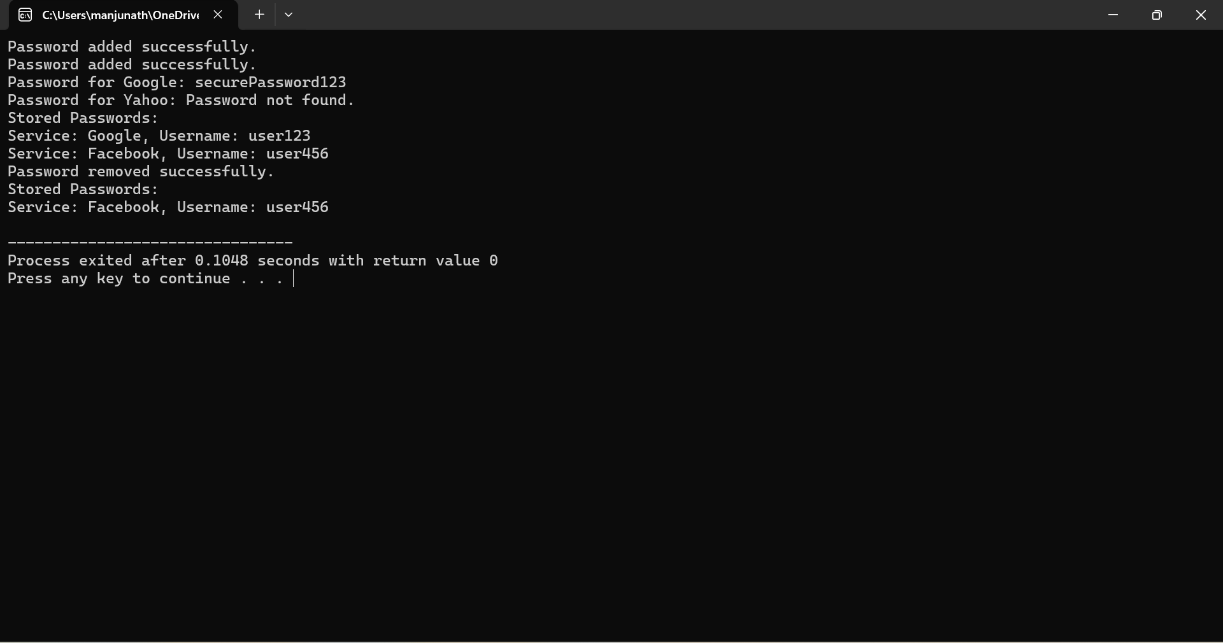
OUTPUT

Slide 12
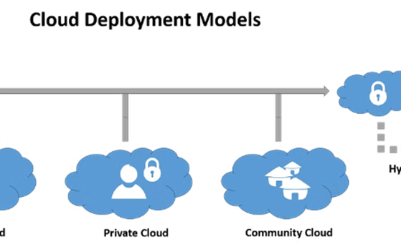
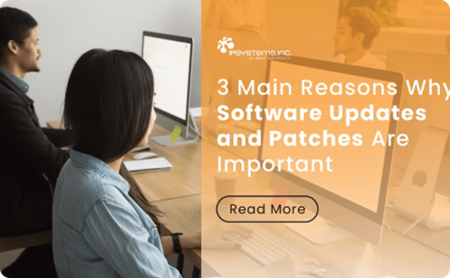
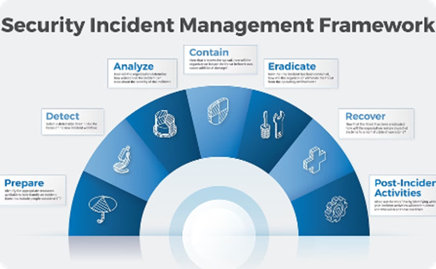
Deployment and Maintenance Considerations
Cloud Infrastructure Setup
Continuous Updates
Proactive Monitoring
Deploy the password management system in a secure cloud environment, ensuring scalability and high availability to handle growing user demands.
Implement a robust patch management process to regularly update the system with the latest security fixes and feature enhancements.
Establish comprehensive security monitoring and incident response procedures to quickly detect and mitigate any unauthorized access or suspicious activities.

Slide 13

Conclusion
In conclusion, the secure password management system we have developed provides comprehensive protection for your organization's sensitive data. By implementing robust encryption, multi-factor authentication, and secure sharing policies, we have created a solution that ensures the highest levels of security and compliance.

