Slide 1
RF-based UAV Identification and Classification
Group members:
Aditya Saxena
Rahul Thakur
Vedanshu Dewangan
Supervisor :
Dr. Shrivishal Tripathi
Date : 15 May 2023
International Institute of Information Technology, Naya Raipur

Slide 2
Table of Contents
Motivation
Problem Statement
Literature Review
Objectives
Methodology
Result and Discussions
Conclusion
References
*
International Institute of Information Technology, Naya Raipur

Slide 3
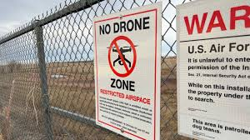
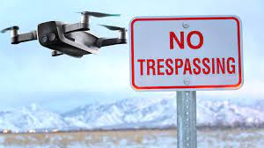
Motivation
In September 2020, two drones were used to drop explosives at an Indian Air Force base in Jammu. The attack caused minor damage to a building and injured two personnel [ Link].
In June 2020, a drone was spotted flying over the Indian Army's Brigade headquarters in the Poonch district of Jammu and Kashmir. The drone was suspected to have been used for spying purposes [Link].
Border Security Force foils drone attempt to smuggle AK series rifle and narcotics from Pakistan to India [Link].
These incidents highlight the need for improved drone detection and counter-drone capabilities in critical areas in India to prevent future incidents.
Link for the provided articles is present in the reference

Slide 4
Problem Statement
UAVs are becoming more common, but they also pose security risks.
UAVs can be used for malicious purposes, such as conducting surveillance or delivering explosives.
Detection and classification of UAVs is important for preventing security breaches.
This study uses radio frequency signals for UAV detection and classification.
Multiple machine learning and deep learning approaches are utilized in the study.
The approach can analyze the characteristics of the UAVs to classify them.
*
International Institute of Information Technology, Naya Raipur

Slide 5
Objectives -
To classify different types drones based on received RF data using Machine and Deep learning.
Also, to detect different states of a drone which are: ON, Hover and Fly.
*
International Institute of Information Technology, Naya Raipur

Slide 6
Research Gap -
Sr no. | Paper/Model Paper | Results/Limitations
1. | RF-based drone detection and identification using deep learning approaches: An initiative towards a large open source drone database(2019) | Classes Accuracy 2 99.7% 4 84.5% 10 46.8%
2. | Micro-uav detection and classification from rf fingerprints using machine learning techniques.(2019) | The paper achieved an accuracy of 96.3% using K-Nearest Neighbours on 14 different UAVs.
3. | Semi-supervised learning framework for uav detection.(2021) | This semi-supervised learning approach achieved an accuracy of 86.0%.
*
International Institute of Information Technology, Naya Raipur

Slide 7
Cont’d
SR no | Paper/Model Paper | Results/Limitations
4. | Drone classification with a convolutional neural network applied to Raw IQ Data(2022) | The proposed method achieved an accuracy of 94% for classification using CNN on spectrogram images generated through matlab.(7 drones) * This work was done on DroneDetect_V2 dataset.
5. | Unmanned aerial vehicle flight mode classification using convolutional neural network and transfer learning.(2020) | The proposed method achieved an accuracy of 87% for a total of 10 classes using 3 drones and different flight modes. * This work was done on DroneDetect_V2 dataset.
6. | Deep Learning Approach to UAV Detection and Classification by Using Compressively Sensed RF Signal.(2019) | This study gave 100% classification accuracy for 10 different classes of drones. The deep learning model used in this approach has also been implemented in our study.

Slide 8
Dataset: Dronedetect_V2*
The DroneDetect_V2 dataset consists of signals of 7 different models of popular Unmanned Aerial Systems (UAS) including the new DJI Mavic 2 Air S, DJI Mavic Pro, DJI Mavic Pro 2, DJI Inspire 2, DJI Mavic Mini, DJI Phantom 4 and the Parrot Disco.
Recordings were collected using a Nuand BladeRF SDR and using open source software GNURadio.
There are 4 subsets of data included in this dataset, the UAS signals in the presence of Bluetooth interference, in the presence of Wi-Fi signals, in the presence of both and with no interference. 3 flight modes are captured - switched on, hovering and flying.
[*] Carolyn J. Swinney, John C. Woods, June 12, 2021, "DroneDetect Dataset: A Radio Frequency dataset of Unmanned Aerial System (UAS) Signals for Machine Learning Detection & Classification ", IEEE Dataport, doi: https://dx.doi.org/10.21227/5jjj-1m32.

Slide 9
Sample rate: 60 Mbits/s
Bandwidth: 28 MHz
Centre Freq: 2.4375 GHz
Each recording consists of 1.2 x 10^8 complex samples equating to 2 seconds recording time. Data is saved into ‘.dat’ files and the complex data is saved as interleaved floats. ‘load_data.py’ is included for the data to be loaded into python and further split into smaller samples 5ms in length.
I/Q data: Default data format of SDR receivers which is in the form of complex numbers.

Slide 10
Naming conventions
Example-
MIN_1100_00
# MIN => Drone name
# 11 => both
# 00 => ON
# 00 => serial number
MIN + 11 + 00 + 00
First 2 digits: “INTERFERENCE”
# 00 for a clean signal
# 01 for Bluetooth only
# 10 for WiFi only
# 11 for Bluetooth and Wi-Fi interference concurrently
Middle 2 digits: “STATE”
# Fly => 10
# Hov => 01
# on => 00
Last 2 digits:
# Serial number.

Slide 11
Methodology
1. PCA
Principal Component Analysis is a linear feature extraction method for dimensionality reduction.
Seeks a projection that preserves as much information in the data as possible
PCA chooses the eigenvectors of the covariance matrix corresponding to the largest eigenvalues.
The eigenvalues correspond to the variance of the data along the eigenvector directions.
Therefore, PCA projects the data along the directions where the data varies most.

Slide 12
2. Approaches:
Logistic Regression:
Logistic regression is an example of supervised learning. It is used to calculate or predict the probability of a binary (yes/no) event occurring.
SVM:
Support vector machines (SVMs) are a set of supervised learning methods used for classification, regression and outliers detection. SVM algorithm finds the closest point of the lines from both the classes. These points are called support vectors.
Decision Trees:
A decision tree is a type of supervised machine learning used to categorize or make predictions based on how a previous set of questions were answered.

Slide 13
Random forest:
It is an supervised learning approach which builds decision trees on different samples and takes their majority vote for classification and average in case of regression.
Naive Bayes:
Naïve Bayes is one of the fast and easy ML algorithms to predict a class of datasets. It can be used for Binary as well as Multi-class Classifications. It is the most popular choice for text classification problems.
KNN:
The k-nearest neighbors algorithm, also known as KNN or k-NN, is a non-parametric, supervised learning classifier, which uses proximity to make classifications or predictions about the grouping of an individual data point.

Slide 14
Deep Neural networks:
Deep learning neural networks, or artificial neural networks, attempts to mimic the human brain through a combination of data inputs, weights, and bias. These elements work together to accurately recognize, classify, and describe objects within the data.
A deep neural network (DNN) is an ANN with multiple hidden layers between the input and output layers.
Convolutional Neural networks:
A CNN is a kind of network architecture for deep learning algorithms and is specifically used for image recognition and tasks that involve the processing of pixel data.
CNNs do not require human supervision for the task of identifying important features. They are very accurate at image recognition and classification.
LSTM:
Long Short-Term Memory (LSTM) is a type of Recurrent Neural Network (RNN) that is specifically designed to handle sequential data, such as time series, speech, and text.

Slide 15
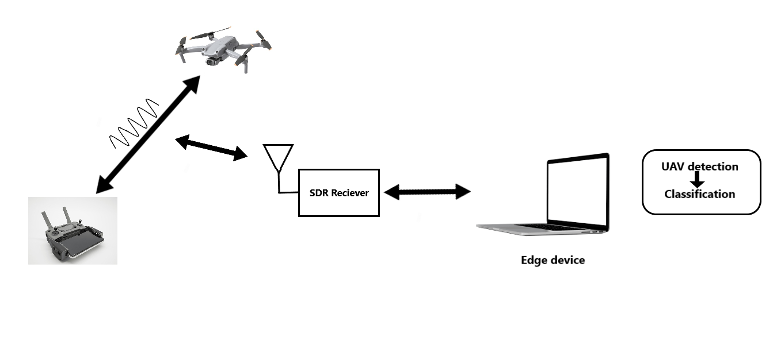
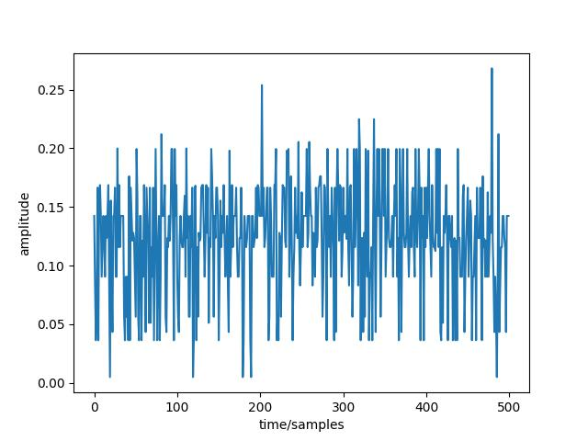
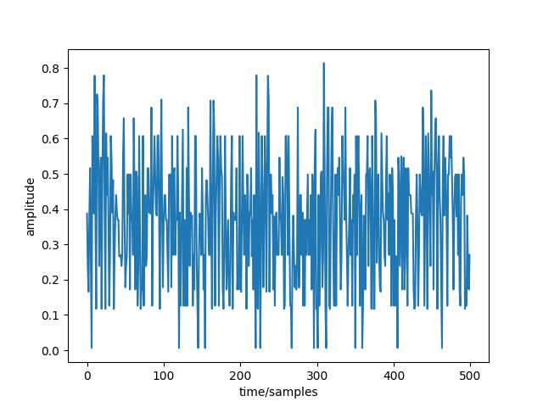
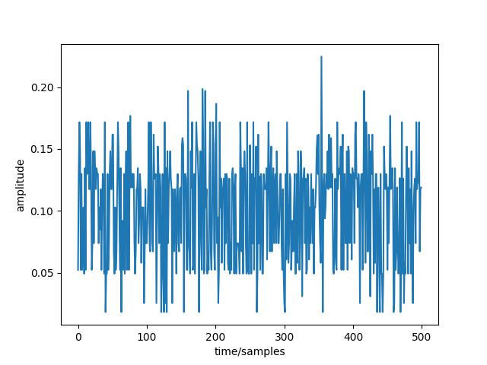
Working:
After taking into account all the drones and their states, along with missing data for three classes, we have a total of 18 classes for the “CLEAN” dataset.
Different Machine learning and deep learning techniques have been applied on this dataset after PCA was applied for feature extraction.
(a) MP1_FY (b) MP1_HO (c) MP1_ON
*
International Institute of Information Technology, Naya Raipur

Slide 16
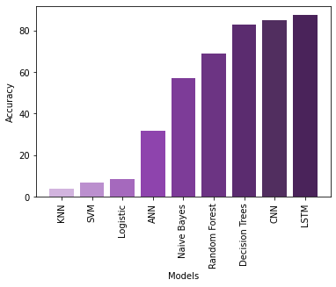
Results and Discussion -
Classification of different types of drones along with their flying modes
Models | Accuracy %
KNN | 3.96
SVM | 6.7
Logistic Regression | 8.4
ANN | 31.7
Naive Bayes | 57.1
Random Forest | 68.8
Decision Trees | 82.9
CNN | 85
LSTM | 87.56

Slide 17
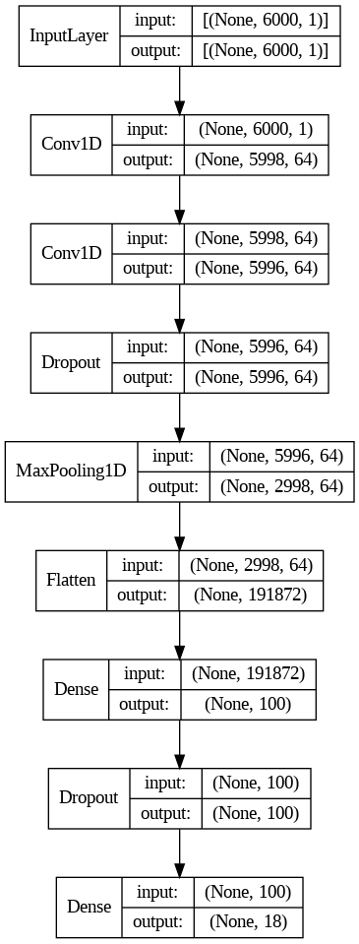
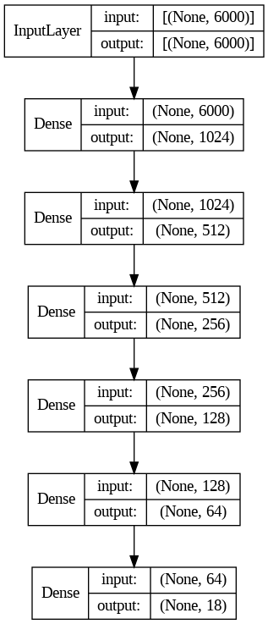
Model architectures
Epoches: 25
Learning rate: 1e-3
Optimizer: Adam
Batch size: 16
1. ANN 2. CNN

Slide 18
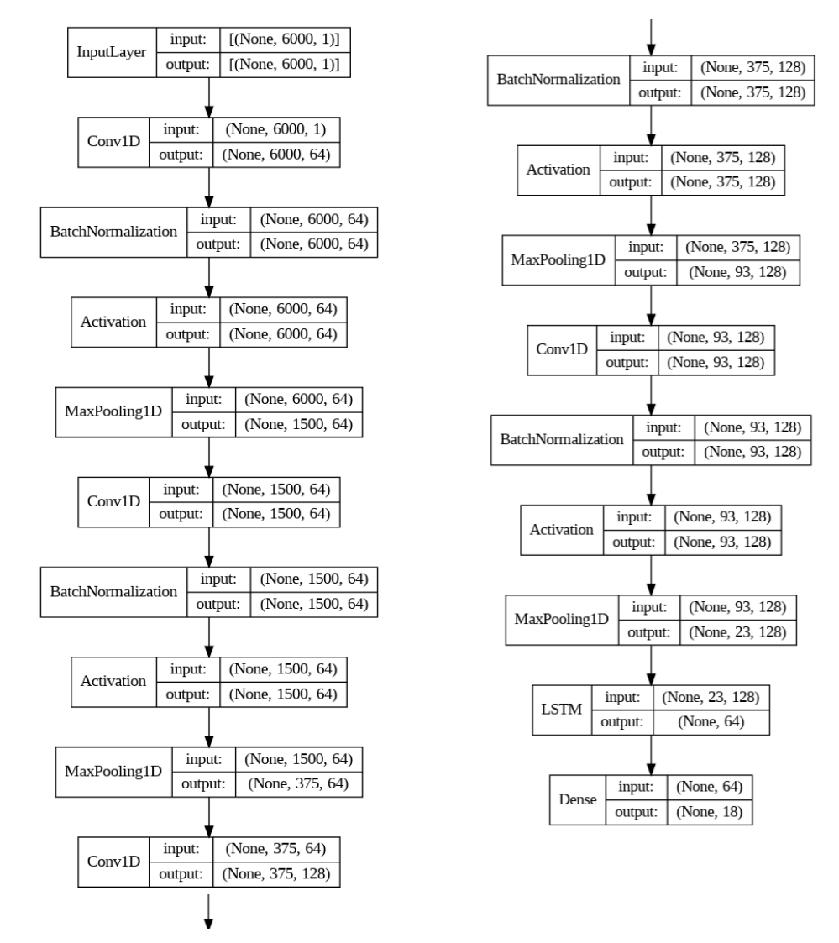
Model architectures
3. LSTM+CNN
Epoches: 25
Learning rate: 1e-3
Optimizer: Adam
Batch size: 16
ANN CNN

Slide 19
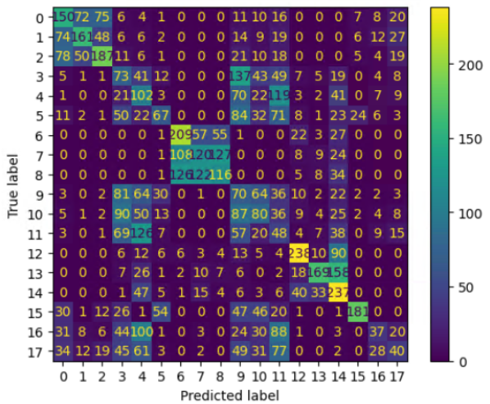
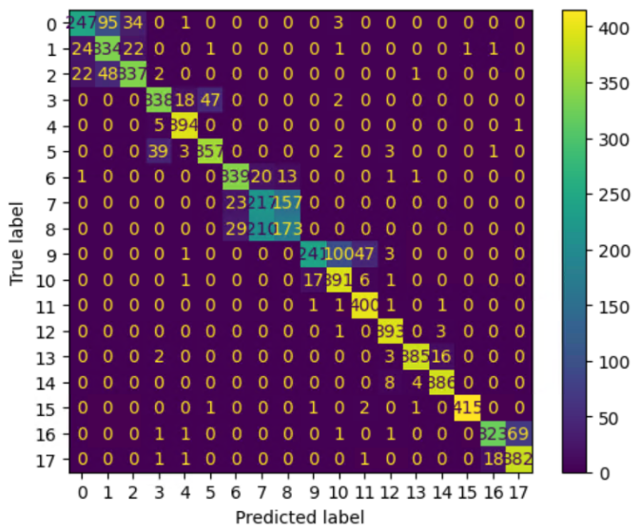
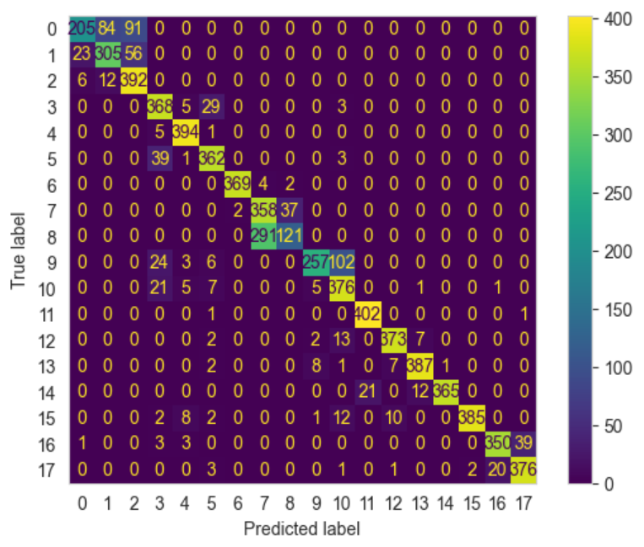
Confusion matrix
Class Mapping
AIR_FY 0
AIR_HO 1
AIR_ON 2
INS_HO 3
INS_ON 4
DIS_FY 5
MIN_FY 6
MIN_HO 7
MIN_ON 8
MP1_FY 9
MP1_HO 10
MP1_ON 11
MP2_FY 12
MP2_HO 13
MP2_ON 14
PHA_HO 15
PHA_ON 16
DIS_ON 17
ANN CNN LSTM

Slide 20
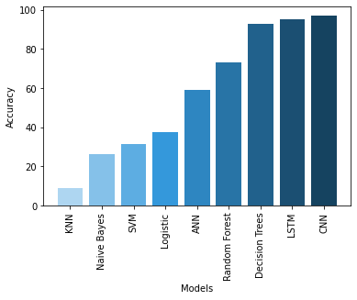
2. Classification of different types of drones
Models | Accuracy %
KNN | 9.12
Naive Bayes | 26.3
SVM | 31.4
Logistic Regression | 37.7
ANN | 59.24
Random Forest | 72.9
Decision Trees | 92.8
LSTM | 95.25
CNN | 97.04

Slide 21
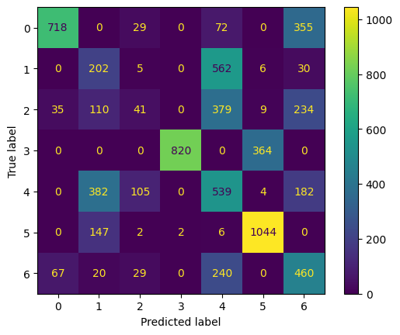
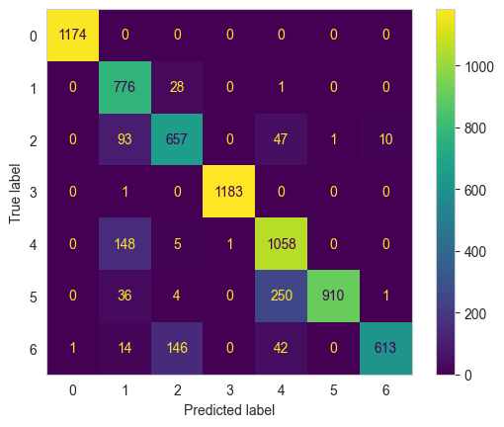
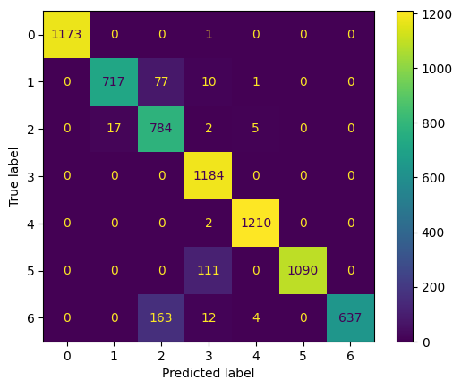
Confusion matrix
Class Mapping
AIR 0
INS 1
DIS 2
MIN 3
MP1 4
MP2 5
PHA 6
ANN LSTM CNN

Slide 22
Conclusion -
The best results obtained for classification of different types of drones along with their flying modes were given by: CNN+LSTM model with an accuracy of 87.56%. (18 classes)
Also, for classification of only different types drones the best results were provided by CNN model with an accuracy of 97.04%. (7 classes)

Slide 23
References -
Al-Sa'd, Mohammad & Al-Ali, Abdulla & Mohamed, Amr & Khattab, Tamer & Erbad, Aiman. (2019). RF-based drone detection and identification using deep learning approaches: An initiative towards a large open source drone database. Future Generation Computer Systems. 100. 10.1016/j.future.2019.05.007.
M. Ezuma, F. Erden, C. K. Anjinappa, O. Ozdemir and I. Guvenc, "Micro-UAV Detection and Classification from RF Fingerprints Using Machine Learning Techniques," 2019 IEEE Aerospace Conference, Big Sky, MT, USA, 2019, pp. 1-13, doi: 10.1109/AERO.2019.8741970.
O. Medaiyese, M. Ezuma, A. P. Lauf, and I. Guvenc, “Semi-supervised Learning Framework for UAV Detection,” in 2021 IEEE 32nd Annual International Symposium on Personal, Indoor and Mobile Radio Communications (PIMRC), Helsinki, Finland, 2021, pp. 1185–1190.
S. Kunze and B. Saha, "Drone Classification with a Convolutional Neural Network Applied to Raw IQ Data," 2022 3rd URSI Atlantic and Asia Pacific Radio Science Meeting (AT-AP-RASC), Gran Canaria, Spain, 2022, pp. 1-4, doi: 10.23919/AT-AP-RASC54737.2022.9814170..
. J. Swinney and J. C. Woods, “Unmanned Aerial Vehicle Flight Mode Classification using Convolutional Neural Network and Transfer Learning,” in 2020 16th International Computer Engineering Conference (ICENCO), Cairo, Egypt, 2020, pp. 83–87.
B. Taha and A. Shoufan, "Machine Learning-Based Drone Detection and Classification: State-of-the-Art in Research," in IEEE Access, vol. 7, pp. 138669-138682, 2019, doi: 10.1109/ACCESS.2019.2942944.
Dataset: Carolyn J. Swinney, John C. Woods, June 12, 2021, "DroneDetect Dataset: A Radio Frequency dataset of Unmanned Aerial System (UAS) Signals for Machine Learning Detection & Classification ", IEEE Dataport, doi: https://dx.doi.org/10.21227/5jjj-1m32
NEWS ARTICLE :
https://www.indiatoday.in/india/story/air-force-station-jammu-blast-drone-attack-suspected-1819895-2021-06-27
https://www.cnbctv18.com/india/border-security-force-foils-drone-attempt-to-smuggle-ak-series-rifle-and-narcotics-from-pakistan-to-india-16140641.htm
https://www.outlookindia.com/national/army-forces-drone-to-retreat-near-loc-in-j-k-s-poonch-news-209656

Slide 24

Thank You
..
Dr. Shyama Prasad Mukherjee International Institute of Information Technology, Naya Raipur
*
International Institute of Information Technology, Naya Raipur

