Slide 1
PROJECT TITLE: Secure Data Hiding in Image Using Steganography
CAPSTONE PROJECT
Presented By: Aditya Sinha
Student Name : Aditya Sinha

Slide 2
OUTLINE
Problem Statement
Technology used
Wow factor
End users
Result
Conclusion
Git-hub Link
Future scope

Slide 3
Problem Statement
With the rise of digital communication, data security and privacy are major concerns.
Traditional encryption methods make data conspicuous, attracting attackers.
Need for a technique to hide data within digital media discreetly.

Slide 4
Technology used
Steganography Techniques: LSB (Least Significant Bit) Substitution
Programming Languages: Python
Libraries & Tools: OpenCV, PIL, NumPy, OS
Encryption Methods: AES for additional security
Implementation: Image-based data hiding using pixel modification

Slide 5
Wow factors
Hidden data is imperceptible to the human eye.
Combines encryption with steganography for double security.
Can be used in various security applications like watermarking and covert communication

Slide 6
End users
Government agencies for secure communication.
Journalists & whistleblowers for confidential data transmission.
Cybersecurity professionals for data protection.
General users for personal privacy.

Slide 7
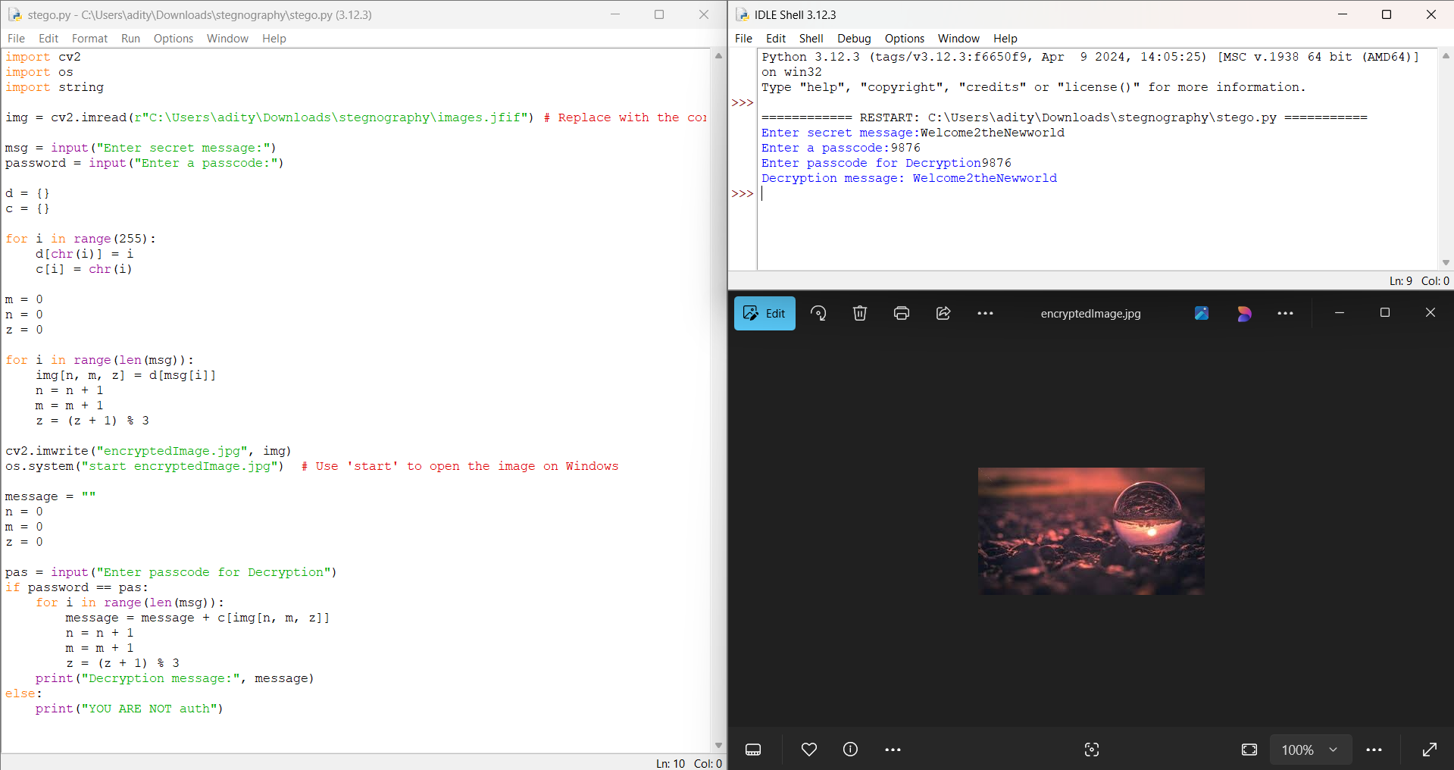
Results

Slide 8
Conclusion
Steganography is an effective way to hide data in plain sight.
Ensures security and confidentiality of sensitive information.
A combination of encryption and steganography enhances protection.

Slide 9
GitHub Link
https://github.com/Aditya2309Sinha/Stenography.git

Slide 10
Future scope(optional)
Implement AI to detect and prevent steganalysis attacks.
Develop mobile and web applications for broader accessibility.
Enhance security with quantum cryptographic techniques.
Explore adaptive steganography for better concealment.

Slide 11
THANK YOU

