Slide 1



LEX-BOT. AI LEGAL ASSISTANT.
By
Aditya Bhadra 123211003003.
Aditya Narayan Saha 123211003005.
Tania Karmakar 123211003179.

Slide 2
CONTENT.
Introduction
Literature
Survey
Tech Stack
Methodology
Limitations
Future Aspects
Conclusion
1

Slide 3
INTRODUCTION
The Lex Bot project is an innovative solution designed to provide legal guidance to users through an advanced AI-powered chatbot. The platform aims to assist individuals by offering accurate, preliminary legal insights on a variety of topics. This tool is especially helpful for those who may not have immediate access to professional legal advice or need initial direction on legal matters. Lex Bot ensures a user-friendly interface, making legal guidance accessible to everyone, regardless of their background. By integrating technology and legal expertise, this project aspires to bridge the gap between the general public and affordable legal support.
2

Slide 4
LITERATURE SURVEY
The Need for AI in Legal Services
Overview of AI Legal Chatbots
Impact of Legal Chatbots
The legal industry faces challenges such as high costs, limited accessibility, and delays. Studies like those by Susskind (2013) highlight the “justice gap” preventing individuals from accessing legal resources. AI-powered chatbots automate repetitive tasks and provide real-time assistance, effectively addressing FAQs, generating legal documents, and clarifying legal terms.
AI legal chatbots mimic human interaction using natural language processing (NLP) and machine learning (ML) to respond to queries.
AI chatbots improve access to underserved populations, reduce costs of basic consultations, and enhance efficiency by automating tasks. While not replacements for professional counsel, they complement existing resources by bridging gaps in legal knowledge.

Slide 5
TECH STACK
Programming Language:
Python – Core language used for AI model, backend development.
Machine Learning & NLP:
Hugging Face Transformers – Used for loading and running LLMs (Large Language Models).
Unsloth – Optimized model loading and inference.
PyTorch – Deep learning framework for training and deploying the AI model.
Model & Tokenizer:
Custom-trained LLM (stored in “/content/drive/MyDrive/LexBot/LexBot”)
AutoTokenizer – Tokenization for model input.
Storage & Deployment:
Google Drive (Colab Integration) – Storing the model.
Colab / GPU (CUDA) – Running the chatbot on GPU for faster inference.
BitsAndBytes (for 4-bit quantization) – Optimized memory usage.
Frontend (if applicable):
HTML/CSS/JavaScript –Web-based UI.
Deployment & Hosting:
Local Server (port 8080) – Running on a local.

Slide 6
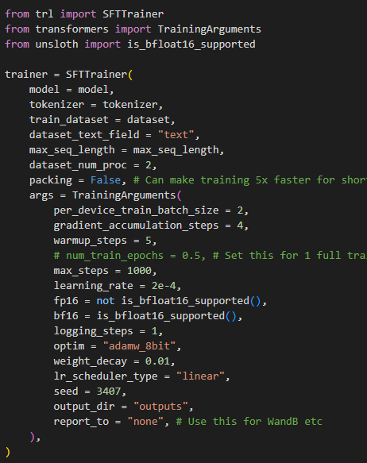
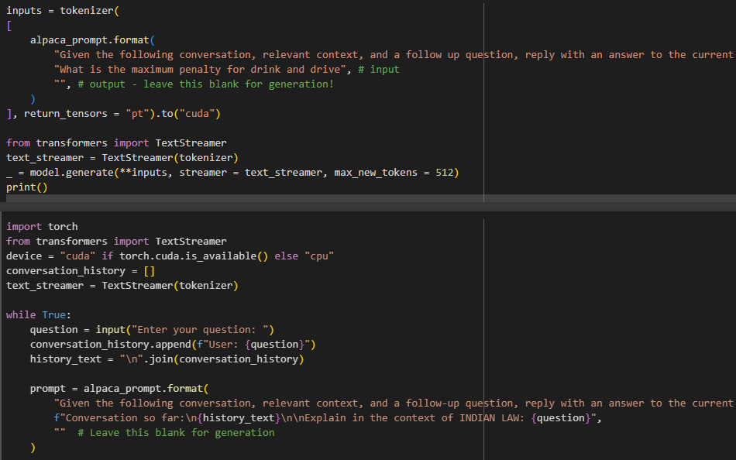
METHODOLOGY
Index Page
6
Register Page

Slide 7
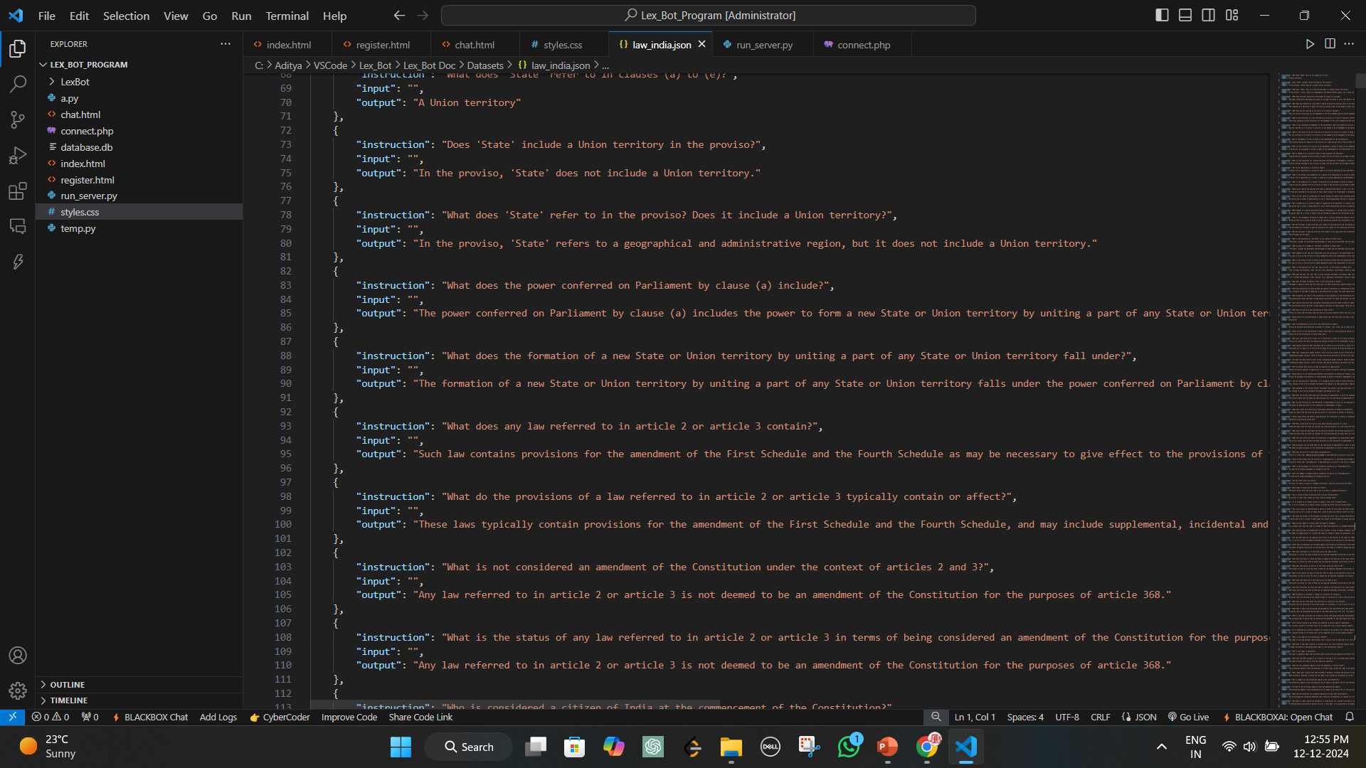
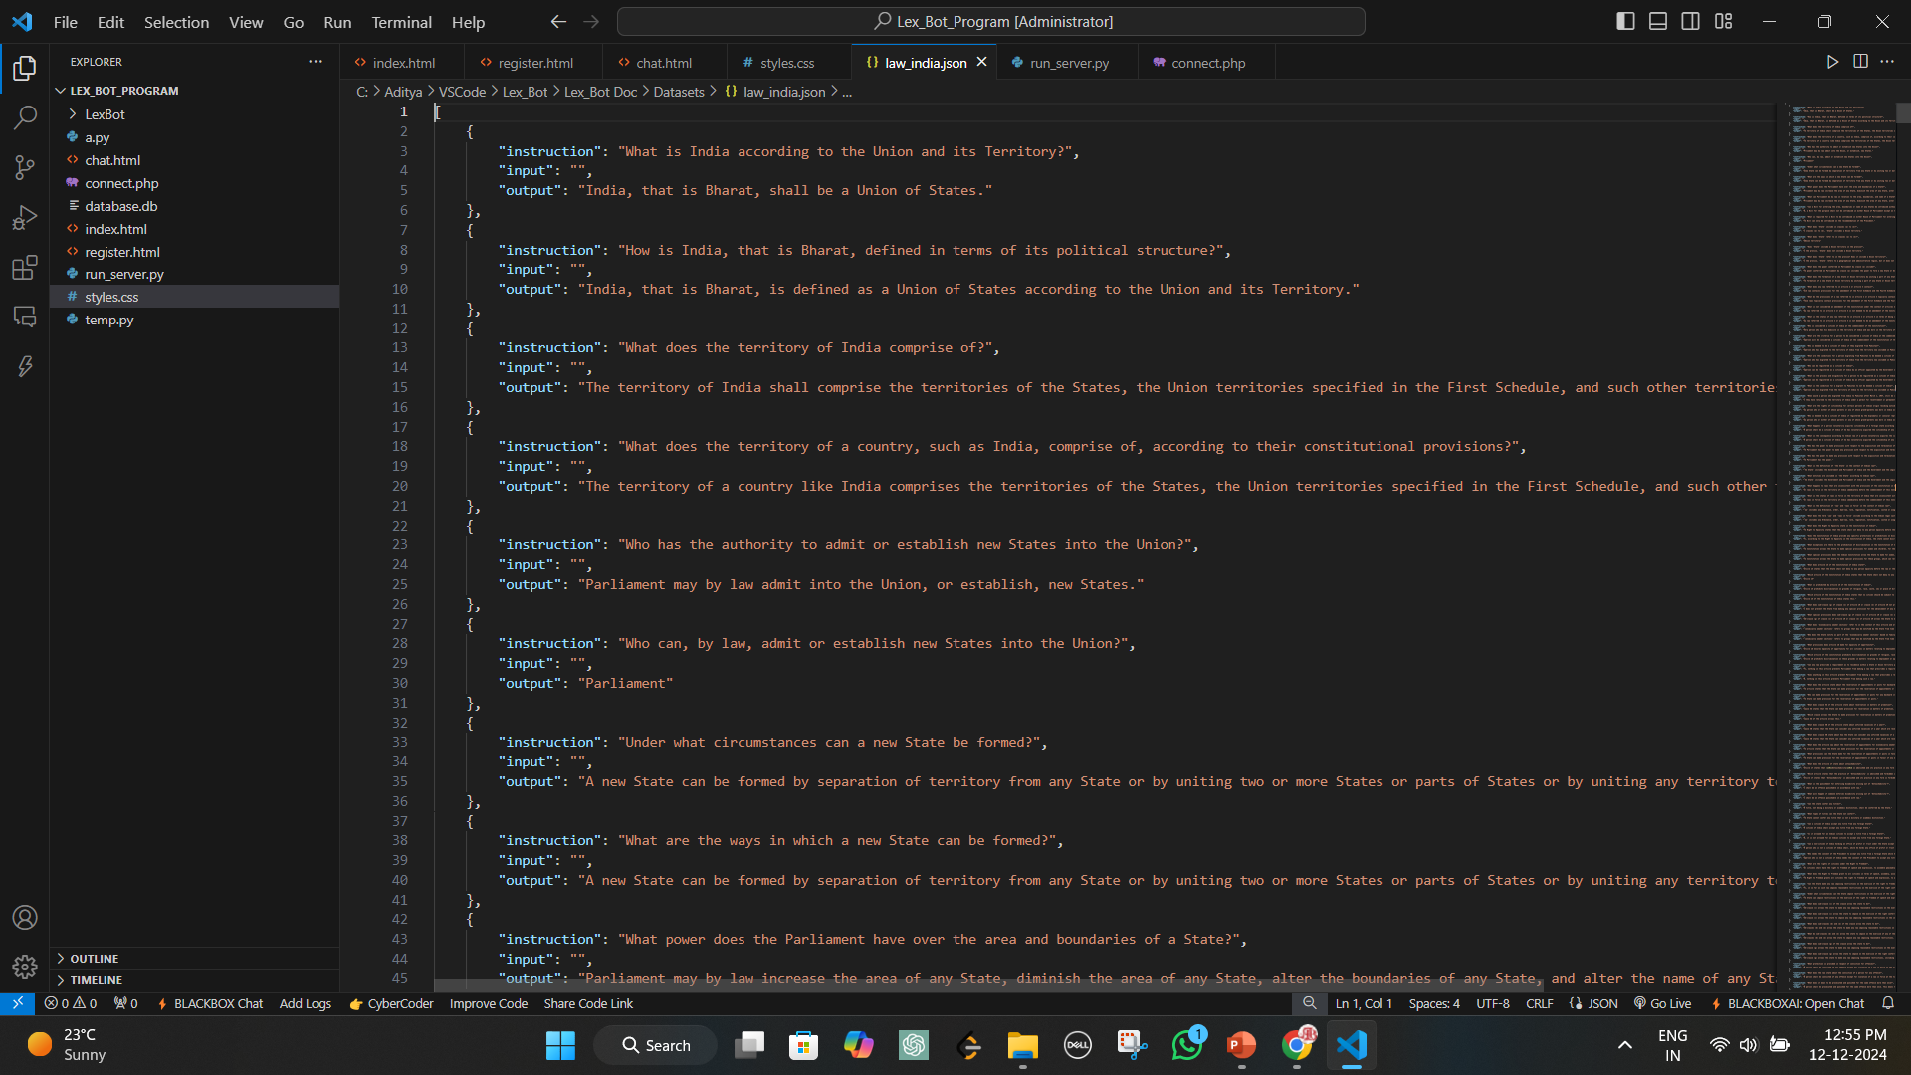
Indian Law Rules
Indian Law Rules

Slide 8
LIMITATIONS
General Legal Information Only: Lex Bot offers broad legal suggestions, but it lacks the ability to delve deeply into complex legal cases that require specialized expertise.
Not a Replacement for Lawyers: It is essential to consult a licensed attorney for legal decisions or actions, as the bot cannot provide legally binding advice.
Jurisdictional Limitations: The bot cannot cater to legal intricacies or variations specific to different regions or countries.
Knowledge Constraints: Its pre-trained model may not include the latest legal amendments or address unique, nuanced scenarios.
Supplementary Tool: Lex Bot is best used as a supplementary resource to gain preliminary legal insights.

Slide 9
FUTURE ASPECTS
Expansion to Support Laws of Specific Countries: Lex Bot will be enhanced to provide region-specific legal advice, making it more relevant to users worldwide. By incorporating the laws of various countries, the bot will deliver tailored insights based on the user’s jurisdiction, ensuring that legal advice aligns with local regulations, rules, and practices.
Improved AI Model for More Accurate Legal Suggestions: The AI model behind Lex Bot will undergo improvements to enhance its ability to provide accurate and reliable legal suggestions. By integrating more advanced machine learning techniques, Lex Bot will better understand complex legal queries and generate responses that are both precise and insightful.
Mobile App Development: To make Lex Bot more accessible, a mobile app for both iOS and Android will be developed. This app will allow users to access legal advice at their convenience, providing an on-the-go solution for anyone in need of legal insights, whether at home, at work, or traveling.
Multi-language Support: To reach a global audience, multi-language support will be added, enabling users from different linguistic backgrounds to interact with Lex Bot in their preferred language.

Slide 10
CONCLUSION
Lex Bot plays a crucial role in democratizing legal knowledge by offering quick and accessible legal advice to users. As a starting point for individuals seeking legal insights, it provides valuable assistance in understanding complex legal matters, especially for those without immediate access to legal professionals. The AI-powered chatbot can address a wide range of queries, guiding users through general legal concepts and helping them make informed decisions. While it is not a replacement for professional legal counsel, Lex Bot offers an efficient, cost-effective solution for obtaining initial legal guidance and fostering legal awareness globally.
10

