Slide 1


G H Raisoni College of Engineering and Management, Pune
An Autonomous Institute Affilated to Savitribai Phule Pune University
Gat No. 1200, Domkhel Road, Wagholi, Pune – 412207
NAAC A+ Grade and NBA Accredited
Department : Electronics and Telecommunication
Course : Microproject
Course Code : 23UECELP2401
Hand Gesture-Based LED Control
Acadamic year : 2024-25
Roll No. | Name
03 | Abhijeet S. Chavan
07 | Aditya D. Parit
10 | Akash R. Jadhao

Slide 2

Introduction:
It feels more natural and easier to use, especially compared to regular switches or remotes.
This kind of control is becoming very important in today’s smart systems, like smart homes and devices that help people with disabilities.
It also helps in situations where we don’t want to touch anything, like for hygiene or convenience.
In our project, we show how you can turn an LED on or off just by moving your hand in front of a sensor.
Hand gesture control lets us use simple hand movements to control electronic devices—no need to press buttons.

Slide 3
Objective:-
To design and build a simple system that turns an LED on or off using just hand gestures.
The goal is to allow people to interact with electronic devices in a more natural and touch-free way.
The system will detect hand movements using a camera or sensor, like a webcam or ultrasonic/IR sensor.
When a specific gesture is recognized, it sends a signal to control the LED in real time.
This project explores how gesture recognition can be used for smart and contactless control systems.

Slide 4
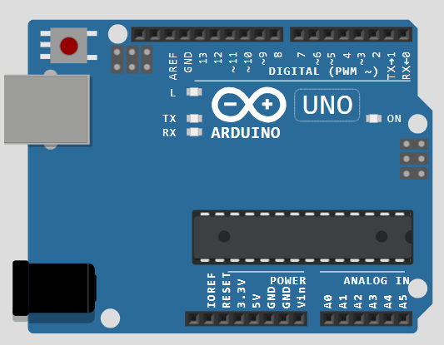
Components Used
1. Arduino UNO This is the brain of our project. It processes the signals from the camera and controls the LED based on the detected gestures.
2. Camera The camera captures the hand gestures. It sends the video feed to the system for processing and recognizing different hand movements.
3. LEDs These are the output devices. They light up or turn off based on the hand gestures detected—acting as the final visual result of our control system.
4. Resistors, Jumper Wires, Breadboard These basic components help connect everything together safely and neatly. The resistors protect the LEDs, and the breadboard helps in building the circuit without soldering.
5. Power Supply It provides the necessary electrical power to the Arduino and the rest of the circuit to make everything work.

Slide 5
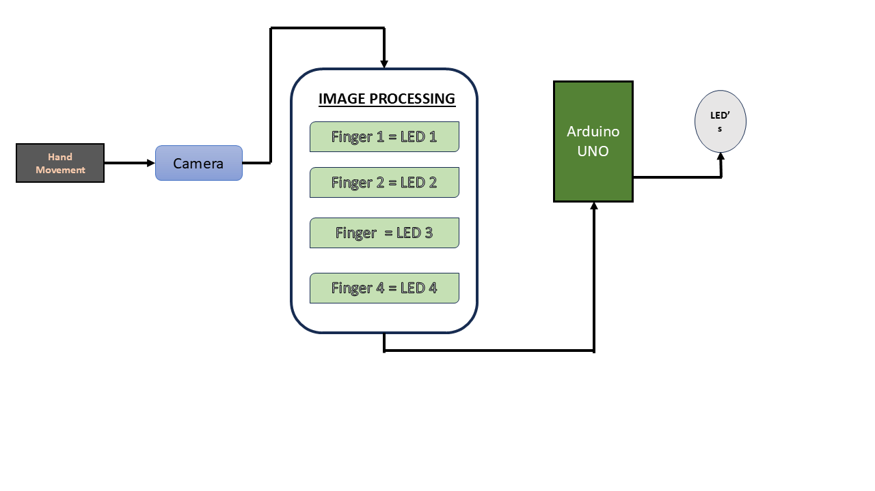
Block Diagram

Slide 6
🔧 Working Principle
A camera watches your hand and notices how it moves or what shape it makes (gesture).
That image or movement is sent to a microcontroller (like the brain of the system).
The microcontroller understands the gesture and decides what to do.
Based on the gesture, it turns the LED ON or OFF — just like giving it a signal without touching anything!

Slide 7
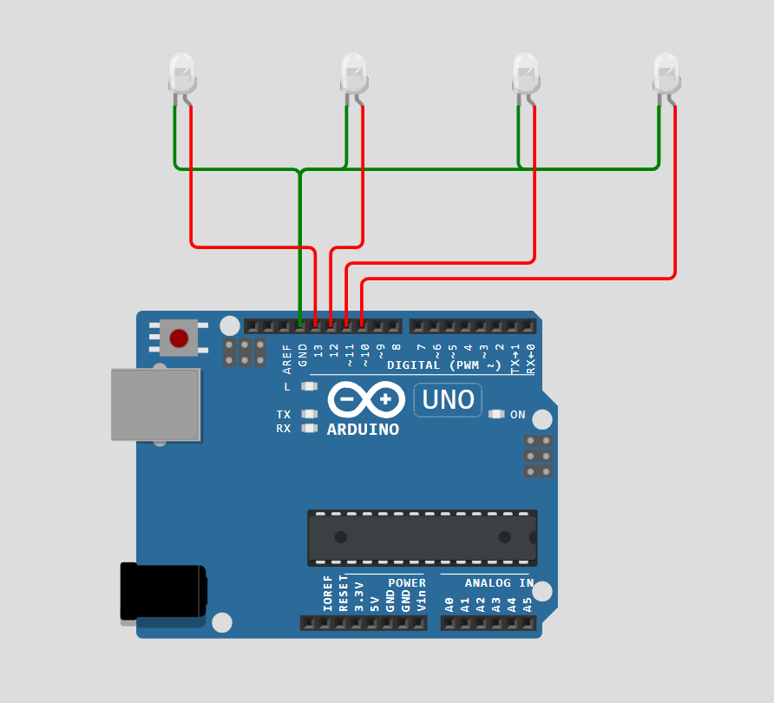
Circuit Diagram:

Slide 8
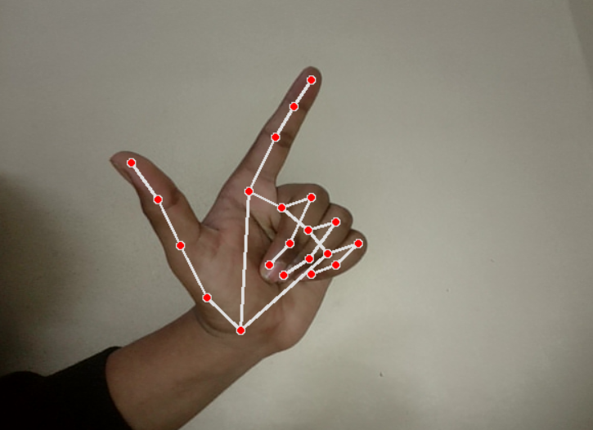
🟢 Output & Results
We successfully demonstrated how hand gestures can turn an LED ON and OFF without touching anything.
A camera or sensor detects specific hand movements (like open palm = ON, closed fist = OFF).
The system then sends signals to the LED circuit to perform the required action.
LED turns ON when hand is shown.
LED turns OFF when fist is made.
You can also include a short clip or step-by-step image of the gesture-to-LED process.
Success Rate: Around 95% accuracy in detecting gestures.
Response Time: LED responds in under 1 second after the gesture is detected.
Works best in good lighting conditions and with clear gestures.
🔍 Visual Proof
📊 Performance

Slide 9
Applications:-
Smart Home Automation: Control lights or appliances in your home simply by using hand gestures, without needing physical switches or remotes.
Assistive Technology for Disabled Individuals: Helps people with limited mobility control lights easily, improving their independence and quality of life.
Interactive Displays or Touchless Interfaces: Can be used in public places, museums, or kiosks for controlling screens or lights without touching anything – great for hygiene and accessibility.

Slide 10
THANK YOU

