Slide 1

Air Quality Index (AQI) Prediction
GROUP-03
Abdul Rafey(03) Bhavya Arora(72)
Aditya Kumar(15) Ayush Raj(66)
Aditya Kumar(16)

Slide 2
Introduction
This project builds a regression model to predict AQI from environmental data. The aim is to visualize pollution patterns across Indian regions. Our goal is to support public health and environmental policy-making.
We have taken our data set from kaggle site:
https://www.kaggle.com/datasets/rohanrao/air-quality-data-in-india

Slide 3
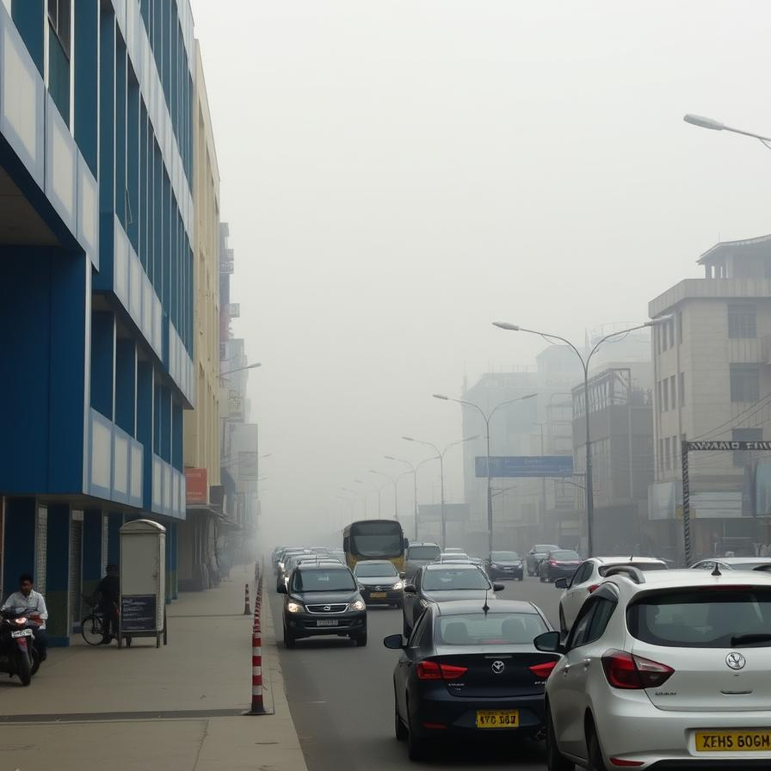
Problem Statement
Complex Pollution Factors
Multiple pollutants impact air quality variably by location and time.
Data Integration Challenges
Diverse data sources require cleaning and feature engineering for accuracy.

Slide 4
Dataset and Features
Data Source
Open-source datasets from Indian cities, 2015-2020 timeframe.
Pollutant Features
PM2.5, PM10, NO, NO2, NOx, NH3
CO, SO2
Geospatial Data
AQI of cities: Delhi, Jaipur, Gorakhpur, Kolkata, Patna, Bhopal etc.
Detailed Data of Ahmedabad
Include diff. Particulate matters like PM, NO, NOx, SO2.

Slide 5





Methodology
Data Acquisition & Preprocessing
Collected air quality and meteorological data from Indian cities, followed by cleaning, handling missing values, and standardizing features..
Feature Selection:
Identified key environmental variables (e.g., PM2.5, PM10, NO2, SO2, CO, O3, temperature, humidity) that significantly impact AQI
Algorithim:
We have used Random Forest Algorithim.
Model Optimization & Evaluation:
Random Fosrest Algorithim includes:
Random forest regressor, Random forest classifier.
Prediction & Visualization:
Predicted AQI for various regions and visualized results with heatmaps and dashboards to illustrate regional pollution levels.

Slide 6
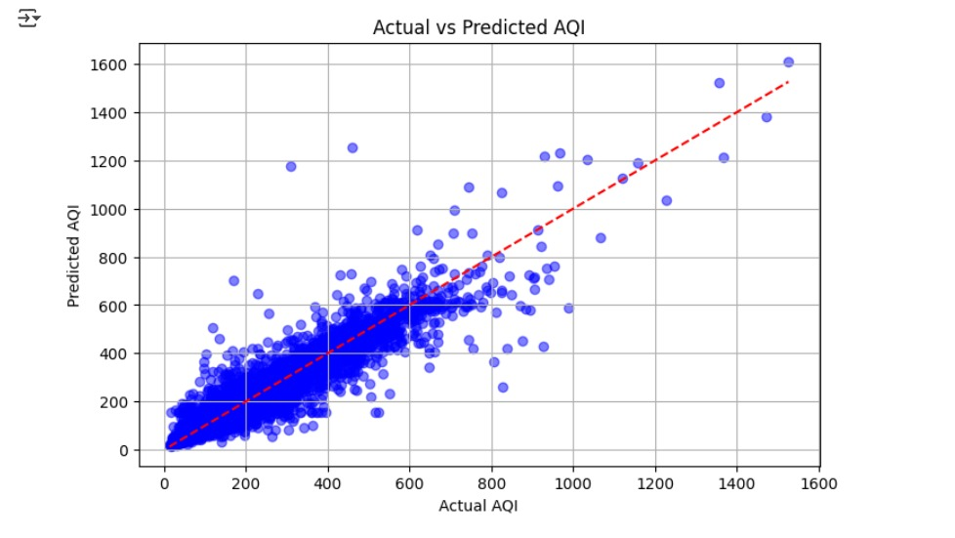
“
”
Richard Branson

Slide 7
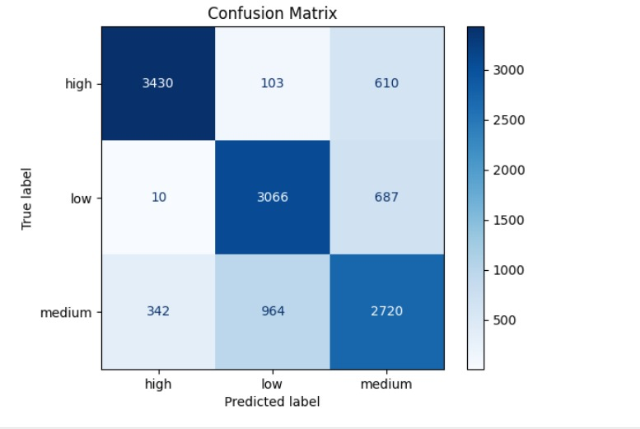
Timeline
Sep 20XX
Synergize scalable e-commerce
Jan 20XX
Coordinate e-business applications
May 20XX
Deploy strategy networks with compelling e-business needs
Nov 20XX
Disseminate standardized metrics
Mar 20XX
Foster holistically superior methodologies

Slide 8
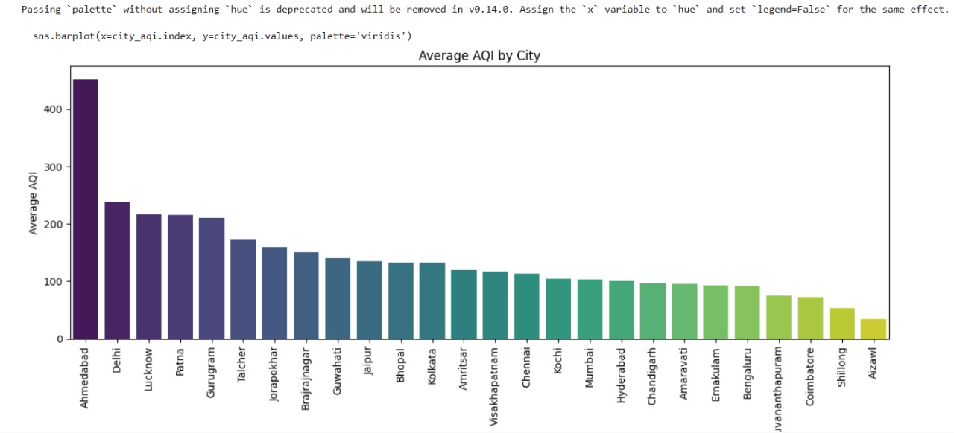
Areas of focus
B2B market scenarios​
Develop winning strategies to keep ahead of the competition
Capitalize on low-hanging fruit to identify a ballpark value
Visualize customer directed convergence
Cloud-based opportunities
Iterative approaches to corporate strategy
Establish a management framework from the inside

Slide 9

Summary
Built an accurate AQI prediction model for Indian cities using Random Forest Regression.
Used key environmental features and effective data processing for reliable results.
Visualized regional pollution levels with clear, interactive dashboards.
The project aids public awareness and supports better policy decisions.

