Slide 1

SAFE.LY
A Modern Woman’s Guide:
The better way to enjoy your safety and ease of life.

Slide 2
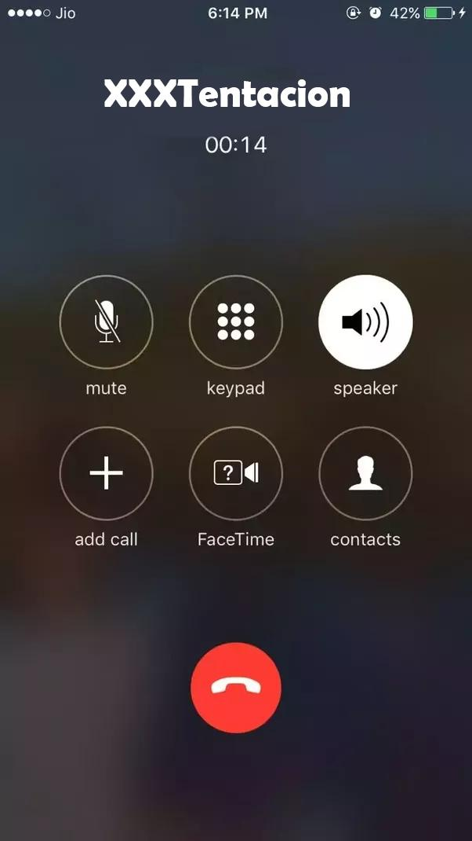
Fake A Call
Reduce the anxiety levels.
Makes stalker think that people know your location.
Creates a sense of Safety in mind.

Slide 3
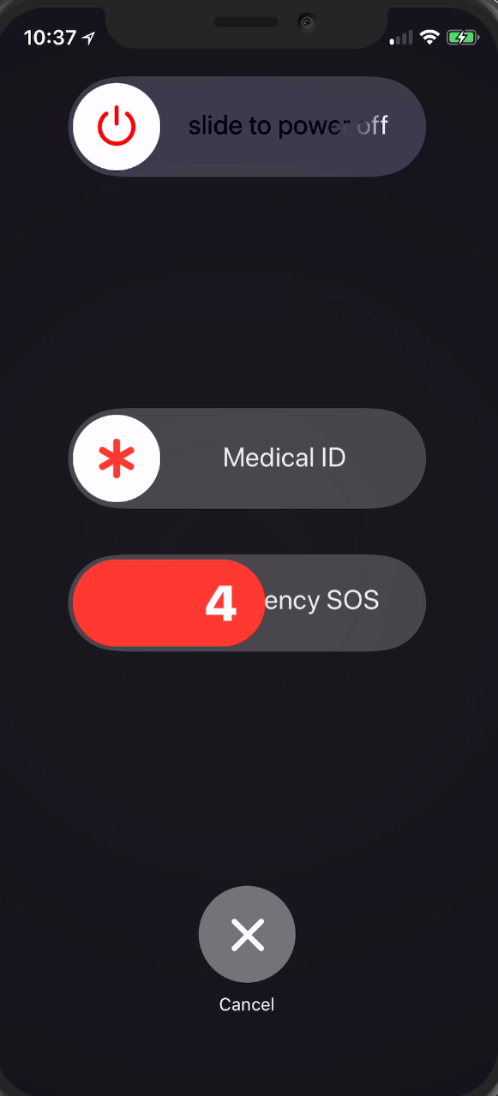
Emergency Call
Immediately place a call to your most trusted person whose phone number will be set you only.

Slide 4
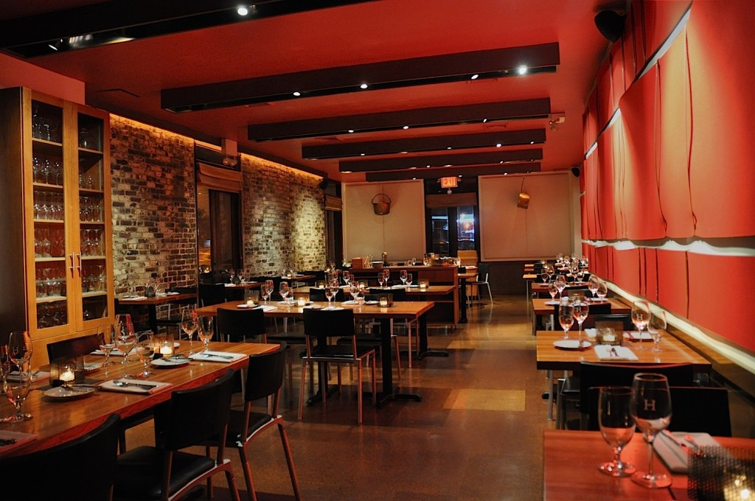


Places and Reviews Find places and reviews near you at just 1 click.
1
2
3
Restaurants
Hotels
Hospitals

Slide 5
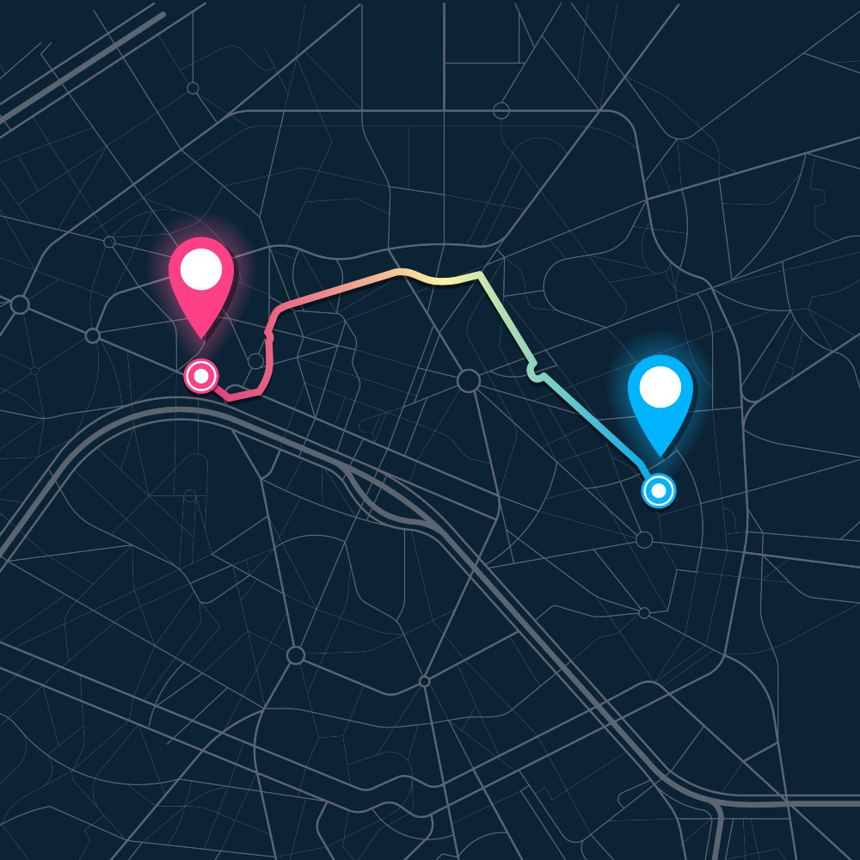
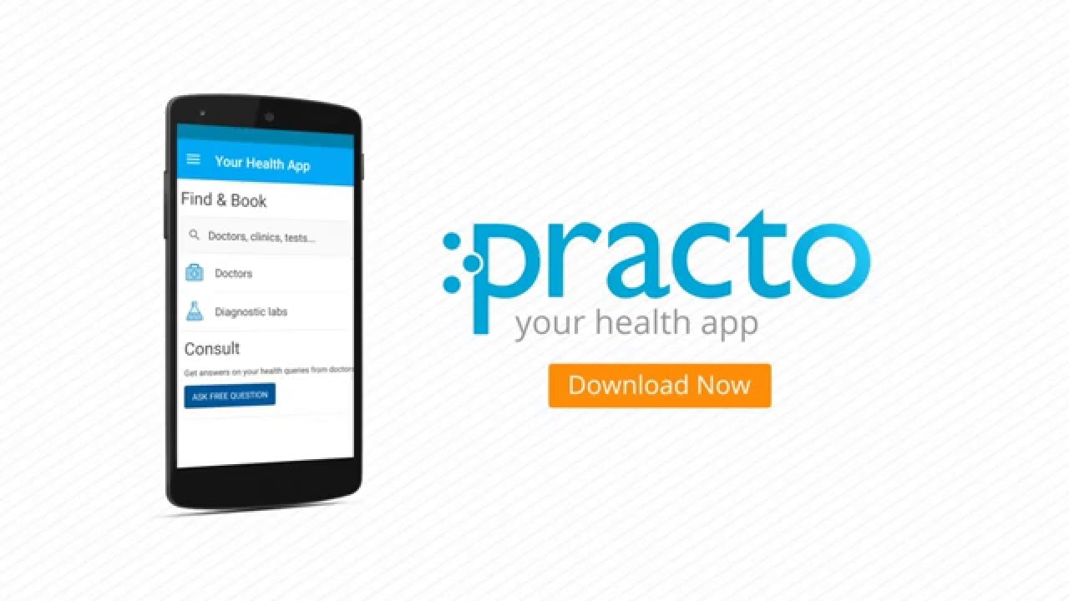
Pocket Tools
Audio Tool allows you to record audio proof in case of any mishap.
Location tool will tell you your current location along with distance to nearest police station.
Practo will give you a list of all available hospitals near you.
1
2
3
Audio
Location
Practo

Slide 6
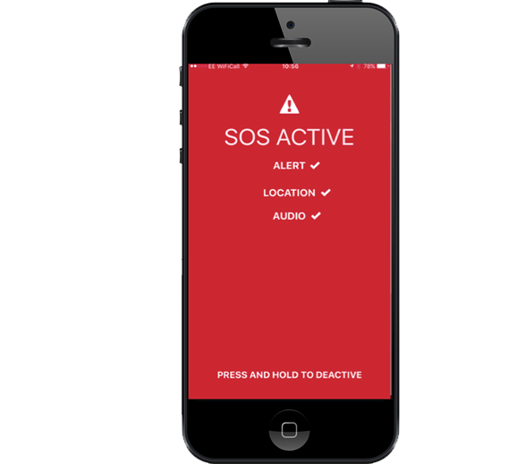
SOS
The SOS feature will immediately alert all your relatives, police stations and policemen with your current location and distress signal and will also start an emergency audio to scare of the attacker.

Slide 7

Thank you
Team Aditya07

