Slide 1
MYCIN
ADITYA KUMAR MOHANTY SUDIPTA MANDAL

Slide 2
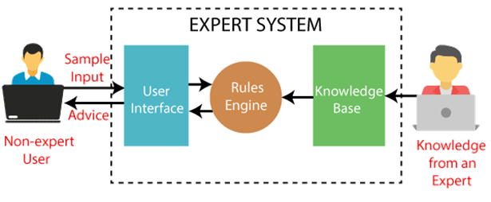
EXPERT SYSTEM
An expert system is a computer program that is designed to solve complex problems and to provide decision-making ability like a human expert. It performs this by extracting knowledge from its knowledge base using the reasoning and inference rules according to the user queries.

Slide 3
Introduction
MYCIN was an earliest designed expert systems in Stanford University in 1972.
Its job was to diagnose and recommend treatment for certain blood infections.
MYCIN was written in LISP Programming Language.
MYCIN is mainly a goal-directed system, using the backward chaining reasoning approach.

Slide 4
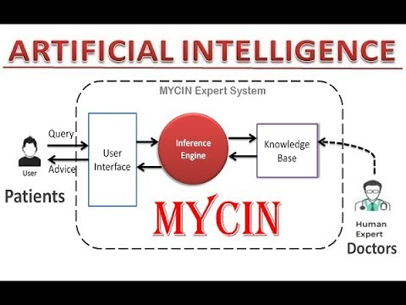
MYCIN DIG.

Slide 5
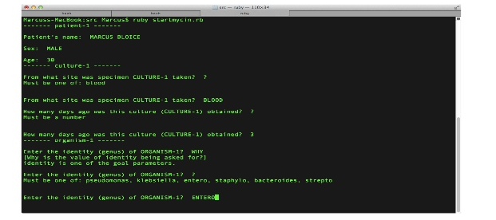
USER INTERFACE OF MYCIN

Slide 6
Is Mycin used Today?
MYCIN has never been used in clinical practice dueto-
expense of computing power required at the time •
The amount of time and typing required for asession• I
ncompleteness of the knowledge base

Slide 7
EMYCIN
EMYCIN provides a domain-independent framework or template to develop expert system
EMYCIN stands for "Empty MYCIN" or "Essential MYCIN" because it basically constitutes a MYCIN system minus its domain-specific medical knowledge.

Slide 8
THANK YOU

Slide 9
REF.
https://www.slideshare.net/hhhchamp/mycin-presentation
https://en.wikipedia.org/wiki/Mycin
https://www.google.com/url?sa=i&url=http%3A%2F%2Fuser.medunigraz.at%2Fmarcus.bloice%2Fseminars%2Fdss%2Fg3%2Fg3.htm&psig=AOvVaw247x9kifxzS0EwaBkhMCFG&ust=1617942669210000&source=images&cd=vfe&ved=0CA0QjhxqFwoTCPifwqDo7e8CFQAAAAAdAAAAABAD

