Slide 1

Car Price prediction
Presented by :
C21027 : Aditya A. Deshpande
Under the Guidance Of
Mr. Pratik Desai sir.

Slide 2

INTRODUCTION
In this fast world, you don’t have your own personal mode of transportation sort of an automobile, life will become even additional agitated. The public choose to obtain their automobile as a result of its convenience to commute between places, permits movement with an outsized cluster of individuals with fuel potency, and safe mode of transport. The used automobile marketplace is witnessing a boom in India, with the decision for luxurious vehicles sometimes increasing. Till a couple of years, owning a luxury automobile won’t be a dream for varied shoppers, as a result of money hurdles, however, this is often bit by bit dynamic as shoppers can simply obtain used luxury vehicles. Machine Learning provides numerous ways through that it's easier to predict the worth of an automobile, by the previous information that is obtainable.

Slide 3
We've enforced the model exploitation supervised Learning techniques of Machine Learning, which is outlined by its use of labeled information sets to coach algorithms to classify data or predict outcomes accurately. As the input file is fed into the model, it adjusts its weights till the model Journal of Emerging Technologies and Innovative Research has been fitted fittingly, which happens as a part of the cross-validation method. If there is also further transparency within the marketplace and fewer intermediaries, the seller ought to get the next value for a vehicle and therefore the shopper ought to get one at a lower fee as margins get reduced on every facet.

Slide 4
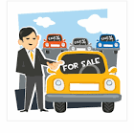
OBJECTIVE :
You as a Data scientist are required to apply some data science techniques for the price of cars with the available independent variables. That should help the management to understand how exactly the prices vary with the independent variables. They can accordingly manipulate the design of the cars, the business strategy etc. to meet certain price levels.

Slide 5

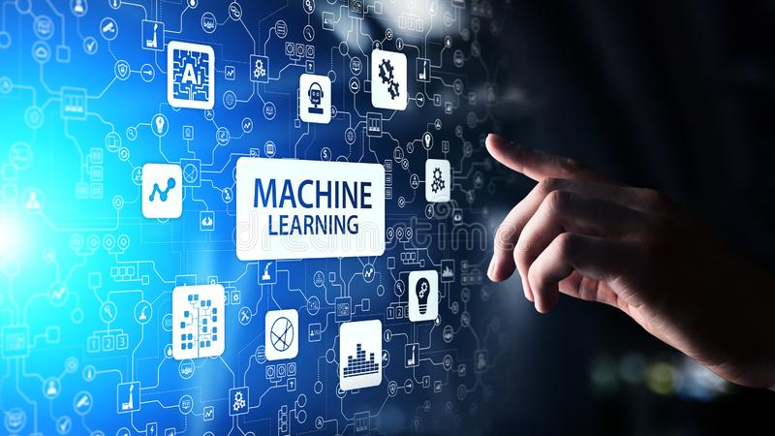
TECHNOLOGY USED
Python
Machine Learning

Slide 6


TOOL USED :
Jupyter notebook
Pycharm
Google Colab

Slide 7
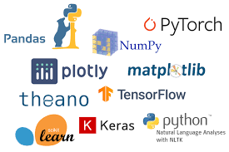

Libraries used : Algorithms :
pandas
matplotlib.pyplot
seaborn
sklearn.model_selection for train ,test, split
sklearn.linear_model for import Lasso
sklearn for metrics
Linear Regression
Lasso Regression

Slide 8
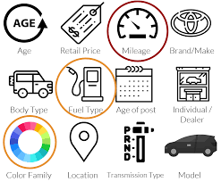
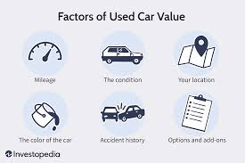
DATASET FEATURES :
Car Brand
Year
Sold Price
Present Price
KMS Driven
Fuel Type
Seller Type
Transmission Type
Owners

Slide 9
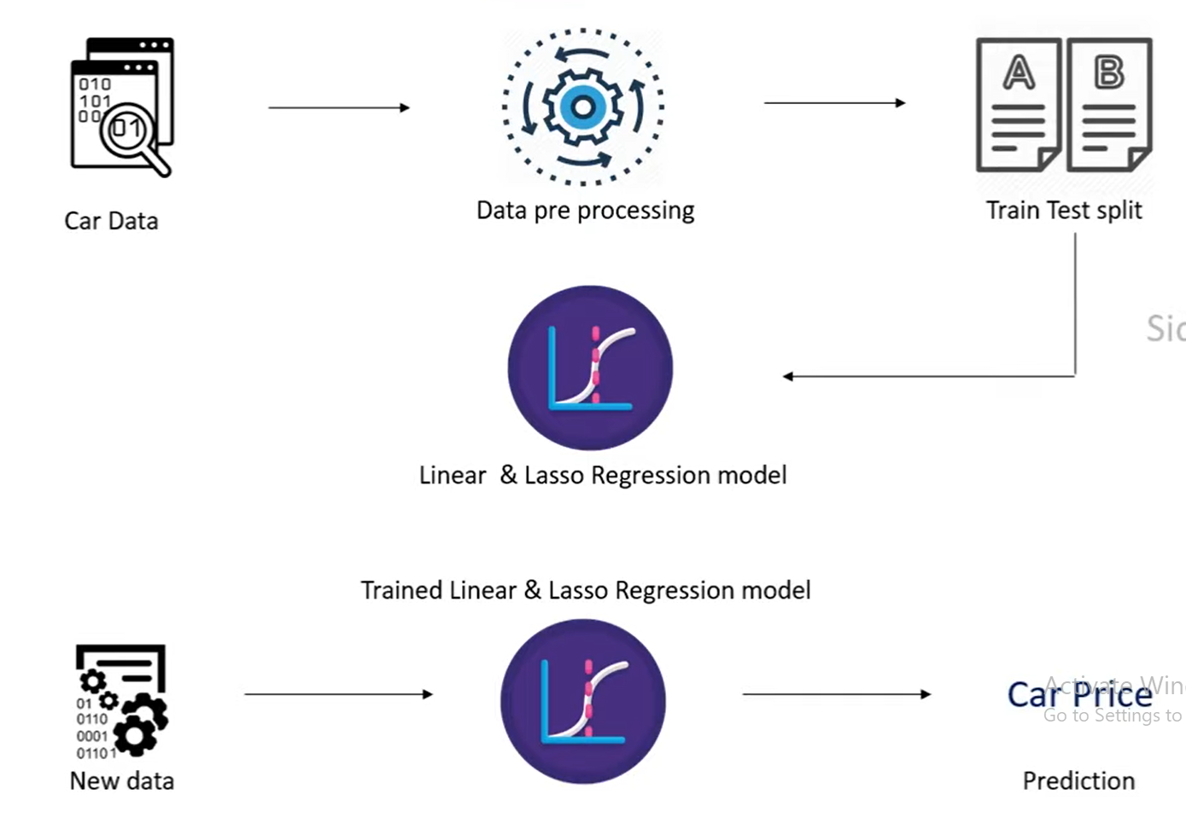
WORK FLOW :

Slide 10
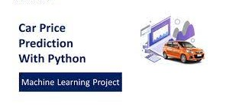
CONCLUSION :
This is how you can train a machine learning model for the task of predicting car prices by using the Python programming language.
It is a major research topic in machine learning because the price of a car depends on many factors.

Slide 11

REFERANCE :
www.Kaggle.com

Slide 12
Thank You

