Slide 1

Time Series Project (Stock Market case study)
Aditya Arun Deshpande
Roll no : C21027
Under the guidance of Dr.Sulakshana Vispute

Slide 2
Problem Statement :
S & P 500 is a stock market index that measures the stock performance of 500 large companies listed on stock exchange in the US ( United States ).
What type of analysis ?
1. Analyzing : ( Analyze what is the daily return of each of the stock in a week).
2. Compare prices on each of the stock company data.

Slide 3
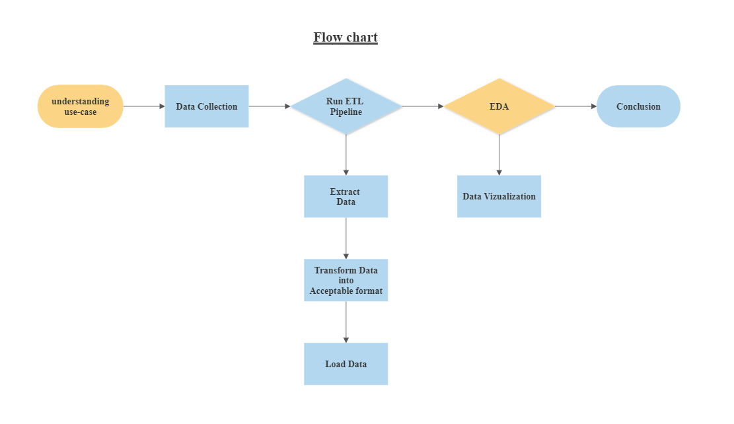
Life cycle / Flow chart :

Slide 4
Liabraries :
Numpy
Pandas
Matplotlib
Plotly
Seaborn
Warnings

Slide 5
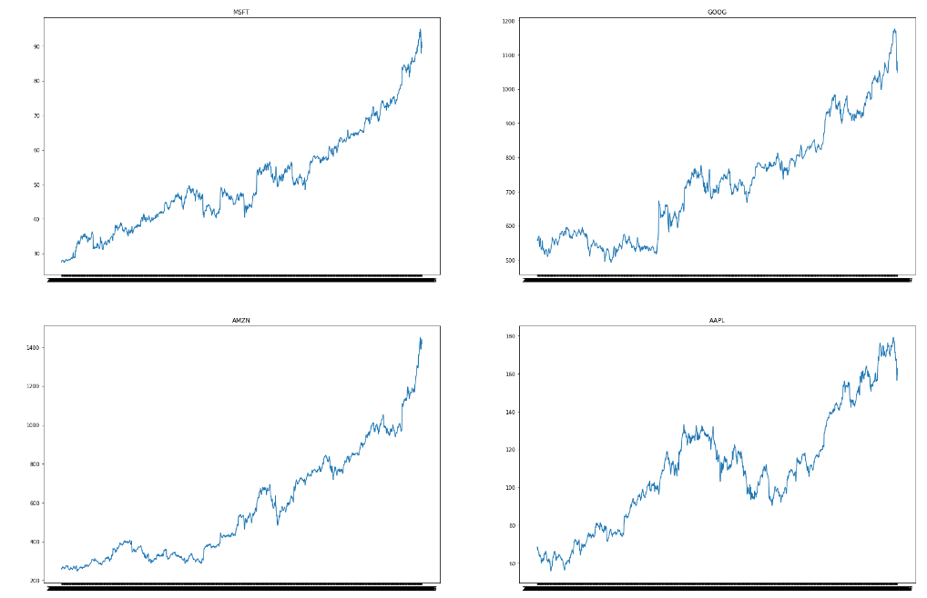
Change in the price of the stock overtime ? :

Slide 6
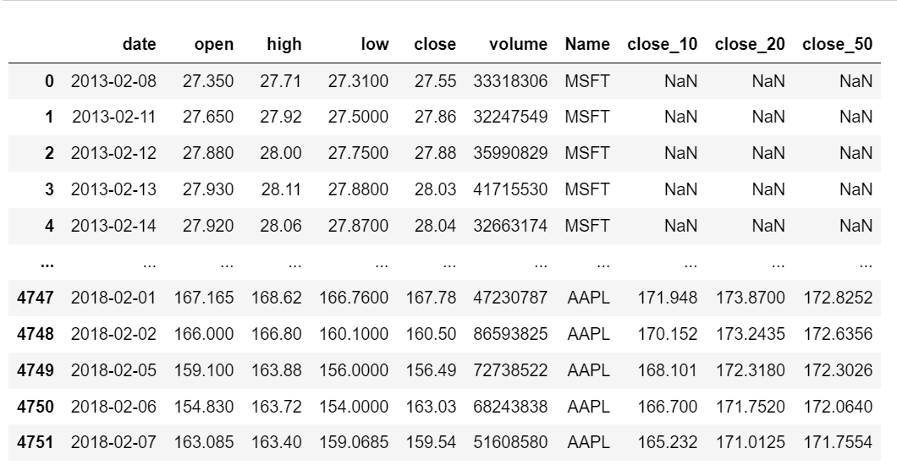
Moving average of the stocks :
Moving average :- It is a statistics that computes the average change in a data over some specific interval.

Slide 7
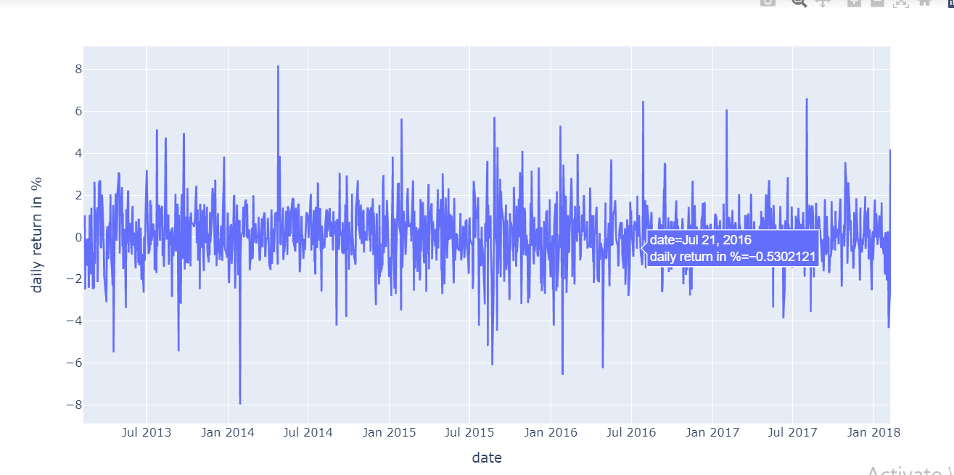
Analyse of closing price change in a apple stock :

Slide 8
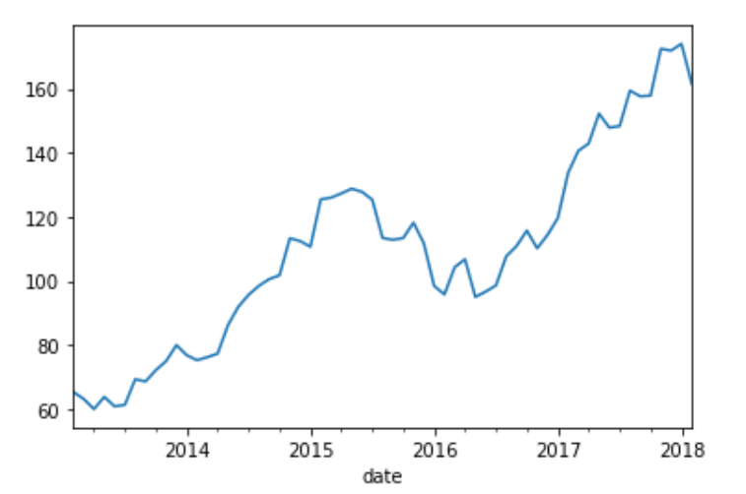
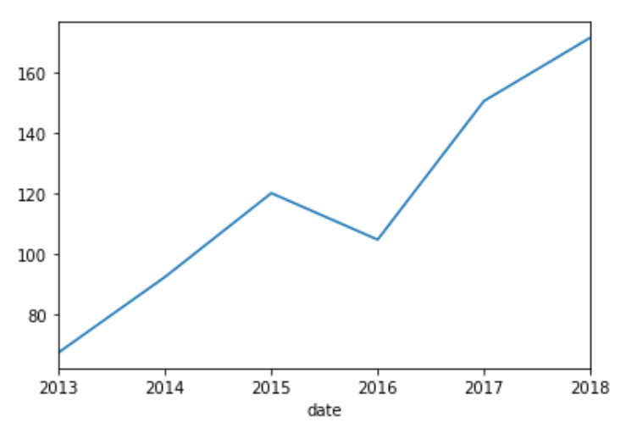
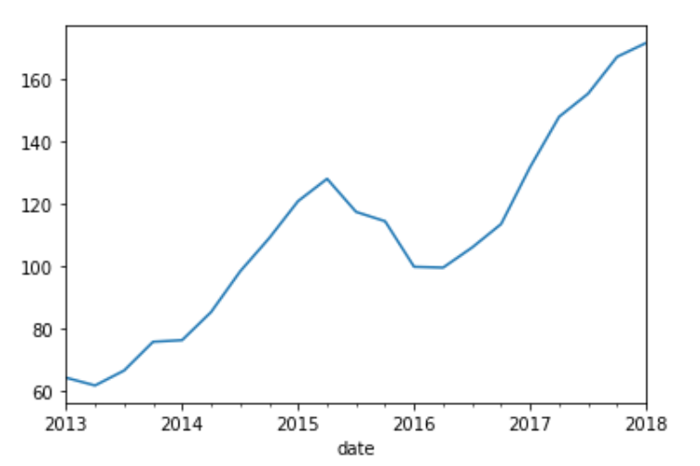
Resampling analysis of closing price (Apple) :

Slide 9
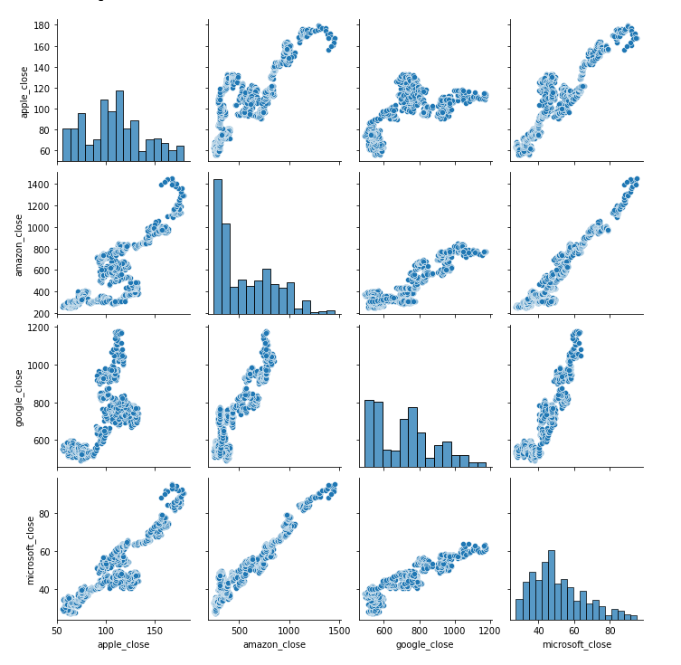
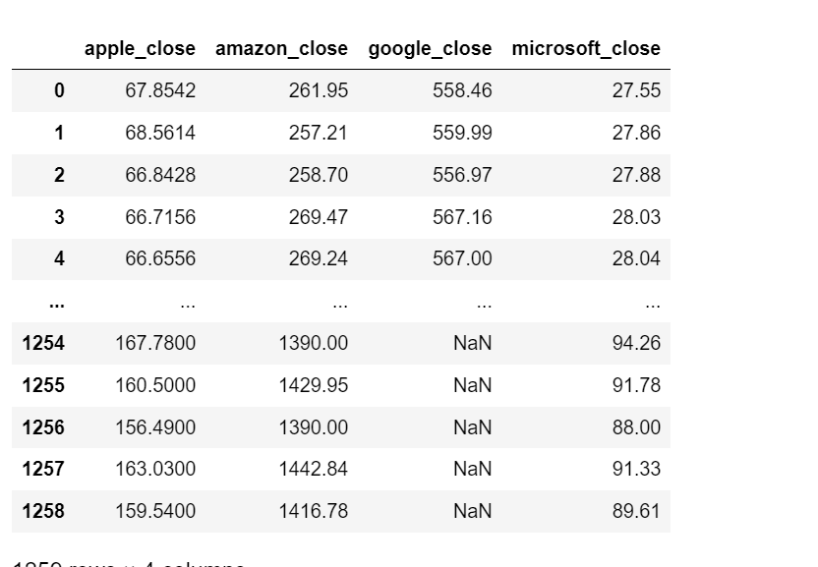
Checking closing prices of these companies are correlated or not :

Slide 10
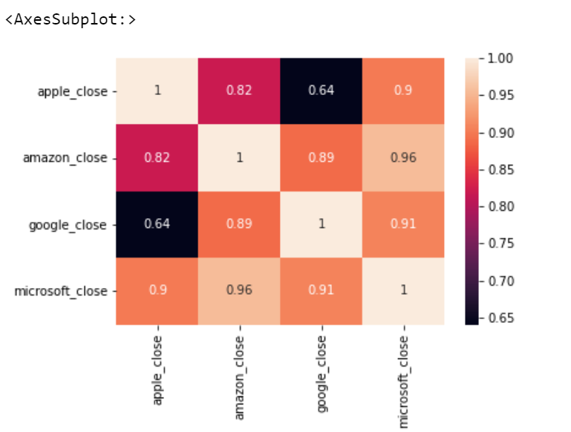
Heatmap correlation analysis :

Slide 11
Conclusion :
The idea behind the correlation is as simple as that so if the value is lets say 0.40, it means that if my amazon stock price is decreses or if the percentage change in the amazon then there is a 40% probability that my Microsoft stock price is also decreases or percentage change is also decreases.

Slide 12
Future Enhancement :
Compairing more stocks with each other.
Visualization (We can add more different different bar graphs.)

Slide 13
Thank You

