Slide 1
THE VIRTUAL SOLDIER Detecting, Recognizing, Tracing, Informing Criminals as well as crimes in real world
Group Members:
Aditya Tripathi (XIEIT171808)
Tapan Poojary (XIEIT171843)
Abhishek Yadav (XIEIT171861)
Guide:
Prof. Jaya Jeswani

Slide 2
Problem Definition
Circuit Television Cameras (CCTV’s) are widely used to control occurrence of crimes in the surroundings.
Although CCTV’s are deployed at various public and private areas to monitor the surroundings there is no improvement in the control of crimes.
This is because CCTV requires human supervision which may lead to human prone errors like missing of some important crime events by human while monitoring so many screens recorded by CCTV’s at same time.
In the past a strong reliance has been put on standard video surveillance in order to achieve this goal. This often creates a backlog of video data that must be monitored by a supervising official. For large urban areas, this creates an increasingly large workload for supervising officials which leads to an increase in error rate.

Slide 3
Literature Survey
First Paper
Thesis: Present systems use traditional method of face recognotion algorithm that are outdated and troublesome.
Proposition:
1st Phase: To use Microsoft Azure Cognitive services and Cloud system for implementation of the proposed system.
2nd Phase: Trying to compare this proposed methodology with traditional techniques like HAAR cascade to judge performance of the proposed System
Strength: Very Detailed
Weakness: Not an exact solution.
Result: A general comparison with HAAR cascade will provide improved accuracy.

Slide 4
Second Paper
Thesis: The second paper proposed a real-time violence detector based on deep-learning methods.
Proposition: To use CNN as a spatial feature extractor and LSTM as temporal relation learning method with a focus on the three-factor overall generality - accuracy - fast response time.
Strength: Accurate, robust and fast.
Weakness: Complex.
Result: 98% percent accuracy with frame rates of 131 frames/sec.

Slide 5
Third Paper:
Thesis: In Third Paper we saw a machine learning based predicting policing algorithm exploiting the modus operandi features of a recent crime and the existing prior criminal records.
Model predicts and probabilistically shortlist the potential suspects who may be involved in a recent crime.
Proposition: Apply the K-means and GMM model on the real data collected from various police stations.
Strength: Real data from police station.
Weakness: Inaccurate.
Result: Identification of potential suspects/criminals who had previous criminal record can prove vital for cases.

Slide 6
Fourth Paper
Thesis: Deep learning model based on 3D convolutional neural networks, without using hand-crafted features or RNN architectures exclusively for encoding temporal information.
Proposition: The improved internal designs adopt compact but effective bottleneck units for learning motion patterns and leverage the Dense Net architecture to promote feature reusing and channel interaction, which is proved to be more capable of capturing spatiotemporal features and requires relatively fewer parameters.
Strength: High Accuracy
Weakness: Different

Slide 7
Fifth Paper
Thesis: This research study reviews various state-of-the-art techniques of violence detection.
Proposition: In this paper, the methods of detection are divided into three categories that is based on classification techniques used: violence detection using traditional machine learning, using Support Vector Machine (SVM) and using Deep Learning.
Strength: Informative
Weakness: Not an exact solution
Result: Violence detection accuracy can be improved.

Slide 8
Sixth Paper
Thesis: For predicting types of crimes in any city based on crime dataset. They have combined weather, and its temporal attributes like cloud cover, lighting and time of day to identify relevance to crime data.
Proposition: They note that weather-related attributes play a negligible role in crime forecasting. They have evaluated the various performance metrics of crime prediction, with and without the consideration of weather datasets, on different types of crime committed using
Strength: New way of solving.
Weakness: Large dataset required to train.
Result: This methodology will enable law enforcement to make effective decisions on appropriate resource allocation, including backup officers related to crime type and location.

Slide 9
Seventh Paper
Thesis: In this paper we came up with Crime Intension Detection System that detects crime in real time videos, images and alerts the human supervisor to take the necessary actions. To alert the supervisors or nearby police station about the occurrence of crime.
Proposition: To alert the supervisors or nearby police station about the occurrence of crime we added SMS sending module to our system which sends SMS to concern person whenever crimes are detected. The proposed system is implemented using Pre-trained deep learning model VGGNet19 which detects gun and knife in the hand of person pointing to some other person. We also compared the working of two different pre-trained models like Google Net InceptionV3 in training. The results obtained with VGG19 are more accurate in terms of training accuracy.
Strength: High Accuracy
Weakness: Complex
Result: Use of Fast RCNN and RCNN algorithms helps us to draw the bounding box over objects in images like person, gun, knife and some untrained images are marked with N/A. Algorithms help for detection and classifications of objects over images.

Slide 10
Eight Paper
Thesis: Study is based on the analysis of faces, emotions, Ages and genders to identify the suspects.
Proposition: Face recognition, emotion, age and gender identifications are implemented using deep learning-based CNN approaches. Suits identification is based on LeNet architecture. In the implementation phase for the classification purpose, Keras deep learning library is used, which is implemented on top of TensorFlow. IMDb is the dataset used for the whole training purpose. Training is performed using in AWS cloud which is more powerful and capable way of training instead of using local machines. Real-time Video and images are taken for the experiment.
Strength: Descriptive and Accurate
Weakness: Requires large dataset

Slide 11
Ninth Paper
Thesis: In this paper the purpose is to classify each facial image.
Proposition: According to the characteristics of facial expression recognition, a new convolution neural network structure is designed which uses convolution kernel to extract implicit features and max pooling to reduce the dimensions of the extracted implicit features. In comparison to AlexNet network, we can improve the recognition accuracy about 4% higher on the CK+ facial expression database by the aid of Batch Normalization (BN) layer to our network.
Strength: Accurate and New Approach.
Weakness: Complex and Required time.
Result: A facial expression recognition system is constructed in this paper for the convenience of application, and the experimental results show that the system could reach the real-time needs.

Slide 12
Tenth Paper
Thesis: In this paper, they present CNN (Convolutional Neural Network) in the use of detect knife, blood and gun from an image. Detecting these threatening objects from image can give us a prediction whether a crime occurred or not and from where the image is taken. They emphasized on the accuracy of detection so that it hardly gives us wrong alert to ensure efficient use of the system.
Proposition: This model uses Rectified Linear Unit (ReLU), Convolutional Layer, fully connected layer and dropout function of CNN to reach a result for the detection. We use TensorFlow, an open source platform to implement CNN to achieve our expected output.
Strength: High Accuracy
Weakness: Large dataset required
Result: The proposed model achieves 90.2% accuracy for the tested dataset.

Slide 13
Implementation Strategy
We have divided our project in 3 modules and in the end it will be a whole system in which all these features will be implanted and can be directly used by any of the CCTV Camera.
Module 1: Criminals like e.g. Dawood using HAAR Cascade
Module 2: Live Crime detecting and passing it to the control room (Mob-Lynching)
Module 3: Vehicle Theft

Slide 14
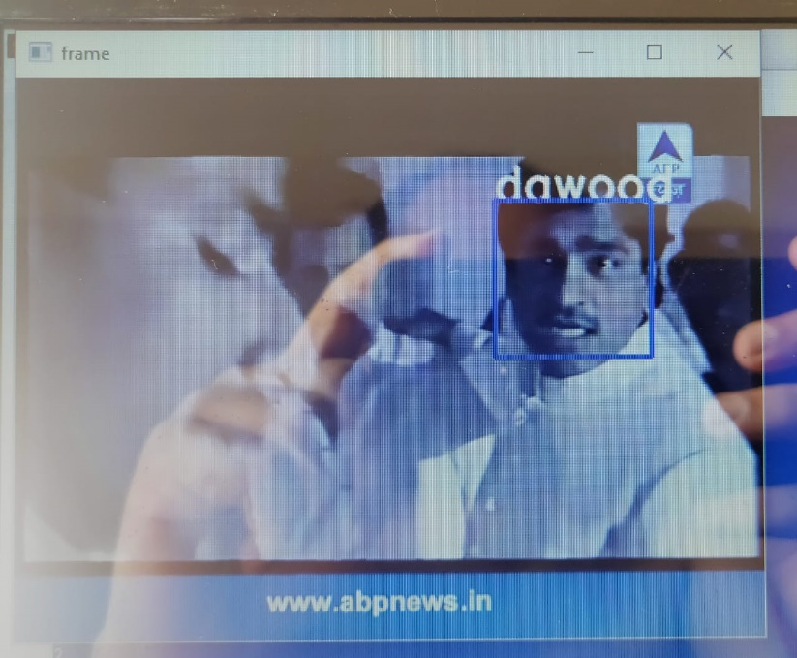
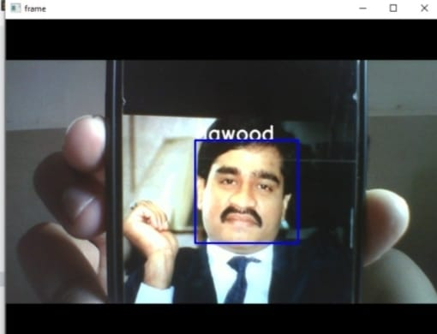
Implementation: Criminal Detection
In this module creates a system to detect the criminals (In our case its Dawood) both in Images and Videos.

Slide 15
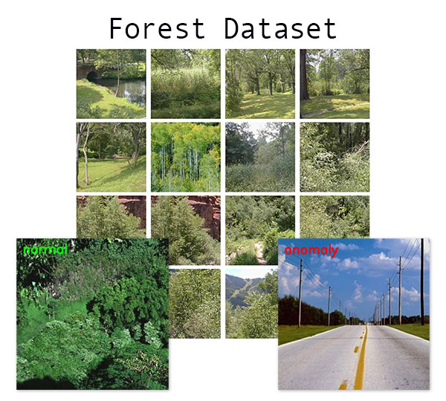
Anomaly Behaviour:
We have also performed anomaly behaviour detection on forest dataset.
For example:

Slide 16
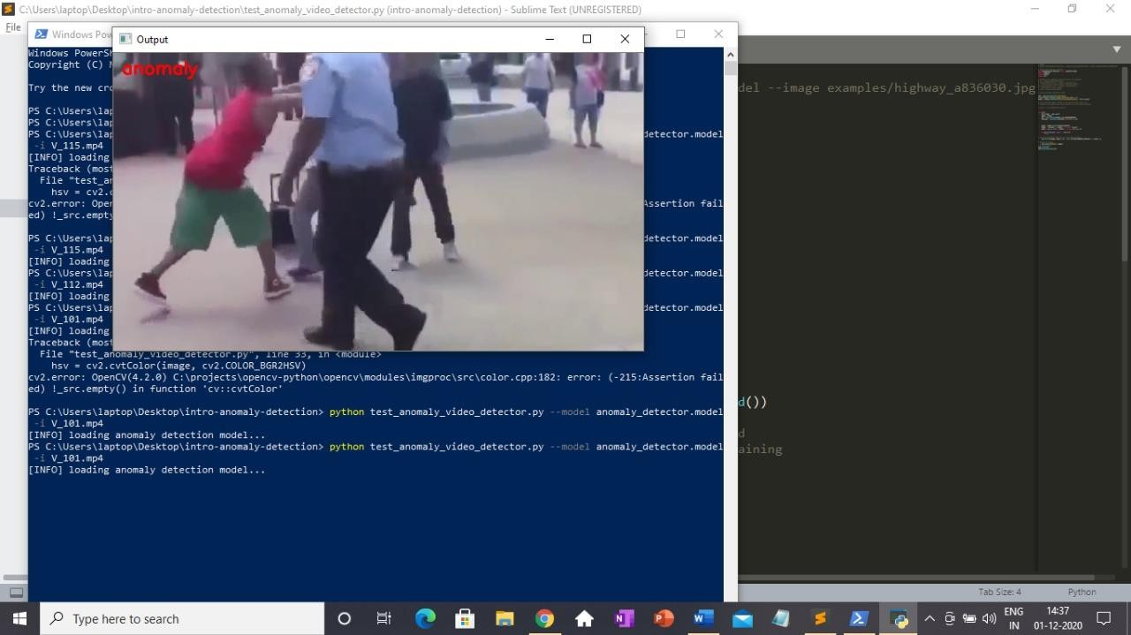
Live Crime detecting and passing it to the control room (Mob- Lynching)

Slide 17
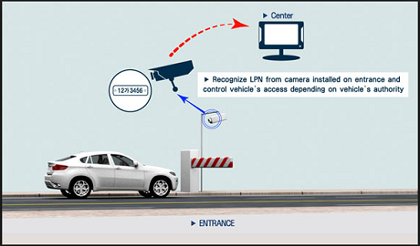
Vehicle Theft:
And Also we have completed the 3rd Module which is the vehicle Theft

Slide 18
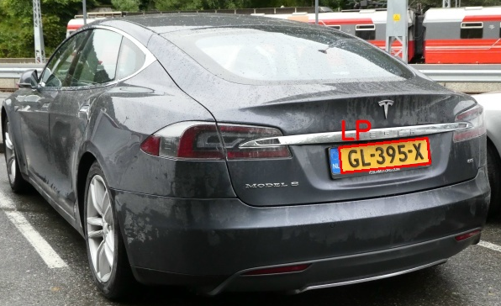
Single car

Slide 19
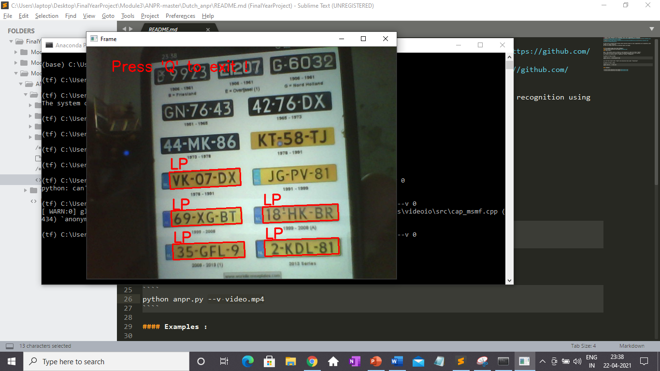
Multiple car

Slide 20
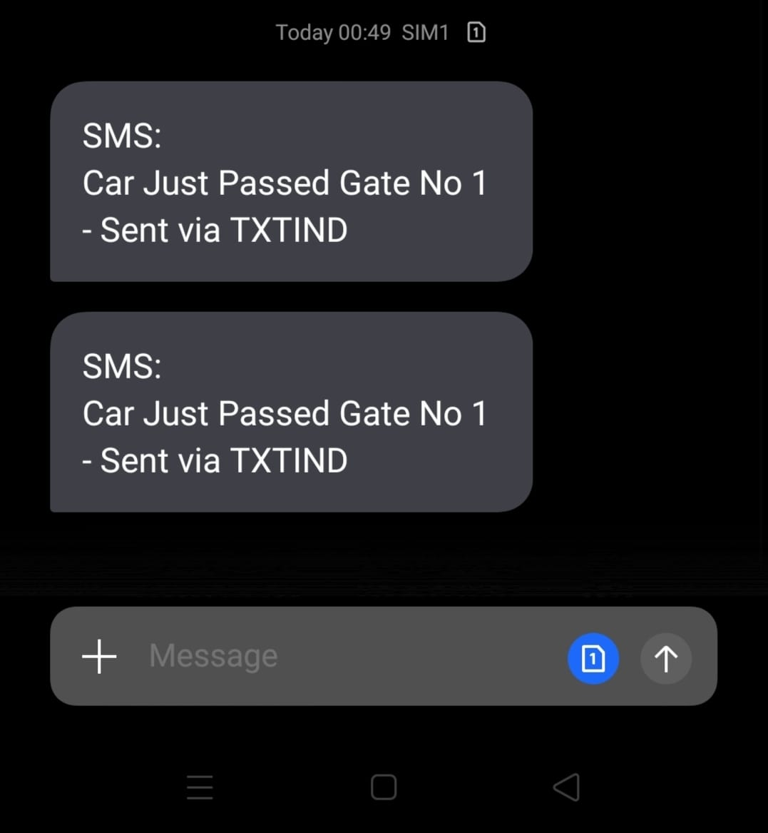
Alert message

Slide 21
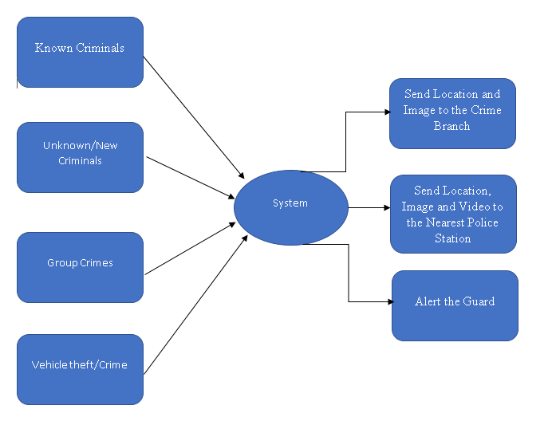
System Design:

Slide 22
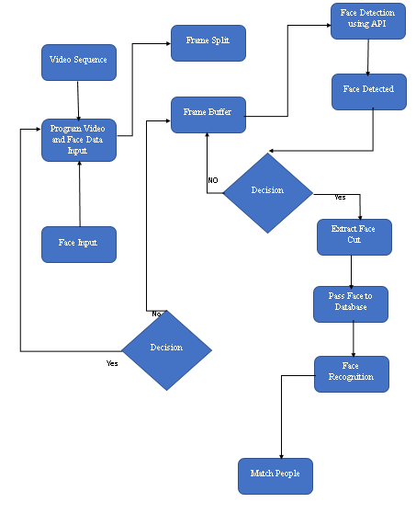
FLOW CHART

Slide 23
References
S.Shirsat, A.Naik, D.Tamse, J.Yadav, P. Shetgaonkar, S.Aswale, “Proposed System for Criminal Detection and Recognition on CCTV Data Using Cloud and Machine Learning”, 2019 International Conference on Vision Towards Emerging Trends in Communication and Networking (ViTECoN), ISBN: 978-1-5386-9353-7, DOI: 10.1109/ViTECoN.2019.8899441.
AMR.Abdali, RFA.Tuma, “Robust Real-Time Violence Detection in Video Using CNN And LSTM”, 2019 2nd Scientific Conference of Computer Sciences (SCCS), University of Technology - Iraq, ISBN: 978-1-7281-0761-5, DOI: 10.1109/SCCS.2019.8852616
S. Ali, SA. Alvi, Atiq Ur Rehman, “The Usual Suspects: Machine Learning Based Predictive Policing for Criminal Identification”, 2019 13th International Conference on Open Source Systems and Technologies (ICOSST), ISBN: 978-1-7281-4613-3, DOI: 10.1109/ICOSST48232.2019.9043925.

Slide 24
J.Li, X.Jiang, T.Sun, K.Xu, “Efficient Violence Detection Using 3D Convolutional Neural Networks”, 2019 16th IEEE International Conference on Advanced Video and Signal Based Surveillance (AVSS), ISBN: 978-1-7281-0990-9,DOI: 10.1109/AVSS.2019.8909883
M.Ramzan, A. Abid, H. Khan, S. Awan, A. Ismail, M. Ahmed, M. Ilyas, A. Mahmood, “A Review on state-of-the-art Violence Detection Techniques”, DOI 10.1109/ACCESS.2019.2932114, IEEE Access.
L.Elluri, V.Mandalapu, N.Roy, “Developing Machine Learning based Predictive Models for Smart Policing”, 2019 IEEE International Conference on Smart Computing (SMARTCOMP), ISBN: 978-1-7281-1689-1, DOI: 10.1109/SMARTCOMP.2019.00053.

Slide 25
M.Soliman, M.Kamal, M.Nashed, Y.Mostafa, B.Chawky, D.Khattab, “Violence Recognition from Videos using Deep
Learning Techniques”, 2019 IEEE Ninth International Conference on Intelligent Computing and Information Systems (ICICIS),
ISBN: 978-1-7281-3995-1, DOI: 10.1109/ICICIS46948.2019.9014714.
S.Chackravarthy, S.Schmitt, Li.Yang,” Intelligent Crime Anomaly Detection in Smart Cities using Deep Learning”, 2018 IEEE 4th International Conference on Collaboration and Internet Computing, ISBN: 978-1-5386-9502-9, DOI: 10.1109/CIC.2018.00060.
A.Mumtaz, Ab.Sargano, Z.Habib, “Violence Detection in Surveillance Videos with Deep Network using Transfer Learning”, 2018 2nd European Conference on Electrical Engineering and Computer Science (EECS), ISBN: 978-1-7281-1929-8, DOI: 10.1109/EECS.2018.00109.

Slide 26
THANK YOU
HOPE YOU LIKED IT AND UNDERSTAND IT….

