Slide 1
AdTech Campaign Performance Report
Generated on December 03, 2025

Slide 2
Key Performance Indicators
Total Spend: $29,269.00
Total Revenue: $304,234.00

Slide 3
🔍 Key Insights
Data analysis completed successfully

Slide 4
💡 Recommendations
Monitor performance daily and adjust bids based on ROI
A/B test different ad creatives and messaging
Analyze top-performing segments and allocate more budget there
Set up automated rules for pause underperforming campaigns

Slide 5
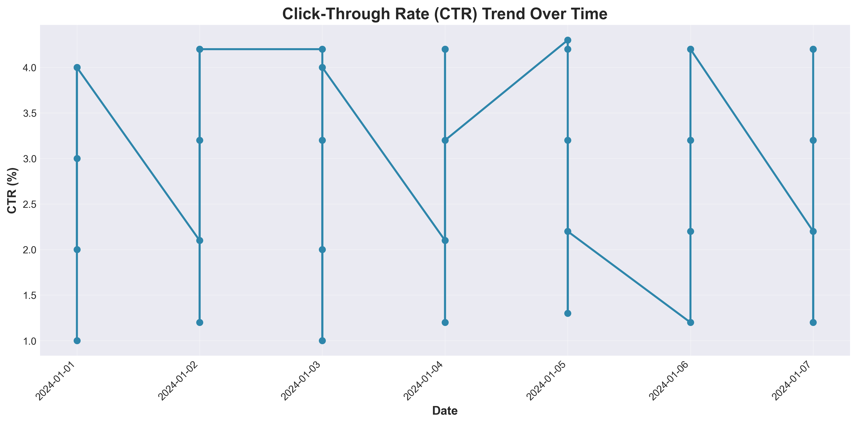
Ctr Trend

Slide 6
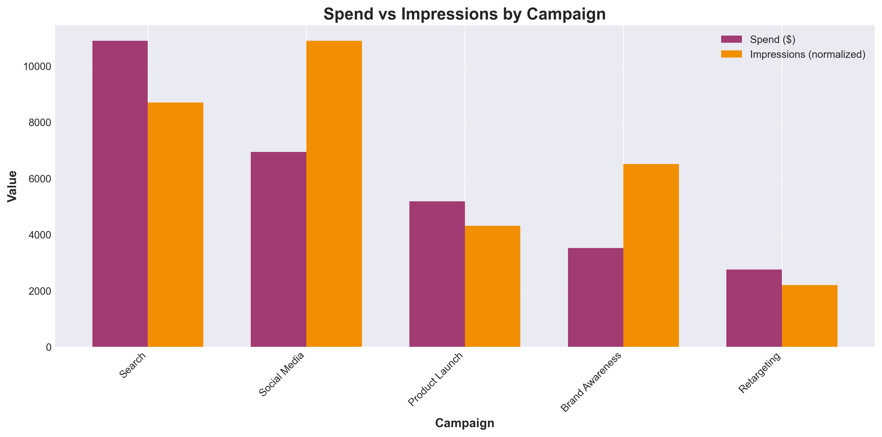
Spend Impressions

Slide 7
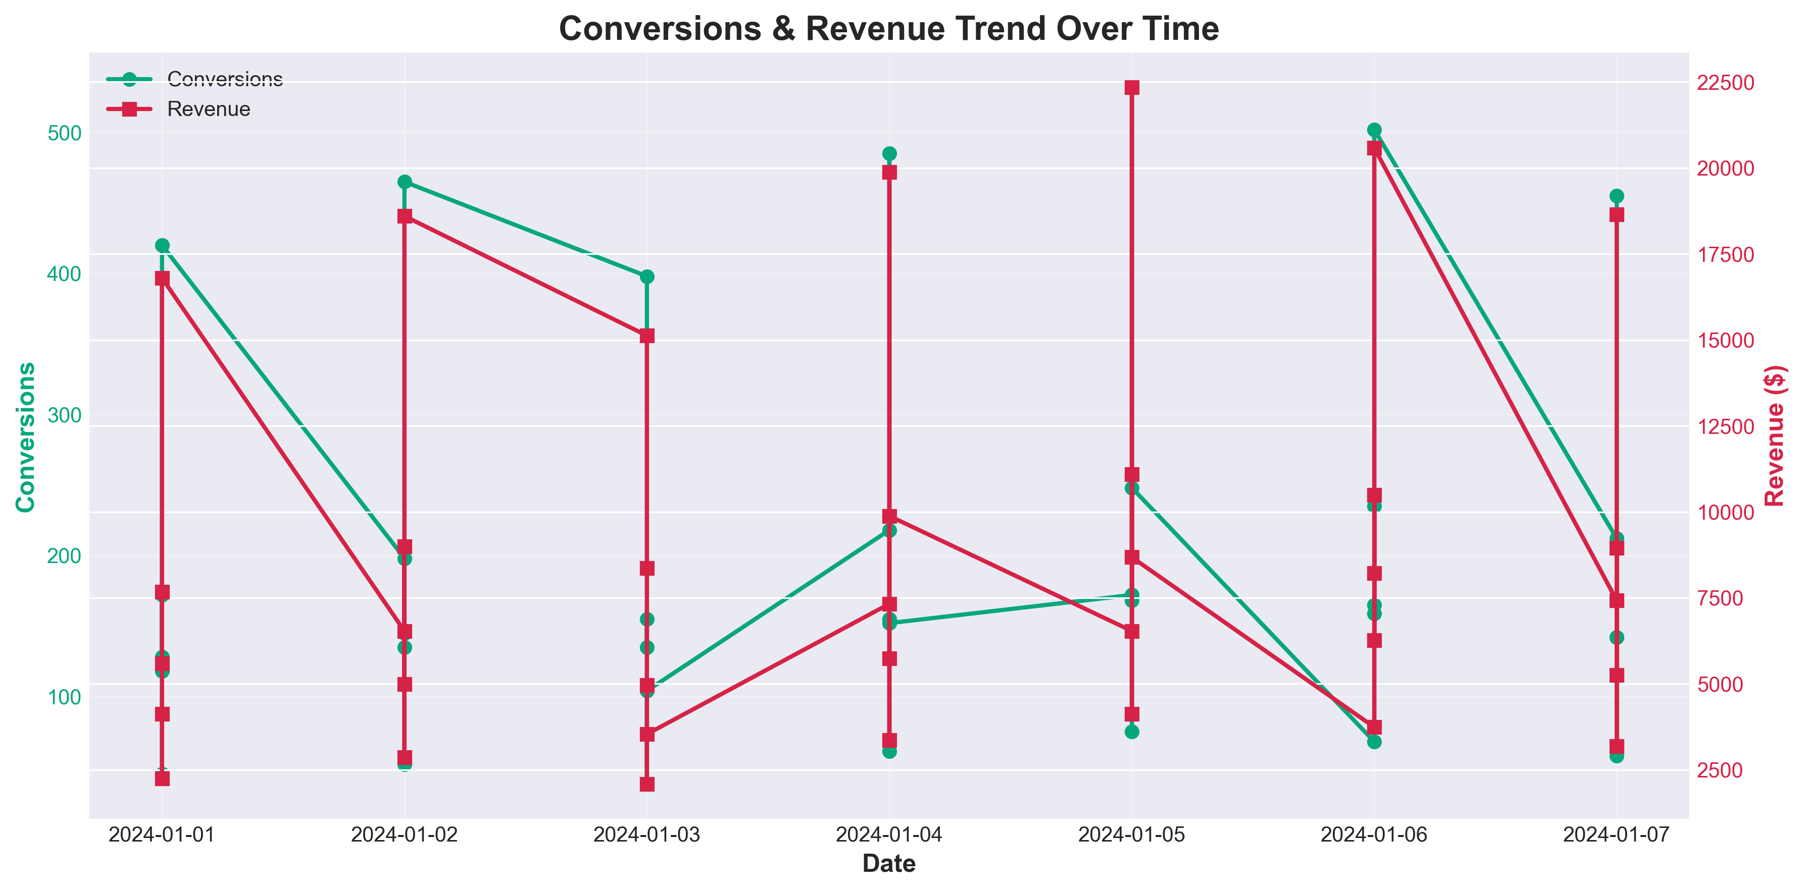
Conversion Revenue

