Slide 1


Swami Keshvanand Institute of Technology, Management & Gramothan, Jaipur
(An Autonomous Institute Affiliated to Rajasthan Technical University, Kota)
Industrial Training
Presentation
TOPIC : LAMIWOOD – MODERN E-COMMERCE PLATFORM
FOR LUXURY ARCHITECTURAL SURFACES
Submitted To:
Name:- Mr Vikash Dhakar
Assistant Professor
Submitted By:
Name:- Aditya Swami
Roll No.:- 24ESKCS024

Slide 2
Index
1. Company Introduction & Certificate
2. Technology Stack
3. Goals of Training & Project Overview
4. Working Project: Storefront & Catalog
5. Working Project: Interactive Design Tools
6. Future Scope & Conclusion
7. Q&A
SKIT, JAIPUR
www.skit.ac.in

Slide 3
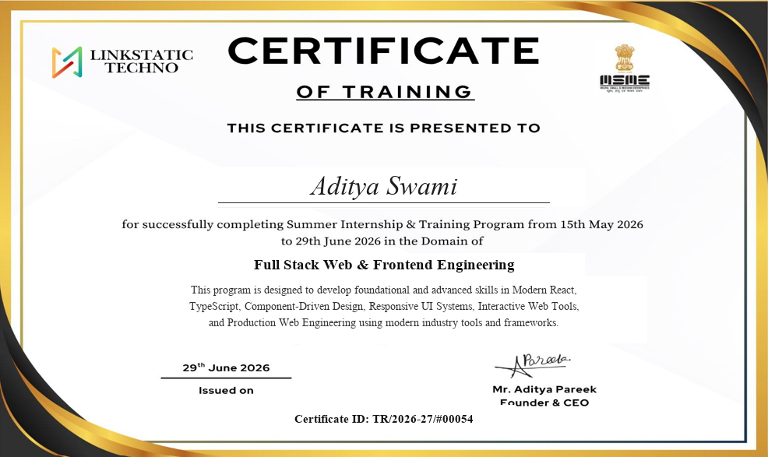
Company Introduction & Certificate
Linkstatic Techno is a premier technology consulting and digital product engineering organization specializing in modern full-stack web applications, reactive user interfaces, and bespoke enterprise solutions.
During my 6-weeks industrial training (15 May 2026 – 29 June 2026), I worked as a Full Stack Web & Frontend Engineering Intern, under the mentorship of Mr. Aditya Pareek (Founder & CEO).
Primary Focus: Architecting the Lamiwood e-commerce web platform using React 19, TypeScript, and Tailwind CSS v4, implementing interactive SVG layout engines, dynamic calculators, and state persistence.
SKIT, JAIPUR
www.skit.ac.in

Slide 4
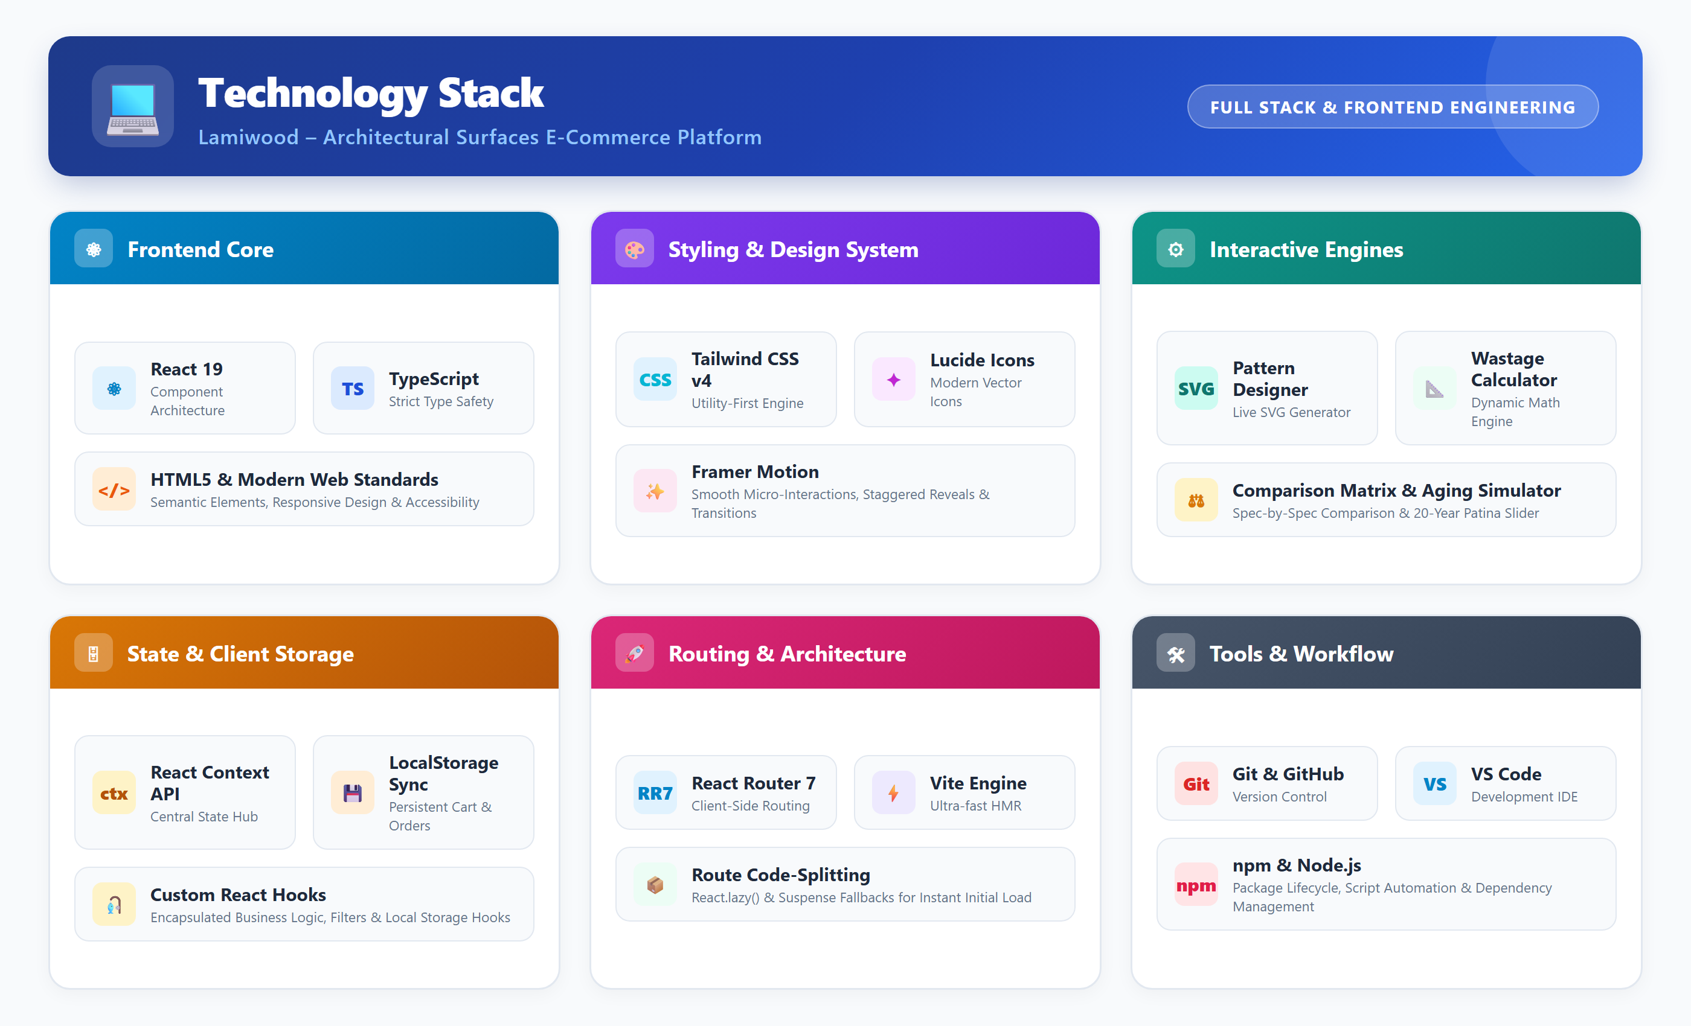
SKIT, JAIPUR
www.skit.ac.in

Slide 5
Training Goals & Project Overview
Goal of Training
1. Real-World Experience: Engineering a production-ready, full-stack architectural surfaces e-commerce application.
2. Modern Frontend Mastery: Applying React 19, TypeScript, and Tailwind CSS v4 for luxury responsive UI systems.
3. Interactive Tool Engineering: Developing live SVG pattern simulators, wastage calculators, and comparison matrices.
4. Professional Practices: Mastering Git version control, GitHub collaboration, Context API state, and performance profiling.
Lamiwood Platform Overview
Lamiwood is an advanced digital showroom designed for architects, interior designers, and homeowners to discover and specify luxury interior surfaces—including engineered hardwood, acoustic wall panels, and outdoor decking.
Key Problem Solved: Replaces fragmented offline sample distribution with instant digital exploration, dynamic pattern previews, material estimation, and a Free Physical Sample Box fulfillment workflow.
Architecture: Component-driven Single Page Application with persistent client-side state (React Context API + LocalStorage), Framer Motion reveals, and sub-second page transitions.
SKIT, JAIPUR
www.skit.ac.in

Slide 6
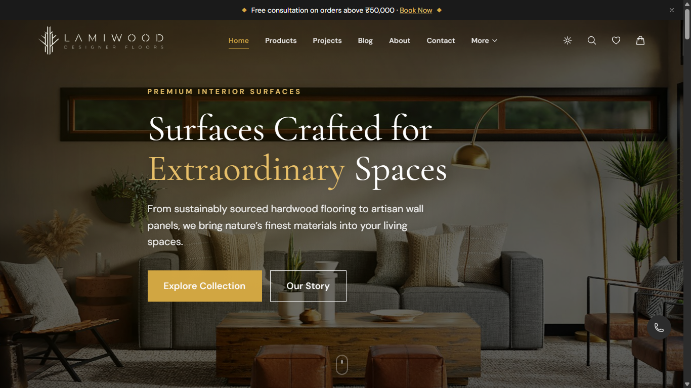
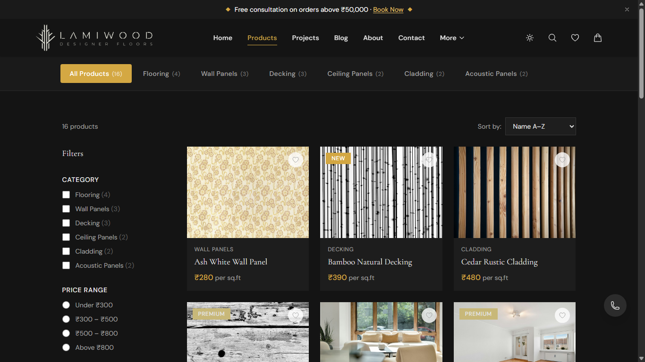
Working Project: Storefront & Catalog
Home Page & Brand Identity
Luxury hero presentation, curated surface categories, and quick navigation.
Product Catalog & Faceted Filters
Multi-attribute category filters, price sliders, technical badges, and responsive grid.
SKIT, JAIPUR
www.skit.ac.in

Slide 7
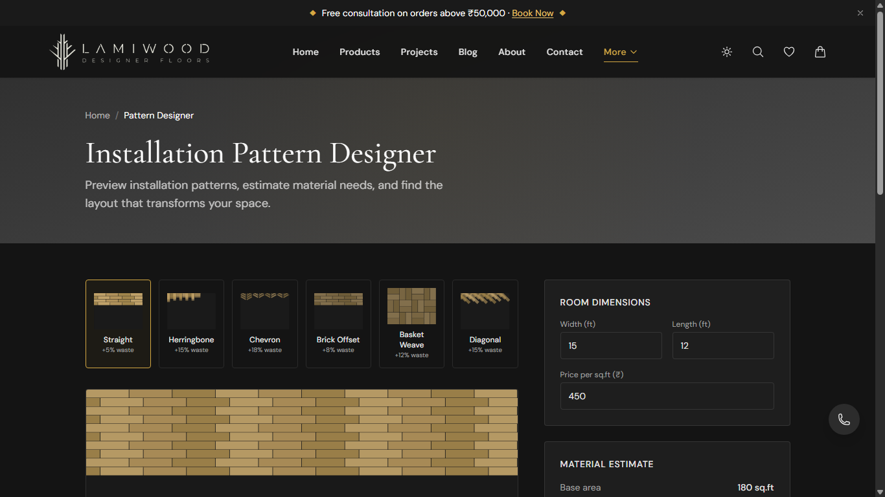
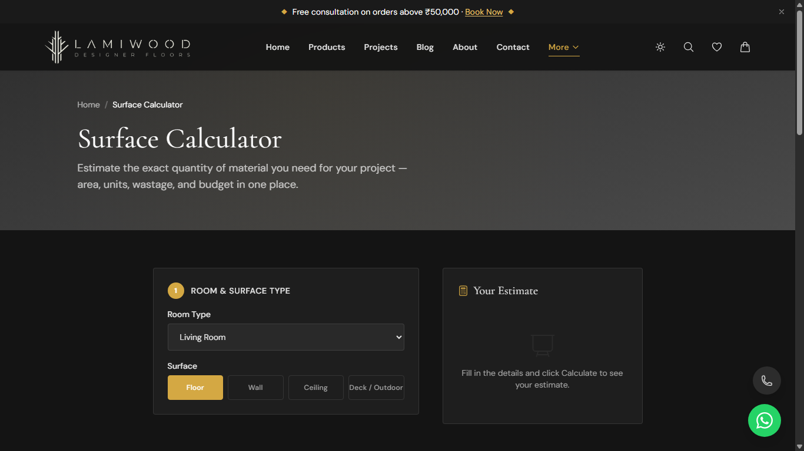
Working Project: Interactive Tools
Installation Pattern Designer
Dynamic SVG visualizer for 6 layouts (Straight, Herringbone, Chevron, Basket Weave).
Surface Area & Wastage Calculator
Room dimension calculation, pattern-specific wastage formula (+5% to +18%), and cost estimation.
SKIT, JAIPUR
www.skit.ac.in

Slide 8
Future Scope & Key Learnings
Future Scope
1. Headless CMS & Cloud API: Integrate Strapi/Supabase for live catalog management and payment gateway.
2. WebGL 3D Room Visualizer: Real-time 3D and Augmented Reality (AR) to project floorings directly into rooms.
3. AI Interior Recommendation: Machine learning model analyzing room photos to suggest matching wood finishes.
4. B2B Trade Portal: Contractor portal with tiered wholesale pricing and CAD/BIM downloads.
Key Industrial Learnings
1. Component-Driven Architecture: Structured reusable, decoupled UI components with strict TypeScript types.
2. Reactive Client-Side State: Managed synchronized carts and sample orders using Context API and LocalStorage.
3. Interactive Tool Engineering: Built dynamic SVG mathematical generators for architectural pattern simulation.
4. Production Standards: Practiced Git workflows, code modularity, route code splitting, and sub-second load times.
SKIT, JAIPUR
www.skit.ac.in

Slide 9
THANK YOU
Questions & Answers
Lamiwood: Modern E-Commerce Platform for Architectural Surfaces
Aditya Swami | 24ESKCS024 | SKIT Jaipur
SKIT, JAIPUR
www.skit.ac.in

